Slide 1

Profit Increase Strategy
Presented by Nonna Titulauri of thinkful
Notes:
Thank you for you time and looking over this presentation. Since I am not presenting this to you, please refer to the notes found in this section for explanations of the slides.

Slide 2
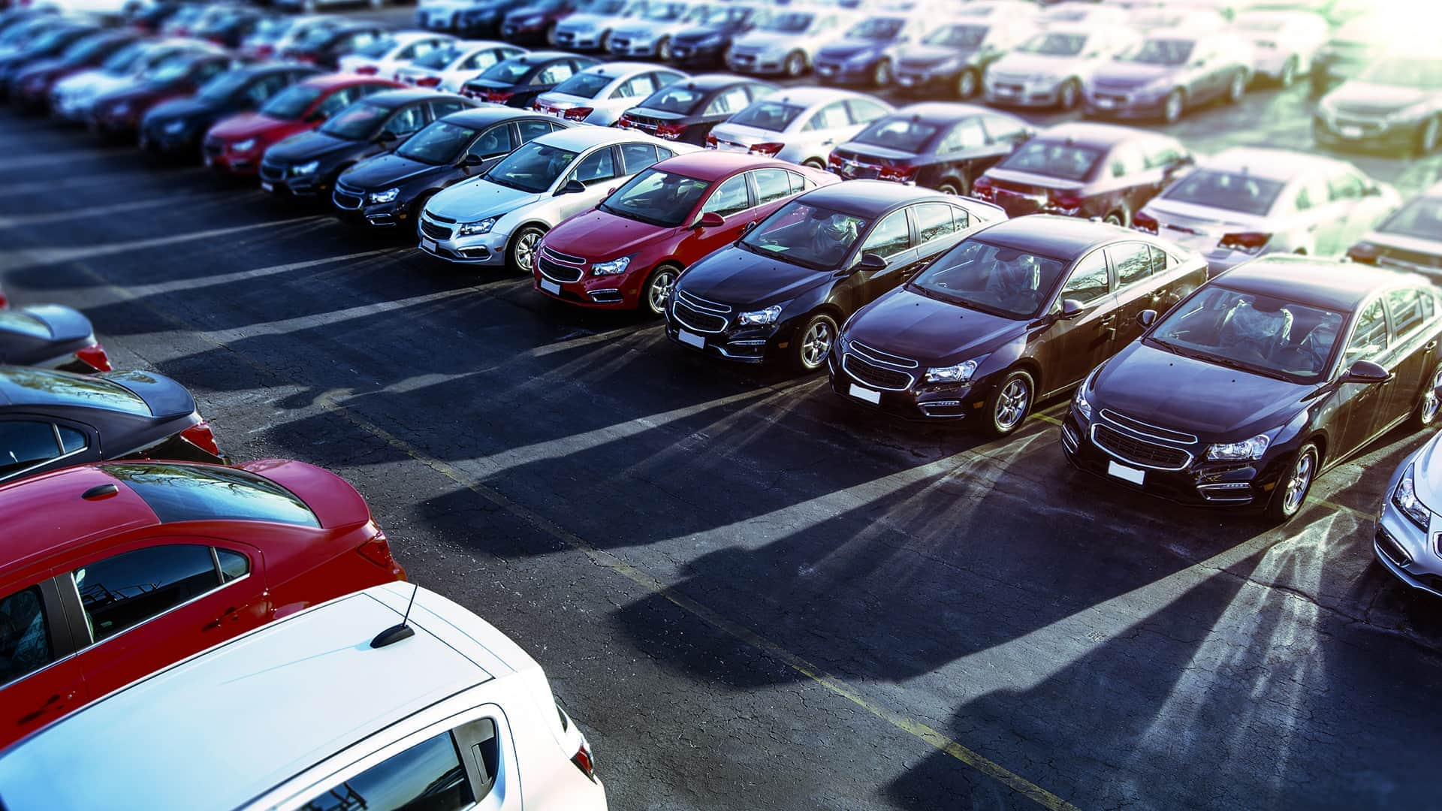
Lariat
Car rental with 50 locations in the United States
Specializing in broad spectrum of car inventory
PR advanced with appearances in the media
Notes:
Here we have an overview of Lariat’s strengths as a company, from the variety of the models of cars, to PR to geographic area placements in several locations in the United States.

Slide 3
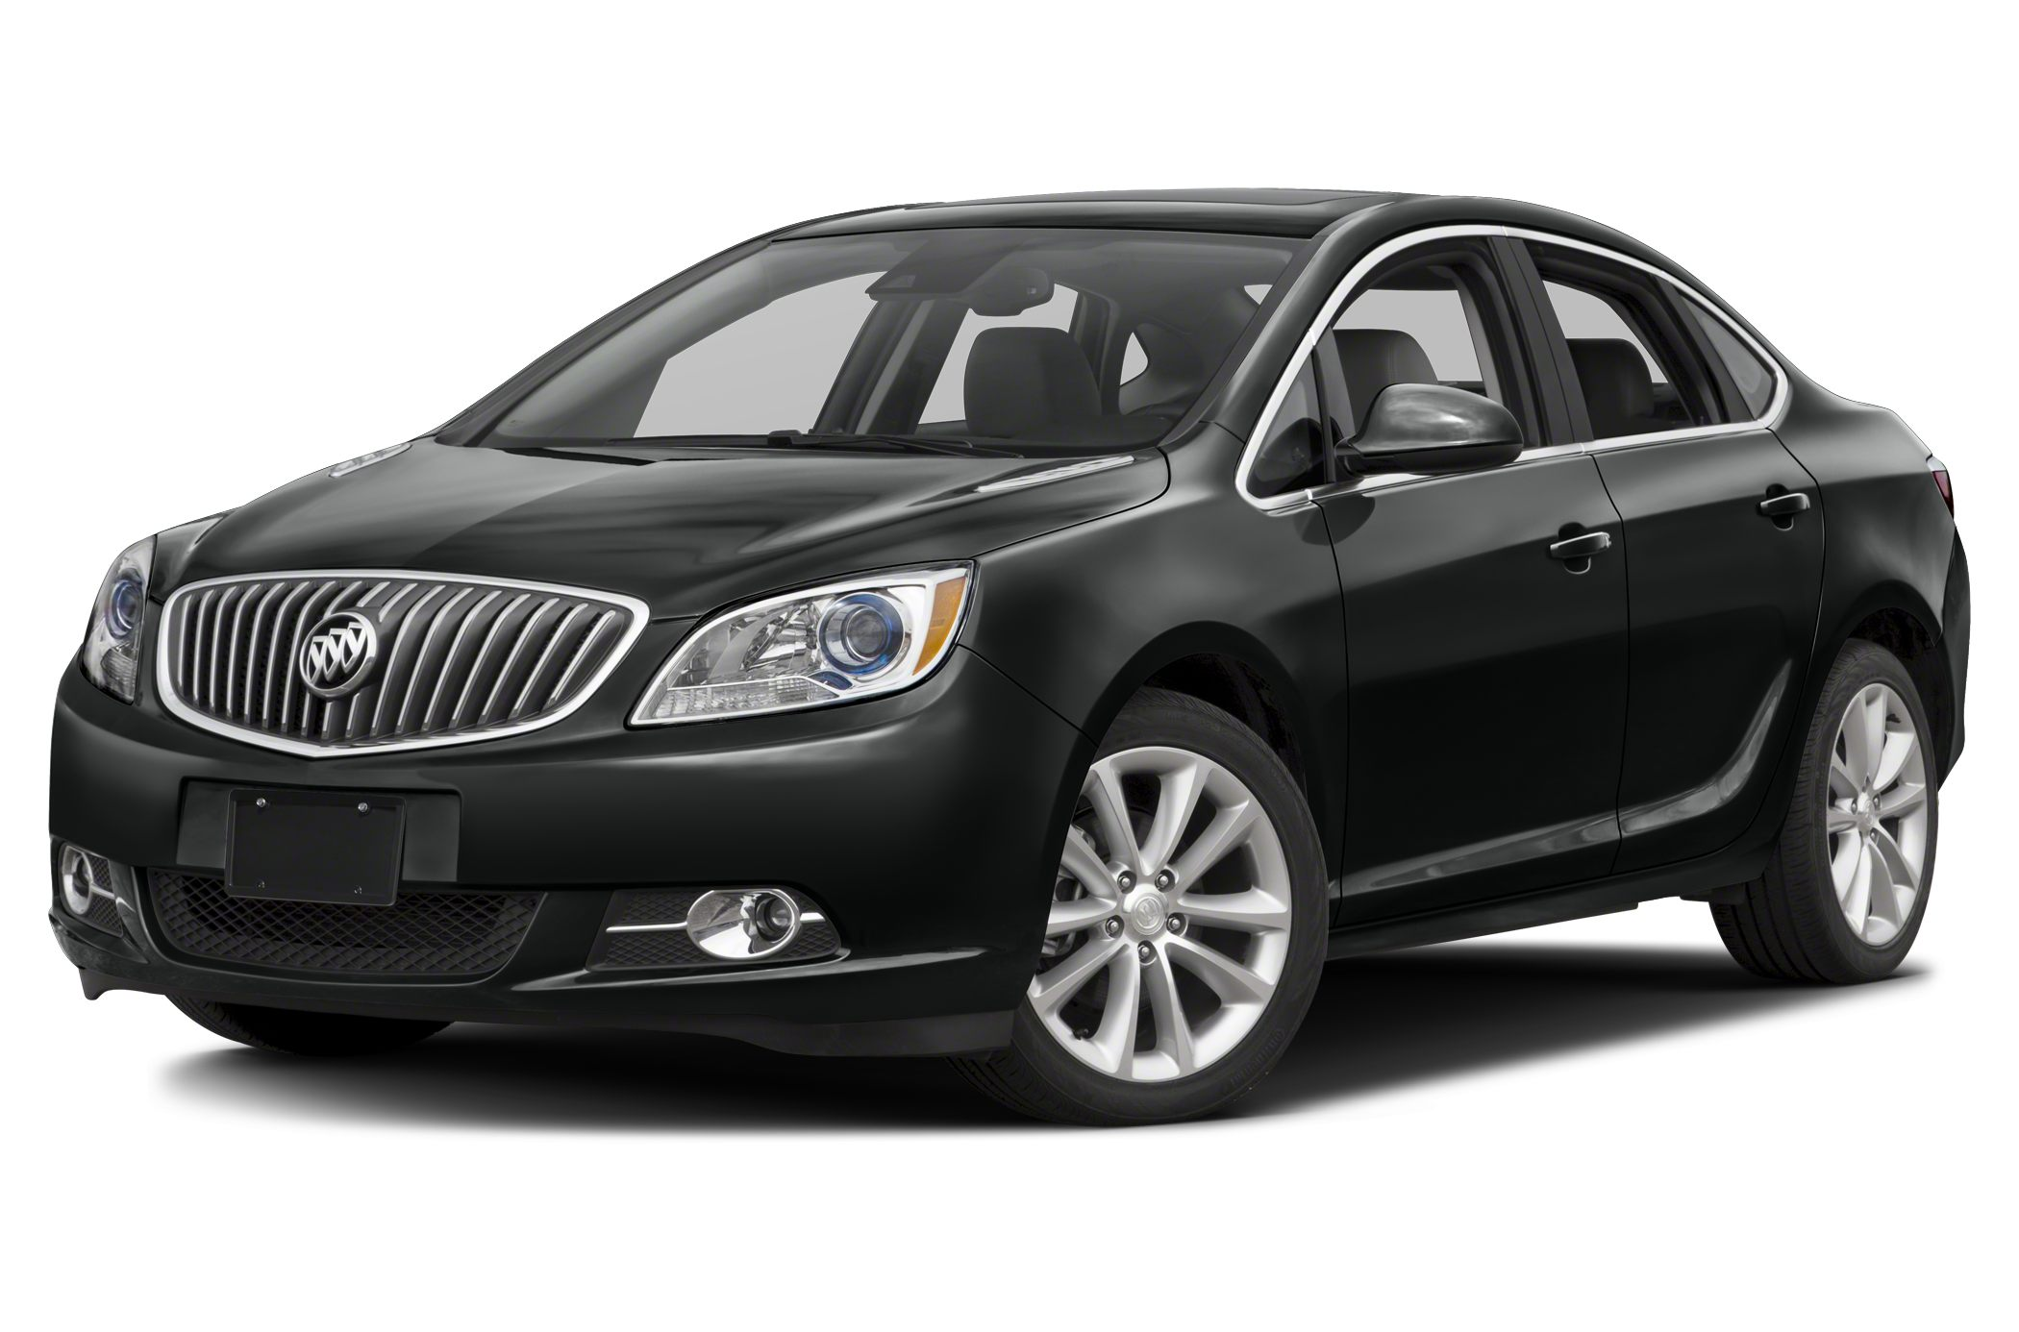
Challenges
-High-cost cars
-Disproportionate amount of low profit cars to high profit cars
-Limited number of branches
High cost cars
Notes:
Here we are presented with key challenges that get in the way of Lariat achieving a higher profit. Each example will be analyzed and have recommended strategies addressed in the following slides. Pictured in the slide is Buick Special 2017, which is part of the high-end, but also VERY high-cost cars in Lariat’s inventory. I mentioned it during my presentation.

Slide 4
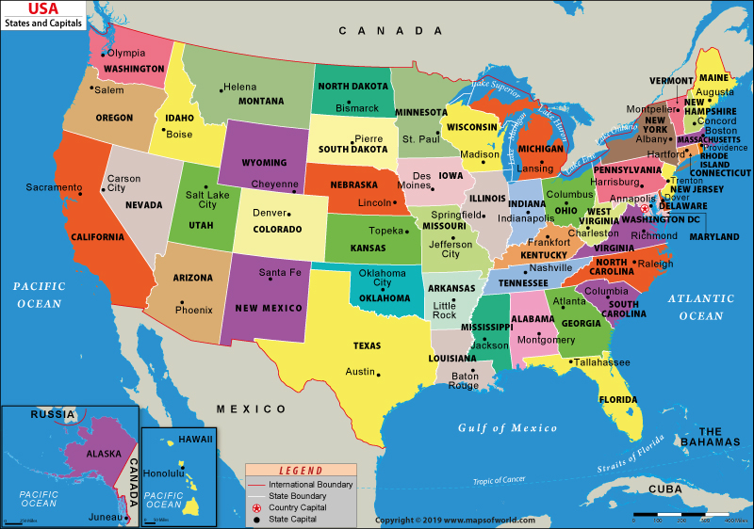
Strategies and solutions
Reducing inventory of high-cost cars
Increasing inventory of high demand cars
Expanding branch locations
Notes:
The audience is presented with 3 strategies I recommend for achieving a higher profit. The map on the slide works well because when presenting, I was using the cursor to show states where Lariat has branches, and states where there is high potential of opening new profitable branches. For example, Portland, OR, which is a growing city and one of top cities known for its marketing industry, primarily for Nike, and for new companies moving from SF to PDX; Hawaii, particularly Honolulu with its high tourism and demands for cars to get around the island.

Slide 5
At a glance:
 | 2018 | Strategy 1 | Strategy 2 | Strategy 3 | Strategy (Combined)
Number of Cars | 4000 | 3980 | 99486 | 653400 | 4000
Number of Branches | 50 | 50 | 50 | 54 | 54
Revenue | $ 64,593,040.00 | $ 64,593,040.00 | $ 64,734,314.42 | $ 70,055,323.20 | $ 64,734,314.42
Cost | $ 33,076,688.64 | $ 32,871,073.92 | $ 33,076,688.64 | $ 35,722,823.73 | $ 32,871,073.92
Profit | $ 31,516,351.36 | $ 31,721,966.08 | $ 31,657,625.78 | $ 34,332,499.47 | $ 31,863,240.50
 |  | $ 205,614.72 | $ 141,274.42 | $ 2,816,148.11 | $ 346,889.14
Notes:
The following is the brief presentation of the strategies. Strategy 1 reduces the number of high-cost cars, thus reducing cost and increasing profit. Strategy 2 suggests increasing inventory of cars that are rented for longer terms and bring bigger profit, thus, the total revenue goes up and so does profit. Strategy 3 suggests that opening more branches in places of high demand for car rental (vacation or conference cities like Honolulu and San Francisco) will increase overall revenue and profit respectively.
Please note that strategies 1-3 are not sufficient alone, as the data approximation uses several controlled variables. For example, strategy 3 has a colossal profit, but this is not considering that some cars may have high cost or that profit is guaranteed to be high. Cost and Revenue are calculated averages based on the 2018 data provided. It all depends on what the selection of the cars in the inventory will be. Opening more branches also does not guarantee high profit, because market researchers needs to study the area and whether there are competitor’s car rentals present.
Combined strategy is the most realistic. The total of the cars is the same, but this is assuming that each high-cost car removed from inventory will be replaced by one that brings most revenue; and there was no relationship found between high revenue cars and high-cost cars.

Slide 6
Houston, Texas
Notes:
Here is an example of strategies 1 (left) and strategy 2 (right) compared to the data from year 2018 that was provided to us.

Slide 7
Houston, Texas
Notes:
This is a visual representation of how the two strategies combined can affect the profit as a whole.

Slide 8

Things to consider
Availability
Accessibility
Variety
Market Study
Notes:
When adopting these strategies, it is important to understand that Lariat should have affordable rental cars available, even if their revenue is small, all because younger and lower income customers will have options within their budget.
Likewise, leaving some high-cost cars is ideal, as high cost sometimes is synonymous with high quality, and Lariat should maintain its range of diverse clientele.
Having a variety of car models is important for the reasons mentioned above, but also suit the various needs outside of finances, like size, color, etc.
Researching the geographic areas for potential expansion and whether there are competitors present will help better predict the profits new branches will bring.

Slide 9
Thank you!
Presented by Nonna Titulauri of thinkful
Notes:
Thank you for your time and attention.
Please feel free to contact me should you have any additional questions.

