Slide 2
The A* (A-star) algorithm
The A* (A-star) algorithm is a powerful and versatile search method used in computer science to find the most efficient path between nodes in a graph.
Widely used in a variety of applications ranging from pathfinding in video games to network routing and AI, A* remains a foundational technique in the field of algorithms and artificial intelligence.

Slide 3
The Mechanism of A* Algorithm
The core of the A* algorithm is based on cost functions and heuristics. It uses two main parameters:
g(n): The actual cost from the starting node to any node n.
h(n): The heuristic estimated cost from node n to the goal. This is where A* integrates knowledge beyond the graph to guide the search.
The sum, f(n)=g(n)+h(n)
f(n)=g(n)+h(n), represents the total estimated cost of the cheapest solution through nnn.
The A* algorithm functions by maintaining a priority queue (or open set) of all possible paths along the graph, prioritizing them based on their fff values

Slide 4
The steps of the algorithm are as follows:
Initialization: Start by adding the initial node to the open set with its f(n).
Loop: While the open set is not empty, the node with the lowest f(n) value is removed from the queue.
Goal Check: If this node is the goal, the algorithm terminates and returns the discovered path.
Node Expansion: Otherwise, expand the node (find all its neighbors), calculating g, h, and f values for each neighbor. Add each neighbor to the open set if it's not already present, or if a better path to this neighbor is found.
Repeat: The loop repeats until the goal is reached or if there are no more nodes in the open set, indicating no available path.

Slide 5
Applications of A*
The A* algorithm's ability to find the most efficient path with a given heuristic makes it suitable for various practical applications:
Pathfinding in Games and Robotics: A* is extensively used in the gaming industry to control characters in dynamic environments, as well as in robotics for navigating between points.
Network Routing: In telecommunications, A* helps in determining the shortest routing path that data packets should take to reach the destination.
AI and Machine Learning: A* can be used in planning and decision-making algorithms, where multiple stages of decisions and movements need to be evaluated.
Pathfinding using A* Algorithm

Slide 6
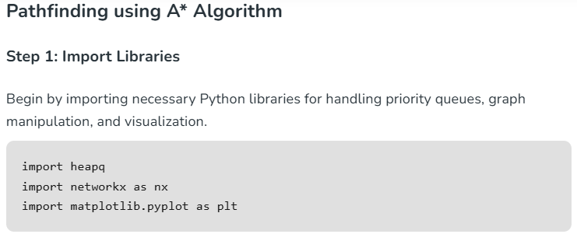

Slide 7
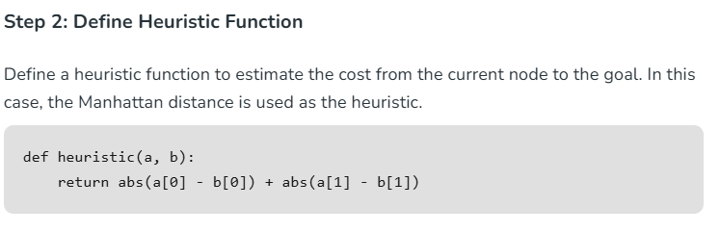

Slide 8
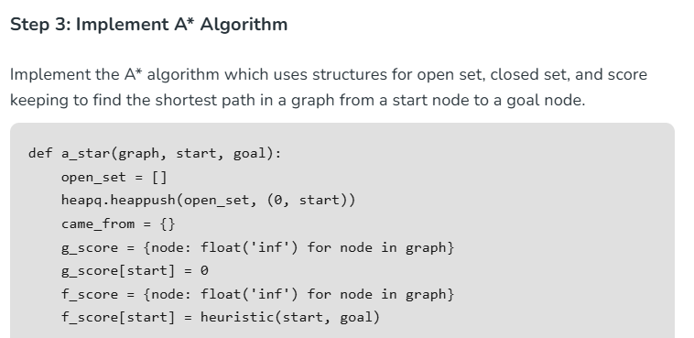

Slide 9
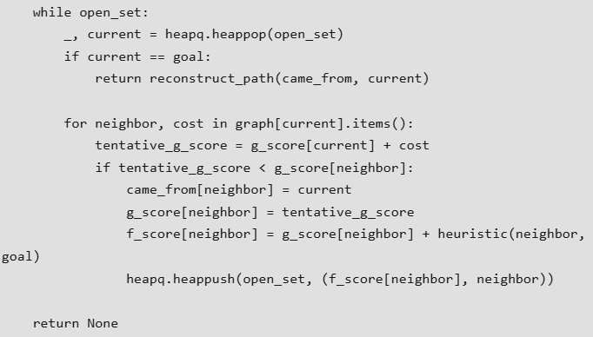

Slide 10
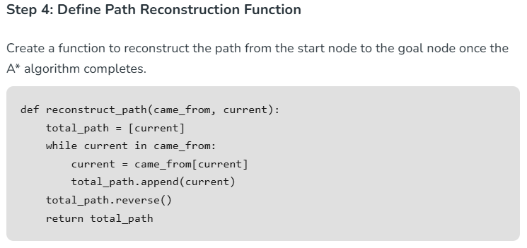

Slide 11
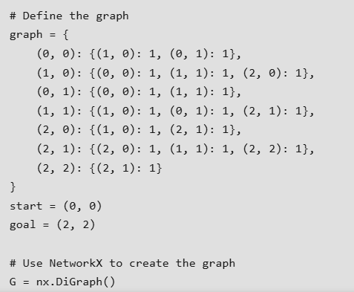

Slide 12
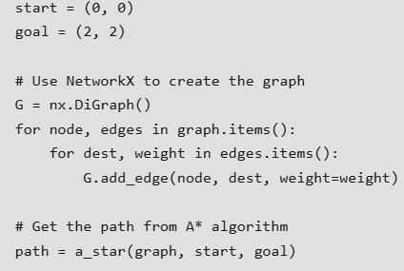

Slide 13
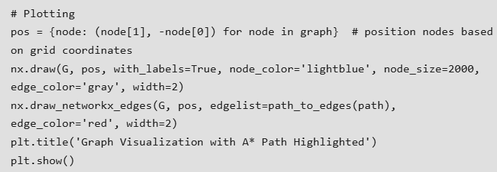

Slide 14
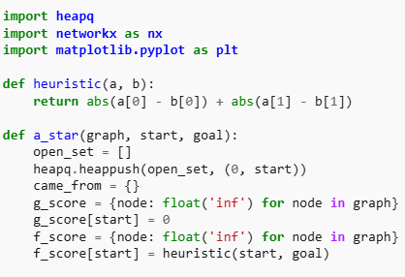

Slide 15
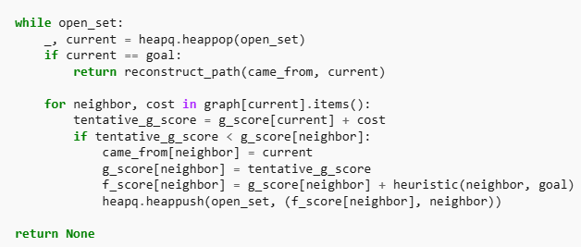

Slide 16
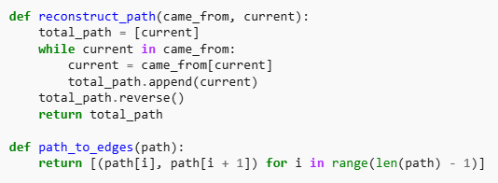

Slide 17
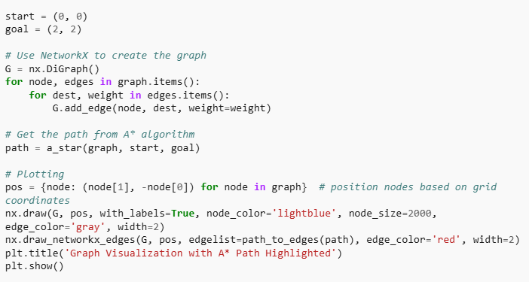

Slide 18
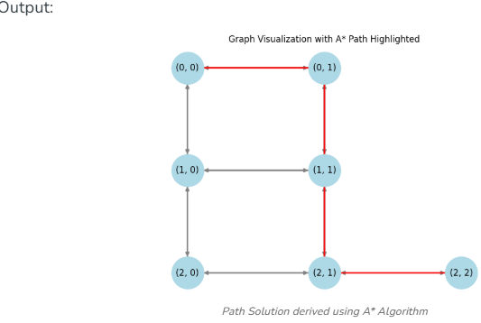

Slide 19
