Slide 1
Summary mp1 & mp2

Slide 2
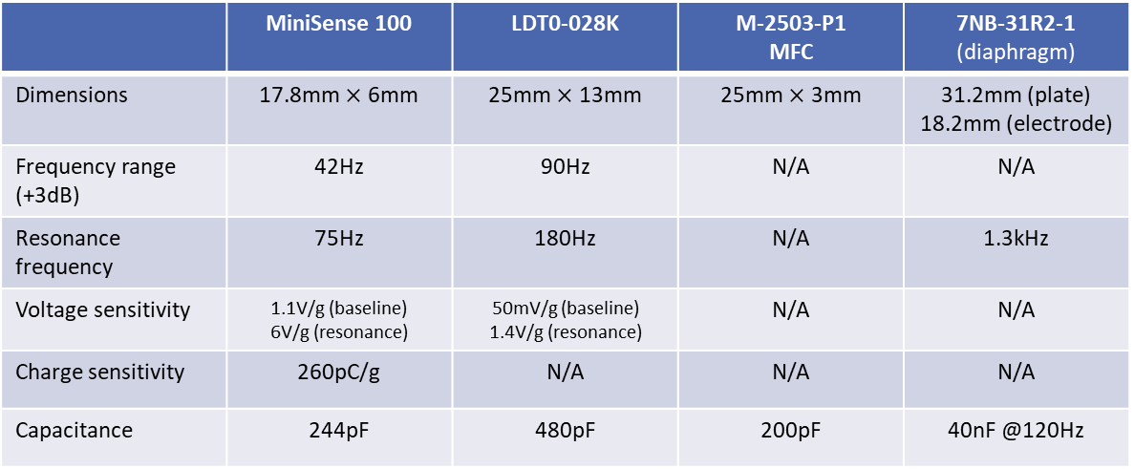
Compare the proposed raw sensors
Make a comparison table
 | MiniSense 100 | LDT0-028K | M-2503-P1 MFC | 7NB-31R2-1 (diaphragm)
Dimensions | 17.8mm $×$ 6mm | 25mm $×$ 13mm | 25mm $×$ 3mm | 31.2mm (plate) 18.2mm (electrode)
Frequency range (+3dB) | 42Hz | 90Hz | N/A | N/A
Resonance frequency | 75Hz | 180Hz | N/A | 1.3kHz
Voltage sensitivity | 1.1V/g (baseline) 6V/g (resonance) | 50mV/g (baseline) 1.4V/g (resonance) | N/A | N/A
Charge sensitivity | 260pC/g | N/A | N/A | N/A
Capacitance | 244pF | 480pF | 200pF | 40nF @120Hz

Slide 3
Motivate the selection of one of the raw sensors
Link your selection with the comparison table
Put your selection in perspective with the specifications
The M-2503-P1 MFC cannot be used for foot pressure monitoring because it is only sensitive to elongation or contraction, as illustrated in the first diagrams of the datasheet
The piezoelectric diaphragm from muRata cannot be used either, because it is an efficient actuator (piezo buzzer) but a poor sensor, and it will likely break when put inside a shoe
The MiniSense 100 vibration sensor is not suitable for the kind of monitoring that we would like to do, because it is a sensor that is meant to be used with the side with the electrodes attached to an object and the side with the mechanical mass left free to move. This gives a second order resonant response (mass – spring dynamics). In addition, this mass makes it impractical/uncomfortable to put it inside a shoe
The LDT0-028K vibration sensor is quite similar to the MiniSense 100, but has a flavor in which there is no additional mechanical mass, which makes it suitable to be placed in a shoe
→ The sensor that is selected is the LDT0-028K because it is the only one that can be placed inside a shoe and that will give a response to the kind of stimuli that we want to measure. The specs do not really play a role in the selection

Slide 4
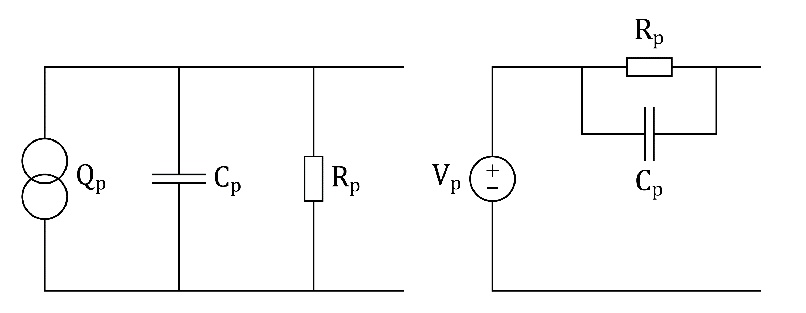
Raw sensor model
Provide an electrical equivalent model of the raw sensor (no parameters required, provide only the symbolic expressions)
Include the primary noise source
Noise mainly comes from the mechanical domain, so we do not try to model it

Slide 5
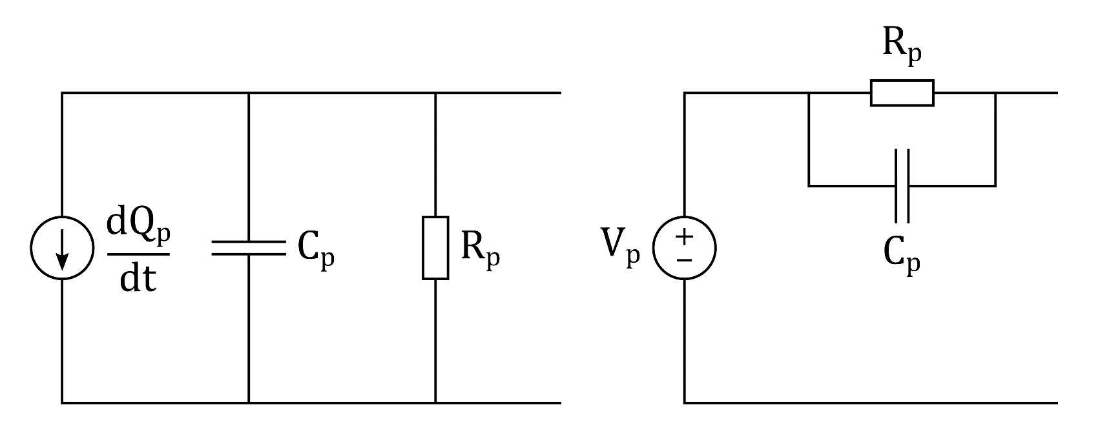
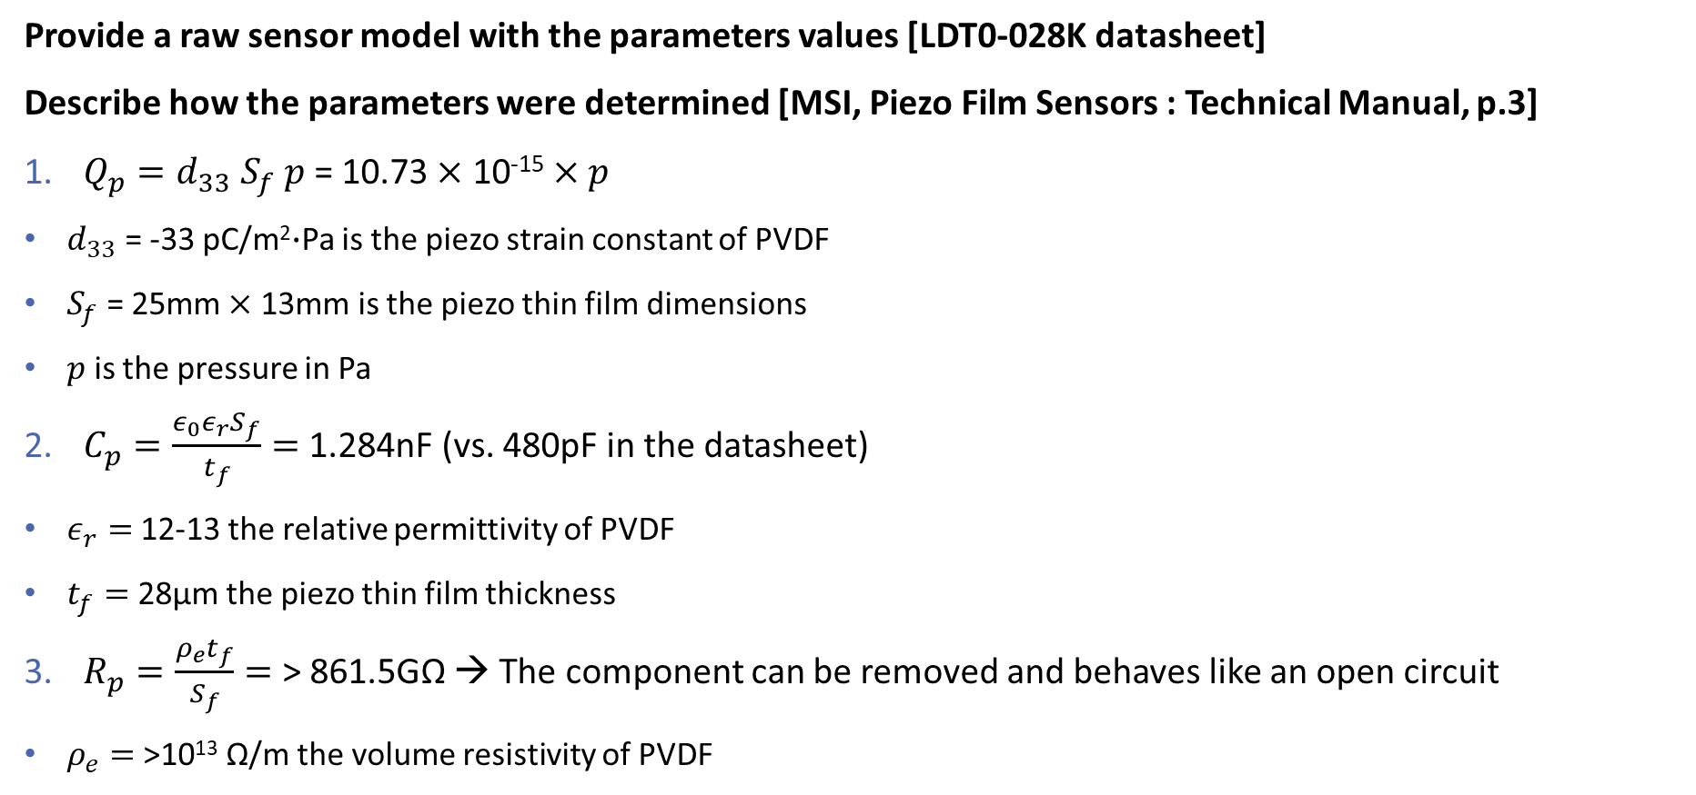
Raw sensor model
Provide a raw sensor model with the parameters values [LDT0-028K datasheet]
Describe how the parameters were determined [MSI, Piezo Film Sensors : Technical Manual, p.3]
$Q_{p}=d_{33} S_{f} p$ = 10.73 $×$ 10⁻¹⁵ $×p$
$d_{33}$ = -33 pC/m²$∙$Pa is the piezo strain constant of PVDF
$S_{f}$ = 25mm $×$ 13mm is the piezo thin film dimensions
$p$ is the pressure in Pa
$C_{p}=\frac{ε_{0}ε_{r}S_{f}}{t_{f}}=$1.284nF (vs. 480pF in the datasheet)
$ε_{r}=$12-13 the relative permittivity of PVDF
$t_{f}=$28µm the piezo thin film thickness
$R_{p}=\frac{ρ_{e}t_{f}}{S_{f}}=$ > 861.5GΩ → The component can be removed and behaves like an open circuit
$ρ_{e}=$>10¹³ Ω/m the volume resistivity of PVDF

Slide 6
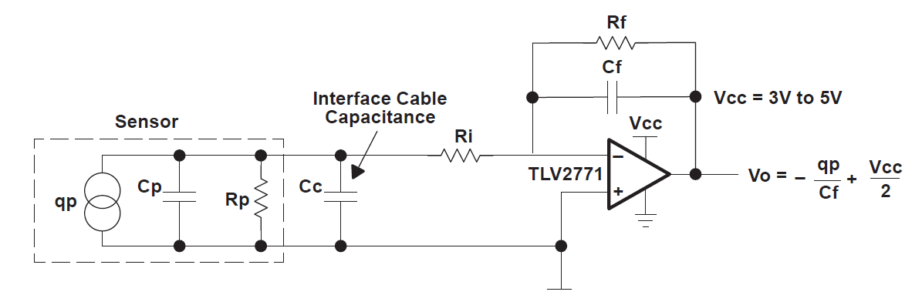
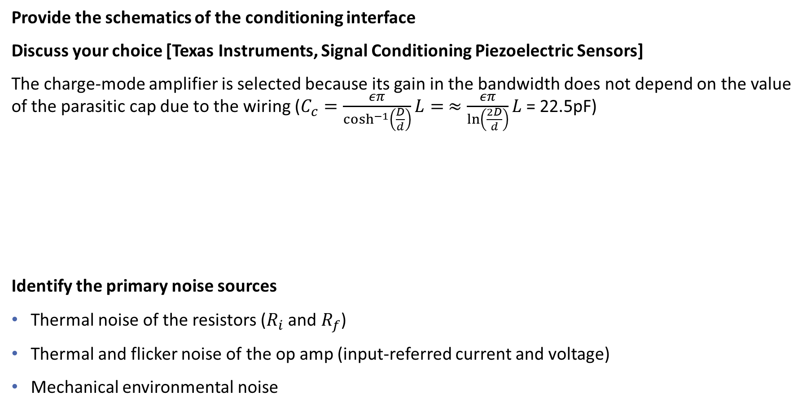
Conditioning interface: selection
Provide the schematics of the conditioning interface
Discuss your choice [Texas Instruments, Signal Conditioning Piezoelectric Sensors]
The charge-mode amplifier is selected because its gain in the bandwidth does not depend on the value of the parasitic cap due to the wiring ($C_{c}=\frac{επ}{\cosh^{−1}\left(\frac{D}{d}\right)}L= ≈\frac{επ}{\ln\left(\frac{2D}{d}\right)}L$ = 22.5pF)
Identify the primary noise sources
Thermal noise of the resistors ($R_{i}$ and $R_{f}$)
Thermal and flicker noise of the op amp (input-referred current and voltage)
Mechanical environmental noise
Notes:
Estimation of the parasitic cap $C_{c}$
d (23AWG) = 0.573mm → Diameter of the cables
D = 1mm → Spacing of the cables
L = 1m → Length of the cables

Slide 7
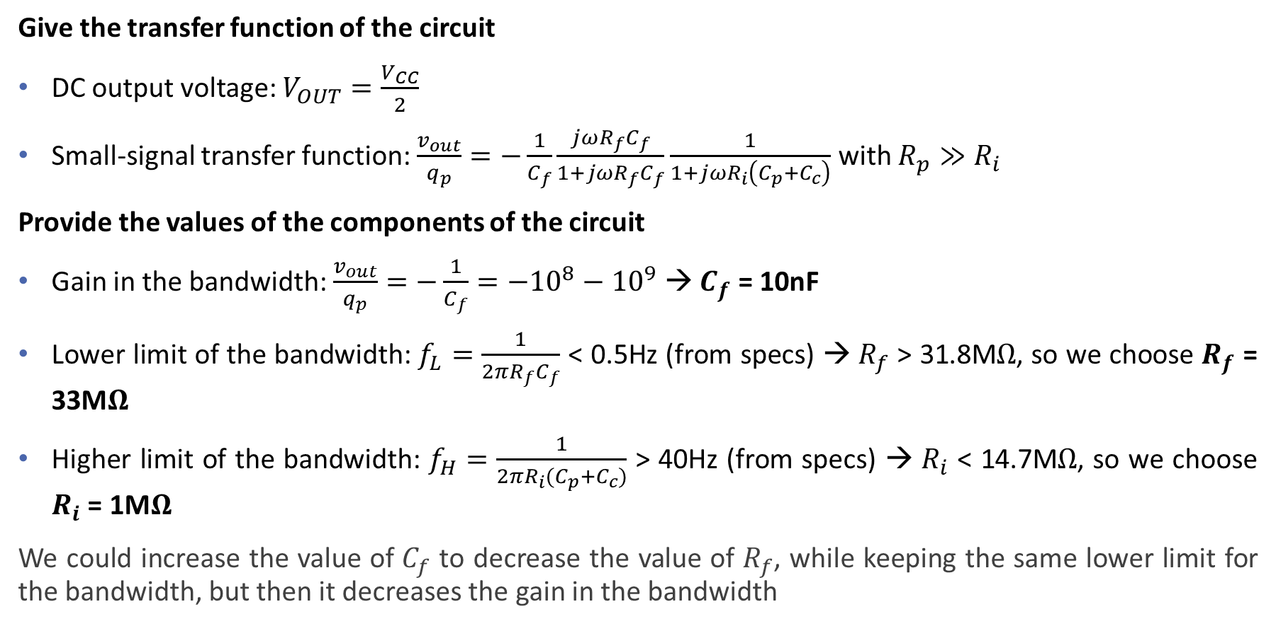
Conditioning interface: sizing
Give the transfer function of the circuit
DC output voltage: $V_{OUT}=\frac{V_{CC}}{2}$
Small-signal transfer function: $\frac{v_{out}}{q_{p}}=−\frac{1}{C_{f}}\frac{jωR_{f}C_{f}}{1+jωR_{f}C_{f}}\frac{1}{1+jωR_{i}\left(C_{p}+C_{c}\right)}$ with $R_{p}≫R_{i}$
Provide the values of the components of the circuit
Gain in the bandwidth: $\frac{v_{out}}{q_{p}}=−\frac{1}{C_{f}}=−{10}^{8}−{10}^{9}$ → $C_{f}$ = 10nF
Lower limit of the bandwidth: $f_{L}=\frac{1}{2πR_{f}C_{f}}$ < 0.5Hz (from specs) → $R_{f}$ > 31.8M$Ω$, so we choose $R_{f}$ = 33M$Ω$
Higher limit of the bandwidth: $f_{H}=\frac{1}{2πR_{i}{(C}_{p}+C_{c})}$ > 40Hz (from specs) → $R_{i}$ < 14.7M$Ω$, so we choose $R_{i}$ = 1M$Ω$
We could increase the value of $C_{f}$ to decrease the value of $R_{f}$, while keeping the same lower limit for the bandwidth, but then it decreases the gain in the bandwidth

Slide 8
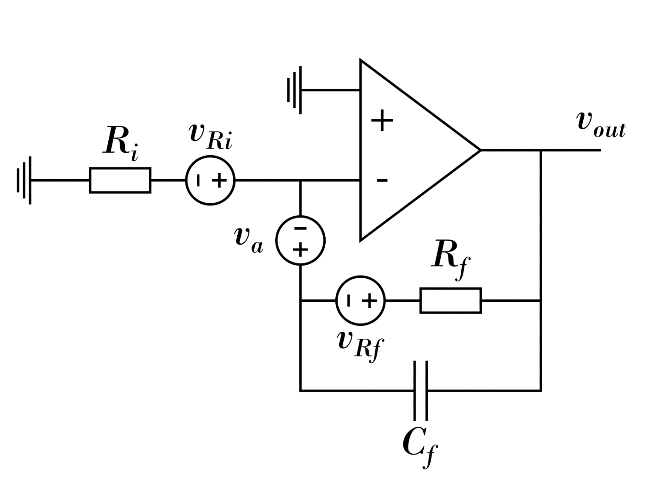

Input-referred (voltage) noise (1/4)
Compute the input-referred noise of the conditioning interface – No 1/f volt. noise, no curr. noise
We should compute both the input-referred current and voltage noise, but if we compute only one, the voltage noise makes more sense, because the charge generated by the piezo results in a voltage when it is put on the piezo sensor capacitance
Step 1: Compute the transfer function between the output voltage $v_{out}$ and the input voltage $v_{in}$
$$\frac{v_{out}}{v_{in}}=−\frac{R_{f}}{R_{i}}\frac{1}{1+jωR_{f}C_{f}}$$
Step 2: Compute the transfer functions between each noise source and the output voltage $v_{out}$, and the transfer functions between each noise source and the input voltage $v_{in}$, with the input grounded ($v_{in}=0$)
$$\frac{v_{out}}{v_{R_{i}}}=−\frac{R_{f}}{R_{i}}\frac{1}{1+jωR_{f}C_{f}} \underset{⇔}{ }\frac{v_{in}}{v_{R_{i}}}=1$$
$$\frac{v_{out}}{v_{R_{f}}}=\frac{1}{1+jωR_{f}C_{f}} \underset{⇔}{ }\frac{v_{in}}{v_{R_{f}}}=−\frac{R_{i}}{R_{f}}$$
$$\frac{v_{out}}{v_{a}}=\left(1+\frac{R_{f}}{R_{i}}\right)\frac{1+jω\left(R_{i}||R_{f}\right)C_{f}}{1+jωR_{f}C_{f}} \underset{⇔}{ }\frac{v_{in}}{v_{a}}=−\left(1+\frac{R_{i}}{R_{f}}\right) \left(1+jω\left(R_{i}||R_{f}\right)C_{f}\right)$$

Slide 9
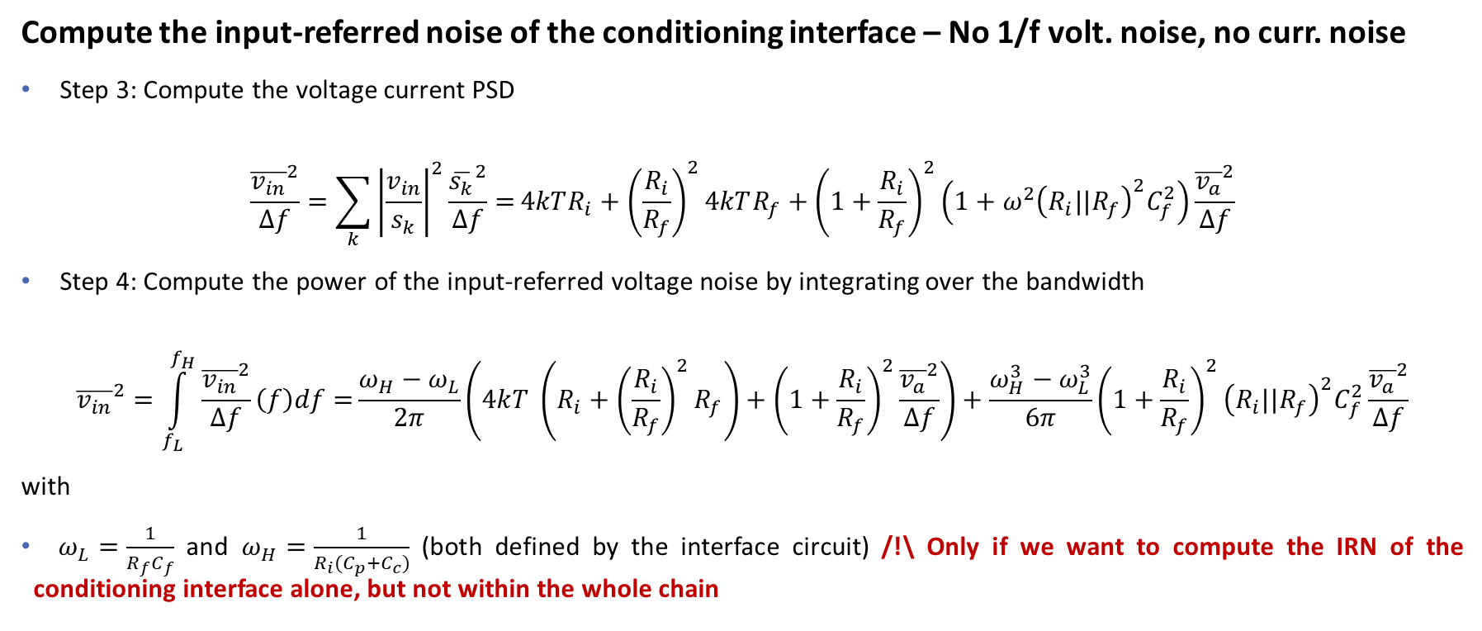
Input-referred (voltage) noise (2/4)
Compute the input-referred noise of the conditioning interface – No 1/f volt. noise, no curr. noise
Step 3: Compute the voltage current PSD
$$\frac{{\overline{v_{in}}}^{2}}{Δf}=\sum_{k}{{\left|\frac{v_{in}}{s_{k}}\right|}^{2}\frac{{\overline{s_{k}}}^{2}}{Δf}=}4kTR_{i}+{\left(\frac{R_{i}}{R_{f}}\right)}^{2}4kTR_{f}+{\left(1+\frac{R_{i}}{R_{f}}\right)}^{2}\left(1+ω^{2}{\left(R_{i}||R_{f}\right)}^{2}C_{f}^{2}\right)\frac{{\overline{v_{a}}}^{2}}{Δf}$$
Step 4: Compute the power of the input-referred voltage noise by integrating over the bandwidth
$${\overline{v_{in}}}^{2}=\int_{f_{L}}^{f_{H}}{\frac{{\overline{v_{in}}}^{2}}{Δf}\left(f\right)df=}\frac{ω_{H}−ω_{L}}{2π}\left(4kT \left(R_{i}+{\left(\frac{R_{i}}{R_{f}}\right)}^{2}R_{f}\right)+{\left(1+\frac{R_{i}}{R_{f}}\right)}^{2}\frac{{\overline{v_{a}}}^{2}}{Δf}\right)+\frac{ω_{H}^{3}−ω_{L}^{3}}{6π}{\left(1+\frac{R_{i}}{R_{f}}\right)}^{2}{{\left(R_{i}||R_{f}\right)}^{2}C}_{f}^{2}\frac{{\overline{v_{a}}}^{2}}{Δf}$$
with
$ω_{L}=\frac{1}{R_{f}C_{f}}$ and $ω_{H}=\frac{1}{R_{i}(C_{p}+C_{c})}$ (both defined by the interface circuit) /!\ Only if we want to compute the IRN of the conditioning interface alone, but not within the whole chain

Slide 10
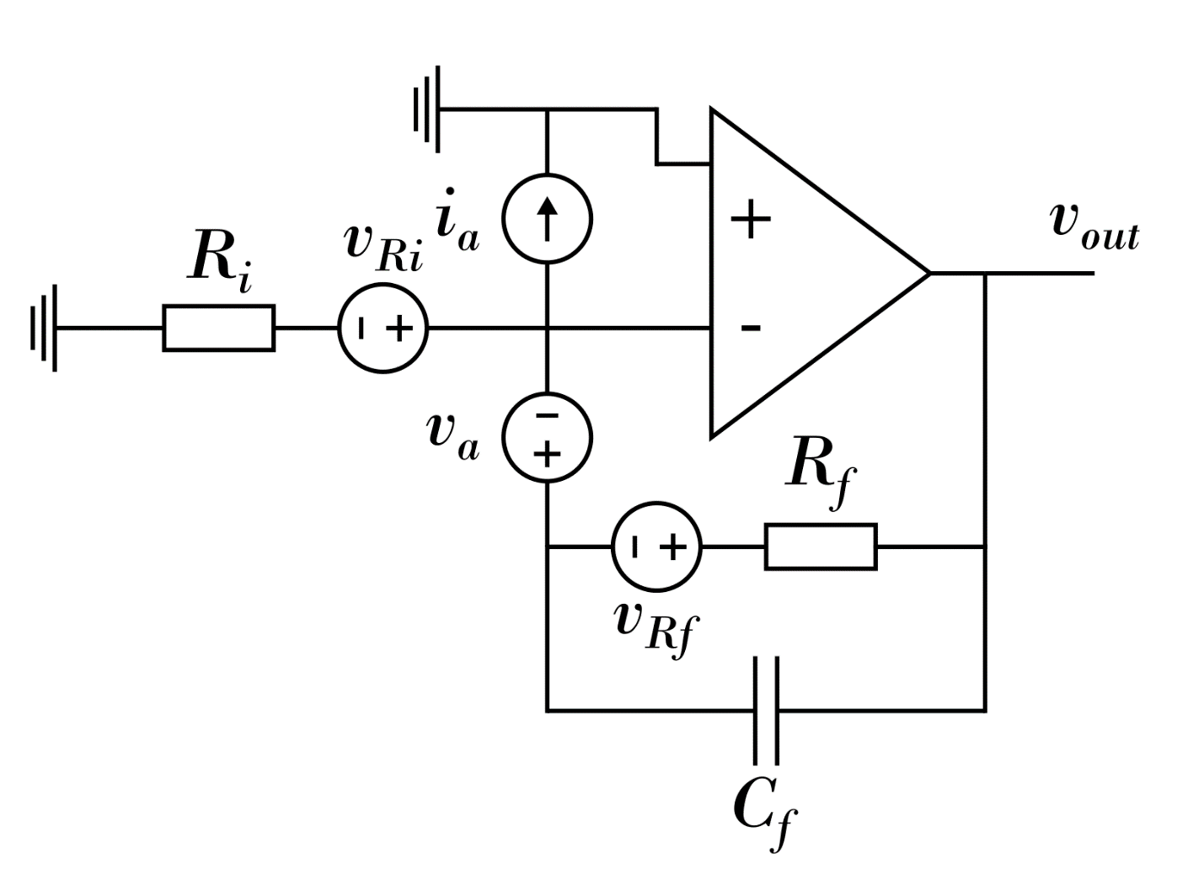
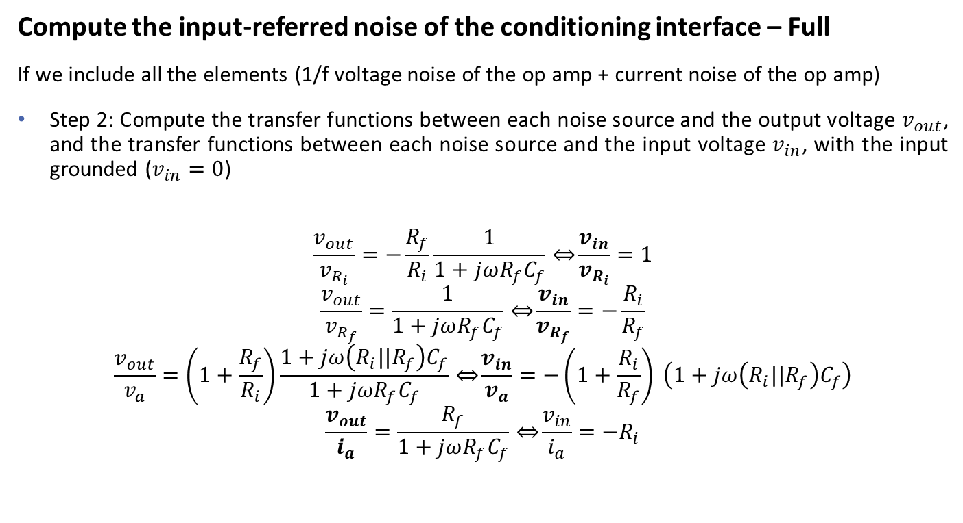
Input-referred (voltage) noise (3/4)
Compute the input-referred noise of the conditioning interface – Full
If we include all the elements (1/f voltage noise of the op amp + current noise of the op amp)
Step 2: Compute the transfer functions between each noise source and the output voltage $v_{out}$, and the transfer functions between each noise source and the input voltage $v_{in}$, with the input grounded ($v_{in}=0$)
$$\frac{v_{out}}{v_{R_{i}}}=−\frac{R_{f}}{R_{i}}\frac{1}{1+jωR_{f}C_{f}} \underset{⇔}{ }\frac{v_{in}}{v_{R_{i}}}=1$$
$$\frac{v_{out}}{v_{R_{f}}}=\frac{1}{1+jωR_{f}C_{f}} \underset{⇔}{ }\frac{v_{in}}{v_{R_{f}}}=−\frac{R_{i}}{R_{f}}$$
$$\frac{v_{out}}{v_{a}}=\left(1+\frac{R_{f}}{R_{i}}\right)\frac{1+jω\left(R_{i}||R_{f}\right)C_{f}}{1+jωR_{f}C_{f}} \underset{⇔}{ }\frac{v_{in}}{v_{a}}=−\left(1+\frac{R_{i}}{R_{f}}\right) \left(1+jω\left(R_{i}||R_{f}\right)C_{f}\right)$$
$$\frac{v_{out}}{i_{a}}=\frac{R_{f}}{1+jωR_{f}C_{f}} \underset{⇔}{ }\frac{v_{in}}{i_{a}}=−R_{i}$$

Slide 11
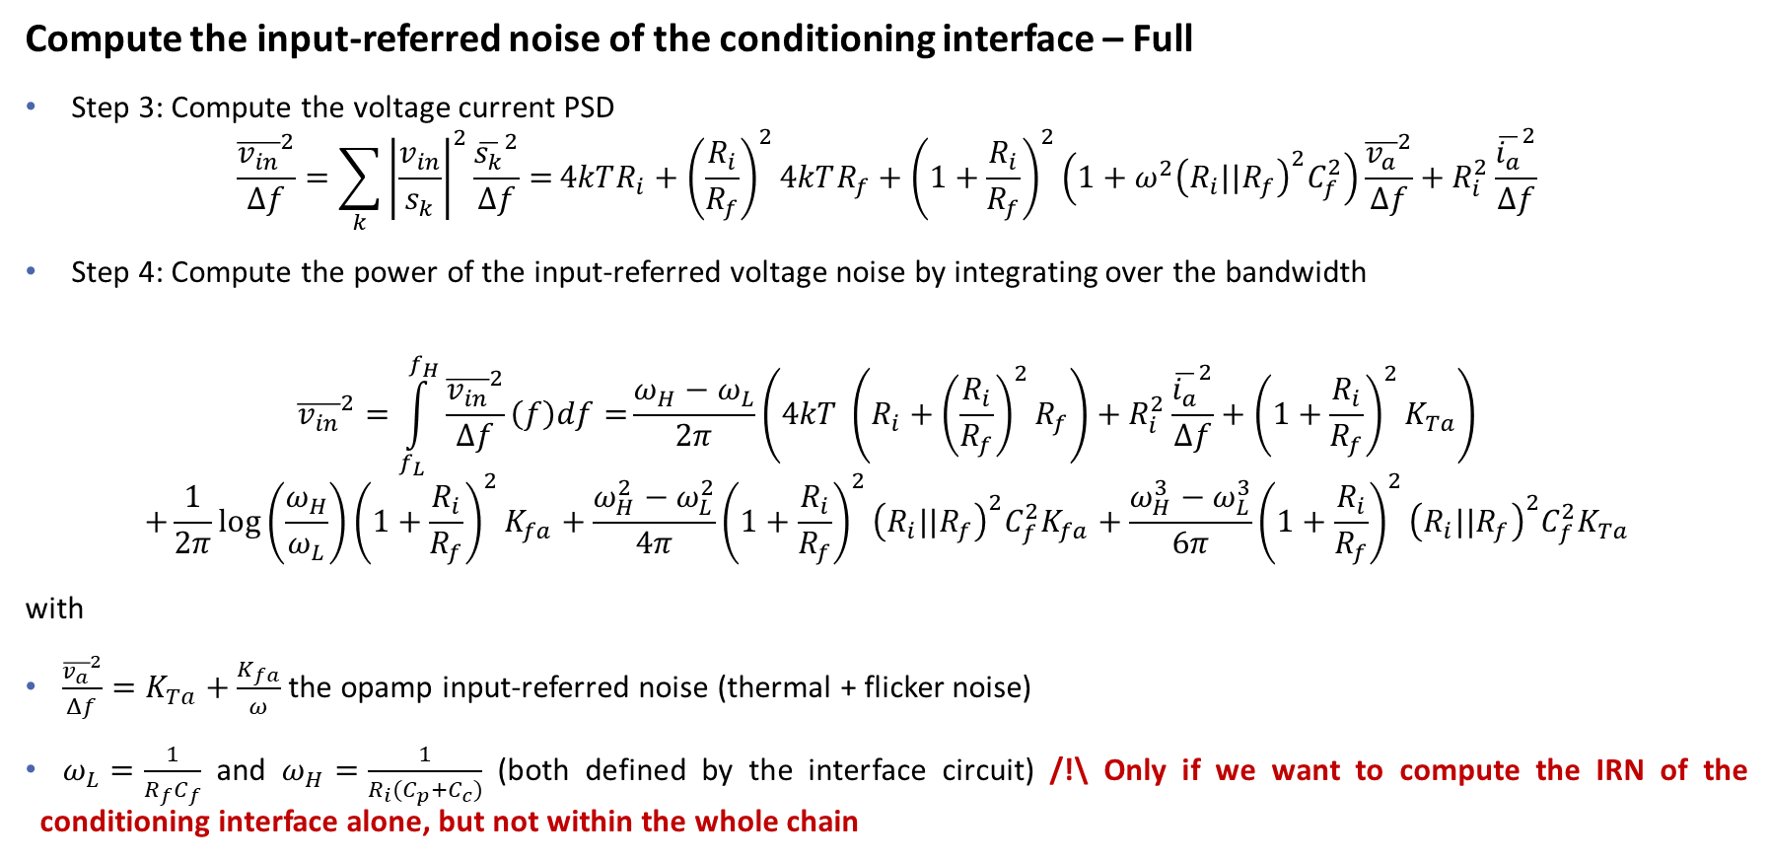
Input-referred (voltage) noise (4/4)
Compute the input-referred noise of the conditioning interface – Full
Step 3: Compute the voltage current PSD
$$\frac{{\overline{v_{in}}}^{2}}{Δf}=\sum_{k}{{\left|\frac{v_{in}}{s_{k}}\right|}^{2}\frac{{\overline{s_{k}}}^{2}}{Δf}=}4kTR_{i}+{\left(\frac{R_{i}}{R_{f}}\right)}^{2}4kTR_{f}+{\left(1+\frac{R_{i}}{R_{f}}\right)}^{2}\left(1+ω^{2}{\left(R_{i}||R_{f}\right)}^{2}C_{f}^{2}\right)\frac{{\overline{v_{a}}}^{2}}{Δf}+R_{i}^{2}\frac{{\overline{i_{a}}}^{2}}{Δf}$$
Step 4: Compute the power of the input-referred voltage noise by integrating over the bandwidth
$${\overline{v_{in}}}^{2}=\int_{f_{L}}^{f_{H}}{\frac{{\overline{v_{in}}}^{2}}{Δf}\left(f\right)df=}\frac{ω_{H}−ω_{L}}{2π}\left(4kT \left(R_{i}+{\left(\frac{R_{i}}{R_{f}}\right)}^{2}R_{f}\right)+R_{i}^{2}\frac{{\overline{i_{a}}}^{2}}{Δf}+{\left(1+\frac{R_{i}}{R_{f}}\right)}^{2}K_{Ta}\right)$$
$$+\frac{1}{2π}\log\left(\frac{ω_{H}}{ω_{L}}\right){\left(1+\frac{R_{i}}{R_{f}}\right)}^{2}K_{fa}+\frac{ω_{H}^{2}−ω_{L}^{2}}{4π}{{\left(1+\frac{R_{i}}{R_{f}}\right)}^{2}{\left(R_{i}||R_{f}\right)}^{2}C}_{f}^{2}K_{fa}+\frac{ω_{H}^{3}−ω_{L}^{3}}{6π}{\left(1+\frac{R_{i}}{R_{f}}\right)}^{2}{{\left(R_{i}||R_{f}\right)}^{2}C}_{f}^{2}K_{Ta}$$
with
$\frac{{\overline{v_{a}}}^{2}}{Δf}=K_{Ta}+\frac{K_{fa}}{ω}$ the opamp input-referred noise (thermal + flicker noise)
$ω_{L}=\frac{1}{R_{f}C_{f}}$ and $ω_{H}=\frac{1}{R_{i}(C_{p}+C_{c})}$ (both defined by the interface circuit) /!\ Only if we want to compute the IRN of the conditioning interface alone, but not within the whole chain

