Slide 1
[Report #MP3 – the music codec]
Group #1
Hugo Bastin
Loïc tumelaire
Vincent Dieuzeide
Zéphyrin Barras

Slide 2
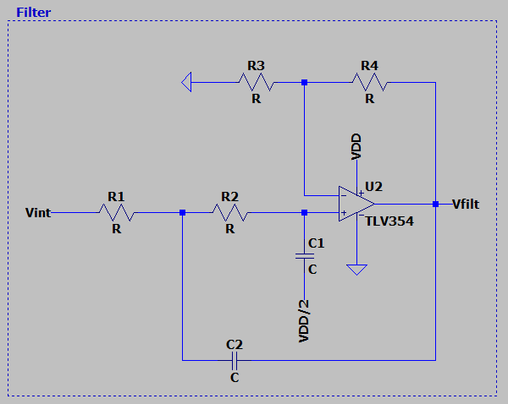


Analog filter: selection and sizing
Provide the schematics of the filter
Sallen and key second order filter where we suppose R=R1=R2=R3,C=C1=C2
Provide the values of the components
We first choose R1=100kΩ because the cut-off frequency desired
is 40 hz with fc=1/2piRC so we need a large R to have an
acceptable C=39.79nF, despite the bigger thermal noise this
Large value of resistance will induce.
The we choose the value of R4 with the following formula
We found, for Q=0.707(to avoid overshoot response ) , R4=58kΩ

Slide 3
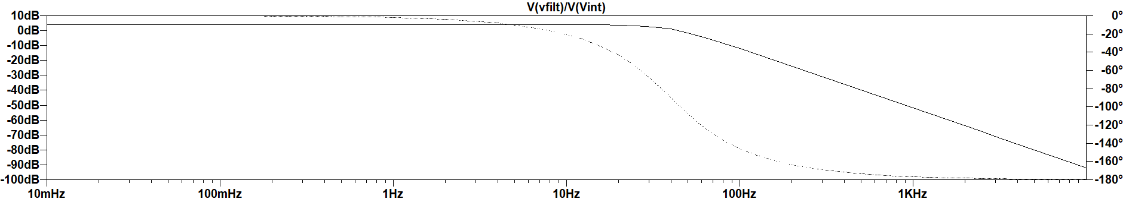
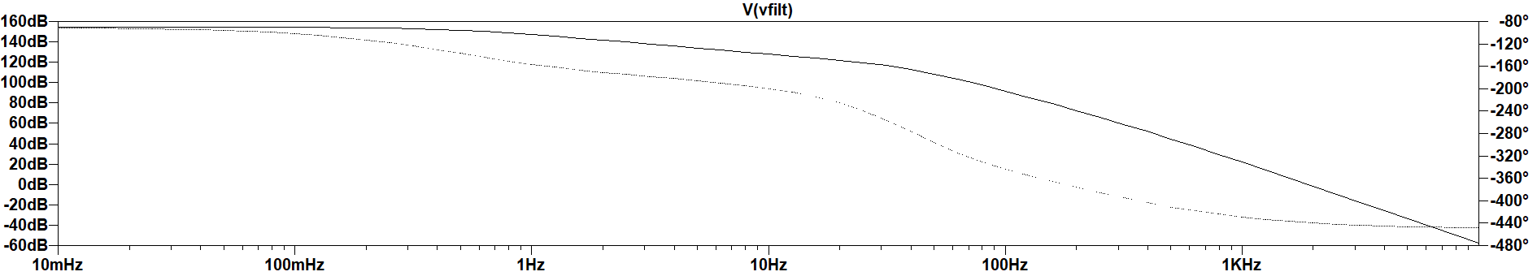
Simulation
Simulate the filter frequency response using LTSpice:
Simulate the whole instrumentation chain using LTSpice:

Slide 4
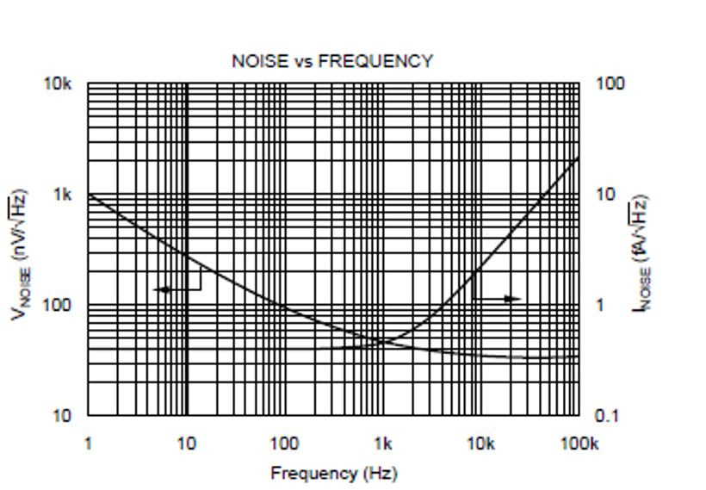
Whole chain noise analysis (1/2)
Evaluate the impact of each noise source on the performance of the whole chain.
- Use the final expression of the noise analysis document Part 1 for the charge amplifier block.
- Consider only the noise of the TLV354 for the filter block (do not account for noise coming from the resistors).
Bring back the noise reference of the enter of the filter for the output noise filter (only TLV354 noise considered)
Voltage:
From datasheet: , with a band from 0.5 to 40 Hz.
Gain is 4dB. We find voltage_noise_input_filter=187 nV
Current:
From datasheet:
We find current_noise_input_filter=1.25pA
Bring back at the input in Coulombs by dividing these value by the charge amplifier gain (30dB) : IRN_filter=5.91 nC
Then we compute the value flicker noise constant for the voltage noise of the charge amplifier from the datasheet (neglect the thermal one car small in our band)
We find K_fa=1.99*10^-14 V²
For the current in the band of interest, we have I²_charge amplifier=5.06 10^-29 A²
For the given formula, we got an IRN_amplifier=6.04 10^-12 V^2 , and so 2.45 μC
The total IRN is so 2.455 μC

Slide 5
Whole chain noise analysis (2/2)
Give the equivalent charge noise of each block of the chain and evaluate their impact.
See previous slide ( no impact of the filter )

