Slide 1
Introduction to Spring

Slide 2
Objectives of this Presentation
Purpose:
Aim of this presentation is to have an basic understanding of the Spring Framework
Product:
Knowledge of the nature of Spring Framework
Understanding of Spring architecture and some Spring modules
Process:
Interactive Theory Sessions (in form of discussion)
Hands on Activity

Slide 3
Table of contents
Spring Framework Overview
Spring Framework Architecture
Spring IoC Containers
Spring Beans
Spring Dependency Injection
Spring Beans Auto-Wiring
Spring Annotation Based Configuration
Spring Java Based Configuration

Slide 4
Table of contents
Event Handling in Spring
AOP with Spring Framework
Spring JDBC Framework Overview
Spring Transaction Management
Spring Web MVC Framework

Slide 5
Spring Framework Overview
What is Spring?
Spring is the most popular application development framework for enterprise Java
Spring framework is an open source Java platform and it was initially written by Rod Johnson and was first released under the Apache 2.0 license in June 2003.
Spring is lightweight when it comes to size and transparency

Slide 6
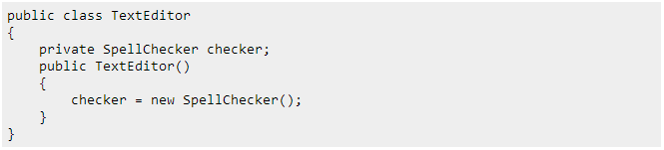
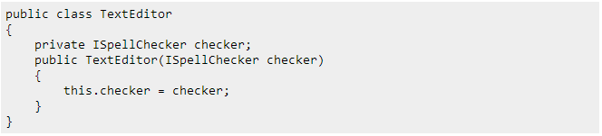
Spring Framework Overview
Dependency Injection (DI)
The technology that Spring is most identified with
Inversion of Control (IoC) - is a programming technique, expressed here in terms of object-oriented programming, in which object coupling is bound at run time by an assembler object and is typically not known at compile time using static analysis

Slide 7
Spring Framework Overview
Aspect Oriented Programming (AOP)
is a programming paradigm that aims to increase modularity by allowing the separation of cross-cutting concerns
entails breaking down program logic into distinct parts (concerns, cohesive areas of functionality).

Slide 8
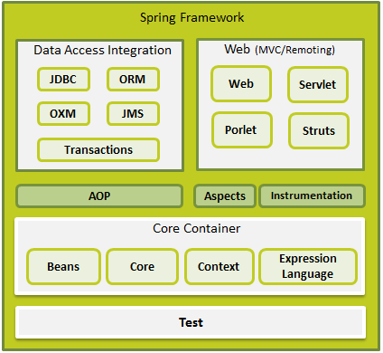
Spring Framework Architecture

Slide 9
Spring Framework Architecture
Core Container
The Core module provides the fundamental parts of the framework, including the IoC and Dependency Injection features..
The Bean module provides BeanFactory which is a sophisticated implementation of the factory pattern.
The Context module builds on the solid base provided by the Core and Beans modules and it is a medium to access any objects defined and configured. The ApplicationContext interface is the focal point of the Context module.
The Expression Language module provides a powerful expression language for querying and manipulating an object graph at runtime.

Slide 10
Spring Framework Architecture
Data Access/Integration
The JDBC module provides a JDBC-abstraction layer that removes the need to do tedious JDBC related coding.
The ORM module provides integration layers for popular object-relational mapping APIs, including JPA, JDO, Hibernate, and iBatis.
The OXM module provides an abstraction layer that supports Object/XML mapping implementations for JAXB, Castor, XMLBeans, JiBX and XStream.
The Java Messaging Service JMS module contains features for producing and consuming messages.
The Transaction module supports programmatic and declarative transaction management for classes that implement special interfaces and for all your POJOs.

Slide 11
Spring Framework Architecture
Web
The Web module provides basic web-oriented integration features such as multipart file-upload functionality and the initialization of the IoC container using servlet listeners and a web-oriented application context.
The Web-Servlet module contains Spring's model-view-controller (MVC) implementation for web applications.
The Web-Struts module contains the support classes for integrating a classic Struts web tier within a Spring application.
The Web-Portlet module provides the MVC implementation to be used in a portlet environment and mirrors the functionality of Web-Servlet module.

Slide 12
Spring Framework Architecture
Miscellaneous
The AOP module provides aspect-oriented programming implementation allowing you to define method-interceptors and pointcuts to cleanly decouple code that implements functionality that should be separated.
The Aspects module provides integration with AspectJ which is again a powerful and mature aspect oriented programming (AOP) framework.
The Instrumentation module provides class instrumentation support and class loader implementations to be used in certain application servers.
The Test module supports the testing of Spring components with JUnit or TestNG frameworks.

Slide 13
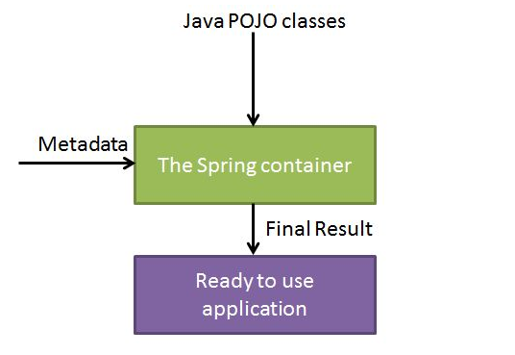
Spring IoC Containers

Slide 14
Spring IoC Containers
Types of Containers
Spring BeanFactory Container
This is the simplest container providing basic support for DI and defined by the org.springframework.beans.factory.BeanFactory interface.
Spring ApplicationContext Container
This container adds more enterprise-specific functionality such as the
ability to resolve textual messages from a properties file and the ability to
publish application events to interested event listeners. This is defined by
org.springframework.context.ApplicationContext interface.

Slide 15
Spring Beans
What is a Spring Bean?
A bean is an object that is instantiated, assembled, and otherwise managed by a Spring IoC container.

Slide 16
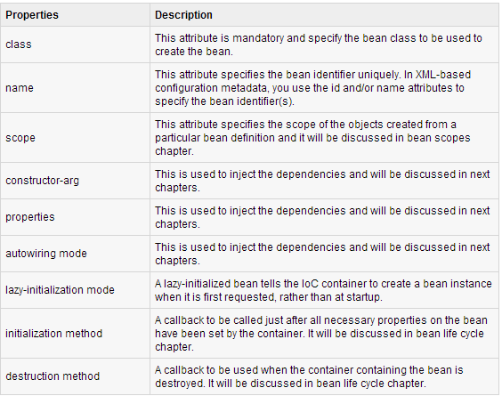
Spring Beans
Spring Bean Properties

Slide 17
Spring Beans
Spring Configuration Metadata
Methods to provide configuration metadata to the Spring Container:
XML based configuration file.
Annotation-based configuration
Java-based configuration

Slide 18
Spring Beans
Spring Configuration Metadata
Methods to provide configuration metadata to the Spring Container:
XML based configuration file.
Annotation-based configuration
Java-based configuration

Slide 19
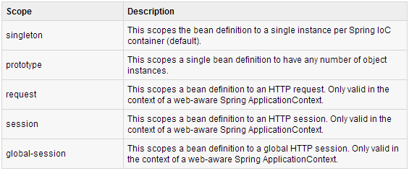
Spring Beans
Spring Bean Scopes

Slide 20
Spring Beans
Spring Bean Life Cycle
Initialization Callbacks:
I. JAVA Class
II. XML Based Configuration
Destruction Callbacks:
I. JAVA Class
II. XML Based Configuration

Slide 21
Spring Beans
Spring Bean Post Processors
The BeanPostProcessor interface defines callback methods that you can implement to provide your own instantiation logic, dependency-resolution logic etc.

Slide 22
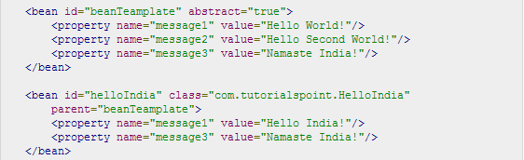
Spring Beans
Spring Bean Definition Inheritance

Slide 23
Spring Dependency Injection
Dependency Injection Type
Constructor-based Dependency Injection
Constructor-based DI is accomplished when the container invokes a class constructor with a number of arguments, each representing a dependency on other class.
Setter-based Dependency Injection
Setter-based DI is accomplished by the container calling setter methods on your beans after invoking a no-argument constructor or no-argument static factory method to instantiate your bean.

Slide 24


Spring Dependency Injection
Spring Injecting Inner Beans

Slide 25
Spring Dependency Injection
Spring Injecting Inner Beans

Slide 26
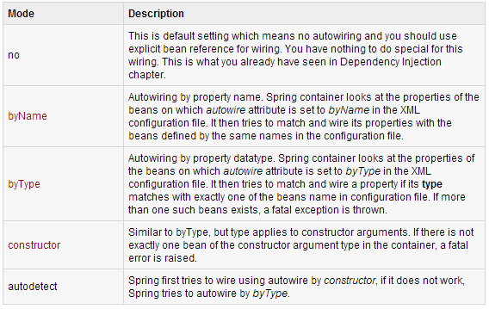
Spring Beans Auto-Wiring
Autowiring Modes
A. XML Configuration

Slide 27
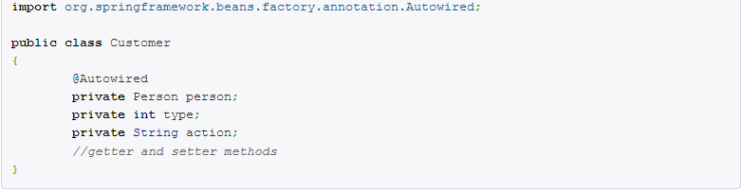
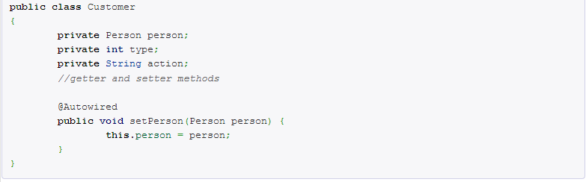
Spring Beans Auto-Wiring
B. @Autowired Annotation
@Autowired field
@Autowired setter method

Slide 28
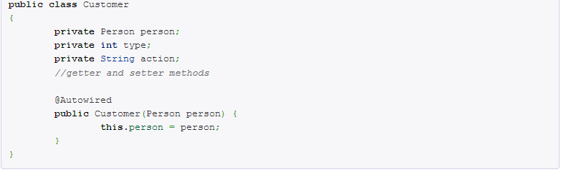
Spring Beans Auto-Wiring
@Autowired constructor

Slide 29
Spring Beans Auto-Wiring
@Autowired constructor

Slide 30
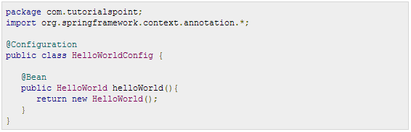

Spring Java Based Configuration
@Configuration - indicates that the class can be used by the Spring IoC container as a source of bean definitions.
@Bean - tells Spring that a method annotated with @Bean will return an object that should be registered as a bean in the Spring application context.

Slide 31
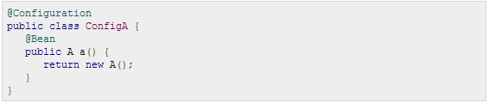
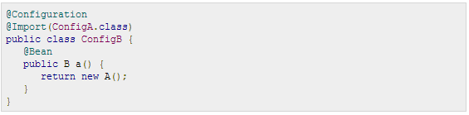
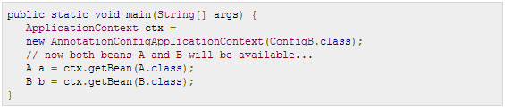
Spring Java Based Configuration
@Import - allows for loading @Bean definitions from another configuration class.

Slide 32
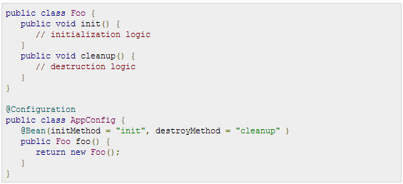
Spring Java Based Configuration
Lifecycle Callbacks:

Slide 33
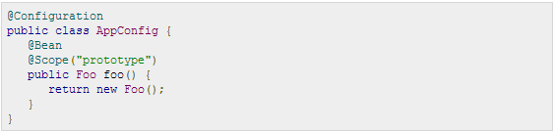
Spring Java Based Configuration
Specifying Bean Scope:

Slide 34
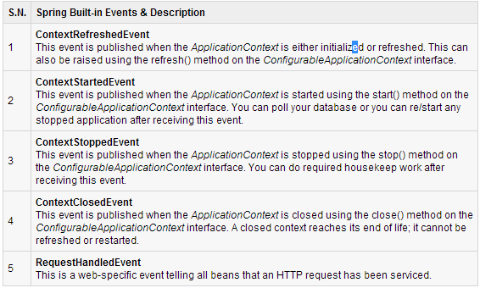
Event Handling in Spring
Event handling in the ApplicationContext is provided through the ApplicationEvent class andApplicationListener interface.

Slide 35
Custom Events in Spring
Creating a Custom Event in Spring
Create an event class by extending ApplicationEvent. This class must define a default constructor which should inherit constructor from ApplicationEvent class.
Once your event class is defined, you can publish it from any class, which implements ApplicationEventPublisherAware. You will also need to declare this class in XML configuration file as a bean so that the container can identify the bean as an event publisher because it implements the ApplicationEventPublisherAware interface.
A published event can be handled in a class which implements ApplicationListener interface and implements onApplicationEvent
Method for the custom event.

Slide 36
AOP with Spring Framework
Aspect Oriented Programming
-entails breaking down program logic into distinct parts called so-called concerns.
cutting concerns - functions that span multiple points of an application

Slide 37
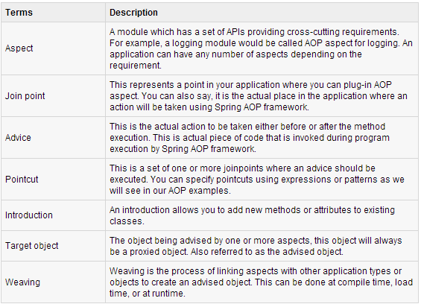
AOP with Spring Framework
AOP Terminologies:

Slide 38
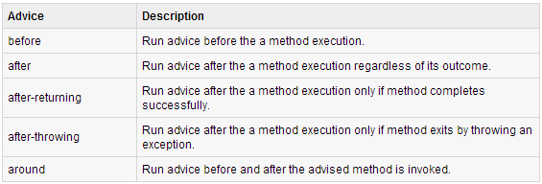
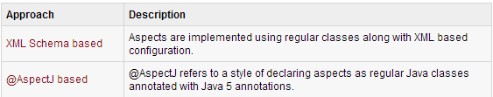
AOP with Spring Framework
Types of Advice
Custom Aspects Implementation

Slide 39
Spring JDBC Framework Overview
Spring JDBC Framework takes care of all the low-level details starting from opening the connection, prepare and execute the SQL statement, process exceptions, handle transactions and finally close the connection.
Spring JdbcTemplate
The JdbcTemplate class executes SQL queries, update statements and stored procedure calls, performs iteration over ResultSets and extraction of returned parameter values. It also catches JDBC exceptions and translates them to the generic, more informative, exception hierarchy defined in the org.springframework.dao package.
Data Access Object (DAO)
stands for data access object which is commonly used for database interaction.

Slide 40
Spring Transaction Management
Database Transaction - a sequence of actions that are treated as a single unit of work.
Transaction Key Properties
Atomicity: A transaction should be treated as a single unit of operation which means either the entire sequence of operations is successful or unsuccessful.
Consistency: This represents the consistency of the referential integrity of the database, unique primary keys in tables etc.
Isolation: There may be many transactions processing with the same data set at the same time, each transaction should be isolated from others to prevent data corruption.
Durability: Once a transaction has completed, the results of this transaction have to be made permanent and cannot be erased from the database due to system failure.

Slide 41
Spring Transaction Management
A real RDBMS database system will guarantee all the four properties for each transaction. The simplistic view of a transaction issued to the database using SQL is as follows:
Begin the transaction using begin transaction command.
Perform various deleted, update or insert operations using SQL queries.
If all the operation are successful then perform commit otherwise rollback all the database operations

Slide 42
Spring Transaction Management
Types of transaction management:
Programmatic transaction management: This means that you have manage the transaction with the help of programming. That gives you extreme flexibility, but it is difficult to maintain.
Declarative transaction management: This means you separate transaction management from the business code. You only use annotations or XML based configuration to manage the transactions.

Slide 43
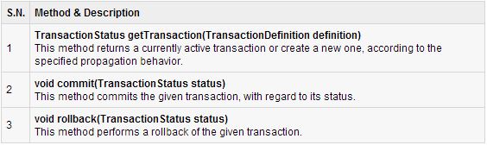
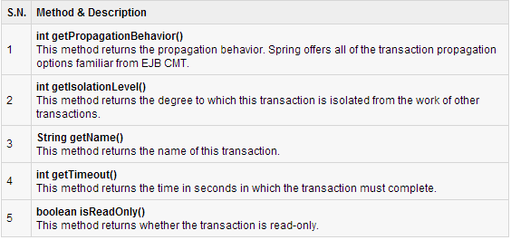
Spring Transaction Management
Spring Transaction Abstractions

Slide 44
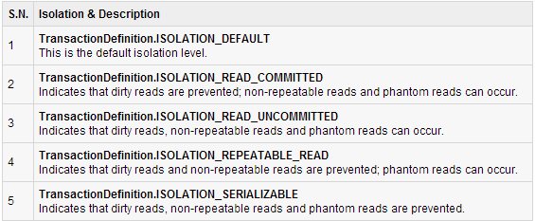
Spring Transaction Management
Transaction Isolation Level

Slide 45
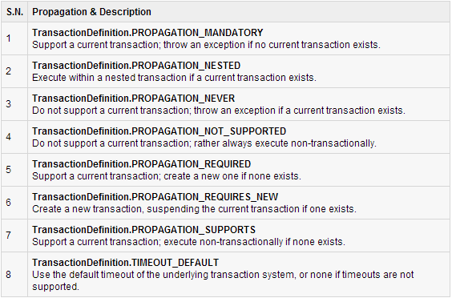
Spring Transaction Management
Transaction Propagation Types

Slide 46
Spring MVC Framework Tutorial
The Model encapsulates the application data and in general they will consist of POJO.
The View is responsible for rendering the model data and in general it generates HTML output that the client's browser can interpret.
The Controller is responsible for processing user requests and building appropriate model and passes it to the view for rendering.

Slide 47
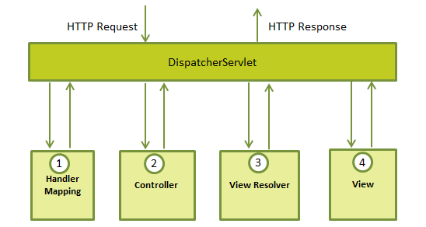
Spring MVC Framework Tutorial
The DispatcherServlet

Slide 48
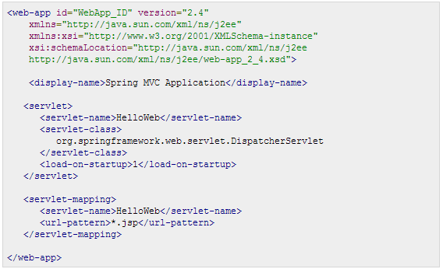
Spring MVC Framework Tutorial
Required Configuration
Web.xml

Slide 49
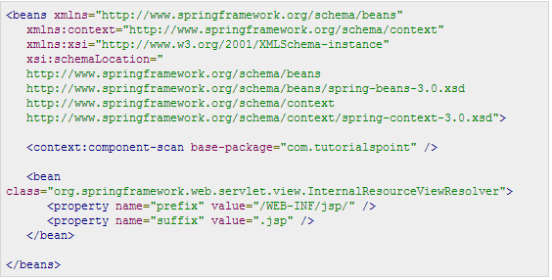
Spring MVC Framework Tutorial
Configuration file

Slide 50
Spring MVC Framework Tutorial
The [servlet-name]-servlet.xml file will be used to create the beans defined, overriding the definitions of any beans defined with the same name in the global scope.
The <context:component-scan...> tag will be use to activate Spring MVC annotation scanning capability which allows to make use of annotations like @Controller and @RequestMapping etc.
The InternalResourceViewResolver will have rules defined to resolve the view names.

Slide 51
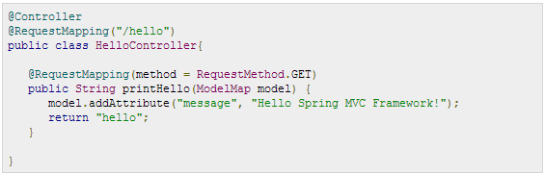
Spring MVC Framework Tutorial
Defining a Controller
@Controller - indicates that a particular class serves the role of a controller.
@RequestMapping - used to map a URL to either an entire class or a particular handler method.

Slide 52
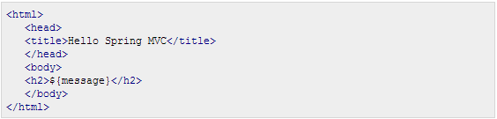
Spring MVC Framework Tutorial
Creating JSP Views

Slide 53
Thank You For Your Time

