Slide 1
INT202 Server-Side Web Programming I (1-2-4)
pichet@sit.kmutt.ac.th
Notes:
ตายแล้วไปไหน เราเกิดมาเพื่ออะไร
เรา สำคัญกว่าทุกสิ่งอย่างในโลก

Slide 2
Resources
เอกสารและข้อมูลสำคัญ
https://www.w3schools.in/category/jsp
https://www.w3spoint.com/servlet-tutorial
https://www.khanacademy.org/computing
https://www.jetbrains.com/help/idea/creating-and-running-your-first-java-ee-application.html https://tomcat.apache.org/tomcat-10.0-doc
3.เอกสารและข้อมูลแนะนำ
https://www.tutorialspoint.com/servlets/index.htm
SIT VM
VM Name : s651int202v001-140.sit.kmutt.ac.th
CPU : 4, Memory : 2 --> 4 GB, Drive : 40 GB, OS : Ubuntu 20.04 LTS x64

Slide 3
Course Descriptions
Web (World Wide Web) architectures
HTML (Hypertext Markup Language)
HTTP (Hypertext Transfer Protocol)
HTTP requests / Http responses
HTTP request parameters, HTTP headers
Web application architectures
Application servers
Simple server-side scripting.
MVC (Model View Controller) Design Pattern.
Application state management: cookies and session management.
ORM (Object-Relational Mapping).
Creating, testing, and deploying simple web applications.
Standard tools, frameworks, and technologies for web.

Slide 4


Multiple Pages (Classic) Web Application
Client
Web/ Http
Server
Application Server
Database
Server
http request
url mapping /
Router
Data Access Engine
Database
Controller
View Template Engine
Model
http response

Slide 5
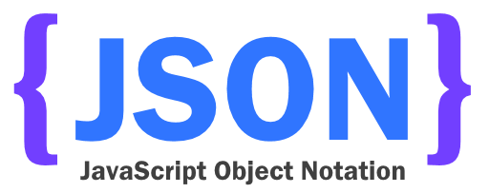
MVC Web Application Architectures (modern/spa)
Web/Http
Server
Application Server
Client
XMLHttpRequest
Database
Server
Front-End
Data Access Engine
url mapping /
Router
Database
HTML/CSS /JavaScript Framework
Controller
Model
HttpResponse

Slide 6
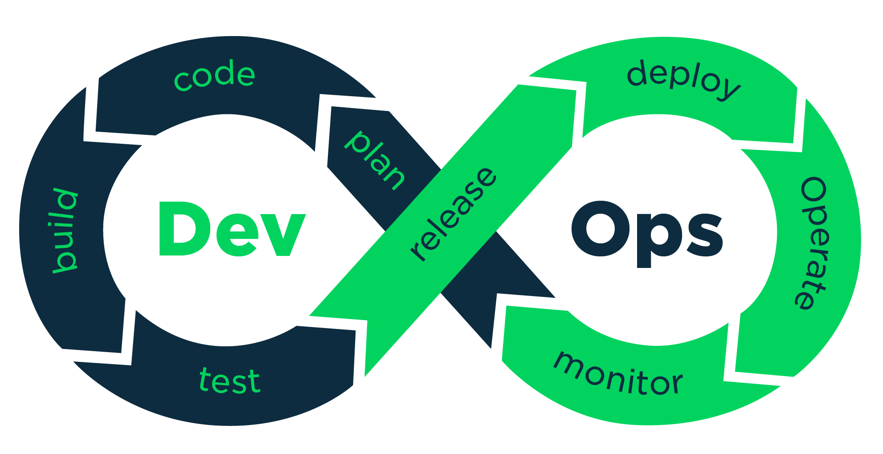

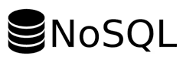
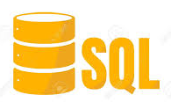



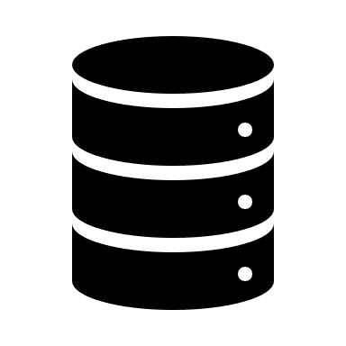




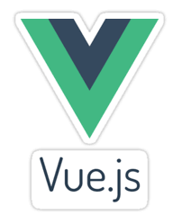


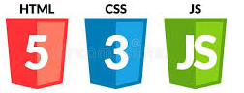


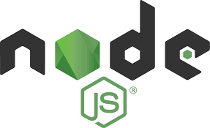



Full Stack Developer
Client Side
Server Side
xPlatform Mobile App.
Microservice
Web API
Database
WebApp
(Classic)
Classic
EIS: Enterprise
Info. System
SPA WebApp. (JS Framework)
Database

Slide 7

Full Stack Web Developer
A full stack web developer is a person who can develop both client and server software.
Program a browser (like using JavaScript, jQuery, Angular, or Vue)
Program a server (like using JavaEE, PHP, ASP, Python, or NodeJS)
Program a database (like using SQL, SQLite, or MongoDB)
https://www.w3schools.com/whatis/whatis_fullstack.asp

Slide 8
Web Development Roadmaps (1)
Front-End Roadmap
Every Web Developer must have a basic understanding of HTML, CSS, and JavaScript.
Responsive Web Design is used in all types of modern web development.
ECMAScript 5 (JavaScript 5) is supported in all modern browsers.
On the CSS side you should choose a framework for responsive web design:
Bootstrap / Material Design / W3.CSS / Tailwind
On the JavaScript side you should learn at least one modern framework:
React.js / Angular.js / Vue.js / W3.JS
https://www.w3schools.com/whatis/default.asp

Slide 9
Web Development Roadmaps (2)
Back-End Roadmaps
SQL / NoSQL
Language: Java / PHP / ASP, C# / Python / Node.js
Frame work: Spring Boot / Laravel / .NET / Django / Adonis, Express
Web Service
Microservice
https://www.w3schools.com/whatis/whatis_fullstack.asp

Slide 10
Java Build Tools
Apache ANT: Another Neat Tool
Using XML to write build scripts
Base on Apache Ivy (local dependency management)
Extremely flexible and does not impose coding conventions or directory layouts
Apache Maven
Improve Ant (use XML in different structure)
Impose coding conventions or directory layouts
Download dependencies over the network
Gradle
DSL: Domain-Specific Language base on Apache Gloovy (JVM Language)
https://technologyconversations.com/2014/06/18/build-tools
https://gradle.org/maven-vs-gradle

Slide 11
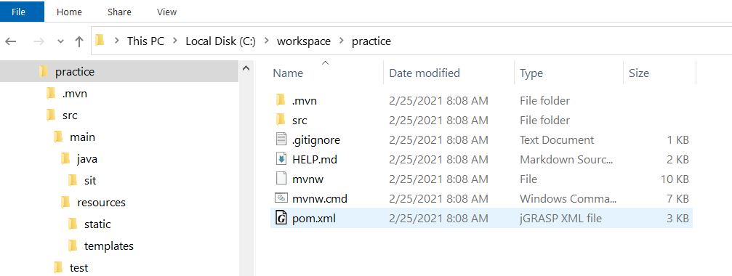
C:\Users\Khaitong Lim\.m2\
Apache Maven
Internet
IDE Tools
Local repositories
Remote repositories
Central repositories
Maven Project
https://repo1.maven.org/maven2/
jar dependencies

Slide 12

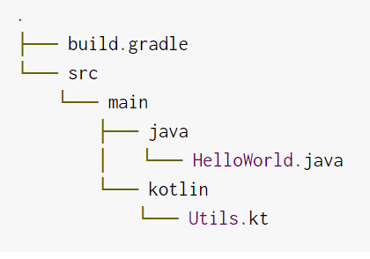
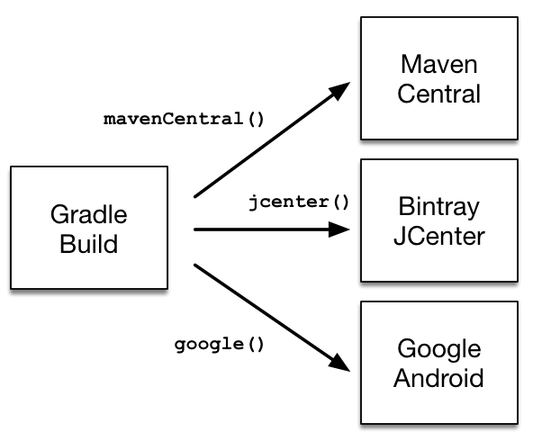

Slide 13
World Wide Web Communication
HTTP stands for Hyper Text Transfer Protocol
WWW is about communication between web clients and servers
Communication between client computers and web servers is done by sending HTTP Requests and receiving HTTP Responses
Clients are often browsers (Chrome, Edge, Safari), but they can be any type of program or device.
Servers are most often computers in the cloud.

Slide 14
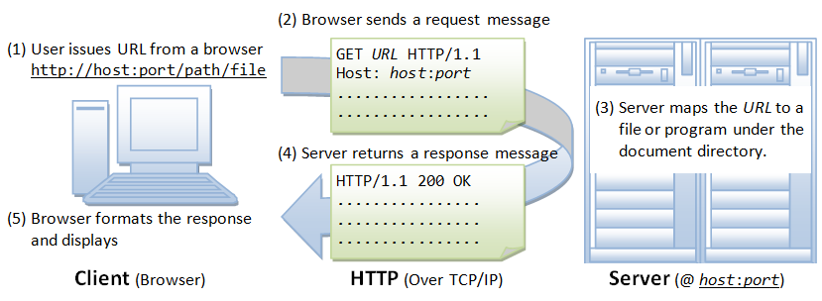
HTTP Protocol
https://www.w3schools.com/whatis/whatis_http.asp

Slide 15
Web Application
Http Request
. . . . . . . . . .
Application
Server
Http Response
. . . . . . . . . .
Database Server

Slide 16
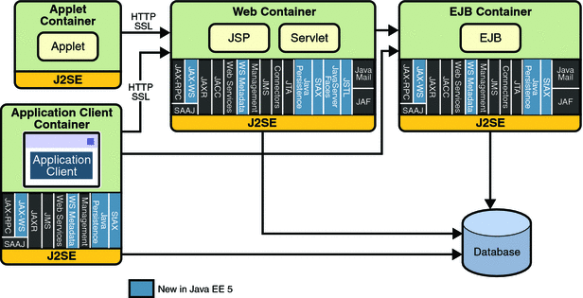
JavaEE Platform API
Java App Server
https://docs.oracle.com/javaee/5/tutorial/doc/bnacj.html

Slide 17
Servlet Example
package com.ibm.example.servlet;
import javax.servlet.http.HttpServlet;
...
public class VerySimpleServlet extends HttpServlet {
public void doGet(HttpServletRequest request,
HttpServletResponse response) throws ServletException, IOException {
String browser = request.getHeader("User-Agent");
response.setStatus(HttpServletResponse.SC_OK);
response.setContentType("text/html");
PrintWriter out = response.getWriter();
out.println("<HTML><HEAD><TITLE>Simple servlet");
out.println("</TITLE></HEAD><BODY>");
out.println ("Browser details: " + browser);
out.println("</BODY></HTML>");
}
}

Slide 18
MVC: application to Java EE
Client
Java EE server
Controller
2
Model
1
Web
browser
Transfer
servlet
Transfer JavaBean
4
Transfer
Result JavaBean
7
5
HTML
doc
3
Balance
JSP
6
Database
View
Persistence
Notes:
This diagram shows how the main Java EE components provide an implementation framework for the MVC pattern. This idea is central to Java EE application development.

Slide 19
MVC: benefits
Promotes code reuse
The purpose of the model is to provide business logic and data access in one place
You can reuse this logic in many applications at the same time, without the need for any extra coding
Reduces development time
The model, view, and controller are developed in parallel
Is more maintainable
You can change the view without affecting the model
You can change the Web page view to display a chart instead of a table with no change to the model
You can change the model without affecting the view
For example, the way in which an insurance premium is calculated changes, but the interface to the business method remains the same
You can move data without affecting the view or model
The layering concept allows for more flexibility
Notes:
With MVC, you (as a developer) can focus on which layer or technology you are most comfortable with.

Slide 20
Java Web Application Development (MVC)

Slide 21



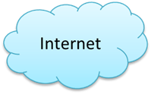

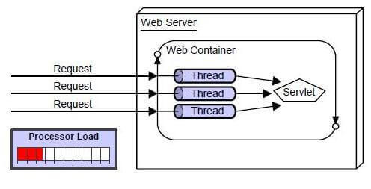


What is a servlet?
A servlet is a standard, server-side component of a Java EE application that executes business logic on behalf of an HTTP request
It runs in the server tier (and not in the client)
It is managed by the Web container
Web Container
Web Server
www.sit.com/
https://www.javatpoint.com/servlet-tutorial
Notes:
Notes:
According to the Java Servlet Specification (version 2.4): “A servlet is a Web component, managed by a container, that generates dynamic content. Servlets are small, platform-independent Java classes compiled to an architecture-neutral bytecode that can be loaded dynamically into and run by a Web server.” In short, a servlet is a piece of Java code that runs on the server on behalf of a request. This is similar to CGI. CGI (Common Gateway Interface) is the original mechanism to allow Web servers to run application code on behalf of an HTTP request.
Because a servlet is Java, it runs within a Java Virtual Machine supplied by the servlet run time.
Instructor notes:
Purpose —
Details —
Additional information — For WebSphere, the Web container is WebSphere Application Server.
Transition statement — Next: HTML Flows Example: Forms / POST Request

Slide 22
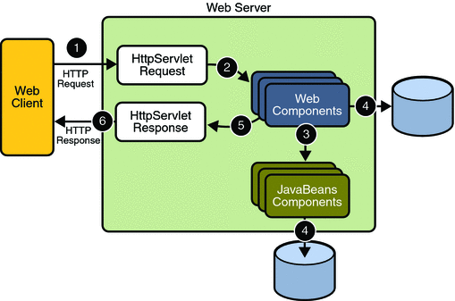
Servlet process flow
The client makes a request naming a servlet as part of the URL.
The Web server forwards the request to a Web container, which locates an instance of a servlet class.
The Web container calls the servlet's service method.
The servlet builds a response dynamically, and passes it to the Web server. External resources may also be used.
The Web server sends the response back to the client.
Notes:
Notes:
Servlets implement a common request-response paradigm for the handling of the message flow between the client and the server. This page shows a high-level client-to-servlet process flow.
javax.servlet.Servlet is an interface.
javax.servlet.GenericServlet implements the Servlet interface
The service() method is defined for all servlets.
Instructor notes:
Purpose —
Details —
Additional information —
Transition statement — Next: Building a Simple Java Servlet for GET or POST Processing

Slide 23
Request protocol
The request object encapsulates all of the information from the client request. The following methods are available to access parameters:
String getParameter(String name)
String name = request.getParameter(“username”);
Enumeration getParameterNames()
Enumeration<String> params = request.getParameterNames();
while(params.hasMoreElements()) {
String name = params.nextElement();
}
String[] getParameterValues(String name)
String favoriteSubj[] = request.getParameterValue(“subjects”);
Map<String,String[]> getParameterMap()
Map<String,String> paramMap = request.getParameterMap();
Notes:
Notes:
The request parameter set is populated with the aggregation of both the query string parameters and post body parameters. The order of this aggregation is that query string parameter data takes precedence over post body parameter data. When a query string and post body both have the same name, the values appear as multiple values for the same name.
Posted form data is only read from the input stream of the request and used to populate the parameter set when all of the following conditions are met:
The request is an HTTP or HTTPS request.
The HTTP request is a POST request.
The content type of the request is application/x-www-form-urlencoded.
The servlet calls any of the getParameter methods against the input request object.
If one or more of the above conditions is not true, the posted data is available to be read via the request object’s input stream.
Instructor notes:
Purpose —
Details —
Additional information — getParameter returns the value, the first value of an array of values, or null if no value is supplied. getParameterValues returns the array or null.
Transition statement — Next: Example HTML Form

Slide 24
Processing input data example
public void processRequest(HttpServletRequest request,
HttpServletResponse response) throws... {
String name = request.getParameter("name");
if (name==null) {
name = "unknown";
} else if (name.length== 0) {
name = "missing";
}
String height[] = request.getParameterValues("height");
if (height == null) {
height = new String[] {"unknown"};
}
for (int i = 0; i < height.length; i++){
if (height[i].length== 0) height[i] = "missing";
}
}
Notes:
Notes:
The assumption here is that processRequest was called from doGet and doPost. The status needs to be set before the document has been written to the PrintWriter.
If the name parameter is not passed to the servlet as query data, null is returned by the getParameter call. Also, if no height parameter is specified, null is returned by the getParameterValues method.
If name= is passed, then the value for name is a String of length 0. If height= is passed, then height returns an array of one element. That element contains a String of length 0.
If the following query data is supplied,
height=125cm.&name=Margaret&height=49in.
then the value for String name is Margaret. The height array contains two values. The value for height[0] is 125cm. and height[1] is 49in.
Instructor notes:
Purpose —
Details —
Additional information — Another way to deal with a parameter having no value is to have the field be checked by JavaScript in the browser before the request is sent.
Transition statement — Next: Checkpoint

Slide 25
Building a simple Java servlet
To create a servlet that responds to HTTP requests, you must:
Create a class that extends javax.servlet.http.HttpServlet
Override the doGet or doPost methods to process HTTP GET or POST requests
Process HttpServletRequest input values
Invoke the business process
Set the HttpServletResponse values
Output HTML to the output PrintWriter
Servlets are inherently multithreaded
MyServlet
instance
Notes:
Notes:
A generic servlet should override its service() method. The HTTP servlet usually does not override the service() method.
If you want your servlet to process both GET and POST requests, you can have the doGet() method call the doPost() method (or vice versa).
The doGet() and doPost() methods both return void, and take two input parameters. The first parameter is of type HttpServletRequest, and the second parameter is of type HttpServletResponse. Both methods can throw the types ServletException and java.io.IOException.
Instructor notes:
Purpose —
Details —
Additional information —
Transition statement — Next: A Simple Java Servlet Example

Slide 26
Java servlet lifecycle
Create
(Initialize failed)
void init()
void init(ServletConfig config)
Initialize
Available
for
service
Unavailable
for
service
void service ( HttpServletRequest req, HttpServletResponse res )
(Unavailable
exception thrown)
Destroy
Servicing
requests
void destroy()
void doGet ( HttpServletRequest req, HttpServletResponse res )
Unload
void doPost ( HttpServletRequest req, HttpServletResponse res )
Notes:
Notes:
The life cycle of a servlet is expressed in the Java Servlet API in the init, service (doGet or doPost), and destroy methods of the Servlet interface. This figure is a visual diagram of an individual servlet.
Creation:
Servlets are loaded and instantiated when the container is started, or when the container determines that the servlets are needed to service requests.
Initialization:
Initialization is required before a servlet can handle requests from clients.
The init method performs one-time activities( such as loading of servlet parameters), and initializes costly resources.
There are two init methods. One takes no input parameters, and one takes a ServletConfig reference as a parameter. The init methods allow the servlet to access name-value pairs for the initialization parameters that are specific to that servlet. The ServletConfig object gives access to the ServletContext object that describes information about the servlet environment.
Request Handling:
The servlet accepts client requests and send responses back via the Web server.
service, doGet, doPost (and so on) methods are called in response to clients (each HTTP request is on a different thread). The default service method calls the doGet method whenever an HTTP GET request is sent by the Web client (usually as a result of a URL), and the doPost method whenever an HTTP POST request is sent by the Web browser client (usually as a result of an action in an HTML form).
End of Service:
The Web container removes the servlet from service when the container needs to conserve memory resources, or when it itself is being shut down.
The container destroys and garbage collects the servlet, and calls the destroy method.
The destroy method should ensure that all servlet threads have completed, and should undo any initialization work that is not undone automatically by the destruction of the servlet.
Instructor notes:
Purpose —
Details —
Additional information — The HttpServlet.service method is not usually overridden.
Transition statement — Next: The Java Servlet API

Slide 27
Request dispatcher
The RequestDispatcher allows you to forward a request to another servlet, or to include the output from another servlet
Used to support both forwarding processing to, and including response from, a variety of local Web resources
For example, JSP pages and HTML files
If a reference to the RequestDispatcher is acquired from the ServletContext
Path information is relative to the ServletContext
If a reference to the RequestDispatcher is acquired from the HttpServletRequest
Path information is relative to the path of the current request
Notes:
Notes:
It is common to want to have different middle-tier services invoke each other (for example, have a Servlet invoke a JSP page to handle the response processing for a request). The interface by which this is done is the RequestDispatcher interface. A RequestDispatcher is obtained for a given resource (specified by URI). There are then two interaction models or methods available to the caller, forwarding and including.
Instructor notes:
Purpose —
Details —
Additional information —
Transition statement — Next: Request Dispatcher Flow

Slide 28
Request dispatcher flow
Servlet
A
forward
Servlet
B
Content returned to browser
Servlet
A
include
Servlet
B
Content returned to browser
Notes:
Notes:
During the handling of a request, a servlet may wish to:
Incorporate the result of another servlet into the output stream (include).
Delegate the continued handling of the request to another servlet (forward).
A RequestDispatcher is obtained via:
getServletContext.getRequestDispatcher(“path_to_resource”);
Path is a relative URI (relative to ServletContext’s root).
Forward: Servlet A should not write to the response stream BODY, but it can set headers and the status code. Also, the request object is changed to reflect Servlet B as being the target of the request. The diagram illustrates the flow of the response, showing how Servlet B is delegated the responsibility of generating the response body. When Servlet B completes, the Web container sends, commits, and closes the response stream. The execution continues in Servlet A after the forward statement that specified Servlet B as the target.
Include: Servlet B should not write any HTTP headers. Here the request object is not altered. It may include static resources( for example, HTML files). Servlet B’s content is included in the current response. Servlet A may generate response content before or after Servlet B’s include (or both before and after) or, possibly, include multiple servlets.
Instructor notes:
Purpose —
Details —
Additional information —
Transition statement — Next: Sample Use of Request Dispatcher

Slide 29
Sharing objects example
// Servlet "A"
public void doGet (HttpServletRequest request, HttpServletResponse resp)... {
// process request headers & query data
Customer cust;
...
request.setAttribute("CUSTOMER", cust);
String viewPage = "/CustomerInfo.jsp";
getServletContext().getRequestDispatcher(viewPage).forward(request, resp);
}
1
setAttribute()
getAttribute()
"CUSTOMER"
Customer
2
HttpServletRequest
// CustomerInfo.jsp
<%
Customer aCust = (Customer) request.getAttribute("CUSTOMER");
%>
Notes:
Notes:
The ServletContext approach is useful when a group of servlets needs to work with the same object. The servlet that wants to share the object calls the ServletContext method setAttribute, and specifies the objectName to be used as a key and a reference to the object. Any other servlet within that ServletContext that wants a reference to the shared object can get to it via the getAttribute method of the ServletContext (and has to use the same objectName used by the original servlet).
The ServletRequest approach is useful when doing a forward or an include, and you want to share objects between the servlets. The servlet that wants to share the object calls the HttpServletRequest object’s setAttribute method. The servlet forwarded to or included calls the request’s getAttribute method to get a reference to the shared object.
Instructor notes:
Purpose —
Details —
Additional information — The HttpSession object can also be used for sharing objects. HttpSession will be covered later.
Transition statement — Next: Sharing Objects Example

Slide 30
JSP : JavaServer Pages JakartaServer Pages
https://www.javatpoint.com/jsp-tutorial

Slide 31
What is JakartaServer Pages technology?
JakartaServer Pages technology that lets you mix static HTML with dynamically-generated HTML
JSP technology allows server-side scripting:
Static tags are HTML, XML, or another markup language.
Dynamic content generated by scripting code
Java is the (default) scripting language
A JSP file (with an extension of .jsp) contains any combination of:
JSP syntax
Markup tags such as HTML or XML
Notes:
Notes:
The first JSP Specification became available in June, 1999. The current version, JSP 2.0, is part of J2EE Specification 1.4.
Instructor notes:
Purpose —
Details —
Additional information — Mention that another example of server-side scripting is Microsoft® Active Server Pages (ASP).
Transition statement — Next: JSP Example

Slide 32
JSP execution model
A JSP page is executed in a Web container
The Web container delivers client requests to the JSP page, and returns the page's response to the client
The JSP page is converted into a servlet (JSP servlet) and executed
This process is known as page compilation:
JSP source is parsed
Java servlet code is generated
This JSP servlet is compiled, loaded, and run
Notes:
Notes:
Before you look at the syntax of JSP technology, you need to understand the difference between the design-time model of a JSP page and the runtime model. Typically, the run-time artifact of a JSP page is a servlet. There is a transformation, which takes place between the design-time JSP source file, and the runtime servlet code. A JSP page compiler handles this conversion. Its purpose is to parse the JSP source, generate code for a runtime artifact (a servlet), and prepare the code for execution (compile the servlet class). This parsing, code generation, and compilation need only be performed once (if the .jsp file does not change).
The loading and execution is a separate step that follows normal servlet loading and execution rules. If the JSP servlet is currently loaded, and a request for the JSP page is made, the JSP servlet's service method is invoked. If the JSP servlet exists (a . class file) but is not yet loaded, it is loaded and then its service method is invoked.
Instructor notes:
Purpose —
Details —
Additional information —
Transition statement — Next: JSP Execution Model (2 of 2)

Slide 33
Scope attributes
A JSP page can access objects at run time via one of four different scopes (or holder objects)
Page
The current JSP page, used with Custom Actions
Request
The current HttpServletRequest object
Session
The current HttpSession object
Application
The current ServletContext object
application
session
request
page
page
request
session
application
Scope Duration
Notes:
Notes:
A JSP page can create or access Java objects when processing a request. Created objects have a scope attribute that defines where there is a reference to that object, and when the reference is removed.
Many action tags have a scope attribute. The value of this scope can be one of four values:
Page scope has the shortest lifespan; even if the request is forwarded to another page, the object reference is lost. Think of a variable that has page scope as a local variable.
Request scope extends for the life of a single request, from the time it is first received by the server until a response has been returned to the client. This allows any forwarded and included pages to access the object (using request.getAttribute and request.setAttribute).
Session scope allows references to be shared across the current user’s session (using session.getAttribute and session.setAttribute).
Application scope allows references to be shared across the entire application (using application.getAttribute and application.setAttribute).
Scopes are not nested, but their lifespans are.
Instructor notes:
Purpose —
Details —
Additional information — Emphasize that the diagram on this and the following slides depicts the nested lifespans of the various scopes, not the nesting of the scopes themselves.
Transition statement — Next: Page Scope

Slide 34
JSP syntax elements
JSP elements fall into four groups:
Directives
Scripting
Declarations
Expressions
Scriptlets
Comments
Actions
Notes:
Notes:
JSP directives are messages for the JSP engine. They do not directly produce any visible output, but tell the engine what to do with the rest of the JSP page.
JSP declarations let you define page-level variables to save information, or define supporting methods that the rest of a JSP page may need.
JSP expressions are evaluated at run time, and the results are converted to a string and directly included within the output page. Typically, expressions are used to display simple values of variables, or return values by invoking a bean's getter methods.
JSP scriptlets are run when the request is serviced by the JSP page. Almost any valid Java code can appear within a scriptlet.
JSP actions include various kinds of JavaBean access and custom tags, and aim to extend HTML or XML syntax with macros that actually result in Java method invocations.
Instructor notes:
Purpose —
Details —
Additional information —
Transition statement — Next: JSP Directives

Slide 35
JSP directives
JSP directives are instructions processed by the JSP engine when the page is compiled into a servlet
<%@ directive {attribute="value"}* %>
JSP technology currently defines page, include, and taglib directives
<%@ page language="java" %>
<%@ include file="companyBanner.html"%>
<%@ taglib uri="tagLibraryURI" prefix="tagPrefix" %>
Notes:
Notes:
Directives are used to provide instructions to the JSP engine itself, that is, its runtime or operational parameters. There are three different JSP directives: page, include, and taglib.
Instructor notes:
Purpose —
Details —
Additional information — The * in the syntax means that multiple instances are allowed
Transition statement — Next: The JSP Page Directive

Slide 36
JSP EL JSP Expression Language

Slide 37
What is JSP EL?
JSP Expression Language (EL) is a simple language based on:
Local variables of the current page
Nested properties and accessors to collections
Relational, logical and arithmetic operators
A set of implicit objects
Extensible functions mapping into static methods in Java classes
EL is invoked via the construct ${ ... }
EL may be used:
In attribute values for standard and custom actions
Within template text

Slide 38
EL Examples
EL can be used directly in template text
<h2>
Hello, ${user.firstName} ${user.lastName}
</h2>
EL expressions can be used in any attribute that can accept a run-time expression
<c:if test=“${a<3}”>
...
</c:if>

Slide 39
Implicit Objects
Several implicit objects are available to EL expressions used in JSP pages:
pageContext
pageScope
requestScope
sessionScope
applicationScope
param
paramValues
header
headerValues
cookie
initParam

Slide 40
Syntax Overview
Variables are accessed by name
Generalized [ ] and . operators
Can be used to access
Maps
Lists
Arrays of objects
JavaBeans properties
Can be nested arbitrarily
Relational comparisons
Arithmetic and Logical operators
Example: to access the name property of the user
bean in session scope:
${sessionScope.user.name}

Slide 41
Basic Syntax Elements
Literals
boolean, integer, floating point, string and null
Operators
Accessor
. []
Arithmetic
+ - * / %
Relational
== != < > <= >=
Logical
&& || !
Empty
empty
Conditional
? :
${param.cost * 1.085}
${empty sessionScope ? “yes” : “no”}

Slide 42
Named Variables
EL contains a variable resolver which will search the page, request, session, and application scopes for values
Example: ${user} will resolve to sessionScope.user
If the attribute is not found in any scope, null is returned
The specification is vague as to what happens when likenamed attributes are found in more than one scope

Slide 43
INT202: Mini Lab
Create/Run-Maven Web App Project
Notes:
ตายแล้วไปไหน เราเกิดมาเพื่ออะไร
เรา สำคัญกว่าทุกสิ่งอย่างในโลก

Slide 44
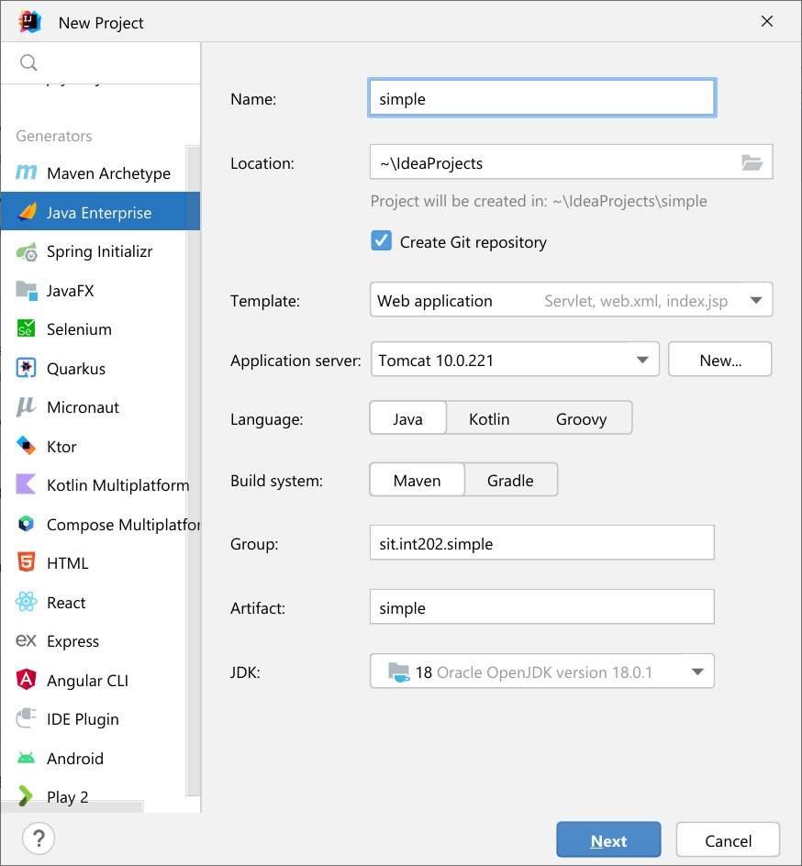
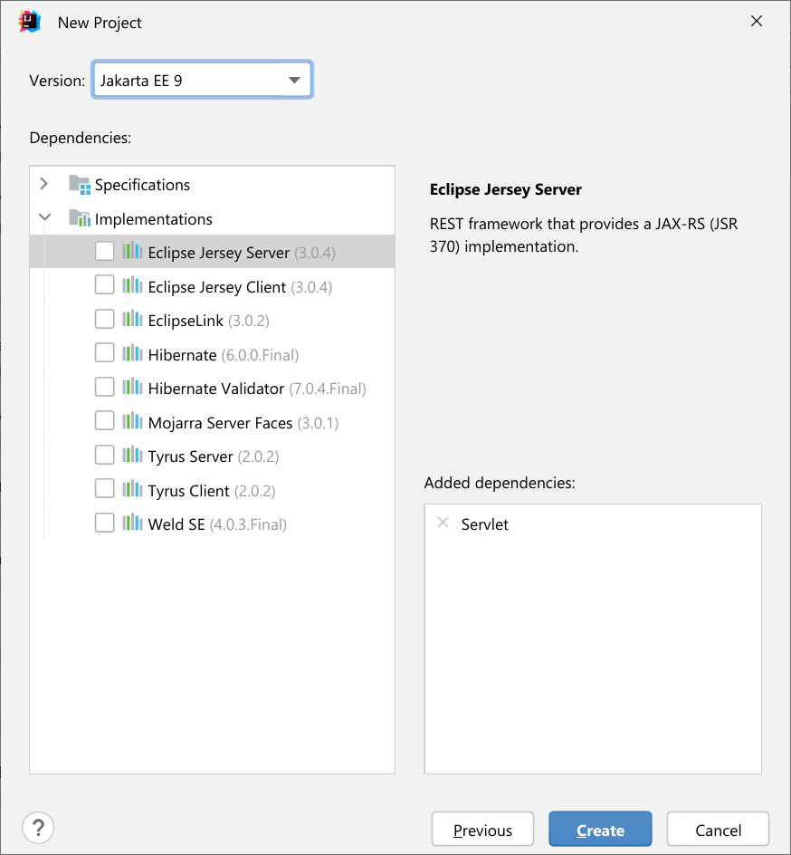
Create Maven Project with IntelliJ Idea

Slide 45
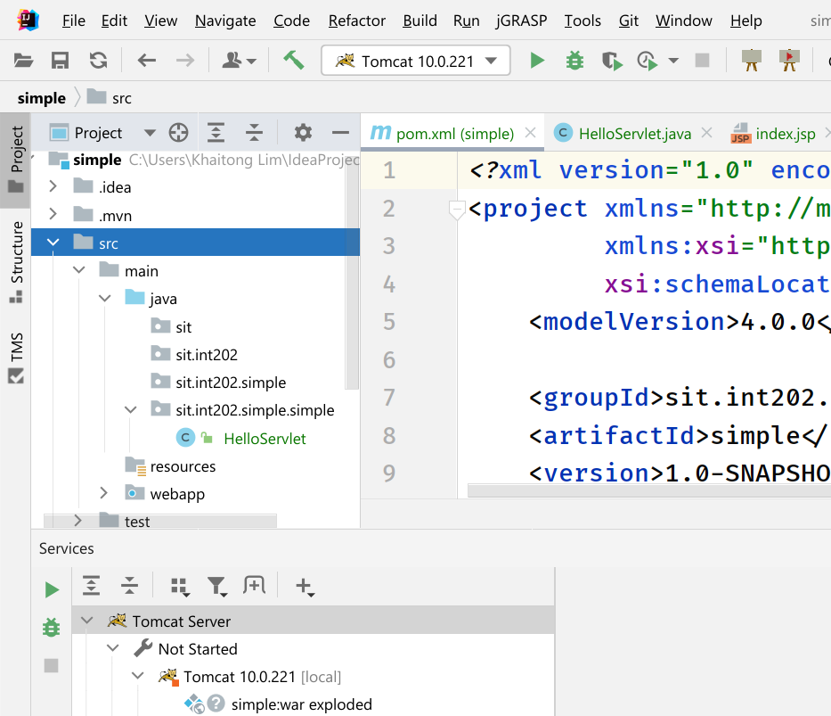
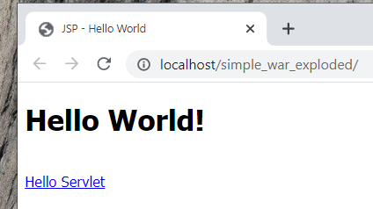

Slide 46
INT202: Simply MVC Lab
Model View Controller Example
Notes:
ตายแล้วไปไหน เราเกิดมาเพื่ออะไร
เรา สำคัญกว่าทุกสิ่งอย่างในโลก

Slide 47
Features: Subject Listing
Create Model:
Subject
SubjectRepository
Create Servlet (Controller)
Create collection of subject when servlet instantiate
Forward collection to JSP for each HTTP Request.
Create JSP (View)
Generate HTTP Response and send back to each client.

Slide 48
Subject class
package sit.int202.simple.entities;
import lombok.*; @Getter @Setter @AllArgsConstructor @NoArgsConstructor @EqualsAndHashCode public class Subject { private String id; private String title; private double credit; }

Slide 49
SubjectRepository
package sit.int202.simple.repositories; : public class SubjectRepository { private static List<Subject> subjects; public List<Subject> findAll() { return subjects; } public SubjectRepository() { initialize(); } private void initialize() { subjects = new ArrayList<>(20);
:
:
: subjects.add(new Subject("INT 100", "IT Fundamentals", 3)); subjects.add(new Subject("INT 207", "Network I",3)); } }

Slide 50
SubjectListServlet
package sit.int202.simple.servlet; : : @WebServlet(name = "SubjectListServlet", value = "/SubjectList") public class SubjectListServlet extends HttpServlet { @Override protected void doGet(HttpServletRequest request, HttpServletResponse response) throws ServletException, IOException { List<Subject> subjects = (List) new SubjectRepository().findAll(); request.setAttribute("subjects",subjects); request.getRequestDispatcher("/subject_listing.jsp").forward(request,response); } @Override protected void doPost(HttpServletRequest request, HttpServletResponse response) throws ServletException, IOException { } }

Slide 51
View: subject_listing.jsp (1)
<%@ page contentType="text/html;charset=UTF-8" language="java" %> <%@taglib prefix="c" uri="http://java.sun.com/jsp/jstl/core" %> <html> <head> <title>Subject Listing</title> <link href="https://cdn.jsdelivr.net/npm/bootstrap@5.1.1/dist/css/bootstrap.min.css" rel="stylesheet"> <script src="https://cdn.jsdelivr.net/npm/bootstrap@5.1.1/dist/js/bootstrap.bundle.min.js"></script> </head> </head> <body style="margin-left: 20px"> <div class="container-fluit"> <h3>Subject Listing:</h3> <div class="row bg-light"> <div class="col-1">No.</div> <div class="col-1">Subject Id</div> <div class="col-3">Subject Title</div> <div class="col-1">Credit</div> <div class="col-6">Note</div> </div>

Slide 52
View: subject_listing.jsp (2)
<c:forEach items="${subjects}" var="subject" varStatus="vs"> <div class="row"> <div class="col-1">${vs.count}</div> <div class="col-1">${subject.id}</div> <div class="col-3">${subject.title}</div> <div class="col-1">${subject.credit}</div> <div class="col-6"></div> </div> </c:forEach> </div> </body> </html>

Slide 53
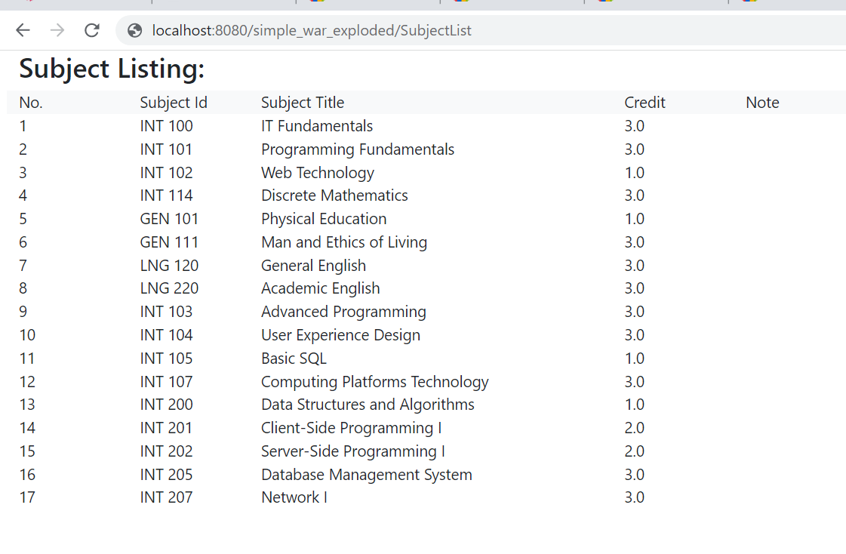
Output

