Slide 1
Meal Planner V2
Recipes, weekly plans, pantry and shopping
WebMCP agent access
Notes:
Product behavior: Meal Planner V2. See the application README for implementation details and limits.

Slide 2
Weekly meal planning
Breakfast, lunch and dinner
Assign a saved recipe to a date and meal slot. Set the number of servings for each meal.
Editable plans
Replace or remove meals without deleting saved recipes. Browse previous and upcoming weeks.
Notes:
Product behavior: Meal Planner V2. See the application README for implementation details and limits.

Slide 3
Recipe storage
Ingredients and instructions
Save quantities, units, base servings, cooking times and ordered preparation steps.
Read and reuse
Open recipes without editing them. Use the same recipe in multiple meal slots.
Ingredient quantities scale to the planned serving count.
Notes:
Product behavior: Meal Planner V2. See the application README for implementation details and limits.

Slide 4
Pantry inventory
Available quantities
Record ingredients with a quantity and unit. Update stock or remove an item when it runs out.
Shopping calculation
Subtract matching pantry quantities from the ingredients required by planned meals.
Matching rules
Use consistent ingredient names and units. Pantry subtraction does not convert kg to g.
Notes:
Product behavior: Meal Planner V2. See the application README for implementation details and limits.

Slide 5
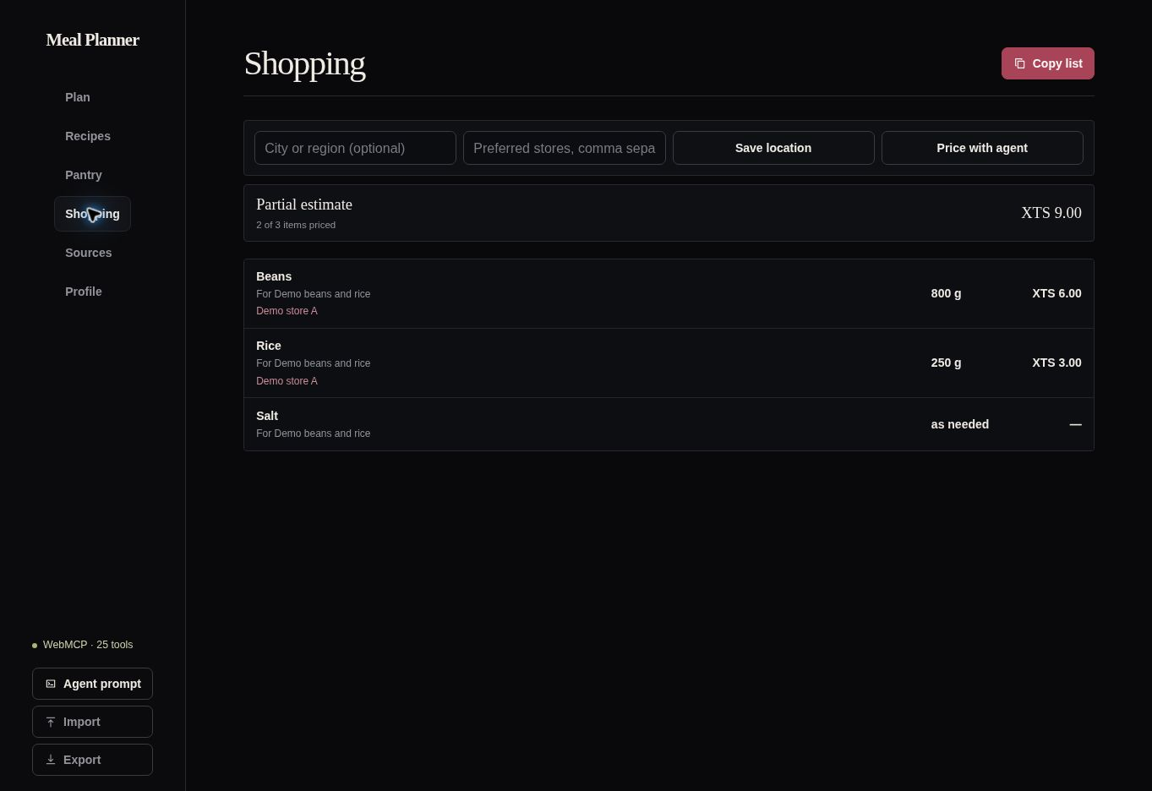
Shopping list
250 g to buy
400 g required
150 g in pantry
Example data
Synthetic prices
Notes:
Example: a recipe uses 200 g rice for two servings. Planning four servings requires 400 g. Subtracting 150 g in the pantry leaves 250 g to buy. Screenshot contains synthetic prices.

Slide 6
Profile and preferences
Household and cooking time
Save household size, available equipment and maximum cooking time.
Diet and goals
Record dietary restrictions, allergies, dislikes and planning goals for the agent to read.
Budget
Save a weekly budget and currency. Preferences guide planning, not automatic safety checks.
Notes:
Product behavior: Meal Planner V2. See the application README for implementation details and limits.

Slide 7
Sources and price estimates
Recipe references
Save articles, videos and notes. Link a source to a recipe and open the original reference.
Price research
An external agent can research offers for a user-supplied location and save package prices.
Shopping estimates
Compare saved quotes and whole-package costs. Missing prices produce a partial estimate.
Notes:
Product behavior: Meal Planner V2. See the application README for implementation details and limits.

Slide 8
WebMCP agent access
25 tools
A compatible external agent can read and update recipes, plans, pantry, preferences and sources.
Shared application state
Agent changes appear in the same interface. The user can inspect and edit the resulting plan.
External AI
The website has no built-in chatbot. Agent use requires a compatible browser and agent.
Notes:
Product behavior: Meal Planner V2. See the application README for implementation details and limits.

Slide 9
Local data and export
Browser storage
Meal records remain in the current browser profile and site address. No application account is required.
Core data transfer
Export or import recipes, plans and pantry as JSON. Import replaces the current core records.
Sources, Profile and pricing are outside the export.
No automatic device or tab synchronization.
Notes:
Product behavior: Meal Planner V2. See the application README for implementation details and limits.

