Slide 1

IOT and Embedded Systems
BY- VEERAL PARMAR
1MJ17CS174
8-C
UNDER GUIDANCE OF:-
dR. K. S. aRVIND
ASSOCIATE PROFESSOR(MVJCE)
Approved by AICTE |Affiliated to VTU | Recognized by UGC with 2(f) & 12(B) status |Accredited by NBA and NAAC

Slide 2
Content
Introduction
Embedded Systems
Need of Embedded Systems
About Microcontrollers
Basic Microcontroller Components
Internet Of Things
Industrial Revolution
Advantages and Disadvantages
Conclusion
References
Approved by AICTE |Affiliated to VTU | Recognized by UGC with 2(f) & 12(B) status |Accredited by NBA and NAAC

Slide 3
Introduction
The Internet of Things (IoT) is a system of interrelated computing devices, mechanical and digital machines, objects that are provided with unique identifiers and the ability to transfer data over a network without requiring human-to-human or human-to-computer interaction
The function is to facilitate useful experiences as part of the device's interface, communication between the device and its end user, and communication between the sensor and the network.
Embedded systems will also be at the cornerstone for the deployment of many Internet of Things (IoT) solutions, especially within certain industry verticals.
Approved by AICTE |Affiliated to VTU | Recognized by UGC with 2(f) & 12(B) status |Accredited by NBA and NAAC

Slide 4
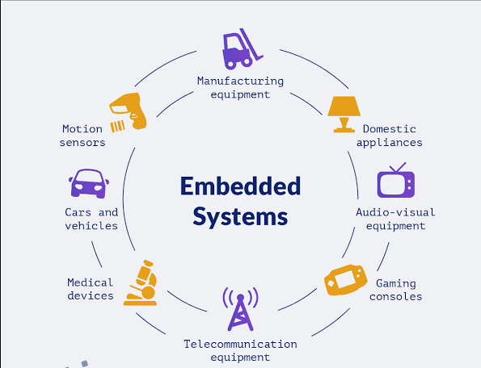
Embedded Systems
An embedded system is a combination of computer hardware and software, designed for a specific function or functions with a larger system.
Industrial machines, agricultural and process industry devices, automobiles. medical equipment, cameras, household appliances, airplanes. vending machines, and even toys and mobile devices are possible locations for embedded systems.
Approved by AICTE |Affiliated to VTU | Recognized by UGC with 2(f) & 12(B) status |Accredited by NBA and NAAC

Slide 5
The need of Embedded Systems
General purpose computers like PC would be far too costly for the majority of products that incorporate some form of embedded system technology.
General purpose solutions might also fail to meet a number of functional or performance requirements such as constraints in power consumption, size limitations, reliability and real-time performance.
Shorter Development time required.
Quality of the solution is much better.
Minimal User Interface
Approved by AICTE |Affiliated to VTU | Recognized by UGC with 2(f) & 12(B) status |Accredited by NBA and NAAC

Slide 6
Characteristics of Embedded Systems
All Embedded systems are task specific.
They are created to perform a certain task in a specific time frame, and have minimal to no user interface.
Some embedded systems are designed to react to external stimuli and react accordingly.
Users cannot change or upgrade the embedded systems as they are high ranked in reliability and stability.
They are expected to function for long periods without users facing any difficulties.
Microcontrollers or microprocessors are used to design embedded systems.
Embedded systems need connected peripherals to attach input and output devices.
Approved by AICTE |Affiliated to VTU | Recognized by UGC with 2(f) & 12(B) status |Accredited by NBA and NAAC

Slide 7
About Microcontrollers
A microcontroller is a single chip microcomputer made through VLSI fabrication.
It is also called an embedded controller because the microcontroller and its support circuits are often built into or embedded in the devices they control.
A microcontroller is available in different word lengths like microprocessors such as 4bit, 8bit, 16bit, 32bit.
Low Cost per unit.
Approved by AICTE |Affiliated to VTU | Recognized by UGC with 2(f) & 12(B) status |Accredited by NBA and NAAC

Slide 8
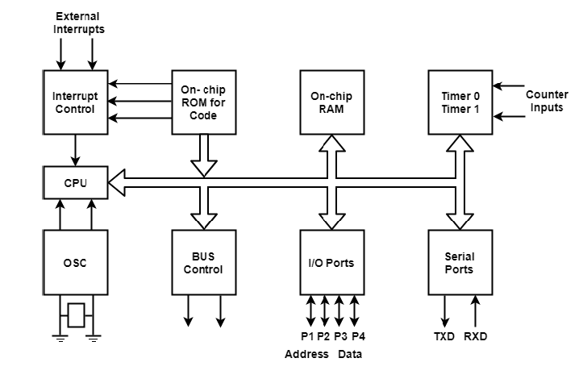
Basic Microcontroller Components
Central Processing Unit
External Oscillators
On Chip ROM
On Chip RAM
I/O Ports
Interrupt Controller
Timers and Counters
Data Bus and Address Bus
Serial Ports for Communication
Approved by AICTE |Affiliated to VTU | Recognized by UGC with 2(f) & 12(B) status |Accredited by NBA and NAAC

Slide 9
Basic Microcontroller Components
Central Processing Unit: Electronic circuitry that executes instructions comprising a computer program.
External Oscillators: Controls how quickly the processor runs.
On Chip ROM:The on-chip ROM memory (Read Only Memory) on a microcontroller is like a microcontroller's hard drive.
On Chip RAM:allows data items to be read or written in almost the same amount of time irrespective of the physical location of data inside the memory
Approved by AICTE |Affiliated to VTU | Recognized by UGC with 2(f) & 12(B) status |Accredited by NBA and NAAC

Slide 10
Basic Microcontroller Components
I/O Ports: Connects the CPU to a peripheral device via a hardware interface or to the network via a network interface
Interrupt Controller: An interrupt controller provides a programmable governing policy.
Timers and Counters: A timer is a specialized type of clock which is used to measure time intervals. A counter stores the number of times a particular event or process occurred, with respect to a clock signal.
Data Bus and Address Bus: The address bus allows the CPU to send the address to RAM, and the data bus allows the actual data transfer to the CPU.
Serial Ports for Communication: A socket that connects to a serial interface.
Approved by AICTE |Affiliated to VTU | Recognized by UGC with 2(f) & 12(B) status |Accredited by NBA and NAAC

Slide 11
Choosing Microcontroller for an Embedded Application
Microcontroller word length
Speed
Packaging
Power consumption
Amount of on chip RAM and ROM
On chip peripherals requirements
Availability of Development tools (Assembler, C Compiler, IDE etc.)

Slide 12
Internet of Things
The ‘thing’ in IOT can be any device with any kind of built in sensors with the ability to connect and transfer data over a network without manual intervention.
IOT is a concept that connects all devices to the internet and let them communicate with each other over the internet. It is a giant network of connected devices.
All devices can gather and share data about how they are used and the environments in which they are operated.
The embedded technology in the objects helps them interact with internal states and external environments, which in turn helps in decision making process.
Approved by AICTE |Affiliated to VTU | Recognized by UGC with 2(f) & 12(B) status |Accredited by NBA and NAAC

Slide 13
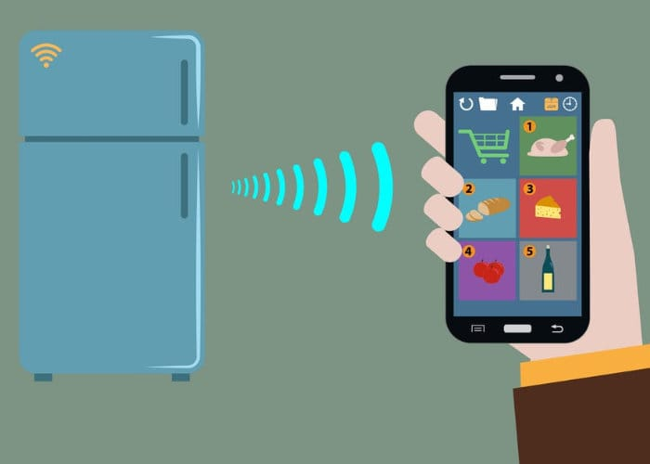
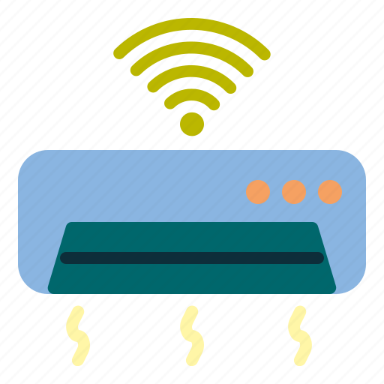
For example, a room temperature sensor gathers the data and sends it across the network, which is then used by multiple device sensors to adjust their temperature accordingly.
A refrigerator’s sensor can gather data regarding the outside temperature and accordingly adjust the refrigerator’s temperature.
Similarly, Air Conditioners can also adjust the temperature accordingly.
Approved by AICTE |Affiliated to VTU | Recognized by UGC with 2(f) & 12(B) status |Accredited by NBA and NAAC

Slide 14
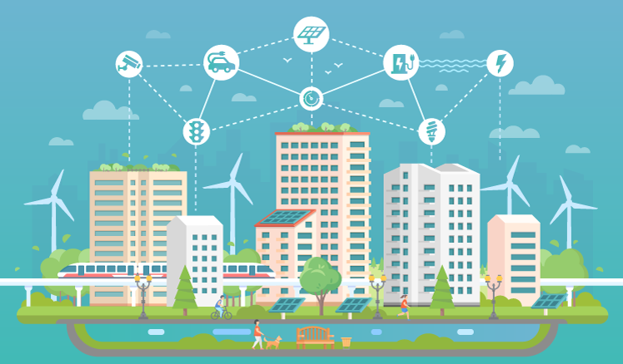
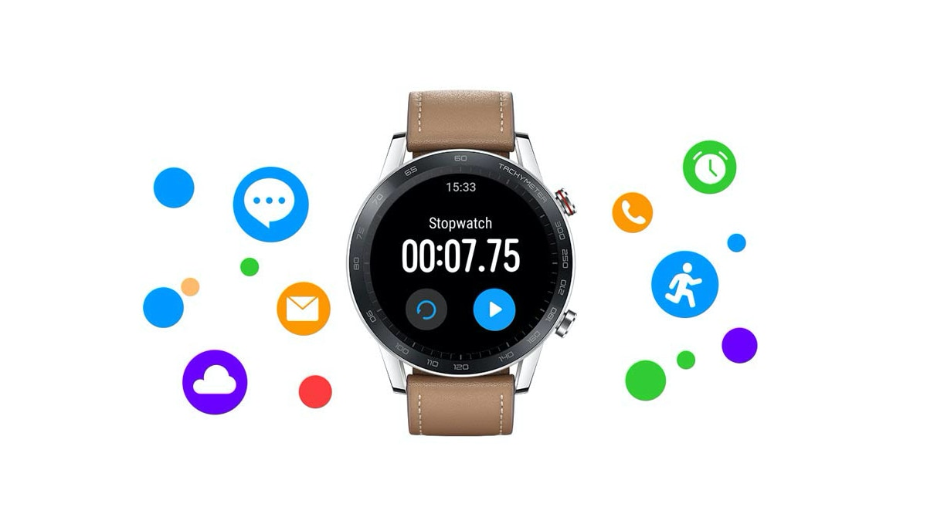
Applications
When thinking about smart homes and home automation, most people mention applications in areas such as security systems, connected entertainment systems, light control, room control and energy management to name a few.
Smartwatches can be used to track health and update data to the cloud.
Smart City plans have been started by different countries all over the globe.
Approved by AICTE |Affiliated to VTU | Recognized by UGC with 2(f) & 12(B) status |Accredited by NBA and NAAC

Slide 15
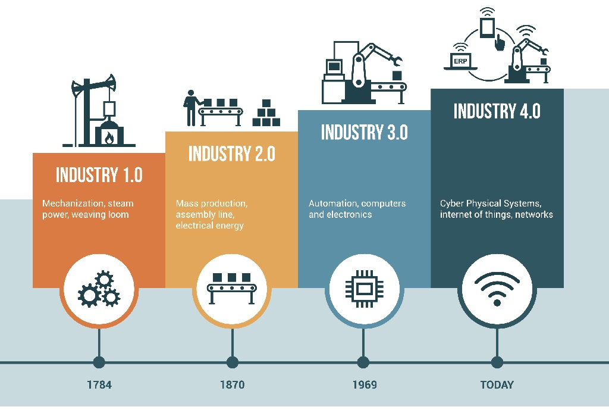
Industrial Revolution
Industry 1.0 : Mechanization, Steam Engines.
Industry 2.0 : Electricity, Gas , Combustion Engines.
Industry 3.0 : Electronics, Telecommunications.
Industry 4.0 : Internet, Robots.
Approved by AICTE |Affiliated to VTU | Recognized by UGC with 2(f) & 12(B) status |Accredited by NBA and NAAC

Slide 16
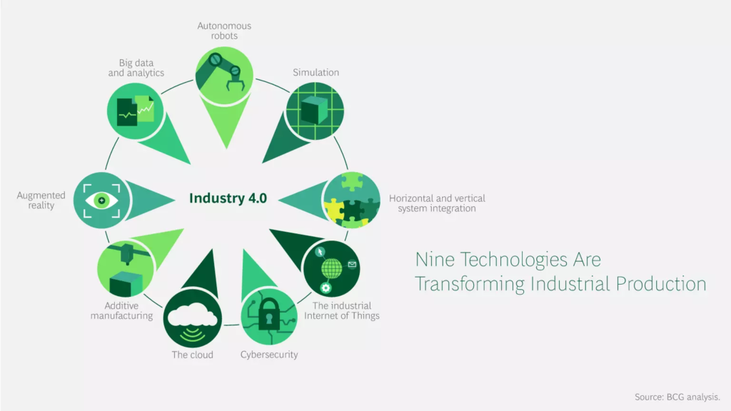
Industry 4.0 Revolution
The Industry 4.0 has the ambition to revolutionize industry management and business processes, enhancing the productivity of manufacturing technologies through field data collection and analysis, thus creating real-time digital twins of industrial scenarios. Moreover, it is vital for companies to be as “smart” as possible and to adapt to the varying nature of the digital supply chains. This is possible by leveraging IoT in Industry 4.0 scenarios.
Approved by AICTE |Affiliated to VTU | Recognized by UGC with 2(f) & 12(B) status |Accredited by NBA and NAAC

Slide 17
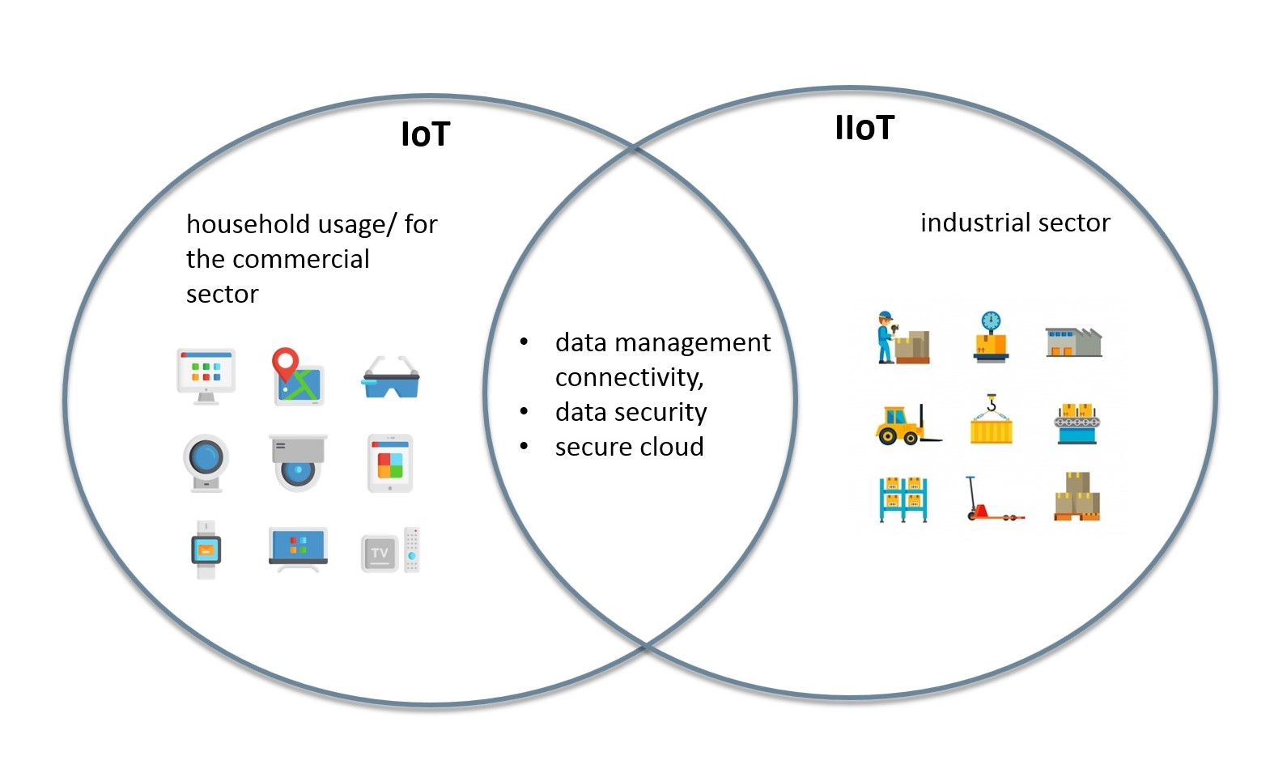
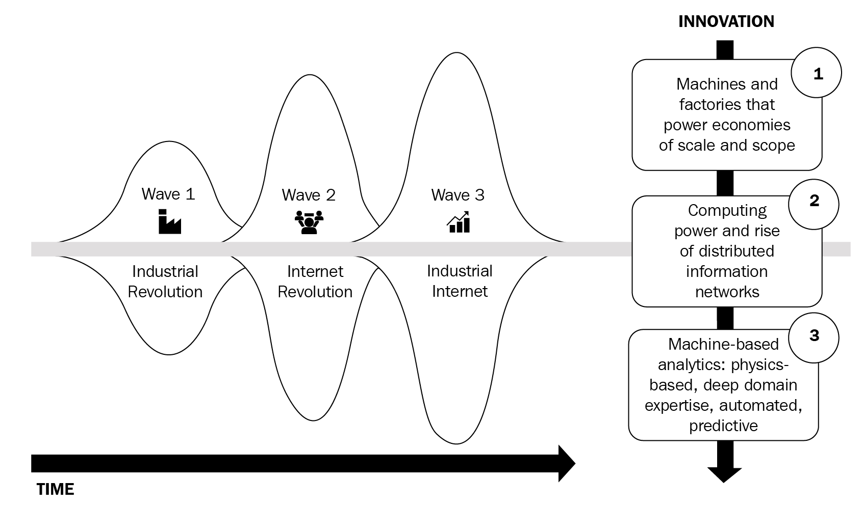
Industrial IOT
Industrial IOT, short for Industrial Internet Of Things, originally described the IOT as it is used across several industries, such as manufacturing industry 4.0, oil and gas, transportation, energy/utilities, mining and metals, and other industrial sectors and the use cases which are typical to three industries.
Approved by AICTE |Affiliated to VTU | Recognized by UGC with 2(f) & 12(B) status |Accredited by NBA and NAAC

Slide 18
Advantages & Disadvantages
Advantages-
Improved productivity of staff and reduced human labor
Efficient operation management
Better use of resources and assets
Improved work safety
Better business opportunities
Disadvantages-
Security flaws
Associated costs
Network dependence
Power supply dependence
Approved by AICTE |Affiliated to VTU | Recognized by UGC with 2(f) & 12(B) status |Accredited by NBA and NAAC

Slide 19
Conclusion
IoT is rightfully regarded as one of the most promising digital technologies that will definitely become more widespread and useful in the nearest future.
Even at the current state, the capabilities of IoT solutions are impressive, and their advantages are tempting.
However, it is important to realize that the integration of IoT in an enterprise requires a lot of efforts and skills in order to achieve those benefits without suffering from its drawbacks.
Approved by AICTE |Affiliated to VTU | Recognized by UGC with 2(f) & 12(B) status |Accredited by NBA and NAAC

Slide 20
References
https://www.frontiersin.org/articles/10.3389/fict.2019.00017/full
https://en.wikipedia.org/wiki/Internet_of_things
https://en.wikipedia.org/wiki/Embedded_system
https://en.wikipedia.org/wiki/Microcontroller
https://ieeexplore.ieee.org/document/8587092
https://light-it.net/blog/9-prominent-benefits-of-iot-for-business/
Approved by AICTE |Affiliated to VTU | Recognized by UGC with 2(f) & 12(B) status |Accredited by NBA and NAAC

