Slide 1
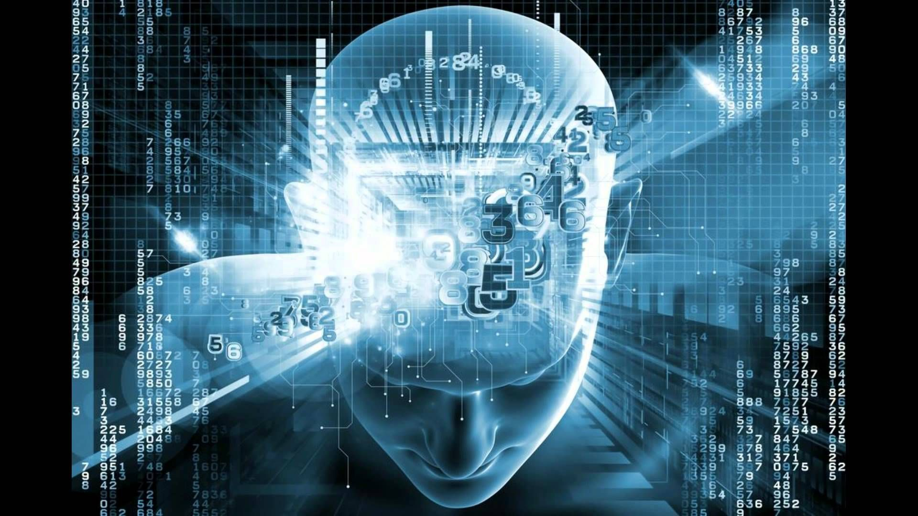
Generative AI
Group 16 :
1) Aniket Tawani : A-17
2) Pranay Ikhar : A-61
3) Pratik Yawalkar : A-62

Slide 2
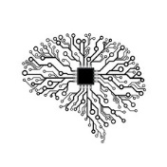
What is Generative AI
Technology to create new content by utilizing existing text, audio files, or images
Detect the underlying pattern related to the input and produce similar content.
Is an innovative technology that helps generate artifacts that formerly relied on humans, offering inventive results without any biases resulting from human thoughts and experiences.
It is a semi-supervised training framework

Slide 3
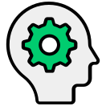
benifits of Generative AI :
Ensuring the generation of higher quality outputs by self-learning from every set of data.
Lowering the risks associated with a project
Training reinforced machine learning models to be less biased
Enabling depth prediction without sensors
Enabling localization and regionalization of content via deepfakes
Allowing robots to comprehend more abstract concepts both in simulation and the real world.

Slide 4

Advantages of GANs, a semi-supervised framework of generative AI against supervised learning
Overfitting: Generative AI models have lesser parameters, so it may be tougher to overfit. Also, generative models need a high quantity of data because of the training procedure, making them sturdier to obstructions.
Human partiality: Human marks are not as evident as in the supervised learning methodology in generative AI modeling. The learning works on the data properties that permit the exclusion of bogus correlations.
Model partiality: Generative models don’t generate results the same as the training data. Hence, the shape and texture problem disappears

Slide 5

Limitations of Generative AI :
Hard to control: Generative AI models like GANs do not always generate desired results. Some outputs are hard to interpret and as the result is derived from an ML model, it is hard to change it.
Pseudo Imagination: Generative AI algorithms perform tasks based on their training data only and cannot create anything new on their own. The technology only allows models to combine things it already knows and present it in new ways.
Security: Fraudsters may use Generative AI for scamming and other fraudulent activities, which may be difficult to track.

Slide 6

challenges of Generative AI :
Security: Some people can use Generative AI for fraudulent purposes like scamming people.
Overestimation of capabilities: Generative AI algorithms require an enormous amount of training data to perform tasks. Yet, GANs cannot create entirely new images or texts. They only combine what they know in different ways.
Unexpected outcomes: In some models of Generative AI like GANs, it is not easy to control their behavior. They perform unstably and generate an unexpected outcome.
Data privacy: Health-related applications involve privacy concerns on individual-level data.

Slide 7
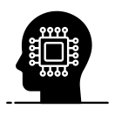
Future of Generative AI :
Unsupervised Learning: Overcoming the limitations to labeled and segregated data used by conventional AI models. Advanced AI algorithms are now being trained through unstructured data without any human assistance.
Federated Learning: Going beyond conventional machine learning from a unified dataset, AI models are trained locally on data subsets.
Transformers: Recurrent neural networks perform data processing sequentially. They may be soon replaced with Transformers, which work on parallelized language processing.
Neural Network Compression: Typical deep learning models are massive and must be reduced. Compressing them would make the neural networks smaller, faster, and power-efficient.
Generative AI: Moving on from recognizing data sets to creating new ones.

Slide 8
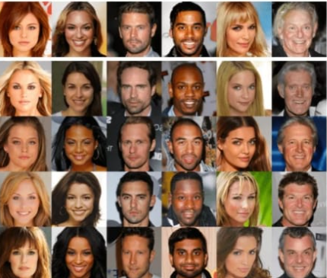
Applications of Generative AI
Generating Photographs of human faces, Objects and scenes. Generative AI Produces real looking Photographs.

Slide 9
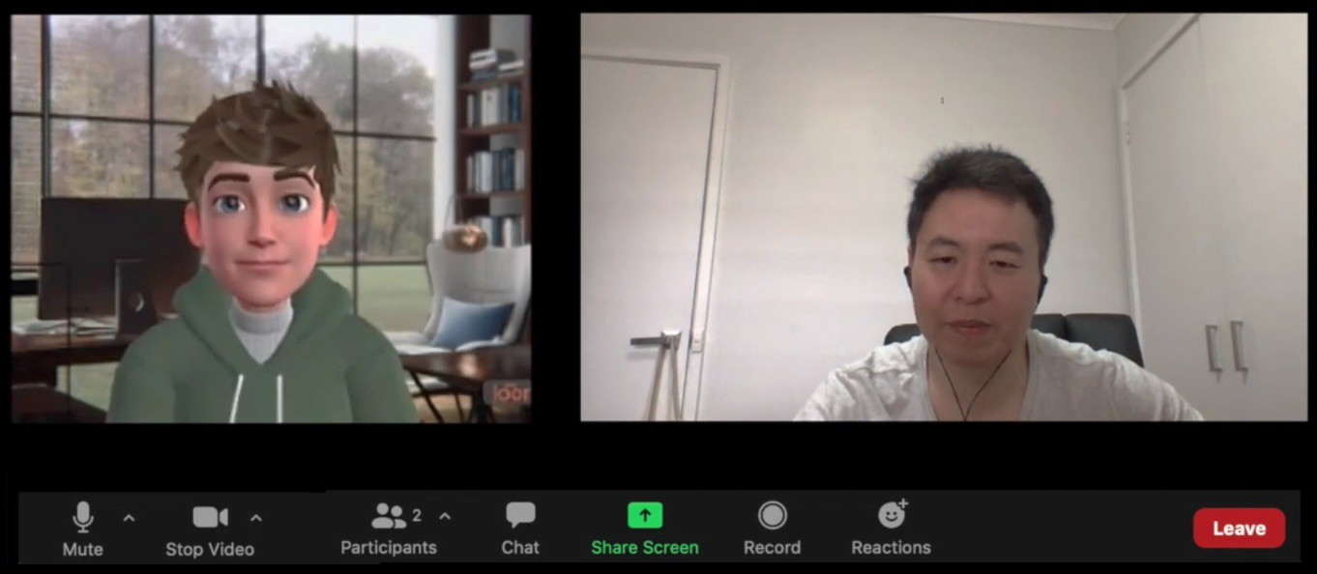
Image to Object Conversation : For Example,
Black and White Photographs to color.
Day Photos to Night Photos.
A Photo to an Artistic Painting.
Satellite Photos to Google Maps Views.

Slide 10
Few Important Applications of Generative AI :
Text-to-Image Translation.
Face Frontal View Generation.
Generate New Human Poses.
Photos to Emojis.
Face Aging.
Super Resolution.
Photo Inpainting.
Clothing Translation.

