Slide 1
HANDWRITTEN DIGIT CLASSIFICATION USING KNN
BY:
Aniket Tawani (A-17)
Pranay Ikhar (A-61)
Pratik Yawalkar (A-62)
Shift 1st , Section A , CSE, RCOEM.

Slide 2
Introduction to KNN
It is based on Supervised Learning technique.
It assumes the similarity between the new case/data and available cases and put the new case into the category that is most similar to the available categories.
It stores all the available data and classifies a new data point based on the similarity. This means when new data appears then it can be easily classified into a well suite category by using KNN algorithm.
It can be used for Regression as well as for Classification but mostly it is used for the Classification problems.
It is a non-parametric algorithm, which means it does not make any assumption on underlying data.
It is also Known as lazy learner algorithm because it does not learn from the training set immediately instead it stores the dataset and at the time of classification, it performs an action on the dataset.
At the training phase it just stores the dataset and when it gets new data, then it classifies that data into a category that is much similar to the new data.

Slide 3
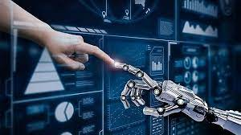
Working of KNN
Step-1: Select the number K of the neighbors
Step-2: Calculate the Euclidean distance of K number of neighbors
Step-3: Take the K nearest neighbors as per the calculated Euclidean distance (or Manhatten distance).
Step-4: Among these k neighbors, count the number of the data points in each category.
Step-5: Assign the new data points to that category for which the number of the neighbor is maximum.
Step-6: Our model is ready.

Slide 4
Handwritten Digit Recognition
Handwritten digit recognition is the process to provide the ability to machines to recognize human handwritten digits.
It is not an easy task for the machine because handwritten digits are not perfect, vary from person-to-person, and can be made with many different flavors.
The MNIST dataset
Among thousands of datasets available in the market, MNIST is the most popular dataset for enthusiasts of machine learning and deep learning.
Above 60,000 plus training images of handwritten digits from zero to nine and more than 10,000 images for testing are present in the MNIST dataset.
So, 10 different classes are in the MNIST dataset. The images of handwritten digits are shown as a matrix of 28×28 where every cell consists of a grayscale pixel value.

Slide 5
Work Flow of the KNN - Program
Importing the Necessary Libraries
Exploration of the Dataset
Training and Testing with the best parameters of KNN
1
3
5
2
4
6
Importing the Dataset files (splitting the dataset into train and test)
Generating the best Parameters for the KNN Algorithm
Plotting the Various Comparision Plots for the Result

Slide 6
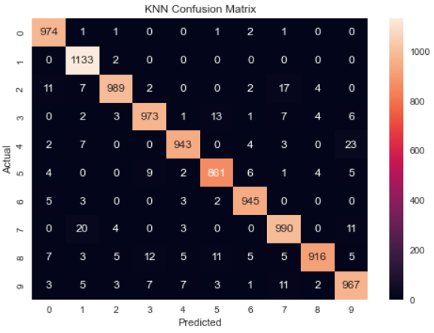
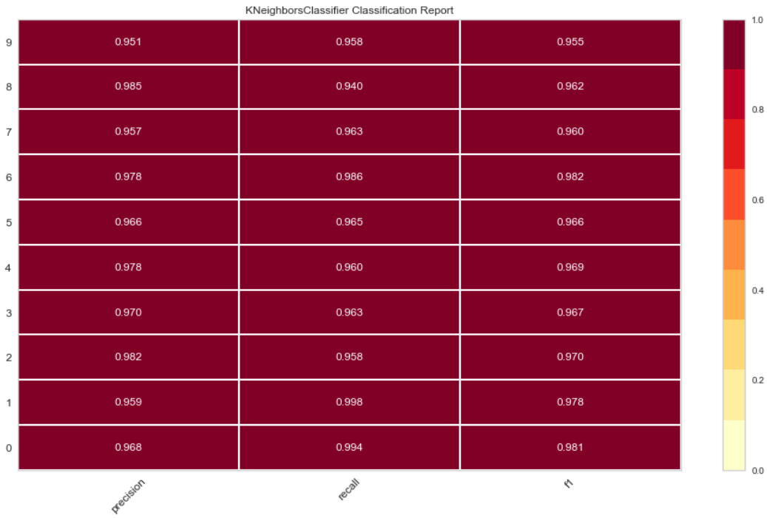
Results
Confusion Matrix
Classification Report

Slide 7
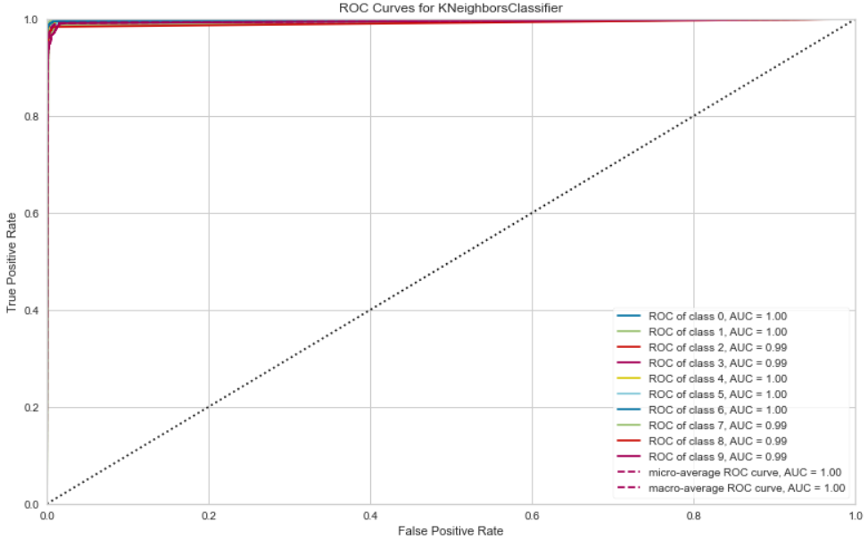
ROC Curve

Slide 8
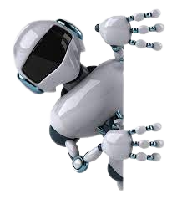
THANKS!
Any questions?
You can find me at pratikyawalkar5263@gmail.com

