Slide 1
To Find natural loop using pfg
BY :-
Pratik Yuvraj Yawalkar,
Roll No. 62,
Section A, Shift 1,
CSE, RCOEM.

Slide 2
Prerequests
3AC (Three Address code)
PFG( Program Control Graph)
Loops using 3AC

Slide 3
What is loop optimization
As we know most execution time of a scientific program is spent on loops, hence Loop Optimization plays a significant role in minimizing the execution time of program.
Loop Optimization is the process of increasing execution speed and reducing the overheads associated with the loops.
It plays an important role in improving cache performance and making effective use of parallel processing capabilities.
Loop Optimization is a machine independent optimization.
Decreasing the number of instructions in an inner loop improves the running time of a program even if the amount of code outside that loop is increased.

Slide 4
Roadmap for natural loop detection
Finding the optimized 3AC for given Problem
Identification of Basic blocks
Identification of Dominators and Back Edges
1
3
5
2
4
6
Identification of Leader Statements
Construction of Program Flow Graph
Identification of Natural Loops

Slide 5
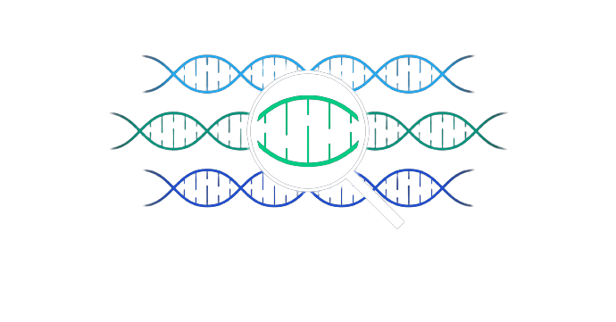
EXAMPLE
Input C Code Snippet:
int demo (int t) {
int a, b;
amt=a;
rate=a;
while(a>10) {
amt=amt*rate;
amt=amt+100;
a=a+1;
}
}

Slide 6
Step 1: Identification of Leader Statements
Rules:
Result of Step 1:
Rule 1: The first instruction is considered the leader.
Rule 2: The target of conditional or unconditional goto is a leader.
Rule 3: The instruction that immediately follows a conditional
goto is a leader.
10: amt=a L1
20: rate=a
30: if(a>10) GOTO 50 L2
40: GOTO 120 L3
50: amt=amt*rate L4
60: amt=amt+100
70: a=a+1
80: GOTO 30
120: Exit L5

Slide 7
Step 2: Identification of Basic Blocks
Rules:
Result of Step 2:
A basic block consists of a leader and ends on the instruction just before the next leader , excluding the next leader.
Any statement not placed in block can never be executed & may now be removed if desired
10: amt=a B0
20: rate=a
30: if(a>10) GOTO 50 B1
40: GOTO 120 B2
50: amt =amt*rate B3
60: amt =amt+100
70: a=a+1
80: GOTO 30
120: Exit B4

Slide 8
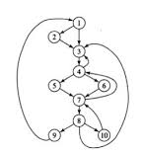
Step 3: Identification of PFG
What is PFG ?
Program Flow graph or PFG is a directed graph.
It contains the flow of control information for the set of basic block.
A control flow graph is used to depict that how the program control is being parsed among the blocks.
It is useful in the loop optimization.

Slide 9
Rules To Find PFG
Analyze the last statement of all the basic blocks.
The flow can be directed to the next basic block or it may jump to another basic block if there is a conditional or unconditional GOTO statement.
There is conditional & unconditional jump from the last statement of B1 to the first statement of B2 or B2 immediately follows B1 in the order of program & B1 does not end in an unconditional jump.
So B1 is predecessor of B2 & B2 is successor of B1.
As output, a CFG is constructed.
Conditional GOTO:
If (amt > 20) GOTO 2
If (x ! 200) GOTO ST_1
Un-Conditional GOTO:
GOTO 20
GOTO STM_13

Slide 10
B0
Result Of Step 3:
10: amt=a B0
20: rate=a
----------------------------------------
30: if(a>10) GOTO 50 B1
----------------------------------------
40: GOTO 120 B2
----------------------------------------
50: amt =amt*rate B3
60: amt =amt+100
70: a=a+1
80: GOTO 30
----------------------------------------
120: Exit B4
B1
B2
B3
B4

Slide 11
Dominators
Node ‘d’ dominates node ‘n’ if all paths from the entry node to ‘n’ go through ‘d’
Representation: d dom n
Every node dominates itself.
The initial node dominates all nodes in G.
The entry node of a loop dominates all nodes in the loop.

Slide 12
Step 4: Identification of Loop
Part A: Find Dominators of Each Block
Result of Part A:
Every node dominates itself.
The initial node dominates all nodes in G.
The entry node of a loop dominates all nodes in the loop.
Block / Node | Dominators
B0 | { 0 }
B1 | { 0 , 1 }
B2 | { 0 , 1 , 2 }
B3 | { 0 , 1 , 3 }
B4 | { 0 , 1 , 2 , 4 }

Slide 13
Step 4: Identification of Loop
Part B: Find Back Edge Table of Each Edge
A back edge of a natural loop is one whose target dominates its source.
In PFG every edge flows from Tail to Head.
If block0 is connected to block1, then Tail=Block0 and Head=Block1
Steps:
1. Compute edges in PFG
2. Compute Head and Tail information from edges
3. Find dominator of head and dominator of tail
Result: If in the dominator of tail, head node is present, then the edge is denoted as back edge.

Slide 14
Result of Part B:
EDGE | HEAD | TAIL | DOMINATOR [ HEAD ] | DOMINATOR [ TAIL ] | REMARKS
0 -> 1 | 1 | 0 | { 0 , 1 } | { 0 }
1 -> 2 | 2 | 1 | { 0 , 1 , 2 } | { 0 , 1 }
1 -> 3 | 3 | 1 | { 0 , 1 , 3 } | { 0 , 1 }
3 -> 1 | 1 | 3 | { 0 , 1 } | { 0 , 1 , 3 } | BACK EDGE
2 -> 4 | 4 | 2 | { 0 , 1 , 2 , 4 } | { 0 , 1 , 2 }

Slide 15
Step 4: Identification of Loop
Part C: Find Natural Loop of Each Back Edge
The natural loop of the back edge is defined to be the smallest set of nodes that includes the back edge and has no predecessors outside the set except for the predecessor of the header.
Formula :
Natural Loop of Edge N -> D = { D } + { X | X can reach N without going through D }

Slide 16
Cont….
B0
Here, the back edge 3 → 1 indicates presence of loop between block 3 and 1.
Hence Natural Loop = { 1 } + { 3 }
= { 1 , 3 }
Therefore,
Natural Loop is ( 3 -> 1 -> 3 )
Natural loops allow us to easily find the innermost loops in a reducible flow graph.
B1
B3
B2
B4

Slide 17
thanks!
pratikyawalkar
71@gmail.com
Any questions?

Slide 18
Credits
Special Thanks to all the people who made and released these awesome resources for free:
https://web.cs.wpi.edu/~kal/PLT/PLT8.6.4.html
https://classroom.google.com/u/1/c/NDQ2NDE1Njk5MDY0/m/NDgxMzAyNDc2NjEy/details
https://www.brainkart.com/article/Loops-in-Flow-Graph_8113/

