Slide 1



Paper ID : ICIDC_71
Paper Title: Gender Recognition by Voice using Machine Learning Techniques
Authors: Sweta Jain, Amey Admane, Neha Pandey, Pratik Yawalkar, Vaidehi Choudhari
ICIDC-2022
2nd International Conference
on
Intelligent Systems, Data Science and Cyber Security
16-17 December 2022

Slide 2
Problem Definition
Identifying the gender using voice by training the Kaggle dataset using six machine learning models and comparing accuracy, precision, recall and F1 score of various models and suggesting the best model that can be used for gender recognition by voice.

Slide 3
Project Scope
Marketing
Public Service Based Sectors
Smart Assistance
Investigating Criminal Voice in crime scenarios

Slide 4
Workflow
Voice (.CSV)
Project WorkFlow
Dataset
Preprocessing
Checking for
null values
Split Data
Train and test data
Scaling
Normalizing the values
Default Implementation
RF, GB, DT,KNN,SVM,
Logistic , Ensemble
Hyperparameter Tuning
Best parameters using GridSearchCV
Recursive Feature Elimination
Training the model using best features
Predict

Slide 5
Our Dataset
CSV file
Datatype: ‘Label’ => Object : other => float
Checking
for
Distribution of data
3168
Null values
Numeric or non-numeric values
Dependent values
1584
1584
Dataset (3168 x 21)
Plotting histogram
Correlation matrix using heatmap

Slide 6
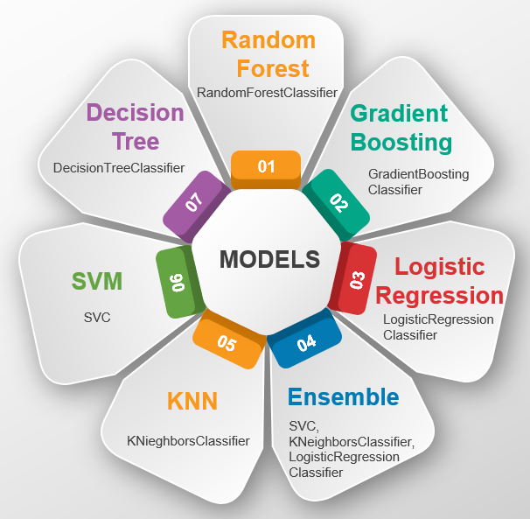
Model Implementation

Slide 7
For every model . . .
Hyperparameter Tuning using GridSearchCV
Recursive Feature Elimination
Default Model
Best Model

Slide 8
Comparison between Models

Slide 9

Parameters for Comparison

Slide 10
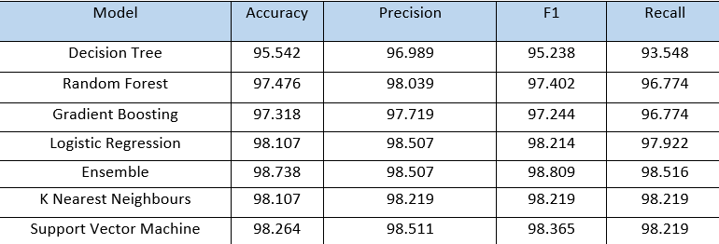
RESULTS
Model Results

Slide 11
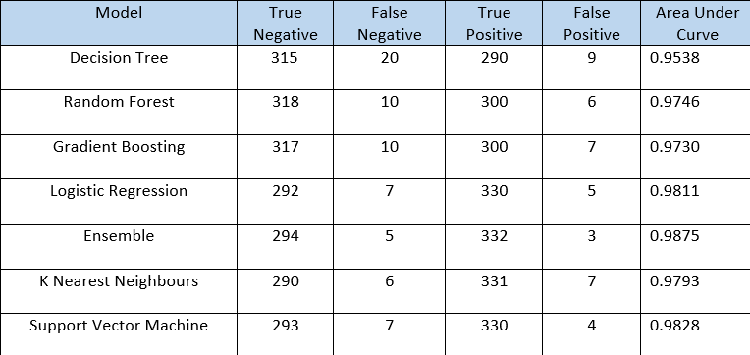
2. Results From Confusion Matrix and ROC Curve

Slide 12
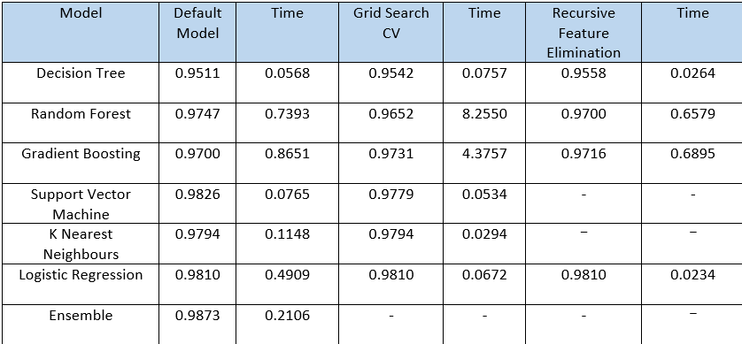
3. Accuracy & Time

Slide 13
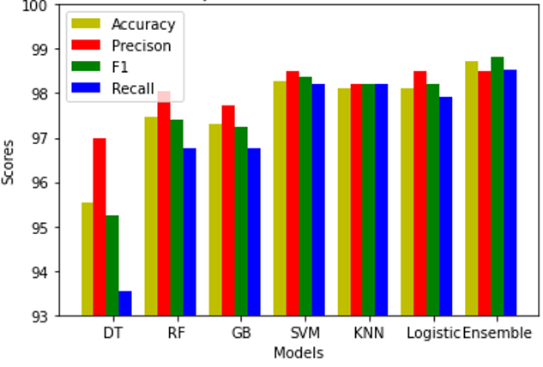
4. Graphical representation

Slide 14
Conclusion
We successfully trained the kaggle dataset using 7 machine learning models.
Out of all the 7 models implemented, Ensemble machine models performed better than other models.
Out of the 3 Ensemble models, Ensemble model build using SVM,Logistic regression and KNN performed the best.
Best case accuracy of Ensemble model is 98.738% followed by SVM.

Slide 15
Future Work
Audio files
Audio files in .wav format
R file to extract features
tuneR and seewave packages
Converting data to .csv
Creating dataset using .csv format
Trained Model
Testing on trained model
Predict
Testing on trained model
Male
Female

Slide 16
Challenges
Low accuracy for real time data
Voice mimicry
Disturbances

