Slide 1
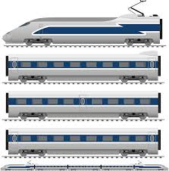

Linked LIST
Why Linked List ?

Slide 2
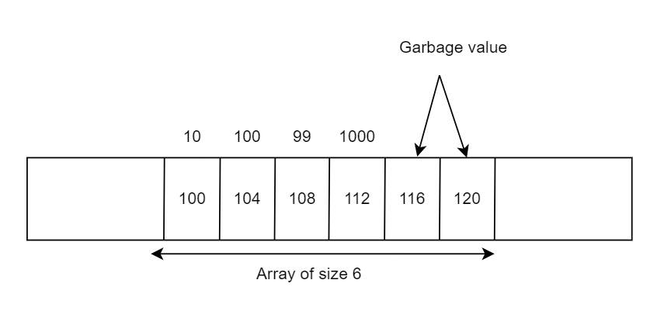
LIMITATIONS OF ARRAY
Limited memory size of our computer.
Sequential access.
Continuous allocation.
Fixed size of array.
Wasted space.
Costly insertion and deletion at ends.

Slide 3
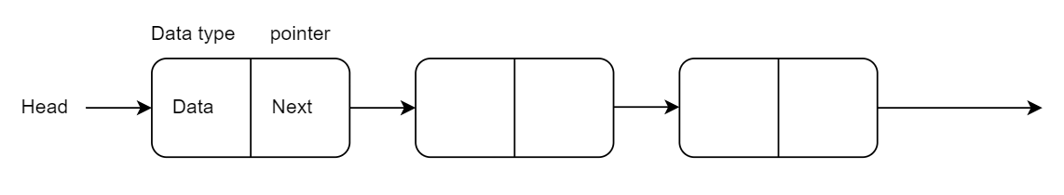
Advantages of linked list over array
Flexible/dynamic
Easy insertion and deletion at ends.
Random allocation.
No wastage of space.
Modification
Large data/scalable

Slide 4
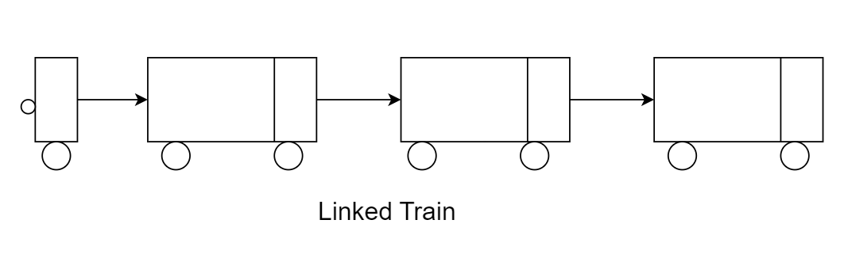
How to visualize linked List
Consider each coach of this train as the coach of a train.
Consider the head node as the engine of the train.
Smaller part of each coach contains the link to next node
Large part of each coach contains the data stored at that node.
Smaller part of the last coach is null (there is no further link)

Slide 5
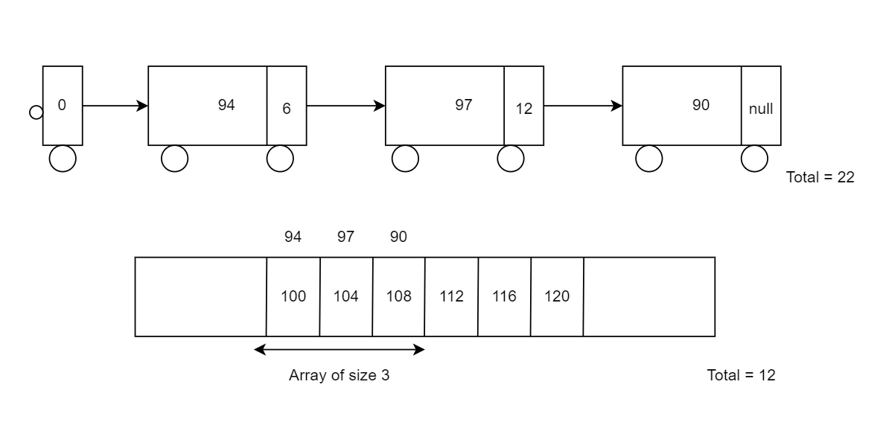
Common misconceptions regarding the linked list
Linked List Occupies Less space than Array.
Linked List means no sequential allocation.

Slide 6
Variations of linked list
Singly Linked List (standard)
Doubly Linked list
Circular linked list
Circular Doubly Linked list

Slide 7
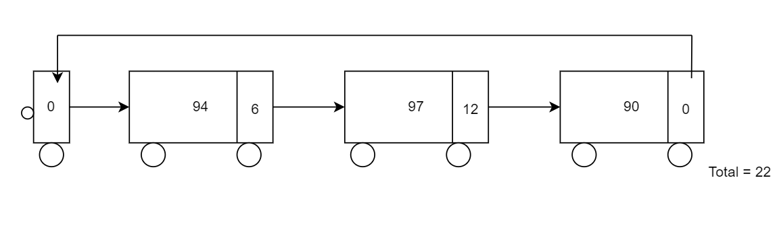
Circular Linked list

Slide 8
Linked list in C++ STL
Template class list provides the implementation of doubly linked list.
Template class Forward_list provides the implementation of singly linked list.
Circular linked list has to be implemented on demand.
Common list methods in c++ STL
list.pop_back()
list.push_back()
list.pop_front()
list.push_front()
list.size()
list.empty()

Slide 9
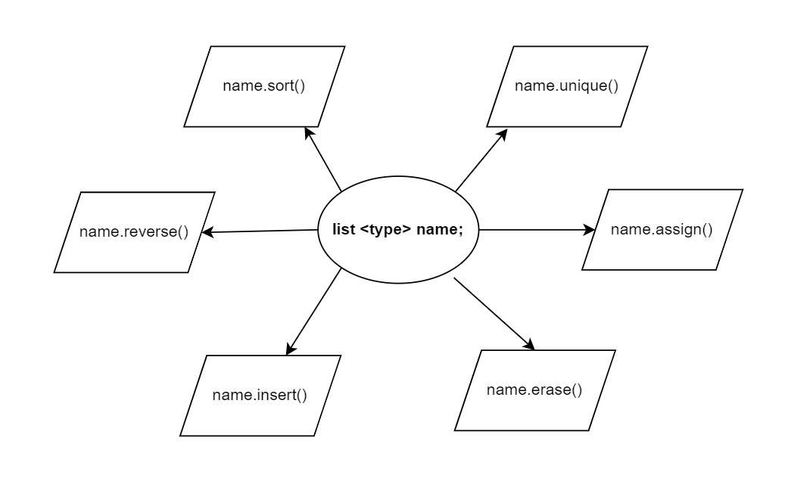
Real power of list in c++ stl

Slide 10
Questions
Print Linked list in reverse order using Recursion. (Interview)
Delete adjacent duplicate elements. (CP)
Cycle detection in linked list. (Concept and proof)
Modify linked list as per the requirement (Interview IMP)
Merge sort using linked list. (Homework)
LRU cache implementation (Interview IMP)

Slide 11
Print a linked List in reverse order using singly recursion
Example
Input: 1 => 10 => 5 => 7
Call smaller
Print data
Output: 7 5 10 1

Slide 12
Given an array, print distinct elements in sorted order
Example
Input
6
9 7 6 9 6 1
Output
1 6 7 9

Slide 13
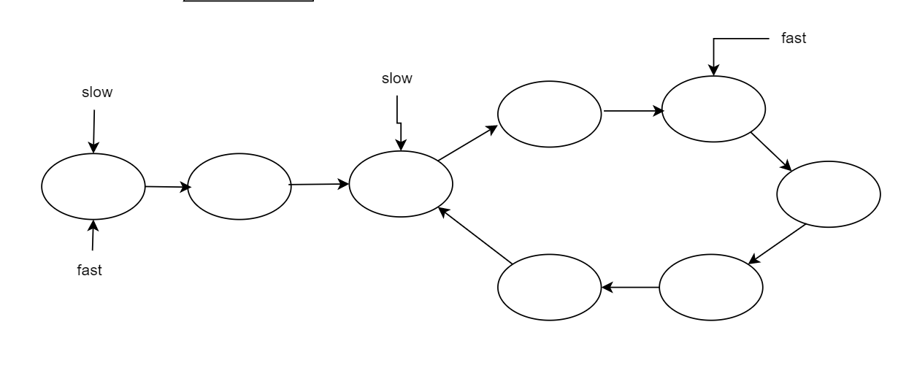
Detect a cycle using Floyd’s cycle detection algorithm
For better understanding visit Mathematical proof of floyd's cycle detection algorithm

Slide 14
Modify Linked list as per the requirement, check the given example. Size of linked list is even.
Example
Input:
1 2 3 4 5 6
Output
2 1 4 3 6 5

Slide 15

Merge Two sorted linked list

Slide 16
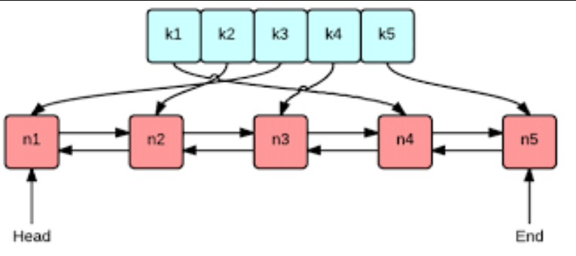
LRU cache implementation
What is LRU cache?
Refer this link LRU Cache data structure

Slide 17
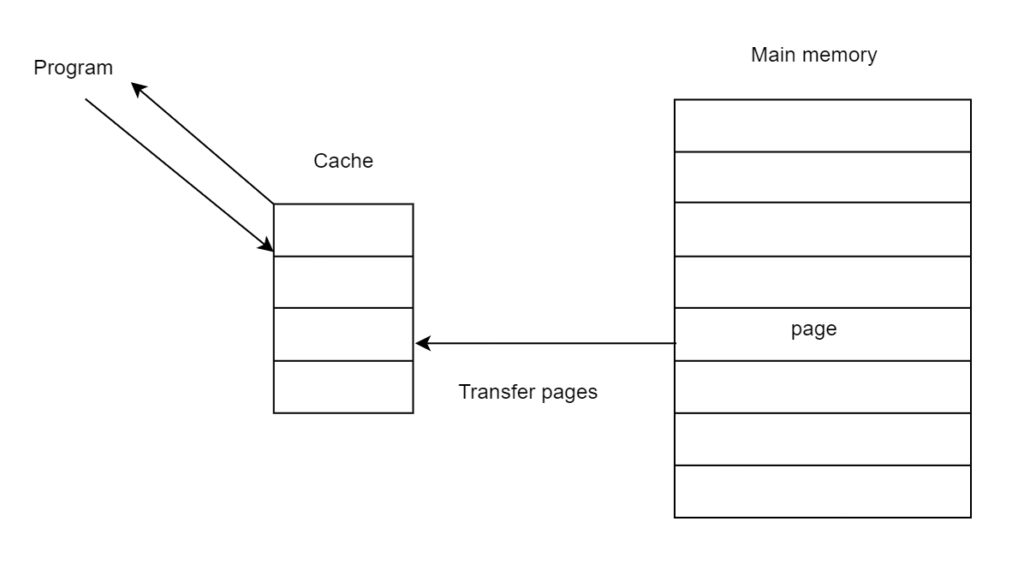
LRU cache explanation

Slide 18
END

