Slide 1
Invasive Ductal Carcinoma Prediction with Convolutional Neural Networks

Slide 2
Team Name
Ibraheem Ziad Alkhuzami

Slide 3
Topic Motivation
Cancer tumors can be classified into two types: malignant and benign.
A benign tumor is one which does not invade its surrounding tissues whereas a malignant tumor is one which may spread to its surrounding tissues or other parts of the body.

Slide 4
Project Scope
This project investigates the Breast Cancer Dataset provided by Kaggle
Applying Deep Learning approach using CNN Model as classifier.

Slide 5
Dataset
We obtained our Dataset from Kaggle
Large Dataset that is 1.6 GB.
It is 277524 RGB images
Collected from 279 patients.

Slide 6
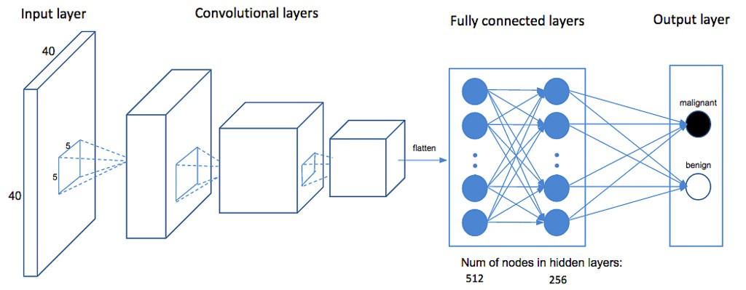
Inputs & Outputs

Slide 7
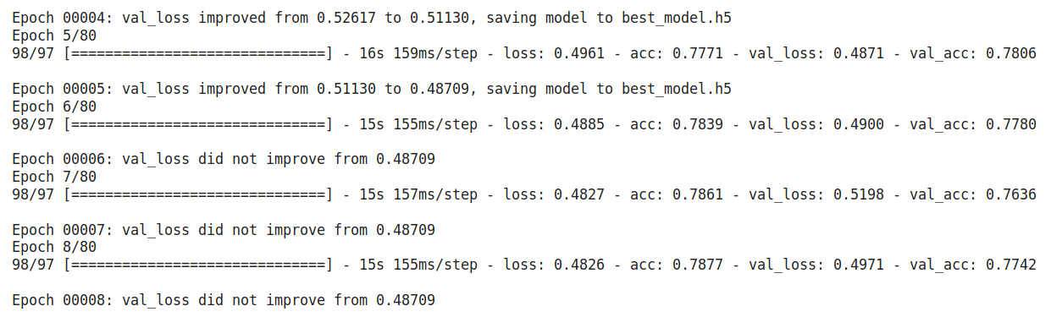
Results – (Training & Validation)

Slide 8
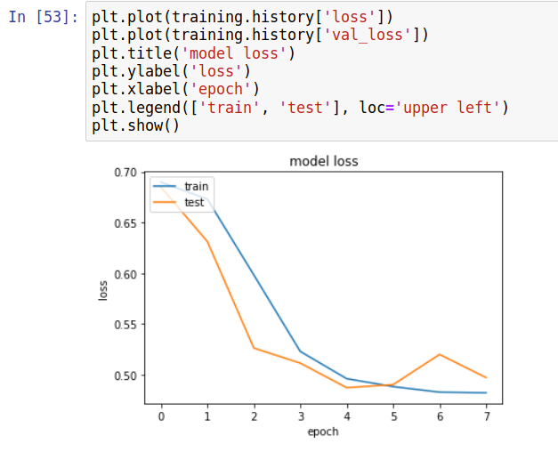
Results – (Train & Test Losses)

Slide 9
Future Work
Improving Accuracy
To make it above
+90%
Deploying
To
Web App
Commercial
Product

Slide 10

Questions & Answers

Slide 11


