Slide 1
Deadlock and concurrency algorithms visualiser
OS PROJECT
Shachi Intodia (2K19/CO/350)
Shikhar Chauhan (2K19/CO/359)

Slide 2

Introduction
Concurrency is the execution of the multiple instruction sequences at the same time. It happens in the operating system when there are several process threads running in parallel. Concurrency results in sharing of resources result in problems like deadlocks and resources starvation. Both interleaved and overlapped processes can be viewed as examples of concurrent processes.
Deadlock is a situation where a set of processes are blocked because each process is holding a resource and waiting for another resource acquired by some other process.
The conditions for deadlock to occur are: (a) Mutual exclusion,
(b) Hold and wait, (c) No pre-emption, (d) Circular wait
Three approaches exist for dealing with deadlock:
Prevention
Avoidance
Detection and recovery

Slide 3

Our Website consists of various deadlock and concurrency algorithms:
• Strict Alteration
• Counting Semaphore
• Producer Consumer Algorithm
• Lock variable
• Binary Semaphore
• Peterson’s Algorithm
• Test and Lock Set
• Banker’s Algorithm
These are implemented using html, css and javascript on visual code studio.
Homepage

Slide 4
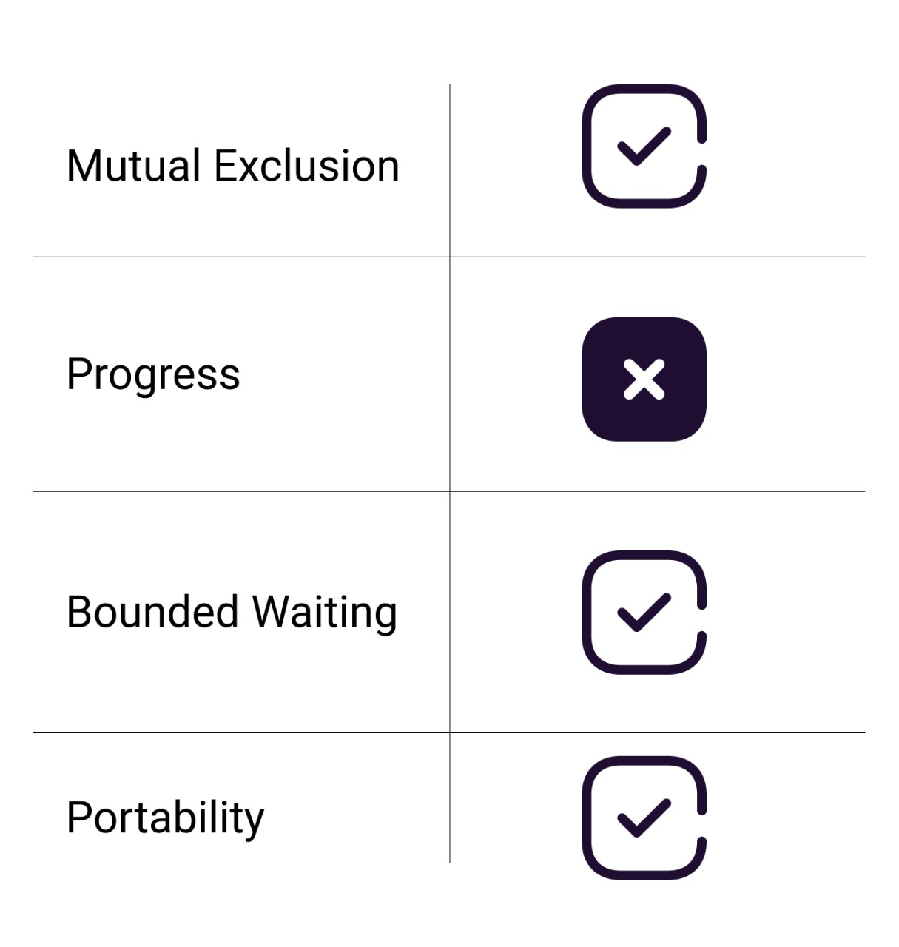
Strict Alteration
Strict Alternation Approach is the software mechanism implemented at user mode. It is a busy waiting solution which can be implemented only for two processes. In this approach, A turn variable is used which is actually a lock. This approach can only be used for only two processes. In general, let the two processes be P0 and P1. They share a variable called turn variable.

Slide 5
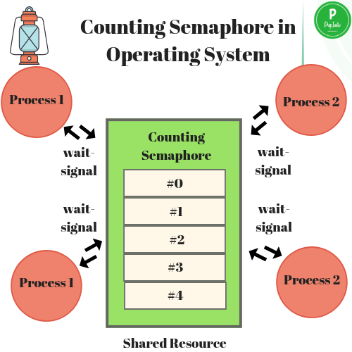
COUNTING SEMAPHORES
In Counting semaphores, firstly, the semaphore variable is initialized with the number of resources available. After that, whenever a process needs some resource, then the wait() function is called and the value of the semaphore variable is decreased by one. The process then uses the resource and after using the resource, the signal() function is called and the value of the semaphore variable is increased by one. So, when the value of the semaphore variable goes to 0 i.e. all the resources are taken by the process and there is no resource left to be used, then if some other process wants to use resources, then that process has to wait for its turn. In this way, we achieve the process synchronization.

Slide 6
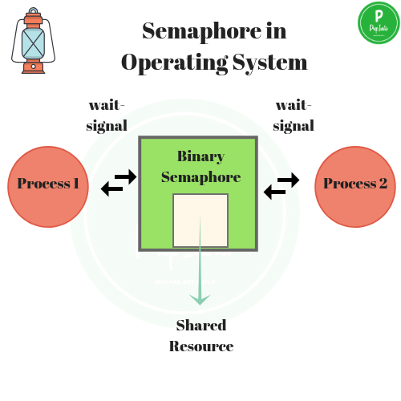
Binary semaphores
1. A binary semaphore has two components-
a. An integer value which can be either 0 or 1.
b. An associated waiting list (usually a queue).
2. The waiting list of binary semaphore contains the processes that got blocked when trying to enter the critical section.
3. In waiting list, the blocked processes are put to sleep.
4. The waiting list is usually implemented using a queue data structure.
5. Using a queue as waiting list ensures bounded waiting.
6. This is because the process which arrives first in the waiting queue gets the chance to enter the critical section first.
7. The wait operation is executed when a process tries to enter the critical section.
8. The signal operation is executed when a process takes exit from the critical section.
9. Binary semaphores are mainly used for two purposes-
a. To ensure mutual exclusion.
b. To implement order in which the process must execute.

Slide 7
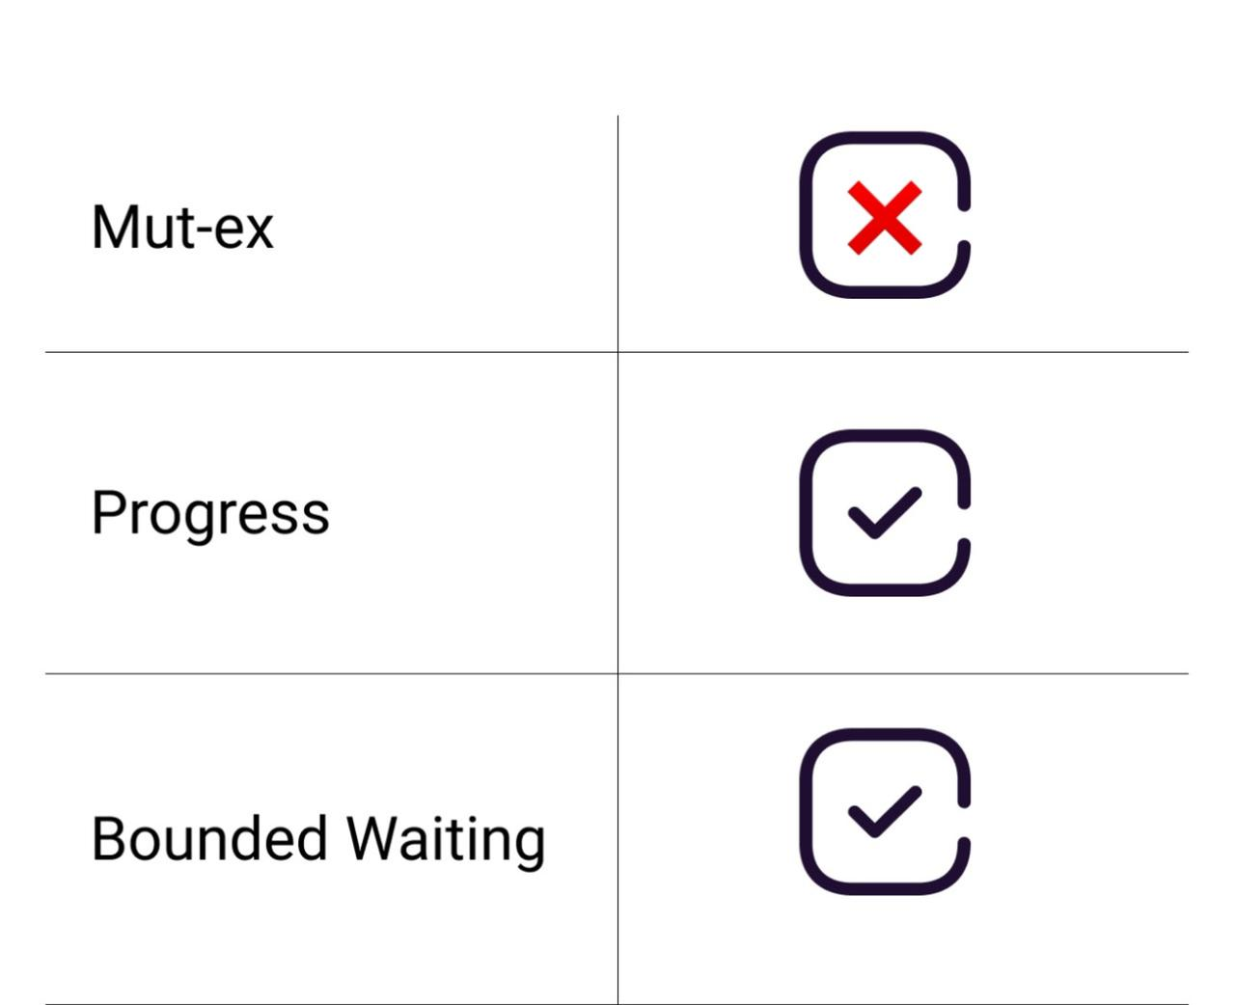
Lock variable
This is the simplest synchronization mechanism. This is a Software Mechanism implemented in User mode. This is a busy waiting solution which can be used for more than two processes. In this mechanism, a Lock variable lockis used. Two values of lock can be possible, either 0 or 1. Lock value 0 means that the critical section is vacant while the lock value 1 means that it is occupied. A process which wants to get into the critical section first checks the value of the lock variable. If it is 0 then it sets the value of lock as 1 and enters into the critical section, otherwise it waits.

Slide 8
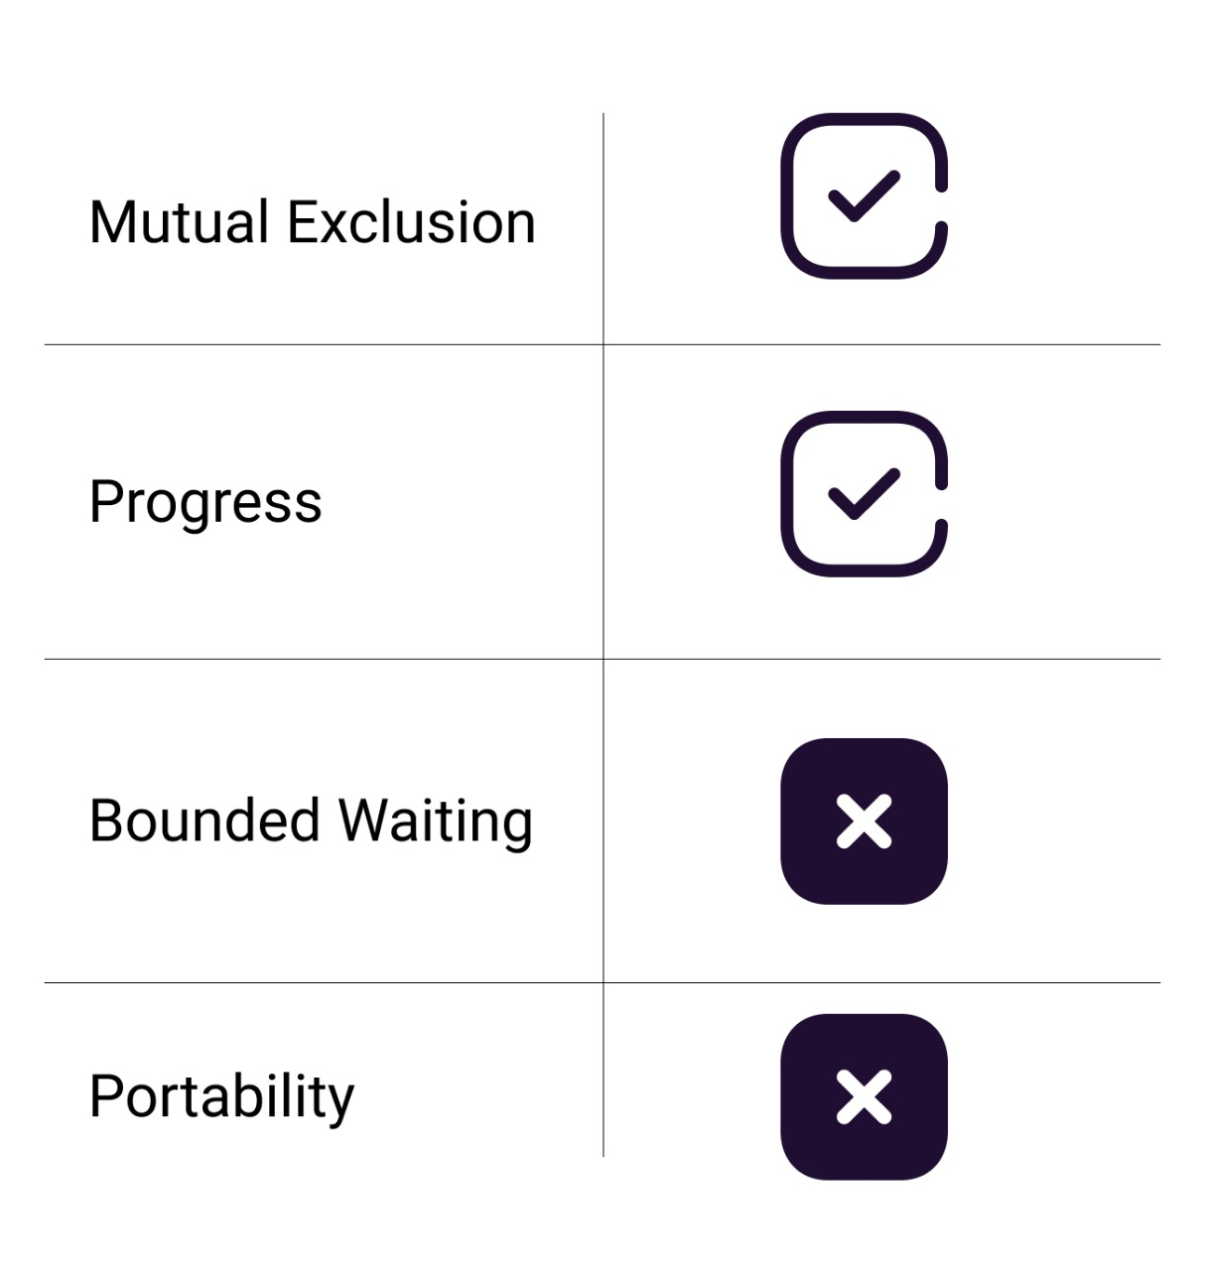
Test and set lock
TestAndSet is a hardware solution to the synchronization problem. In TestAndSet, we have a shared lock variable which can take either of the two values, 0 or 1.
Before entering into the critical section, a process inquires about the lock. If it is locked, it keeps on waiting until it becomes free and if it is not locked, it takes the lock and executes the critical section.

Slide 9
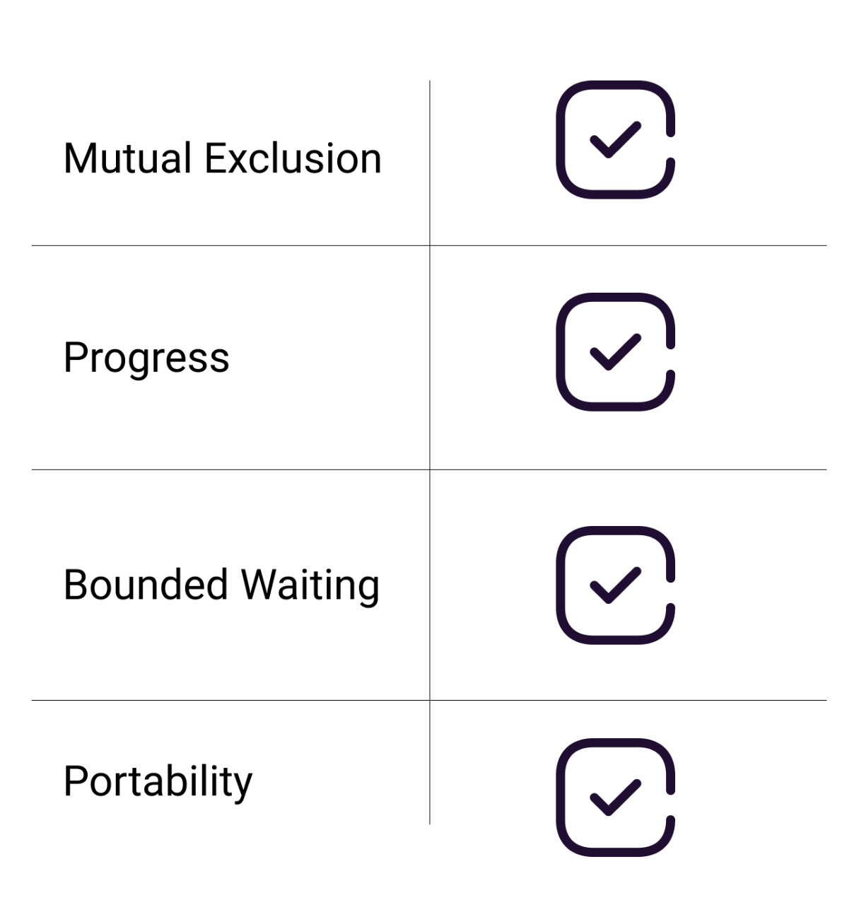
Petersons algorithm
Peterson’s solution provides a good algorithmic description of solving the critical-section problem and illustrates some of the complexities involved in designing software that addresses the requirements of mutual exclusion, progress, and bounded waiting. Peterson's algorithm is considered a standard low-level algorithm for two-thread mutual exclusion.

Slide 10
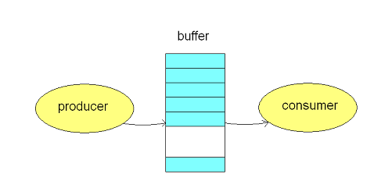
Producer-consumer algorithm
The Producer-Consumer problem is a classical multi-process synchronization problem, that is we are trying to achieve synchronization between more than one process. There is one Producer in the producer-consumer problem, Producer is producing some items, whereas there is one Consumer that is consuming the items produced by the Producer. The same memory buffer is shared by both producers and consumers which is of fixed-size. The task of the Producer is to produce the item, put it into the memory buffer, and again start producing items. Whereas the task of the Consumer is to consume the item from the memory buffer..

Slide 11

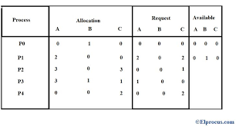
Banker’s algorithm
The banker’s algorithm is a resource allocation and deadlock avoidance algorithm that tests for safety by simulating the allocation for predetermined maximum possible amounts of all resources, then makes an “s-state” check to test for possible activities, before deciding whether allocation should be allowed to continue. Banker’s algorithm is named so because it is used in banking system to check whether loan can be sanctioned to a person or not. Suppose there are n number of account holders in a bank and the total sum of their money is S. If a person applies for a loan then the bank first subtracts the loan amount from the total money that bank has and if the remaining amount is greater than S then only the loan is sanctioned. It is done because if all the account holders comes to withdraw their money then the bank can easily do it. In other words, the bank would never allocate its money in such a way that it can no longer satisfy the needs of all its customers. The bank would try to be in safe state always.

