Slide 1

INFORMATION AND
CYBERSECURITY SCE
Topic:- RSA ALGORITHM
Name | Gr No. | Roll No.
Aadarsh Shetty | 21810861 | 321048
Raj Thakkar | 21810934 | 321052
Amey Bobade | 21810866 | 321007
Vedant Gampawar | 21810949 | 321014

Slide 2
RSA ALGORITHM
RSA algorithm is asymmetric cryptography algorithm. Asymmetric actually means that it works on two different keys i.e. Public Key and Private Key. As the name describes that the Public Key is given to everyone and Private key is kept private.

Slide 3
An example of asymmetric cryptography :
A client (for example browser) sends its public key to the server and requests for some data. The server encrypts the data using client’s public key and sends the encrypted data. Client receives this data and decrypts it. Since this is asymmetric, nobody else except browser can decrypt the data even if a third party has public key of browser.

Slide 4
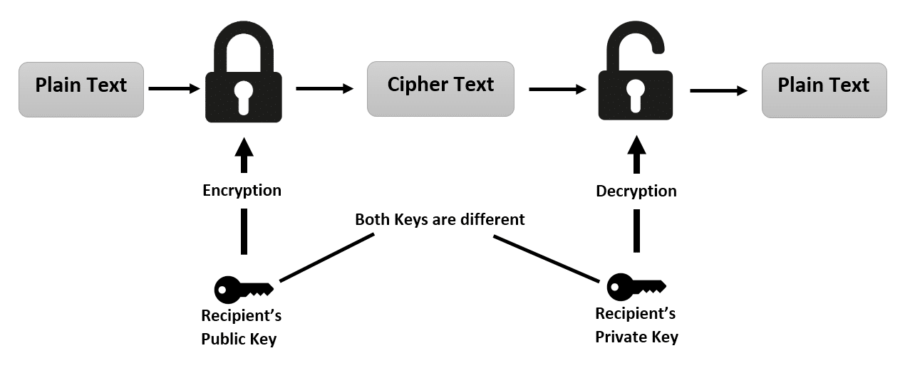

Slide 5
ATTACKS ON RSA ALGORITHM
1. Plain text Attack
Short message attack:
Cycling attack:
Unconcealed message attack:
2. Chosen cipher Attack
3. Factorization Attack
4.Searching the Message Space

Slide 6
vulnerabilities in rsa algorithm
It takes the algorithm different amounts of time to decrypt different inputs when using the same key.
Some implementations of RSA use weak random number generators
Small encryption exponent
Small encryption exponent and small message
Using the same key for encryption and signing
SOLUTIONS:
Don't use the same RSA key for encryption and signing.
Don't encrypt or sign a blind message.

Slide 7

THANKYOU!

