Slide 1
IOT SCE HOME AUTOMATION
Name | Roll No. | Gr No.
Anish Mudaliar | 321002 | 21810945
Amey Bobade | 321007 | 21810866
Vedant Gampawar | 321014 | 21810949

Slide 2


Slide 3
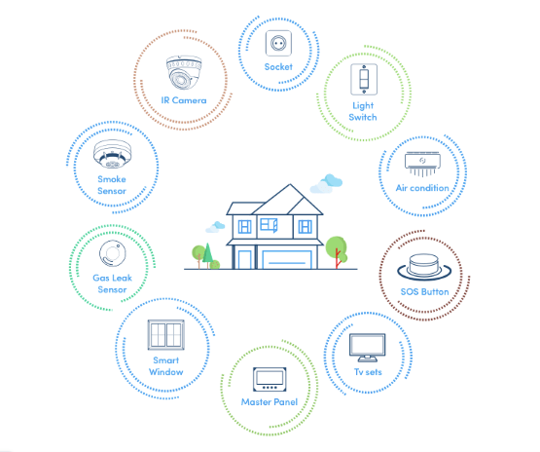
Lighting control HVAC Lawn/Gardening management Smart Home Appliances Improved Home safety and security Home air quality and water quality monitoring Natural Language-based voice assistants Better Infotainment delivery AI-driven digital experiences Smart Switches Smart Locks Smart Energy Meters

Slide 4
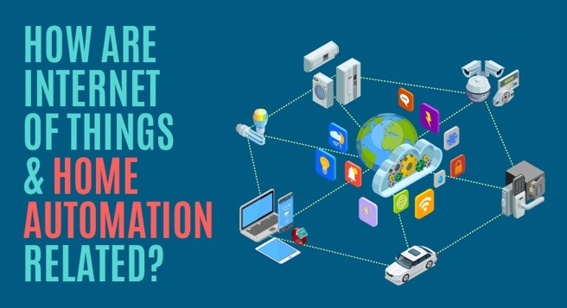

Slide 5
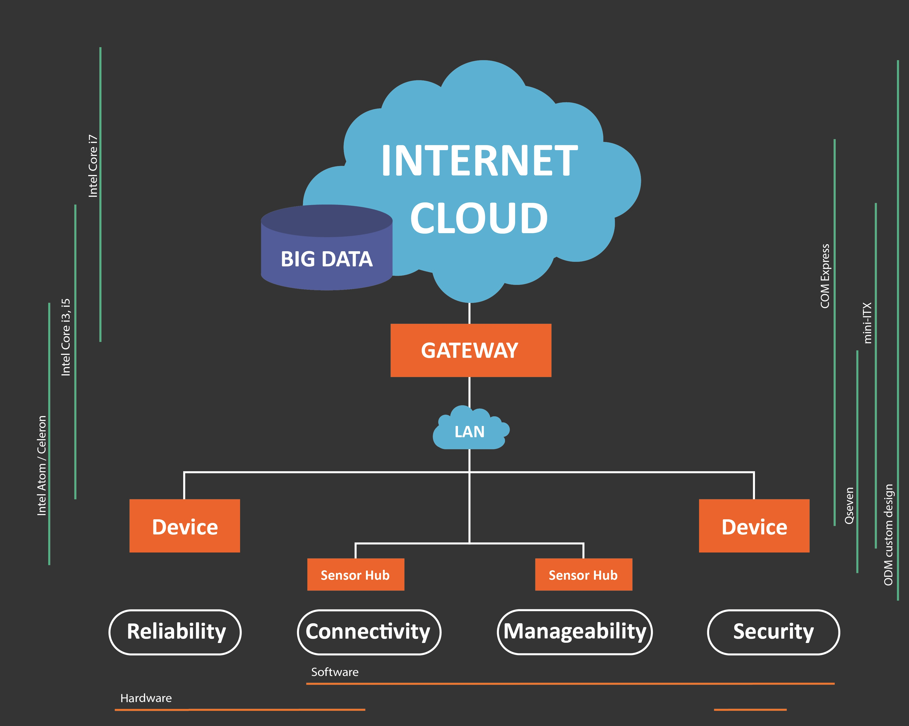
C O M P O N E N T S

Slide 6
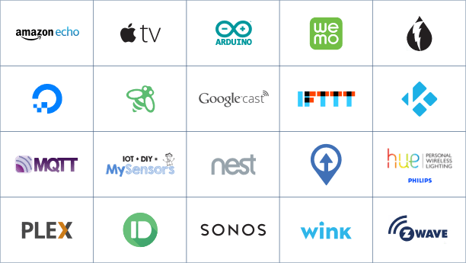

Slide 7

ZEMOTE One of the Leading Home Automation Company PUNE India
Automate Your Home

Slide 8
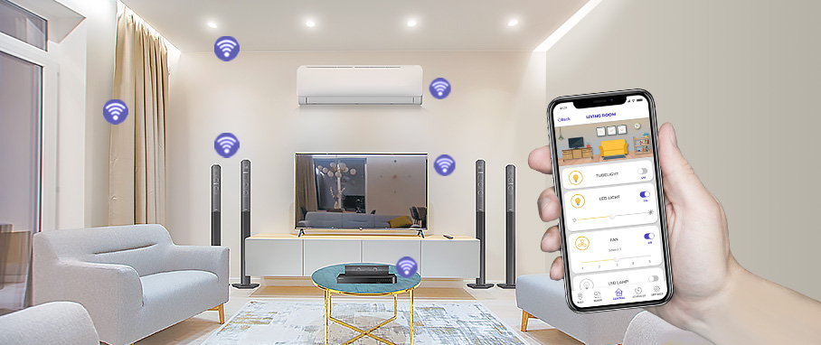

Slide 9
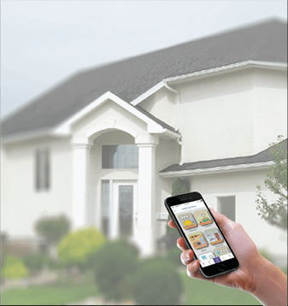


FEATURES PROVIDED BY ZEMOTE
HOME AUTOMATION
SECURITY AUTOMATION
LIGHTING AUTOMATION

Slide 10


Advantages of Home automation systems:
Reduced Installation Costs 2)System scalability and easy extension

Slide 11
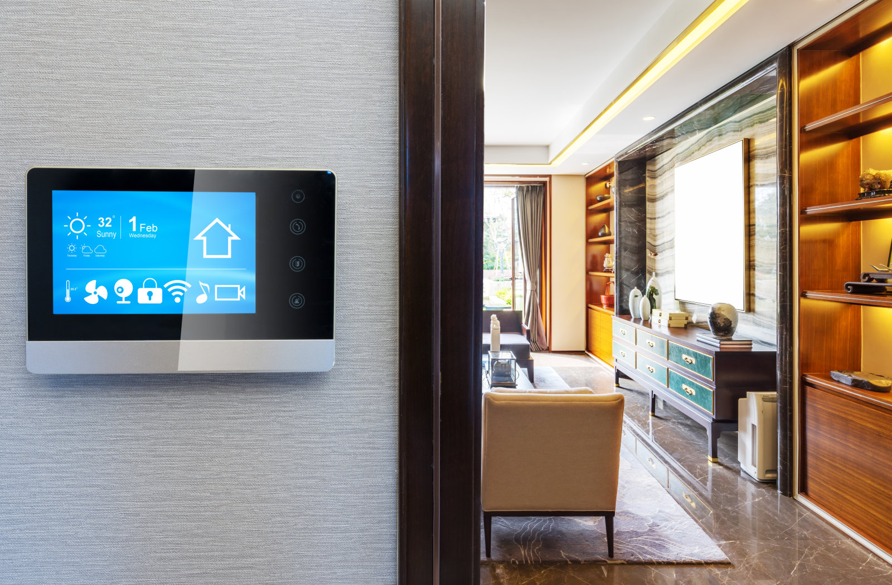

Aesthetical benefits 4) Integration of mobile devices

Slide 12
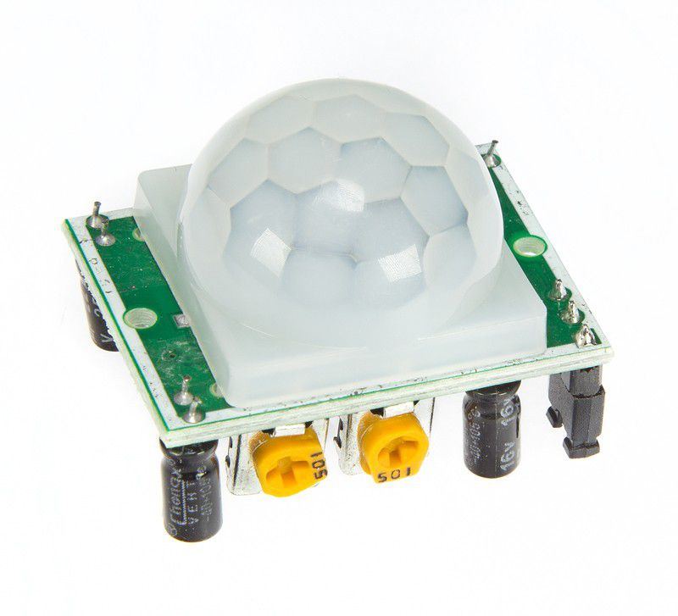
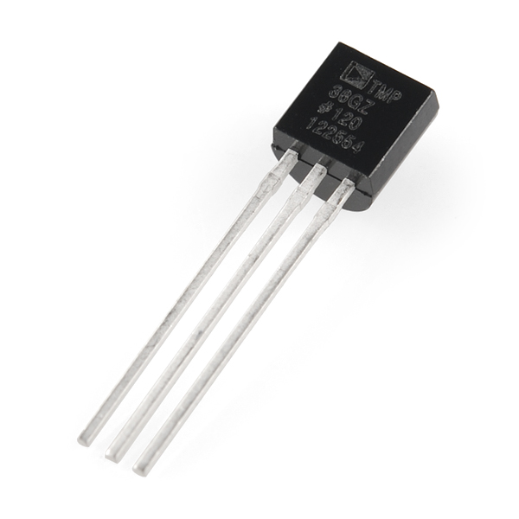
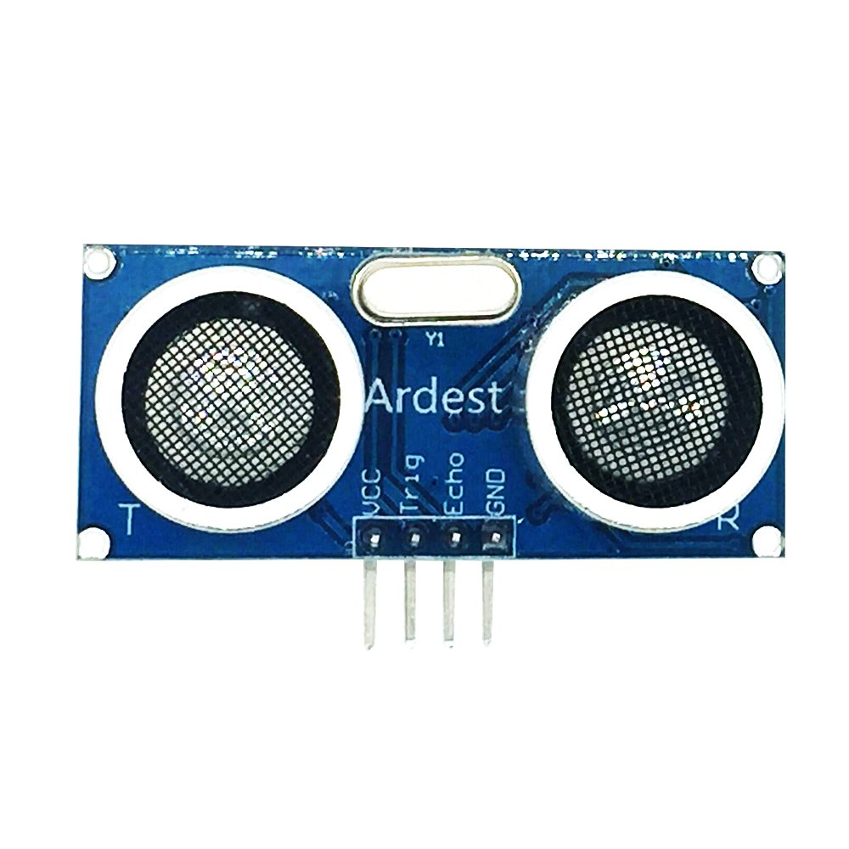
Sensors
Ultrasonic Distance
Sensor
PIR Sensor
Temperature Sensor
12

Slide 13
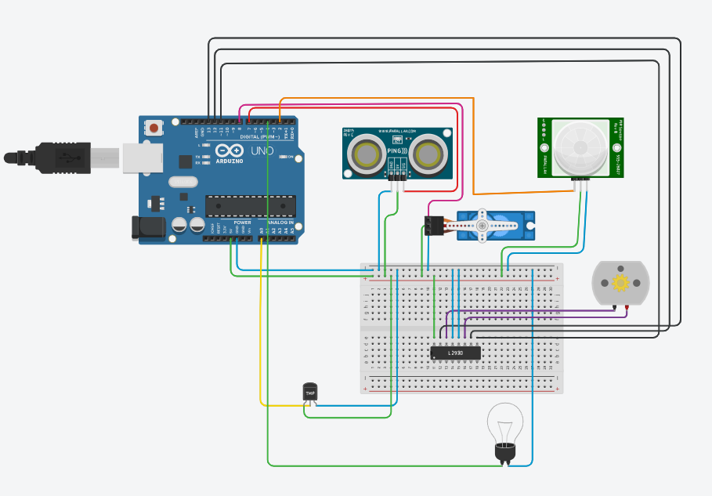
Sr No. | Components List | Price(In Rs.) Ref - Amazon
1. | Arduino UNO | 350
2. | Ultrasonic Distance Sensor | 200
3. | PIR Sensor | 200
4. | Temperature Sensor | 100
5. | Jumper Wires(1 Packet) | 50
6. | H-bridge Motor Driver | 40
7. | DC Motor | 80
8. | Positional Servo Motor | 195
9. | Bread Board | 70
10. | Bulb | 20
Total - |  | 1305

Slide 14
THANKYOU

