Slide 1
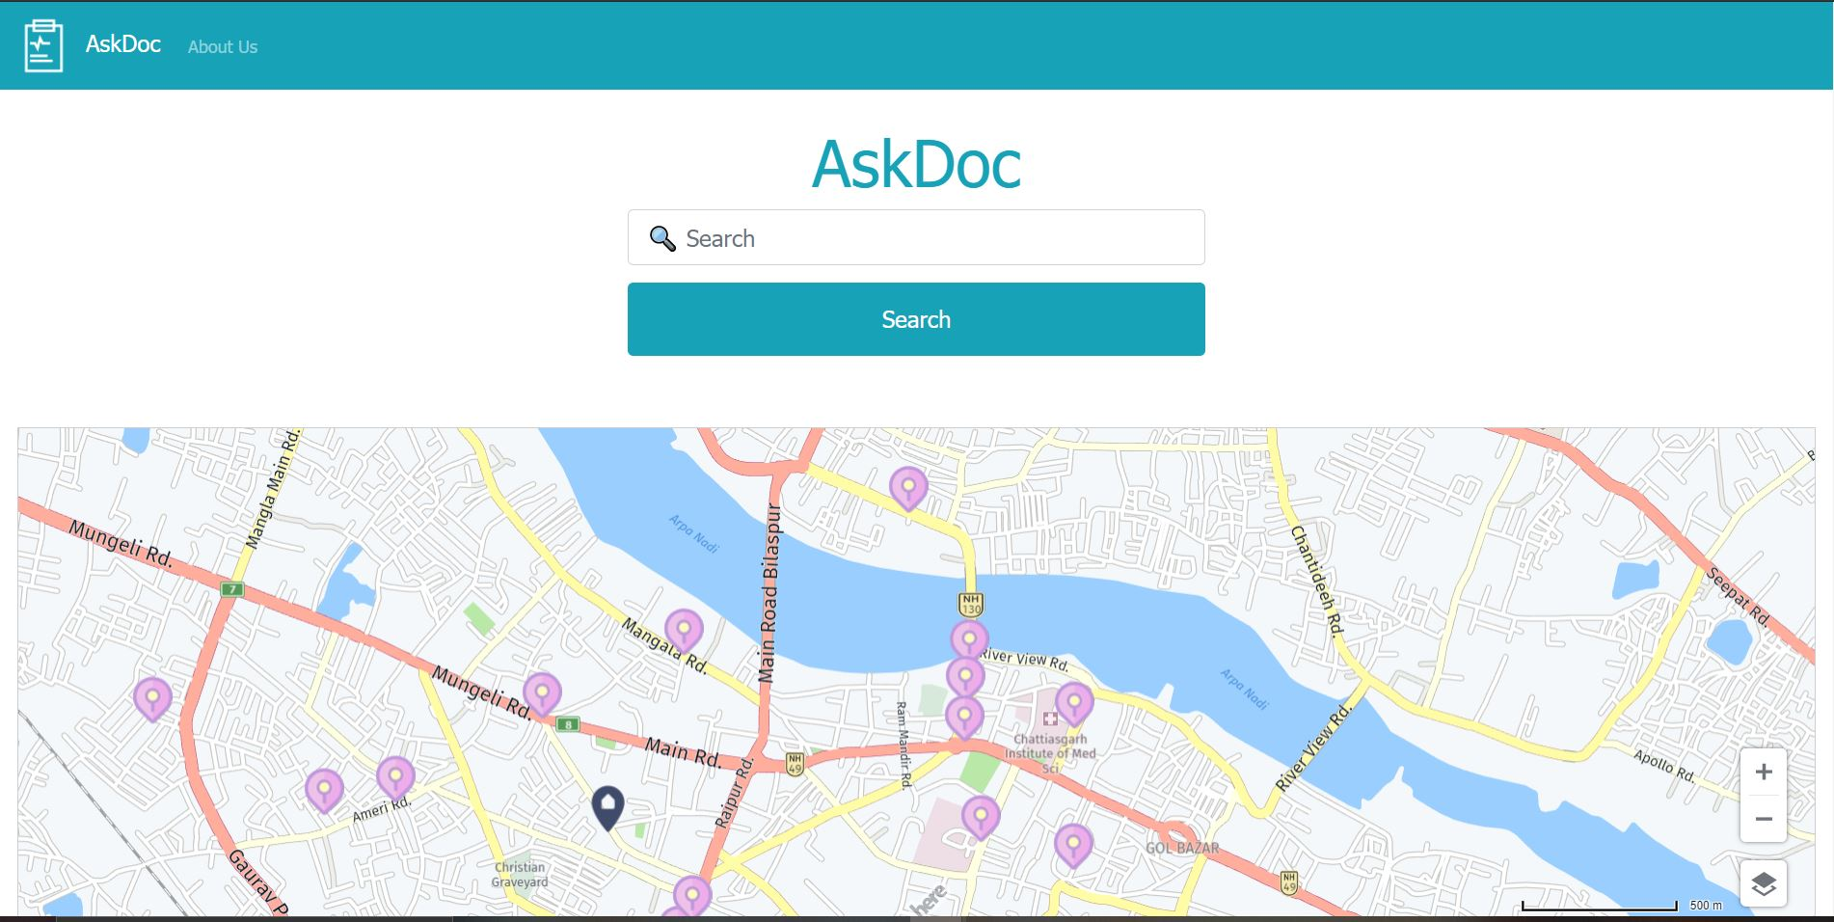
Ask Doc
A website that based on the user input predicts disease and suggest him/her nearby hospitals within a radius of 10km

Slide 2


Machine Learning Architecture.
Problem Statement :
Multiclass Classification Problem : Disease prediction from symptoms as given by user.
Approach
Majority voting using 4 classifiers(OneVsRest) to predict a disease given its symptoms.
User Input
In form of text and customized labels.

Slide 3
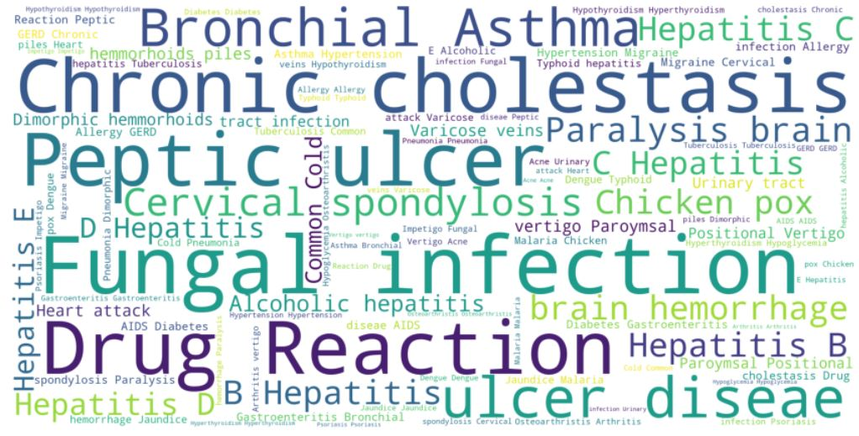
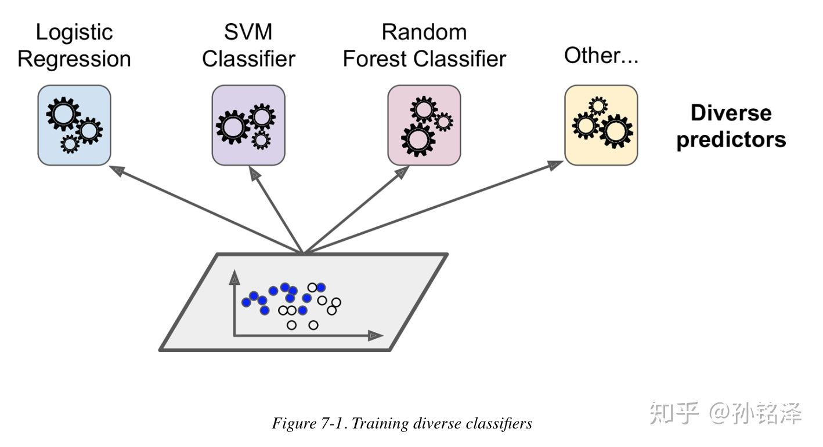
Classification Techniques
Classification Algorithms :
Support Vector Classifier
Logistic Regression
Gradient Boosting
Random Forest
Based on these algorithms voting ensembler is used to classify on the basis of majority voting.

Slide 4
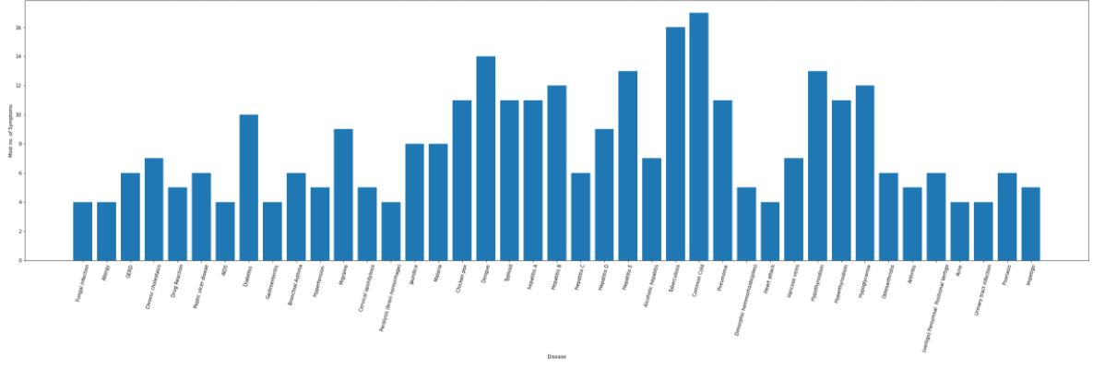
User Input Handling
The user text is preprocessed and cleaned using various techniques briefly discussed in Trial.ipynb notebook. User is also given an option to select from customized buttons
Following important points have been kept in mind while handling user inputs:
User input is tokenized and the word and its synonym are checked if it matches to any of the symptom in our dictionary.
Invalid symptoms are correctly classified and a message is flashed asking user to enter a valid symptom.

