Slide 1
Supermart Grocery Sales
AACS1573 Introduction to Data Science
Presented by:
Yong Vin Sen
Chua Teng Hui
Wong Wai Kin
Siow Jun Jie

Slide 2
Table of contents
1.0 Introduction
2.0 Case Study
3.0 Data Science Process
4.0 Result & Discussion
5.0 Conclusion

Slide 3
1.0 Introduction

Slide 4
1.1 Introduction to Data Science
A branch of study that combines business, computer science, and understanding of math and statistics.
The insights produced by the tools of data science like Excel can then be transformed into real commercial value by analysts and business users.

Slide 5
1.2 Significance of Data Science
To understand the pattern of datasets.
Allows researchers to draw insights from the data that has been analysed.
Make predictions from the data and know what is the trend in the future.
Data science is useful in many aspects.

Slide 6
2.0 Case Study

Slide 7
2.0 Case Study
Case Study: Supermart Grocery Sales
Many aspects that will affect supermarket grocery sales.
Purpose: Find out the factors that affected the supermart grocery sales.
Hypothesis factor:
Customers’ region
Supermarts’ located city
Profit margin of the supermarts’ city
Category and subcategory of goods
Customers’ order date
Order’s discount

Slide 8
3.0 Data Science Process

Slide 9
3.0 Data Science Process
3.1 Data Preparation
3.2 Data Exploration
3.3 Data Representation
Reading the data from various sources.
Convert the data into the same format type.
Cleansing the data
Remove corrupt or problematic data.
Analyse data and get some useful data.
Find out the similarities, differences, outliers.
Hidden data can be figure out.
Allows us to transform raw data into a dataset.
Interpret the data more easily and accurately.

Slide 10
3.0 Data Science Process
3.4 Data Discovery
3.5 Learning From Data
Conducting initial data analysis.
Collecting and evaluating data from different sources.
To filter out less significant correlations.
Vital in data science process.
Learn types of useful data from the datasets.
Can totally understand what the datasets are trying to interpret.

Slide 11
4.0 Result & Discussion

Slide 12
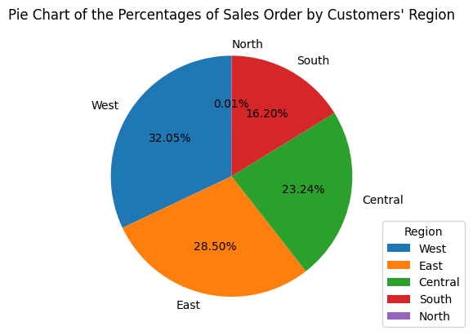
4.1 Customers’ Region

Slide 13
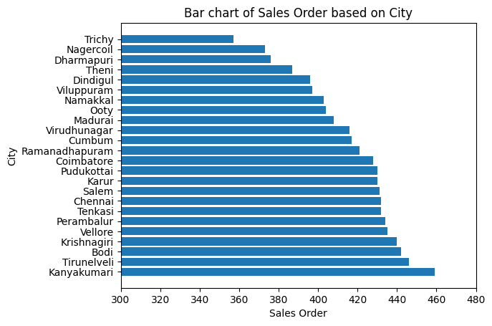
4.2 Sales Order Based on City

Slide 14
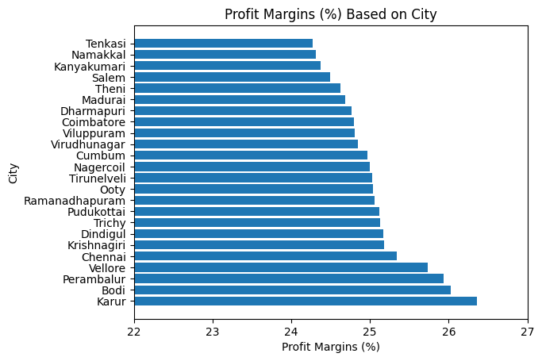
4.3 Profit Margins Based on City

Slide 15
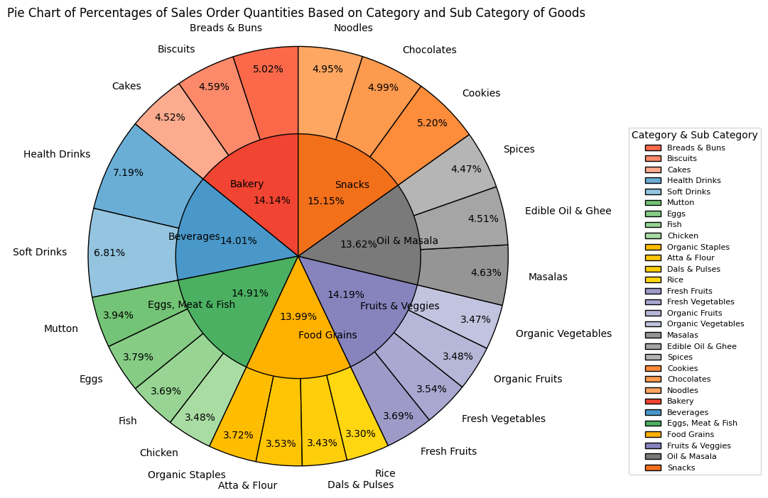
4.4 Category and Sub Category

Slide 16
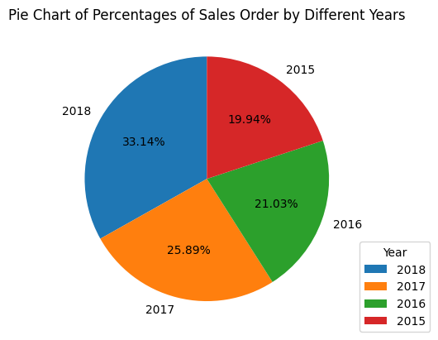
4.5 Order Date Based on Year

Slide 17
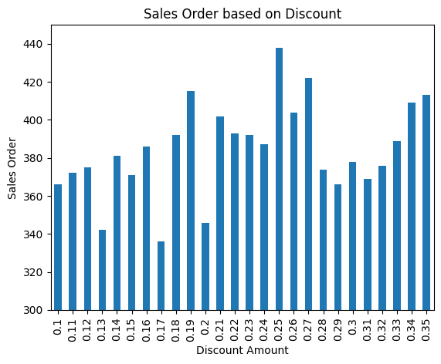
4.6 Discount Amount

Slide 18
5.0 Conclusion

Slide 19
5.0 Conclusion
Factors influence supermart sales:
Region
City
Category of goods
Subcategory of goods

Slide 20
5.0 Conclusion
Advantages:
To prevent out of stock problems
Increase the customer’s satisfaction and retention towards the supermart.
To identify the popularity of the supermart in each city of Tamil Nadu.
Disadvantages:
The correlation between discount rate and sales orders is relatively weak.
A large number of sales orders does not indicate that it will bring high profit to our supermart.

Slide 21
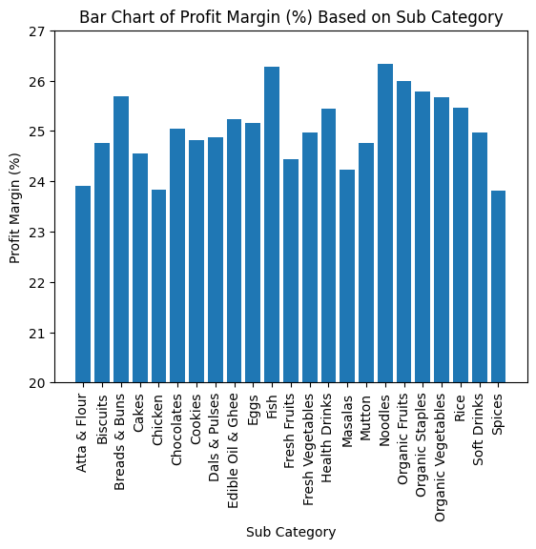

Slide 22
Thank You!

