Slide 1
Regional Weather Forecasting Using Neural Networks
Professor: Prof. Tet Yeap, Prof. Iluju Kiringa
Students:
Sattar Abdul
Osa Ikhinmwin
David Yin

Slide 2
Understanding the Challenge
Overview of 2020 Weather Patterns:
"Record low precipitation levels and unusually high temperatures observed across key agricultural regions in Canada."
"Statistics: Specific regions experienced rainfall deficits up to 50% below the long-term average."
Micro-Climate Prediction
Micro-climate predictions focus on localized weather forecasting, crucial for agricultural decisions like planting and irrigation scheduling.

Slide 3
Our Approach
"Our project uses MLP (Multilayer Perceptron) and TDNN (Time Delay Neural Network) to analyze patterns in temperature, precipitation, air pressure, and sunlight."
"These models are trained on historical weather data, enabling them to predict future conditions with higher accuracy than traditional methods."
Notes:
Accurate forecasting leads to appropriate response to future weather events, potentially increasing working efficiency and lowering production costs.
E.g. in local farming, an accurate forecast of temperature and precipitation statistics well into the future can help farmers adopt corrective responses to mitigate and reduce damages.

Slide 4
Leveraging MLP and TDNN for Precision Prediction
Introduction to MLP and TDNN:
MLP (Multilayer Perceptron): "A type of neural network known for its ability to learn and model non-linear and complex relationships. MLPs are composed of at least three layers of nodes: an input layer, a hidden layer, and an output layer."
TDNN (Time Delay Neural Network): "Specialized for temporal data processing, TDNNs are effective at recognizing patterns across time, making them ideal for sequential prediction tasks like weather forecasting."
Why MLP?:
Pattern Recognition Capabilities
Adaptability to Non-linear Relationships
Why TDNN?:
Handling Temporal Sequences
Improving Forecast Accuracy

Slide 5
Data
Model Attributes (both models):
Avg. hourly temperature (℃)
Precipitation (mm)
Air pressure at station (psi)
Solar radiation (kJ/m²)
Data source
Canada Weather Stats (WeatherStats.ca)
Two stations: Ottawa and Ottawa South
Data processing
Interpolation of Missing Values
Feature Selection
Normalization: MinMaxScaler
Data Transformation

Slide 6
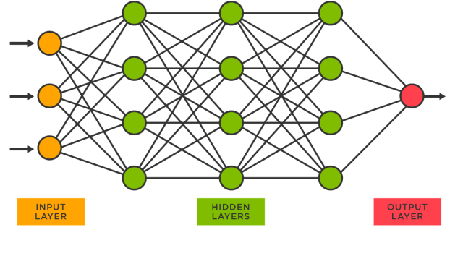
Model specifics: MLP
Architecture:
Input Layer: processed and scaled weather data
Hidden Layers: Two layers with 128 and 64 neurons respectively, using ReLU activation functions to introduce non-linearity.
Output Layer: Produces forecasts for weather parameters
Training:
Backpropagation with gradient descent to update weights.
Loss Function: Mean Squared Error minimized d to improve forecast accuracy.
Early stopping to prevent overfitting
Epochs: 50 iterations over the dataset.
Forecasting:
Recursive Strategy with 14-day window, spanning 7 months (May to November inclusive)
Source:
https://vitalflux.com/sklearn-neural-network-regression-example-mlpregressor/
Notes:
MLP (Multilayer Perceptron)
A type of artificial neural network that is fully connected (each neuron in one layer is connected to all neurons in the next layer). It consists of at least three layers of nodes: an input layer, one or more hidden layers, and an output layer. Each node, or artificial neuron, in the network uses a non-linear activation function, except for input nodes.
4 attributes:
Avg. hourly temperature (℃)
Precipitation (mm)
Air pressure at station (psi)
Solar radiation (kJ/m²)
Prediction using 14-day sliding window
MLP (Multilayer Perceptron)
A fully connected artificial neural network
Consists of at least three layers of nodes
an input layer
one or more hidden layers
an output layer
Each node uses a non-linear activation
Except for input nodes

Slide 7
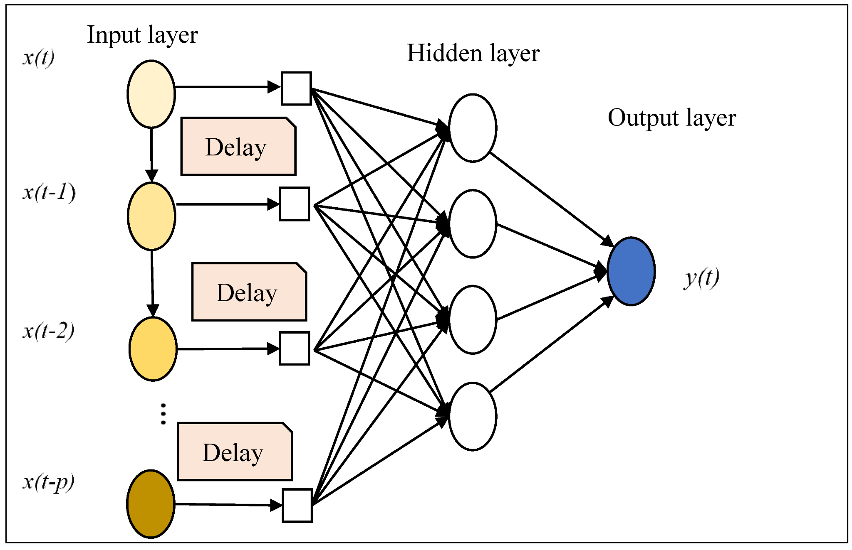
Model specifics: TDNN
Architecture:
Input Layer: processed and scaled weather data
Hidden Layers: Two layers with 128 and 64 neurons respectively, using ReLU activation functions to introduce non-linearity.
Output Layer: Produces forecasts for weather parameters
Training:
Backpropagation with gradient descent to update weights.
Loss Function: Mean Squared Error minimized d to improve forecast accuracy.
Early stopping to prevent overfitting
Epochs: 50 iterations over the dataset.
Recursive Strategy with 14-day window, spanning 7 months (May to November inclusive)
Source:
https://www.mdpi.com/2227-7390/7/10/959/htm

Slide 8
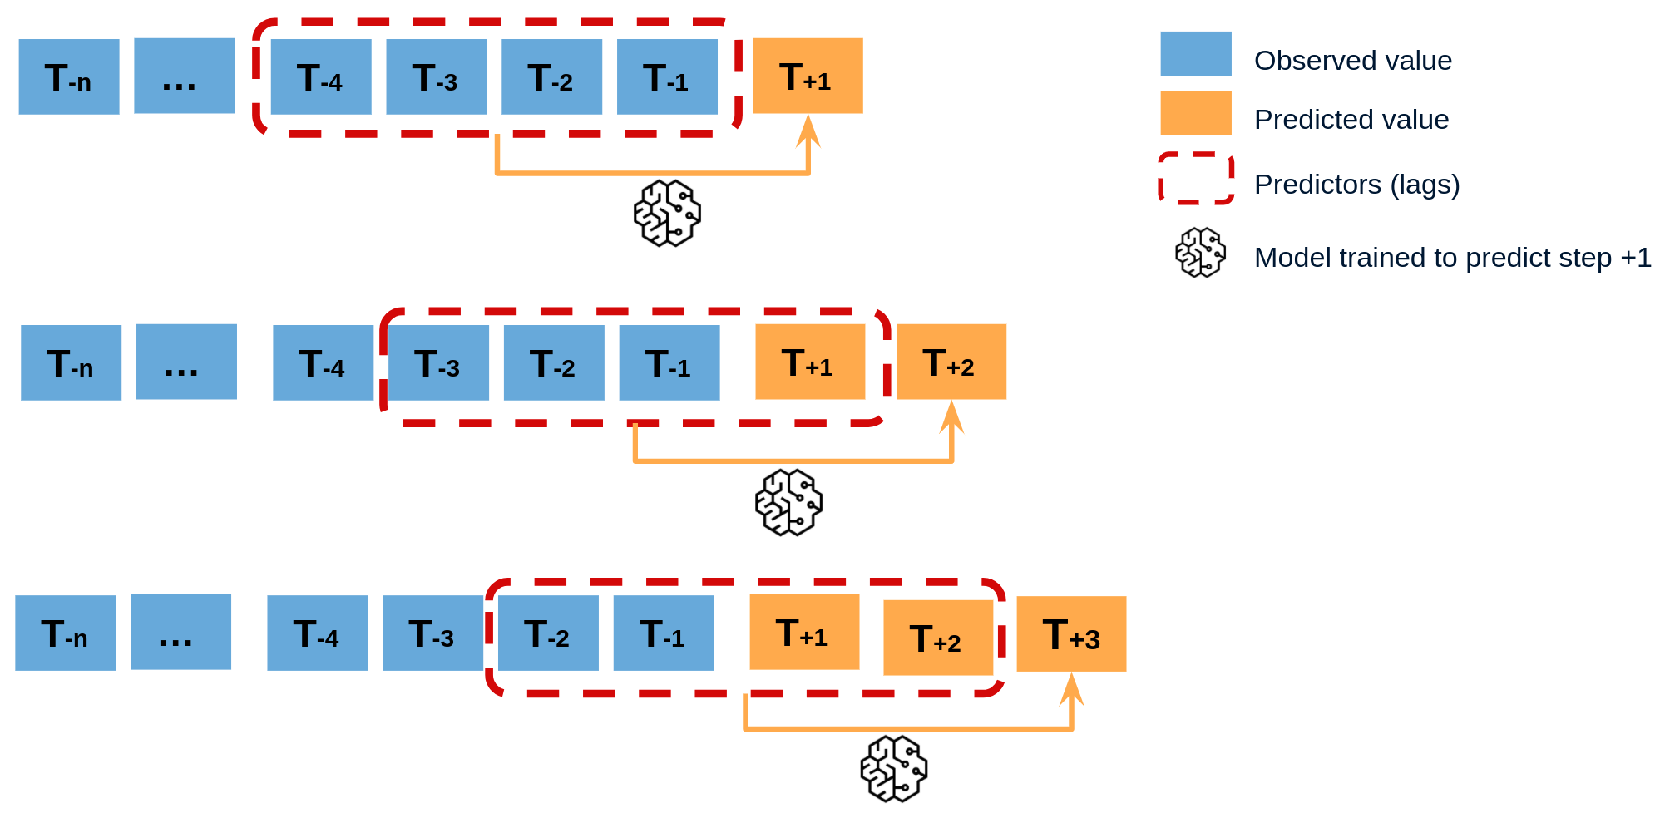
Forecasting Method
Recursive Forecasting with Rolling Window
Process:
Initial Forecasting Window: model initially provided with a set window of historical data (e.g., 30 days) to predict the subsequent time step.
Sequential Predictions: As each new forecast is generated, it becomes part of the input window, effectively "rolling" the window forward.
Iterative Approach: This process is repeated, with the model recursively using its own predictions as part of the input for future forecasts.
Source:
https://skforecast.org/0.9.1/user_guides/autoregresive-forecaster

Slide 9
Forecasting Method
Advantages:
Dynamic Updates: dynamically incorporates recent predictions, adapting to potential shifts in patterns as new data is forecasted.
Consistent Input Structure: Ensures the model always receives input of consistent shape and size
Challenges:
Error Propagation: Initial errors can compound over time, potentially leading to drift in longer-term forecasts.
Dependency on Model Accuracy: Quality of the forecast relies heavily on the model's ability to make accurate short-term predictions.

Slide 10
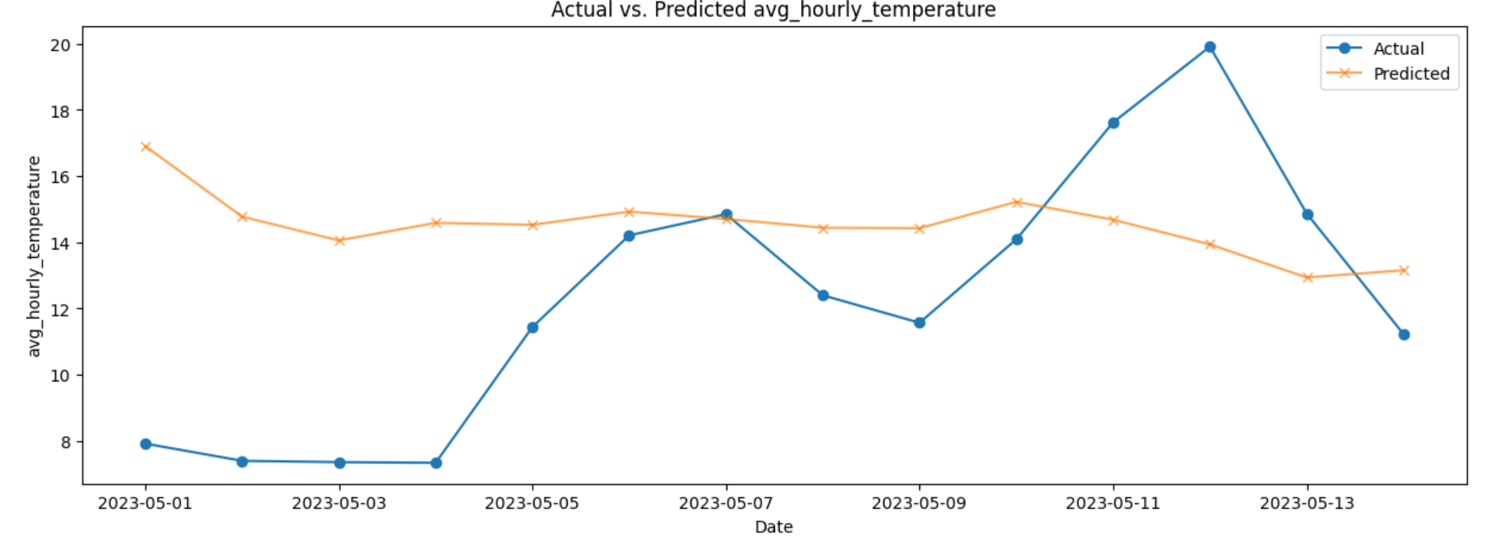
Results (MLP)
Graph/Chart of results
MAE: 3.79 RMSE: 4.69

Slide 11
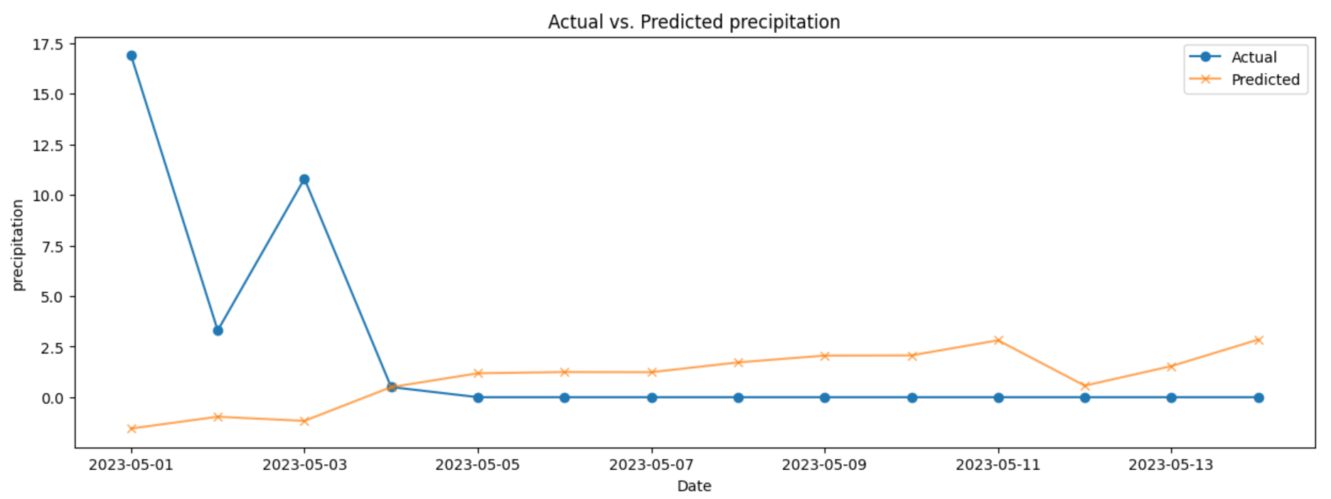
Results (MLP)
Graph/Chart of results
MAE: 3.71 RMSE: 6.19

Slide 12
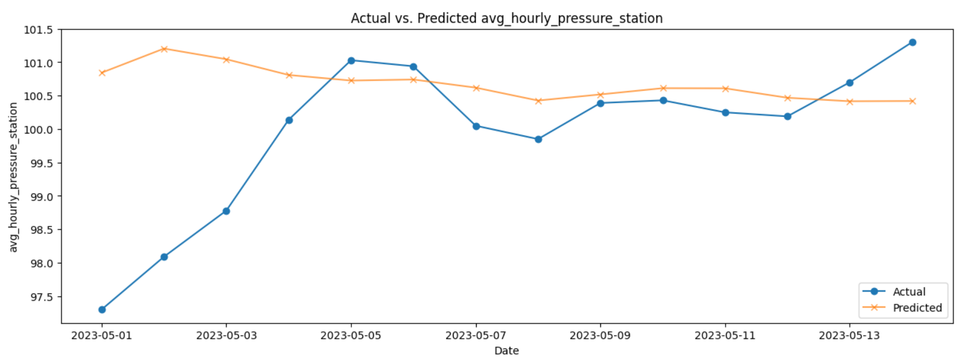
Results (MLP)
Graph/Chart of results
MAE: 0.95 RMSE: 1.45

Slide 13
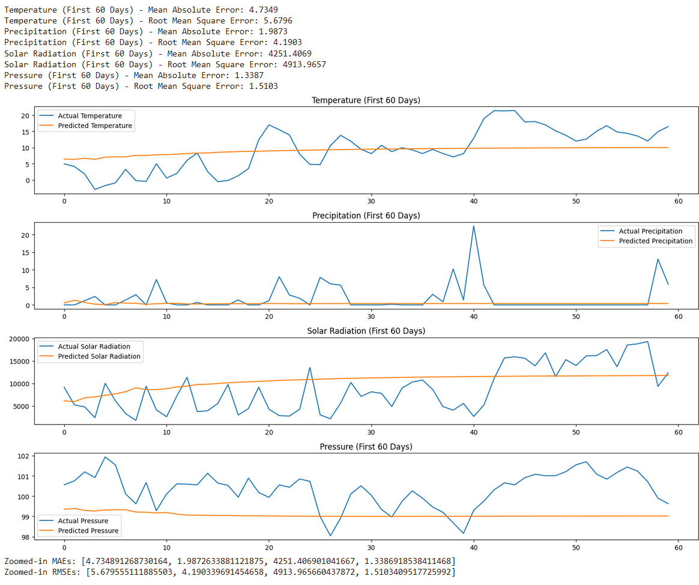
Results (TDNN)
Graph/Chart of results
Temperature MAE: 5.18 RMSE: 35.74
Precipitation MAE: 1.22 RMSE: 4.43

Slide 14
Results (TDNN)
Graph/Chart of results
S. Radiation MAE: 4251.41 RMSE: 1.34
Pressure MAE: 4913.97 RMSE: 1.51

Slide 15
Answer to main questions
Capabilities:
Prediction time frame
How many days into the future can the model predict accurately within an accuracy of 2 standard deviations?
Prediction attributes
Which features can the model properly predict?

Slide 16
Challenges
Data-Related Challenges
Missing or Incomplete Data
Noisy and Non-Stationary Data
High Dimensionality
Model-Related Challenges
Model Selection and Complexity
Capturing Temporal Dependencies
Computational Challenges
Scalability and Performance
Real-time Prediction Requirements
Interpretability and Validation Challenges
Model Explainability
Validation and Trust
Environmental and External Challenges
Micro-climate Specificity
Adapting to Climate Change
Notes:
Data-Related Challenges
Missing or Incomplete Data: Weather datasets often have missing values due to issues with data collection or transmission. Interpolating missing values, especially for critical parameters like solar radiation, can introduce bias or inaccuracies.
Noisy and Non-Stationary Data: Weather data is inherently noisy and non-stationary. This means that statistical properties such as mean and variance change over time, complicating the modeling process.
High Dimensionality: Weather data can be high-dimensional with many interrelated variables, making it difficult to select the right features and manage the curse of dimensionality.
Model-Related Challenges
Model Selection and Complexity: Finding the appropriate model complexity that can capture the nuances of micro-climates without overfitting to the training data is a difficult balance to achieve.
Capturing Temporal Dependencies: Weather data has strong temporal dependencies. Standard MLP models may not effectively capture these, leading to less accurate predictions, especially for variables like solar radiation that are influenced by daily and seasonal cycles.
Computational Challenges
Scalability and Performance: Processing and analyzing large volumes of data with complex models require significant computational resources, and there can be trade-offs between model performance and computational efficiency.
Real-time Prediction Requirements: Operational forecasting systems often require real-time or near-real-time predictions, which can be challenging to deliver, particularly when dealing with large datasets and complex models.
Operational Challenges
Deployment and Integration: Integrating the prediction model into an existing system or workflow can be challenging, especially when the model's input requirements or output format do not align with the operational systems.
Model Maintenance and Updating: Weather patterns change over time, and models need regular updates with new data to maintain accuracy, which can be a challenge in terms of ongoing data management and computational cost.
Interpretability and Validation Challenges
Model Explainability: Complex models like deep neural networks can act as black boxes, making it difficult to interpret the model's predictions and understand the underlying meteorological factors driving those predictions.
Validation and Trust: Building trust in model predictions is critical, especially when those predictions are used to make decisions that could impact safety or resource allocation. Rigorous validation and uncertainty quantification are necessary but can be challenging.
Environmental and External Challenges
Micro-climate Specificity: Micro-climates have unique local weather patterns that might not be captured by regional or global models, necessitating the development of specialized models that can be more challenging to train and validate.
Adapting to Climate Change: Long-term shifts in climate patterns due to climate change can render historical data less predictive of future conditions, requiring models to adapt to changing baselines.

Slide 17
Conclusion and future work
We deployed two deep learning models to predict micro-climate using recursive forecasting technique in order to get prediction for the next 14 days based on a 3 day initial window of actual data. Based on our results our two models can confidently establish an acceptable prediction up to two weeks. Comparing to other deep learning models our numbers are impressive.
Modifying window size and starting date in recursive forecasting
More complex model, e.g. RNN, LSTM
Hybridized prediction technique
Modifying model features
(e.g. humidity, wind)

Slide 18
Q&A
We are happy to answer your questions

Slide 19
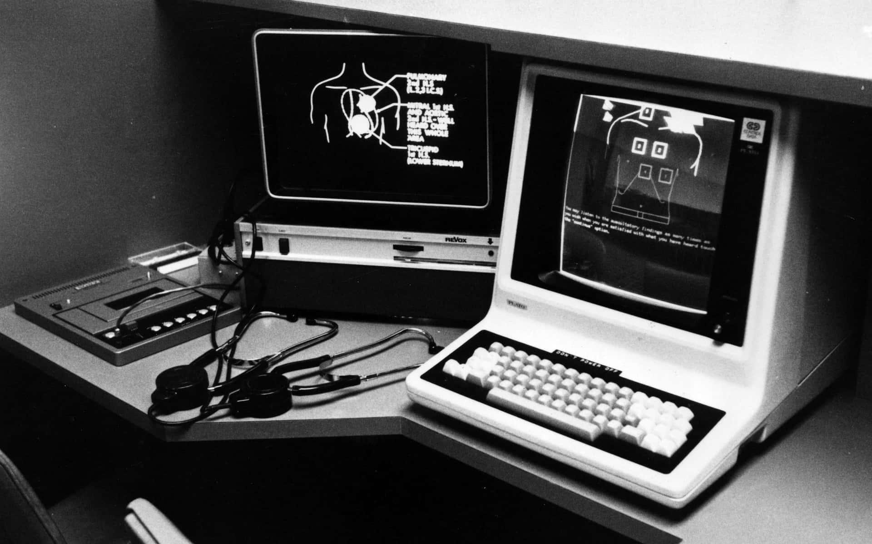
Thanks!

Slide 20
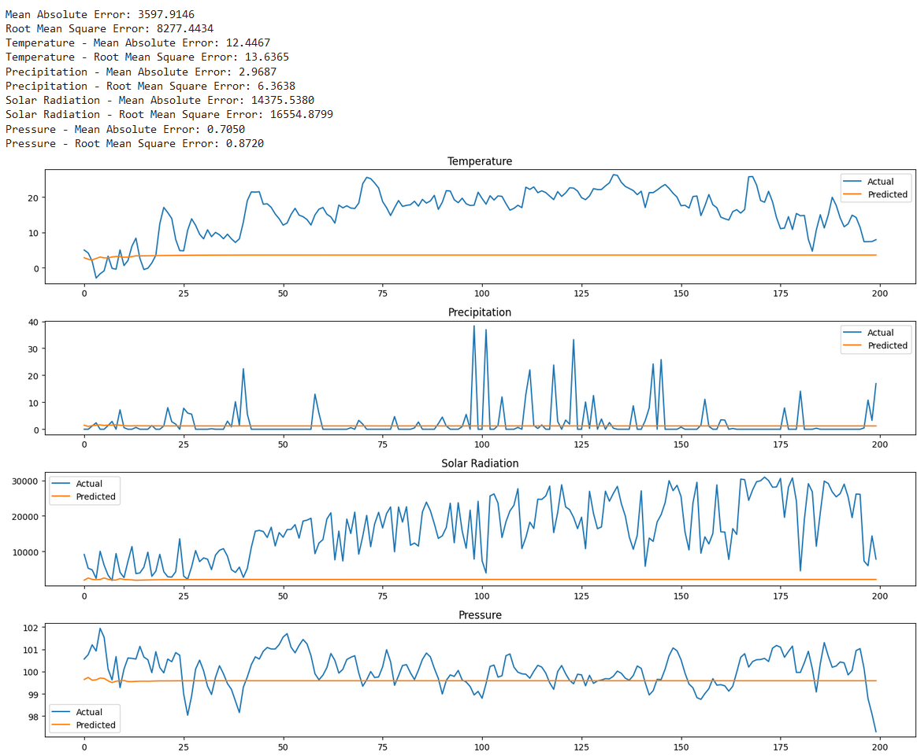
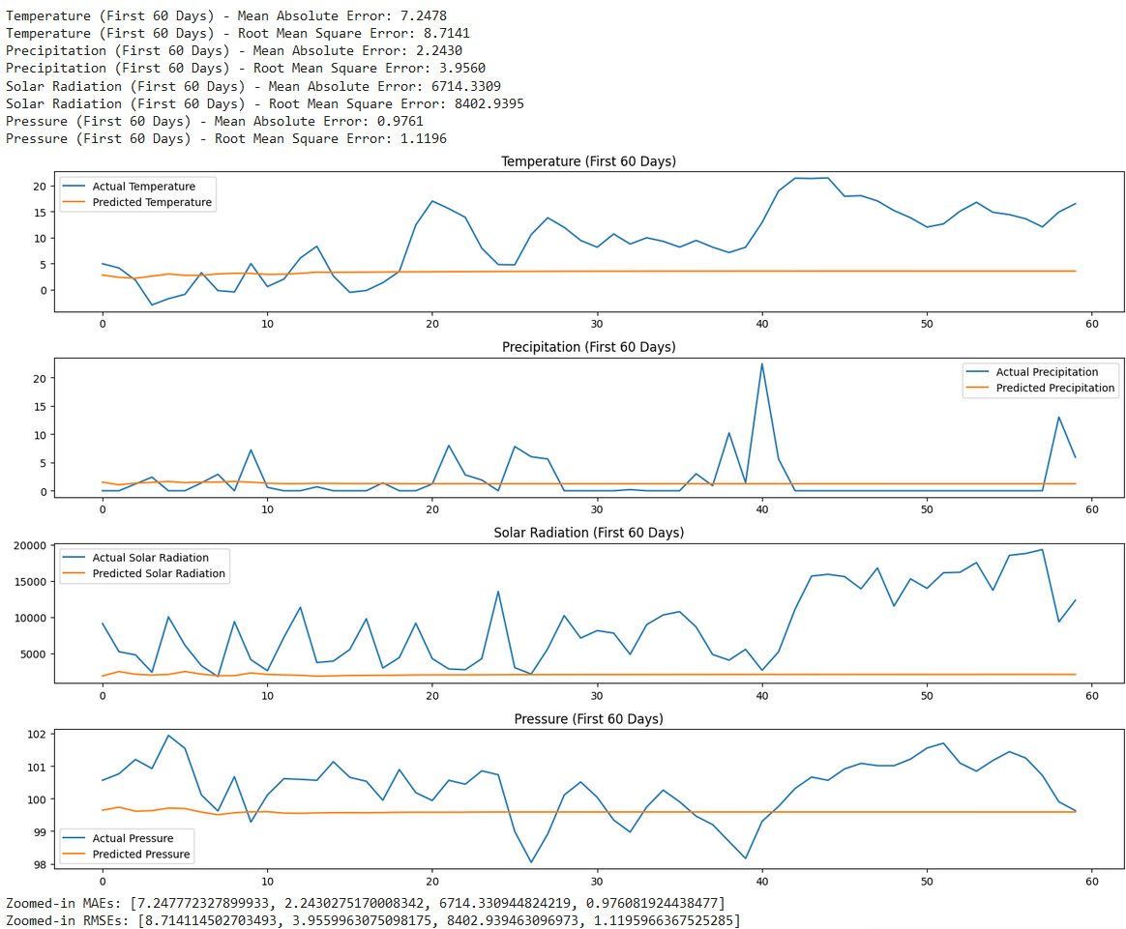
Appendices: Other results of TDNN with modified parameters
Window size: 14 days
Learning rate: 1e-4

