Slide 1
Applying Gradient Boosted Decision Tree Algorithm for Predicting Interstitial Lung Cancer
Group Members:
Mohammad Nafees Bin Zaman – 1616357
Mahamat Nour Ali Mai – 1510455
Ilham Fadhillah Amka – 1434071
Ahmed Amer Shafie Abdelrahman Aly – 1432285
MHD Khaled Maen – 1523591

Slide 2

Introduction
According to the World Health Organization (WHO), 7.6 million deaths globally each year are caused by cancer; cancer represents 13% of all global deaths.
Using machine learning algorithm to detect the possibility of having lung cancer depending on some informations collected from patients.
Using Gradient Boosted Decision Tree since it’s an interpretable algorithm which is necessary in medical field and also it can give some indication of how much each variable affect the result.

Slide 3
Objectives
Expected Outcome
Collect information and dataset for interstitial lung cancer with relevant label.
Analyze and visualize dataset to predict the chance of lung cancer correctly.
Develop a machine learning model using Gradient Boosted Decision Tree and implement in real life scenarios.
Conclude the result based on the outcome of our constructed algorithm.
Measure how much smoking affect lung cancer.
Successfully build a machine learning model using Decision Tree which can predict the chances of having
Lung Cancer whether it’s low, medium, or high.

Slide 4
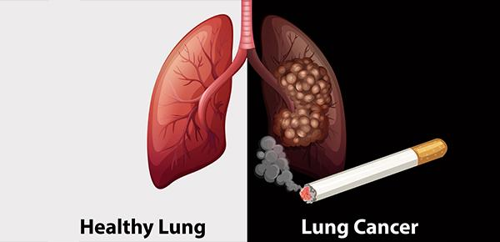
Lung Cancer
Lungs are two spongy organs in chest that take in oxygen when human inhales and release carbon dioxide when exhales. One of the most dangerous type of cancer is lung cancer that attacks the lungs. It is the leading cause of cancer deaths in Malaysia, among both men and women. Lung cancer claims more lives each year than do colon, prostate, ovarian and breast cancers combined.
Risk factors for lung cancer include:
Smoking
Exposure to secondhand smoke
Exposure to radon gas
Exposure to asbestos and other carcinogens
Family history of lung cancer

Slide 5
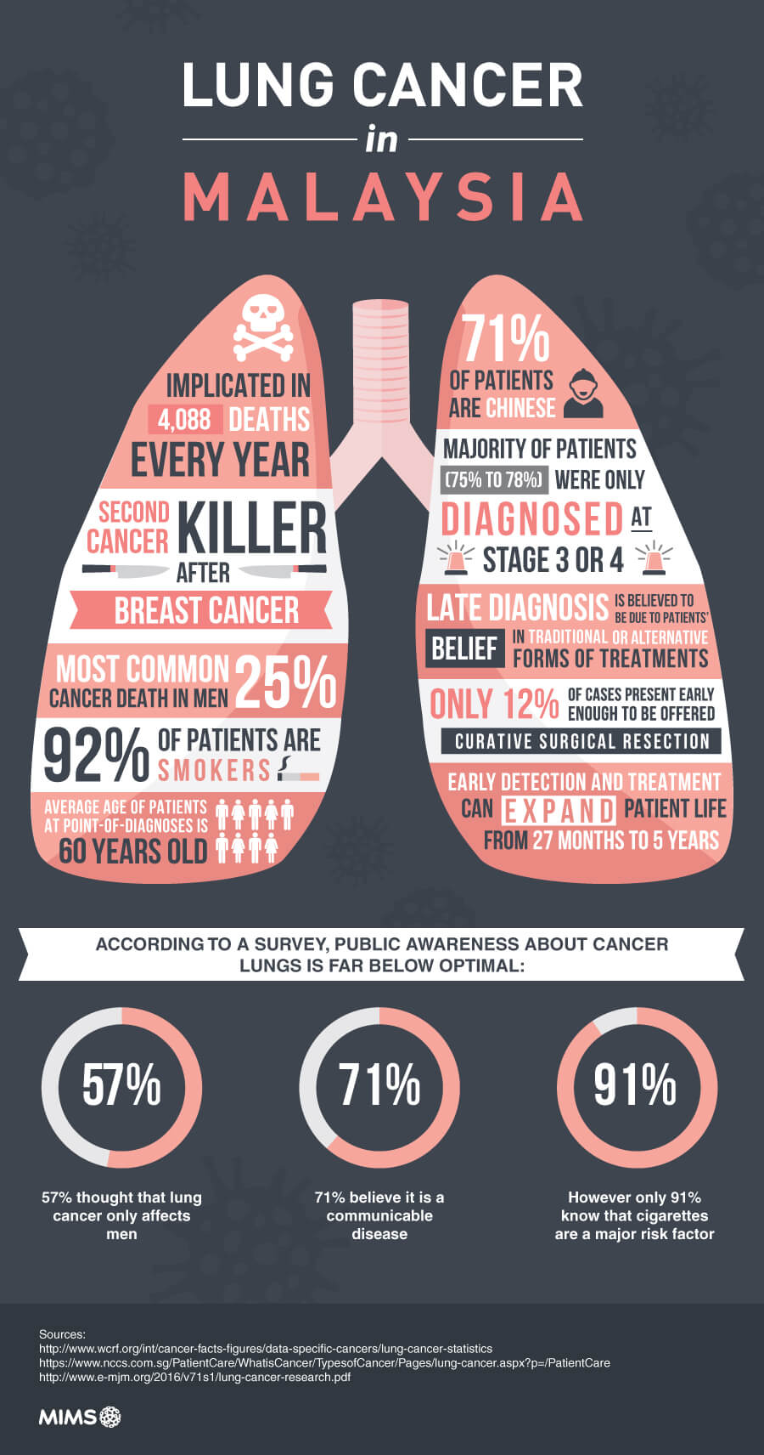


Slide 6
Data Collection
The dataset is about lung cancer patients in US. it consists of 1000 observations to people who have different lung diseases. There are total of 25 columns (attributes); patient id, age, gender, air pollution, alcohol use, dust allergy, occupational hazards, genetic risk, chronic lung disease, balanced diet, obesity, smoking, passive smoker, chest pain, coughing of blood, fatigue, weight loss, shortness of breath, wheezing, swallowing difficulty, clubbing of finger nails, frequent cold, dry cough, snoring and level. The level attribute is the label or dependable variable of the dataset. It has three values low, medium and high and it is labelled based on the features mentioned above. So, the scenario of the dataset is a supervised classification problem.
The dataset : https://drive.google.com/drive/folders/1lKdvbjxle_9jU5tNZV9kjDRvyyitGuit?usp=shari ng

Slide 7
Machine Learning Model
Applying Decision Tree algorithm to achieve the goal from the selected dataset.
The Decision Tree algorithm builds classification or regression models in the form of a tree structure.
The final result is a tree with decision nodes and leaf node.
The core algorithm for building decision trees called ID3 by J. R. Quinlan which employs a top-down, greedy search through the space of possible branches with no backtracking.
ID3 uses Entropy and Information Gain to construct a decision tree.

Slide 8
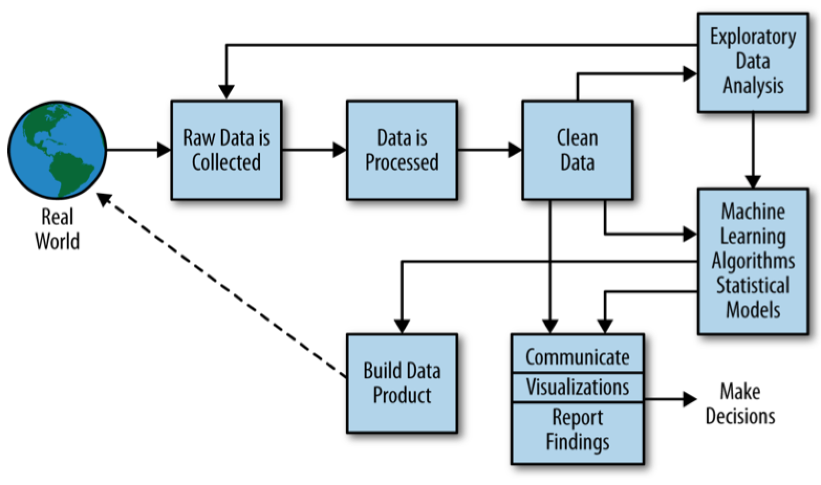
Experimental Setup
We follow the data science process to analyze the problem and to complete our project successfully

Slide 9
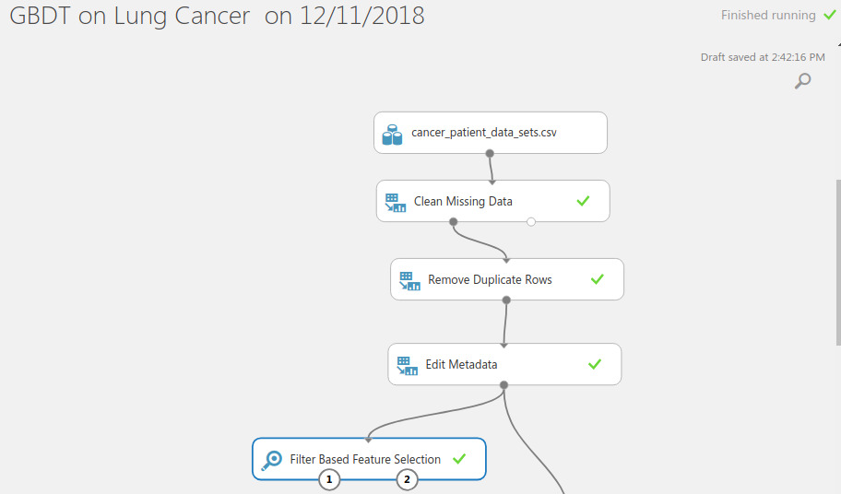
Data Pre-Processing
By running basic R functions such as “str()”, “ summary()”, and “head()” we found that our dataset is almost clean since there are no outliers nor missing values.

Slide 10
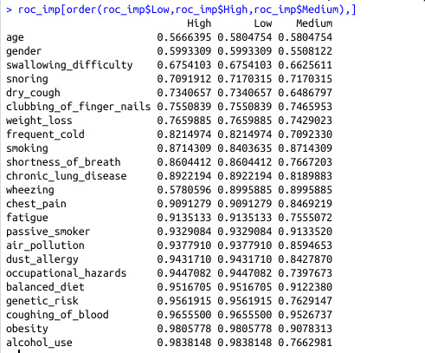
Feature Importance
We used “filterVarImp” function from “caret” package which compare each variable with the label and measure their influencing degree. We found that Features can be divided into two parts; Syndromes and Causes. The most important cause of lung cancer depending on our data is alcohol using. The most significant Syndromes to include coughing blood, fatigue, and chest pain.

Slide 11
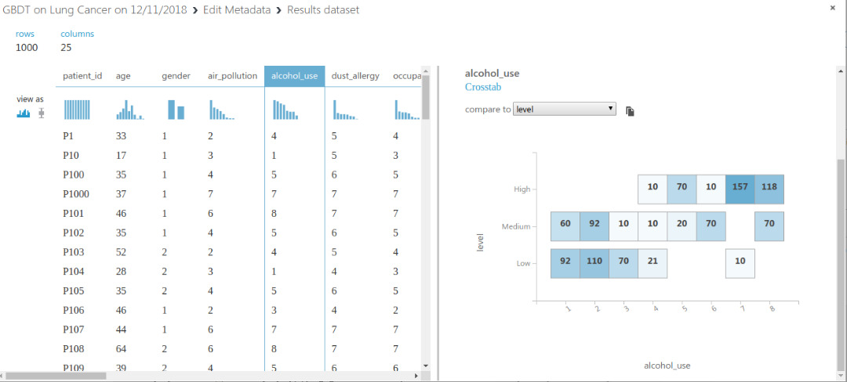
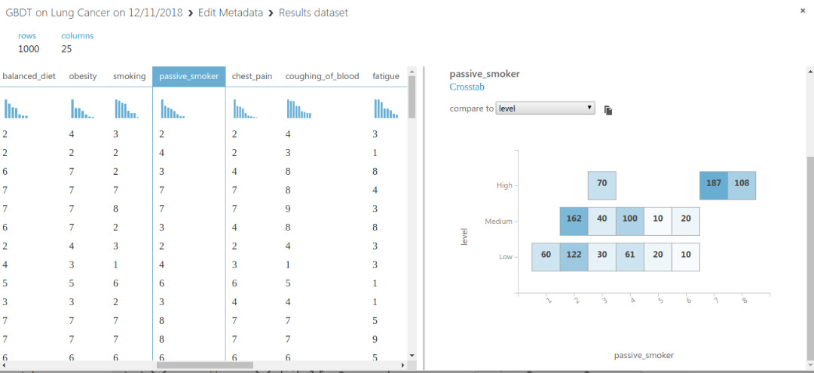
Exploratory Data Analysis (EDA)
After cleaning the data, we plot graphs such as histograms and scatter diagrams as well as a statistical summary to help understand more about the correlations and relationships between the variables.

Slide 12
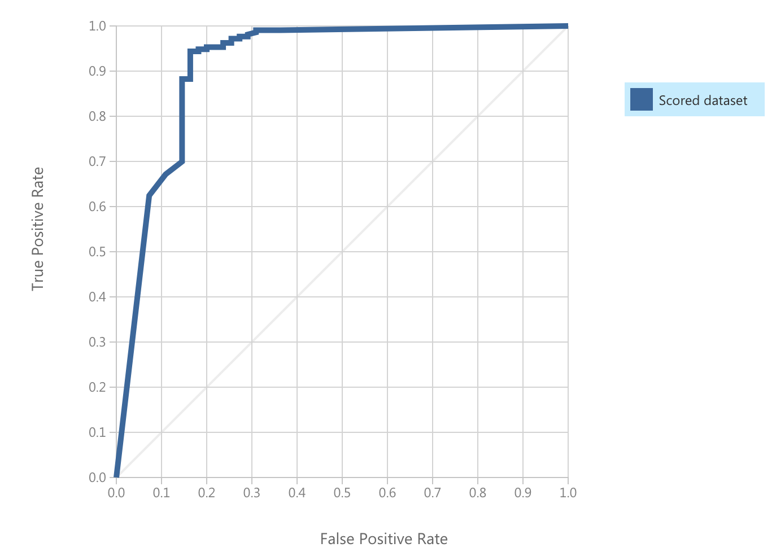
Machine Learning Algorithm
Using Gradient Boosted Decision Tree algorithm to predict lung cancer. The dataset consists of 25 variables where 24 of them are independent variable and the rest one is dependent. We train our model by feeding data from the dataset and get an accuracy of 91.4 % of our model. So it means our model can predict possibilities more than 91 % accuracy.
Figure : ROC curve with 91.4 % of accuracy

Slide 13
Data Visualization
Results are interpreted and visualized to report our findings, which is used to communicate with real life problems, in our case which is Lung Cancer.

Slide 14
Data Product
Data product is a commercial based model that can be used in general and commercially.
In our case, as it is as experimental process, we do not prefer our model as a data product.
We recommend trying other models that are available.

Slide 15
Feedback Loop
New hospitals will eventually get involved with this model once we publish it as a data product, thus generating more data that can be fed into the model to further refine it and help to make it more accurate.

Slide 16
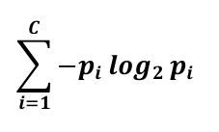
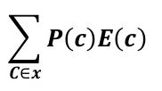
Calculation
Gradient Boosted Decision Tree is an optimized algorithm which uses multiple decision trees.
Entropy: If the sample is completely homogeneous the entropy is zero and if the sample is an equally divided it has entropy of one. To build a decision tree, we need to calculate two types of entropy.
Entropy using the frequency table of one attribute : Entropy (Set) =
Entropy using the frequency table of two attributes : E(T,X) =

Slide 17
Calculation
Gradient Boosted Decision Tree is an optimized algorithm which uses multiple decision trees.
Information Gain : Information gai is based on the decrease in entropy after a dataset is split on an attribute. Constructing a decision tree is all about finding attribute that returns the highest information gain.
Calculate entropy of the target
The dataset is then split on the different attributes. The entropy for each branch is calculated. Then it is added proportionally, to get total entropy for the split. The resulting entropy is subtracted from the entropy before the split. The result is the Information Gain or decrease in entropy.
Choose attribute with the largest information gain as the decision node, divide the dataset by its branches and repeat the same process on every branch.
Branch with entropy of 0 is a leaf node, while branch with entropy more than 0 needs further splitting.
The ID3 algorith is run recursively on the non-leaf branches, until all data is classified.

Slide 18
Conclusion
To sum up, after training several times our data using azure and code written from scratch, it can be found high accuracy from both training. We found a huge correlation between the people who are smoking, alcoholic and passive smoker. Based on our prediction passive smoker are most likely to get lung cancer more than even the people smoke by themselves. for instance, alcoholic and smoker have high chance of getting lung cancer. furthermore, the symptoms for getting lung cancer are fatigue, dry cough, chest pain and coughing blood.

Slide 19
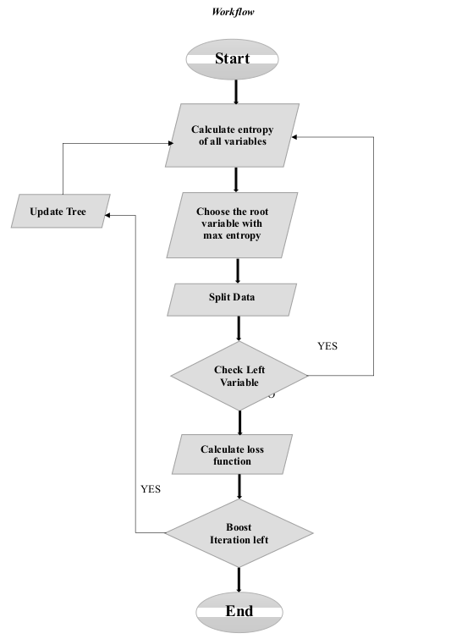
Workflow

