Slide 1
A [128,4096]
Embedded input
[19,1,4096] (FP16)
Layer Norm
LN_k: [1,4096]
LN_bias: [4096]
step-1：LN0
LayerNorm
step-2：MVMBN0
34个head一起
CHin4096
CHout4352
B [128,4096]
Layer Norm output
[19,1,4096] (FP16)
step-7：MVMBN0
2个head一起
CHin4096
CHout256
MVM_BN _{(x 32)}
W^{Q}: [4096,128]
Scale: [32,128]
Bias: [128]
MVM_BN _{(x 2)}
W^{K}: [4096,128]
Scale: [32,128]
Bias: [128]
MVM_BN _{(x 2)}
W^{V}: [4096,128]
Scale: [32,128]
Bias: [128]
step-3：EMB
Pos_EMB
32个head一起
执行1次
C
Query_{(x 32)}
[19,1,128]
Key _{(x 2)}
[19,1,128]
Value _{(x 2)}
[19,1,128]
rotary_pos_emb
rotary_pos_emb
step-4：EMB
Pos_EMB
2个head一起
执行1次
D
EmbQuery_{(x 32)}
[19,1,128]
Emb_Key_{(x 2)}
[19,1,128]
step-5：TRP
MVM_after_TRP
rsqrt为定值，用寄存器配置送入
32个feature_head一起, 执行1次
MVM_after_TRP
这两个地方需要cache，也即KV cache
scores _{(x 32)}
[19, 19]
step-6：softmax
32个feature_head一起, 执行1次
E
step-8：F2W
MVM_after_F2W
32个feature_head一起, 执行1次
MVM_after_F2W
Softmax
F
scores _{(x 32)}
[19，19]
Attention out _{(x 32)}
[19,128]
G

Slide 2
阅读模式，KV_cache_mode=0
A
Embedded input [19,1,4096]
G
Attention output _{(x 32)}
[19,128]
MVM
[4096,4096]
step-9：MVMBNRES0
output
[19,1,4096]
elementwise_Add
[19,1,4096]
H
Res_output
[19,1,4096]
post_attention_layernorm
[4096]
step-10：LN1
LayerNorm
I
post_norm_output
[19,1,4096]
step-11：MVM_BN1
取前13696个CHout
dense_h_to_4h_0(MVM)
[4096,27392]
step-13：MVMBNRES1
取后13696个CHout
J
Dense_4h_output
[19,1,27392]
step-12：ACT
作为res送入step-11
Swiglu (ACT)
K
ACT_output
[19,1,13696]
step-14：MVMBNRES2
dense_4h_to_h_0(MVM)
[13696,4096]
L
Attention Scores
[19,1,4096]
Next Embedded input
[20,1,4096]
CPU处理

Slide 3
Embedded input
[19,1,4096]
output_layer (MVM)
[65024, 4096]
GLMBlock
x28
1次MVM_BN算子
Attention Scores
[19,1,4096]
Output
[19,1, 65024]
final_layernorm
LN_k: [1,4096] (FP16)
LN_bias: [4096] (FP16)
1次LayerNorm算子
hidden_states
[19,1,4096]

Slide 4
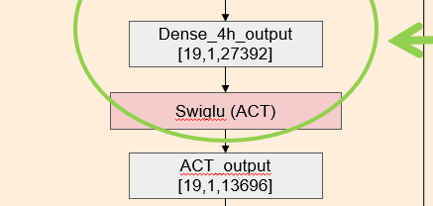


Swiglu 函数的计算图
Dense_4h_output
[19,1,27392]
最后一维 0，1，2，3…13695
Torch.chunk (x, 2, -1)
最后一维 13696，13697，13698 ,…, 27391
chunk_output0
[19,1,13696]
chunk_output1
[19,1,13696]
Sigmoid
Torch.chunk (tensor, chunk_num, dim): 和torch.cat 相反，它是讲tensor按dim 切成chunk_number 块
Silu, 实现的功能 就是 silu(x)=x∗σ(x)
sigmoid_output
[19,1,13696]
Element-wise multiplication
Element-wise multiplication
Ele_output
[19,1,13696]
ACT_output
[19,1,13696]

Slide 5
hidden_states
input_layernorm
layernorm_output
input_layernorm * hidden_states * rsqrt(var(hidden_states) + 1e-5)
input_layernorm: (4096)
hidden_states: (19,1,4096)
layernorm_output: (19,1,4096)

Slide 6
hidden_states
input_layernorm * hidden_states * rsqrt(var(hidden_states) + 1e-5)
input_layernorm
layernorm_output: (19,1,4096)
key_weight：(4096, 256)
k_scales：(32, 256)
k_bias: (256)
k_layer: (19, 1, 256)
layernorm_output
FC_MVM
FC_MVM
FC_MVM
q_layer
k_layer
v_layer
k_layer = layernorm_output.matmul (key_weight * k_scales) + k_bias

Slide 7
q_layer
k_layer
v_layer
minmax量化
k_layer
k_layer
minmax量化：FP16->INT4
max_val = Max( | FP16 | )
scale = 2 * max_val / 14_{fp16}
INT4 = (FP16 / scale)_{int4}
本方法中，groupsize=128，
所以每128个值共享一个scale

Slide 8
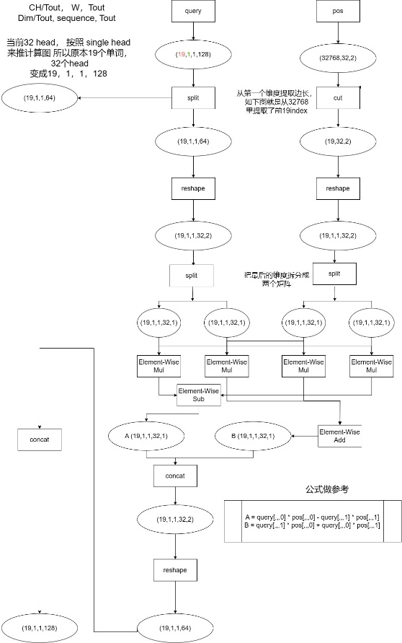
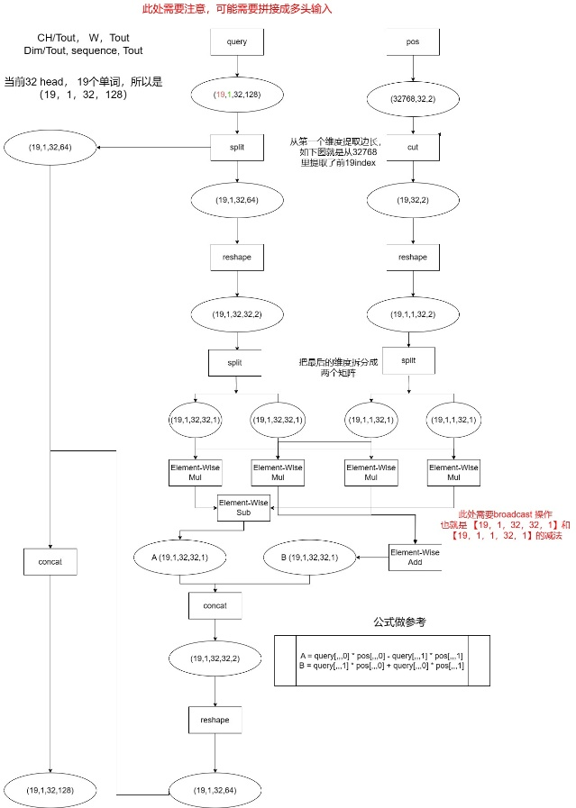
多头的计算图
单头的计算图

Slide 9
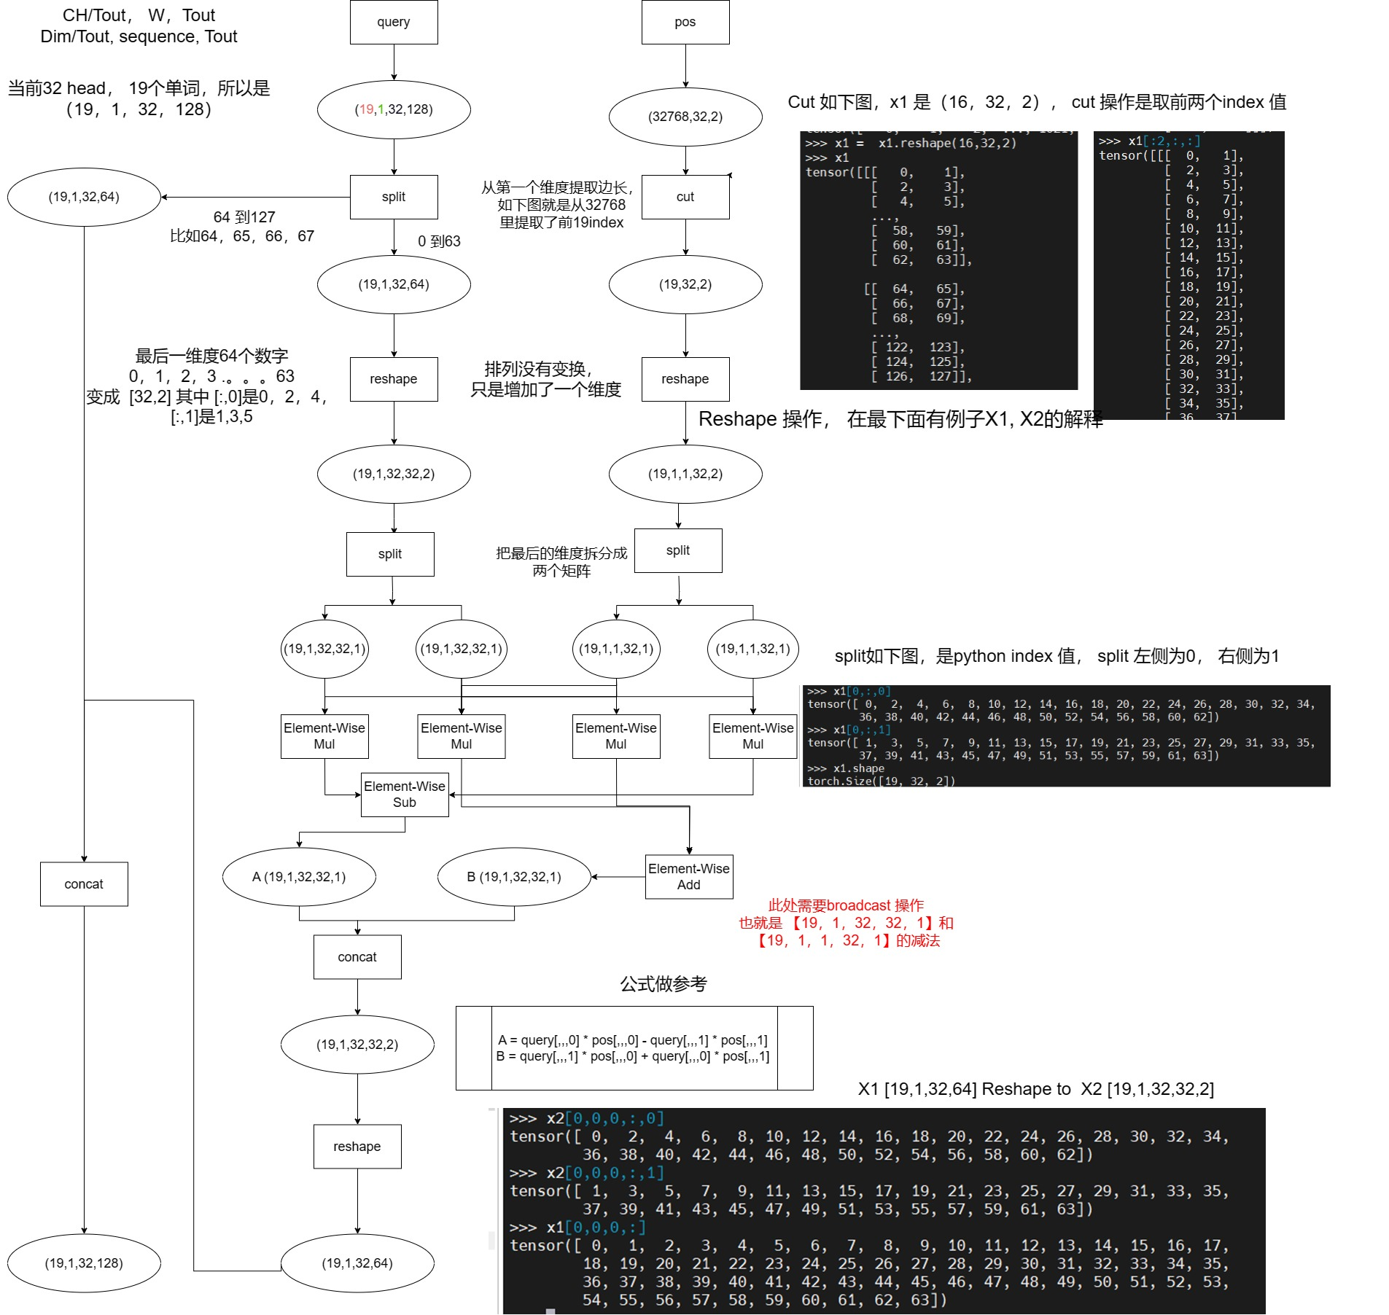

Slide 10
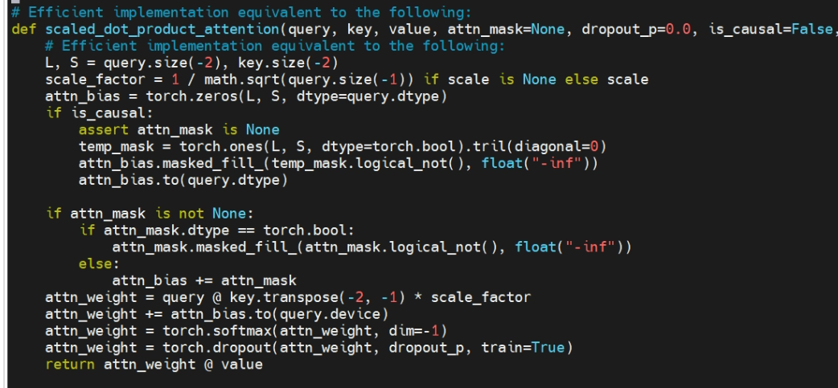
Scaled Dot Production
Emb_Query_{(x 32)}
[19,128]
Quan_Key_{(x 2)}
[128,19]
Quan_Value_{(x 2)}
[19,128]
2次MVM_BN_RES算子
（skip factor 设置为2）
(transpose)
scores _{(x 32)}
[19，19]
1次Softmax算子（head=32)
element-wise rsqrt
Add Mask
Mask_{(x 32)}
[19,19]
2次MVM_BN算子
（skip factor 设置为2）
Softmax
scores _{(x 32)}
[19，19]
Attention output _{(x 32)}
[19,128]

