Slide 1
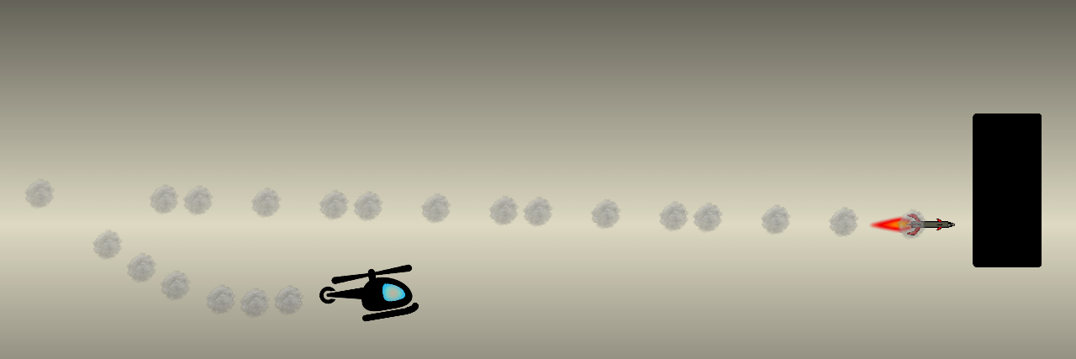
Guncopter

Slide 2

Guncopter

