Slide 1
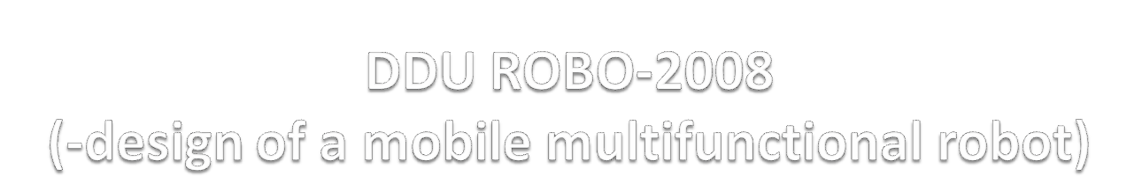
Developed at
R & D center, DDU, Nadiad
DEVELOPED BY
Nookala Lakshmi V (ID – 054016)
Khandelwal Ankit M (ID-056116)
INTERNAL GUIDE: EXTERNAL GUIDE:
PROF. R. S. Chhajed Dr. H. S. Mazumdar
Head, IT DEPT, DDU R & D Center, DDU

Slide 2
PROJECT DEFINITION
Design a mobile robot with gripper based on ATMEGA series microcontrollers. The following are the major specifications of the robot:-
Four wheel DC motor drive with gear.
Horizontal gripper with pick and place.
Array of optical sensors to track path.
Proximity sensors to avoid obstacles.
Interface with remote control.
Optional specifications:-
Interface 4GB SDRAM for path data acquisition and history storage.
Automatic charging of its own battery using docking station.

Slide 3
SCOPE
The robot can perform multiple actions such as:
Detect obstacles and take appropriate action.
Find its own path and follow it, i.e. a line tracker.
It can work as a gripper, i.e. it can be used for picking and placing things.
It can be operated by IR-remote
It also has certain drawbacks like:
The gripper cannot function properly for all sizes, shapes and weights of an object.
The distance from which the robot can be operated through remote is limited.
The system is battery operated hence it has to be charged when required.
It can not sense black colored objects.

Slide 4
OBJECTIVE
The objective to build this kind of a system was to make a multi-purpose, multitasking, automobile robot which if enhanced can be made as powerful medium for security and other basic services at various places such as offices, high security regions like Railway station and airport, general house hold services and a guide to elderly persons in society.
Another important objective is to achieve the task of networking between CPU thus making it possible to perform more than one function at a time and according to the result obtained by one CPU to be analyzed and action taken by another CPU, thus obtaining master-slave like functionality which again is a gateway to perform multiple activities.

Slide 5
HARDWARE REQUIREMENTS
The system needs a 12 V battery supply for the system to be alive.
USB Programmer board to program the system.
USB cable for interfacing the board with the computer.
SOFTWARE REQUIREMENTS
Programmers’ Notepad.
WINAVR Compiler.
USB Programmer software – Robokits USB Programmer or AVR Studio or Code Vision AVR.

Slide 6
SYSTEM DESIGN AND ARCHITECTURE
The system is designed such that it can perform many different activities like a gripper, a line tracker, an obstacle avoider and an interface to the remote control. The different modules in the system are: -
Obstacle avoider
Line Tracker
Gripper for pick and place
An interface with the remote control

Slide 7
TASKS UNDERTAKEN BY PROJECT TEAM
USB Programmer for programming microcontroller
Obstacle avoider with IR sensors
Wheel rotation sensors
Line Tracker
Gripper for pick and place
An interface with the remote control
Robot working with different speed grades
Ultrasonic sensor for avoiding obstacles

Slide 8
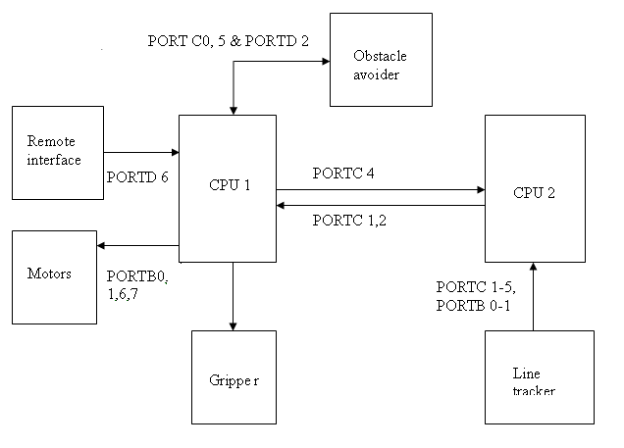
SYSTEM ARCHITECTURE
Block Diagram of the robot

Slide 9
As it can be seen in the diagram, two CPUs are interfaced with each other. The first CPU is used for remote interface, obstacle detector and gripper and the second CPU is used for the line tracker module. The microcontroller ATMEGA8L has 3 I/O ports of which two are 8-bit and one is 7-bit.
Different I/O ports are used for the modules mentioned. The ports used are mentioned below : -
  Obstacle avoider uses PORTC0, PORTC5 & PORTD2
  Line tracker uses PORTC1, PORTC2, PORTC4 in CPU 1 and PORT C 2 -5, PORTB 1 in CPU2
  Remote interface uses PORTD6
  Also the system’s speed can be controlled.

Slide 10
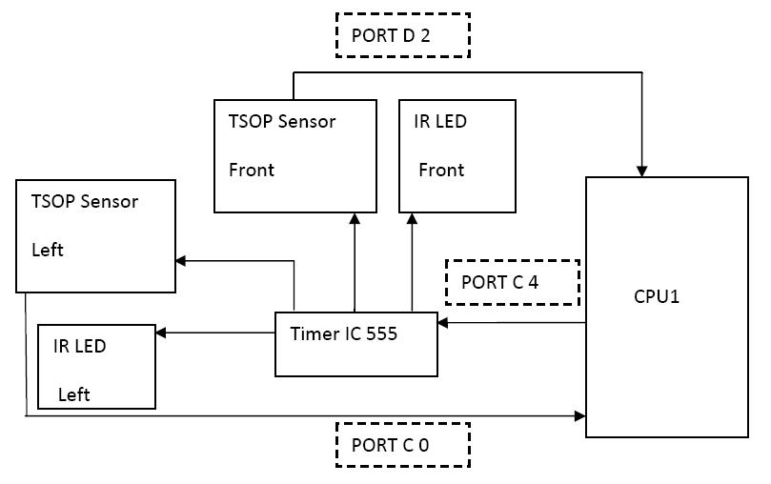
OBSTACLE AVOIDER
Obstacle Avoider Block

Slide 11
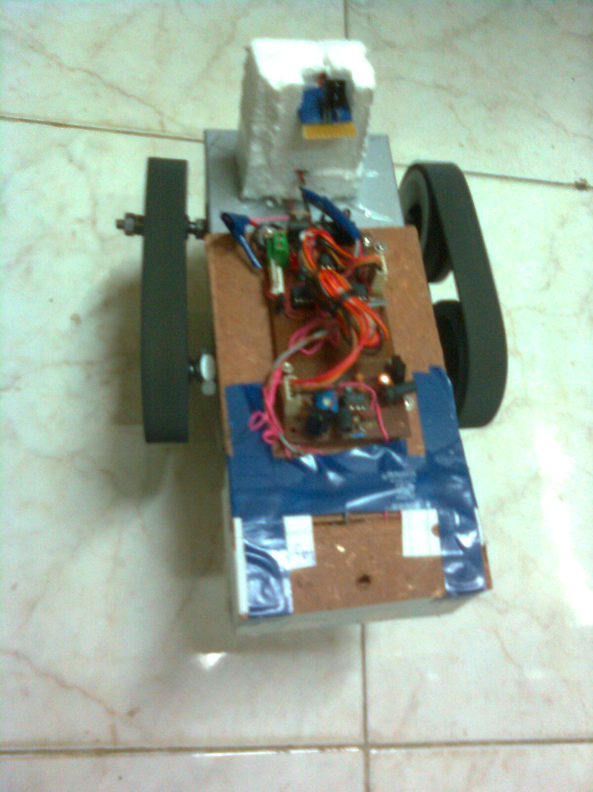
Working of the Obstacle Avoider
The obstacle avoider block has two sensors as shown, one in the front and one in the left to sense the obstacles in the front and left respectively and their respective IR LEDs.
Sensors

Slide 12
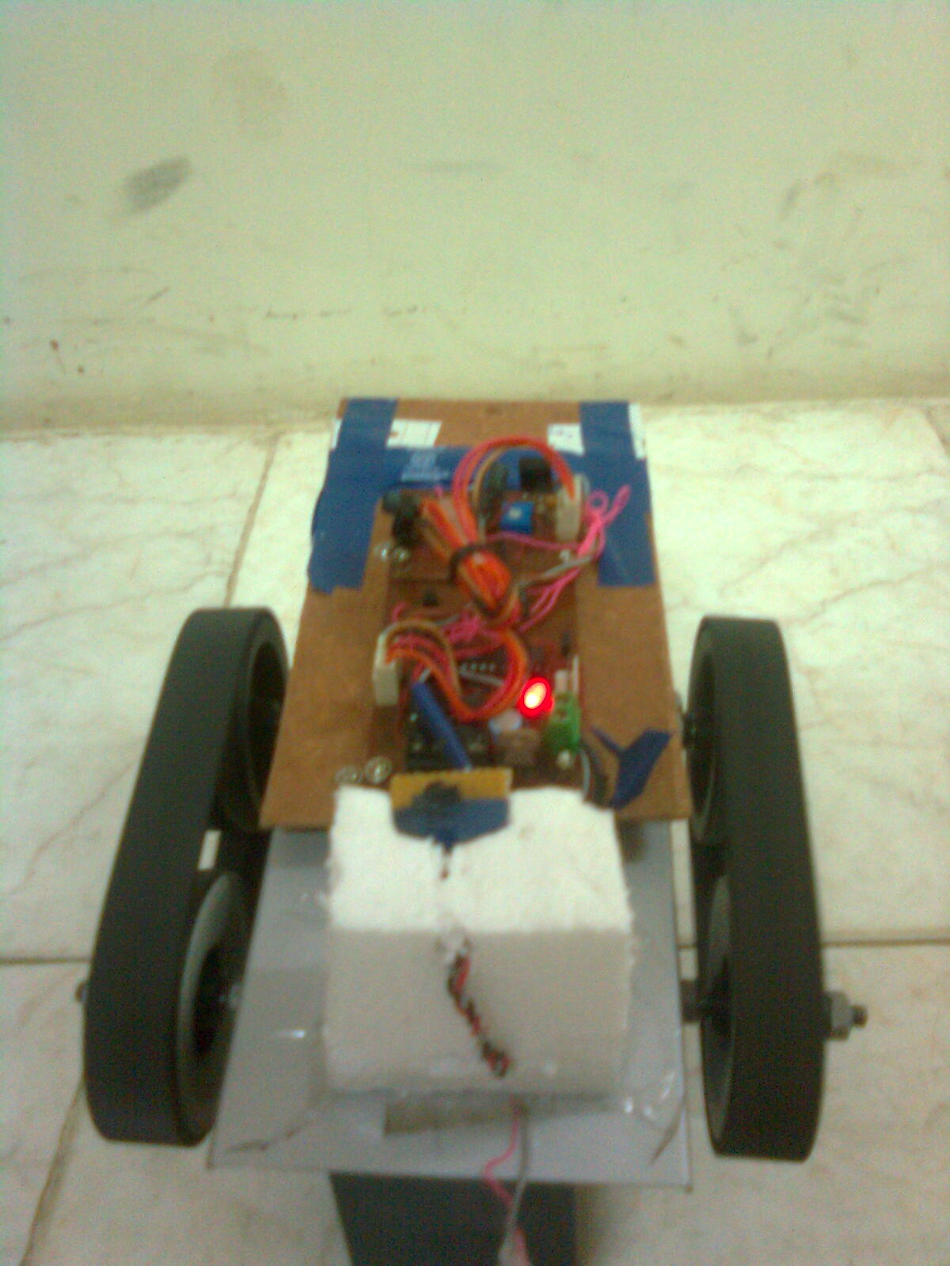
The IR LEDs keep radiating 36 KHz IR rays continuously. In case of an object in the robot’s way, the object will reflect the rays radiated by the IR LED and the sensor will detect these rays through which it learns about the object in its way.
This is conveyed to the microcontroller i.e. the CPU 1 and appropriate action is taken according to the mode the robot is in.
The obstacle if sensed in the front, the LED mounted glows as shown and the robot moves left and the left sensor also does its work. So the need of a right sensor is lessened significantly.

Slide 13
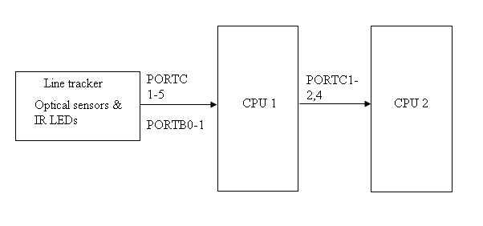
LINE TRACKER
Line Tracker block

Slide 14
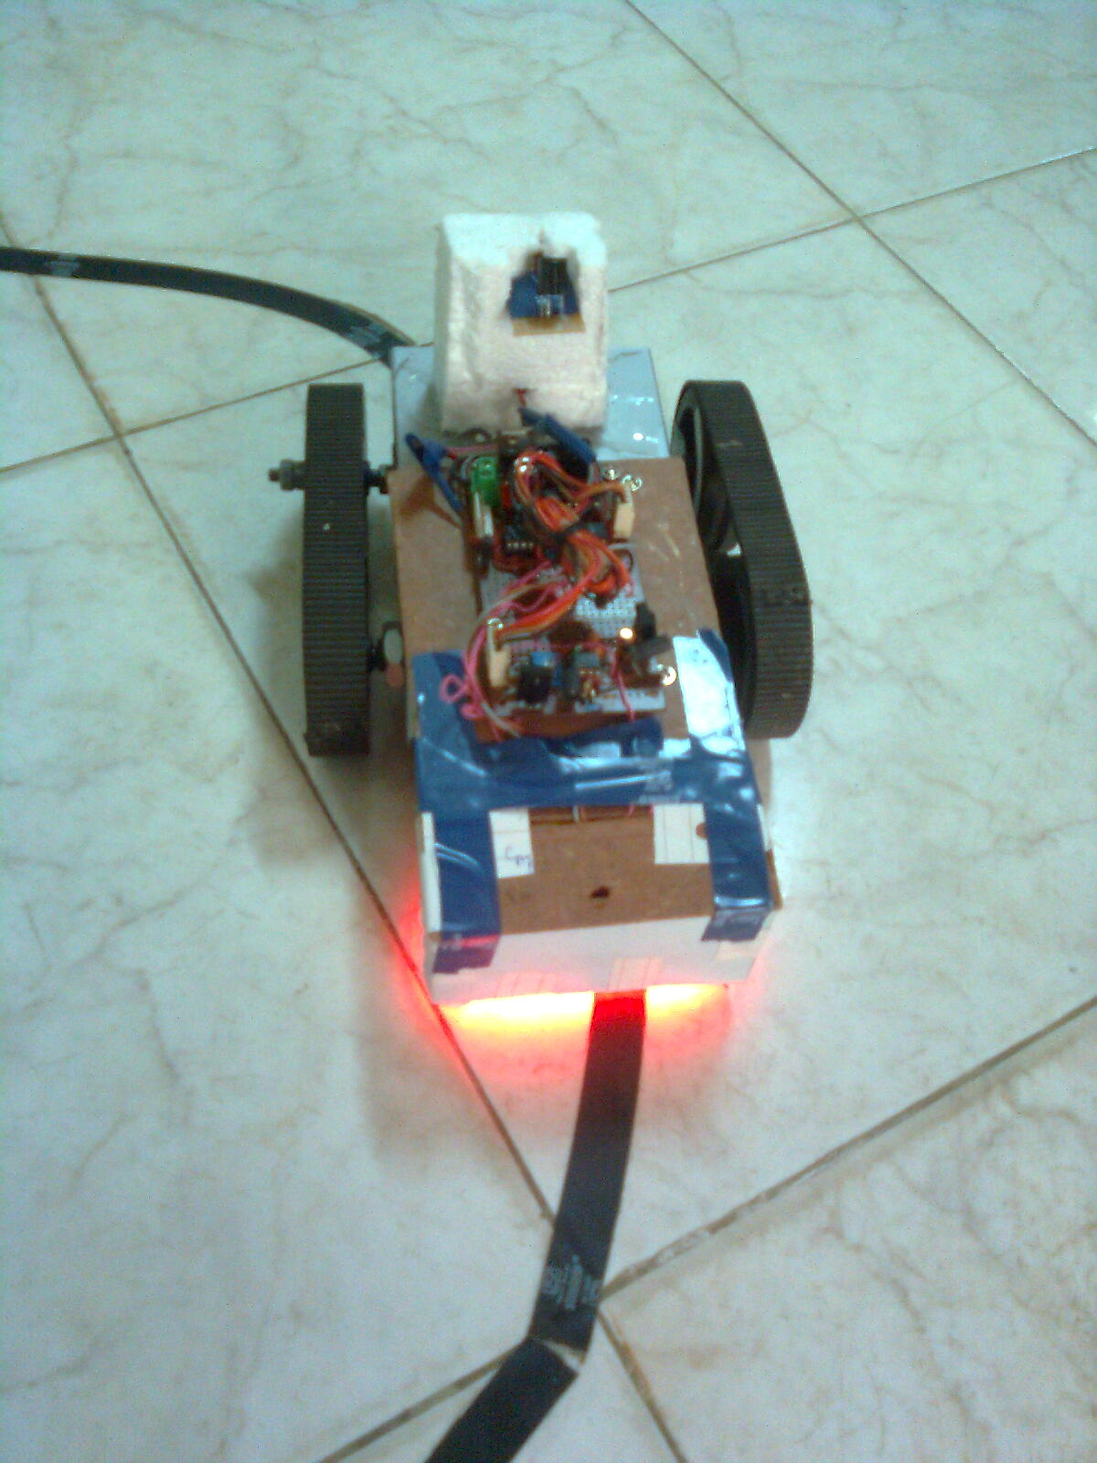
Working of the Line Tracker
The IR LEDs radiates IR rays when they get power supply and the optical sensors detect the light reflected by the objects they are exposed to.
Also this block has indicator LEDs to show if there is an object in front or not. They glow in case of no object present or if a black object is present and they don’t if any other coloured object is present.
Thus the sensors learn about the black path and this knowledge is conveyed to the CPU 2 of where the black path is. This is sent to the CPU 1 which accordingly decides what to do.

Slide 15
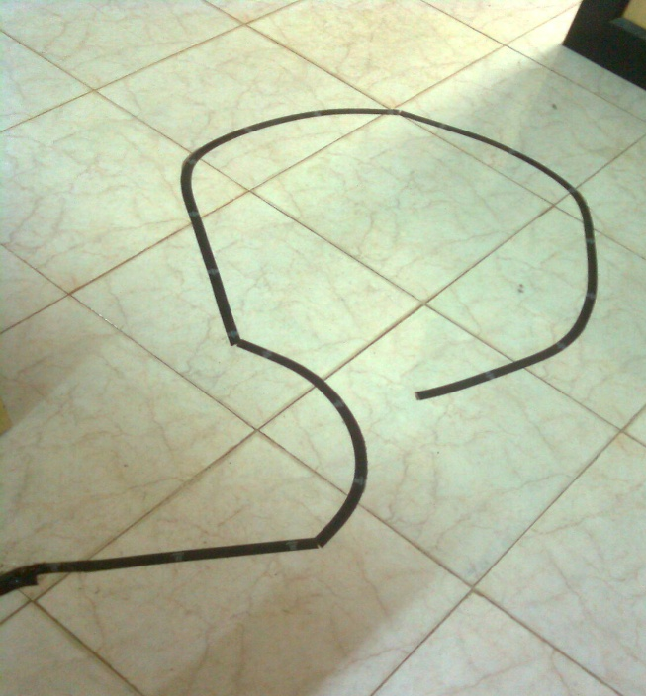
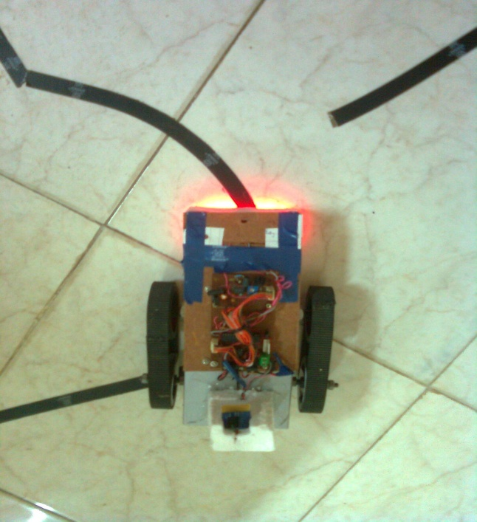
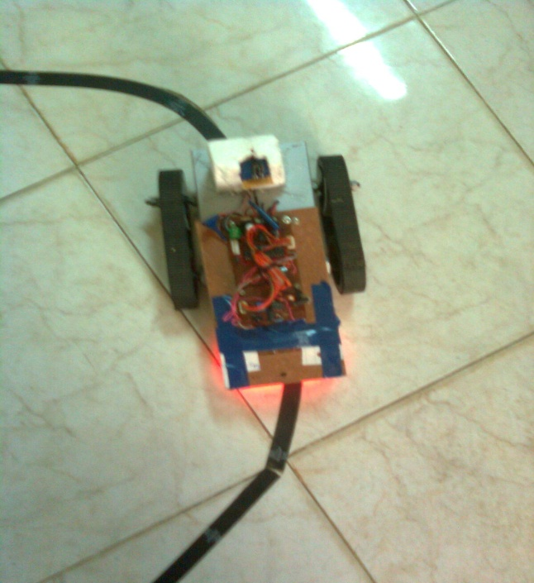
As shown in the figures below, the tracker once kept on a black path or once it gets the command from the remote to starts following a black path on which it is placed.

Slide 16
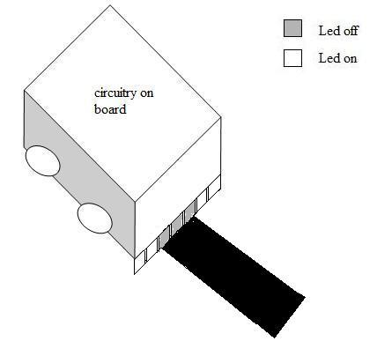
The figure shown here depicts the reaction of the robot when it is on track i.e. it moves forward.
The 5 center LEDs who’s on and off condition helps the line tracker in determining its position are shown by the boxes in the robot.
In this figure, the robot moves in the forward direction and the 3 LEDs in the centre are off through which the tracker gets to know its position and hence moves forward.

Slide 17
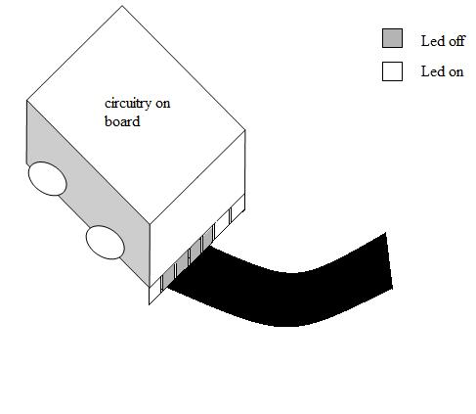
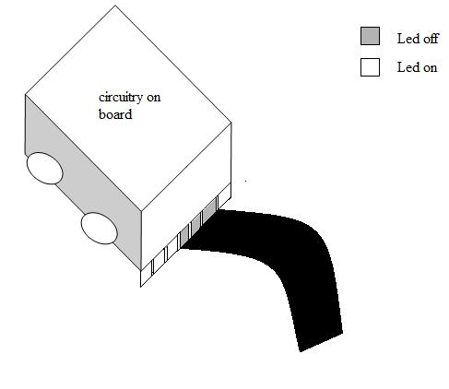
The robot moving right
The robot moving left
The figures shown here depict the reaction of the robot when it is not on track i.e. it either has to move left or light or stop. Of the 5 center LEDs, 2 from the left and 2 from the right determine the line tracker’s position. For the robot to move right either of the two left LEDs or both have to be on as shown in the 1st figure and similarly for the left turn shown in the 2nd figure.

Slide 18
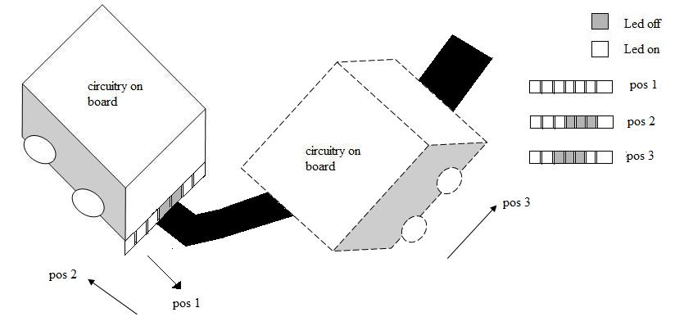
How does the lone tracker take steep turns?
The robot is initially moving on its path. Pos 1, pos 2 and pos 3 indicate the different LED states of the line tracker during the algorithm. Once it encounters a steep turn, it goes to pos 1 first i.e. stops and then pos 2 i.e. goes back a bit. It then checks for a turn in any direction but forward. Here it finds a path in left direction hence the tracker goes left and it new state becomes pos 3 as shown in figure and follows the path.

Slide 19
GRIPPER FOR PICK AND PLACE
The gripper is used for pick and place of objects.
Many gripper designs have been studied which are available on the internet. Almost all of them use two or more motors for its working, i.e. the gripper drive, then its pick and place actions. The use of more motors increases the load on the system.
To reduce this, a design using just a single motor was to be implemented which seemed to be necessary and sufficient requirement for the gripper to work properly.

Slide 20
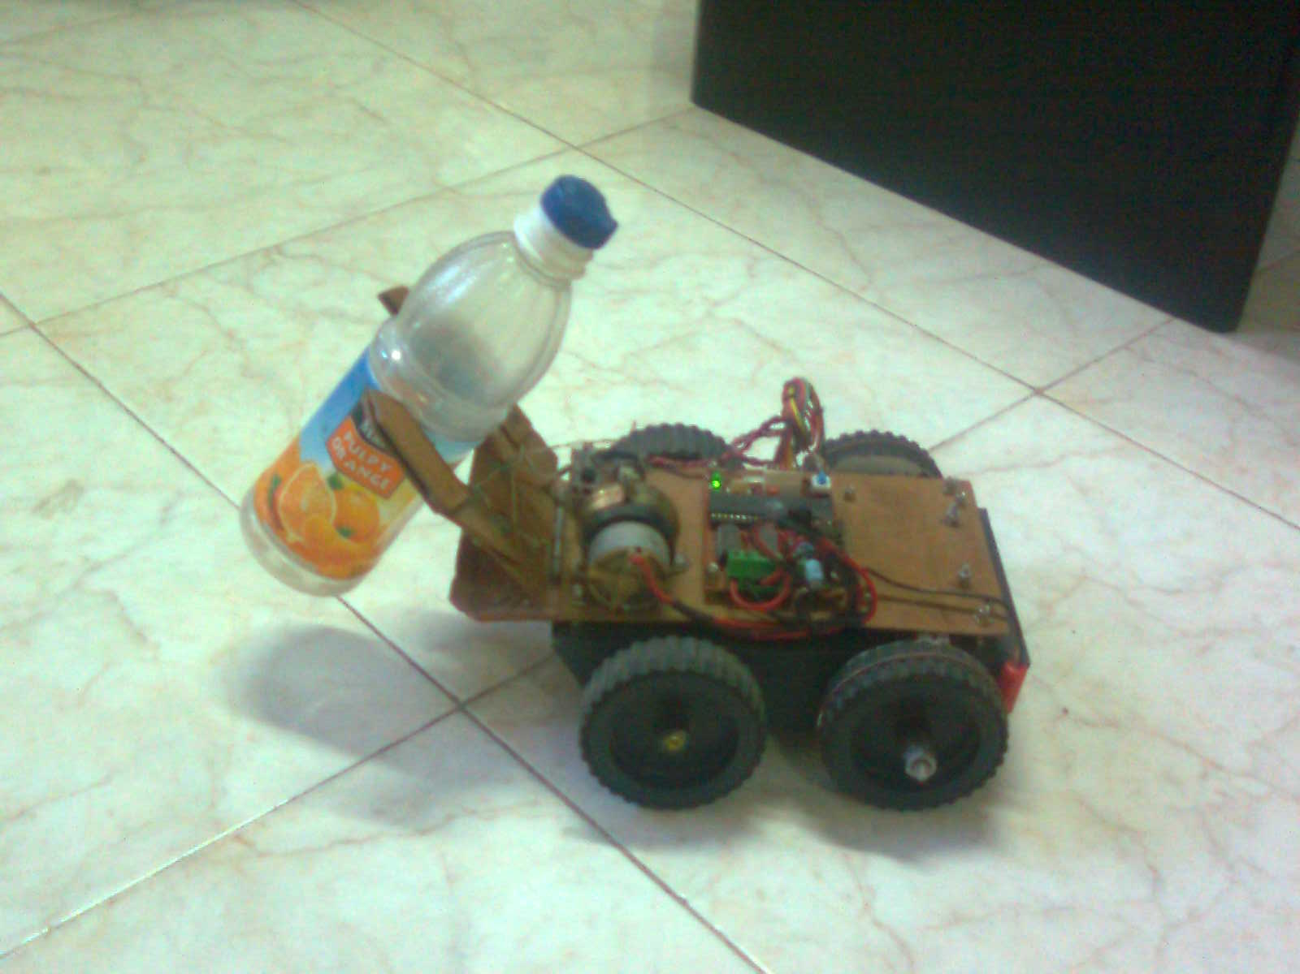
Gripper in Action
The gripper we designed for our system includes a single motor which drives the gripper, and also does the pick and place. The gripper arms are easy to make and provide up to four Degrees of Freedom. The lever action used to open, close, lift and place is done with a counter spring to avoid backlash.
Gripper in action

Slide 21
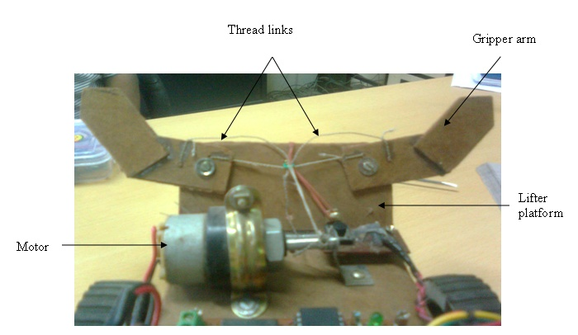
Gripper Construction
The Figure shows the construction of the gripper. It consists only of three parts as shown in the figure.
The proposed design uses thread links to perform the gripper functions, using a ‘reversible’ 100 rpm motor.
The motor shaft winds and unwinds two strings at a time which in turn opens, closes, lifts up and down the gripper jaws.
The construction time with the help of minimal tools like hex saw and drill is less than one hour.
Gripper construction

Slide 22
The proposed gripper has four degrees of freedom.
What is Degree of Freedom?
In mechanics, DOF of a system is the number of independent displacements and/or rotations that specify completely the displaced or deformed position and orientation of the body or system. The number of DOF of a system is the number of parameters of the system which can be independently varied.
As stated above, our gripper has four DOF as below: -
The gripper arms can open and close freely in space.
The lifter platform can move up and down freely.
The entire system to which the gripper is connected can move forward and backward.
Also the system can move leftwards and rightwards.

Slide 23
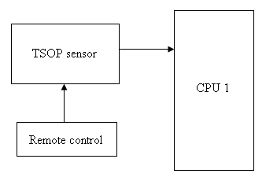
IR REMOTE CONTROL INTERFACE
Remote Control Block

Slide 24
Shown in the figure is the remote control block of the system. The remote can be any audio/video TV remote used in daily life. The remote gives the commands to the robot as per the instructions in the user manual. These commands are caught by the sensor, which are then transferred to CPU 1. This then decodes the command and understands and takes appropriate action.
The different modes in which the remote can work are as follows: -
Obstacle avoider where the robot will avoid obstacle on its path as soon as it gets this command from through the remote.
Gripper where the robot acts like a grabber for pick and place.
Line Tracker where the robot follows a black path.
In addition to all these different speed grades can also be achieved. The robot is programmed to travel in four different speeds.

Slide 25
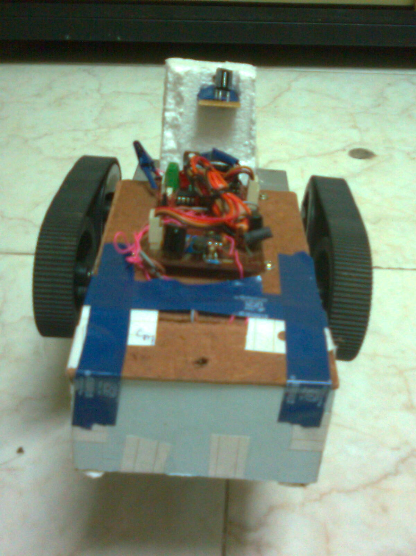
ROBOT’S CONSTRUCTION
The robot is structured such that it can sustain any accidents which it is likely to
meet with.

Slide 26
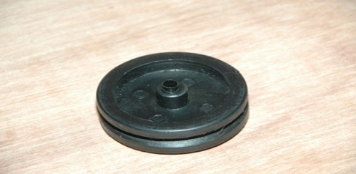
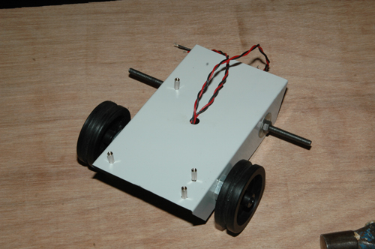
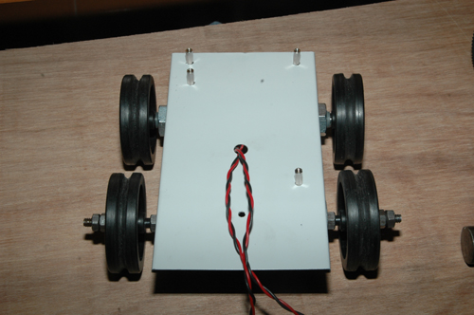
Wheels of the Robot
A wheeled robot was the best for our specifications and constraints. The robot in our case is four-wheeled.
Of these four, two are powered wheels and two are unpowered.
The powered wheels are used to drive the robot and the unpowered wheels are used for the balancing the robot by providing a point of contact with the ground.

Slide 27
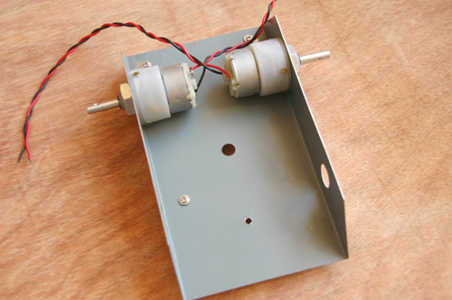
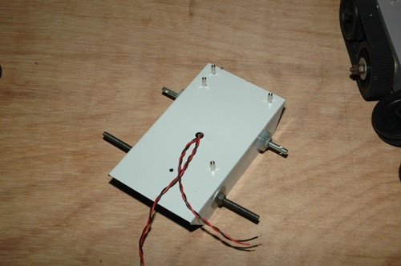
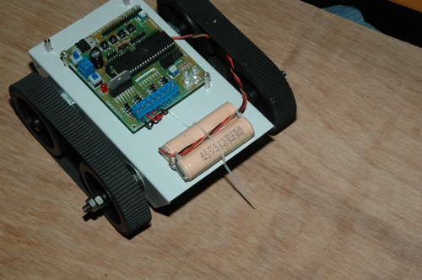
The balancing is achieved in a way that the centre of mass will be concentrated between the wheels; also the battery, motors, etc. can be kept between the wheel spaces.

Slide 28
Why Wheels?
Wheels of a robot provide many advantages like:-
Low cost.
Simple design and construction.
Near infinite different dimensions cater to your specific project.
Diameter, width, material, weight, tread, etc. can all be custom to our needs.
An excellent choice for beginners.
It also has some disadvantages like:-
Wheels may lose traction or may slip easily.
They have very small contact surface area.
But these disadvantages can be overcome by choosing wider wheels.

Slide 29
What are the options available other than wheels to build our system?
Other than wheels the robot can have legs or tracks for its mobility. Tracked robots are similar to those used in tanks. They don’t tend to slip and distribute the weight of the robot evenly. The legged robots use legs for their mobility. They suit well for movement on uneven surfaces.
How are wheels better than the other options available?
Tracked robots, unlike wheeled robots which are easy to build, increase mechanical complexity and they also tend to wear themselves out while taking a turn. The legged robots are difficult to code, build and thus their complexity increases electronically and mechanically too.

Slide 30
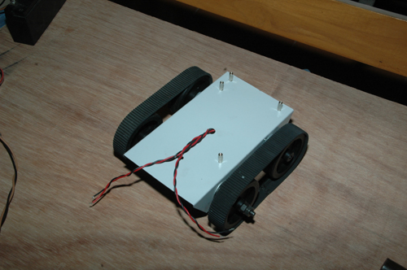
Belt Drives
The robot uses belt drives to transfer the rotary motion between the two wheels. The motion of the driving wheel is, generally, transferred to the driven wheel via the friction between the belt and the wheel. Belt drives however have relatively high inspection and maintenance demands

Slide 31
Why Belt Drives?
The advantages of belt drives include:-
Easy, flexible equipment design, as tolerances are not important.
Isolation from shock and vibration between driver and driven system.
Belt drives require no lubrication.
Maintenance is relatively convenient.
A rubber belt around the wheels decreases the friction and gives a good grip to the wheels. This also makes the wheels heavy and is susceptible to slipping on wet surfaces.

Slide 32
What options are available instead of belt drives?
An alternate solution to rubber/leather grip is sponge grip which is very light in weight, give a good grip and is also better suited for rainy seasons.
How are belt drives better than the available options?
The disadvantage the above mentioned solutions provide is that they get dirty easily and also tend to exhaust the motor very soon. On the other hand, belt drives provide the required lubrication without wasting the motor power just that they require good maintenance.

Slide 33
Robot Hardware construction
The chassis of the robot, is made of mild steel and is strong enough to bear minor accidents that the robot might face.
Also the hardware is mounted on the chassis with a hardboard base supporting it.
All the blocks are mounted such that no other block or hardware is required to be disturbed to access the other.
Also the entire hardware board can be separated from the chassis removing just two screws from the board.

Slide 34
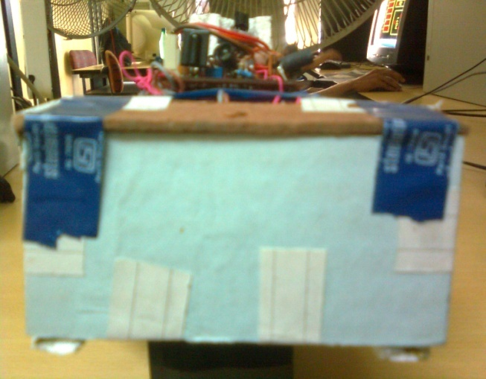
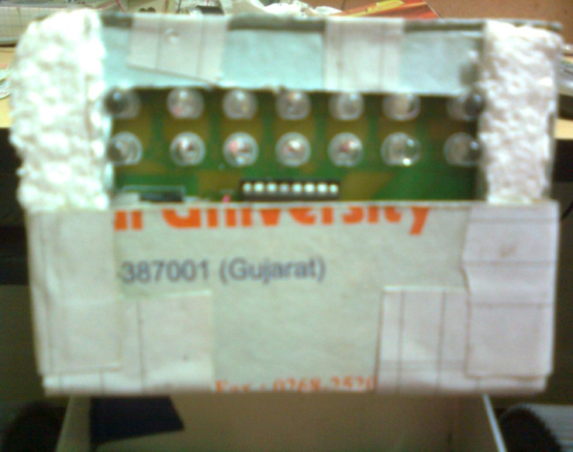
The line tracker module is packed in to a strong cardboard box like structure as shown in figures.
This packing is mainly done so that external light rays don’t affect the working of the sensors.
The packing is kept such that hardboard platform attached to the chassis protects it from the top and the line tracker box being a little inside the chassis and below the hard board.
Thus it is made independent and also safe. These factors help making the design to be good in terms of accessibility and organization.

Slide 35
Hardware Considerations
The system uses normal LEDs which use at least 15mA of current to glow. This effects the current consumption of the circuit as a whole to a significant extent. Instead, low power (or simply dimmer) LEDs can be used. This drastically reduces how much current your circuits consume.
The system uses CMOS ICs and not TTL. Using CMOS instead of TTL provides many advantages. CMOS ICs consume less power in comparison to TTL. CMOS ICs with reducing current usage, allow a more relaxed power supply. A variable power supply n a specific range will also work for CMOS ICs. CMOS are also smaller and cheaper but slower compared to TTL.

Slide 36
The microcontroller here needs to work on its maximum speed grade to make it faster. The disadvantage is that more the clock of the microcontroller more is its current consumption.
The IR LEDs used are 5mm diameter, with 45nm bandwidth. Infrared LED is commonly used in a wide variety of remote control and communications projects. Its wide 60 degree beam width and high output power make it a great infrared transmitter and hence better for the system.
Motors: - The motors used in the system are 100 rpm, reversible, 12 V and single phase.

Slide 37
LIMITATIONS
An The CPU used here is a 28 pin IC. An enhanced version of the CPU can be used to get increased functionalities.
As a prototype, the system is made of material like hardboard and mild steel. Hence it cant safeguard itself from very major accidents.
The line tracker in the current system is not capable of following a path having steep turns of less than 30° bend from the horizontal.
The proximity sensors are insensitive to black colored objects; hence they cannot detect black colored objects.
The system is battery powered and so has to be charged frequently. Also this poses a threat of the system getting burnt due to short-circuit currents in it.
The gripper is not strong enough to lift objects of all shapes, sizes and weights.

Slide 38
ENHANCEMENTS
Bluetooth instead of IR to increase the distance range from which the robot can be controlled.
Gripper arms will be made strong using fiber glass to carry heavy load and enhance it so that it can have many business applications.
Motors with higher power ratings and better battery will be used.
A better CPU having more internal speed and more port pins for increased functionalities will be used.
The system would be enhanced to be as mobile and as independent as possible.
Flash card interface with the robot working so that it can save the location of each and every point it visits and thus perform history storage which will guide robot where to go and where it is.

Slide 39
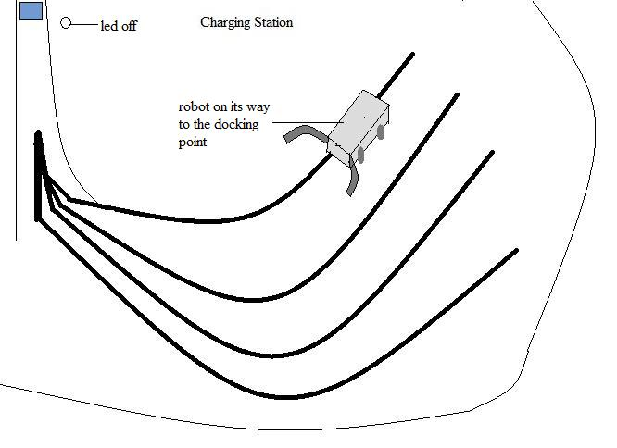
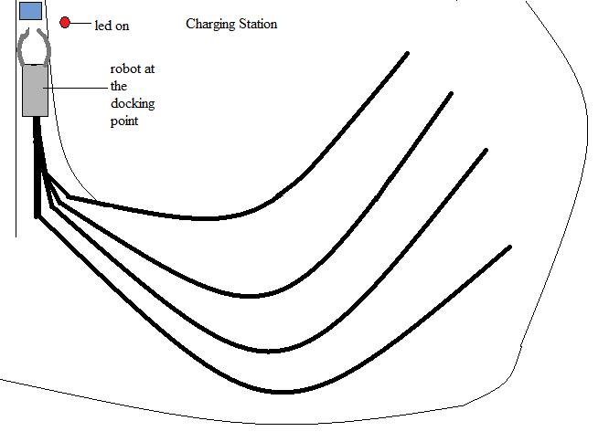
Automatic charging station: - A charging station would be built so that if the system gets discharged, it finds the charging station and goes there by itself and gets charged. When it is charged it automatically comes out of the region by itself.

Slide 40
CONCLUSION
This model is the prototype model of the original system.
This system requires development of both hardware and software efficiently.
Gripper - The gripper would enable pick and place of objects which when professionally developed can be advantageous in different fields which would have business scope as well.
Interfacing with Remote Control – This would allow user to interface with system from distant places and can operate from good distance.
Obstacle detecting sensors – This sensors are economical and very useful these can be used in various areas such as to avoid an obstacle, to show that there is obstacle or to follow the dynamic objects. Thus has wider business application.
Line Tracker – This technology can work as a dedicated path to various functionality it performs.

Slide 41


