Slide 1
Microprocessor based Design for Biomedical Applications
MBE 3 – MDBA
II : The ATmega8
Basic Features (1)

Slide 2
II: Atmega8 – Basic features
ATmega8 - RISC Architecture
● 130 Instructions – Most Single-clock Cycle Execution
● 32 x 8 General Purpose Working Registers
● 64 x 8 Special Function Registers (I/O Registers)
● Up to 16 MIPS Throughput at 16 MHz
● On-chip 2-cycle Multiplier
Nonvolatile Program and Data Memories
● 8K Bytes of In-System Self-Programmable Flash
10,000 Write/Erase Cycles
● Optional Boot Code Section with Independent Lock Bits
● 512 Bytes EEPROM (100,000 Write/Erase Cycles)
● 1K Byte Internal SRAM
● Programming Lock for Software Security

Slide 3
II: Atmega8 – Basic features
Peripheral Features
● Two 8-bit Timer/Counters
● One 16-bit Timer/Counter with Capture Mode
● Real Time Counter with Separate Oscillator
● Three PWM Channels
● 6-channel ADC with 10 resp 8 Bit resolution (TQFP: 8 channels)
● Two-wire Serial Interface (TWI)
● Programmable Serial USART
● Master/Slave SPI Serial Interface
● Programmable Watchdog Timer with On-chip Oscillator
● On-chip Analog Comparator

Slide 4
II: Atmega8 – Basic features
Special Microcontroller Features
● Programmable Brown-out Detection
● Internal Calibrated RC Oscillator
● External and Internal Interrupt Sources
● Five Sleep Modes
I/O and Packages
● 23 Programmable I/O Lines
● 28-lead PDIP, 32-lead TQFP, and 32-pad MLF

Slide 5
II: Atmega8 – Basic features
Operating Voltages
● 2.7 - 5.5V (ATmega8L)
● 4.5 - 5.5V (ATmega8)
Speed Grades
● 0 - 8 MHz (ATmega8L)
● 0 - 16 MHz (ATmega8)
Power Consumption at 4 Mhz, 3V, 25°C
● Active: 3.6 mA
● Idle Mode: 1.0 mA
● Power-down Mode: 0.5 μA

Slide 6
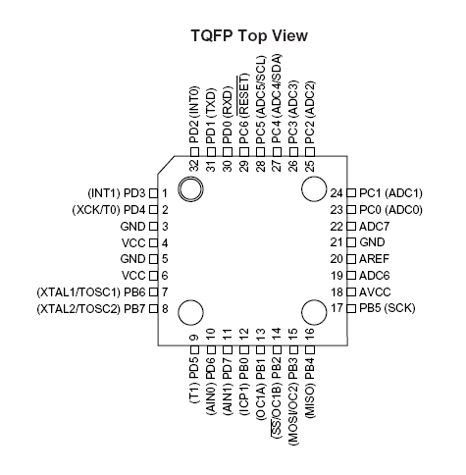
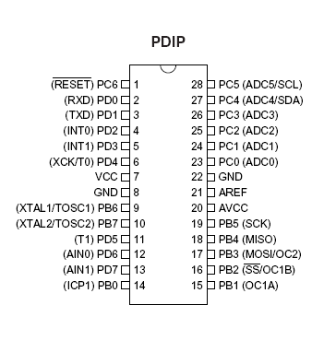
II: Atmega8 – Basic features
ATmega8 Pinout and Packages (DIP and TQFP)

Slide 7
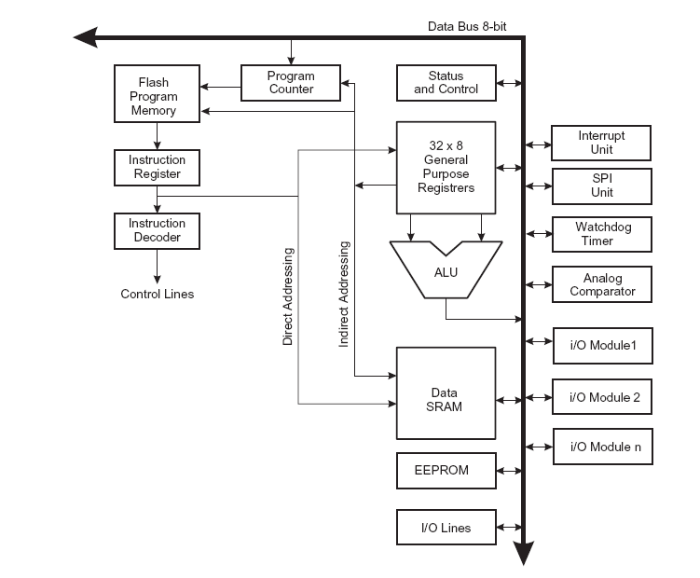
II: Atmega8 – Basic features
Mega8 CPU Core
● Seperate Instruction and
Data Memories (Harvard)
● all 32 General Purpose
Registers connected to
ALU
● I/O Modules connected to
Data Bus and accessible via
Special Function Registers
ATmega8 Core Architecture

Slide 8
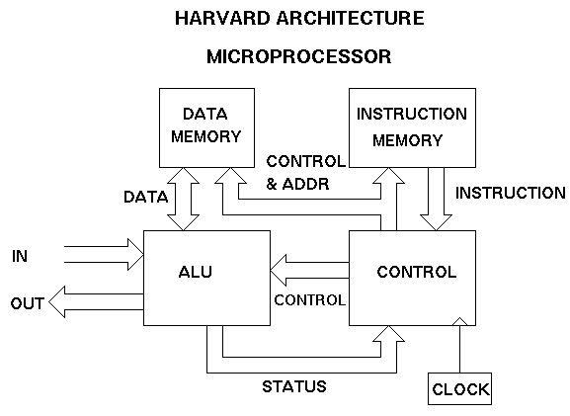
II: Atmega8 – Basic features

Slide 9
II: Atmega8 – Basic features
Harvard architecture
● Separate storage and signal pathways for
instructions and data.
● History: Harvard Mark I
relay-based computer
● word width, timing, and implementation
technology of instruction and data memories
can differ.
● Contrast: ‘Von Neumann’ - architecture:
Instructions and data use the same signal
pathways and memory.

Slide 10
II: Atmega8 – Basic features
Harvard architecture
● Ability to fetch the next instruction at the
same time it completes the current
instruction.
● Speed is gained at the expense of more
complex electrical circuitry.
In a computer with Harvard architecture, the CPU can read
an instruction and data from memory at the same time.

Slide 11
II: Atmega8 – Basic features
Pin and Port Overview:
GND: Ground (0V)
VCC: Digital Supply Voltage (2,7 – 5,5V)
AVCC: Analog Supply Voltage
connect to low-pass filtered VCC
AREF: Analog Reference Voltage, usually AVCC
/Reset: Low level on this pin will generate a reset
Port B, Port C, Port D:
General Purpose 8 Bit bidirectional I/O - Ports,
optional internal pullup-resistors when configured as input
output source capability: 20mA
Special Functions of the Ports available as configured using the SFRs:
Port D: Uart, external Interrupts, Analog Comparator
Port B: External Oscillator/Crystal, SPI
Port C: A/D converters, TWI

Slide 12
II: Atmega8 – Basic features
Memory organization

Slide 13
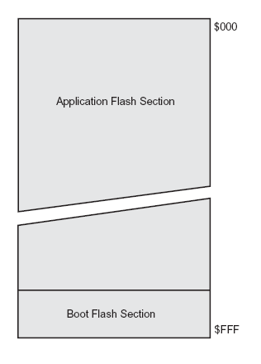
II: Atmega8 – Basic features
AVR Memory organization:
● Program Flash Memory:
On-chip, in system programmable
8 Kbytes, organized in 4K 16 bit words
Program Counter (PC) = 12 bits
Accessible via special instructions: LPM, SPM
Boot Loader support: Boot Flash Section,
SPM can be executed only from Boot Flash

Slide 14
II: Atmega8 – Basic features
AVR Memory organization:
● EEPROM - Memory:
  512 Bytes, single Bytes can be read and written
  Special EEPROM read and write procedure using SFRs:
  EEPROM Address Register, EEPROM Data Register,
  EEPROM Control Register
  C – Library Functions available
  Precautions to prevent EEPROM memory corruption:
  ● no flash memory or interrupt operations
  ● stable power supply

Slide 15
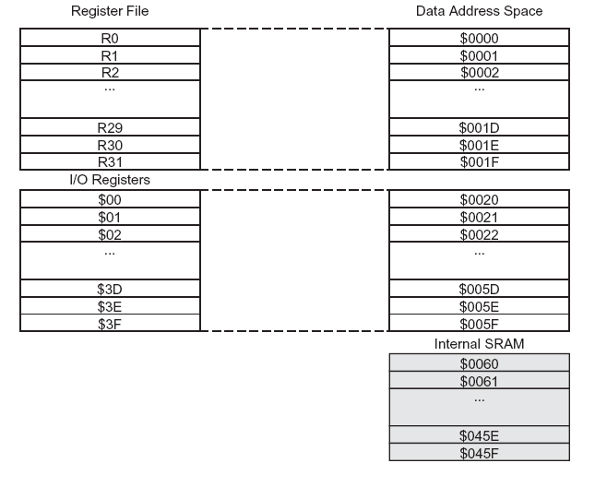
II: Atmega8 – Basic features
AVR Memory organization:
● SRAM Data Memory:
32 GPR’s and
64 SFR’s mapped
to SRAM memory space
SFR’s accessed
via in / out instructions
(I/O-registers)
1 Kbytes of internal
SRAM can be accessed
from address 0x060
to address 0x45f
5 Direct and indirect addressing modes

Slide 16
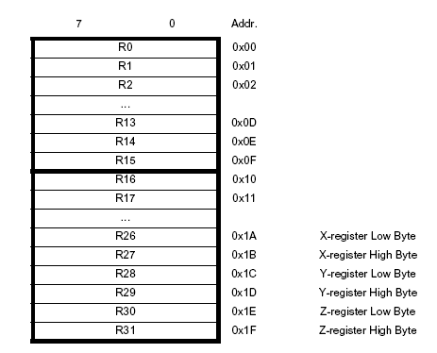
II: Atmega8 – Basic features
AVR Memory organization:
● General Purpose Registers:
Although not being physically
implemented as SRAM locations,
GPR’s can be accessed
by SRAM locations
X, Y and Z 16-bit registers
can be used for indirect addressing
ALU - Input / output schemes:
one 8-bit operand, 8-bit result
two 8-bit operands, 8-bit result
two 8-bit operands, 16-bit result
one 16-bit operand, 16-bit result

Slide 17
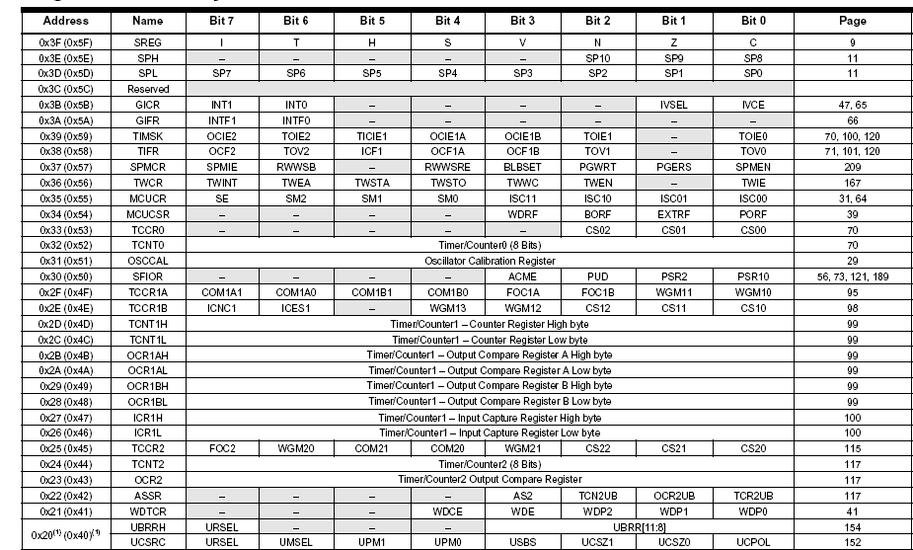
II: Atmega8 – Basic features
I/O Memory (SFR) Overview

Slide 18
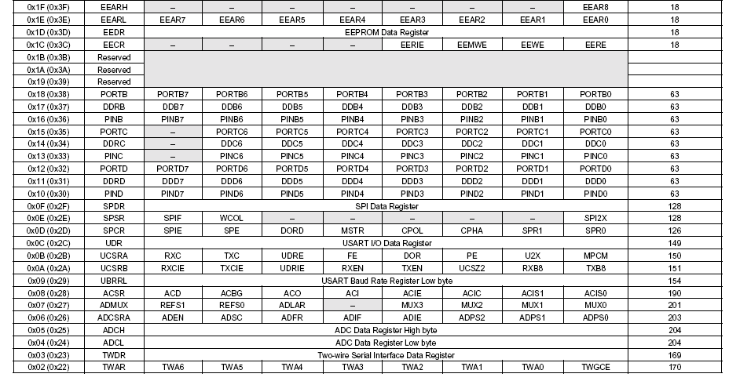
II: Atmega8 – Basic features
I/O Memory (SFR) Overview

Slide 19
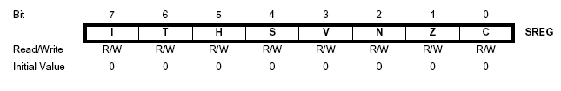
II: Atmega8 – Basic features
Important I/O Registers:
SREG – Status Register
Bit 7 – I: Global Interrupt Enable
Bit 6 – T: Bit Copy Storage
Bit 5 – H: Half Carry Flag
Bit 4 – S: Sign Bit
Bit 3 – V: Two’s Complement Overflow Flag
Bit 2 – N: Negative Flag
Bit 1 – Z: Zero Flag
Bit 0 – C: Carry Flag

Slide 20
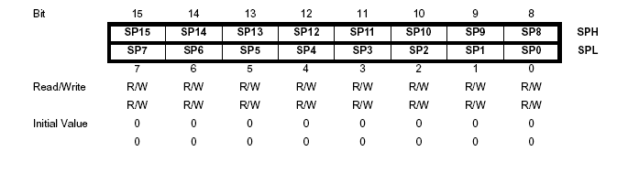
II: Atmega8 – Basic features
Important I/O Registers:
Stack Pointer (SPH and SPL)
● Stack is a LIFO buffer located in SRAM
● Stack Pointer addresses the current location
● Push and pop instructions write / read from Stack
● Enter or return from subroutines / interrupt routines:
Address and Parameters transferred via Stack

Slide 21
II: Atmega8 – Basic features
Clock Options

Slide 22
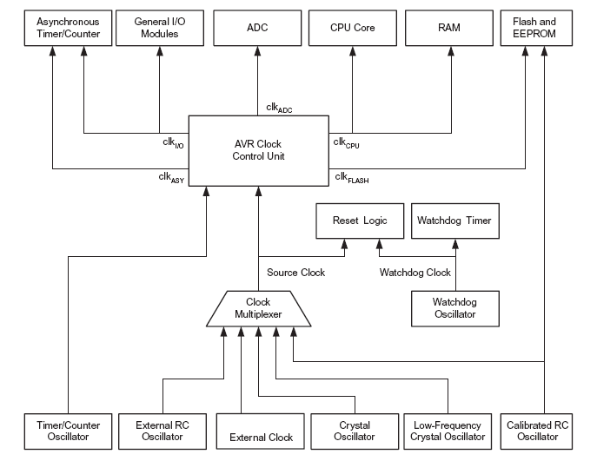
II: Atmega8 – Basic features
System Clock Options:

Slide 23
II: Atmega8 – Basic features
System Clock Options:
● Clock Muliplexer selects the clock
source according to FUSE settings
● Clock Control Unit distributes clocks
clocks can be halted to reduce power
consumption
● CPU Clock: CPU, ALU, GPRs
● I/O Clock: Ports, Timers, SPI, UART
● ADC Clock: seperate cock for ADC
noise reduction in sleep mode
● Asynchronous Timer Clock:
external 32kHz Crystal for realtime clock,
keeps timer module running during sleep mode

Slide 24
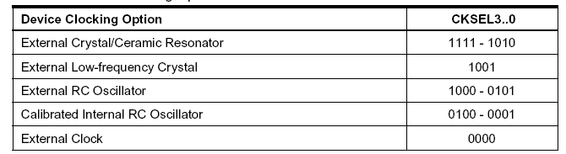
II: Atmega8 – Basic features
System Clock Options - FUSE bits:
● The four CKSEL Bits of the FUSE – Byte select the main Clock Source
● The startup time to stabilize power supply and oscillator can be changed
with the SUT fuses
● The device is shipped with CKSEL = 0001 ( 1 MHZ internal RC oscillator )
and SUT = 10 ( slowly rising power, 65ms )

Slide 25
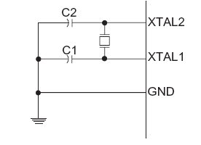
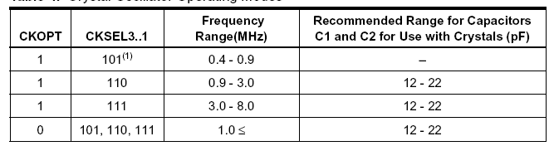
II: Atmega8 – Basic features
System Clock Options - using an external crystal:
● CKOPT influences the output swing of the inverting oscillator amplifier
(1 = full rail to rail swing, 0 = power save mode)
● For crystals from 3 – 8 MHz set CKOPT = 1 and CKSEL3..1 = 111

Slide 26
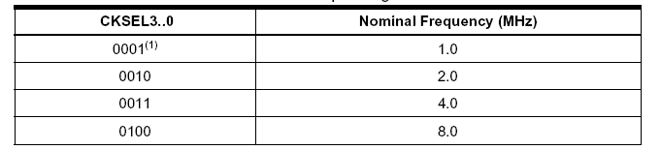
II: Atmega8 – Basic features
System Clock Options - using the internal RC oscillator
  ● Fixed 1, 2, 4 or 8 MHz clock
  ● works without external components
  ● changes with temperature and operating voltage
detailed information on other clock options, startup times, calibration
is found in the ATmega8 data sheet, pp. 23

Slide 27
II: Atmega8 – Basic features
I/O Ports

Slide 28
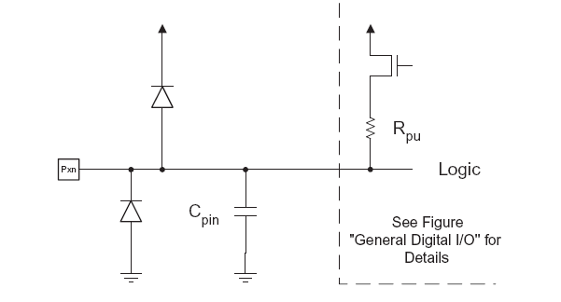
II: Atmega8 – Basic features
I/O Ports
● General Purpose IO : Data Direction Input or Output
● Internal Pullup can be used for Input Pins
● Output driver can source 20mA current
● protection diodes to GND and VCC

Slide 29
II: Atmega8 – Basic features
I/O Ports
● 3 I/O-Registers for each port:
Data Register (r/w):
PORTB, PORTC, PORTD
Data Direction Register (r/w):
DDRB, DDRC, DDRD
Port Input Pin Register (r):
PINB, PINC, PIND
The Bits of these registers set the configuration for one Port Pin.

Slide 30
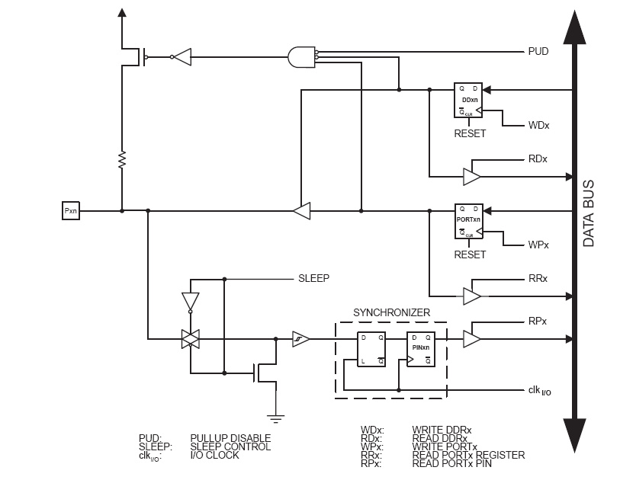
II: Atmega8 – Basic features
I/O Ports
General Digital IO
Logic of GPIO-Ports:
DDx
PORTx
PINx
Common to all Ports:
Pullup disable (PUD),
SLEEP

Slide 31
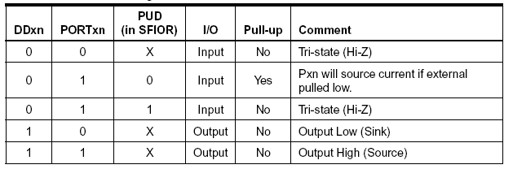
II: Atmega8 – Basic features
I/O Ports – Configuration and usage
C-Example 1 - Configure Pin B3 as output, set output level to VCC:
DDRB |= (1<<3); PORTB |= (1<<3);
C-Example 2 - Configure Pin D2 as input with pullup, read pin value:
DDRD &= ~(1<<2); PORTD |= (1<<2); uint8_t x = PIND & (1<<2);

Slide 32
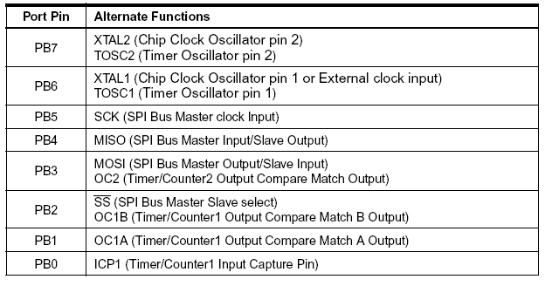
II: Atmega8 – Basic features
Alternate Port functions Port B

Slide 33
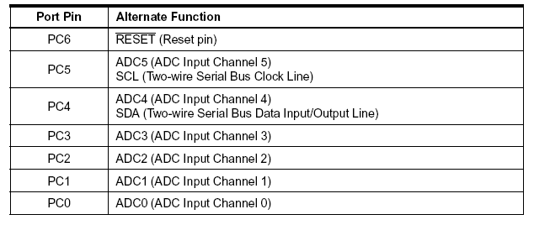
II: Atmega8 – Basic features
Alternate Port functions Port C

Slide 34
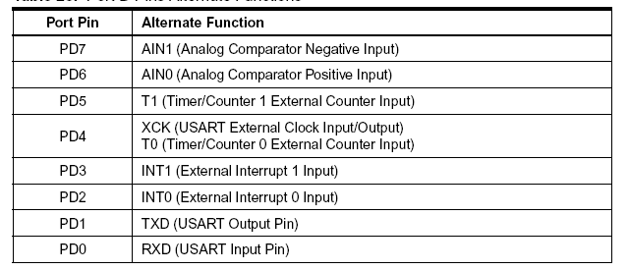
II: Atmega8 – Basic features
Alternate Port functions Port D

Slide 35
II: Atmega8 – Basic features
Reset- and Interrupt Handling

Slide 36
II: Atmega8 – Basic features
Interrupt Processing
● several Interrupt Sources:
External Interrupts, Timer, Bus-Peripherals,
ADC, EEPROM
● individual Interrupt-Enable bits in the SFR‘s
● global interrupt enable Bit in SREG,
set with sei() and clear with cli() instruction
● flagged (remembered) and non-flagged interrupt sources
● lowest addresses in program memory reserved
for the interrupt vector table
● higher priority interrupts have lower addresses

Slide 37
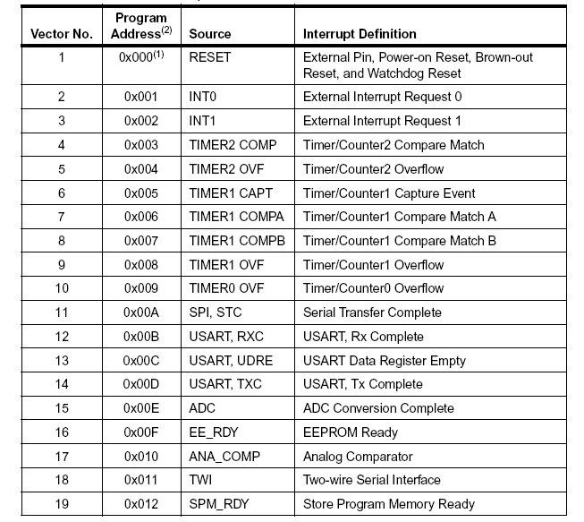
II: Atmega8 – Basic features
Reset-Vector and
Interrupt-Vectors
● Word addresses
0, 1 – 19 in Flash Ram
● When a reset or
interrupt occurs,
the CPU calls
the address
● Install an Interrupt
Handler: modify
the vector table to
jump to your user-
handler
● return from interrupt:
reti

Slide 38
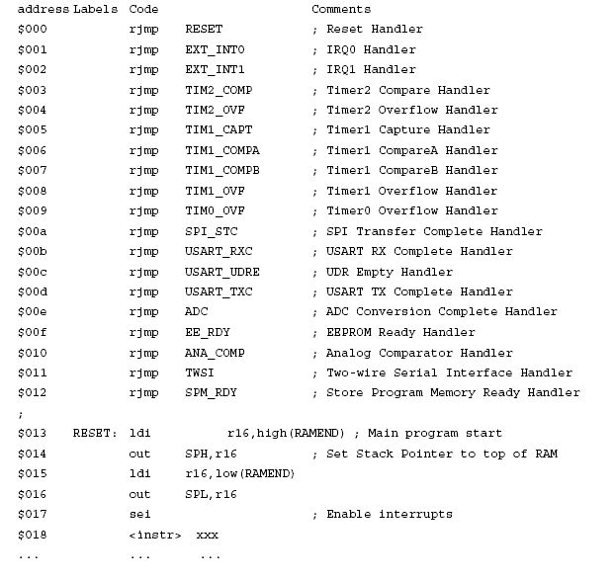
II: Atmega8 – Basic features
Reset-Vector and
Interrupt-Vectors
● example shows
full featured
vector table
● 19 handlers installed
● program execution
after reset:
jmp RESET ($013)
● Main program is
located at $013,
beyond the vectors

Slide 39
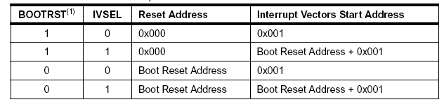
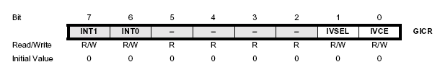
II: Atmega8 – Basic features
Reset- and Interrupt- Vectors
● Reset vector can be set to the Bootloader section using the
BOOTRST fuse bit
● Interrupt vectors can be set to the Bootloader
section using the IVSEL bit of the General Interrupt Contol Register

Slide 40
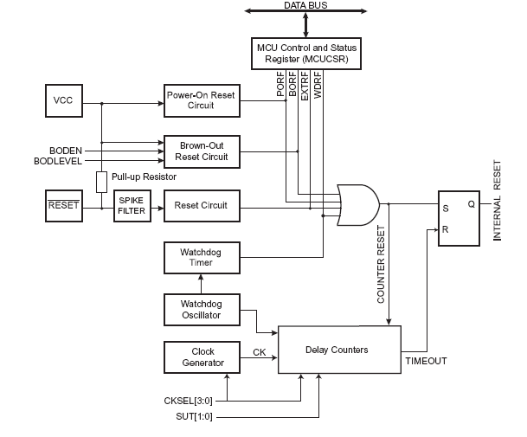
II: Atmega8 – Basic features
AVR Reset Sources:

Slide 41
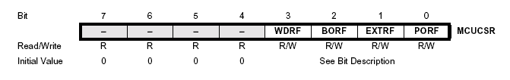
II: Atmega8 – Basic features
Reset Sources:
• Power-on Reset: supply voltage is
below the Power-on Reset threshold
• External Reset: low level is present on
/RESET – input pin
• Watchdog Reset: Watchdog Timer
enabled and period expires
• Brown-out Reset: Brown-out Detector
enabled and supply voltage below
threshold
MCUCSR provides information on which reset source caused a CPU reset

Slide 42
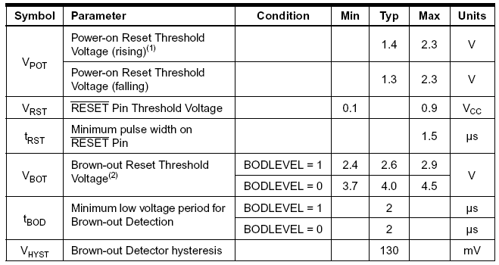
II: Atmega8 – Basic features
Reset Voltage Thresholds

Slide 43
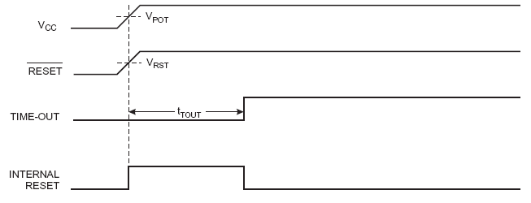
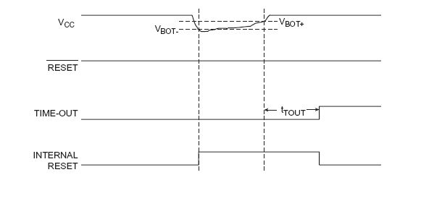
II: Atmega8 – Basic features
Reset Voltage Thresholds:
Example:
Power-on Reset
Example:
Brown Out Reset

Slide 44
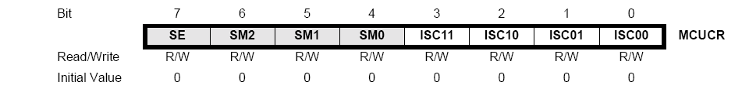
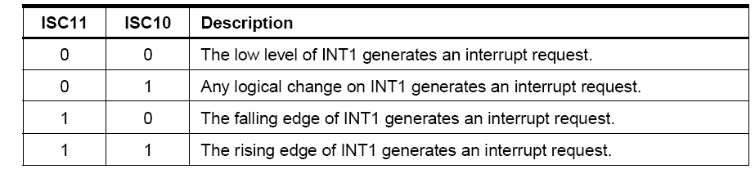
II: Atmega8 – Basic features
External Interrupts Int0 and Int1:
• Int0 connected to PD2
• Int1 connected to PD3
• asynchronous operation: can wake up CPU
• rising/falling edge or low level can trigger interrupt,
defined by Interrupt Sense control – bits of MCUCR SFU

Slide 45
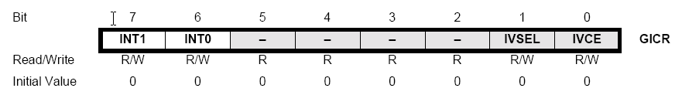
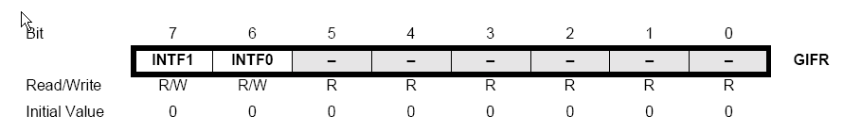
II: Atmega8 – Basic features
External Interrupts Int0 and Int1:
• Int0 and Int1 have to be enabled by the GICR (+ I-bit in SREG)
• flagged interrupts: General Interrupt Flag Register (GIFR)
indicates when an interrupt request happened
• flags are cleared by executing the interrupt service routine (ISR)
or by writing 1 to the flag bit of GIFR

Slide 46
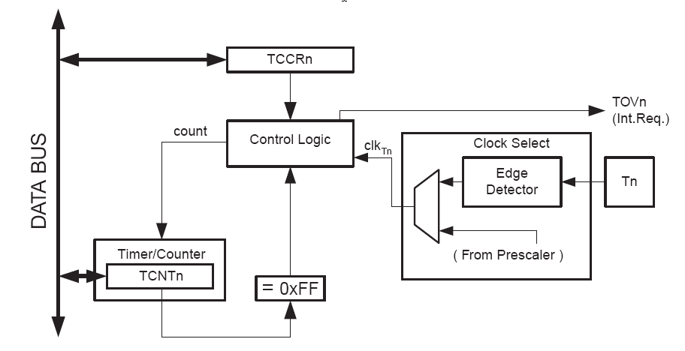
II: Atmega8 – Basic features
8-bit Timer / Counter0
• 10-bit clock Prescaler
timer-clk (t0) = clk (IO) / prescaler
• External clock source T0 connected to PD4
cannot be prescaled, clk(ext) <= clk (IO) / 2.5

Slide 47
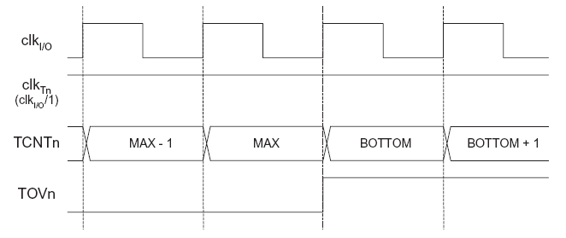
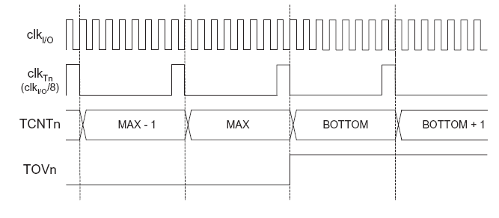
II: Atmega8 – Basic features
8-bit Timer / Counter0 - prescaler operation
No prescaler
MAX=0xff
BOTTOM=0
Prescaler = 8

Slide 48
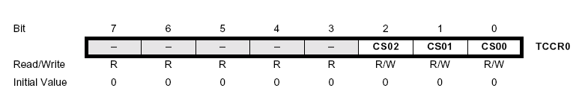
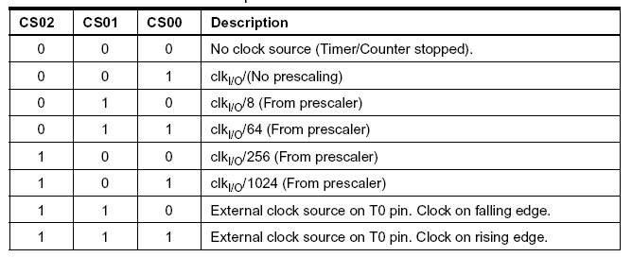
II: Atmega8 – Basic features
8-bit Timer / Counter0 usage
Timer/Counter0 Control Register (TCCR0), Bits CS02-CS00
select Clock Source and Prescaler Value :

Slide 49
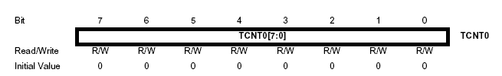
II: Atmega8 – Basic features
8-bit Timer / Counter0 usage
Timer/Counter0 Register (TCNT0) :
read/write, incremented per CLK cycle, overflow: 0xff
• A Reload-Value is used to fine-tune the interrupt interval
• write Reload-Value to TCNT0 in the ISR

Slide 50
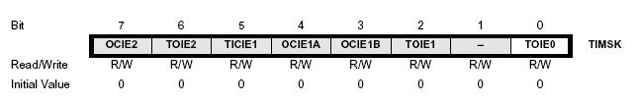
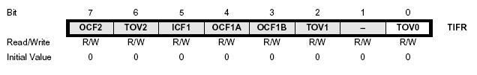
II: Atmega8 – Basic features
8-bit Timer / Counter0 usage
Timer/Counter Interrupt Mask Register (TIMSK) :
Bit 0 : Timer 0 interrupt enable
set 1 to enable timer 0 overflow interrupt ( + I-Bit in SREG)
Timer Interrupt Flag Register (TIFR) :
TOV0 indicates a Timer0 overflow, cleared by hardware when
the ISR is executed or by writing 1 to the flag

