Slide 1


Increasing access to Local Language Content
Virtual Digital Noolaham
Presenter:
Shaseevan Ganeshananthan

Slide 2


Contents
Problem Statement
Motivation
What is Noolaham?
Features &Functionality
Benefits Achieved
Challenges Faced
Future Work

Slide 3
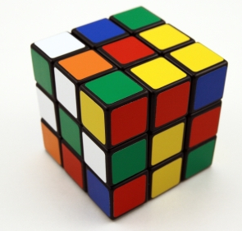
Problem Statement
Relevant local content has to be made accessible.
Different categories of Tamil speaking communities exist in Sri Lanka.
Need to access their language content through various means.
To conduct research and to make researchers get involved in the welfare of these communities

Slide 4
Motivation
To create a virtual digital library.
To enhance access : increased access and new forms of access
To engage in research.
To collaborate with similar efforts.
“Noolaham”

Slide 5
What is “Noolaham”?
A non‐profitable, collective endeavor
Indexes published content which are online
Enables increased access to the traditional local language content
Noolaham Foundation collaborates with various institutions and projects in order to create a collaborative Virtual Digital Library (VDL).

Slide 6
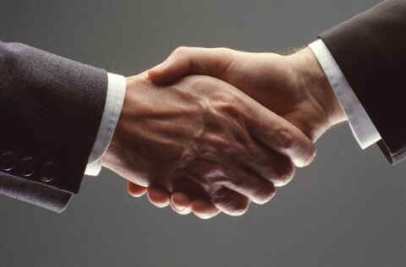
Participation
Participants from all around the world
Direct participation in wiki contribution and other contributions such as donations, coordination of projects..
Collaboration made with various organizations like WERC
Many prominent publishers reposit their work at Noolaham
Noolaham is truly global by virtue of its participants and functioning

Slide 7
Indexed Projects
Project Noolaham
Internet Archive
ULIB (Universal Digital Library)
Tamil Heritage Foundation
Project Thamizham
Muktabodha
Jainworld
Others

Slide 8
Growth of Noolaham
100
2888
362
1618
3800
June 2009
Year
2008
2007
2006
2005
Indexed Documents

Slide 9
Noolaham System
Noolaham
Document Types
Books
Magazines
Categories
Authors
Newspapers
Pamphlets
Research Papers
Year of Publication
Publishers
Book Type
Network
Portals
Mallihai
Grantha

Slide 10
Sectional Overview

Slide 11
Unique Visits per Month

Slide 12

Technology
MediaWiki – Open Source Software
Designed for open collaboration
Registered users can edit the web pages
Pages are creating using Wiki Markup
All Contribution are logged in the Mediawiki System
Enhancing access
Open access
Browsable metadata categories
Various user interfaces

Slide 13
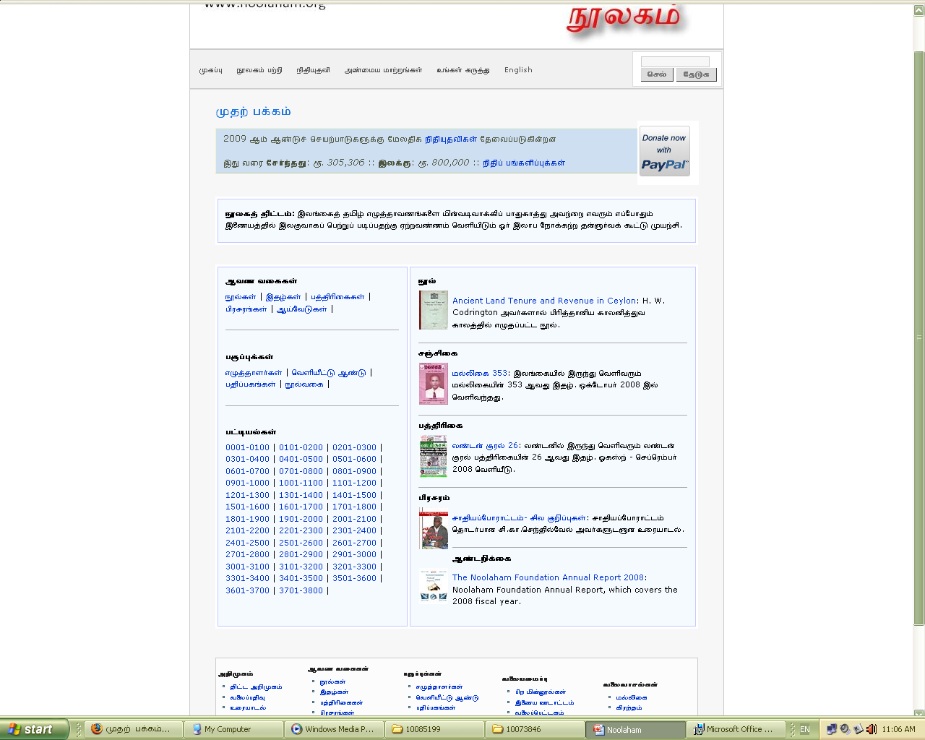
Main Menu Bar
Search Bar
You can donate with Paypal ☺
Donation Template
Noolaham Short Intro
Browse by Category
Prominent Newly Added Documents
Noolaham Document List
Easy Quick Navigation Bar

Slide 14
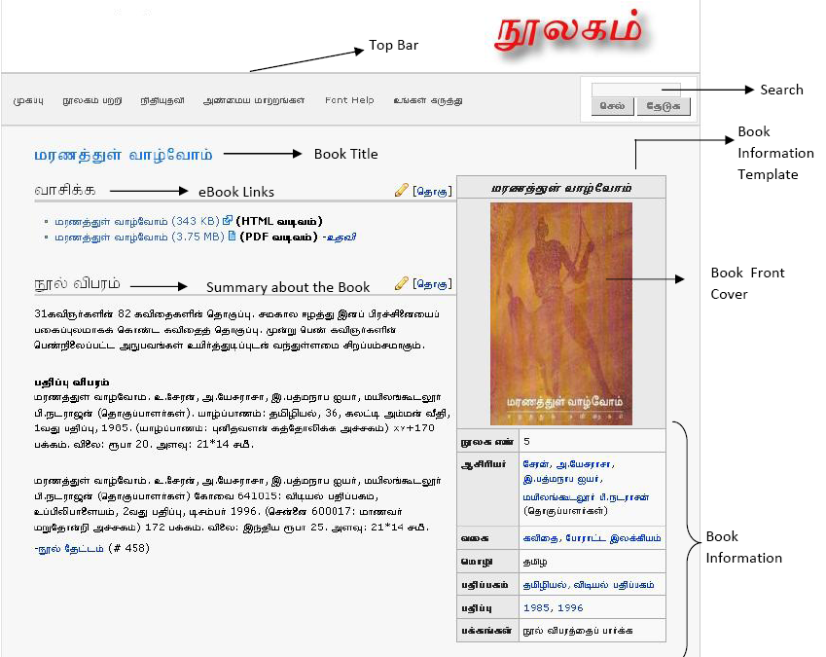
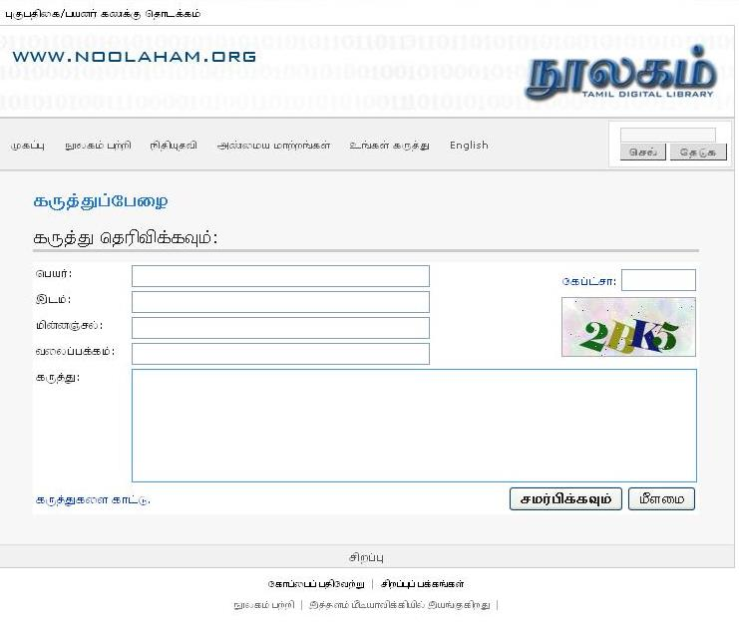

Slide 15

Benefits Achieved
Enables increased access to traditional local language content
Supports cognitive work of scholars and researchers
Literary Heritage is being indexed for future generation
Enables social interaction for the achievement of constructive social outcomes
Functions as a repository for various institutions

Slide 16
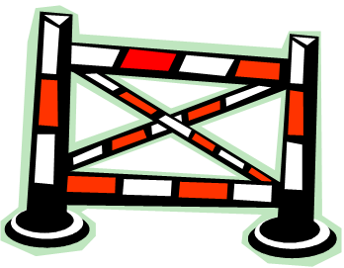
Challenges Faced
Noolaham Depends on Voluntary Contribution
Insufficient Voluntary Contribution
Slows the pace of the work being done
Financial Difficulties

Slide 17

Future Work
To implement web 2.0 concepts in to the system
Empower researchers/users to collaborate in knowledge creation
Communicate this to schools, universities, libraries and private institutions

Slide 18
A Last Thought..
“The ready availability of relevant local language content is critical for the development of productive capacity… Without locally relevant content in local languages, immediate uses of ICTs for day-to-day activities may not be apparent.”
- Danny Butt and Madanmohan Rao
(PAN Localisation - Authors’ Working Group on Content)

Slide 19

Thank You !

