Slide 1
Social connections and loneliness
shachar kalderon , Noga eichenbaum

Slide 2
Dataset
We chose ISSP 2017 - Social Networks and Social Resources.
This questionnaire measures social capital via personal networks, social justice attitudes, care responsibilities, help-seeking patterns, trust and loneliness, and civic participation norms.
Following our Preliminary analysis, we continued to focused on questions regarding social habits, connections, and perceived loneliness, depression or isolation.

Slide 3
Background
initially we decided to explore the relation between how frequently one felt depressed or lonely in the last month (Q28 in the questionnaire) and other variables, such as; the country of origin, age and how often does one talk to family or friends.

Slide 4
depressed vs. how much you socialize
Since we really wanted to see the connection between Q28 (perceived depression ) and how much you socialize with other people:
Q21 – frequency of communication with parents
Q25 - frequency of communication with close friends
we decided to check the correlation and distribution by mean for these questions in relation to Q28.

Slide 5
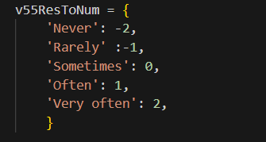
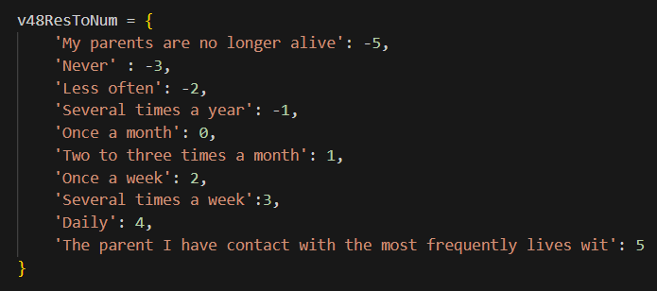
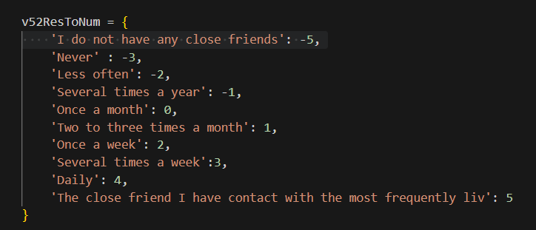
mapping we used:
Q28 Q21
Q25

Slide 6
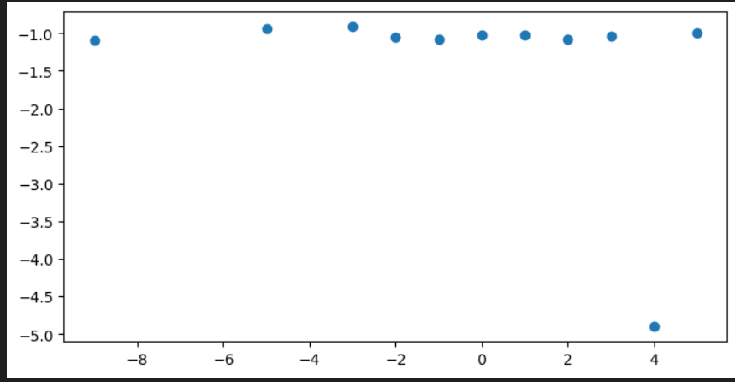
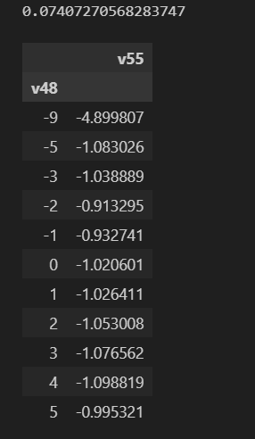
Results( Q21 to Q28)

Slide 7
We ended getting a relatively straight line .
From this we gathered that, most respondents are rarely depressed regardless of how often they talk to their parents aside from a few exceptions.
However, we considered that analyzing the relationship by examining the distribution of responses to Q28 based on another parameter, rather than the overall average responses, might provide a more precise measure of the correlation between the questions.

Slide 8
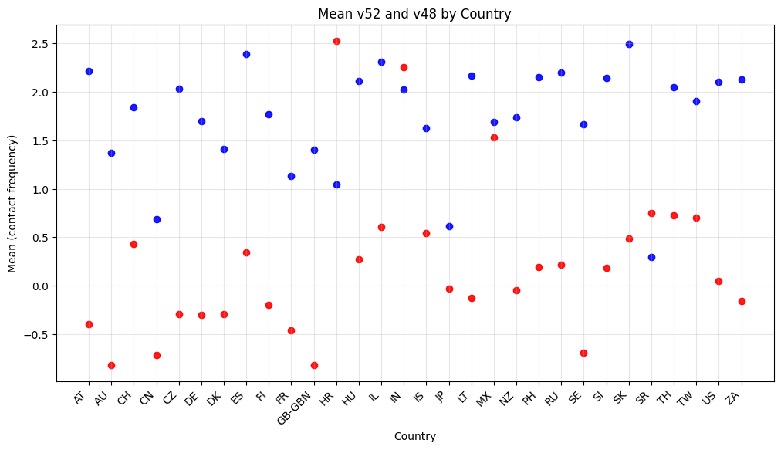
Sociability by country
So, we looked at the average amount of communication people had with parents or friends, broken down by country, and combined the scatter plots into one graph to see a better comparison.
red - Q25 (friends) vs. blue - Q21(parents)

Slide 9
As shown in the graph, most countries’ mean for communication with parents is around 0 (between several times a year and once a month) and around 2 (once a week) when it comes to communication with friends.
It seems that except for a few outliers most people across various countries engage with their close friends more often than their parents.
Some patterns in this graph also hint at a possible link between the two.
Based on this, we hypothesized there might be a correlation between the responses to Q21 and Q25 when analyzed by country averages (using the mapped values), rather than by the mean of other question responses as initially done.
Consequently, we decided to pursue this approach next.

Slide 10
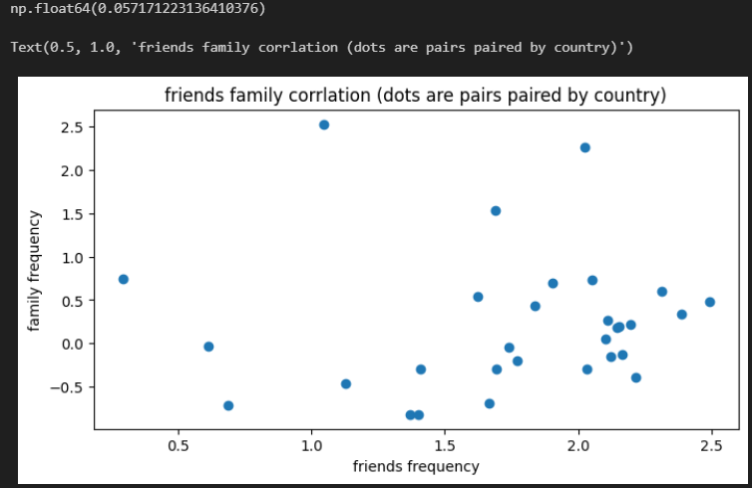
Here are the results we obtained:
Correlation:
Although no direct correlation is clearly observed, there seems to be a pattern that reinforces our previous conclusion:
most individuals interact more frequently with their friends and peers than with their parents.
* both questions values are in the same range according to the mapping hence 1.0 frequency in talking to parents is lower the 2.0 talking to friends

Slide 11
depression vs. sociability (by country)
After identifying a stronger correlation between the questions than in our initial attempt, we chose to apply the country means pairing method to examine the relationship between Q21 and Q25 through Q28 to determine if this approach yields improved results compared to those previously presented.
We computed the average responses for each question by the respondent's country, then paired the results of Q21-Q28 and Q25-Q28, plotting them together on a single scatter graph.
Q21 - Frequency of communication with your parents
Q25 - Frequency of communication with your friends
Q28 - Level of depression experienced

Slide 12
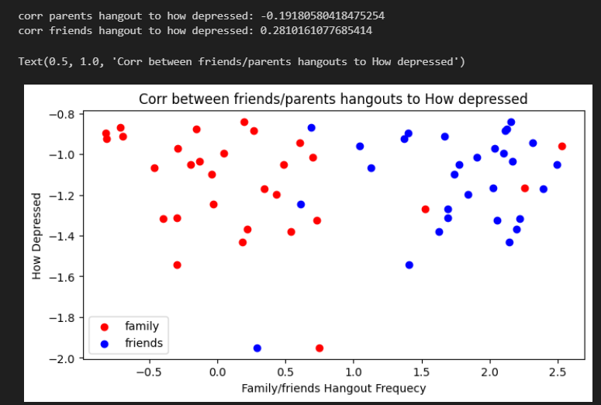
Here is the outcome we obtained:
​
* Each point corresponds to the average value for a given country.
As a result, each country is represented by two mean values shown as dots on the perceived depression scale.

Slide 13
The graph demonstrates that the majority of country means fall between -1.6 and -1 regarding depression levels, suggesting that most countries report minimal to no perceived feelings of depression.
Furthermore, a noticeable distinction exists between the mean frequencies of communication with parents and friends, with individuals tending to communicate more frequently with friends than with parents.
Based on this observation, we deduced that there may be no definitive correlation between the frequency of social interactions with either family or friends and depression levels across countries.
Considering these findings align with prior conclusions, we opted to reassess the latest analyses using an alternative parameter.

Slide 14
Third topic - depressed correlation by age
In addition to country, the questionnaire includes other parameters for classifying respondents, one of which is age.
Although the questionnaire covers only 30 countries, it includes participants from 88 different age groups.
Therefore, we considered age as a potentially more significant factor for calculating the mean responses ([1]).
We chose to re-evaluate earlier questions by computing the average answers for each question based on age rather than country and then comparing the results across age groups.
[1] -due to a bigger number of point which will bring to a more accurate distribution

Slide 15
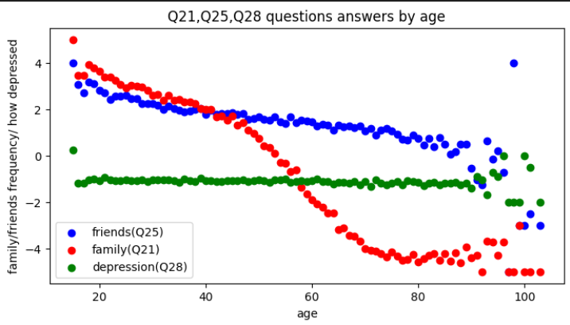
First, we decided to test the age effect on the answer to each question:

Slide 16
The graph illustrates that as age increases, communication with friends decreases, and communication with family declines even more sharply, while levels of depression remain relatively constant (hinting at a finding we will discuss later).
Subsequently, we examined the correlation between the frequency of communication with friends and with parents, applying the age group categorization. As well as applying a polynomial regression given the shape of graph we obtained.

Slide 17
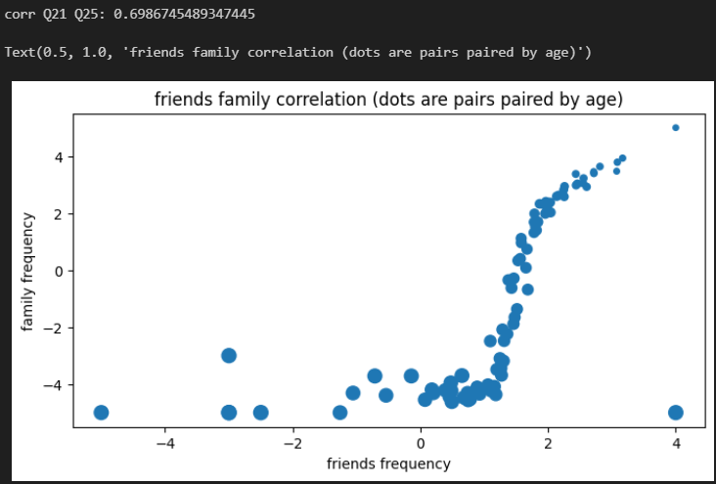
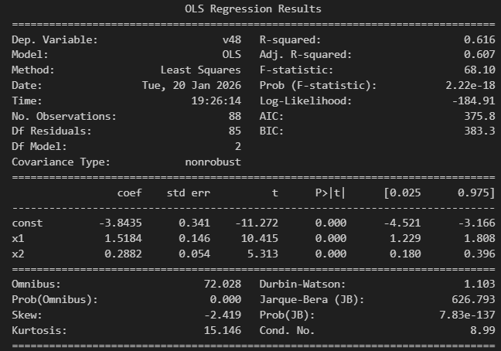
And this is the result we got:
Polynomial regression

Slide 18
This time, there is a clear correlation between the frequency of conversations with friends and family.
It appears that increased communication with family corresponds with more frequent interactions with friends, which contrasts with previous findings.
The dot size in the graph represents the age group used to pair responses from the two questions.
This allows us to observe that most age groups ([1]) closely follow this trend, while the older age groups ([2]) serve as outliers.
[1] -15-89 , 15 is the min age for this graph
[2] 90-103 , 103 is the max age for this graph

Slide 19
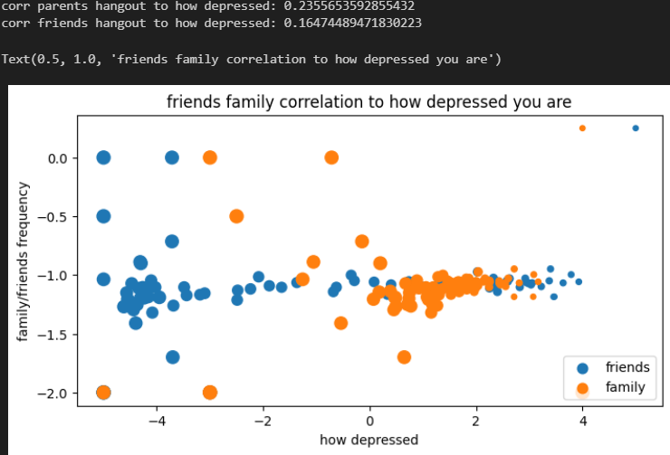
Since we got a clear correlation in the two different analyses we did with age, we decided to test the connection of how often you talk to family/friends to how depressed you are, using the same age grouping method.
This is the result:
* (The size of the dot in the graph is determined by the age used to pair the results of the two questions together)

Slide 20
Once again, our findings indicate that there is no clear correlation between the frequency of communication with family and friends and levels of depression. Even across various age groups.
It appears that the majority of individuals report low levels of depression regardless of their responses to the questions. This observation was also suggested by the age-based response graph, which shows consistent answers across age groups, except for the 90 to 103 age range where there is greater variability in the results.[1]
Unsatisfied with this outcome, we chose to explore alternative questions to determine if they might influence the reported levels of depression.
[1] - the age range of 90-100 are scattered across the left-middle side of the graph.

Slide 21
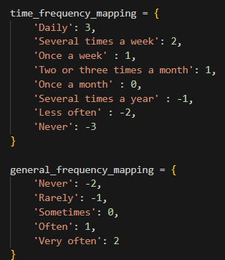
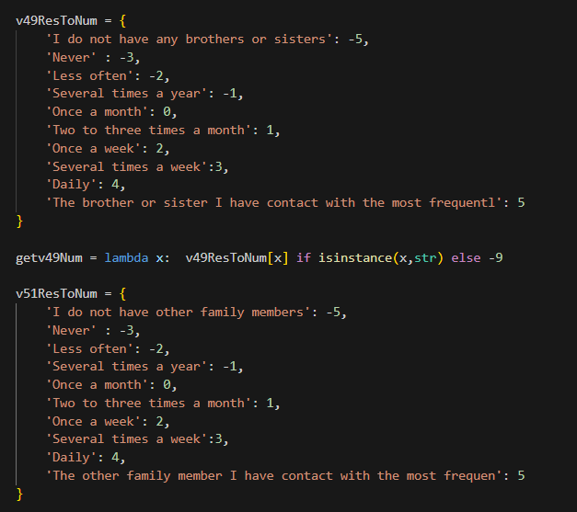
mapping we used:
Q17
Q22
Q24
Q16, Q19

Slide 22
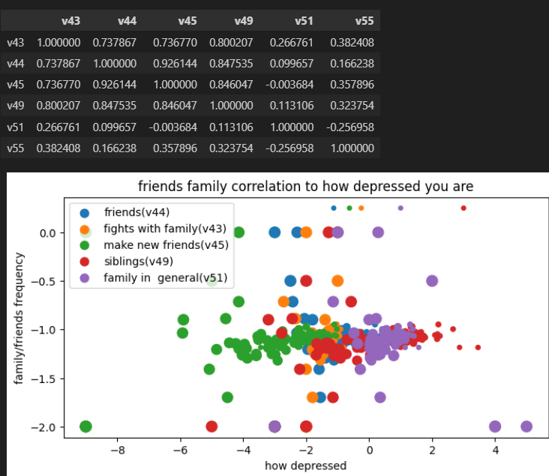
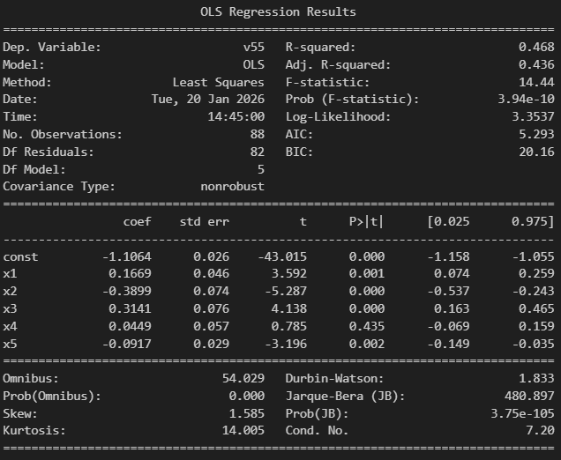
And this is the result we got:
X1- v43, x2- v44, x3- v45,x4- v49, x5- v51(this is normalized)

Slide 23
Once again, our analysis confirmed that there is no significant correlation between the amount of communication with family and friends and the level of depression, even after examining different questions.
Furthermore, the correlation map indicates that questions v43 (Q16 [1] ), v44 (Q17 [2] ), v45 (Q18 [3]), and v49 (Q22 [4]) exhibit stronger correlations among themselves than with the depression measure (v55), which aligns with intuitive expectations.
Similar patterns are observed in the linear regression results, although these should be interpreted cautiously due to an R² value below 0.5. Notably, the regression suggests that the effect of v49 (Q22) is insignificant, which contrasts with the findings from the correlation graph.
Given these unsatisfactory outcomes, we have decided to revisit the analysis by exploring combinations of questions to better understand the relationships.
[1] -Past 4 weeks how often: family members act angry with you
[2] -How often: go out with friends or acquaintances?
[3]-How often: make new friends when going out with friends?
[4]-How often contact with sibling most frequently in contact with?

Slide 24
The metrics we created
family connections:
1. v48:think about the parent you have contact with most frequently: How often do you
have contact with that parent, either face-to-face, by phone, internet or any other
communication device?
2. v46:Please indicate about how many people do you have contact with on a typical weekday
irrespective of whether you know them or not.
3. v47:About how many of *these people do you see face-to-face on a typical weekday?
*Refers to the previous question.
4. v53: Think now of your contact with all of your family members and close friends. How much of it is through text messages, mobile phones, or other communication devices that use the
internet?
5. v41: In general, do your family members put pressure on you about the way you live or organize your personal life?
6. v42: Do you feel that your family, relatives and/or friends make too many demands on you?
7. v49: Think about the brother or sister you have contact with most frequently: How often do you
have contact with that brother or sister, either face-to-face, by phone, internet or any other
communication device?
8. v50: Think about your adult child you have contact with most frequently: How often do you
have contact with this child aged at least 18, either face-to-face, by phone, internet or any other
communication device?
9. v51: Now, think about the other family member you have contact with most frequently, aside of your spouse or partner, parents, siblings or adult children. How often do you have contact with that family member, either face-to-face, by phone, internet or any other communication device?
loneliness metric:
1. How often in the past 4 weeks have you felt that…
v31: you lack companionship?
v32: you are isolated from others?
v33: you are left out?
2. During the past 4 weeks how often…
v55: have you felt unhappy and depressed?
v56: have you felt difficulties were piling up so high that you could not overcome them?
3. v58: All things considered, how satisfied are you with your life nowadays?
friend connections:
1.v44 :How often do you go out to eat or drink with three or more friends or acquaintances who are not family members?
2. v45 :At these occasions, how often do you make new friends or acquaintances?
*referring to v44
3. v52:think about the close friend you have contact with most frequently: How often do you have contact with that close friend, either face-to-face, by phone, internet or any other communication device?
4. v17: In the past 12 months, how often, if at all, have you taken part in activities of groups or associations for leisure, sports or culture ?

Slide 25
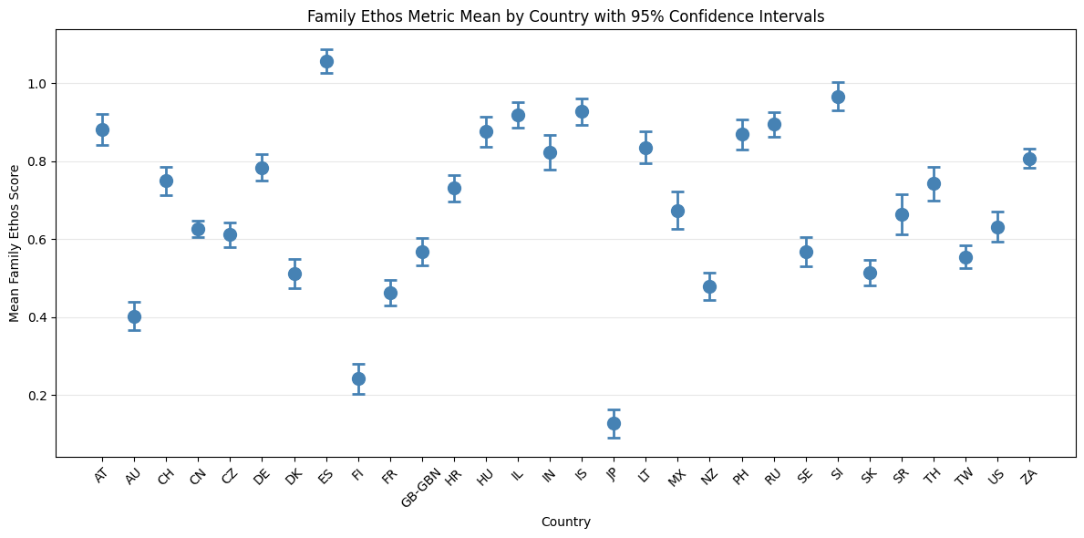
initial tests with new metrics
We repeated testing by country, anticipating that expanding our scope could yield different results and potentially lead to more definitive conclusions.
Additionally, we incorporated a 95% confidence interval in several of the plots.
Japan (JP, Lowest)
Cultural norms emphasize indirect communication and emotional restraint
A demanding work environment reduces opportunities for family interaction
Finland (FI, Second-Lowest)
Cultural values prioritize independence and self-reliance
Preference for personal space and a reserved communication style
Spain (ES, Highest)
Strong emphasis on close family ties and multi-generational living
More expressive, communicative, and collectivist cultural values
Traditions include frequent family gatherings and social interactions

Slide 26
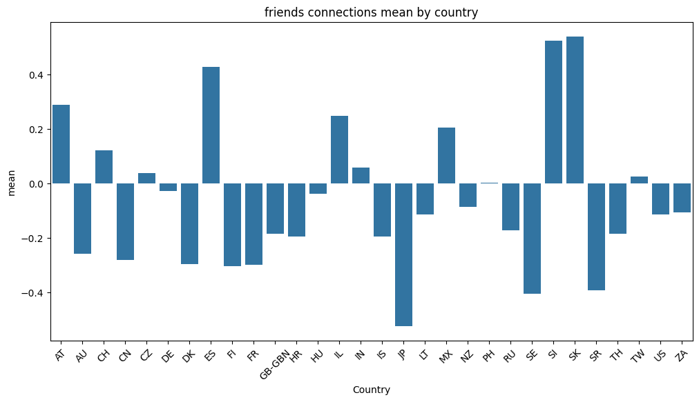
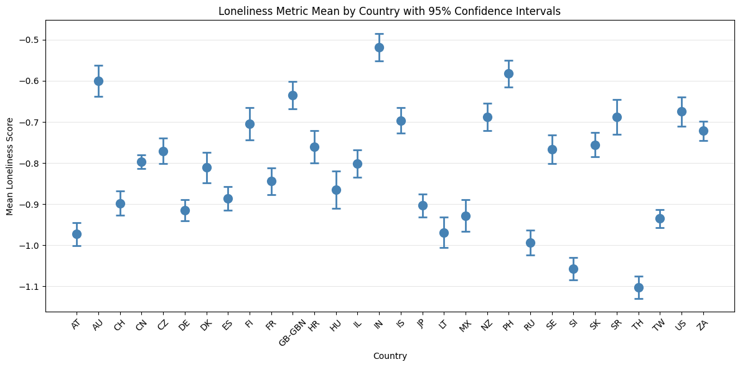
As illustrated, this graph exhibits the greatest variance in mean values,
with Japan maintaining the lowest mean while Spain ranks among the highest.
These differences can be attributed to the factors previously discussed.
Most countries cluster around similar loneliness means
India and Japan emerge as notable outliers
India (Surprising Outlier - High Loneliness) Contradicts expectations given strong collectivist values and tight family/community structures (similar to Spain)
Japan (Interesting Paradox) Lowest communication frequency with family and friends, Yet exhibits one of the lower loneliness means
Emphasizes our general conclusion that loneliness is highly subjective and not directly correlated with communication frequency.

Slide 27
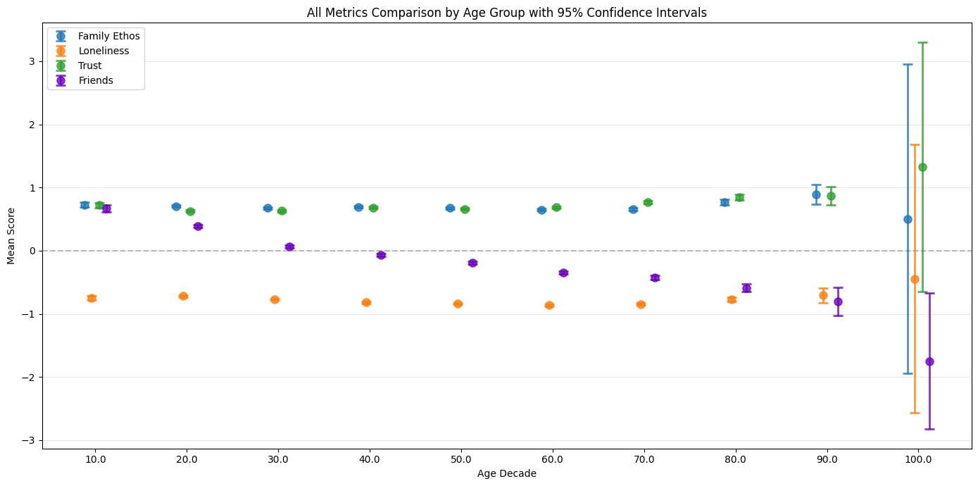
Further tests
We started by analyzing the average values of our metrics across different age groups, incorporating 95% confidence intervals to gain deeper insight into possible trends.
The following is the final combined plot displaying the means of all three metrics to examine potential correlations.
As observed, the confidence intervals are quite narrow around the means, except for the small group of respondents aged over 100.
(Indeed, one respondent is 103 years old!)
* It is important to note that we initially evaluated a Trust metric; however, we discontinued its use because it did not demonstrate significant correlations with any of our other metrics.

Slide 28
Further conclusions
Interestingly, contrary to our earlier findings when analyzing isolated questions about communication with parents versus friends, the mean of family connections metric, which also includes questions about siblings and children, remains relatively stable across all age groups, with a slight increase among older respondents.
This trend can be intuitively explained by people's growing reliance on family as they age. where reduced communication with parents in older groups is offset by more frequent interactions with children and siblings.
Conversely, the friends’ connections metric gradually declines with age, suggesting a reduction in social activities and fewer outings.
Additionally, a similar pattern is observed in the family ethos and loneliness metrics across different age groups.

Slide 29
Final conclusions
To conclude, our aim was to test whether communication frequency with family and friends was associated with perceived depression or loneliness.
We first analyzed individual survey questions by country and age group, then created composite measures by averaging related items. Across all analyses, we found no clear correlation.
This outcome may be attributed to the subjective and complex nature of loneliness and depression.
Such experiences are complex and influenced by a wide range of factors, including social norms, culture, household environment, education, and more, making it difficult to link them directly to any single external metric.

