Slide 1
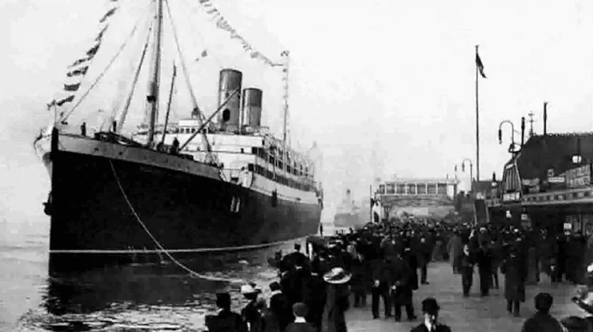
Prediction of survivor on Titanic

Slide 2
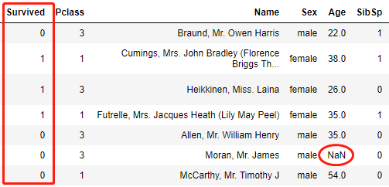
Quick intro to data set
Slice:
Dimension: 891 X 12

Slide 3
Research problem
Approach
Evaluation
Result
What was the key factors that made passengers survive?
Can we predict survivers in a similar situation?

Slide 4
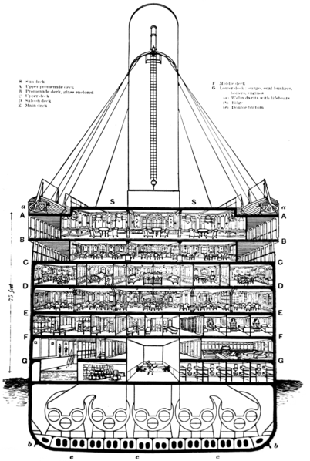
Research problem
Approach
Evaluation
Result
Feature engineering
Split data into train & test set
Model selection: (GridSearch)
Baseline model : Naïve Bayes
Decision Tree & Random Forest & Logistics regression
Ensemble model (Voting classifier)
Evaluation.

Slide 5
Research problem
Approach
Evaluation
Result
F1-score & Accuracy
Five models → Best model
ROC & AUC
Baseline vs Best model
McNemar’s test
Baseline vs Best model

Slide 6
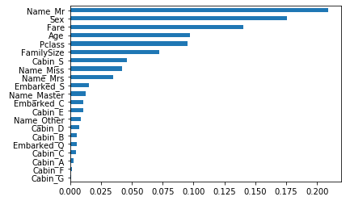
Features importance
From Random Forest
Most important: gender, Fare, Age, class of people

Slide 7
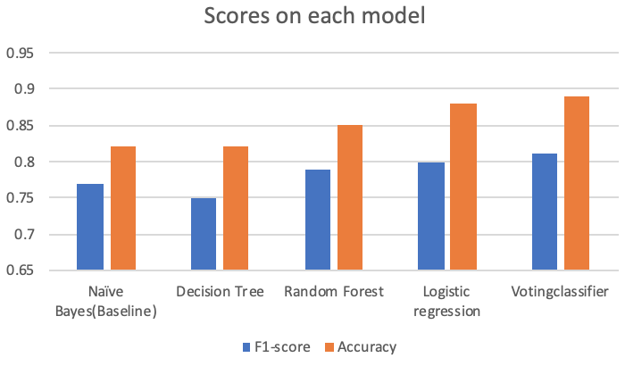
F1-score &Accuracy
Best model: Voting Classifier

Slide 8
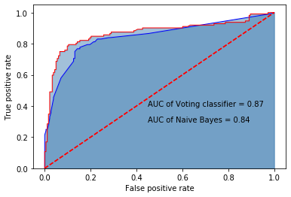
ROC & AUC
Baseline vs Best model
Voting Classifier:
Naïve Bayes:

Slide 9
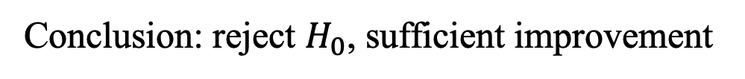
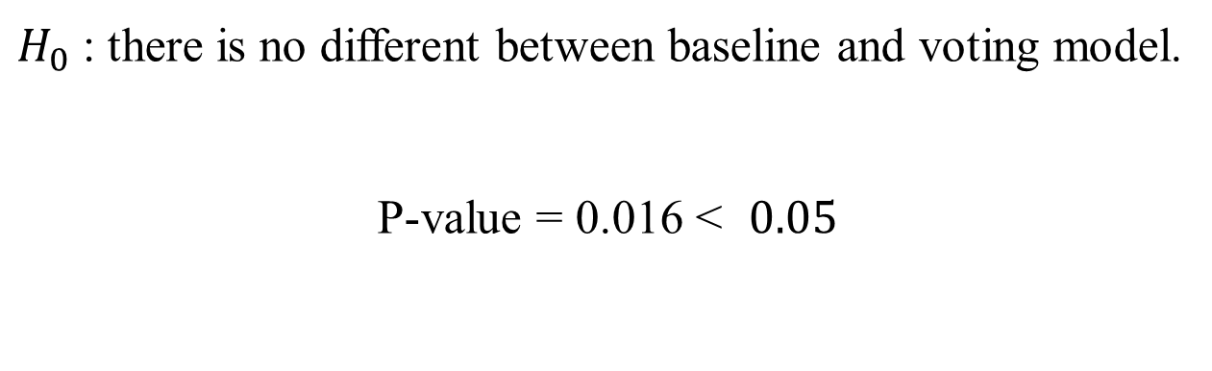
MC Nemar’s Test
Baseline vs Best model
$H_{0}$: there is no different between baseline and voting model.
P-value = 0.016 < $0.05$
Conclusion: reject $H_{0}$, sufficient improvement

Slide 10
Thank you!

