Slide 1

The Clotting System
The Big Cover-Up

Slide 2
The Platelets

Slide 3
The Most Common Cause of Clots
Most Common Cause of Venous Clot
Stasis
Most Common Cause of Arterial Clots
Endothelial damage
This damage exposes VWF
  Most common cause is sepsis

Slide 4
A Triangle of Risk Factors
Endothelial Damage
Hypercoagulable state
Stasis

Slide 5
Hypercoagulable States
These are rare
Most common genetic cause of venous clots
  Factor V Leiden defect

Slide 6
Platelets
First cells involved for arterial clots, and last cells involved in venous clots

Slide 7
VWF
First clotting factor to be exposed when the basement membrane is damaged
Platelets anchor to this with their glycoprotein 1-B

Slide 8
Platelets
Last only 8 to 10 days in circulation
Originate from the bone marrow from megakaryocytes
Are responsible for bleeding from the skin and mucosal surfaces
Deficiency: leads to petechiae, purpura and ecchymoses and mucosal bleeding
Normal: 150K to 350K

Slide 9
Bleeding Time
A measure of platelet function
Normal is 5 to 6 minutes

Slide 10
Thrombocytosis
Thrombocythemia: more than two standard deviations too high
Primary: myeloproliferative syndrome (cancer)
Secondary: reactive

Slide 11
Thrombotic Microangiopathy
Main cell involved is the platelet
Causes tiny clots-involves platelets and VWF only
TTP
HUS
DIC

Slide 12
TTP
Most deadly vasculitis
Starts by attacking the brain
Deficiency of VWF esterase (AdamTS13)
Treat immediately with plasmapheresis

Slide 13
HUS
The most common cause of renal failure in children
Associated with E. Coli (raw hamburgers)
Endemic HUS: EHEC
Epidemic HUS: 0157:H7

Slide 14
DIC
Most common cause: (1) sepsis and (2) trauma
A consumptive coagulopathy
Labs: elevated fibrin split products and D-dimers
Labs: increased PT and PTT, low platelets

Slide 15
DIC Treatment
If low fibrinogen: use cryoprecipitate
If fibrinogen is normal: use FFP

Slide 16
Microangiopathic Hemolytic Anemia
Main cells involved: RBCs
Endothelial injury causes fibrin mesh, leading to schistocytes

Slide 17
Thrombocytopenia
Mcc: (1)viral infection (2) drugs
Due to platelet consumption: vasculitis
Due to autoimmune reaction: asa; heparin
Idiopathic Thrombocytopenic Purpura
  90% resolve without problems in children
  90% remain chronic in adults
  Can precede SLE in adolescent females
  Tx: Steroids. Do NOT transfuse platelets into a destructive process

Slide 18
ITP
Platelet counts you should know
  Normal: 150,000 to 350,000
  When to begin steroids: <40,000
  Risk of spontaneous bleeding: <20,000
    Plasmapheresis or IV gamma globulins
  Risk of spontaneous intracranial bleeding begins <10,000
    Splenectomy will raise platelet count over 100,000
One unit of platelets will increase your platelets by 7000 to 10000

Slide 19
Vaccination After Splenectomy
Give Prevnar 13 one week after surgery and follow with pneumovax 23 ten weeks later
Also give Hib and Meningococcal vaccines one week after the splenectomy

Slide 20
Thrombocytopenia
Viruses:
Parvovirus B-19
Hepatitis C
Hepatitis E
Drugs:
AZT
Vinblastine
Chloramphenicol
Benzene

Slide 21
Formation of the Platelet Plug
1. Platelet adhesion to injured vessel
2. Platelet degranulation
3. Platelet aggregation

Slide 22
Clotting Factors

Slide 23
Clotting Factors
Stop bleeding in cavities
Intrinsic clotting system
Extrinsic clotting system

Slide 24
Intrinsic Clotting Pathway
Involves Internal damage: NO external trauma
Most common cause: sepsis
Measure PTT

Slide 25
Extrinsic Clotting Pathway
Involves EXTERNAL trauma
Measure PT

Slide 26
Large Cavities
Intracranial
Mediastinum
Pleural
Pericardium
Abdominal
Pelvis
Retroperitoneum
Thighs

Slide 27
Intracranial Bleeding
Epidural bleeding: involves middle meningeal artery
Caused by trauma in temple area of scalp
Has a LENS shape on CT scan
Subdural bleeding: involves bridging veins
Has a crescent shaped side on CT scan

Slide 28
Mediastinal Bleeding
Cause by deceleration injuries
A tear in the aorta: widened mediastinum
To diagnose: do a spiral CT scan
Treatment: control BP, go to surgery

Slide 29
Pleural Cavity Bleeding
Causes: Gun shots and stab wounds

Slide 30
Pericardial Bleeding
Signs: Kussmaul sign; pulsus paradoxus
On EKG: electrical alternans; low voltage in all leads
On exam: pulsus alternans; distal of muffled heart sounds
On CXR: enlarged cardiac shadow
On echo: shrunken heart (from external pressure)

Slide 31
Abdominal Bleeding
Suspect it with gun shots and stab wounds
  ALL of these should go to surgery
Compartment syndrome: if abdomen suddenly gets tense after surgery with decreased urine output

Slide 32
Pelvic Fracture
Always keep the hip stabilized to avoid bleeding
If any urethral blood: do retrograde urethrogram

Slide 33
Retroperitoneal Bleeding
Commonly seen with pancreatitis
Grey-Turner sign
Cullen sign
Diagnose with CT scan

Slide 34
Thigh Fractures
Fat embolus: usually occurs on first day
  Give supplemental oxygen
DVT with pulmonary embolus usually occurs several days after the trauma
  Start heparin and supplemental oxygen

Slide 35
Compartment Syndrome
Pain
Pallor
Paresthesias
Poikilothermia
Paralysis
Pulselessness

Slide 36
Reflex Sympathetic Dystrophy
Severe autonomic discharge due to pain
Caused by Norepinephrine
Treatment: Phentolamine

Slide 37
Endothelium
Produce:
  Factor V
  Factor V111
  VWF

Slide 38
Platelets
Have glycoprotein 1B to anchor to VWF
Release their glycoprotein 11-B: 111-A
To attract other platelets
Release Calcium, ADP, and Microtubules

Slide 39
Thromboxane & Serotonin
Released by platelets
Actions: vasoconstrict and promote platelet aggregation
Actions wear off in 2 hours
  Example: 2-hour lucid period of epidural hematomas

Slide 40
Epidural Hematomas
Involves middle meningeal arteries
Has a 2-hour lucid period before patient deteriorates quickly
  Vasoconstriction action of serotonin and thromboxane have worn off

Slide 41
Vitamin K Clotting Factors
Clotting Factors
Factor 11
Factor V11
Factor 1X
Factor X
Protein C has the shortest half-life of 6 hours
Factor V11 has the short half-life of 2 days
Thrombolytics
  Protein C
  Protein S

Slide 42
Protein C & Protein S
Protein C is first thrombolytic to show up to block Factor V
Protein S is its Cofactor

Slide 43
Factor V Leiden
Factor V is so strange in structure that Protein C does NOT recognize it anymore
Most common cause of GENETIC venous clot formation

Slide 44
Warfarin
Action: blocks vitamin K
Protein C is inhibited first, then factor V11
Follow PT: shoot for INR of 2 to 3
INR of 2.5 to 3.5 only for metallic heart valves and a foreign body still in heart

Slide 45
Heparin
Heparin before Warfarin-For ALL venous clots
Unfractionated
Activates antithrombin 111
Needs 2-day bridge with most anticoagulants

Slide 46
No Bridge
Rivaroxaban
Apixaban

Slide 47
How Long On Warfarin?
First clot (as long as you know the risk factor)
  3 months
Second clot (as long as you know risk factor
  1 year
Third clot (as long as you know risk factor)
  lifelong
Any time you do NOT know a risk factor
  Life long

Slide 48
Factor X111
2 hours to go from factor X11 to fibrin
Fibrin stabilization factor
Deficiency: recurrent umbilical stump bleeding

Slide 49
Glycoprotein IIB:IIIA
Bernard-Soulier Syndrome: defective glycoprotein IB
  Big platelets
Glanzman’s Thrombesthenia: congenital absence of glycoprotein IIb:IIIa
Drugs: abciximab; eptifibatide; tirofiban

Slide 50
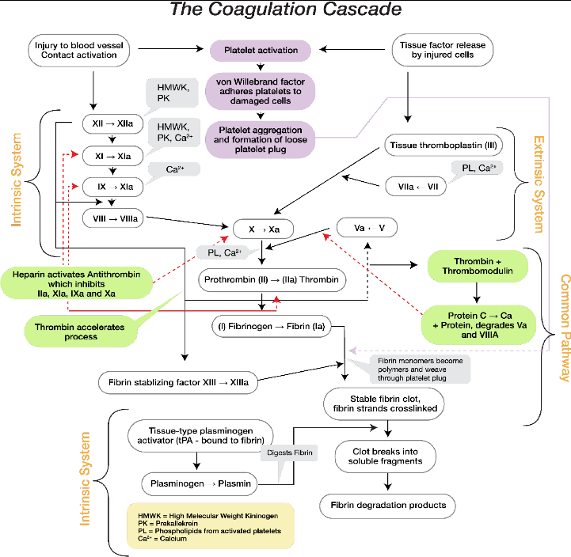
Figure 8.1 Coagulation Cascade

Slide 51
ADP-Receptor Blockers
Ticlopidine
Ticagrelor
Clopidogrel
Prasugrel

Slide 52
Ticlopidine
Blocks ADP receptor
Side effects: agranulocytosis, seizures

Slide 53
Clopidogrel or Ticagrelor
May be used with stents
May be used with aspirin for acute MIs

Slide 54
Stents
Bare Metal Stent
  May be used with aspirin for acute Mis
Drug Eluting Stent
  Continue aspirin and clopidogrel for one year; then stop clopidogrel and continue aspirin for life

Slide 55
Clopidogrel
Most used with aspirin
Blocks ADP receptors
Increased risk of TTP in first two weeks of use

Slide 56
Endothelium Makes…
Factor V
Factor V111
VWF

Slide 57
Platelets
Have Gp1b to bind to VWF
Displays Gp11b:111a to recruit other platelets
Produce Thromboxane and Serotonin

Slide 58
Thromboxane and Serotonin
Vasoconstrict vessels and promote platelet aggregation

Slide 59
Platelets
Release Calcium, ADP, and microtubules
Calcium on platelets attracts the Vitamin K factors

Slide 60
Vitamin K Factors
Factors:
  11
  V11
  1X
  X
Thrombolytics
Protein C
Protein S

Slide 61
Protein C
First thrombolytic to show up to a clot
Uses Protein S as a cofactor
Action: to block Factor V and stop clot extension

Slide 62
Factor V Leiden
Most common cause of GENETIC venous clot formation
Stay on anticoagulants lifelong

Slide 63
Warfarin
Blocks vitamin K
Blocks Protein C first (half-life of 6 hours)
Must give heparin first for venous clots to activate antithrombin 111
Blocks factor V11 in two days

Slide 64
Heparin
Unfractionated
Activates antithrombin 111

Slide 65
Protein C Deficiency
Cause skin necrosis if you start warfarin without heparin

Slide 66
How Long on Warfarin
3 months: for first clot with risk factor
1 year: for second clot with risk factor
Lifelong: for third clot with risk factor
Lifelong: for a clot without known risk factor

Slide 67
If You Do NOT Want to Use A 2-Day Bridge…
Use rivaroxaban or Apixaban

Slide 68
Figure 8.1 Coagulation Cascade

Slide 69
Phosphodiesterase Inhibitor
Cilastozole
Dipyradimole

Slide 70
Inhibiting Thromboxane
Aspirin
NSAIDs

Slide 71
Von Willebrand’s Disease
Autosomal dominant
VWF anchors factor VIII to platelets and anchors the platelet to the glycoproteins
Elevated PTT and bleeding time
Bleeding into cavities and from skin and mucosal surfaces

Slide 72
Von Willebrand’s Disease: Treatment
Mild bleeding: DDAVP
Moderate bleeding: cryoprecipitate
Severe bleeding: FFP

Slide 73
Hemophilia A
X-linked recessive
Bleeding into cavities
Check PTT
This is a factor ACTIVITY deficiency

Slide 74
Hemophilia A: Treatment
Mild bleeding: DDAVP
Moderate bleeding: cryoprecipitate
Severe bleeding: factor VIII concentrate

Slide 75
Hemophilia B
Factor IX deficiency
X-linked recessive
Low factor IX levels
Elevated PTT
Bleeding into cavities
Treatment: FFP for all levels of bleeding

Slide 76
Figure 8.1 Coagulation Cascade

Slide 77
Fibrin
Is laid down after about 2 hours
Forms white lines (of Zahn)
Dysfibrinogenemia: initial clot is made; then, it falls apart after 2 hours
Fibrin stabilization factor tightens the fibrin after it is laid down

Slide 78
Fibrin Stabilization Factor Deficiency
Presentation: recurrent umbilical stump bleeding
Treatment: FFP

Slide 79
Endothelial Repair
The second phase of clotting and repair; EDGF gets released
Platelets release-PDGF
Fibroblasts-Stimulated by PDGF and EDGF

Slide 80
Endothelium Releases
Brady kininogen which gets cleaved to bradykinin
  Dilates arteries and veins
  Causes itching

Slide 81
Fibroblast Release
Type 3 collagen: to repair vessels
Type 4 collagen: to restore basement membranes

Slide 82
ACE
Breaks down bradykinin

Slide 83
INR
International Normalization Ratio
Target: 2 to 3; 2.5 to 3.5 for metallic heart valves and foreign body left in heart

Slide 84
Prothrombin Complex
Has the four vitamin K clotting factors
Has become the better treatment for warfarin induced bleeding
  FFP has now become second line

Slide 85
DDAVP
Synthetic ADH
Squeezes the endothelial cells, which then release factor V, factor V111, and VWF

Slide 86
Cryoprecipitate
Frozen, then thawed when needed
Contains factor V111, VWF and Fibrinogen
Factor V111 activity less than 40%
  Transfuse factor V111 concentrate

Slide 87
Tissue Plasminogen Activator
Used in acute strokes less than 4.5 hrs. old
Used in acute Mis
Used for massive pulmonary embolism

Slide 88
Urokinase
Used to open up clotted feeding tubes and fistulas

Slide 89
Plasmin
Converted from plasminogen
The most effective clot buster in your blood stream
Activation increased during exercise

Slide 90
What if you don’t need the clot?
Question

Slide 91
Figure 8.1 Coagulation Cascade

Slide 92
Convert Plasminogen to Plasmin
tPA
Streptokinase
Urokinase
Alteplase
Antidote: aminocaproic acid

Slide 93
Direct Acting Anticoagulants

Slide 94
Direct Thrombin Inhibitors
Argatroban
Lepirudin
Bivalirudin
Dabigatran

Slide 95
Factor X Inhibitors
Rivaroxaban
Apixaban
Edoxaban

Slide 96
To Stop Massive Hemorrhage
Tranexamic acid
Activated Factor VII
Activated prothrombin concentrate
Activated Fibrinogen Complex Concentrate

Slide 97
Figure 8.1 Coagulation Cascade

Slide 98
The End… of The Bleeding

