Slide 1

Breaking It All Down
Catabolic Pathways

Slide 2
Sources of Energy
Glucose (40% of diet)
Proteins (30% of diet)
Fats (30% of diet)
Ketones (last resort)

Slide 3
Breaking Down Sugars First
Begins With Glycolysis

Slide 4
Breaking Down Sugars
 | Normal | Stress | Extreme Stress
Brain | Glucose | Glucose | Ketones
Heart | FFa | Glucose | Glucose
Muscles | Glucose | FFa | FFa
RBCs | Glucose | Glucose | Glucose

Slide 5
To Burn off the Most Fat…
Keep muscles in the stressed position
Keep heart in the normal position

Slide 6
Maximum Sinus Rate
220 – Age(in years)
Maximum fat burning rates:
  70% of above number = upper limit
  40% of above number = lower limit

Slide 7
How Long to Stress Muscles?
20 to 30 Minutes

Slide 8
RBC Connection
RBCs use ONLY glucose for energy
Hypoglycemia will ALWAYS affect RBCs first, causing a hemolytic anemia
The only other pathway RBCs have is the pentose pathway for making NADPH to maintain the membrane

Slide 9
Glycolysis
The most active pathway in your body
CATABOLIC in all cells except the liver where it is ANABOLIC

Slide 10
Catabolic State
Is controlled by the sympathetic system
Second messenger is C-amp
Is controlled hormonally by epinephrine and glucagon
Is controlled by the sympathetic system
Second messenger is C-amp
Is controlled hormonally by epinephrine and glucagon

Slide 11
Plasma
Glucose
2-4 hrs.
How to Use Energy
Liver
Glycogen
24-28 hrs.
Proteolysis
>36 hrs.
Lipolysis
>36 hrs.
Ketogenesis
>36 hrs.

Slide 12
Glucose
G6P
F6P

Slide 13
Glucokinase Vs Hexokinase
Glucokinase
Located only in the liver and the pancreas after a meal
Has high Km for glucose
Hexokinase
Located in all organs and tissues
Has a very low Km for glucose
*Hexokinase is first regulatory step in glycolysis.

Slide 14
Lowest Km Enzymes Are Always Found…
In the Brain
In the Heart
In the kidneys

Slide 15
DHAP
F6P
F16DP
G3P

Slide 16
Phosphofructokinase (PFK-1)
Rate-limiting enzyme for glycolysis
The slowest enzyme in the pathway
Kinetic curve is sigmoidal

Slide 17
If You Start Exercising…
PFK-1 is too slow
Fructose 6-phosphate will build up
This buildup activates PFK-2

Slide 18
Phosphofructokinase (PFK-1)
Allosteric activator: Fructose 2, 6 DP
Allosteric inhibitor: Citrate

Slide 19
DHAP
F6P
F16DP
G3P

Slide 20
Feed Forward
Involves Fructose 1,6 diphosphate
Jumps ahead in the cycle to activate pyruvate kinase

Slide 21
Aldolase A
Breaks up Fructose 1,6 diphosphate into DHAP and glyceraldehyde 3 phosphate

Slide 22
DHAP
F16DP
G3P
NAD₊
NADH
G13DP

Slide 23
Triose Phosphate Isomerase
DHAP G3P

Slide 24
DHAP
Used in the glycerol 3 phosphate shuttle
Used in triglyceride synthesis

Slide 25
DHAP
F16DP
G3P
NAD₊
NADH
G13DP

Slide 26
Glyceraldehyde 3 Phosphate Dehydrogenase
Has sulphur in the active site
Is blocked by mercury poisoning

Slide 27
Mercury Toxicity
Mcc: (1) Tuna (2) a child biting into a thermometer
Blocks glyceraldehyde 3 phosphate dehydrogenase
LOW ENERGY STATE
RBCs affected first
Brain affected the most

Slide 28
DHAP
F16DP
G3P
NAD₊
NADH
G13DP

Slide 29
Pellagra
Niacin deficiency
The 4 Ds
  Dermatitis
  Diarrhea
  Dementia
  Death
Hartnup’s: presents just like pellagra.
  Defective renal transport of tryptophan

Slide 30
G13DP
G23DP
3PG
2 PG
PEP
Pyruvate

Slide 31
2,3 Diphosphoglycerate (2,3DPG)
Shifts the oxygen dissociation curve to the right
Decreases oxygen affinity of hemoglobin

Slide 32
Preserving Blood on the Shelf
Acid-Citrate-Dextrose: creates a shelf life of five days
Inosine: currently used; creates a shelf life of about 45 days

Slide 33
Preserving Blood on the Shelf
Citrate and EDTA are now added to bind up any calcium in the plasma, to prevent cellular death

Slide 34
Creates an Enol Group
Phosphoglyceratekinase

Slide 35
Naming the Remaining 10% of Enzymes…
We name the enzyme after the product when the product is so unique that we want to bring attention to it
Unless you know the product to be so special, please do not use this approach

Slide 36
Creates an enol group
O
II
C
I
O – C – PO₄³⁻
Enolase

Slide 37
Fluoride Poisoning
Blocks the enzyme ENOLASE
Caused in the past by eating rocks of fluoride
Rare today since fluoride added to water and toothpaste
Clue: extra white teeth and bones

Slide 38
G13DP
G23DP
3PG
2 PG
PEP
Pyruvate

Slide 39
Pyruvate Kinase
Last regulatory step in glycolysis
Activated by Fructose 1,6 diphosphate
Creates 2 more ATP, which is the net gain of glycolysis

Slide 40
DHAP
Glucose
G6P
F6P
F16DP
Hexokinase
Glucokinase
PFK-1
G3P
G13DP
23DPG
3PG
2PG
PEP
Pyruvate Kinase
Pyruvate

Slide 41
How much energy you get from breaking the first two bonds of ATP?
7300 calories

Slide 42
How much of any nutrient do you need to avoid a deficiency state in 95% of the population?
Recommended daily allowance (RDA)

Slide 43
Gluconeogenesis
Controlled by epinephrine and glucagon
Second messenger is C-amp
Occurs only in the liver (90%) and the adrenal cortex (10%)
Occurs while other tissues are running glycolysis
Occurs in the mitochondria and cytoplasm

Slide 44
Occurs in Cytoplasm and Mitochondria
Gluconeogenesis
Urea cycle
Heme synthesis
Fatty acid synthesis
Nucleotide synthesis

Slide 45
When Tissues Need Glucose
Liver shuts down its own glycolysis
Liver shuts down Krebs Cycle
Acetyl-CoA builds up and activates gluconeogenesis

Slide 46
Acetyl-CoA
Acetyl-CoA activates pyruvate carboxylase, turning on gluconeogenesis
Acetyl-CoA turns off pyruvate dehydrogenase

Slide 47
DHAP
Glucose
G6P
F6P
F16DP
G3P
G13DP
3PG
2PG
ATP
Asp
OAA
PEP
CO₂
Cytoplasm
Pyruvate
ATP
Mitochondria
CO₂
Asp
OAA

Slide 48
Together, they are able to sneak around pyruvate kinase
Pyruvate Carboxylase and PEP Carboxykinase

Slide 49
DHAP
Glucose
G6P
F6P
F16DP
G3P
G13DP
3PG
2PG
ATP
Asp
OAA
PEP
CO₂
Cytoplasm
Pyruvate
ATP
Mitochondria
CO₂
Asp
OAA

Slide 50
Fructose 1,6 Diphosphatase
Takes F1,6 diphosphate to fructose 6 phosphate

Slide 51
Glucose 6 Phosphatase
Takes glucose 6 phosphate to glucose conversion

Slide 52
Glucose 6 Phosphatase
Found ONLY in the liver and the adrenal cortex

Slide 53
To Reverse Glycolysis
Pyruvate carboxylase (rate limiting)
PEP Carboxykinase
F16DPase
G6Pase

Slide 54
Galactose Metabolism

Slide 55
Lactose = Glucose + Galactose

Slide 56
Epimerase turns galactose to glucose.

Slide 57
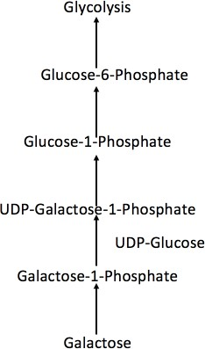
Galactose Metabolism
Figure 9.9: Galactose Metabolism, Steps 1-5

Slide 58
What to Do With The Glucose?
Make glycolipids
Make glycoproteins
Make lactalbumin
Enter the glucose molecule into glycolysis

Slide 59
Galactose is only sugar that gives you twice the energy as glucose.

Slide 60
Detecting Sugars
In the urine: CLINITEST
In the stool: positive REDUCING SUBSTANCES
  Separates osmotic diarrhea from secretory diarrhea

Slide 61
Sugar malabsorption occurs before fat malabsorption

Slide 62
D-Xylose Test
NOT absorbed means that mucosa is inflamed
If absorbed means that mucosa is intact; the absorbed portion will go to the kidney

Slide 63
NPO test
Secretory Diarrhea: continues
Osmotic (Inflammatory) Diarrhea stops

Slide 64
Stool positive for reducing substances?
This means that you have an osmotic diarrhea

Slide 65
Stool Osmolarity
Is diluted in secretory diarrhea
Is increased in osmotic (inflammatory) diarrhea

Slide 66
Calprotectin
New Test
Elevated levels indicate inflamed gastrointestinal mucosa
Indicates inflammatory diarrhea

Slide 67
Secretory Diarrheas
Vibrio Cholera
Enterotoxigenic E. Coli
Cryptosporidium
VIPoma

Slide 68
Galactosuria
Galactokinase deficiency
Hexokinase fills in for galactokinase
Galactose in the urine (clinitest positive)
Symptoms: polyuria; polydipsia; UTIs

Slide 69
Urinary Tract Infections
Most common: Adenovirus
Most common bacteria: E. Coli, Proteus Mirabilis, Klebsiella
Nitrite negative: Enterococcus

Slide 70
Galactosemia
Galactose 1 phosphate uridylyl transferase deficiency
Galactose 1 phosphate builds up in the cells
RBCs affected first
Brain affected the most
LOW ENERGY STATE

Slide 71
Aldose Reductase
Creates sorbitol from glucose
Creates galactitol from galactose
These two chemicals are responsible for the neuropathic changes seen in diabetes and galactosemia

Slide 72
Fructose Metabolism

Slide 73
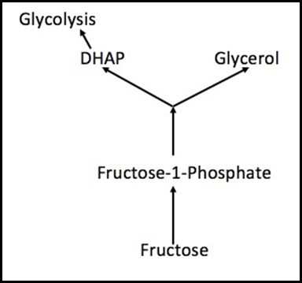
Fructose Metabolism
Figure 9.10: Fructose Metabolism

Slide 74
Fructose
Most metabolized sugar
Unregulated because it comes in after PFK-1
Least likely to increase your serum glucose if you are a diabetic
Least likely to contribute to obesity

Slide 75
Canned fruit = too much DHAP =
Hypertriglyceridemia

Slide 76
Fructosuria
Fructokinase is missing
Hexokinase fills in
Fructose in the urine (clinitest positive)
Polyuria
Polydipsia
UTIs

Slide 77
Fructosemia
Aldolase B is missing
Fructose 1 phosphate is trapped within the cells and can not leave
RBCs affected first
Brain affected the most
LOW ENERGY STATE

Slide 78
Before you enter the KREB CYCLE YOU NEED TO KNOW…

Slide 79
THE FIVE FATES OF PYRUVATE

Slide 80
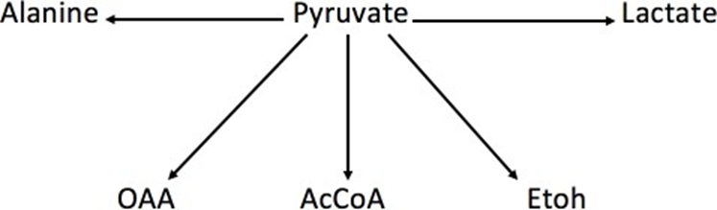
5 FATES OF PYRUVATE
Figure 9.11: 5 Fates of Pyruvate

Slide 81
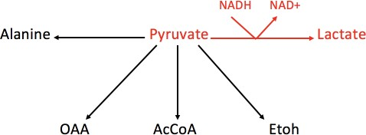
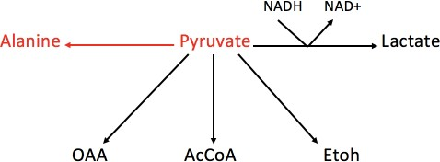
Anaerobic Products
Figure 9.12: Anaerobic Product-Lactate
Figure 9.13: Anaerobic Function-Alanine

Slide 82
Acidosis Hurts You By…
Denatures proteins
Cause hyperkalemia
Causes Kussmaul breathing
Increases GABA

Slide 83
Why Turn Pyruvate Into Lactic Acid?
To regenerate NAD+ for use by glyceraldehyde 3 phosphate dehydrogenase

Slide 84
Lactate Dehydrogenase (LDH)
Creates lactic acid from pyruvate
Regenerates NAD+ to keep glycolysis running
Has five isoenzymes

Slide 85
LDH 1
Found in cardiac muscle only
Increased levels means myocardial injury
Rises at 24 hours
Peaks at 48 hours
Gone at 72 hours

Slide 86
LDH 2 & LDH 3
Found in muscles and red blood cells

Slide 87
LDH 4 & LDH 5
The higher the value, the more severe the disease.

Slide 88
LDH good for prognostication
Found in kidneys, lung and liver

Slide 89
Alanine Transaminase (ALT)
Turns pyruvate into alanine
Alanine rises with metabolic acidosis
Located in the cytoplasm

Slide 90
Cori Cycle
Located in the liver
Turns lactate into glucose

Slide 91
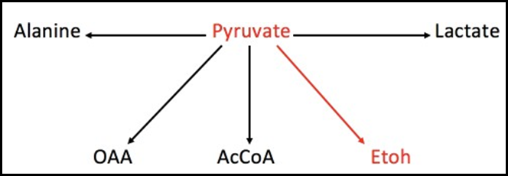
Fermentative Product
Figure 9.14: Fermentative Function-Alcohol

Slide 92
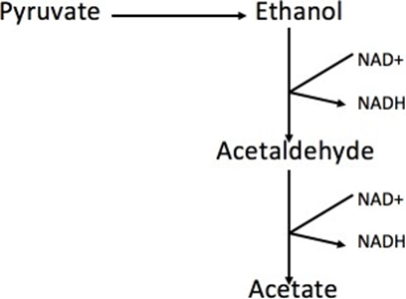
Alcohol Metabolism
Figure 9.15: Alcohol Metabolism

Slide 93
Alcohol Dehydrogenase
Changes alcohol into acetaldehyde

Slide 94
Acetaldehyde Dehydrogenase
Turns acetaldehyde into acetate

Slide 95
Alcohol Dehydrogenase
Works on alcohol, methanol, and ethylene glycol

Slide 96
Methanol > formaldehyde >Formic acid

Slide 97
Ethylene glycol > Glyoxylate crystals

Slide 98
Fomepizole
Blocks alcohol dehydrogenase
Treats methanol and ethylene glycol poisoning

Slide 99
Acetaldehyde Dehydrogenase
Blocked by Disulfiram

Slide 100
Acetaldehyde Dehydrogenase
Also blocked by:
  Metronidazole
  Chlorpropamide
  Cefotetan
  Cefamandole
  Moxalactam
  Cefoperazone

Slide 101
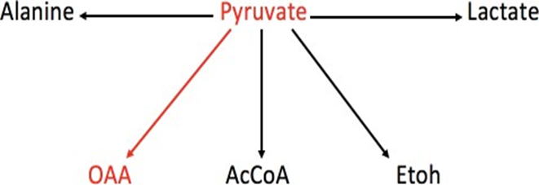
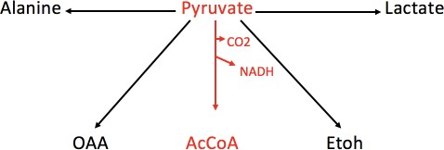
Anaplerotic Function
Figure 9.16: Anapleurotic Function-OAA
Figure 9.17: Aerobic Function-AcCoA

Slide 102
Anapleurotic = “To fill in”

Slide 103
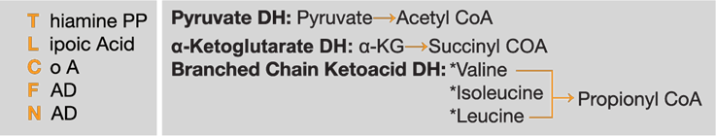
Pyruvate Dehydrogenase
P
L
A
N
F
Figure 9.18: PLAN F, Cofactors of Pyruvate Dehydrogenase

Slide 104
Pyruvate Dehydrogenase
First large quaternary enzyme discovered
Has three proteins
Uses five vitamins
Uses five cofactors

Slide 105
Pyruvate Dehydrogenase
TPP
Lipoic acid
CoA
NAD
FAD

Slide 106
Match Cofactor with Action:
TPP: decarboxylates
Lipoic acid: accepts 2 carbon unit
CoA: fina 2 carbon acceptor
NAD: oxidizes FADH2
FAD: oxidizes Lipoic acid

Slide 107
Put Them In Order
TPP
Lipoic acid
CoA
FAD
NAD

Slide 108
Match Cofactor with Vitamin
TPP: thiamine
Lipoic acid
CoA: pantothenic acid
NAD: niacin
FAD: riboflavin

Slide 109
Match Vitamin with Letter Name
Thiamine: vitamin B1
Riboflavin: vitamin B2
Niacin: vitamin B3
Lipoic acid: vitamin B4
Pantothenic acid: vitamin B5

Slide 110
You need five B vitamins to enter the Kreb cycle

Slide 111
Why are alcoholics hypoglycemic?
Too much NADH from alcohol metabolism

Slide 112
Always give thiamine before any sugar to an alcoholic.
Give all vitamins to all alcoholics!

Slide 113
Have all B vitamins with breakfast!
Breakfast is most important meal of the day!
Take your vitamins each morning !

Slide 114
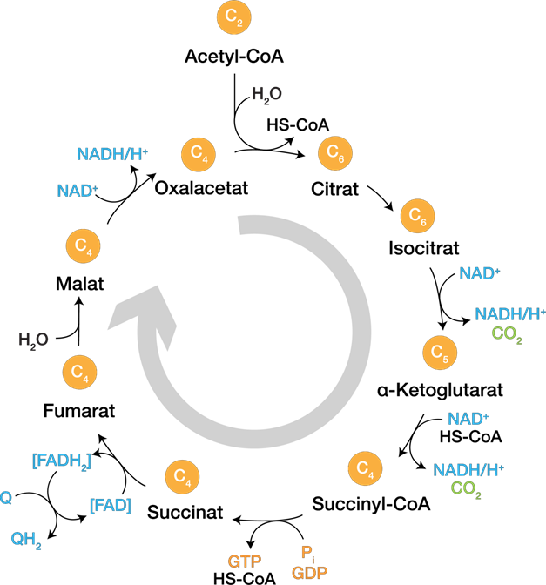
KREB CYCLE
Figure 9.19 Krebs Cycle

Slide 115
Acetyl CoA
Used to make the ketogenic amino acids
Used for fatty acid synthesis
Allosteric activator of gluconeogenesis
Allosteric inhibitor of pyruvate dehydrogenase

Slide 116
Citrate
Shuttles acetyl CoA units out to cytoplasm for fatty acid synthesis
Allosteric inhibitor of PFK 1
Allosteric activator of acetyl CoA carboxylase for fatty acid synthesis

Slide 117
Isocitrate Dehydrogenase
The rate limiting enzyme of the Kreb cycle

Slide 118
Alpha Ketoglutarate
Used in 90% of transaminations
Alpha Ketoglutarate Dehydrogenase: large quaternary enzyme; uses PLANF

Slide 119
Succinyl CoA
Used to make ringed structures

Slide 120
Succinyl CoA Thiokinase
The only substrate level phosphorylation

Slide 121
Succinate Dehydrogenase
The only enzyme attached to the electron transport system
Attached to complex 2 of ETS

Slide 122
Fumarase
Also seen in urea cycle ( in cytoplasm)
Connects urea cycle to Kreb cycle

Slide 123
Malate & Oxaloacetate
Used in the malate-aspartate shuttle

Slide 124
After one round of the Kreb cycle:
3 NADH
1 FADH2
1 GTP
Total: 10 ATPs

Slide 125
2 Acetyl CoAs Go Around Kreb
20 ATPs total

Slide 126
From Pyruvate to Acetyl CoA:
2 NADHs: adds 5 more ATPs to total

Slide 127
Add 2 NADHs From Glycolysis:
2 NADHs: adds 5 more ATPs
Total: 30 ATPs

Slide 128
Add 2 ATPs From Substrate Level Phosphorylation:
Total is now 32 ATPs

Slide 129
One molecule of glucose nets 32 ATPs.

Slide 130
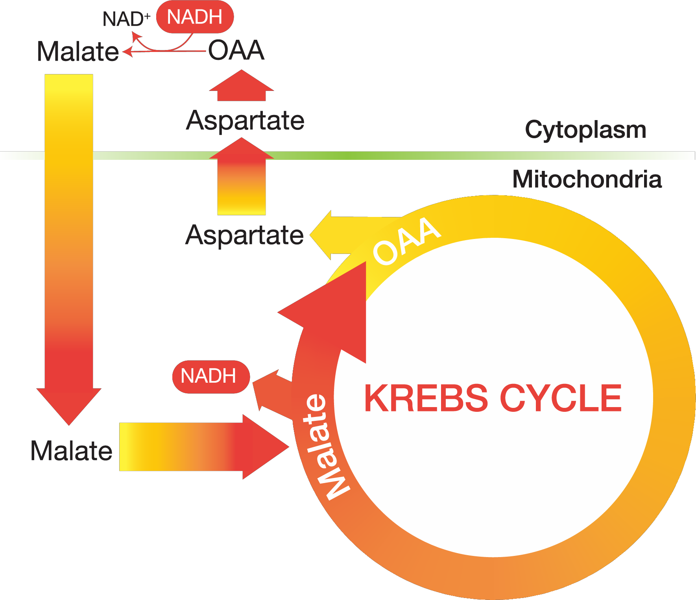
Malate-Aspartate Shuttle
Figure 9.20: Malate-Aspartate Shuttle

Slide 131
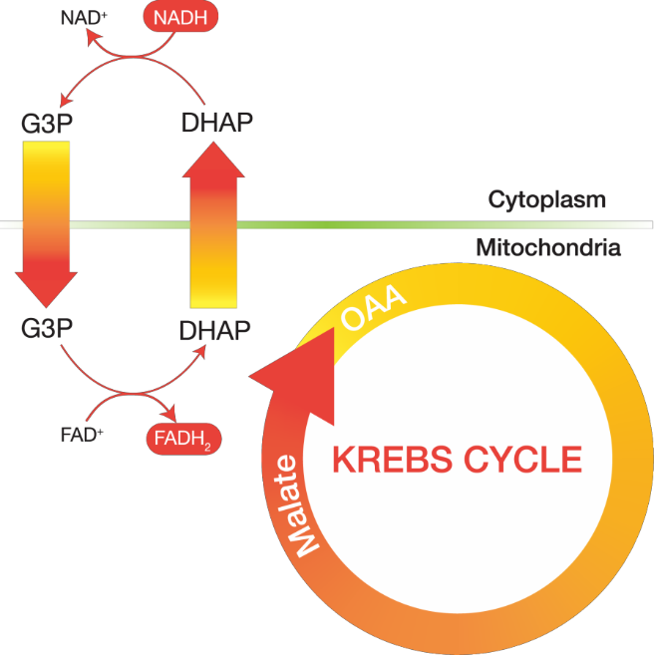
Glycerol 3 Phosphate Shuttle
Figure 9.21: G3P Shuttle

Slide 132
When you use the malate aspartate shuttle.
NO energy is lost

Slide 133
If you use the G3P shuttle:
You lose 2 ATPs!

Slide 134
We use the G3P shuttle…
During the periods of rapid growth

Slide 135
Ki-67
Communicates from cell to cell
Tells cells that we are in a state of rapid cellular division

Slide 136
TNF (Cachexia)
Send same message as Ki-67
Causes weight loss in chronic disease
Revs up your BMR

Slide 137
WIC Program
Women Infant Children Program
Initially a 0-to-2-year program but has now been extended to 5 years

Slide 138
Adipose cells not fixed at age 8 years as we thought.

Slide 139
Thiazolidinediones
Action: stimulates PPAR-gamma, which transcribes insulin receptor proteins
Reassembles the insulin receptor
Stimulates the adipose cells to begin replicating again

Slide 140
Liposuction

Slide 141
TNF
Produced by T-cells and macrophages
Causes weight loss in chronic disease

Slide 142
Amino Acid Catabolism
AST: ALT: | AA + OAA → Aspartate + CC (carbons) AA + Pyruvate → Alanine + CC | Cytoplasm
AST: GGT: | AA + OAA → Aspartate + CC (carbons) AA + alpha-KG → Glutamate + CC | Mitochondria

Slide 143
Transaminases
Used in amino acid metabolism
All use vitamin B-6

Slide 144
Three Most Important Transaminases
GGT: Gamma-glutamyl transaminase
AST: aspartate transaminase
ALT: alanine transaminase

Slide 145
GGT does 90% of transaminations in the mitochondria.
AST does 10% of transaminations in the mitochondria.
AST and ALT each do 50% of transaminations in cytoplasm

Slide 146
Hepatitis
AST and ALT are 1:1

Slide 147
Alcoholic Hepatitis
Alcohol denatures the mitochondrial membrane (second AST leaks out)
AST:ALT is now 2:1
Elevated GGT as well

Slide 148
Non-Alcoholic Hepatitis
AST:ALT is 1:1

Slide 149
Alcoholic Hepatitis
AST:ALT is now 2:1
Elevated GGT

Slide 150
Hepatic Necrosis
AST and ALT are in the thousands

Slide 151
Fulminant Hepatitis
Also called hepatic encephalopathy
There are signs and symptoms of GABA

Slide 152
Cirrhosis
Liver is unable to do its simple duties
Albumin less the 2g (normal is 4g)
Elevated prothrombin time

Slide 153
All transaminases use vitamin B6
Vitamin B6 def > Neuropathy

Slide 154
Neuropathy
First line: Amitriptyline
If they have H/o heart disease: Gabapentin
If pain becomes shooting/stabbing: carbamazepine

Slide 155
Fatty Acid Catabolism
Palmitic acid: C-16 the main fatty acid we make daily
Three formulas to know:
  (C/2 – 1) : the number of rounds it takes to break down a fatty acid chain or the number of rounds it took to make a fatty acid chain
  (C/2 – 1) 2 : the number of NADPHs it cost to make a fatty acid chain
  (C - 1): the number of ATPs it cost to make it

Slide 156
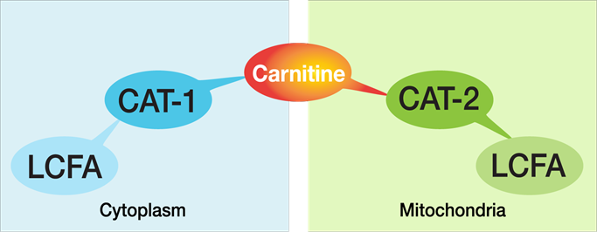
Fatty Acid Catabolism
Figure 9.22: Carnitine Shuttle, Step 7

Slide 157
ONLY glucagon controls lipolysis and ketogenesis

Slide 158
Arachidonic Acid (C-22)
Rounds to make it: 10
How many NADPHs to make it: 20
How many ATPs to make it: 21

Slide 159
Hormone Sensitive Lipase
Activated by glucagon
Mobilizes triglycerides from adipose tissue

Slide 160
Short and medium chain triglycerides easily cross mitochondrial walls

Slide 161
Carnitine

Slide 162
Carnitine
Used by long chain triglycerides only to cross the mitochondrial membrane

Slide 163
It costs 2 ATPs to activate long chain fatty acid chain.

Slide 164
The only X-linked dominant enzyme deficiency
Pyruvate Dehydrogenase Deficiency

Slide 165
Adrenoleukodystrophy
Defective carnitine shuttle
Long chain free fatty acids accumulate in the cytoplasm, unable to enter mitochondria
X-linked recessive
Adrenal gland failure
Early white matter involvement

Slide 166
X-linked Recessive Enzymes
G6PD
NADPH-Oxidase
HGPRT (Lesch-Nyhan)
Alpha-Galactosidase (Fabry’s)
Iduronates (Hunter’s)
CAT-1 (Adrenoleukodystrophy)
Ornithine Transcarbmylase
Adenosine Deaminase
PRPP Synthetase
Tyrosine Kinase

Slide 167
Beta - Oxidation
O = Oxidation Yields NADH
H = Hydration Yields H2O
O = Oxidation Yields FADH2
T = Thiolysis Yields AcCoA

Slide 168
Breaking Down Palmitic Acid
Takes 7 rounds
  Produces 7 NADH
  Produces 7 FADH2
  Produces 8 Acetyl CoA

Slide 169
Palmitic Acid
Takes 15 ATPs to make it
You get back: 106 ATPs
7:1 ratio

Slide 170
How Much Energy?
Fats: 9 cal/gram
Proteins: 4 cal/gram
Sugars: 4cal/gram

Slide 171
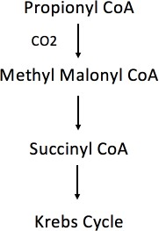
Odd Numbered Carbon Fatty Acid Metabolism
Figure 9.23: Odd Chain FA Catabolism

Slide 172
Requires Vitamin B12
Homocysteine methyltransferase
Methylmalonyl-CoA mutase

Slide 173
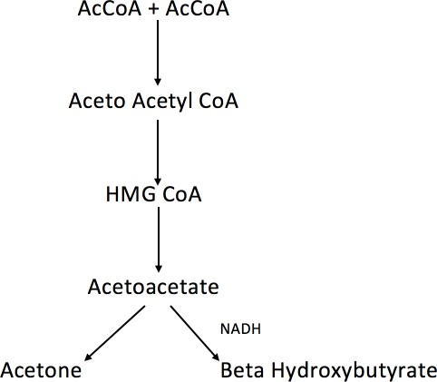
Ketogenesis
Figure 9.24: Ketogenesis

Slide 174
Glucagon is only hormone to control ketogenesis.

Slide 175
Ketogenesis
Figure 9.24: Ketogenesis

Slide 176
HMG CoA Synthase
Rate limiting enzyme of ketogenesis
Turned on by glucagon
Turned off by insulin

Slide 177
Ketogenesis
Figure 9.24: Ketogenesis

Slide 178
90% of your ketone by weight; used only by the brain
Beta Hydroxybutyrate

Slide 179
Ketones

Slide 180
Made by the liver but can not be used by the liver
Ketones

Slide 181
IDDM (TYPE 1 DIABETES)
Autoimmune
2 weeks after a viral (Cocksackie B) infection
Anti-islet cell antibody
Sx begin after 90% of islet cells are destroyed
Remaining 10% will undergo hyperplasia (honeymoon period)
Signs and Sx: LOW ENERGY STATE
DKA
  Hypovolemia
  Lack of insulin
  Low body potassium
  Hyperkalemia
  Hypophosphatemia
  Pseudohyponatremia
  Correcting sodium
  Visceral pain
  False high creatinine
  Correcting glucose
  Correcting acidosis

Slide 182
Most children require 1 unit/kg/day of insulin.

Slide 183
IDDM (TYPE 1 DIABETES)
Autoimmune
2 weeks after a viral (Cocksackie B) infection
Anti-islet cell antibody
Sx begin after 90% of islet cells are destroyed
Remaining 10% will undergo hyperplasia (honeymoon period)
Signs and Sx: LOW ENERGY STATE
DKA
  Hypovolemia
  Lack of insulin
  Low body potassium
  Hyperkalemia
  Hypophosphatemia
  Pseudohyponatremia
  Correcting sodium
  Visceral pain
  False high creatinine
  Correcting glucose
  Correcting acidosis

Slide 184
Low Body Potassium
Transcellular (out of cell into plasma) shift of potassium due to acidosis
Increased urination of potassium

Slide 185
IDDM (TYPE 1 DIABETES)
Autoimmune
2 weeks after a viral (Cocksackie B) infection
Anti-islet cell antibody
Sx begin after 90% of islet cells are destroyed
Remaining 10% will undergo hyperplasia (honeymoon period)
Signs and Sx: LOW ENERGY STATE
DKA
  Hypovolemia
  Lack of insulin
  Low body potassium
  Hyperkalemia
  Hypophosphatemia
  Pseudohyponatremia
  Correcting sodium
  Visceral pain
  False high creatinine
  Correcting glucose
  Correcting acidosis

Slide 186
This is number one cause of death in the treatment of DKA
Hypokalemia Induced Arrhythmia

Slide 187
IDDM (TYPE 1 DIABETES)
Autoimmune
2 weeks after a viral (Cocksackie B) infection
Anti-islet cell antibody
Sx begin after 90% of islet cells are destroyed
Remaining 10% will undergo hyperplasia (honeymoon period)
Signs and Sx: LOW ENERGY STATE
DKA
  Hypovolemia
  Lack of insulin
  Low body potassium
  Hyperkalemia
  Hypophosphatemia
  Pseudohyponatremia
  Correcting sodium
  Visceral pain
  False high creatinine
  Correcting glucose
  Correcting acidosis

Slide 188
Hyperkalemia
Due to transcellular (out of cell into plasma) shift of potassium

Slide 189
Hypophosphatemia
Phosphate is used to excrete hydrogens
H2P04 and H2S04 are called titratable acids

Slide 190
IDDM (TYPE 1 DIABETES)
Autoimmune
2 weeks after a viral (Cocksackie B) infection
Anti-islet cell antibody
Sx begin after 90% of islet cells are destroyed
Remaining 10% will undergo hyperplasia (honeymoon period)
Signs and Sx: LOW ENERGY STATE
DKA
  Hypovolemia
  Lack of insulin
  Low body potassium
  Hyperkalemia
  Hypophosphatemia
  Pseudohyponatremia
  Correcting sodium
  Visceral pain
  False high creatinine
  Correcting glucose
  Correcting acidosis

Slide 191
Add potassium and phosphate to the first bag of saline!

Slide 192
Pseudohyponatremia
Caused by ketones and glucose osmotically pulling water into plasma

Slide 193
For every 100mg of glucose rise above normal, sodium is diluted by 1.6 meq

Slide 194
Do not let sodium fall any faster than 0.5Meq/hr. or 10 – 12 Meq/day

Slide 195
IDDM (TYPE 1 DIABETES)
Autoimmune
2 weeks after a viral (Cocksackie B) infection
Anti-islet cell antibody
Sx begin after 90% of islet cells are destroyed
Remaining 10% will undergo hyperplasia (honeymoon period)
Signs and Sx: LOW ENERGY STATE
DKA
  Hypovolemia
  Lack of insulin
  Low body potassium
  Hyperkalemia
  Hypophosphatemia
  Pseudohyponatremia
  Correcting sodium
  Visceral pain
  False high creatinine
  Correcting glucose
  Correcting acidosis

Slide 196
Visceral pain caused by ketones

Slide 197
IDDM (TYPE 1 DIABETES)
Autoimmune
2 weeks after a viral (Cocksackie B) infection
Anti-islet cell antibody
Sx begin after 90% of islet cells are destroyed
Remaining 10% will undergo hyperplasia (honeymoon period)
Signs and Sx: LOW ENERGY STATE
DKA
  Hypovolemia
  Lack of insulin
  Low body potassium
  Hyperkalemia
  Hypophosphatemia
  Pseudohyponatremia
  Correcting sodium
  Visceral pain
  False high creatinine
  Correcting glucose
  Correcting acidosis

Slide 198
False high creatinine created by ketones, which interfere with the assay.

Slide 199
IDDM (TYPE 1 DIABETES)
Autoimmune
2 weeks after a viral (Cocksackie B) infection
Anti-islet cell antibody
Sx begin after 90% of islet cells are destroyed
Remaining 10% will undergo hyperplasia (honeymoon period)
Signs and Sx: LOW ENERGY STATE
DKA
  Hypovolemia
  Lack of insulin
  Low body potassium
  Hyperkalemia
  Hypophosphatemia
  Pseudohyponatremia
  Correcting sodium
  Visceral pain
  False high creatinine
  Correcting glucose
  Correcting acidosis

Slide 200
Correcting glucose
Do NOT correct faster than 100mg/hour

Slide 201
Central Pontine De-myelinolysis

Slide 202
When blood sugar is 250mg or less
Add D5 to your saline infusion

Slide 203
When patient has a normal ion gap
You can switch to subcutaneous insulin injections

Slide 204
IDDM (TYPE 1 DIABETES)
Autoimmune
2 weeks after a viral (Cocksackie B) infection
Anti-islet cell antibody
Sx begin after 90% of islet cells are destroyed
Remaining 10% will undergo hyperplasia (honeymoon period)
Signs and Sx: LOW ENERGY STATE
DKA
  Hypovolemia
  Lack of insulin
  Low body potassium
  Hyperkalemia
  Hypophosphatemia
  Pseudohyponatremia
  Correcting sodium
  Visceral pain
  False high creatinine
  Correcting glucose
  Correcting acidosis

Slide 205
Causes of death in DKA
Hypokalemia induced arrhythmias
Cerebral edema causing herniation

Slide 206
Reasons NEVER to give bicarbonate in treatment of DKA…
It merely corrects a number without correcting the actual problem
Decreased cardiac output
Causes hypokalemia
Shifts hemoglobin dissociation curve to the left
Bicarbonate ion does NOT cross the blood brain barrier (CSF pH falls paradoxically)

Slide 207
NIDDM (Type II Diabetes)
Genetic
Connected to obesity
Downregulation of insulin receptors
Hyperinsulinemia
Nonketotic
Hyperglycemic, nonketotic coma
Complications
  Vasculitis
  Clots
  Bleeds
  Nephropathy
  Neuropathy
  IDM
  Tx: weight loss
    Meds
      Insulin

Slide 208
Caused by glycosylation of endothelial cells
Vasculitis

Slide 209
NIDDM (Type II Diabetes)
Genetic
Connected to obesity
Downregulation of insulin receptors
Hyperinsulinemia
Nonketotic
Hyperglycemic, nonketotic coma
Complications
  Vasculitis
  Clots
  Bleeds
  Nephropathy
  Neuropathy
  IDM
  Tx: weight loss
    Meds
      Insulin

Slide 210
First sign of nephropathy
Microalbuminuria

Slide 211
Proteinuria
Once it starts, start ACE inhibitors, ARBs, or CCBs
These drugs open the efferent vessel, which decreases filtration of protein
Drugs decreases GFR

Slide 212
From onset of diabetes to evidence of proteinuria: 16-20 years
From microalbuminuria to nephrotic syndrome: <4years
From nephrotic syndrome to dialysis: <2years

Slide 213
Sorbitol
Created by Aldose Reductase
Responsible for all of the neuropathic changes seen in diabetes

Slide 214
Acarbose and Miglitol
They block alpha 1 glucosidase; used to treat postprandial hyperglycemia

Slide 215
Metformin
Blocks gluconeogenesis in the liver
Current first line drug for type 2 diabetes
Interferes with vitamin B12 absorption

Slide 216
Sulfonylureas
Chlorpropamide
Tolbutamide
Tolezalide
Glipizide
Glyburide
Glomeperide

Slide 217
Other Oral Hypoglycemics
Acarbose
Miglitol
Metformin/Fanformin
Piaglitazone
Rotiglitazone
Repaglinide
Troglitazone

Slide 218
Thiazolidinediones
Stimulates PPAR-gamma
Stimulates transcription of new receptors
Stimulates replication of adipose cells

Slide 219
SGLT-2 Blockers
Block reabsorption of glucose in the kidneys
Causes more UTIs
Associated with more limb amputations

Slide 220
Newer Drugs for NIDDM
Incretin Mimetics
Incretins are secreted by the intestinal wall in response to food
Exenatide
  Mimics glucagon like peptide-1 (GLP-1) which is deficient
  Injected SC with breakfast and dinner
GLP-1
  Potentiates glucose induced insulin release
  Inhibits glucagon release
  Inhibits GI secretion and motility
  Inhibit appetite and food intake
  Leads to weight loss

Slide 221
Newer Drugs for NIDDM
Dipeptide Peptidase-4 inhibitors
Sitagliptin
Inhibits degradation of endogenous GLP-1
Vildagliptin
These drugs are weight neutral
Amylin analog
Pramlintide: can be used by type1 dm as well
  Decreases glucose absorption
  Decreases appetite
  Slows gastric emptying
  Decreases glucagon secretion

Slide 222
Newer Insulins
Insulin detemir: less daily serum insulin level variability than with NPH or insulin glargine
Insulin glulisine: rapid acting (w/in 15 min)
  Lispro and Aspart
Inhaled Insulin (Exubera and Humira): less predictable. Can make COPD worse

Slide 223
Insulins
 | ONSET | PEAK | OFF
Regular
NPH/Semilente
Lente
Ultralente Protamine Zinc-insulin
Notes:
Dr. Francis will fill in during lecture

Slide 224
Regular Insulin
Onset: 30 minutes
Peak: 4 hours
Off: 6 hours

Slide 225
NPH
Onset: 2.5 hours
Peak: 6 hours
Off: 8 hours

Slide 226
Dawn Effect
Increase in blood sugar each morning caused by the normal increase in epinephrine, glucagon and cortisol that occurs each morning
Tx: increase morning regular insulin

Slide 227
Somogyi Effect
Actually, caused by HYPOGLYCEMIA that occurred in the early morning ( 2 to 3 am) leading to reactive HYPERGLYCEMIA in the late morning (6 to 7 am)
Tx: decrease evening NPH insulin

Slide 228
Glycogen Synthesis
Skeletal muscle
Adrenal Cortex
Liver
Intestinal wall
Heart

Slide 229
Glucose 6 Phosphatase
Found only in the liver and adrenal cortex

Slide 230
Ileus
Peristalsis stops
Third-spacing occurs

Slide 231
Glycogen: Synthesis/Catabolism
Glycogenin - OH

Slide 232
Glycogen: Synthesis/Catabolism
Glycogenin + UTP
Glycogenin – O – PO₄³⁻ + UDP

Slide 233
Glycogen: Synthesis/Catabolism
Glycogenin – O – PO₄³⁻ + UDP -GLU
Glycogenin – O – GLU + UTP

Slide 234
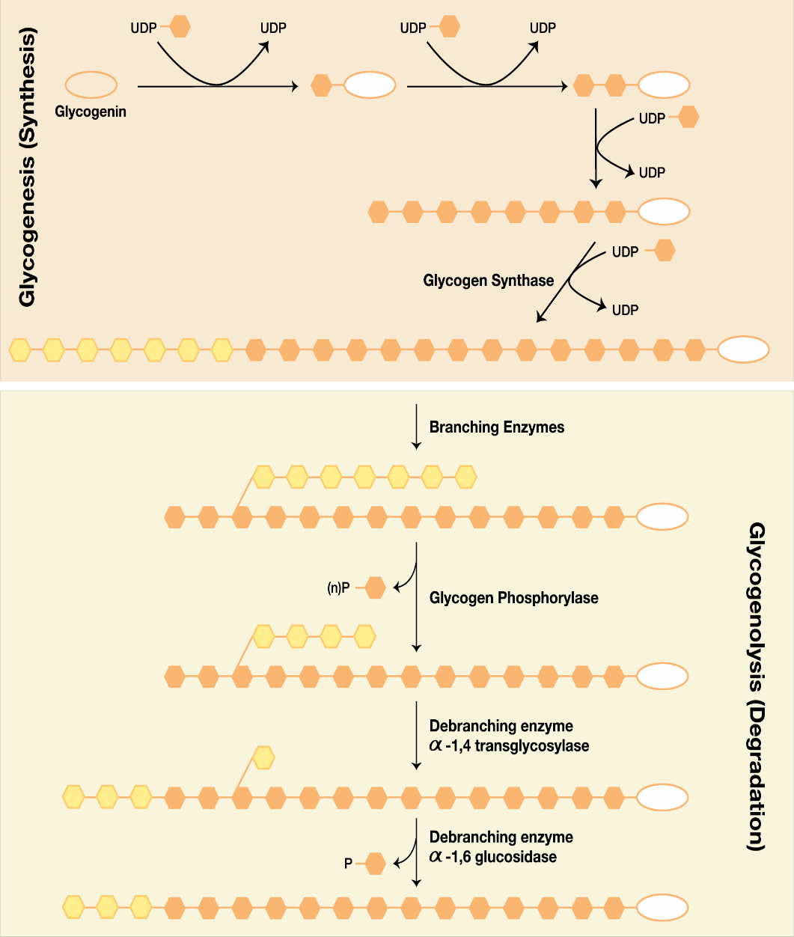
Glycogen: Synthesis/Catabolism
Figure 6.1 Glycogen Synthesis, Steps 1-8

Slide 235
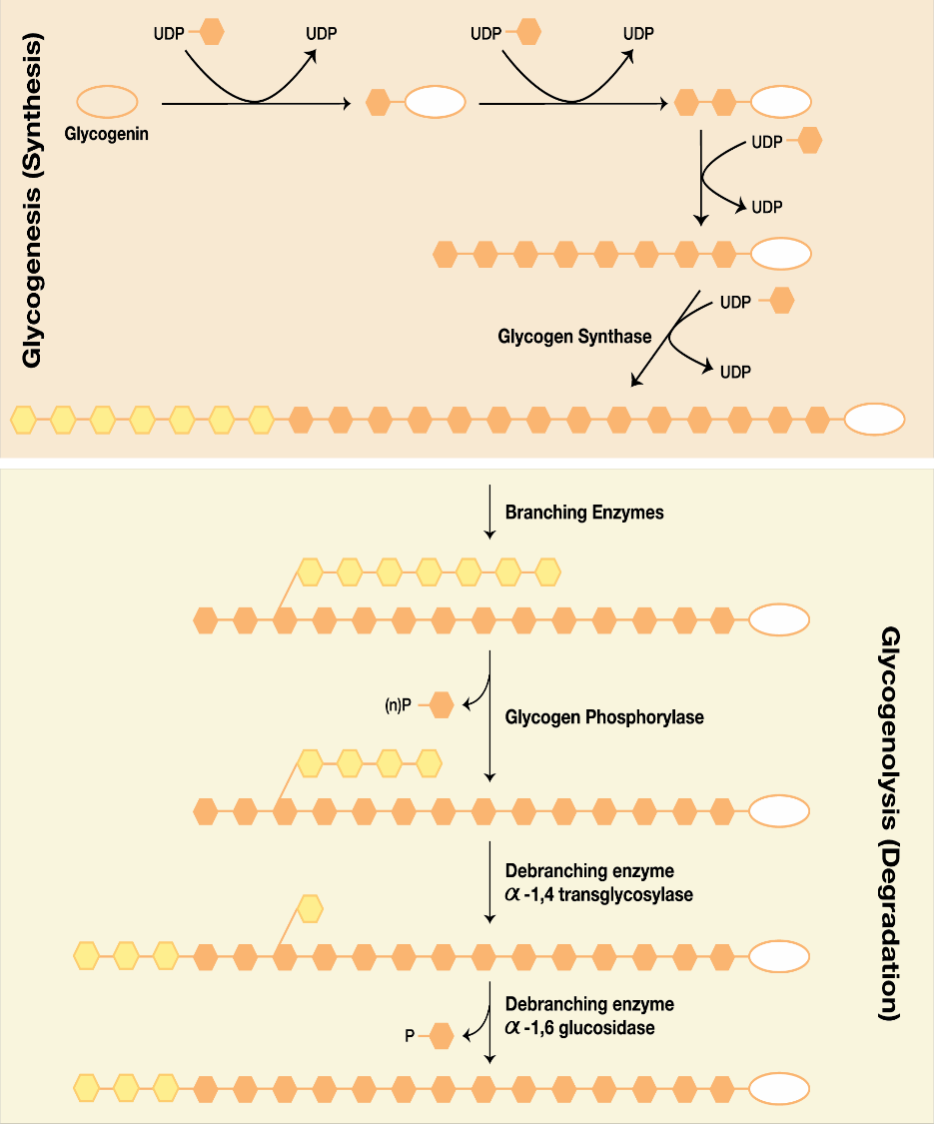
Glycogen: Synthesis/Catabolism
Figure 6.2 Glycogen Synthesis, Steps 9-12

Slide 236
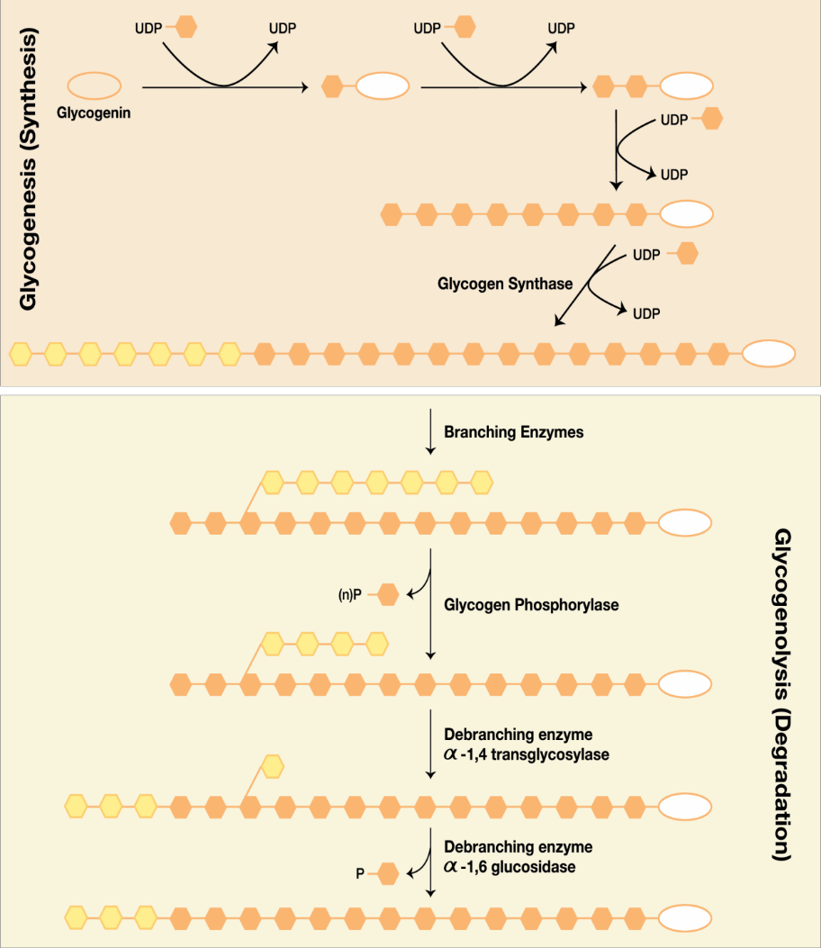
Glycogen Breakdown
Figure 9.25: Glycogen Breakdown

Slide 237
Alpha 1,4 Glucosidase: found only in the heart
Every residue of glycogen comes off as free glucose in the heart

Slide 238
Glycogen Storage Diseases
 | Enzyme Deficiency | Notes
Von Gierke’s | Glucose-6- Phosphatase | Liver and adrenal cortex enlarged
Anderson’s | Branching Enzyme | Straight chains of glycogen on liver biopsy
Cory’s | Debranching Enzyme | Short outer branches of glycogen
Her’s | Liver Phosphorylase | Hepatomegaly
McArdle’s | Muscle Phosphorylase | Muscle cramps during exercise
Pompe’s | Cardiac Alpha 1,4 Glucosidase | Heart failure shortly after birth; dies before first birthday

Slide 239
The End of CATABOLISM
The Beginning of ANABOLIC PATHWAYS

