Slide 1

具有能量收集, 常規電池與批次抵達的無線感測器網路研究
A Study on the Wireless Sensor Network with Energy Harvesting, Regular Battery, and Batch Arrivals
指導教授： 鍾順平 教授
研 究 生： 鄭靖諼
西元2023年07月12日

Slide 2
Outline
Motivation
System Model
Analytical Model
Numerical Results
Conclusions and Future Works

Slide 3
Outline
Motivation
System Model
Analytical Model
Numerical Results
Conclusions and Future Works

Slide 4
Motivation
The demand for Wireless sensor networks (WSNs) continues to grow. WSN has gained attention due to its real-time monitoring capabilities and various applications in the Internet of Things (IoT).
collecting, storing, and processing environmental information
low power consumption, low cost, small size, and dynamic networking
WSNs face the challenge of limited battery life, particularly in hard-to-reach locations.
The trade-off between energy consumption and efficiency becomes important.

Slide 5
Motivation
In [5], a queue with non-preemptive priority is considered in WSN considering multi-event environments containing mobile targets.
In [10], due to impatience, packets in the queue may abandon the system before being serviced by the server.
In order to make the system still operate when out of energy, it is mentioned in [15] that by adding a regular battery, the energy in the battery can be used at a certain probability to achieve a balance between energy consumption and system operation.

Slide 6
Motivation
The Energy Harvesting-based WSN with auxiliary regular battery is studied, and various packet properties are considered simultaneously.
For a more realistic scenario, we assume the packet arrival process to be a batch arrival process.
We define an additional performance measure, regular energy consumption ratio (RECR), and propose a more flexible analytical model for this purpose.
Two scenarios are considered :
1. Only one sensor
2. A network with three interconnected nodes

Slide 7
Outline
Motivation
System Model
One sensor node system (Scenario 1)
Three nodes network (Scenario 2)
Analytical Model
Numerical Results
Conclusions and Future Works

Slide 8



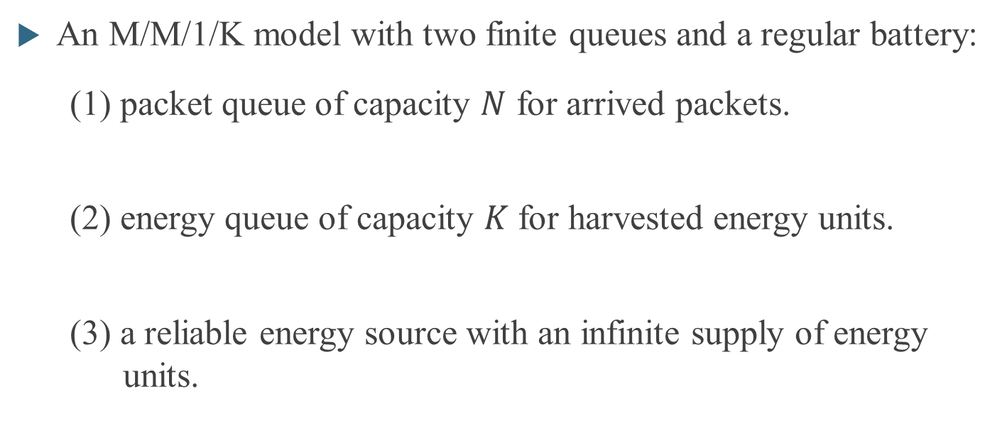
System Model- One sensor node system
An M/M/1/K model with two finite queues and a regular battery:
(1) packet queue of capacity $N$ for arrived packets.
(2) energy queue of capacity $K$ for harvested energy units.
(3) a reliable energy source with an infinite supply of energy units.

Slide 9
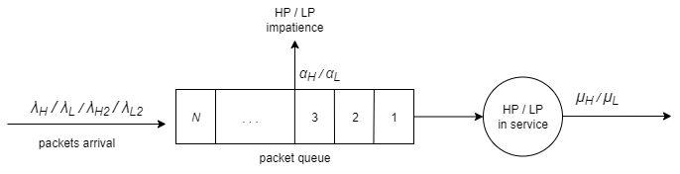
System Model- One sensor node system
Batch arrived packets can be divided into four classes according to impatience and priority:
single HP batches
single LP batches
HP packets have non-preemptive priority over LP packets.
double HP batches
double LP batches

Slide 10
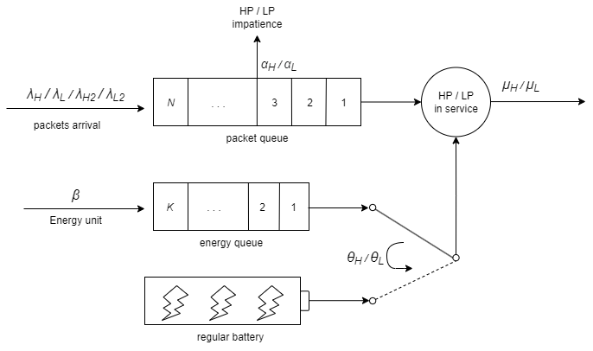
System Model- One sensor node system
Queueing model：

Slide 11
Outline
Motivation
System Model
One sensor node system (Scenario 1)
Three nodes network (Scenario 2)
Analytical Model
Numerical Results
Conclusions and Future Works

Slide 12


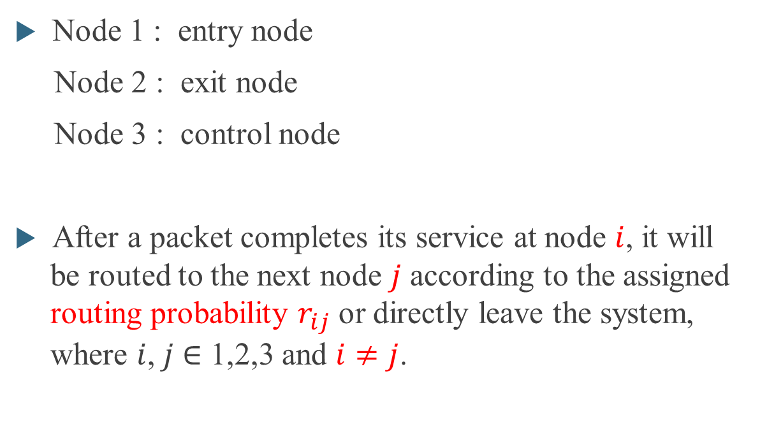

System Model- Three nodes network
Node 3
Node 1 : entry node
Node 2 : exit node
Node 3 : control node
After a packet completes its service at node $i$, it will be routed to the next node $j$ according to the assigned routing probability $r_{ij}$ or directly leave the system, where $i$,$j$ $∈$ 1,2,3 and $i≠j$.
$$r_{13}$$
$$r_{23}$$
Node 1
$$r_{12}$$
Node2

Slide 13
System Model- Three nodes network
Some restrictions for the routing policy:
(1) Packets are not allowed to be routed from the exit node to the entry node.
(2) Packets are only permitted to pass through the control node once. After this, they will be forwarded to the previous node and follow the correct path to the exit node and leave successfully.
Node 3
$$r_{13}$$
$$r_{23}$$
Node 1
$$r_{12}$$
Node2

Slide 14
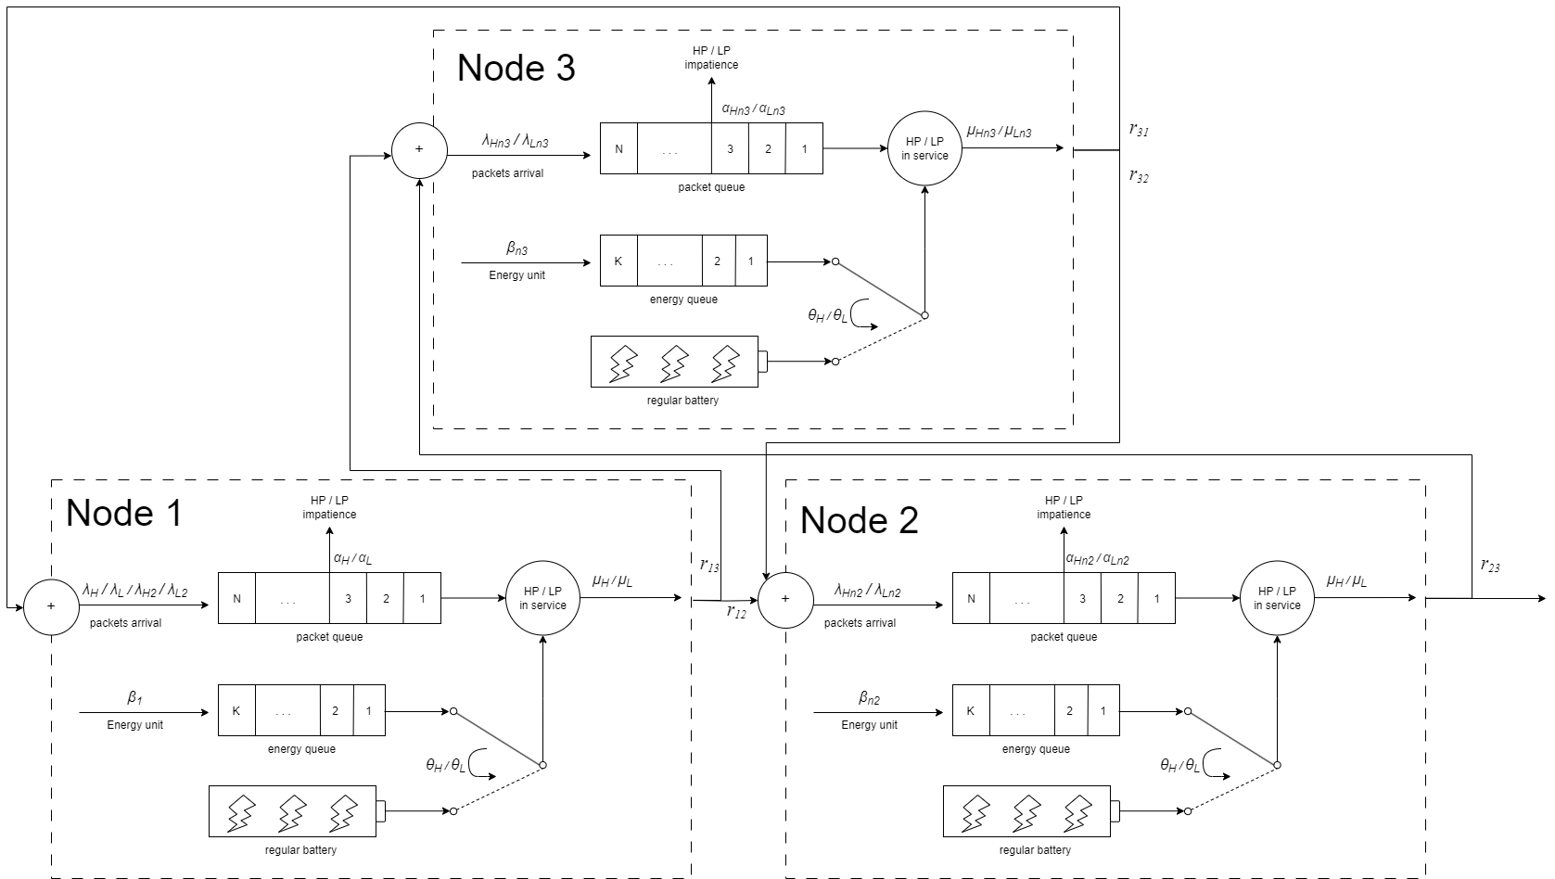
System Model- Three nodes network
Queueing model：

Slide 15
Outline
Motivation
System Model
Analytical Model
Numerical Results
Conclusions and Future Works

Slide 16
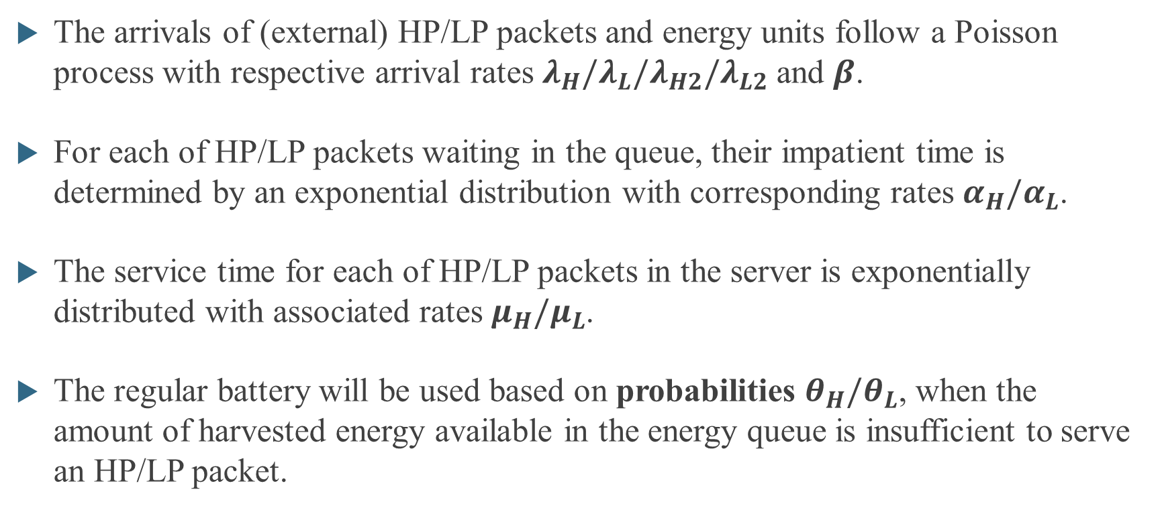
Analytical Model
The arrivals of (external) HP/LP packets and energy units follow a Poisson process with respective arrival rates $λ_{H}/λ_{L}/λ_{H2}/λ_{L2}$ and $β$.
For each of HP/LP packets waiting in the queue, their impatient time is determined by an exponential distribution with corresponding rates $α_{H}/α_{L}$.
The service time for each of HP/LP packets in the server is exponentially distributed with associated rates $μ_{H}/μ_{L}$.
The regular battery will be used based on probabilities $θ_{H}/θ_{L}$, when the amount of harvested energy available in the energy queue is insufficient to serve an HP/LP packet.

Slide 17
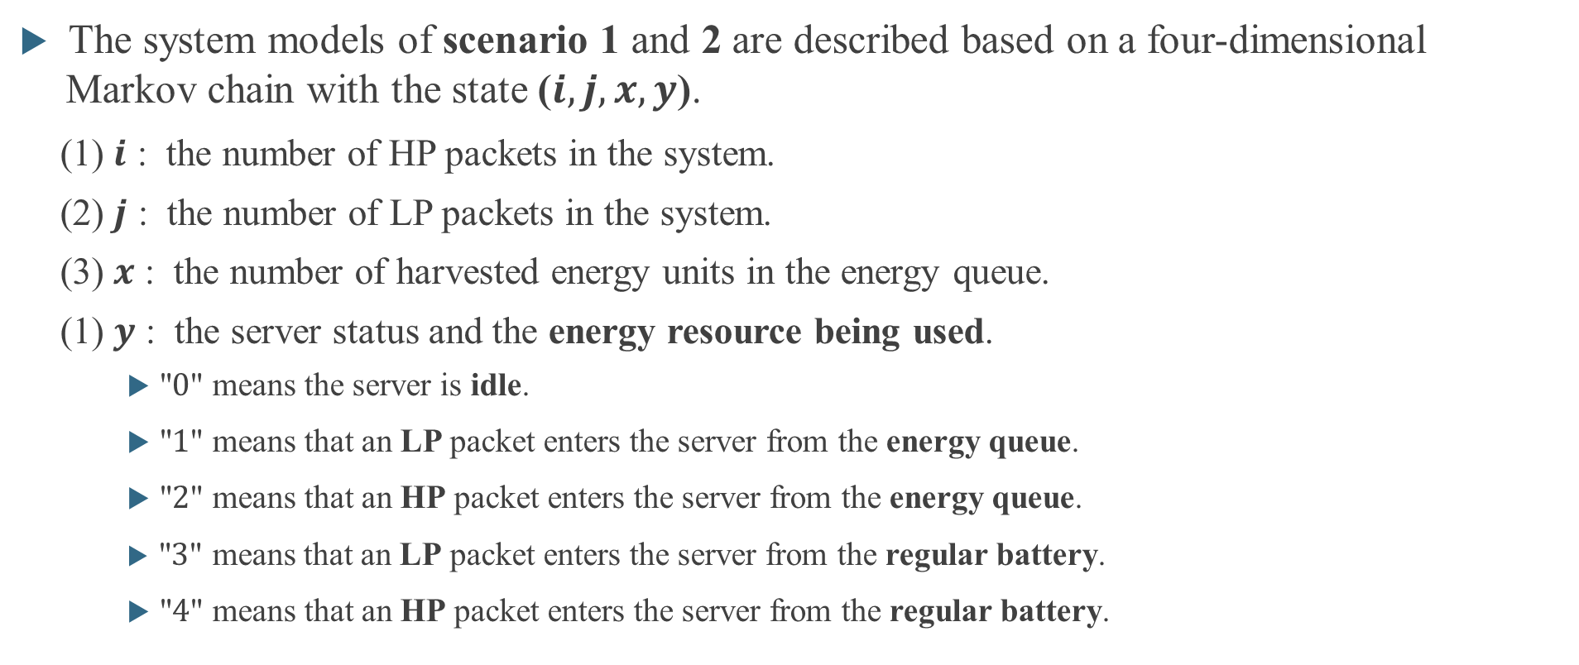
Analytical Model
The system models of scenario 1 and 2 are described based on a four-dimensional Markov chain with the state ($i, j, x, y$).
(1) $i$ : the number of HP packets in the system.
(2) $j$ : the number of LP packets in the system.
(3) $x$ : the number of harvested energy units in the energy queue.
(1) $y$ : the server status and the energy resource being used.
"$0$" means the server is idle.
"$1$" means that an LP packet enters the server from the energy queue.
"$2$" means that an HP packet enters the server from the energy queue.
"$3$" means that an LP packet enters the server from the regular battery.
"$4$" means that an HP packet enters the server from the regular battery.

Slide 18
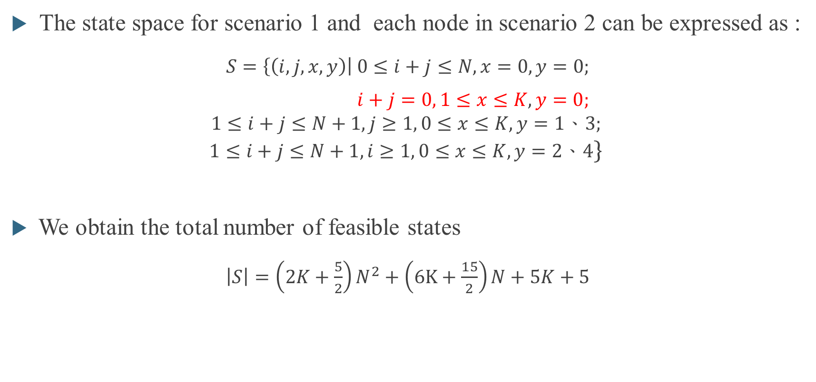
Analytical Model
The state space for scenario 1 and each node in scenario 2 can be expressed as :
$S=\left\{\left(i,j,x,y\right)\right| 0≤i+j≤N, x=0, y=0;$
$i+j=0, 1≤x≤K, y=0;$
$$1≤i+j≤N+1,j≥1, 0≤x≤K, y=1、3;$$
$$1≤i+j≤N+1,i≥1, 0≤x≤K, y=2、4\}$$
We obtain the total number of feasible states
$\left|S\right|=\left(2K+\frac{5}{2}\right)N^{2}+\left(6K+\frac{15}{2}\right)N+5K+5$

Slide 19
Analytical Model- Identical energy requirement
According to the following eleven events, the total system states can be further divided into 190 types of state transitions.
(1) Batch arrival of one-packet HP (3) Batch arrival of two-packet HP
(2) Batch arrival of one-packet LP (4) Batch arrival of two-packet LP
(5) Energy arrival of harvesting energy
(6) Impatience of an HP packet in the packet queue
(7) Impatience of an LP packet in the packet queue
(8) Departure of an HP packet by consuming the harvested energy
(9) Departure of an LP packet by consuming the harvested energy
(10) Departure of an HP packet by consuming the regular battery
(11) Departure of an LP packet by consuming the regular battery

Slide 20
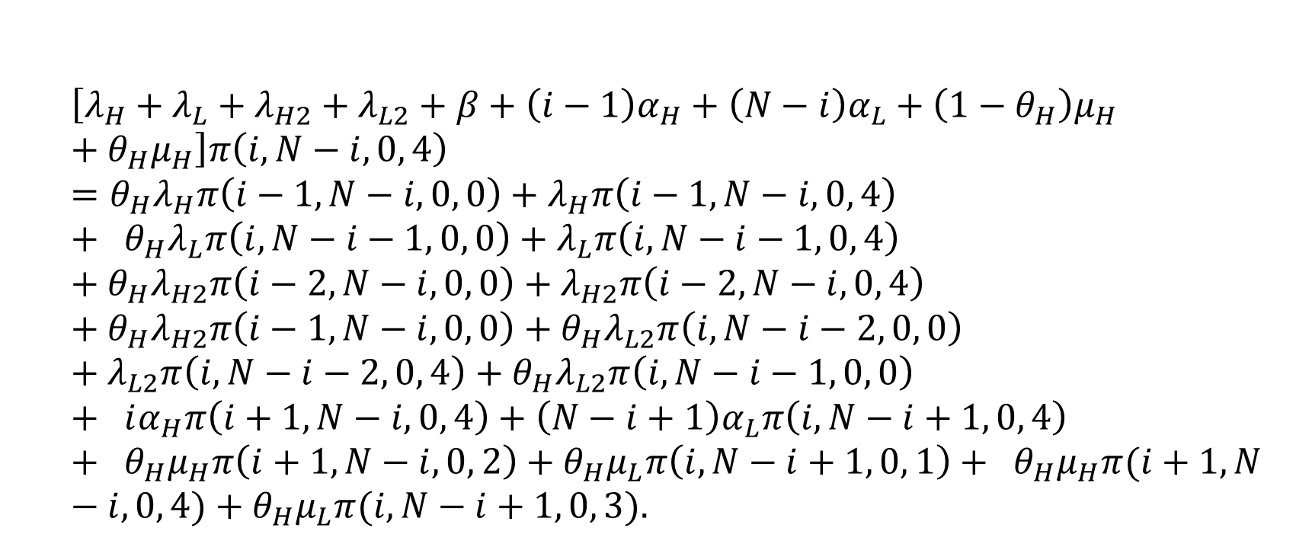
Analytical Model- Scenario 1 State balance equations
For $3≤i≤N−3$, $j=N−i$, $x=0$, and $y=4$ (Case 159)
$$\left[λ_{H}+λ_{L}+λ_{H2}+λ_{L2}+β+\left(i−1\right)α_{H}+\left(N−i\right)α_{L}+\left(1−θ_{H}\right)μ_{H}+θ_{H}μ_{H}\right]π\left(i, N−i, 0, 4\right)=θ_{H}λ_{H}π\left(i−1, N−i, 0, 0\right)+λ_{H}π\left(i−1, N−i, 0, 4\right)+ θ_{H}λ_{L}π\left(i, N−i−1, 0, 0\right)+λ_{L}π\left(i, N−i−1, 0, 4\right)+θ_{H}λ_{H2}π\left(i−2, N−i, 0, 0\right)+λ_{H2}π\left(i−2, N−i, 0, 4\right)+θ_{H}λ_{H2}π\left(i−1, N−i, 0, 0\right)+θ_{H}λ_{L2}π\left(i, N−i−2, 0, 0\right)+λ_{L2}π\left(i, N−i−2, 0, 4\right)+θ_{H}λ_{L2}π\left(i, N−i−1, 0, 0\right)+ iα_{H}π\left(i+1, N−i, 0, 4\right)+\left(N−i+1\right)α_{L}π\left(i, N−i+1, 0, 4\right)+ θ_{H}μ_{H}π\left(i+1, N−i, 0, 2\right)+θ_{H}μ_{L}π\left(i, N−i+1, 0, 1\right)+ θ_{H}μ_{H}π(i+1, N−i, 0, 4)+θ_{H}μ_{L}π(i, N−i+1, 0, 3).$$

Slide 21
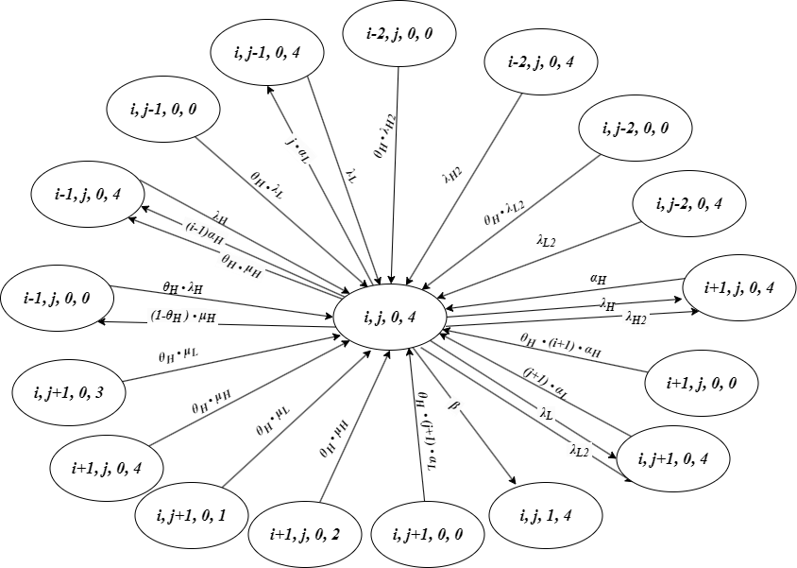
Analytical Model- Scenario 1 State balance equations
For $3≤i≤N−3$, $j=N−i$, $x=0$, and $y=4$ (Case 159)

Slide 22
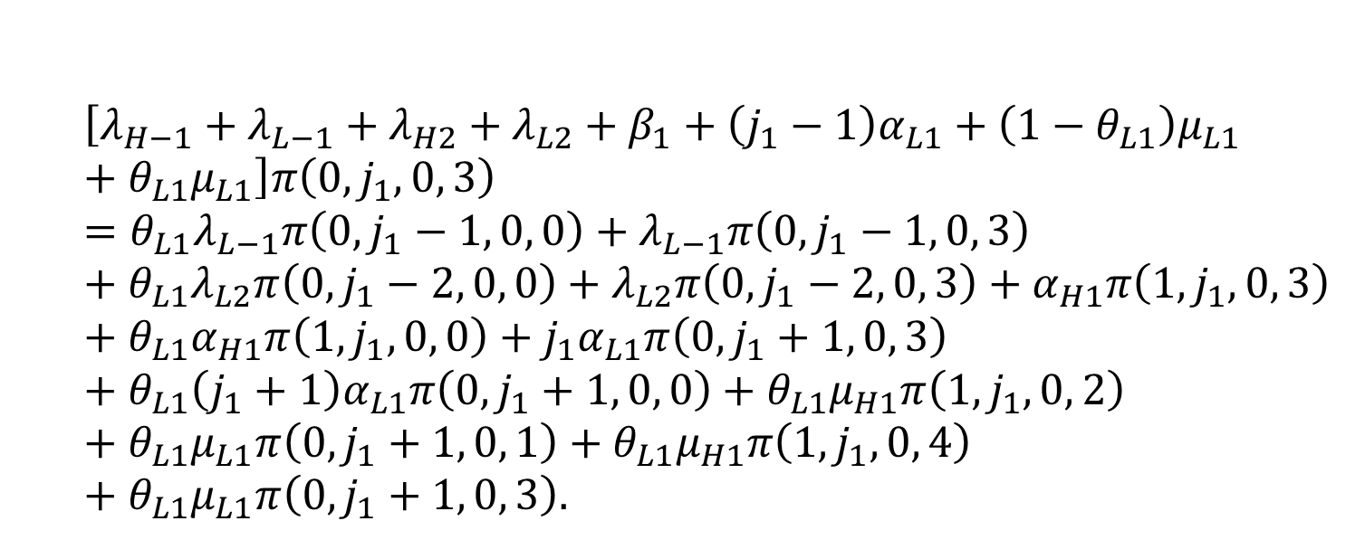
Analytical Model- Scenario 1 State balance equations
For $i_{1}=0$, $3≤j_{1}≤N−1$, $x_{1}=0$, and $y_{1}=3$ (Case A103)
$$\left[λ_{H−1}+λ_{L−1}+λ_{H2}+λ_{L2}+β_{1}+\left(j_{1}−1\right)α_{L1}+\left(1−θ_{L1}\right)μ_{L1}+θ_{L1}μ_{L1}\right]π\left(0, j_{1}, 0, 3\right)=θ_{L1}λ_{L−1}π\left(0, j_{1}−1, 0, 0\right)+λ_{L−1}π\left(0, j_{1}−1, 0, 3\right)+θ_{L1}λ_{L2}π\left(0, j_{1}−2, 0, 0\right)+λ_{L2}π\left(0, j_{1}−2, 0, 3\right)+α_{H1}π\left(1, j_{1}, 0, 3\right)+θ_{L1}α_{H1}π\left(1, j_{1}, 0, 0\right)+j_{1}α_{L1}π\left(0, j_{1}+1, 0, 3\right)+θ_{L1}\left(j_{1}+1\right)α_{L1}π\left(0, j_{1}+1, 0, 0\right)+θ_{L1}μ_{H1}π\left(1, j_{1}, 0, 2\right)+θ_{L1}μ_{L1}π\left(0, j_{1}+1, 0, 1\right)+θ_{L1}μ_{H1}π\left(1,j_{1}, 0, 4\right)+θ_{L1}μ_{L1}π\left(0, j_{1}+1, 0, 3\right).$$

Slide 23
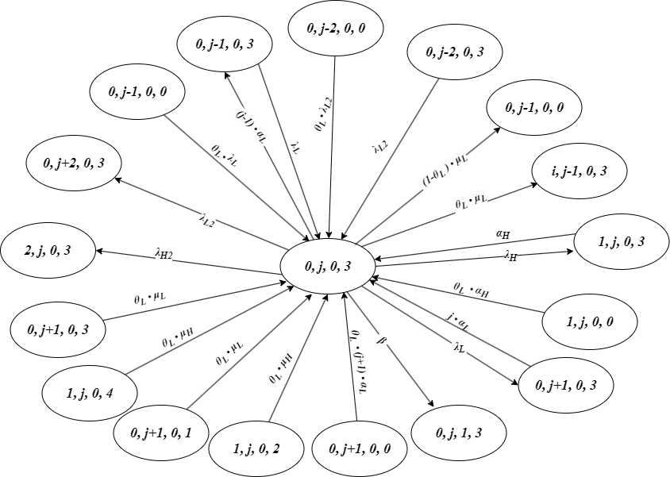
Analytical Model- Scenario 1 State balance equations
For $i_{1}=0$, $3≤j_{1}≤N−1$, $x_{1}=0$, and $y_{1}=3$ (Case A103)

Slide 24
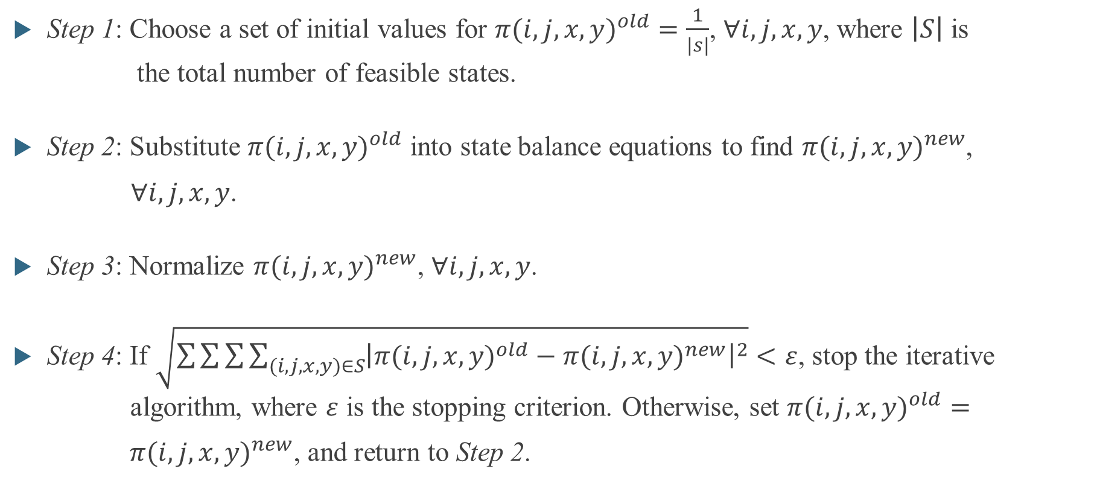
Iterative algorithm
Step 1: Choose a set of initial values for ${π(i,j,x,y)}^{old}=\frac{1}{\left|s\right|}$, $∀i,j,x,y$, where $\left|S\right|$ is the total number of feasible states.
Step 2: Substitute ${π(i,j,x,y)}^{old}$ into state balance equations to find ${π(i,j,x,y)}^{new}$,
$∀i,j,x,y$.
Step 3: Normalize ${π(i,j,x,y)}^{new}$, $∀i,j,x,y$.
Step 4: If $\sqrt{\sum{\sum{\sum{\sum_{(i,j,x,y)∈S}{{\left|{π(i,j,x,y)}^{old}−{π(i,j,x,y)}^{new}\right|}^{2}}}}}}<ε$, stop the iterative algorithm, where $ε$ is the stopping criterion. Otherwise, set ${π(i,j,x,y)}^{old}=$
${π(i,j,x,y)}^{new}$, and return to Step 2.

Slide 25
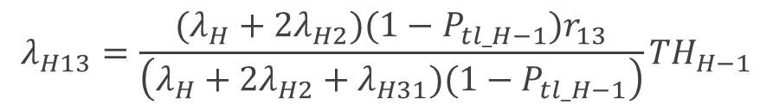
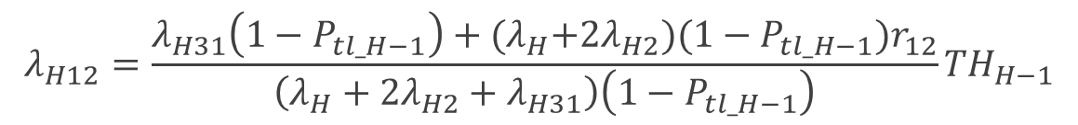
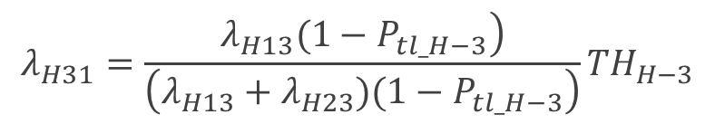
Internal arrival rates for Three nodes network
The HP and LP packet arrival rates from node 1 to node 3
The HP and LP packet arrival rates from node 3 to node 1
The HP and LP packet arrival rates from node 1 to node 2
$$λ_{H13}=\frac{(λ_{H}+2λ_{H2})(1−P_{tl_H−1})r_{13}}{\left(λ_{H}+2λ_{H2}+λ_{H31})(1−P_{tl_H−1}\right)}{TH}_{H−1}$$
$$λ_{H31}=\frac{\left.λ_{H13}(1−P_{tl_H−3}\right)}{\left(λ_{H13}+λ_{H23})(1−P_{tl_H−3}\right)}{TH}_{H−3}$$
$$λ_{H12}=\frac{λ_{H31}\left(1−P_{tl_H−1}\right)+{(λ}_{H}+2λ_{H2})(1−P_{tl_H−1})r_{12}}{\left(λ_{H}+2λ_{H2}+λ_{H31}\right)\left(1−P_{tl_H−1}\right)}{TH}_{H−1}$$

Slide 26
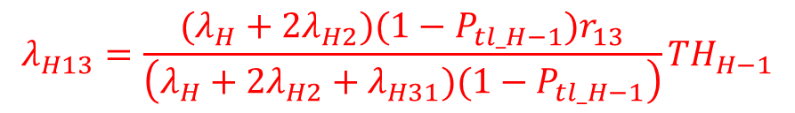
Internal arrival rates for Three nodes network
The HP and LP packet arrival rates from node 1 to node 3
The HP and LP packet arrival rates from node 3 to node 1
The HP and LP packet arrival rates from node 1 to node 2
$$λ_{H13}=\frac{(λ_{H}+2λ_{H2})(1−P_{tl_H−1})r_{13}}{\left(λ_{H}+2λ_{H2}+λ_{H31})(1−P_{tl_H−1}\right)}{TH}_{H−1}$$
$$λ_{H31}=\frac{\left.λ_{H13}(1−P_{tl_H−3}\right)}{\left(λ_{H13}+λ_{H23})(1−P_{tl_H−3}\right)}{TH}_{H−3}$$
$$λ_{H12}=\frac{λ_{H31}\left(1−P_{tl_H−1}\right)+{(λ}_{H}+2λ_{H2})(1−P_{tl_H−1})r_{12}}{\left(λ_{H}+2λ_{H2}+λ_{H31}\right)\left(1−P_{tl_H−1}\right)}{TH}_{H−1}$$

Slide 27
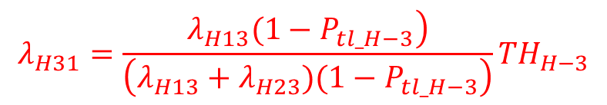
Internal arrival rates for Three nodes network
The HP and LP packet arrival rates from node 1 to node 3
The HP and LP packet arrival rates from node 3 to node 1
The HP and LP packet arrival rates from node 1 to node 2
$$λ_{H13}=\frac{(λ_{H}+2λ_{H2})(1−P_{tl_H−1})r_{13}}{\left(λ_{H}+2λ_{H2}+λ_{H31})(1−P_{tl_H−1}\right)}{TH}_{H−1}$$
$$λ_{H31}=\frac{\left.λ_{H13}(1−P_{tl_H−3}\right)}{\left(λ_{H13}+λ_{H23})(1−P_{tl_H−3}\right)}{TH}_{H−3}$$
$$λ_{H12}=\frac{λ_{H31}\left(1−P_{tl_H−1}\right)+{(λ}_{H}+2λ_{H2})(1−P_{tl_H−1})r_{12}}{\left(λ_{H}+2λ_{H2}+λ_{H31}\right)\left(1−P_{tl_H−1}\right)}{TH}_{H−1}$$

Slide 28
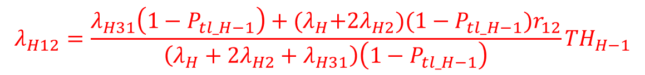
Internal arrival rates for Three nodes network
The HP and LP packet arrival rates from node 1 to node 3
The HP and LP packet arrival rates from node 3 to node 1
The HP and LP packet arrival rates from node 1 to node 2
$$λ_{H13}=\frac{(λ_{H}+2λ_{H2})(1−P_{tl_H−1})r_{13}}{\left(λ_{H}+2λ_{H2}+λ_{H31})(1−P_{tl_H−1}\right)}{TH}_{H−1}$$
$$λ_{H31}=\frac{\left.λ_{H13}(1−P_{tl_H−3}\right)}{\left(λ_{H13}+λ_{H23})(1−P_{tl_H−3}\right)}{TH}_{H−3}$$
$$λ_{H12}=\frac{λ_{H31}\left(1−P_{tl_H−1}\right)+{(λ}_{H}+2λ_{H2})(1−P_{tl_H−1})r_{12}}{\left(λ_{H}+2λ_{H2}+λ_{H31}\right)\left(1−P_{tl_H−1}\right)}{TH}_{H−1}$$

Slide 29

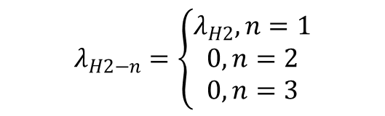
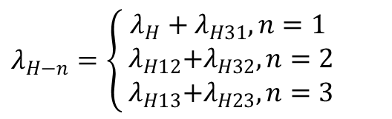
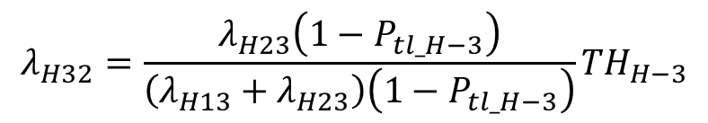
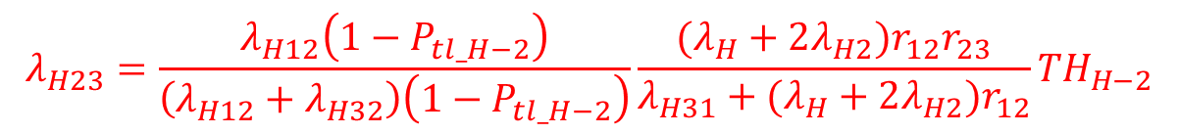
Internal arrival rates for Three nodes network
The HP and LP packet arrival rates from node 2 to node 3
The HP and LP packet arrival rates from node 3 to node 2
The HP and LP packet arrival rates with one packet / two packets per batch for each node $n$, $λ_{H−n}$ and $λ_{L−n }/{ λ}_{H2−n}$ and $λ_{L2−n}$
$$λ_{H23}=\frac{λ_{H12}\left(1−P_{tl_H−2}\right)}{\left(λ_{H12}+λ_{H32}\right)\left(1−P_{tl_H−2}\right)}\frac{(λ_{H}+2λ_{H2})r_{12}r_{23}}{{λ_{H31}+(λ}_{H}+2λ_{H2})r_{12}}{TH}_{H−2}$$
$$λ_{H32}=\frac{λ_{H23}\left(1−P_{tl_H−3}\right)}{\left(λ_{H13}+λ_{H23}\right)\left(1−P_{tl_H−3}\right)}{TH}_{H−3}$$
$λ_{H−n}=\left\{\begin{aligned}λ_{H}+λ_{H31}, n=1 \\ { λ}_{H12}+λ_{H32}, n=2 \\ { λ}_{H13}+λ_{H23}, n=3\end{aligned}\right.$
$$λ_{H2−n}=\left\{\begin{aligned}λ_{H2}, n=1 \\ 0, n=2 \\ 0, n=3\end{aligned}\right.$$
,

Slide 30
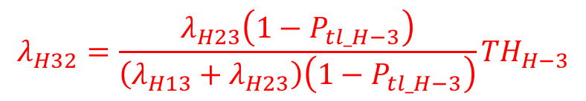
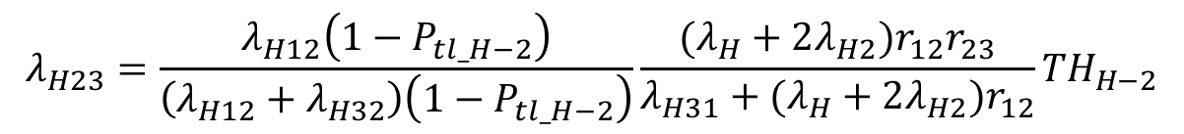
Internal arrival rates for Three nodes network
The HP and LP packet arrival rates from node 2 to node 3
The HP and LP packet arrival rates from node 3 to node 2
The HP and LP packet arrival rates with one packet / two packets per batch for each node $n$, $λ_{H−n}$ and $λ_{L−n }/{ λ}_{H2−n}$ and $λ_{L2−n}$
$$λ_{H23}=\frac{λ_{H12}\left(1−P_{tl_H−2}\right)}{\left(λ_{H12}+λ_{H32}\right)\left(1−P_{tl_H−2}\right)}\frac{(λ_{H}+2λ_{H2})r_{12}r_{23}}{{λ_{H31}+(λ}_{H}+2λ_{H2})r_{12}}{TH}_{H−2}$$
$$λ_{H32}=\frac{λ_{H23}\left(1−P_{tl_H−3}\right)}{\left(λ_{H13}+λ_{H23}\right)\left(1−P_{tl_H−3}\right)}{TH}_{H−3}$$
$λ_{H−n}=\left\{\begin{aligned}λ_{H}+λ_{H31}, n=1 \\ { λ}_{H12}+λ_{H32}, n=2 \\ { λ}_{H13}+λ_{H23}, n=3\end{aligned}\right.$
$$λ_{H2−n}=\left\{\begin{aligned}λ_{H2}, n=1 \\ 0, n=2 \\ 0, n=3\end{aligned}\right.$$
,

Slide 31
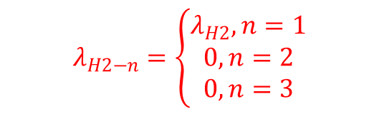
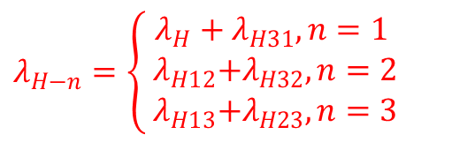
Internal arrival rates for Three nodes network
The HP and LP packet arrival rates from node 2 to node 3
The HP and LP packet arrival rates from node 3 to node 2
The HP and LP packet arrival rates with one packet / two packets per batch for each node $n$, $λ_{H−n}$ and $λ_{L−n }/{ λ}_{H2−n}$ and $λ_{L2−n}$
$$λ_{H23}=\frac{λ_{H12}\left(1−P_{tl_H−2}\right)}{\left(λ_{H12}+λ_{H32}\right)\left(1−P_{tl_H−2}\right)}\frac{(λ_{H}+2λ_{H2})r_{12}r_{23}}{{λ_{H31}+(λ}_{H}+2λ_{H2})r_{12}}{TH}_{H−2}$$
$$λ_{H32}=\frac{λ_{H23}\left(1−P_{tl_H−3}\right)}{\left(λ_{H13}+λ_{H23}\right)\left(1−P_{tl_H−3}\right)}{TH}_{H−3}$$
$λ_{H−n}=\left\{\begin{aligned}λ_{H}+λ_{H31}, n=1 \\ { λ}_{H12}+λ_{H32}, n=2 \\ { λ}_{H13}+λ_{H23}, n=3\end{aligned}\right.$
$$λ_{H2−n}=\left\{\begin{aligned}λ_{H2}, n=1 \\ 0, n=2 \\ 0, n=3\end{aligned}\right.$$
,

Slide 32


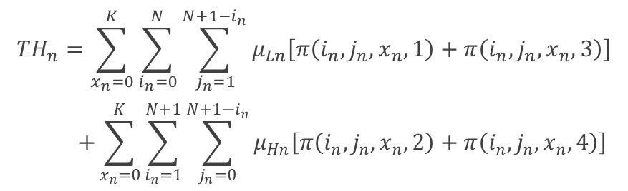



Performance Measures
The expected number of packets in node $n$
The expected number of all packets for the system
The throughput of packets for node $n$
The throughput of all packets for the system
$${E\left[N\right]}_{n}=\sum_{i_{n}=0}^{N}{\sum_{j_{n}=0}^{N−i_{n}}{\left(i_{n}+j_{n}\right)π\left(i_{n}, j_{n}, 0, 0\right)}}$$
$$+\sum_{x_{n}=0}^{K}{\sum_{i_{n}=0}^{N}{\sum_{j_{n}=1}^{N+1−i_{n}}{\left(i_{n}+j_{n}\right)\left[π\left(i_{n}, j_{n}, x_{n}, 1\right)+π\left(i_{n}, j_{n}, x_{n}, 3\right)\right]}}}$$
$$+\sum_{x_{n}=0}^{K}{\sum_{i_{n}=1}^{N+1}{\sum_{j_{n}=0}^{N+1−i_{n}}{\left(i_{n}+j_{n}\right)\left[π\left(i_{n}, j_{n}, x_{n}, 2\right)+π\left(i_{n}, j_{n}, x_{n}, 4\right)\right]}}}$$
$${TH}_{n}=\sum_{x_{n}=0}^{K}{\sum_{i_{n}=0}^{N}{\sum_{j_{n}=1}^{N+1−i_{n}}{μ_{Ln}\left[π\left(i_{n}, j_{n}, x_{n}, 1\right)+π\left(i_{n}, j_{n}, x_{n}, 3\right)\right]}}}$$
$$+\sum_{x_{n}=0}^{K}{\sum_{i_{n}=1}^{N+1}{\sum_{j_{n}=0}^{N+1−i_{n}}{μ_{Hn}\left[π\left(i_{n}, j_{n}, x_{n}, 2\right)+π\left(i_{n}, j_{n}, x_{n}, 4\right)\right]}}}$$
$$\left.TH={TH}_{2}−(λ_{H23}+λ_{L23}\right)$$
$$E\left[N\right]=\sum_{n=1}^{3}{{E\left[N\right]}_{n}}$$

Slide 33
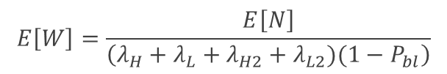

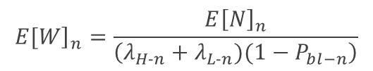

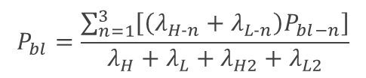

Performance Measures
The blocking probability of each arrived packet for node $n$ , regardless of priority
The blocking probability of each arrived packet for the system
The mean waiting time of packets in node $n$
The mean waiting time of all packets for the system
$${\left.E[W\right]}_{n}=\frac{{E\left[N\right]}_{n}}{\left(λ_{H−n}+λ_{L−n})(1−P_{bl−n}\right)}$$
$$P_{bl−n}=\sum_{i_{n}=0}^{N}{π\left(i_{n}, N−i_{n}, 0, 0\right)}$$
$$+\sum_{x_{n}=0}^{K}{\sum_{i_{n}=0}^{N}{\left[π\left(i_{n}, N+1−i_{n}, x_{n}, 1\right)+π\left(i_{n}, N+1−i_{n}, x_{n},3\right)\right]}}$$
$$+\sum_{x_{n}=0}^{K}{\sum_{i_{n}=1}^{N+1}{\left[π\left(i_{n}, N+1−i_{n}, x_{n}, 2\right)+π\left(i_{n}, N+1−i_{n}, x_{n}, 4\right)\right]}}$$
$$E\left[W\right]=\frac{E\left[N\right]}{\left(λ_{H}+λ_{L}+λ_{H2}+λ_{L2})(1−P_{bl}\right)}$$
$$P_{bl}=\frac{\sum_{n=1}^{3}{\left[\left(λ_{H−n}+λ_{L−n}\right)P_{bl−n}\right]}}{λ_{H}+λ_{L}+λ_{H2}+λ_{L2}}$$

Slide 34
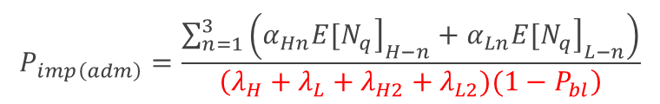

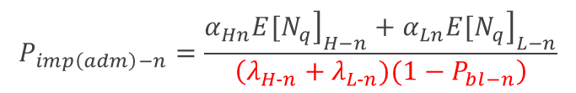
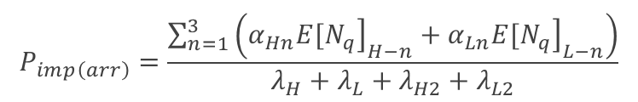
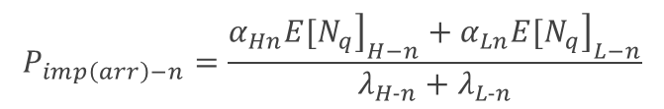

Performance Measures
The impatient loss probability of arrived packets for node $n$
The impatient loss probability of arrived packets for the system
The impatient loss probability of admitted packets for node $n$
The impatient loss probability of admitted packets for the system
$$P_{imp\left(arr\right)−n}=\frac{α_{Hn}{\left.{E[N}_{q}\right]}_{H−n}+α_{Ln}{\left.{E[N}_{q}\right]}_{L−n}}{λ_{H−n}+λ_{L−n}}$$
$$P_{imp\left(adm\right)−n}=\frac{α_{Hn}{\left.{E[N}_{q}\right]}_{H−n}+α_{Ln}{\left.{E[N}_{q}\right]}_{L−n}}{\left(λ_{H−n}+λ_{L−n})(1−P_{bl−n}\right)}$$
$$P_{imp\left(arr\right)}=\frac{\sum_{n=1}^{3}{\left(α_{Hn}{\left.{E[N}_{q}\right]}_{H−n}+α_{Ln}{\left.{E[N}_{q}\right]}_{L−n}\right)}}{λ_{H}+λ_{L}+λ_{H2}+λ_{L2}}$$
$$P_{imp\left(adm\right)}=\frac{\sum_{n=1}^{3}{\left(α_{Hn}{\left.{E[N}_{q}\right]}_{H−n}+α_{Ln}{\left.{E[N}_{q}\right]}_{L−n}\right)}}{\left(λ_{H}+λ_{L}+λ_{H2}+λ_{L2})(1−P_{bl}\right)}$$

Slide 35
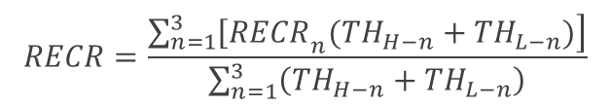

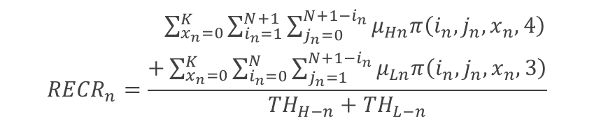
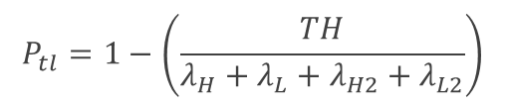


Performance Measures
The total loss probability for node $n$
The total loss probability for the system
The regular energy consumption ratio of packets for node $n$
The regular energy consumption ratio of packets for the system
$$P_{tl−n}=1−\left(\frac{{TH}_{n}}{λ_{H−n}+λ_{L−n}}\right)$$
$${RECR}_{n}=\frac{\begin{aligned} \sum_{x_{n}=0}^{K}{\sum_{i_{n}=1}^{N+1}{\sum_{j_{n}=0}^{N+1−i_{n}}{μ_{Hn}π\left(i_{n}, j_{n}, x_{n}, 4\right)}}} \\ +\sum_{x_{n}=0}^{K}{\sum_{i_{n}=0}^{N}{\sum_{j_{n}=1}^{N+1−i_{n}}{μ_{Ln}π\left(i_{n}, j_{n}, x_{n}, 3\right)}}}\end{aligned}}{{TH}_{H−n}+{TH}_{L−n}}$$
$$P_{tl}=1−\left(\frac{TH}{λ_{H}+λ_{L}+λ_{H2}+λ_{L2}}\right)$$
$$RECR=\frac{\sum_{n=1}^{3}{\left.{\left[RECR\right.}_{n}({TH}_{H−n}+{TH}_{L−n})\right]}}{\sum_{n=1}^{3}{\left({TH}_{H−n}+{TH}_{L−n}\right)}}$$

Slide 36
Outline
Motivation
System Model
Analytical Model
Numerical Results
One sensor node (Scenario 1)
Three nodes network (Scenario 2)
Conclusions and Future Works

Slide 37

Numerical Results- One sensor node system (Scenario 1)
The default values of the various system parameters
$N=9$ , $K=100$
$λ_{H}=0.$05 , $λ_{L}=0.25$
$λ_{H2}=0.0$25 , $λ_{L2}=0.125$ , $β=0.3$
$α_{H}=0.02$ , $α_{L}=0.01$
$μ_{H}=1$ , $μ_{L}=1$
Energy request rate is defined as $φ_{req}={(λ}_{H}+λ_{H2})e_{H}+{(λ}_{L}+λ_{L2})e_{L}$.
Effective service rate is defined as $μ_{eff}≤min (\max\left(μ_{H}, μ_{L}\right), β+max(θ_{H}, θ_{L}))$
Next, we use the default parameters to determine suitable regular battery usage probabilities $θ_{H}/θ_{L}$.

Slide 38

Numerical Results- One sensor node system (Scenario 1)

Slide 39

Numerical Results- One sensor node system (Scenario 1)
We select the minimum $θ_{H}/θ_{L}$ on the curve such that the upper bound is not violated as the suboptimal parameter value, that is, $θ_{H}=θ_{L}=0.6$
Afterwards, the influences of HP packet arrival rate on various performance measures are studied.

Slide 40


Numerical Results- HP packet arrival rate (Scenario 1)

Slide 41


Numerical Results- HP packet arrival rate (Scenario 1)

Slide 42


Numerical Results- HP packet arrival rate (Scenario 1)

Slide 43


Numerical Results- Comparison of single and batch arrivals (Scenario 1)

Slide 44


Numerical Results- Comparison of single and batch arrivals (Scenario 1)

Slide 45


Numerical Results- Comparison of single and batch arrivals (Scenario 1)

Slide 46
Outline
Motivation
System Model
Analytical Model
Numerical Results
One sensor node (Scenario 1)
Three nodes network (Scenario 2)
Conclusions and Future Works

Slide 47


Numerical Results- Three nodes network (Scenario 2)
The default values of the various system parameters
For the system :
$λ_{H}=0.05$ , $λ_{L}=0.25$
$λ_{H2}=0.025$ , $λ_{L2}=0.125$
$r_{13}=r_{23}=0.1$
Energy request rate of each node n is defined as
$φ_{req−n}=\left(λ_{H−n}+λ_{H2−n}\right)e_{H}+(λ_{L−n}+λ_{L2−n})e_{L}$.
Effective service rate of each node n is defined as
$μ_{eff−n}≤min (\max\left(μ_{Hn}, μ_{Ln}\right), β_{n}+max(θ_{Hn}, θ_{Ln}))$
Next, we use the default parameters to determine suitable regular battery usage probabilities $θ_{H}/θ_{L}$.
For each node n :
$N=9$ , $K=100 \text{,} β_{n}=0.3$
$α_{Hn}=0.02$ , $α_{Ln}=0.01$
$μ_{Hn}=1$ , $μ_{Ln}=1$

Slide 48

Numerical Results- Three nodes network (Scenario 2)

Slide 49

Numerical Results- Three nodes network (Scenario 2)
We select the minimum $θ_{H}/θ_{L}$ on the curve such that the upper bound is not violated as the suboptimal parameter value, that is, $θ_{H}=θ_{L}=0.8$
Afterwards, the influences of HP packet arrival rate on various performance measures are studied

Slide 50


Numerical Results- HP packet arrival rate (Scenario 2)

Slide 51


Numerical Results- HP packet arrival rate (Scenario 2)

Slide 52


Numerical Results- HP packet arrival rate (Scenario 2)

Slide 53


Numerical Results- HP packet arrival rate (Scenario 2)

Slide 54


Numerical Results- HP packet arrival rate (Scenario 2)

Slide 55
Outline
Motivation
System Model
Analytical Model
Numerical Results
Conclusions and Future Works

Slide 56
Conclusions
First, the curves of expected number of all and LP packets in queue and system for batch arrival are higher than those for single arrival first and then they cross over in scenario 1. (node 1 and the whole network in scenario 2)
Second, compared to Energy Harvesting-based WSNs without the regular battery, our models exhibit noticeable enhancements in performance across various metrics, particularly in terms of throughput.
Third, among the aforementioned two scenarios, the maximum average RECR reaches approximately 0.6. This indicates that our model can extend the lifetime of a standard battery by a minimum of 40% when compared to relying only on a regular battery as an energy source.
In most of the studied cases, the analytical results are shown to be in fairly close agreement with the simulation results.

Slide 57
Future Works
First, the optimization of using regular battery probability might dynamically changes as any system parameter, e.g., λ_(H-arr) changes..
Second, to better reflect real-world scenarios, the number of packets in a batch arrival should be set as an arbitrary positive integer, instead of limiting it to just one or two packets.
Third, waiting time should exclude the time until an impatient departure occurs in order to accurately account for such scenarios.

Slide 58
Thank you for listening

