Slide 1

具有能量收集, 常規電池與批次抵達的無線感測器網路研究
A Study on the Wireless Sensor Network with Energy Harvesting, Regular Battery, and Batch Arrivals
指導教授： 鍾順平 教授
研 究 生： 鄭靖諼
西元2023年07月12日

Slide 2
Outline
Motivation
System Models
Analytical Models
Numerical Results
Conclusions and Future Works

Slide 3
Outline
Motivation
System Models
Analytical Models
Numerical Results
Conclusions and Future Works

Slide 4
Motivation
WSN has gained attention due to its real-time monitoring capabilities and various applications in the Internet of Things (IoT).
WSNs face the challenge of limited battery lifetime as the replacement of the battery is difficult and undesirable, particularly in hard-to-reach locations.
The trade-off between energy consumption and QoS becomes important.

Slide 5
Motivation
In [5], a queue with non-preemptive priority is considered in WSN considering multi-event environments containing mobile targets.
In [10], due to impatience, packets in the queue may leave the system before being serviced by the server.
In order to make the system still operate when out of harvested energy, it is mentioned in [15] that by adding a regular battery, the energy in the battery can be used at a certain probability to achieve a balance between energy consumption and system performance.

Slide 6
Motivation
The Energy Harvesting-based WSN with auxiliary regular battery is studied, and various packet properties are considered simultaneously.
For a more realistic scenario, we assume the packet arrival process to be a batch arrival process.
We define an additional performance measure, regular energy consumption ratio (RECR), to represent the efficiency of energy usage.
Two scenarios are considered:
1. one sensor node
2. three-node network

Slide 7
Outline
Motivation
System Models
One sensor node (Scenario 1)
Three-node network (Scenario 2)
Analytical Models
Numerical Results
Conclusions and Future Works

Slide 8



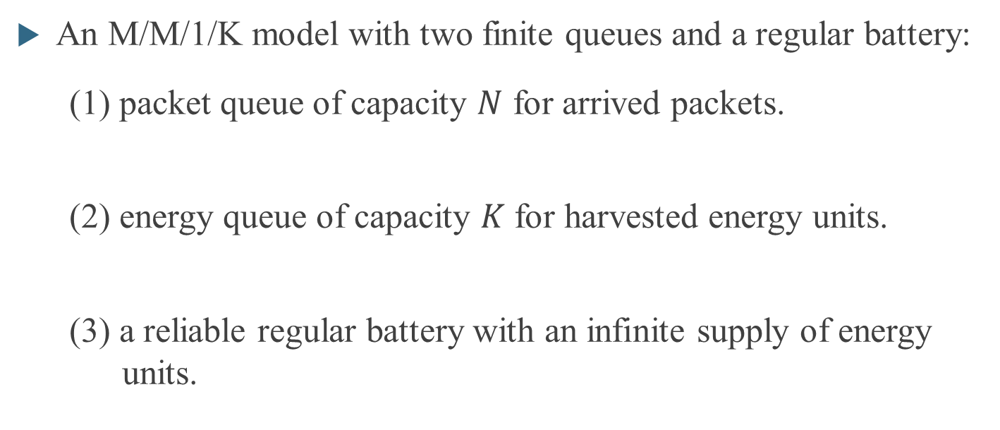
System Models - One Sensor Node
An M/M/1/K model with two finite queues and a regular battery:
(1) packet queue of capacity $N$ for arrived packets.
(2) energy queue of capacity $K$ for harvested energy units.
(3) a reliable regular battery with an infinite supply of energy units.

Slide 9
System Models - One Sensor Node
Batch arrived packets can be divided into four classes according to batch size and priority:
single HP batches
single LP batches
HP packets have non-preemptive priority over LP packets.
double HP batches
double LP batches

Slide 10
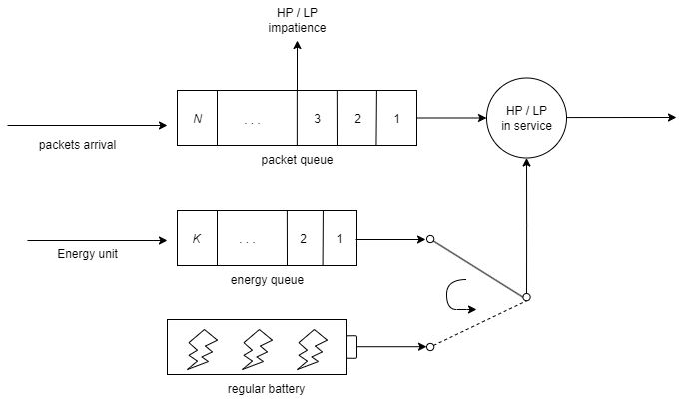
System Models - One Sensor Node
Queueing model:

Slide 11
Outline
Motivation
System Models
One sensor node (Scenario 1)
Three-node network (Scenario 2)
Analytical Models
Numerical Results
Conclusions and Future Works

Slide 12
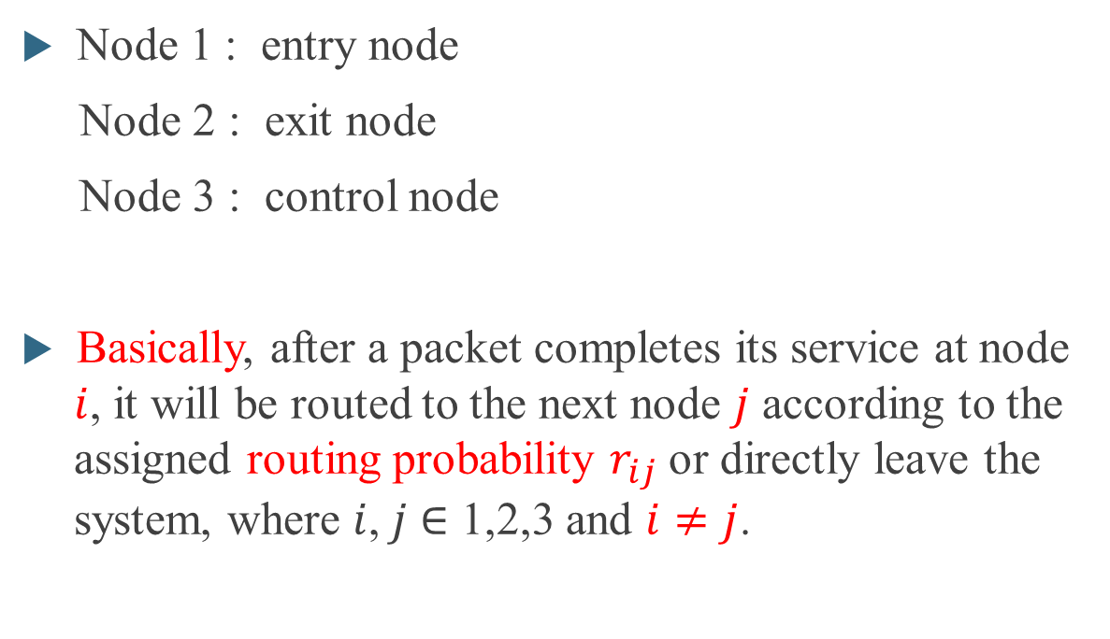



System Models - Three-node Network
Node 3
Node 1 : entry node
Node 2 : exit node
Node 3 : control node
Basically, after a packet completes its service at node $i$, it will be routed to the next node $j$ according to the assigned routing probability $r_{ij}$ or directly leave the system, where $i$,$j$ $∈$ 1,2,3 and $i≠j$.
$$r_{13}$$
$$r_{23}$$
Node 1
$$r_{12}$$
Node2

Slide 13



System Models - Three-node Network
Some restrictions for the routing policy:
(1) Packets are not allowed to be routed from the exit node to the entry node.
(2) Packets are only permitted to pass through the control node once. After this, they will be forwarded to the previous node and follow the correct path to the exit node and leave successfully.
Node 3
$$r_{13}$$
$$r_{23}$$
Node 1
$$r_{12}$$
Node2

Slide 14
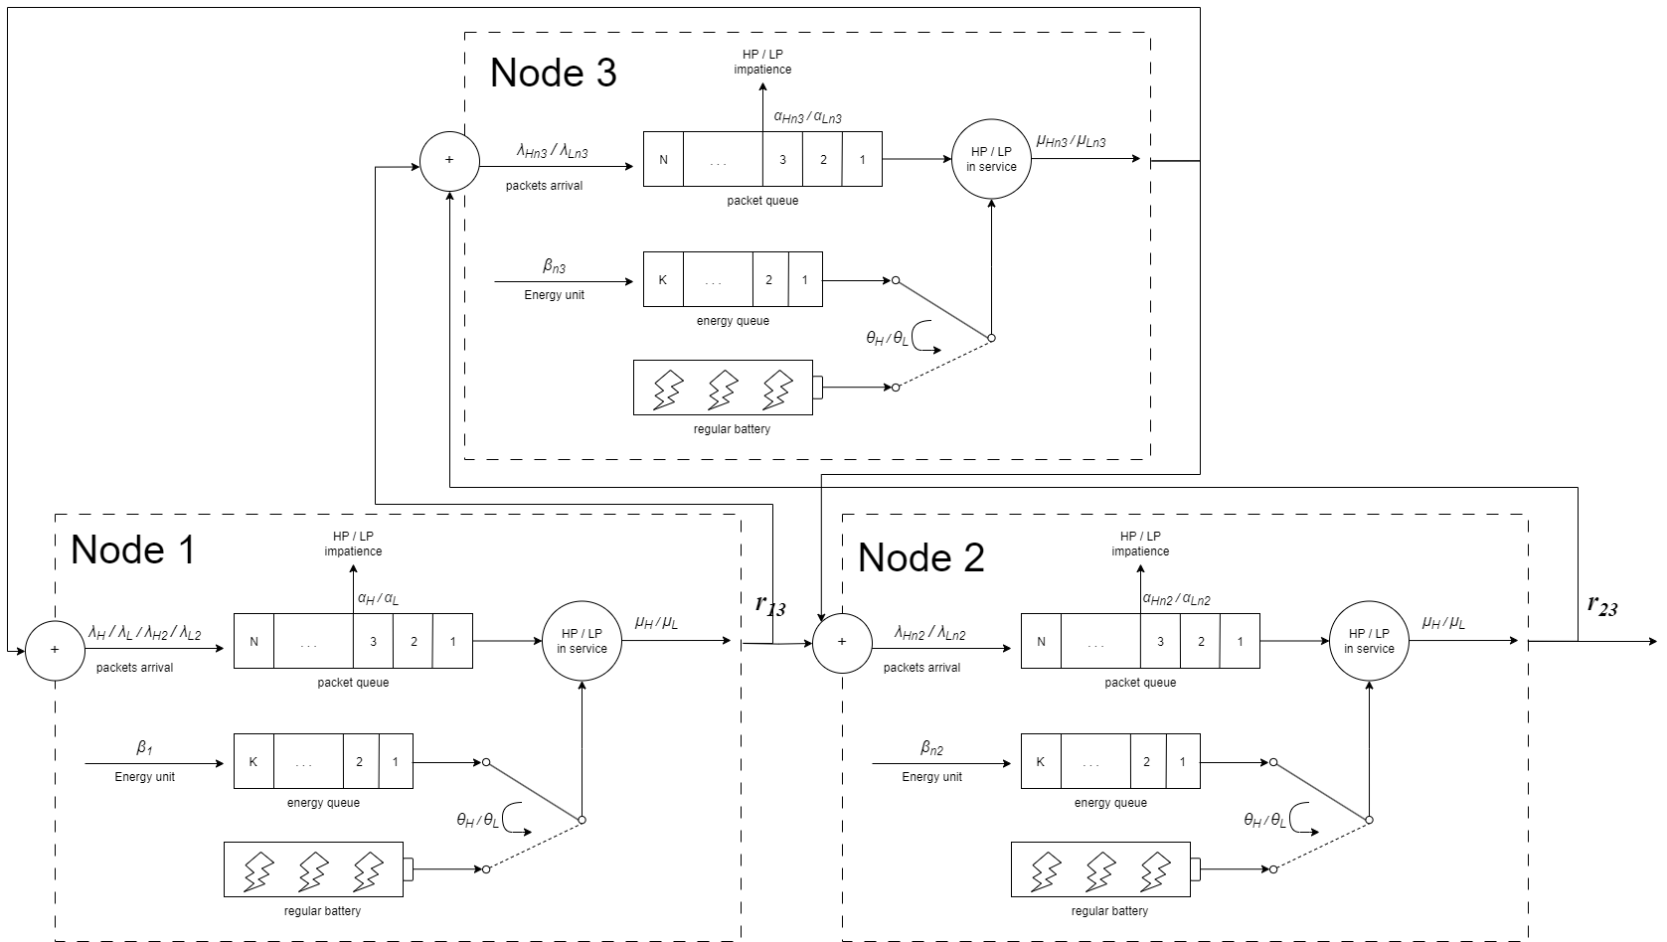
System Models - Three-node Network
Queueing model:

Slide 15
Outline
Motivation
System Models
Analytical Models
Numerical Results
Conclusions and Future Works

Slide 16
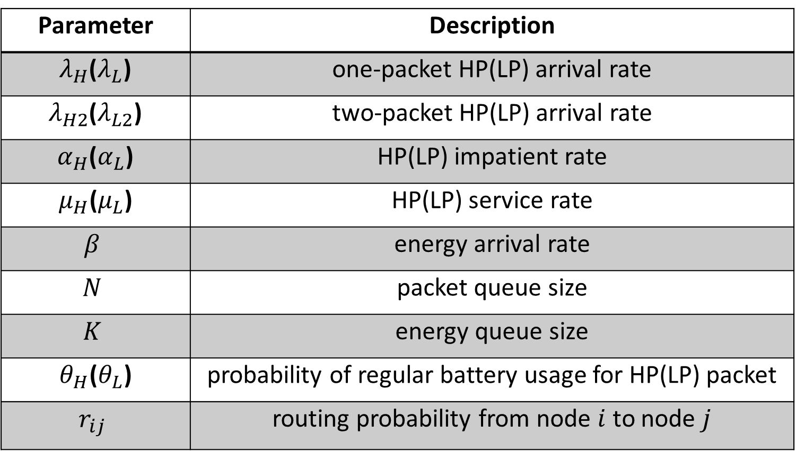
Analytical Models
Parameter | Description
$λ_{H}$($λ_{L}$) | one-packet HP(LP) arrival rate
$λ_{H2}$($λ_{L2}$) | two-packet HP(LP) arrival rate
$α_{H}$($α_{L}$) | HP(LP) impatient rate
$μ_{H}$($μ_{L}$) | HP(LP) service rate
$$β$$ | energy arrival rate
$$N$$ | packet queue size
$$K$$ | energy queue size
$θ_{H}$($θ_{L}$) | probability of regular battery usage for HP(LP) packet
$$r_{ij}$$ | routing probability from node $i$ to node $j$

Slide 17
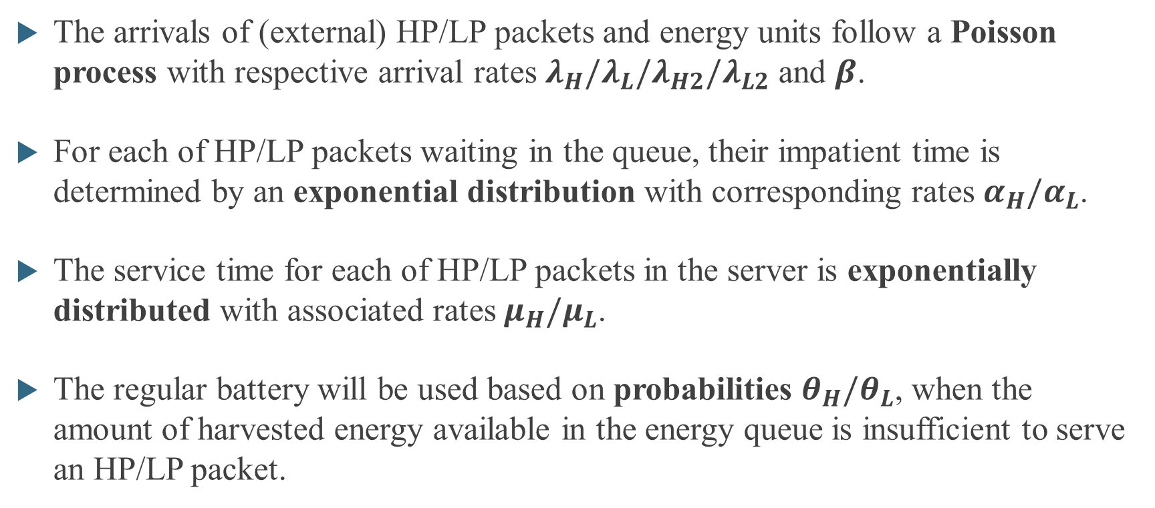
Analytical Models
The arrivals of (external) HP/LP packets and energy units follow a Poisson process with respective arrival rates $λ_{H}/λ_{L}/λ_{H2}/λ_{L2}$ and $β$.
For each of HP/LP packets waiting in the queue, their impatient time is determined by an exponential distribution with corresponding rates $α_{H}/α_{L}$.
The service time for each of HP/LP packets in the server is exponentially distributed with associated rates $μ_{H}/μ_{L}$.
The regular battery will be used based on probabilities $θ_{H}/θ_{L}$, when the amount of harvested energy available in the energy queue is insufficient to serve an HP/LP packet.

Slide 18
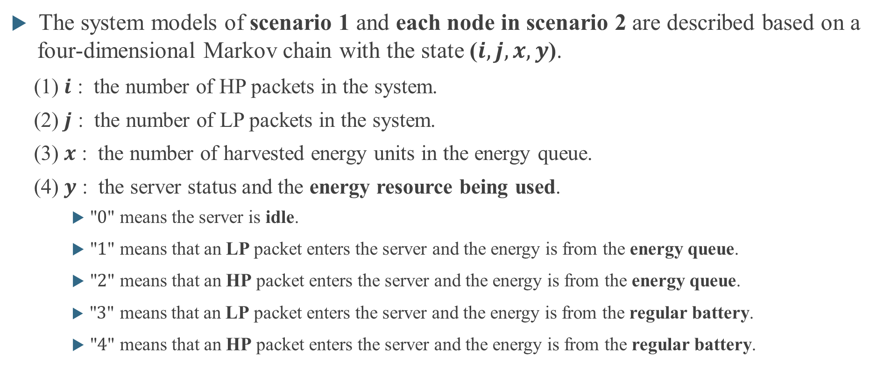
Analytical Models
The system models of scenario 1 and each node in scenario 2 are described based on a four-dimensional Markov chain with the state ($i, j, x, y$).
(1) $i$ : the number of HP packets in the system.
(2) $j$ : the number of LP packets in the system.
(3) $x$ : the number of harvested energy units in the energy queue.
(4) $y$ : the server status and the energy resource being used.
"$0$" means the server is idle.
"$1$" means that an LP packet enters the server and the energy is from the energy queue.
"$2$" means that an HP packet enters the server and the energy is from the energy queue.
"$3$" means that an LP packet enters the server and the energy is from the regular battery.
"$4$" means that an HP packet enters the server and the energy is from the regular battery.

Slide 19
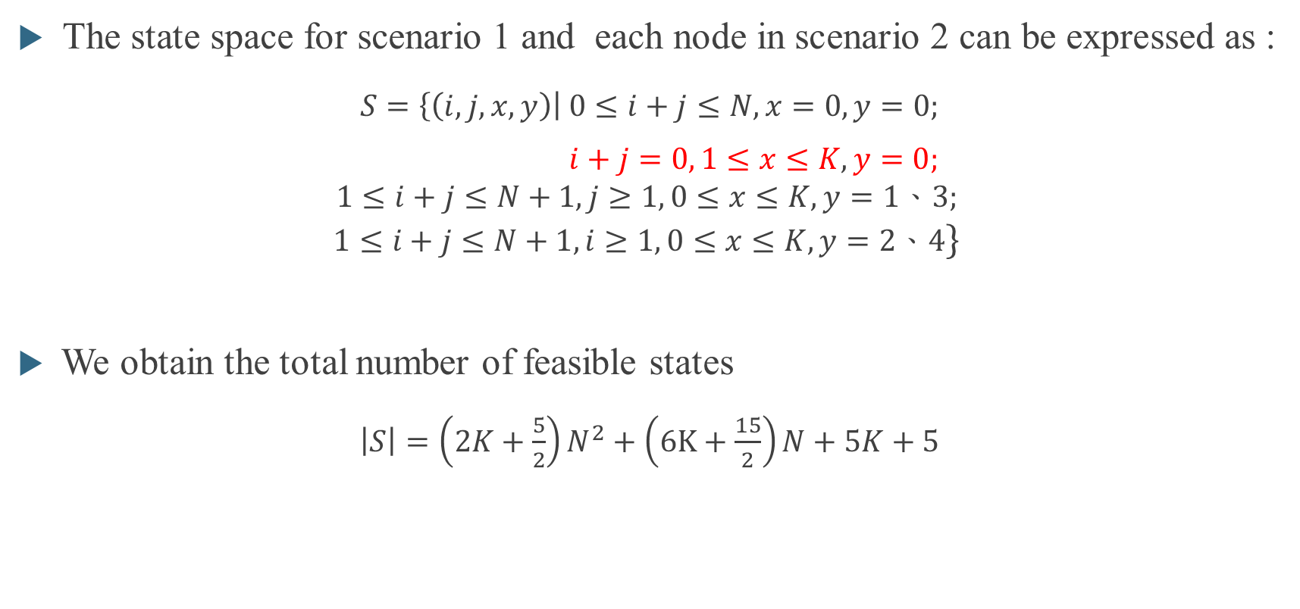
Analytical Models
The state space for scenario 1 and each node in scenario 2 can be expressed as :
$S=\left\{\left(i,j,x,y\right)\right| 0≤i+j≤N, x=0, y=0;$
$i+j=0, 1≤x≤K, y=0;$
$$1≤i+j≤N+1,j≥1, 0≤x≤K, y=1、3;$$
$$1≤i+j≤N+1,i≥1, 0≤x≤K, y=2、4\}$$
We obtain the total number of feasible states
$\left|S\right|=\left(2K+\frac{5}{2}\right)N^{2}+\left(6K+\frac{15}{2}\right)N+5K+5$

Slide 20
Analytical Models
According to the following eleven events, the total state balance equations can be further divided into 190 cases in scenario 1.
(1) Batch arrival of one-packet HP (3) Batch arrival of two-packet HP
(2) Batch arrival of one-packet LP (4) Batch arrival of two-packet LP
(5) Energy arrival of harvesting energy
(6) Impatience of an HP packet in the packet queue
(7) Impatience of an LP packet in the packet queue
(8) Departure of an HP packet by consuming the harvested energy
(9) Departure of an LP packet by consuming the harvested energy
(10) Departure of an HP packet by consuming the regular battery
(11) Departure of an LP packet by consuming the regular battery

Slide 21
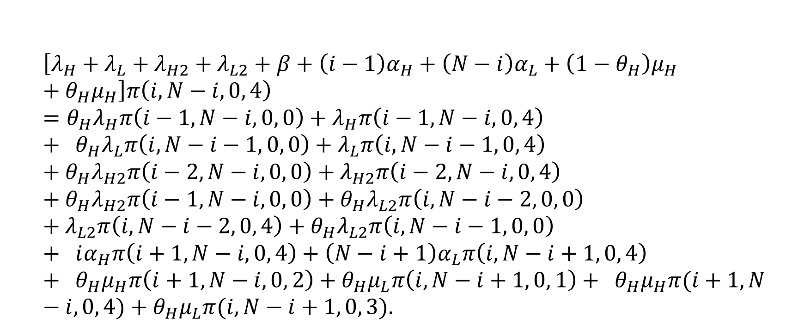
Analytical Models - Scenario 1 State Balance Equations
For $3≤i≤N−3$, $j=N−i$, $x=0$, and $y=4$ (Case 159)
$$\left[λ_{H}+λ_{L}+λ_{H2}+λ_{L2}+β+\left(i−1\right)α_{H}+\left(N−i\right)α_{L}+\left(1−θ_{H}\right)μ_{H}+θ_{H}μ_{H}\right]π\left(i, N−i, 0, 4\right)=θ_{H}λ_{H}π\left(i−1, N−i, 0, 0\right)+λ_{H}π\left(i−1, N−i, 0, 4\right)+ θ_{H}λ_{L}π\left(i, N−i−1, 0, 0\right)+λ_{L}π\left(i, N−i−1, 0, 4\right)+θ_{H}λ_{H2}π\left(i−2, N−i, 0, 0\right)+λ_{H2}π\left(i−2, N−i, 0, 4\right)+θ_{H}λ_{H2}π\left(i−1, N−i, 0, 0\right)+θ_{H}λ_{L2}π\left(i, N−i−2, 0, 0\right)+λ_{L2}π\left(i, N−i−2, 0, 4\right)+θ_{H}λ_{L2}π\left(i, N−i−1, 0, 0\right)+ iα_{H}π\left(i+1, N−i, 0, 4\right)+\left(N−i+1\right)α_{L}π\left(i, N−i+1, 0, 4\right)+ θ_{H}μ_{H}π\left(i+1, N−i, 0, 2\right)+θ_{H}μ_{L}π\left(i, N−i+1, 0, 1\right)+ θ_{H}μ_{H}π(i+1, N−i, 0, 4)+θ_{H}μ_{L}π(i, N−i+1, 0, 3).$$

Slide 22
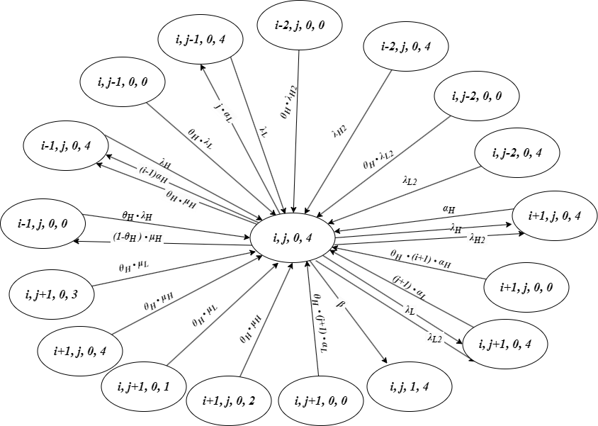
Analytical Models - Scenario 1 State Balance Equations
For $3≤i≤N−3$, $j=N−i$, $x=0$, and $y=4$ (Case 159)

Slide 23
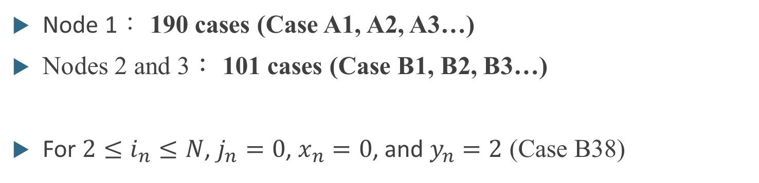
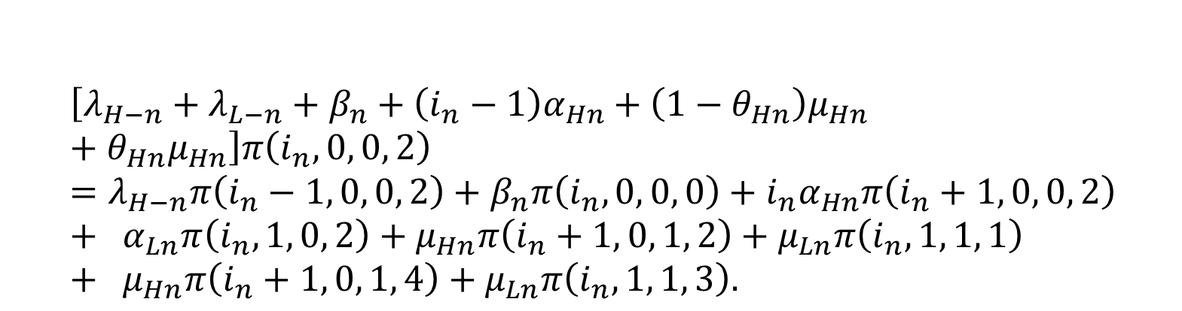
Analytical Models - Scenario 2 State Balance Equations
Node 1： 190 cases (Case A1, A2, A3…)
Nodes 2 and 3： 101 cases (Case B1, B2, B3…)
For $2≤i_{n}≤N$, $j_{n}=0$, $x_{n}=0$, and $y_{n}=2$ (Case B38)
$$\left[λ_{H−n}+λ_{L−n}+β_{n}+\left(i_{n}−1\right)α_{Hn}+\left(1−θ_{Hn}\right)μ_{Hn}+θ_{Hn}μ_{Hn}\right]π\left(i_{n}, 0, 0, 2\right)=λ_{H−n}π\left(i_{n}−1, 0, 0, 2\right)+β_{n}π\left(i_{n}, 0, 0, 0\right)+i_{n}α_{Hn}π\left(i_{n}+1, 0, 0, 2\right)+ α_{Ln}π\left(i_{n}, 1, 0, 2\right)+μ_{Hn}π\left(i_{n}+1, 0, 1, 2\right)+μ_{Ln}π\left(i_{n}, 1, 1, 1\right)+ μ_{Hn}π\left(i_{n}+1, 0, 1, 4\right)+μ_{Ln}π\left(i_{n}, 1, 1, 3\right).$$

Slide 24
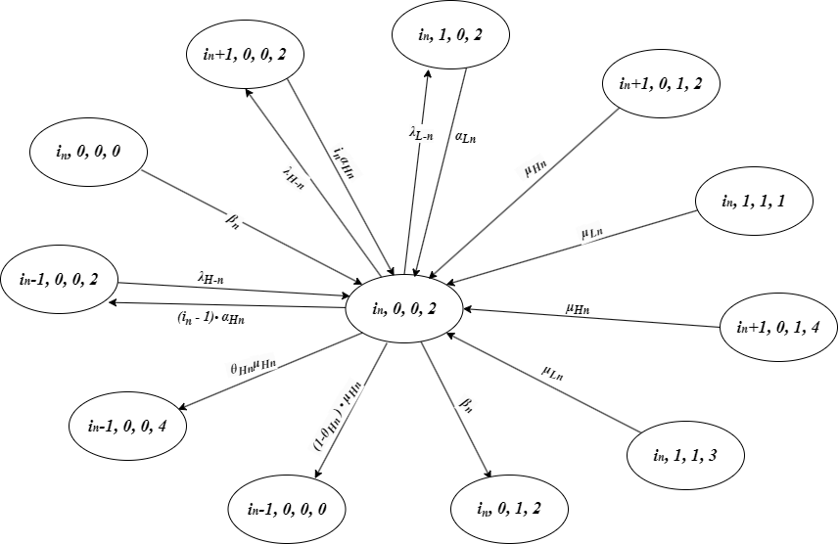
Analytical Models - Scenario 2 State Balance Equations
For $2≤i_{n}≤N$, $j_{n}=0$, $x_{n}=0$, and $y_{n}=2$ (Case B38)

Slide 25
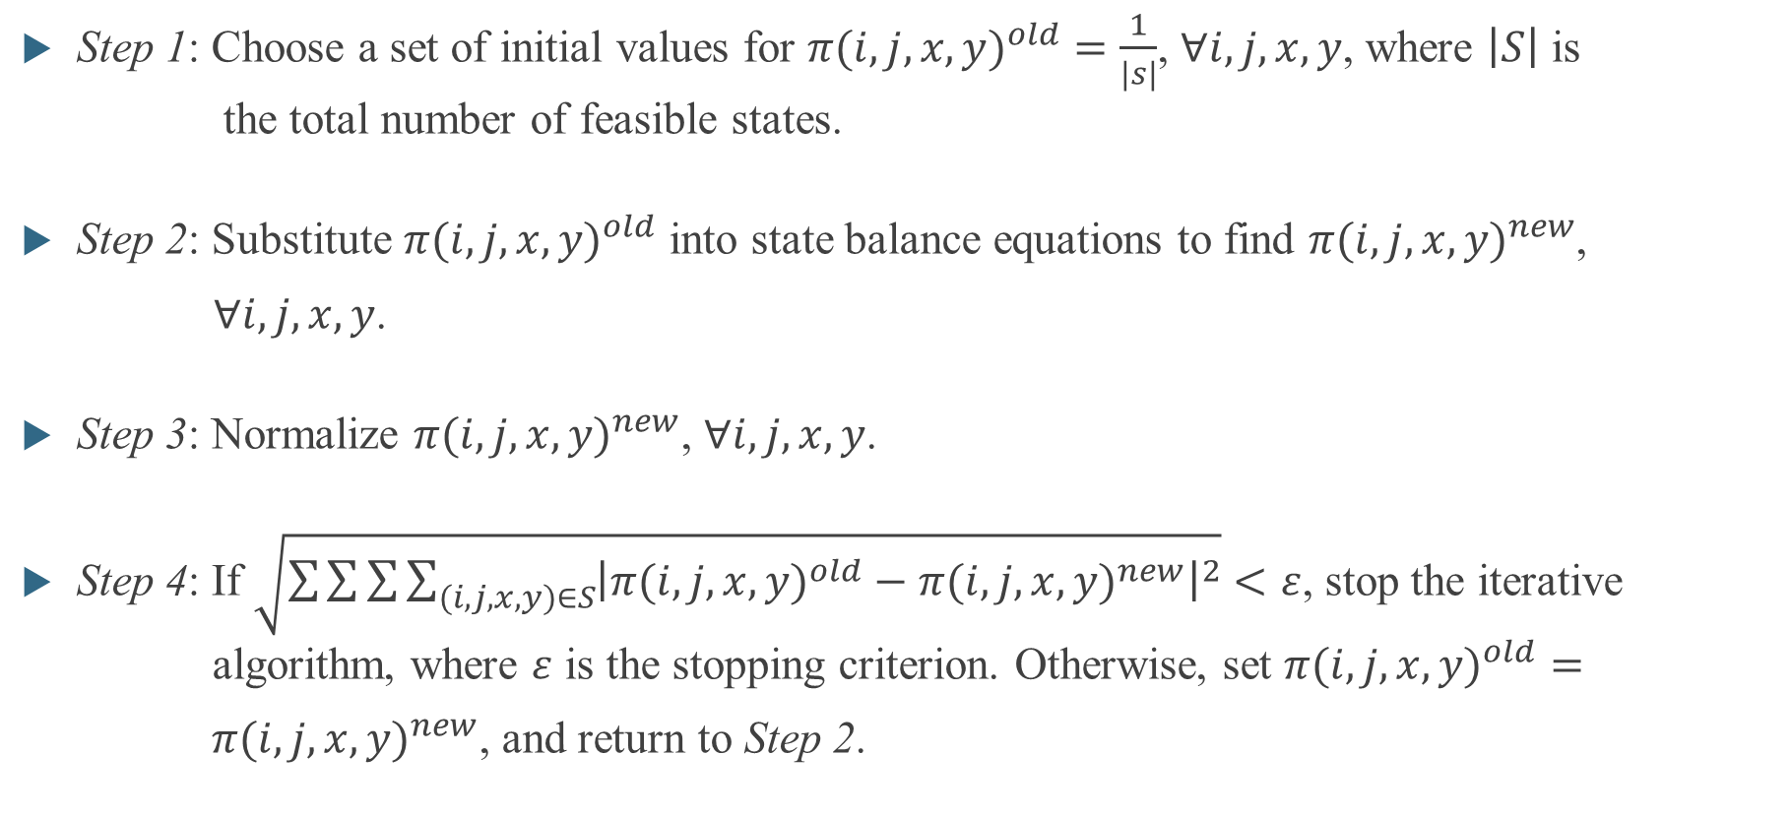
Iterative algorithm
Step 1: Choose a set of initial values for ${π(i,j,x,y)}^{old}=\frac{1}{\left|s\right|}$, $∀i,j,x,y$, where $\left|S\right|$ is the total number of feasible states.
Step 2: Substitute ${π(i,j,x,y)}^{old}$ into state balance equations to find ${π(i,j,x,y)}^{new}$,
$∀i,j,x,y$.
Step 3: Normalize ${π(i,j,x,y)}^{new}$, $∀i,j,x,y$.
Step 4: If $\sqrt{\sum{\sum{\sum{\sum_{(i,j,x,y)∈S}{{\left|{π(i,j,x,y)}^{old}−{π(i,j,x,y)}^{new}\right|}^{2}}}}}}<ε$, stop the iterative algorithm, where $ε$ is the stopping criterion. Otherwise, set ${π(i,j,x,y)}^{old}=$
${π(i,j,x,y)}^{new}$, and return to Step 2.

Slide 26
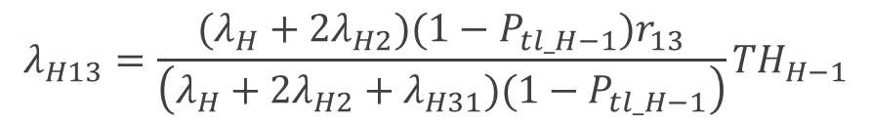
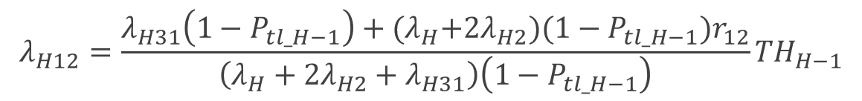
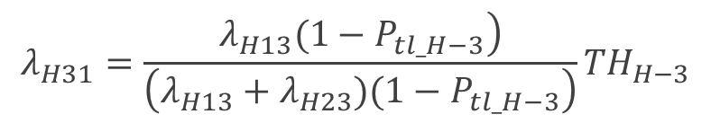
Internal arrival rates for three-node network
The HP and LP packet arrival rates from node 1 to node 3
The HP and LP packet arrival rates from node 3 to node 1
The HP and LP packet arrival rates from node 1 to node 2
$$λ_{H13}=\frac{(λ_{H}+2λ_{H2})(1−P_{tl_H−1})r_{13}}{\left(λ_{H}+2λ_{H2}+λ_{H31})(1−P_{tl_H−1}\right)}{TH}_{H−1}$$
$$λ_{H31}=\frac{\left.λ_{H13}(1−P_{tl_H−3}\right)}{\left(λ_{H13}+λ_{H23})(1−P_{tl_H−3}\right)}{TH}_{H−3}$$
$$λ_{H12}=\frac{λ_{H31}\left(1−P_{tl_H−1}\right)+{(λ}_{H}+2λ_{H2})(1−P_{tl_H−1})r_{12}}{\left(λ_{H}+2λ_{H2}+λ_{H31}\right)\left(1−P_{tl_H−1}\right)}{TH}_{H−1}$$

Slide 27

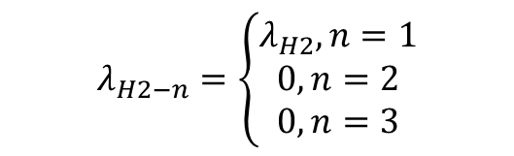
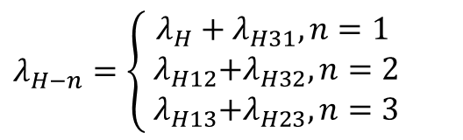
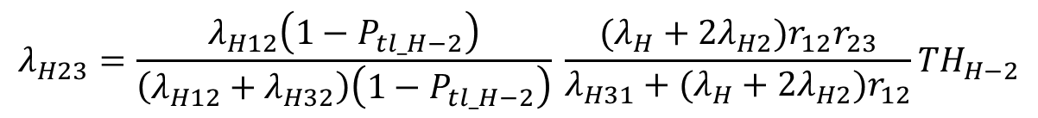
Internal arrival rates for three-node network
The HP and LP packet arrival rates from node 2 to node 3
The HP and LP packet arrival rates with one packet / two packets per batch for each node $n$, $λ_{H−n}$ and $λ_{L−n }/{ λ}_{H2−n}$ and $λ_{L2−n}$
$$λ_{H23}=\frac{λ_{H12}\left(1−P_{tl_H−2}\right)}{\left(λ_{H12}+λ_{H32}\right)\left(1−P_{tl_H−2}\right)} \frac{(λ_{H}+2λ_{H2})r_{12}r_{23}}{{λ_{H31}+(λ}_{H}+2λ_{H2})r_{12}}{TH}_{H−2}$$
$λ_{H−n}=\left\{\begin{aligned}λ_{H}+λ_{H31}, n=1 \\ { λ}_{H12}+λ_{H32}, n=2 \\ { λ}_{H13}+λ_{H23}, n=3\end{aligned}\right.$
$$λ_{H2−n}=\left\{\begin{aligned}λ_{H2}, n=1 \\ 0, n=2 \\ 0, n=3\end{aligned}\right.$$
,

Slide 28
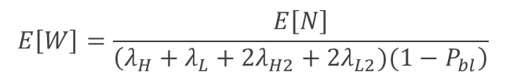

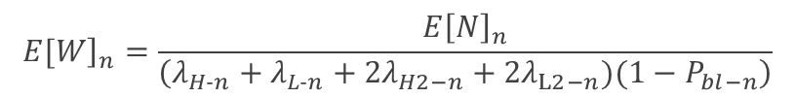



Performance Measures
The expected number of packets in node $n$
The expected number of all packets for the system
The mean waiting time of packets in node $n$
The mean waiting time of all packets for the system
$${E\left[N\right]}_{n}=\sum_{i_{n}=0}^{N}{\sum_{j_{n}=0}^{N−i_{n}}{\left(i_{n}+j_{n}\right)π\left(i_{n}, j_{n}, 0, 0\right)}}$$
$$+\sum_{x_{n}=0}^{K}{\sum_{i_{n}=0}^{N}{\sum_{j_{n}=1}^{N+1−i_{n}}{\left(i_{n}+j_{n}\right)\left[π\left(i_{n}, j_{n}, x_{n}, 1\right)+π\left(i_{n}, j_{n}, x_{n}, 3\right)\right]}}}$$
$$+\sum_{x_{n}=0}^{K}{\sum_{i_{n}=1}^{N+1}{\sum_{j_{n}=0}^{N+1−i_{n}}{\left(i_{n}+j_{n}\right)\left[π\left(i_{n}, j_{n}, x_{n}, 2\right)+π\left(i_{n}, j_{n}, x_{n}, 4\right)\right]}}}$$
$${\left.E[W\right]}_{n}=\frac{{E\left[N\right]}_{n}}{\left(λ_{H−n}+λ_{L−n}+{2λ}_{H2−n}+{2λ}_{L2−n})(1−P_{bl−n}\right)}$$
$$E\left[W\right]=\frac{E\left[N\right]}{\left(λ_{H}+λ_{L}+{2λ}_{H2}+{2λ}_{L2})(1−P_{bl}\right)}$$
$$E\left[N\right]=\sum_{n=1}^{3}{{E\left[N\right]}_{n}}$$

Slide 29
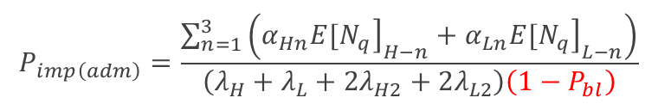

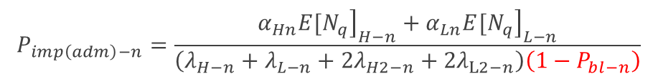
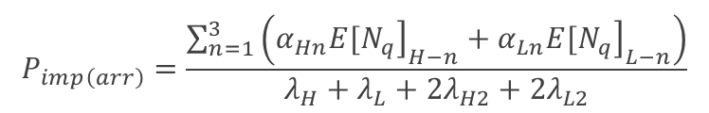
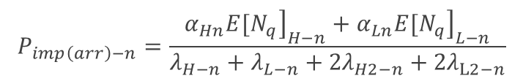

Performance Measures
The impatient loss probability of arrived packets for node $n$
The impatient loss probability of arrived packets for the system
The impatient loss probability of admitted packets for node $n$
The impatient loss probability of admitted packets for the system
$$P_{imp\left(arr\right)−n}=\frac{α_{Hn}{\left.{E[N}_{q}\right]}_{H−n}+α_{Ln}{\left.{E[N}_{q}\right]}_{L−n}}{λ_{H−n}+λ_{L−n}+{2λ}_{H2−n}+{2λ}_{L2−n}}$$
$$P_{imp\left(adm\right)−n}=\frac{α_{Hn}{\left.{E[N}_{q}\right]}_{H−n}+α_{Ln}{\left.{E[N}_{q}\right]}_{L−n}}{\left(λ_{H−n}+λ_{L−n}+{2λ}_{H2−n}+{2λ}_{L2−n}\right)\left(1−P_{bl−n}\right)}$$
$$P_{imp\left(arr\right)}=\frac{\sum_{n=1}^{3}{\left(α_{Hn}{\left.{E[N}_{q}\right]}_{H−n}+α_{Ln}{\left.{E[N}_{q}\right]}_{L−n}\right)}}{λ_{H}+λ_{L}+2λ_{H2}+{2λ}_{L2}}$$
$$P_{imp\left(adm\right)}=\frac{\sum_{n=1}^{3}{\left(α_{Hn}{\left.{E[N}_{q}\right]}_{H−n}+α_{Ln}{\left.{E[N}_{q}\right]}_{L−n}\right)}}{\left(λ_{H}+λ_{L}+2λ_{H2}+2λ_{L2}\right)\left(1−P_{bl}\right)}$$

Slide 30
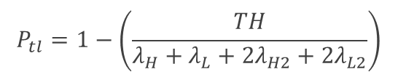

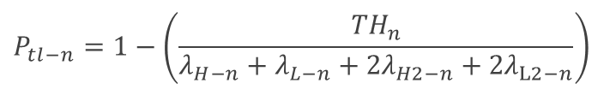

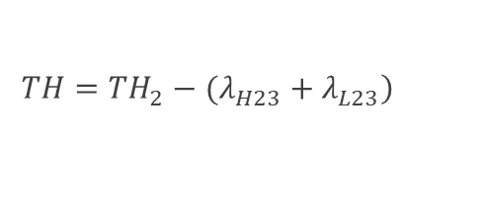
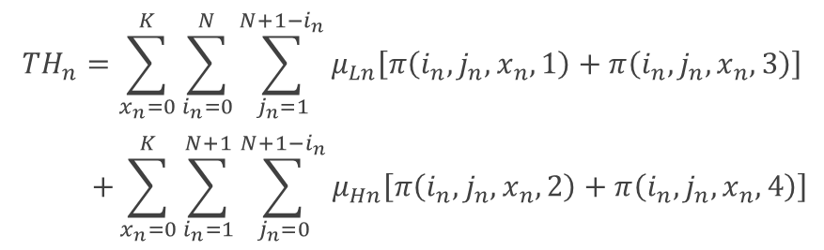
Performance Measures
The throughput of packets for node $n$
The throughput of all packets for the system
The total loss probability for node $n$
The total loss probability for the system
$${TH}_{n}=\sum_{x_{n}=0}^{K}{\sum_{i_{n}=0}^{N}{\sum_{j_{n}=1}^{N+1−i_{n}}{μ_{Ln}\left[π\left(i_{n}, j_{n}, x_{n}, 1\right)+π\left(i_{n}, j_{n}, x_{n}, 3\right)\right]}}}$$
$$+\sum_{x_{n}=0}^{K}{\sum_{i_{n}=1}^{N+1}{\sum_{j_{n}=0}^{N+1−i_{n}}{μ_{Hn}\left[π\left(i_{n}, j_{n}, x_{n}, 2\right)+π\left(i_{n}, j_{n}, x_{n}, 4\right)\right]}}}$$
$$P_{tl−n}=1−\left(\frac{{TH}_{n}}{λ_{H−n}+λ_{L−n}+{2λ}_{H2−n}+{2λ}_{L2−n}}\right)$$
$$\left.TH={TH}_{2}−(λ_{H23}+λ_{L23}\right)$$
$$P_{tl}=1−\left(\frac{TH}{λ_{H}+λ_{L}+2λ_{H2}+2λ_{L2}}\right)$$

Slide 31

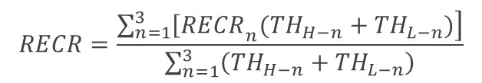
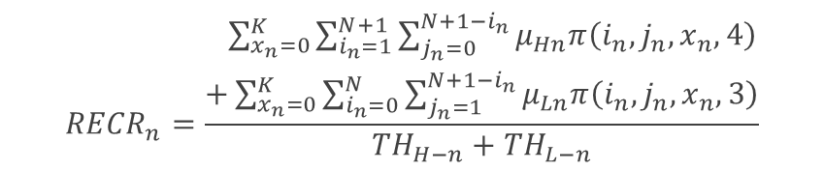
Performance Measures
The regular energy consumption ratio of packets for node $n$
The regular energy consumption ratio of packets for the system
$${RECR}_{n}=\frac{\begin{aligned} \sum_{x_{n}=0}^{K}{\sum_{i_{n}=1}^{N+1}{\sum_{j_{n}=0}^{N+1−i_{n}}{μ_{Hn}π\left(i_{n}, j_{n}, x_{n}, 4\right)}}} \\ +\sum_{x_{n}=0}^{K}{\sum_{i_{n}=0}^{N}{\sum_{j_{n}=1}^{N+1−i_{n}}{μ_{Ln}π\left(i_{n}, j_{n}, x_{n}, 3\right)}}}\end{aligned}}{{TH}_{H−n}+{TH}_{L−n}}$$
$$RECR=\frac{\sum_{n=1}^{3}{\left.{\left[RECR\right.}_{n}({TH}_{H−n}+{TH}_{L−n})\right]}}{\sum_{n=1}^{3}{\left({TH}_{H−n}+{TH}_{L−n}\right)}}$$

Slide 32
Outline
Motivation
System Models
Analytical Models
Numerical Results
One sensor node (Scenario 1)
Three-node network (Scenario 2)
Conclusions and Future Works

Slide 33
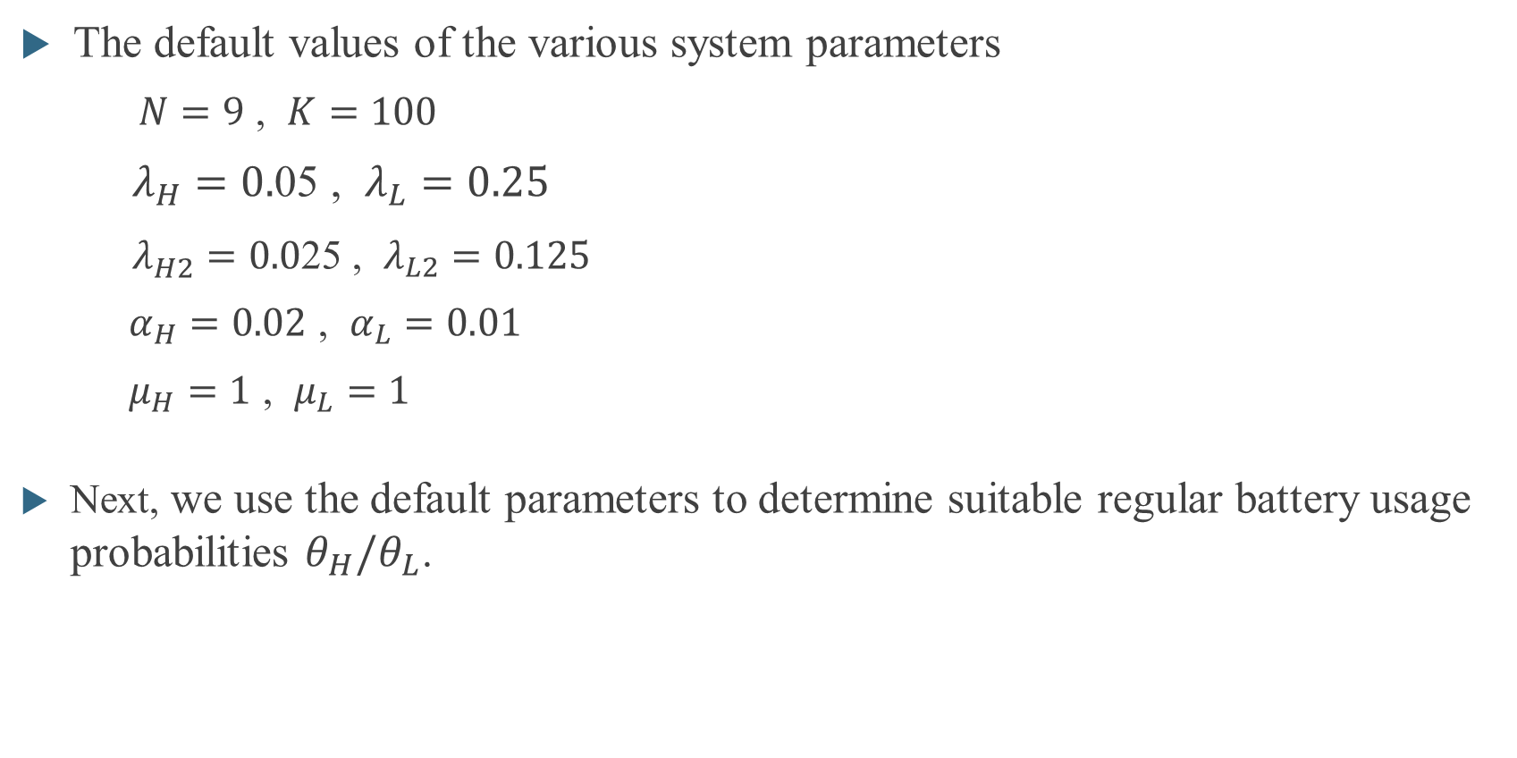
Numerical Results-Scenario 1 One sensor node
The default values of the various system parameters
$N=9$ , $K=100$
$λ_{H}=0.$05 , $λ_{L}=0.25$
$λ_{H2}=0.0$25 , $λ_{L2}=0.125$
$α_{H}=0.02$ , $α_{L}=0.01$
$μ_{H}=1$ , $μ_{L}=1$
Next, we use the default parameters to determine suitable regular battery usage probabilities $θ_{H}/θ_{L}$.

Slide 34
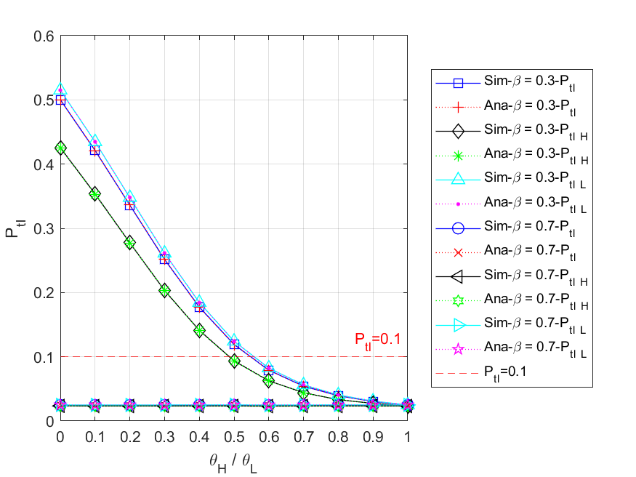
Numerical Results-Scenario 1 One sensor node

Slide 35
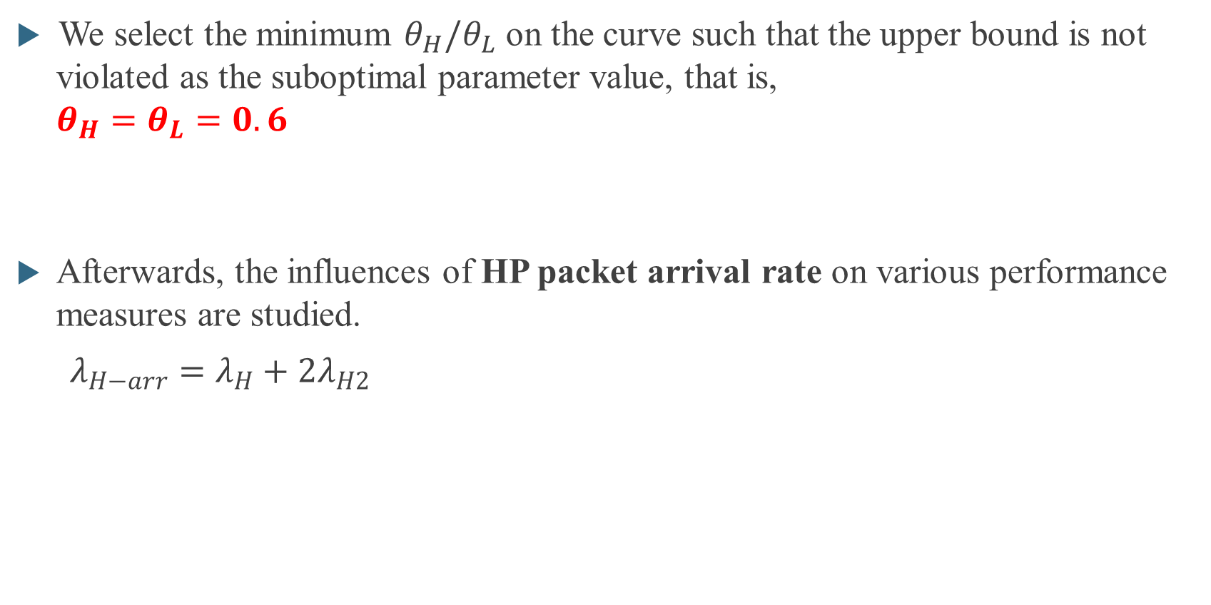
Numerical Results-Scenario 1 One sensor node
We select the minimum $θ_{H}/θ_{L}$ on the curve such that the upper bound is not violated as the suboptimal parameter value, that is, $θ_{H}=θ_{L}=0.6$
Afterwards, the influences of HP packet arrival rate on various performance measures are studied.
${λ_{H−arr}=λ}_{H}+{2λ}_{H2}$

Slide 36
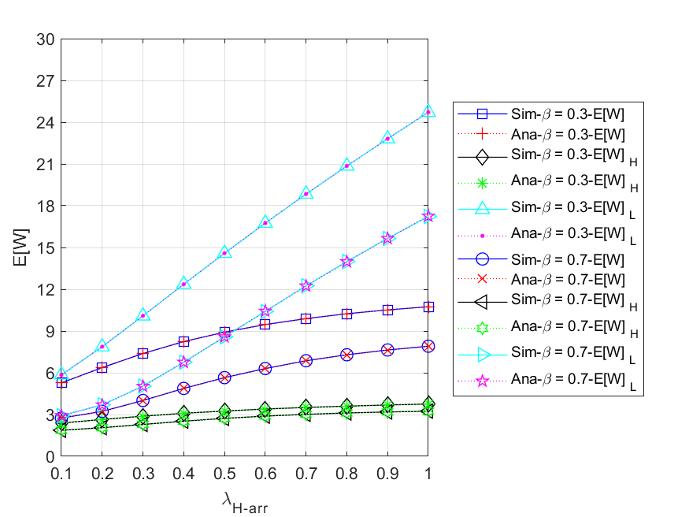
Numerical Results-Scenario 1 HP packet arrival rate

Slide 37
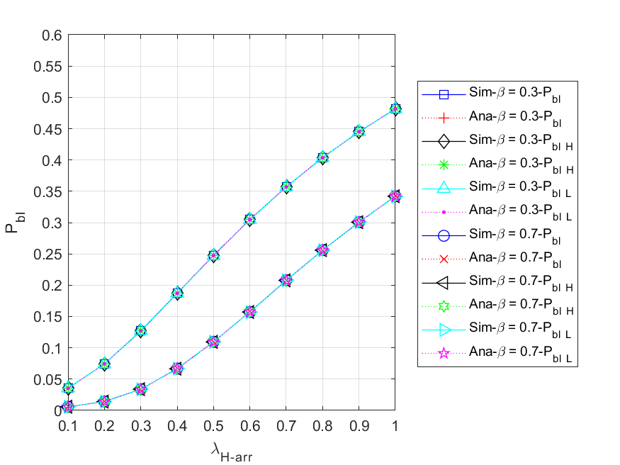
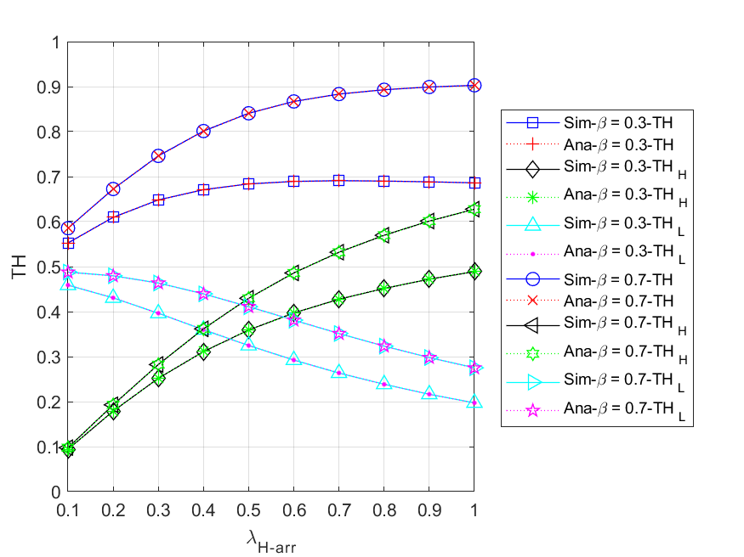
Numerical Results-Scenario 1 HP packet arrival rate

Slide 38
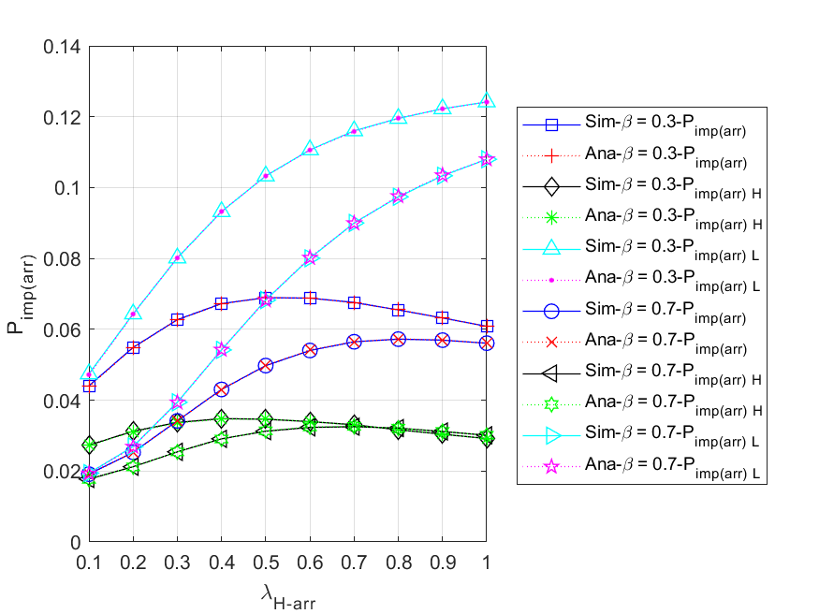
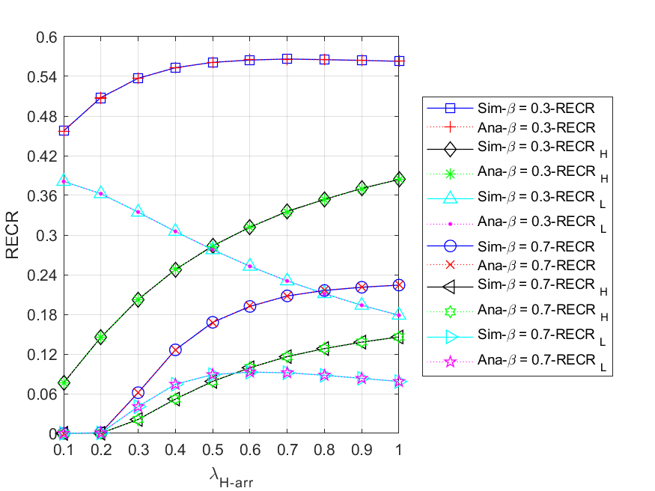
Numerical Results-Scenario 1 HP packet arrival rate

Slide 39


Numerical Results-Scenario 1 Comparison of single and batch arrivals

Slide 40


Numerical Results-Scenario 1 Comparison of single and batch arrivals

Slide 41
Outline
Motivation
System Models
Analytical Models
Numerical Results
One sensor node (Scenario 1)
Three-node network (Scenario 2)
Conclusions and Future Works

Slide 42


Numerical Results - Scenario 2 Three-node network
The default values of the various system parameters
For the system :
$λ_{H}=0.05$ , $λ_{L}=0.25$
$λ_{H2}=0.025$ , $λ_{L2}=0.125$
$r_{13}=r_{23}=0.1$
Next, we use the default parameters to determine suitable regular battery usage probabilities $θ_{H}/θ_{L}$.
For each node n :
$N=9$ , $K=100 \text{,} β_{n}=0.3$
$α_{Hn}=0.02$ , $α_{Ln}=0.01$
$μ_{Hn}=1$ , $μ_{Ln}=1$

Slide 43

Numerical Results - Scenario 2 Three-node network

Slide 44

Numerical Results - Scenario 2 Three-node network
We select the minimum $θ_{H}/θ_{L}$ on the curve such that the upper bound is not violated as the suboptimal parameter value, that is, $θ_{H}=θ_{L}=0.8$
Afterwards, the influences of HP packet arrival rate on various performance measures are studied
${λ_{H−arr}=λ}_{H}+{2λ}_{H2}$

Slide 45


Numerical Results - Scenario 2 HP packet arrival rate

Slide 46


Numerical Results - Scenario 2 HP packet arrival rate

Slide 47


Numerical Results - Scenario 2 HP packet arrival rate

Slide 48


Numerical Results - Scenario 2 HP packet arrival rate

Slide 49


Numerical Results - Scenario 2 HP packet arrival rate

Slide 50
Outline
Motivation
System Models
Analytical Models
Numerical Results
Conclusions and Future Works

Slide 51
Conclusions
Compared to Energy Harvesting-based WSNs without the regular battery, our models exhibit noticeable enhancements in performance across various metrics, particularly in terms of throughput.
Among the aforementioned two scenarios, the maximum average RECR reaches approximately 0.6.
The curves of expected number and waiting time for batch arrival are higher than those for single arrival first and then they cross over.
In most of the studied cases, the analytical results are shown to be in fairly close agreement with the simulation results.

Slide 52
Future Works
The regular battery usage probability should dynamically change as any system parameter varies.
To better reflect real-world scenarios, the number of packets in a batch arrival should be set as an arbitrary positive integer.
Error-prone channels are more realistic and should be considered.

Slide 53
Thank you for listening

