Slide 1
DHT11 Azure IOT Data Monitoring

Slide 2
Hardware components
Raspberry Pi 3
DHT11 Temperature & Humidity Sensor (3 pins)

Slide 3
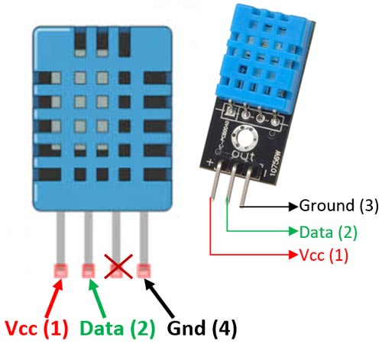
Overview of DHT11 Sensor:
The DHT11 sensor can measure relative humidity and temperature with the following specifications:
Temperature Range: 0-50°C
Temperature Accuracy: ±2 °C
Humidity Range: 20-90% RH
Humidity Accuracy: ±5 %

Slide 4
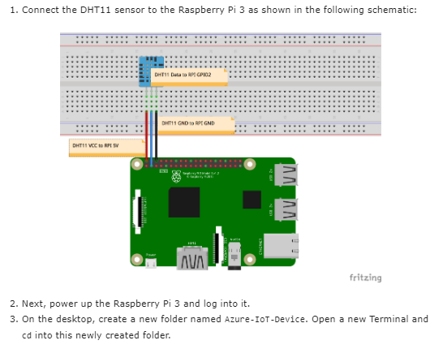

Slide 5
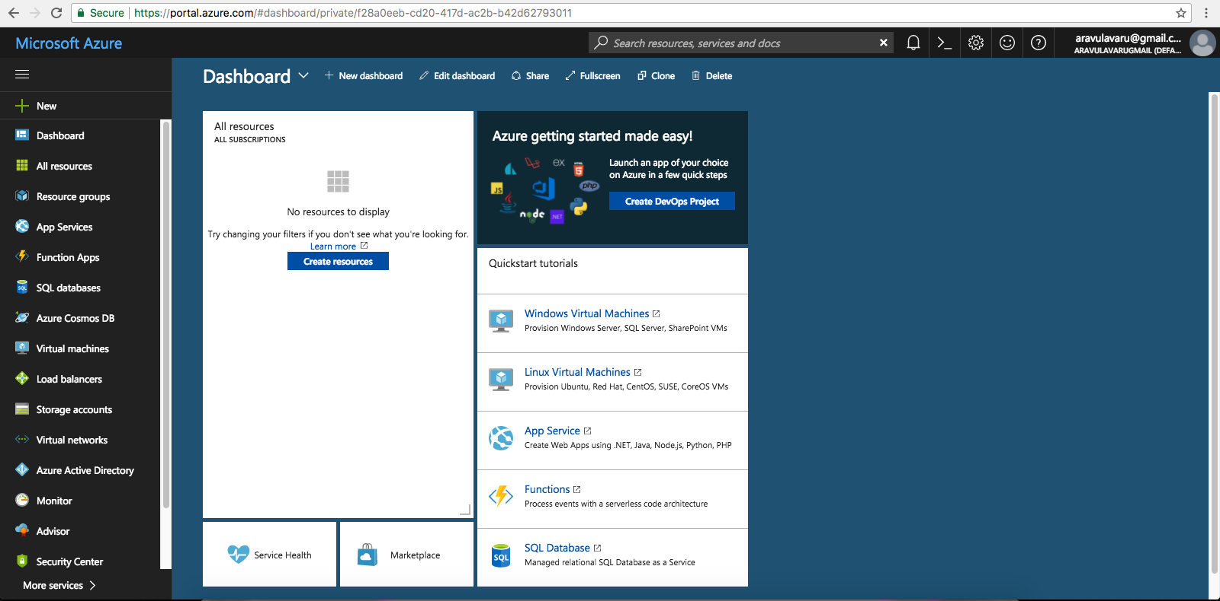
Setting up the IoT hub
The following are the steps required for the setup. Once we are on the portal dashboard, we will be presented with the dashboard home page as illustrated here:

Slide 6
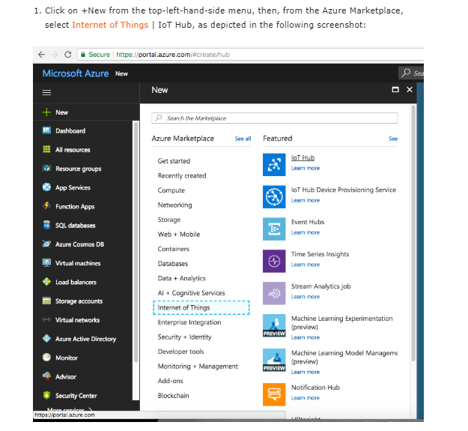

Slide 7
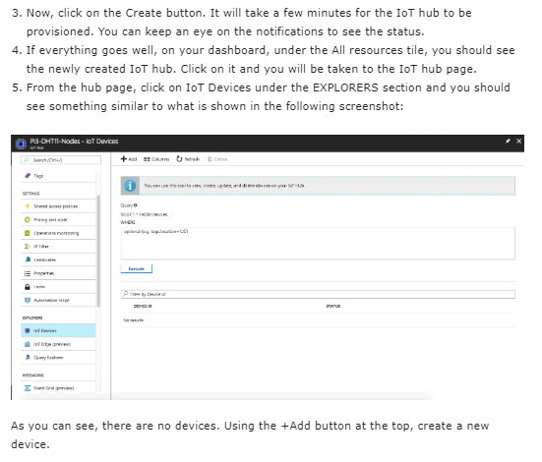

Slide 8
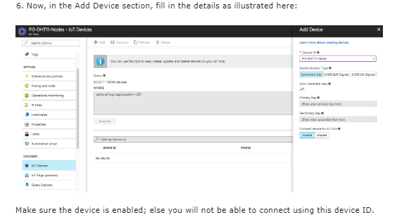

Slide 9
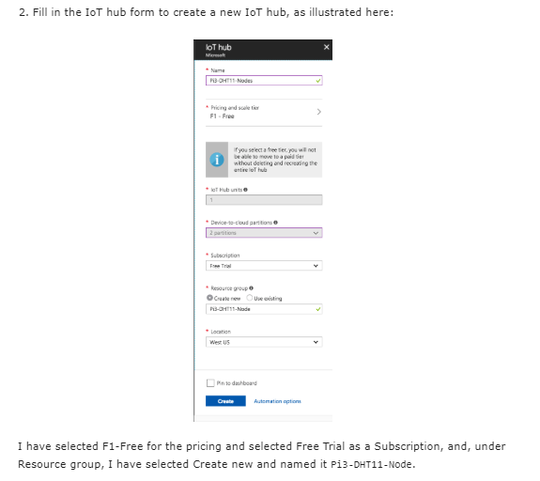

Slide 10
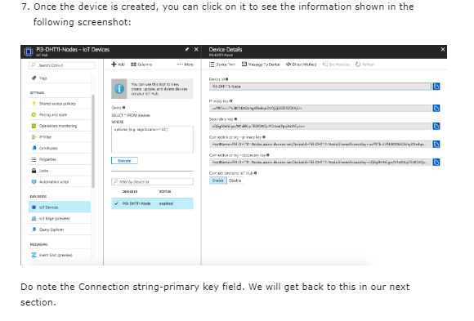

Slide 11
How DHT11 Sensor works:
The DHT11 sensor comes with a blue or white colour casing. Inside this casing we have two important componentswhich help us to sense the relative humidity and temperature. The first component is a pair of electrodes; the electrical resistance between these two electrodes is decided by a moisture holding substrate. So the measured resistance is inversely proportional to the relative humidity of the environment. Higher the relative humidity lower will be the value of resistance and vice versa. Also note that Relative humidity is different from actual humidity. Relative humidity measures the water content in air relative to the temperature in the air.
The other component is a surface mounted NTC Thermistor. The term NTC stands for Negative temperature coefficient, for increase in temperature the value of resistance will decrease

Slide 12
Installing the Adafruit DHT11 library on Raspberry Pi:
Enter the four command lines one by one on the terminal to install the DHT library:
pi@raspberrypi:~ $ git clone https://github.com/adafruit/Adafruit_Python_DHT.git
pi@raspberrypi:~ $ cd Adafruit_Python_DHT
pi@raspberrypi:~ $ sudo apt-get install build-essential python-dev
pi@raspberrypi:~ $ sudo python setup.py install

Slide 13
End-to-end communication
To get started with Azure IoT, we need to have an Azure account. If you do not have an Azure account, you can create one by navigating to this URL: https://azure.microsoft.com/en-in/free/.
Once you have created your account, you can log in and navigate to the Azure portal or you can visit https://portal.azure.com to reach the required page.

Slide 14
Send DHT11 Sensor telemetry
Before continuing any further I do recommend testing the DHT11 sensor is working correctly.
This can quickly be done by changing some of the lines of the file simpletest.py in the location: /Adafruit_Python_DHT/examples/
Below are the areas of the file which require changing and the values required (e.g. pin = 4) to enable the test script to work:
uncomment the Pin=4 line and put comment in Beaglebone pin.change Dht22 to Dht11.
Now, In a local terminal window, navigate to the root folder of the Python project. Open the Dht11Azure.py file in a text editor of your choice.
Replace the value of the CONNECTION_STRING variable with the device connection string you made a note of previously. Then save your changes to Dht11Azure.py file.

Slide 15
In the local terminal window, run the following commands to install the required libraries for the simulated device application:
pi@raspberrypi:~ $ pip install azure-iothub-device-client
In the local terminal window, run the following commands to run the DHT11 device application:
pi@raspberrypi:~ $ python Dht11Azure.py

Slide 16
Read the telemetry from your hub
The IoT Hub CLI extension can connect to the service-side Events endpoint on your IoT Hub. The extension receives the device-to-cloud messages sent from your simulated device. An IoT Hub back-end application typically runs in the cloud to receive and process device-to-cloud messages.
Run the following commands in Azure Cloud Shell, replacing YourIoTHubName with the name of your IoT hub:
>>az iot hub monitor-events --hub-name YourIoTHubName --device-id <urdevicename>

Slide 17
