Slide 1
Note: The data and information in this document is reflective of a hypothetical situation and client. This document is to be used for KPMG Virtual Internship purposes only.
Sprocket Central Pty Ltd
Targeting Analysis : Data Analytics Approach
Analytics Team - Nour
March 2023

Slide 2
Note: The data and information in this document is reflective of a hypothetical situation and client. This document is to be used for KPMG Virtual Internship purposes only.
Agenda
Introduction
Project Overview
Data Exploration
Model Development
Interpretation

Slide 3
Note: The data and information in this document is reflective of a hypothetical situation and client. This document is to be used for KPMG Virtual Internship purposes only.
Introduction

Slide 4
Note: The data and information in this document is reflective of a hypothetical situation and client. This document is to be used for KPMG Virtual Internship purposes only.
Background on Sprocket Central Pty Ltd
A long-standing KPMG client specializing in high-quality bikes and accessible cycling accessories for riders.
Data sources for the analysis:
Customer Demographic, Customer Address, Transactions
Objective:
Leverage these 3 datasets to identify and recommend the top 1000 customers to target in order to boost business sales and drive the most most value for Sprocket Central Pty Ltd.
Overview of 3-phase approach:
Data Exploration
Model Development
Interpretation

Slide 5
Note: The data and information in this document is reflective of a hypothetical situation and client. This document is to be used for KPMG Virtual Internship purposes only.
Project Overview

Slide 6
Note: The data and information in this document is reflective of a hypothetical situation and client. This document is to be used for KPMG Virtual Internship purposes only.
Key Aspects Of Analysis
Analyzing age distributions for both new and existing customers.
Investigating bike-related purchases over the last 3 years, broken down by gender.
Examining the distribution of customers across various job industries.
Segmenting customers by wealth within different age groups.
Comparing the number of cars owned versus not owned by customers in each state.
Conducting RFM (Recency, Frequency, Monetary value) analysis for customer classification.

Slide 7
Note: The data and information in this document is reflective of a hypothetical situation and client. This document is to be used for KPMG Virtual Internship purposes only.
Data Quality Assessment
Accuracy: Ensuring correct values in the dataset.
Completeness: Verifying that all data fields contain appropriate values.
Consistency: Maintaining values free from contradiction across the dataset.
Currency: Keeping values up-to-date and relevant to the current analysis.
Relevancy: Identifying valuable data items and their associated metadata.
Validity: Confirming that data contains only allowable values.
Uniqueness: Detecting and addressing duplicate records.
A comprehensive analysis has been sent via email.

Slide 8
Note: The data and information in this document is reflective of a hypothetical situation and client. This document is to be used for KPMG Virtual Internship purposes only.
Data Quality Assessment - Summary Table
Data Quality Aspect | Customer Demographic | Customer Address | Transaction Data
Accuracy | Missing column : Age |  | Profit column missing
Completeness | Empty values in several columns: job_title |  | Empty values in several columns: 'brand' column
Consistency | Inconsistent data types and corrupt values in the 'default' & 'gender' columns | Inconsistencies in the 'state' column
Currency | Filter out deceased customers |  | Mismatch between requested and provided data periods
Relevancy | Additional customer ids not in Customer Master list | Additional customer ids not in Customer Master list | Additional customer ids not in Customer Master list & cancelled orders filtered out
Validity |  |  | Incorrect entries and missing values in 'product first sold date' column
Uniqueness

Slide 9
Note: The data and information in this document is reflective of a hypothetical situation and client. This document is to be used for KPMG Virtual Internship purposes only.
Data Exploration

Slide 10
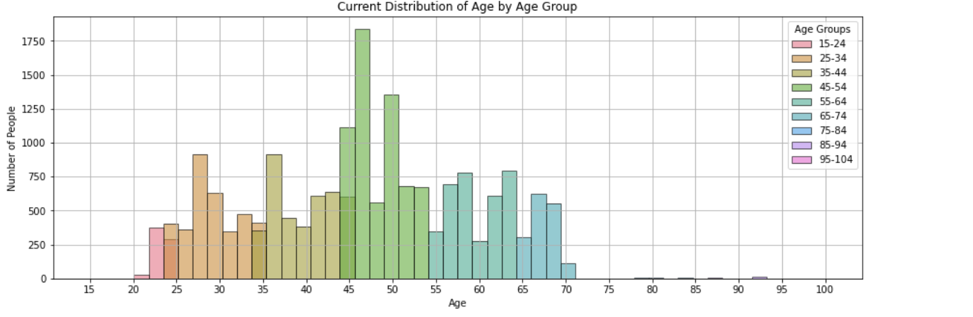
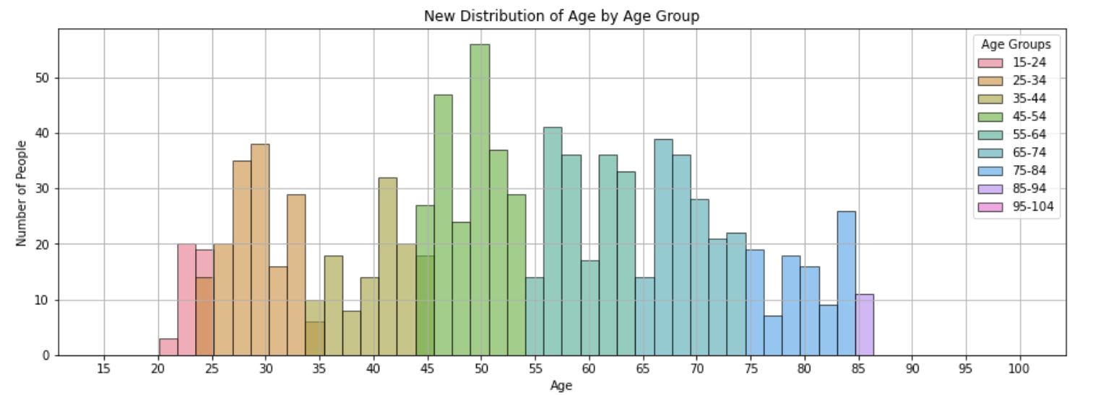
Note: The data and information in this document is reflective of a hypothetical situation and client. This document is to be used for KPMG Virtual Internship purposes only.
Customer Age Distribution
The majority of customers in both the "New" and "Old" lists fall within the 40-50 age group.
The least represented age groups in both lists are those under 20 and 80+.
The "New" customer list shows higher populations in the 20-29 and 40-69 age groups, whereas the "Old" customer list indicates a more evenly distributed population across the 20-69 age range.
A noticeable decline in the number of customers is observed within the 30-39 age group for the "New" list.

Slide 11
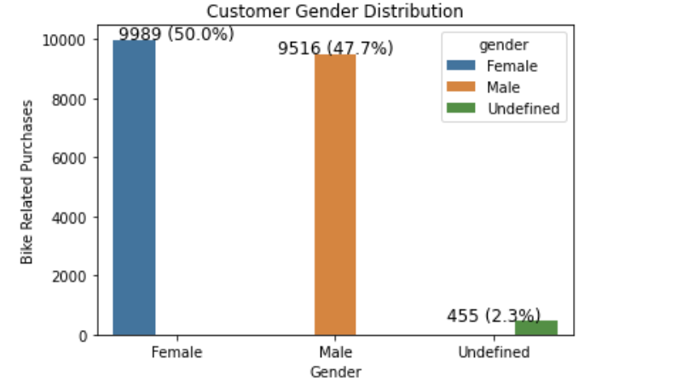
Note: The data and information in this document is reflective of a hypothetical situation and client. This document is to be used for KPMG Virtual Internship purposes only.
Bike Related Purchases Over The Last 3 Years
50% of bike-related purchases were by females, compared to 48% by males.
Around 2% of purchases had an unknown gender.
Women made nearly 1,000 more purchases than men.
The majority of bike-related sales are attributed to females.

Slide 12
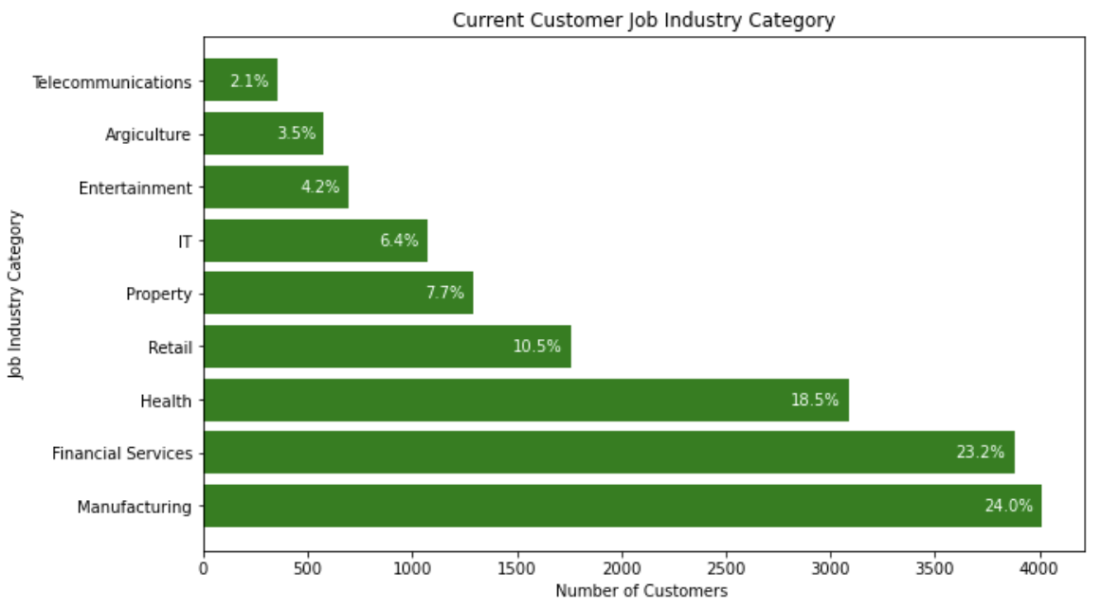
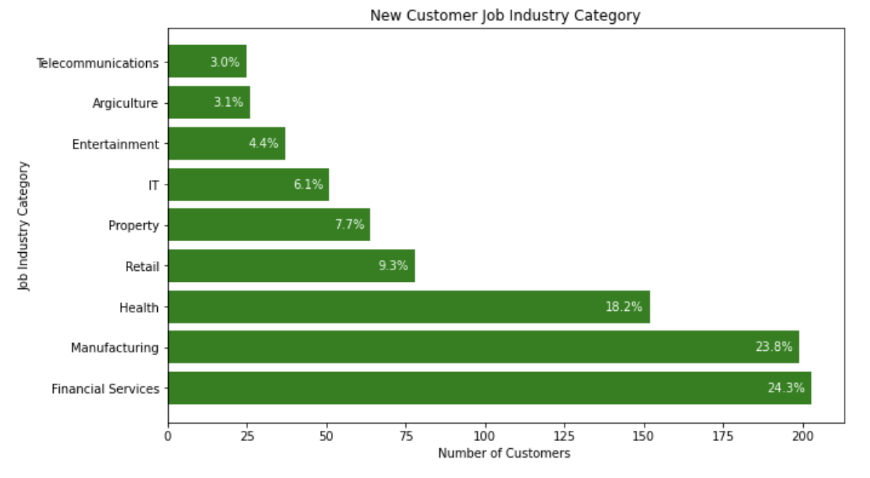
Note: The data and information in this document is reflective of a hypothetical situation and client. This document is to be used for KPMG Virtual Internship purposes only.
Job Industry Distribution
The majority of both new and existing customers are employed in the manufacturing, financial services, and health sectors.
The least represented customer segments are those in telecommunications and agriculture.
Among current customers, 24% work in financial services; however, this figure drops to 23% for new customers.

Slide 13
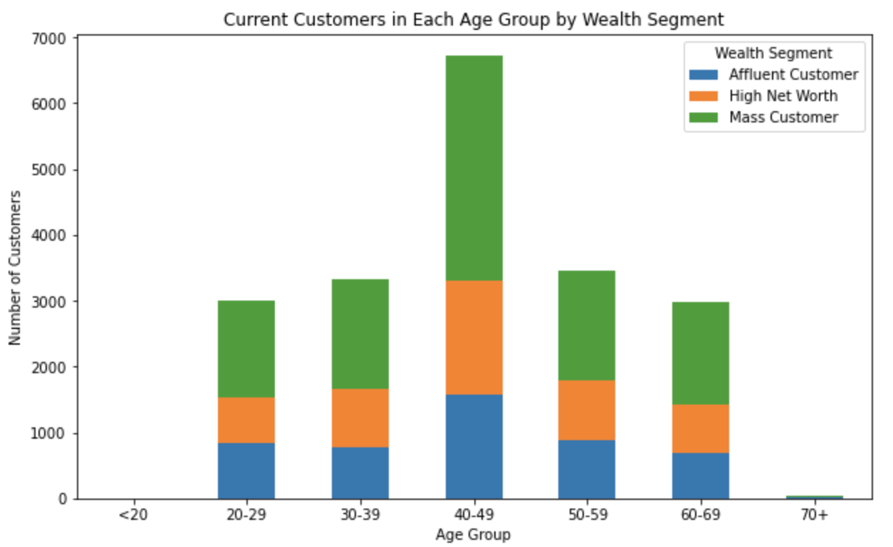
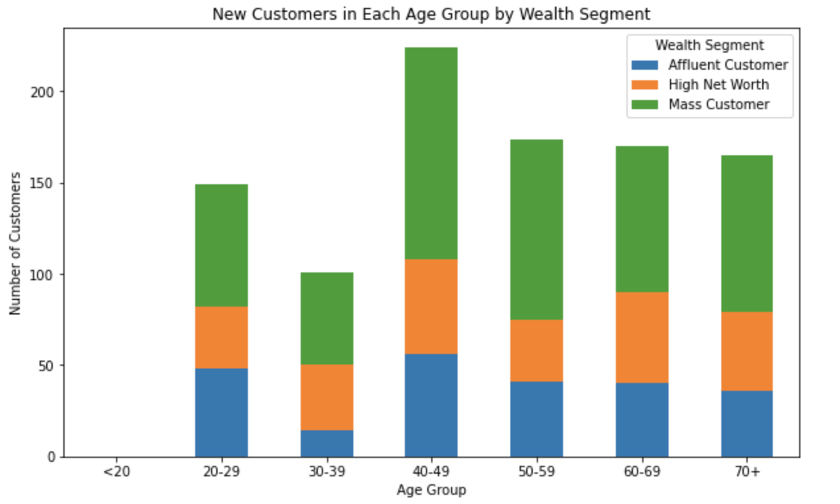
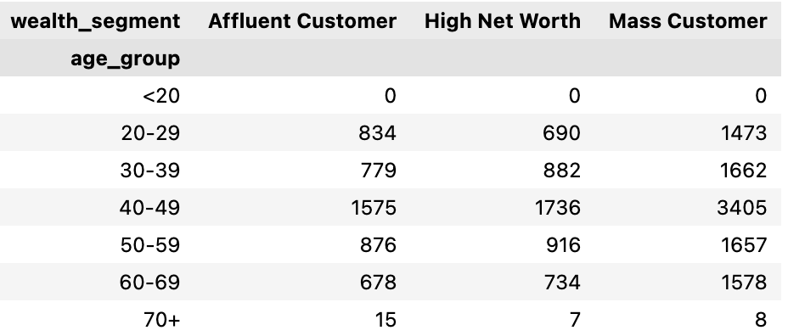
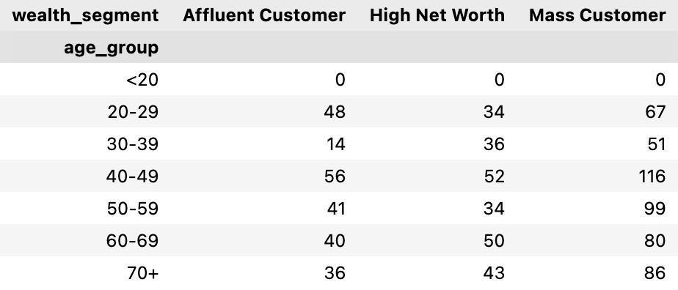
Note: The data and information in this document is reflective of a hypothetical situation and client. This document is to be used for KPMG Virtual Internship purposes only.
Wealth distribution
'Mass Customer' is the largest customer category across all age groups.
Following 'Mass Customer', 'High Net Worth' customers have the next highest count in each age group.

Slide 14
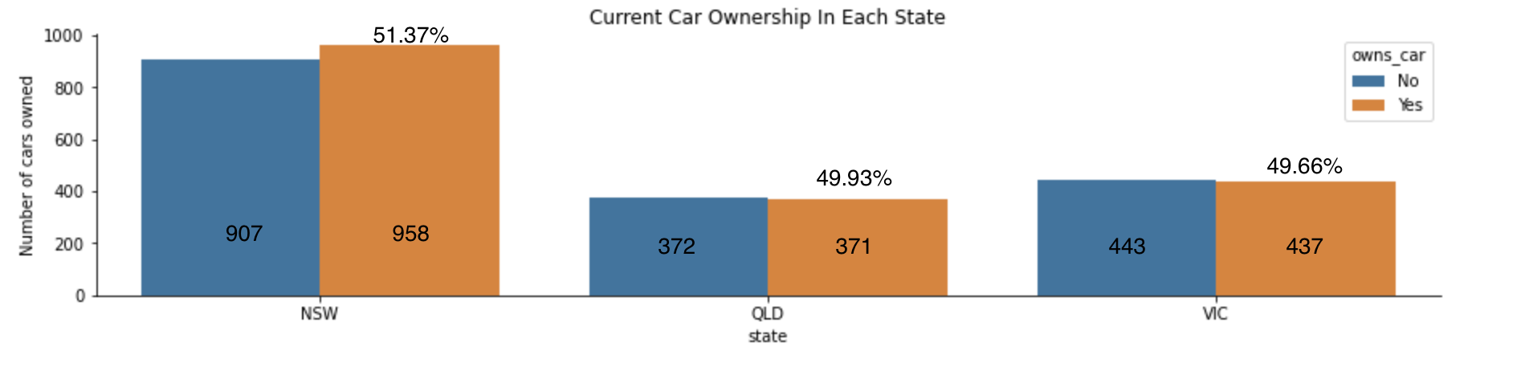
Note: The data and information in this document is reflective of a hypothetical situation and client. This document is to be used for KPMG Virtual Internship purposes only.
Cars Owned Distribution
New South Wales (NSW) boasts the largest population of current customers who own cars, making it a primary market for our offerings.
Both Victoria (VIC) and Queensland (QLD) have comparable numbers of car-owning customers, but their figures are notably lower than those in NSW.

Slide 15
Note: The data and information in this document is reflective of a hypothetical situation and client. This document is to be used for KPMG Virtual Internship purposes only.
Model Exploration

Slide 16
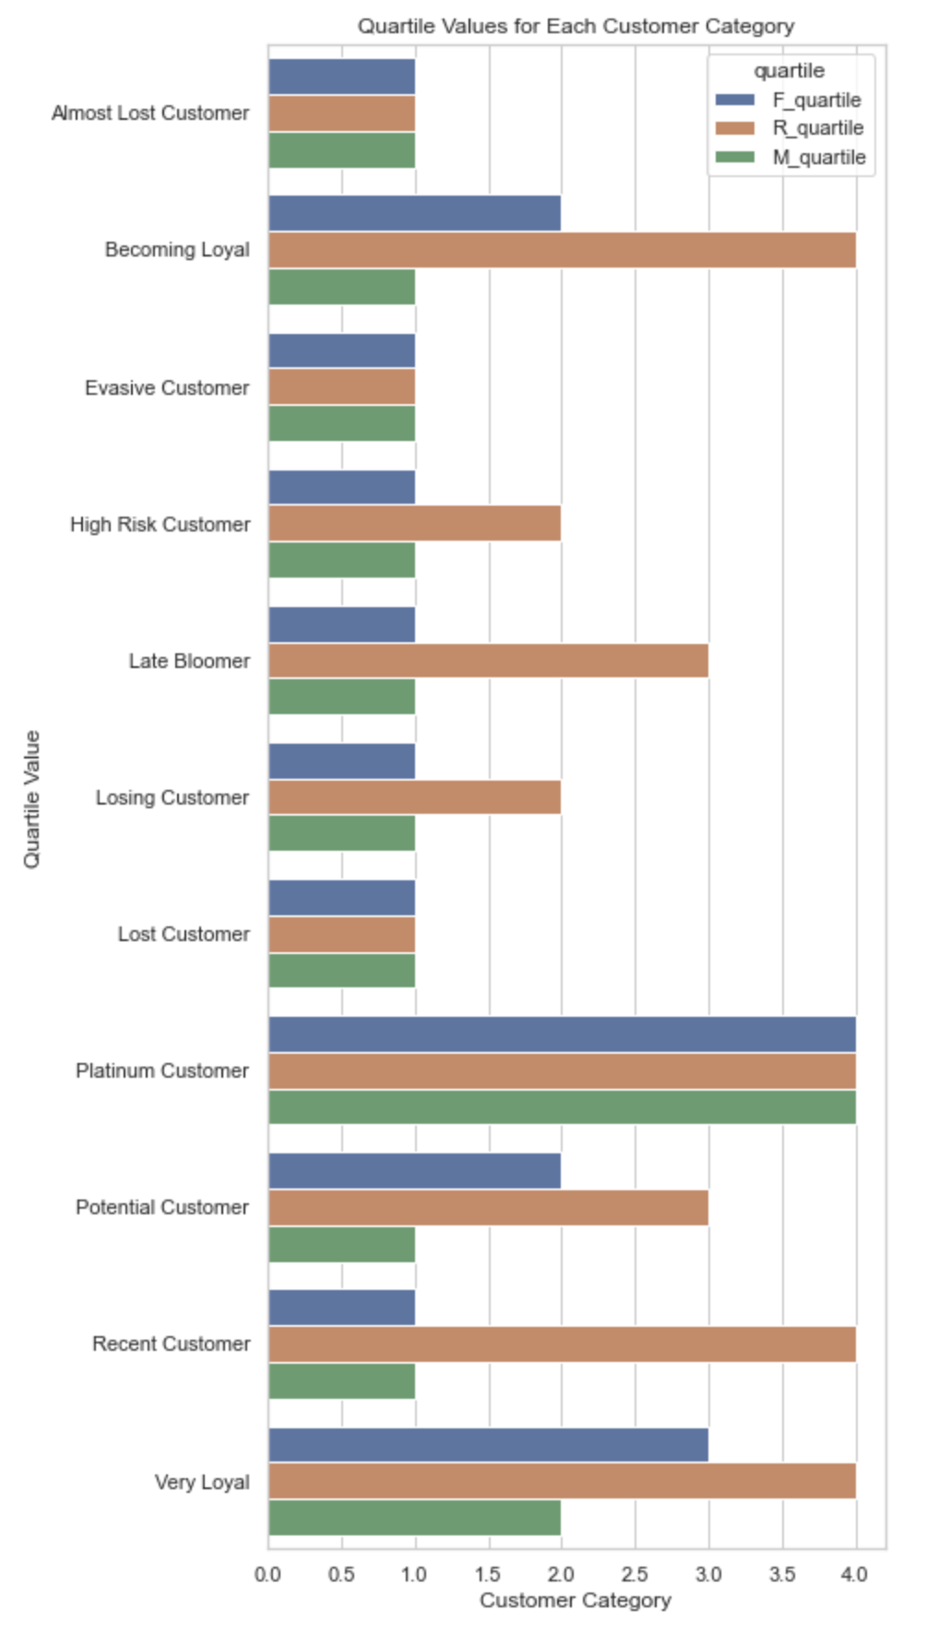
Note: The data and information in this document is reflective of a hypothetical situation and client. This document is to be used for KPMG Virtual Internship purposes only.
RFM Analysis & Customer Classification
RFM Analysis: Key Tool for Customer Targeting
Determines high-potential customers to maximize revenue and business value
Focuses on three dimensions of customer engagement:
Recency: Time since last purchase or interaction
Frequency: Number of purchases or interactions over a period
Monetary: Total spending or revenue generated by the customer
Helps prioritize marketing efforts and resources for maximum impact

Slide 17
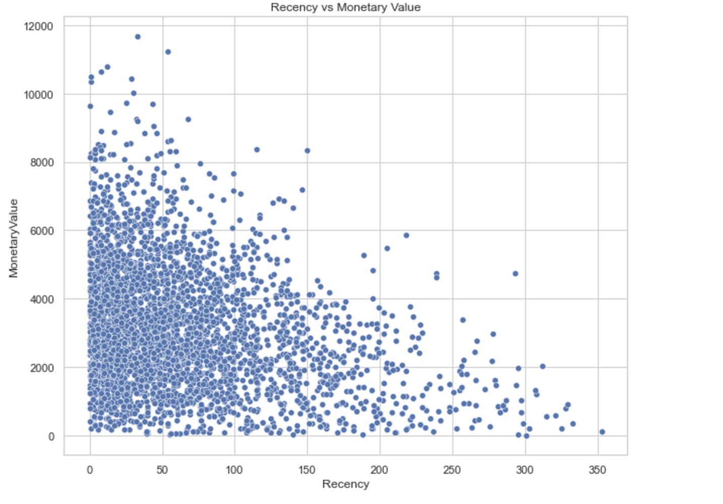
Note: The data and information in this document is reflective of a hypothetical situation and client. This document is to be used for KPMG Virtual Internship purposes only.
Scatter Plot Based Off RFM Analysis
Recency & Monetary Relationship
The chart highlights that recent customers generate the highest revenue compared to those who visited less recently.
Customers who made purchases within the last 0 -100 days contribute a moderate amount of revenue.
Revenue generation is significantly lower for customers whose last visit was more than 200 days ago.

Slide 18
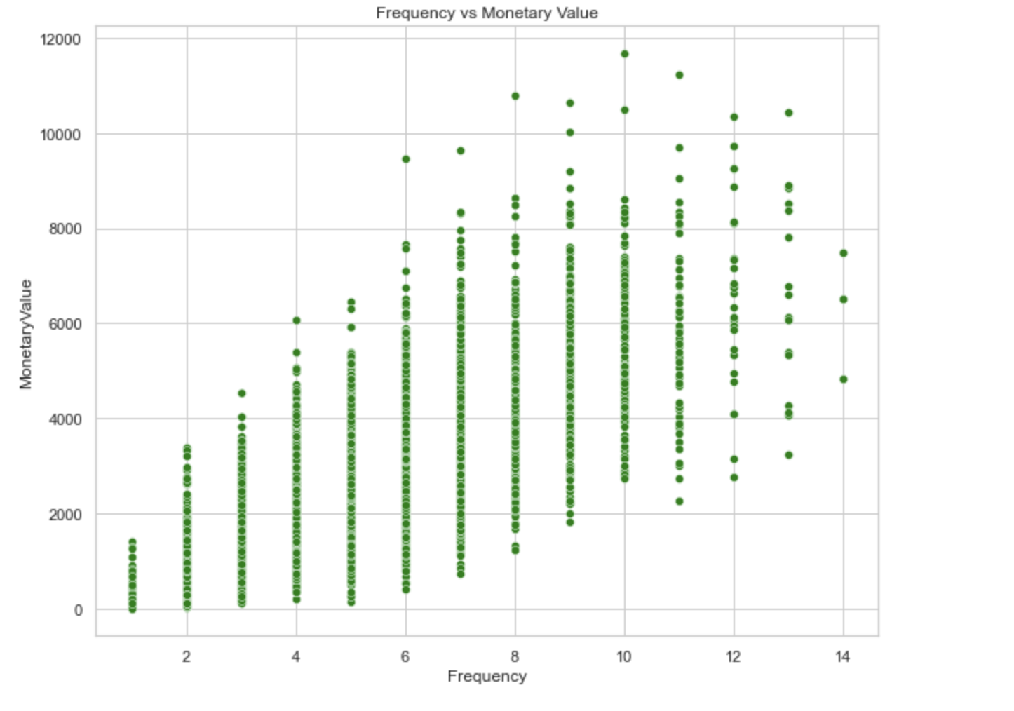
Note: The data and information in this document is reflective of a hypothetical situation and client. This document is to be used for KPMG Virtual Internship purposes only.
Scatter Plot Based Off RFM Analysis
Frequency & Monetary Relationship
Customers classified as "Platinum Customer," "Very Loyal," and "Becoming Loyal" demonstrate frequent visits, leading to higher revenue for the business.
A positive correlation exists between visit frequency and monetary gain, resulting in increased revenue generation.

Slide 19
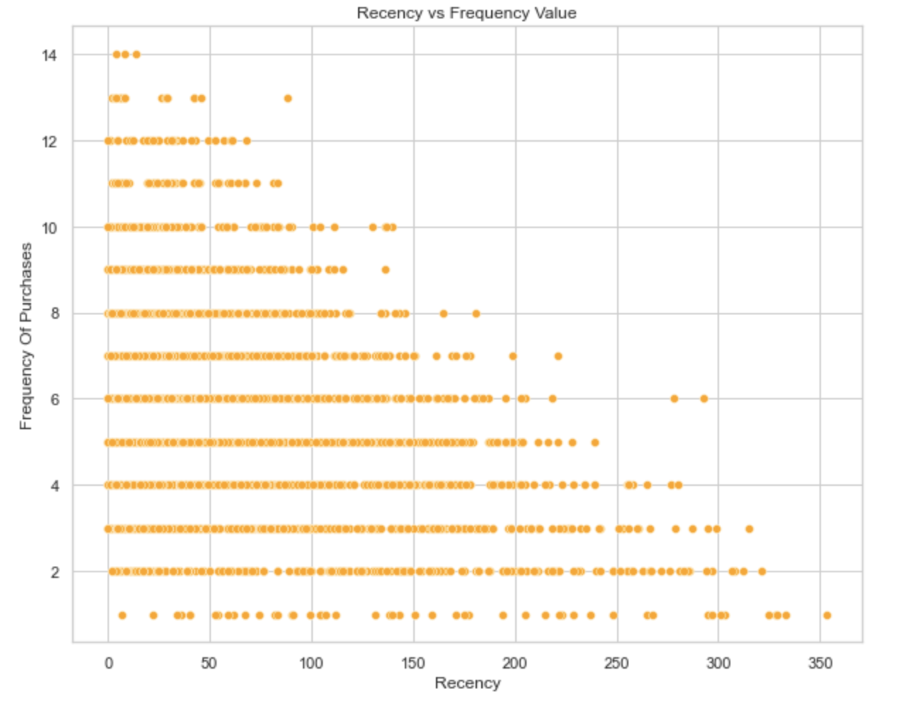
Note: The data and information in this document is reflective of a hypothetical situation and client. This document is to be used for KPMG Virtual Internship purposes only.
Scatter Plot Based Off RFM Analysis
Recency & Frequency Relationship
A very low frequency of 0-2 purchases is associated with high recency values, i.e., customers who visited more than 250 days ago.
Customers who have visited more recently (0-50 days) demonstrate a higher likelihood of visiting more frequently.
A negative relationship exists between purchase frequency and recency values, indicating that very recent customers tend to be more frequent buyers.

Slide 20
Note: The data and information in this document is reflective of a hypothetical situation and client. This document is to be used for KPMG Virtual Internship purposes only.
Customer Definition List
Rank | Customer Category | Description | RFM Value
1 | Platinum Customer | Most recent buy, buys often, most spent. | 444
2 | Very Loyal | Most recent, buys often, spends large amount of money. | 433
3 | Becoming Loyal | Relatively recent, bought more than once, spends large amount of money. | 421
4 | Recent Customer | Bought recently, not very often, average money spent. | 344
5 | Potential Customer | Bought recently, never bought before, spent small amount. | 323
6 | Late bloomer | No purchases recently, but RFM value is larger than average. | 311
7 | Losing Customer | Purchases was a while ago, below average RFM value. | 224
8 | High Risk Customer | Purchase was long time ago, frequency is quite high, amount spent is high. | 212
9 | Almost Lost Customer | Very low recency, low frequency, but high amount spent. | 124
10 | Evasive Customer | Very low recency, Very low frequency, small amount spent. | 112
11 | Lost Customer | Very Low RFM. | 111

Slide 21
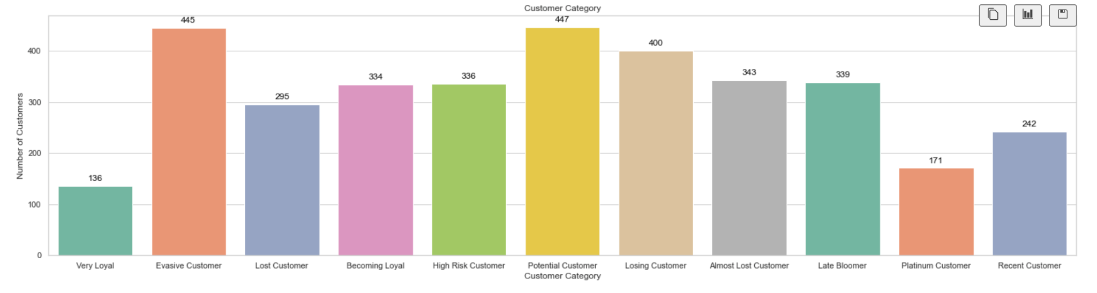
Note: The data and information in this document is reflective of a hypothetical situation and client. This document is to be used for KPMG Virtual Internship purposes only.
Customer Category Distribution

Slide 22
Note: The data and information in this document is reflective of a hypothetical situation and client. This document is to be used for KPMG Virtual Internship purposes only.
Summary Table Of The Top 1000 Customers To Target
Rank | Customer Category | Description | Number Of Customers | Cumulative | Customer Selection
1 | Platinum Customer | Most recent buy, buys often, most spent. | 171 | 171 | 171
2 | Very Loyal | Most recent, buys often, spends large amount of money. | 136 | 307 | 136
3 | Becoming Loyal | Relatively recent, bought more than once, spends large amount of money. | 334 | 641 | 334
4 | Recent Customer | Bought recently, not very often, average money spent. | 242 | 883 | 242
5 | Potential Customer | Bought recently, never bought before, spent small amount. | 447 | 1330 | 0
6 | Late bloomer | No purchases recently, but RFM value is larger than average. | 339 | 1669 | 0
7 | Losing Customer | Purchases was a while ago, below average RFM value. | 400 | 2069 | 0
8 | High Risk Customer | Purchase was long time ago, frequency is quite high, amount spent is high. | 336 | 2405 | 0
9 | Almost Lost Customer | Very low recency, low frequency, but high amount spent. | 343 | 2748 | 0
10 | Evasive Customer | Very low recency, Very low frequency, small amount spent. | 445 | 3193 | 0
11 | Lost Customer | Very Low RFM. | 295 | 3488 | 0

Slide 23
Note: The data and information in this document is reflective of a hypothetical situation and client. This document is to be used for KPMG Virtual Internship purposes only.
Questions? I'm all ears!”

