Slide 1


Machine Learning and Data Science
Assignment #2
Prepared by :Noura khdour

Slide 2
Part -1
Non-Linear Regression

Slide 3
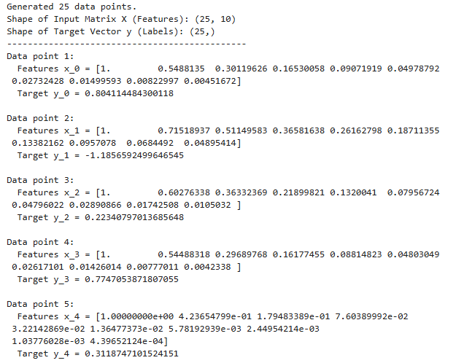
Generate set S
  25 data points were created.
  Each data point has 10 features → because we used polynomial degree 9 (features: 1, x, x², x³, …, x⁹)
  The target vector y has 25 values, one for each x.

Slide 4

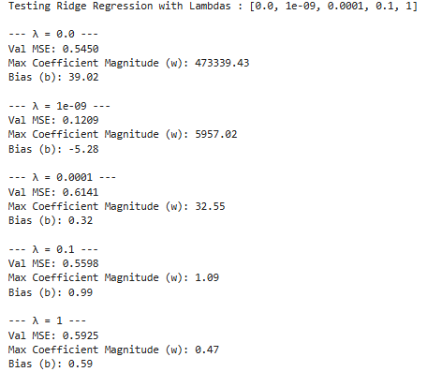
Ridge regression
  split the data into training (15) , testing (5) and validation (5).
  Ridge regression advantage is to avoid overfitting
  Ridge regression works by applying penalizing to reduce the weights and biases to overcome the overfitting
  When λ increases, Coefficients become smalle.

Slide 5
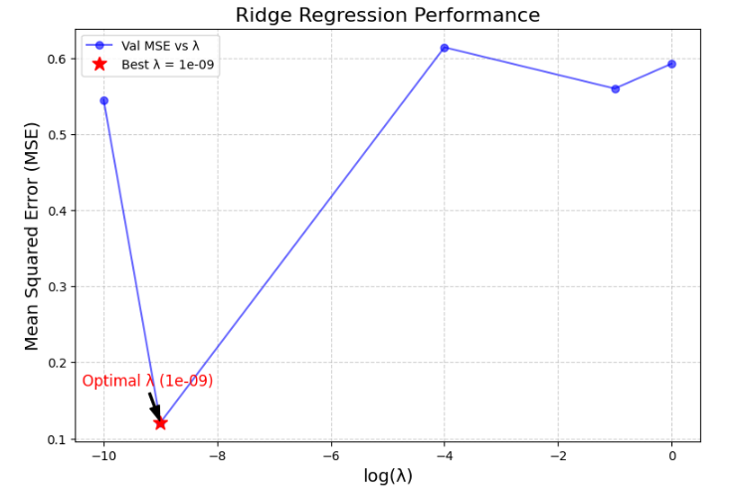
Ridge regression
  As shown ,the value of 𝜆 that produces the model with the best generalization performance is 1e-9 becouse it give the min value of MSE

Slide 6
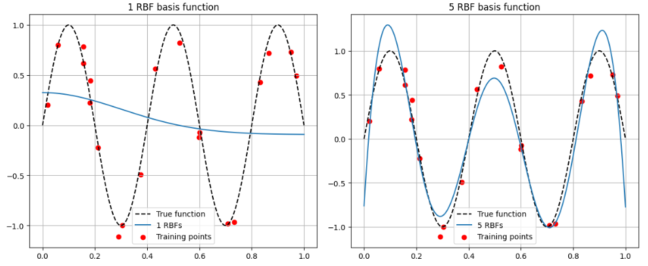
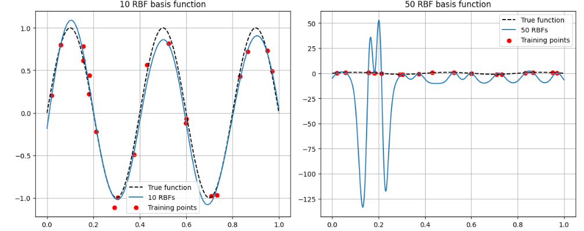
RBF basis functions
  1 RBF has underfitting, Fails to fit training data well
  5 RBF ,the model significantly improves and starts to follow the overall shape of the True function.
  10 RBF, Best Generalization The model almost perfectly overlaps with the True function.
  50 RBF , the model has Overfitting.

Slide 7

Part -2
Logistic Regression

Slide 8


preprocessing and spliting
Before apply the logistic regression I did :
  Handle missing values
  Apply standardization on numeric features
  Split the dataset into: 2500 training samples, 500 validation samples,
  and 500 test samples

Slide 9


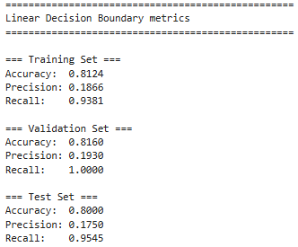
Logistic Regression with a linear decssion boundary
  The model correctly identifies most customers overall (good accuracy).
  It catches all customers who churn (recall = 1.0).
  However, many of the customers predicted as “churn” are actually not churners (low precision).
  If the classes are perfectly linearly separable, a logistic regression model can achieve high accuracy and recall by finding a decision boundary that effectively isolates the classes.

Slide 10
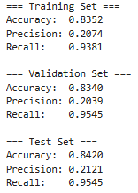
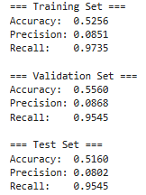
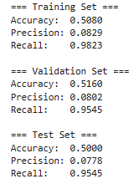
Logistic Regression with a non-linear decssion boundary
Degree 2 polynomial Features
Degree 5 polynomial Features
Degree 9 polynomial Features
As the polynomial degree increases, the model becomes more complex.Low-degree models generalize well, but high-degree models overfit by memorizing noise, which reduces accuracy and stability on new data.

Slide 11
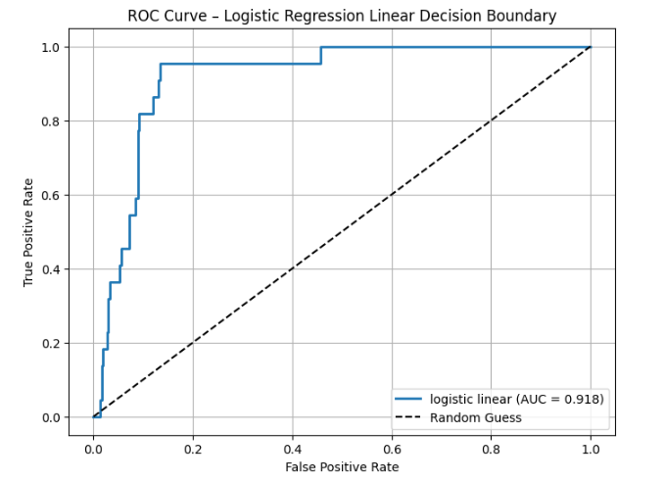

ROC curve
  Choose the best model based on the highest recall .
  A higher AUC means the model is doing good and the model effectively distinguishes between positive and negative instances.

Slide 12


Thank you :)
Thank You!

