Slide 1
CAMERA TECHNOLOGY

Slide 2
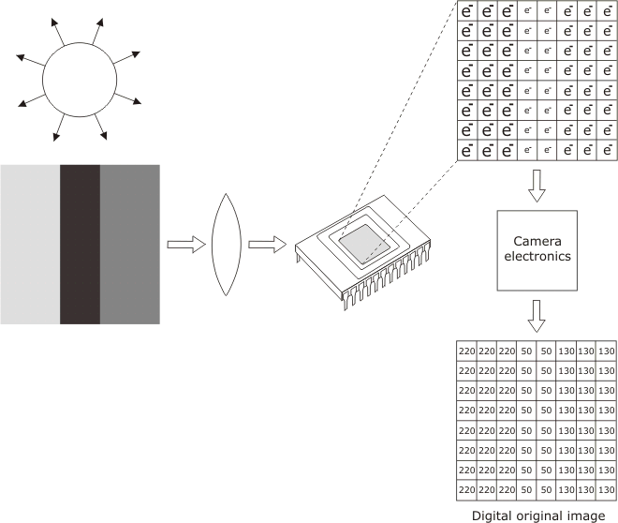

Slide 3
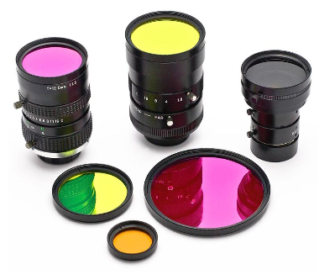
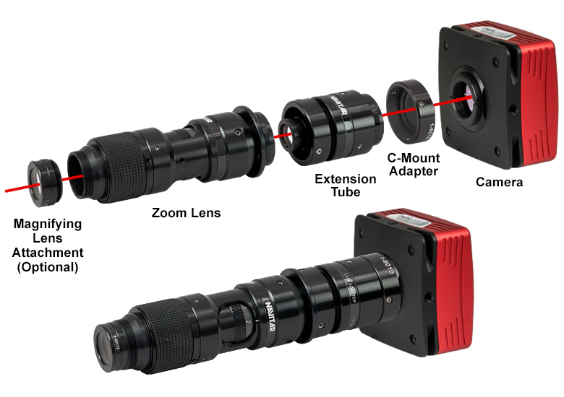
Filters and other accessories
https://midopt.com/wp-content/uploads/2019/12/mounting-solutions.jpg
https://www.thorlabs.com/images/TabImages/Zoom_Lens_A1-780.jpg
Notes:
3

Slide 4
Lens Mount
C -mount and CS-mount
Lens thread
Focal
plane
Lens flange
Flange back distance
C-mount 17.526 mm
CS-mount 12.526 mm
(With a 5 mm adapter ring, a C-mount lens can be used on a CS-mount camera.)
F-mount: Large format (line scan and large matrix sensors). Bayonet connection.
S-mount: Small lens mount system (board level and micro head cameras). Allow only a minimum of adjustment.
T-Mount / M42 mount: Alternative to F-mount for line scan cameras or large, high resolution matrix sensors.
Notes:
3

Slide 5
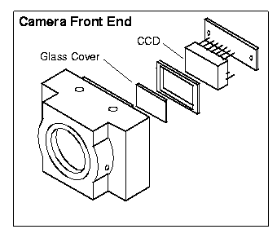
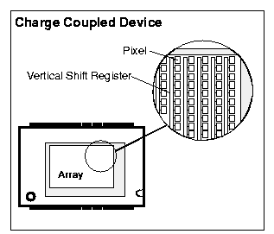
Kameran sensoriyksikkö

Slide 6
CCD Sensor
Image Format
The image size in inches relates back to the tube camera. The image format of a tube which could be placed in a 1” deflection coil was called 1” format.
BIPM (Bureau International des Poids & Mesures) recommend to use metric designation. Below is the most common image formats shown.
1”
Tube
Deflection
yoke
1” format
2/3” format
1/2” format
1/3” format
Diagonal:
16 mm
11 mm
8 mm
6 mm
Image
size
8 mm
3.3 mm
16 mm
11 mm
6.6 mm
4.8 mm
6 mm
9.3 mm
6.4 mm
4.4 mm
8.8 mm
12.8 mm
Optiikan tuottaman kuvan (ympyrämäinen) koko (annetaan myös tuumissa) oltava vähintään yhtä suuri kuin kennon koko!

Slide 7
Kameran toiminnan perusperiaate
The ”photon collecting” element (collecting light)
Incoming photons (light)
Converted to Electrons
(Charge)
Anti Blooming
Gate
(Reset Gate)
Charge
Transfer
Gate

Slide 8
Kameran toiminnan perusperiaate
Moving the Charge to the output
Measuring how many Photons
(how much light) have been collected
Horizontal CCD Shift Register

Slide 9
Trigger/Read-out mode
trigger
Trigger mode 1
Edge
Shutter
Exposure
Video
Read-out
trigger
Exposure
Trigger mode 2
Pulse width
Video
Read-out

Slide 10
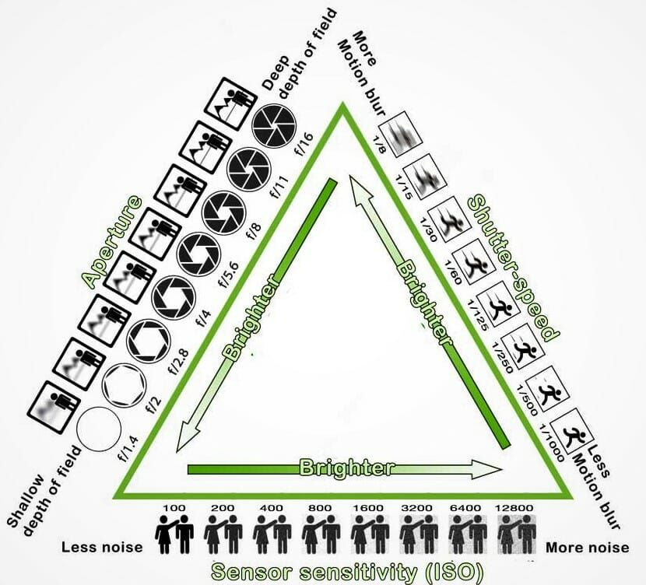
Valotusaika, suljin, herkkyys, (vahvistus, …)
https://www.premiumbeat.com/blog/know-the-basics-of-global-shutter-vs-rolling-shutter/
https://www.photoblog.com/learn/exposure-triangle-guide/

Slide 11
Spectral response
sensitivity
Tungsten lamp
2856 K
100
90
80
Night sky
70
60
50
40
30
Eye
night
20
Eye
10
CCD ICX024
200
400
600
800
(nm)
UV
IR

Slide 12
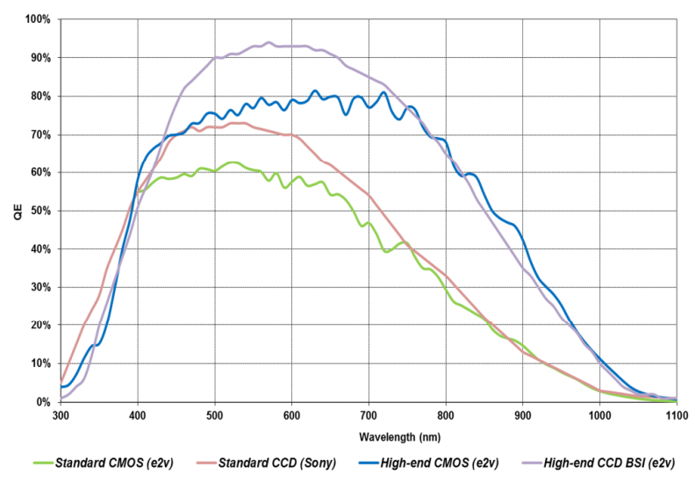
Spectral response
https://imaging.teledyne-e2v.com/content/uploads/2020/05/e2v_CMOS_Image_Sensors_are_Entering_a_New_Age_V4.pdf

Slide 13
CCD with on chip micro lens
Interline CCD
Light rays at right
angle to CCD surface
On interline transfer CCD sensors, the active photo diode area is only about 35% of the surface. By placing a micro lens on top of each photo diode, the sensitivity can be improved. The micro lens covers most of the cell area, and it will collect nearly all incoming light and refract it onto the photo diode.
The drawback is that the sensitivity now depends more of the angle of incidence of the light rays. This occurs when the exit pupil position is close to the CCD surface, as is the case in wide angle lenses.
Light rays with an angle to the optical axis
Photo diode
Micro lens

Slide 14
Interlaced Scan Non-Interlaced Scan
2
1
1
2
3
3
4
4
5
5
6
6
7
7
8
8
9
9
10
10
11
11
12
Even
Odd
Non-interlaced scan or progressive scan is used in machine vision. The lines are scanned progressive from top to bottom in one full frame.
1 FRAME = 2 FIELDS

Slide 15
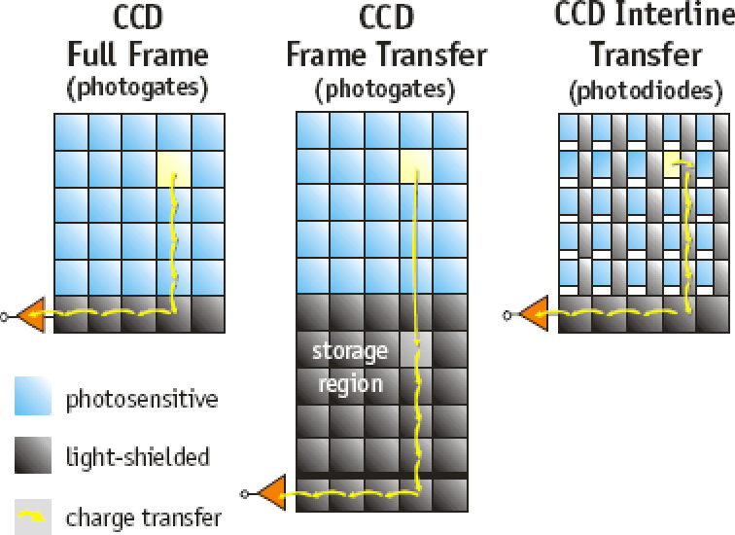
Full frame, frame, Interline Transfer CCD
Monochrome
https://www.semanticscholar.org/paper/Spin-on-siloxane-polymers-in-image-sensor-Karaste-Honkanen/fa131da4964c81e987c866afddea34c5a38dc9e6

Slide 16
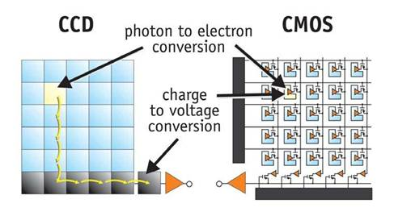
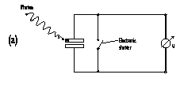
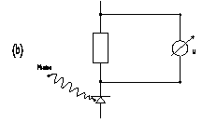
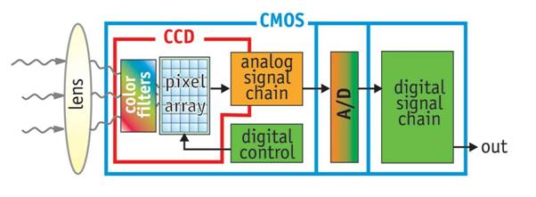
CCD (a) vs. CMOS (b)
CCDs move photogenerated charge from pixel to pixel and convert it to voltage at an output node. CMOS imagers convert charge to voltage inside each pixel. (https://meroli.web.cern.ch/lecture_cmos_vs_ccd_pixel_sensor.html)
CMOS imagers can be fabricated with more “camera” functionality on the chip. (https://meroli.web.cern.ch/lecture_cmos_vs_ccd_pixel_sensor.html)
Notes:
3

Slide 17
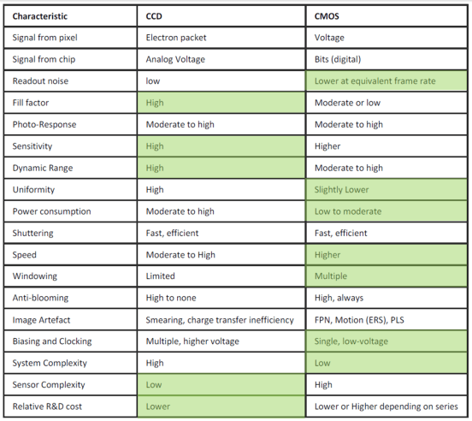
CCD - CMOS COMPARISON
https://imaging.teledyne-e2v.com/content/uploads/2020/05/e2v_CMOS_Image_Sensors_are_Entering_a_New_Age_V4.pdf

Slide 18
VÄRIKAMERATEKNOLOGIAA

Slide 19
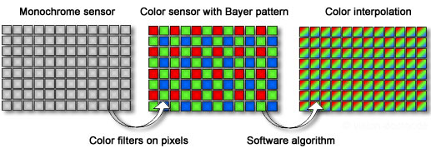
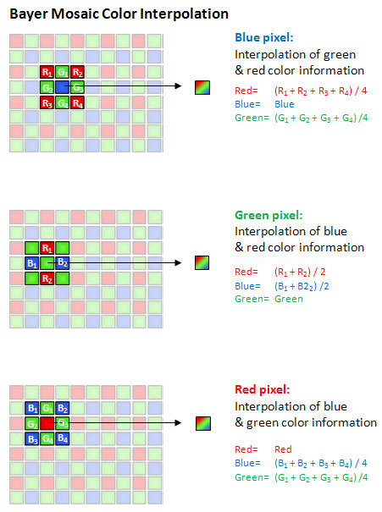
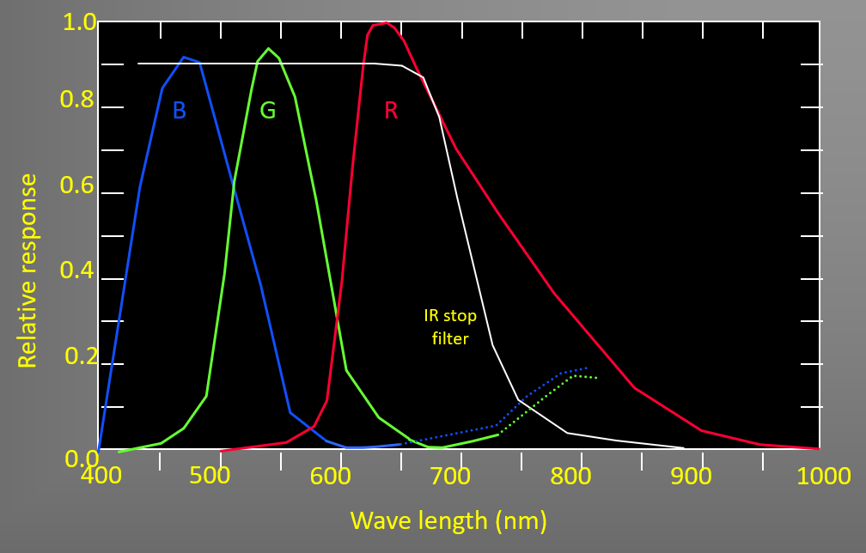
Single sensor colour camera
https://www.vision-doctor.com/en/area-scan-cameras.html
Notes:
36
38
38
36

Slide 20
3 chip CCD camera
Co-site sampling
Blue pixel X,Y
Green pixel X,Y
Red pixel X,Y
RGB sensors are
aligned pixel to pixel

Slide 21
3 chip CCD camera
Color shading
Red reflecting
layer
Blue reflecting
layer
Lens
exit pupil
Colour shading
White shading
Dynamic shading
V-saw shading
1.0
Transit wave length depend of the angle the light rays pass the color reflection dichroic layer
0.8
B
G
R
Relative transmission
0.6
Solution: Use lens designed for 1/3” 3 chip CCD with exit pupil as far away as possible. Telecentric lens.
0.4
0.2
0.0
400
500
600
700
Wave
length
(
nm
)

Slide 22
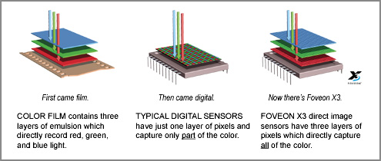
Foveon-värikamerateknologia

Slide 23
VIIVAKAMERATEKNOLOGIAA

Slide 24
Line Scan Theory
A line scan sensor ”lifts” an image, usually from a moving object, line by line (compare this with a fax machine).
Scan 1
Scan 2
Scan 3
Scan
Direction
Scan n

Slide 25
Line Scan Theory
Ø_{EXP}
A.B. / Exposure Control Gate
PHOTODIODES
Transfer Gate
Ø_{TG}
Horizontal CCD
Ø_{H1}
Ø_{H2}
Output
Ø_{RST}

Slide 26
CV-103: Line Scan Camera Co-site sampling
Blue pixel X,Y
Green pixel X,Y
Red pixel X,Y
RGB sensors are
alligned pixel to pixel

Slide 27
CV-L103: Line Scan Camera Typical Set-up
DRUM
Rev
X
Encoder
N pulse/rev
CV-103
Y
Start index
1 pulse/rev
PCLK
Scan
PC
DRUM
X
RGB video
3 x 8 bit
CCLK, ENB
DISPLAY

Slide 28
Colour Line Scan Applications
Typical set-up for food inspection (bulk fruit, vegetables, nuts, etc)
Accepted objects are hurled into the ”good” bin as they fall off the end of the conveyor belt.
☹ Rejected objects are shot away, into the ”bad” bin by high pressure air nozzles.

Slide 29
Colour Line Scan Applications
Print inspection on a round object, such as a food container (extremely difficult to do well with an area scan camera).

Slide 30
Colour Line Scan Applications
Typical set up for inspection of wide webs, such as printed textile.

Slide 31
Colour Line Scan Applications
High Speed print inspection, at up to 300 metres / minute.

Slide 32
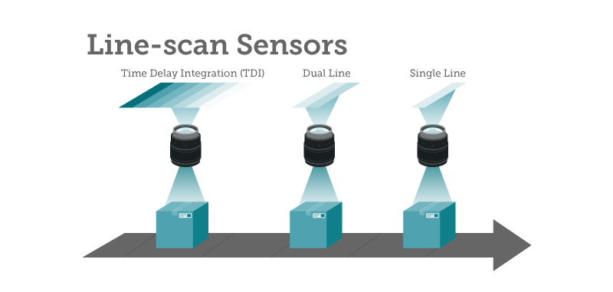
TDI-camera
Notes:
3

Slide 33
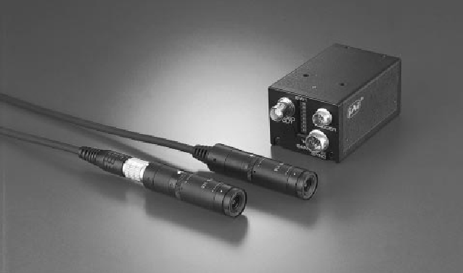
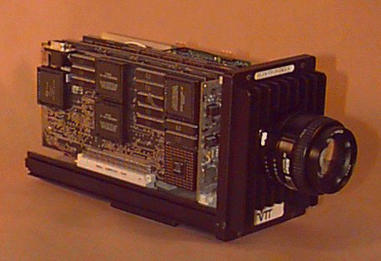
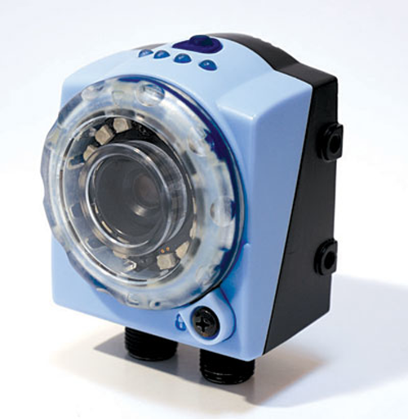
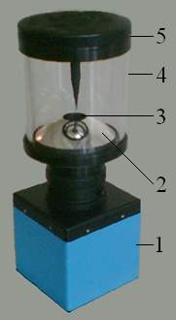
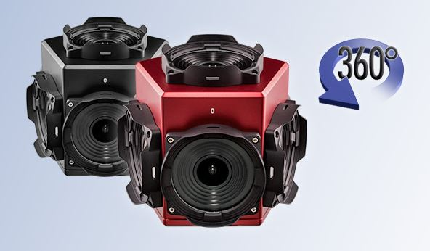
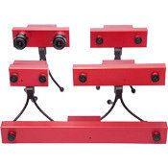
Microhead-camera, smart camera, vision systems, …
Stereo camera, time-of-flight camera, …
UV, NIR, IR, X-ray, multispectral, …
Notes:
3

