Slide 1

Noida Institute of Engineering and Technology, Greater Noida
Data Interpretation
Unit:V
Subject Name:
Cognitive Ability(BMCA0206)
Dr. Anil Agarwal
Associate Professor
Dept. of Mathematics
Course Details MCA (2nd Sem)

Slide 2

Faculty Introduction
Name : Dr. Anil Agarwal
Designation: Associate professor
Department: Mathematics
Teaching Experience: 25years
Ph.D. : Agra University, Agra.

Slide 3
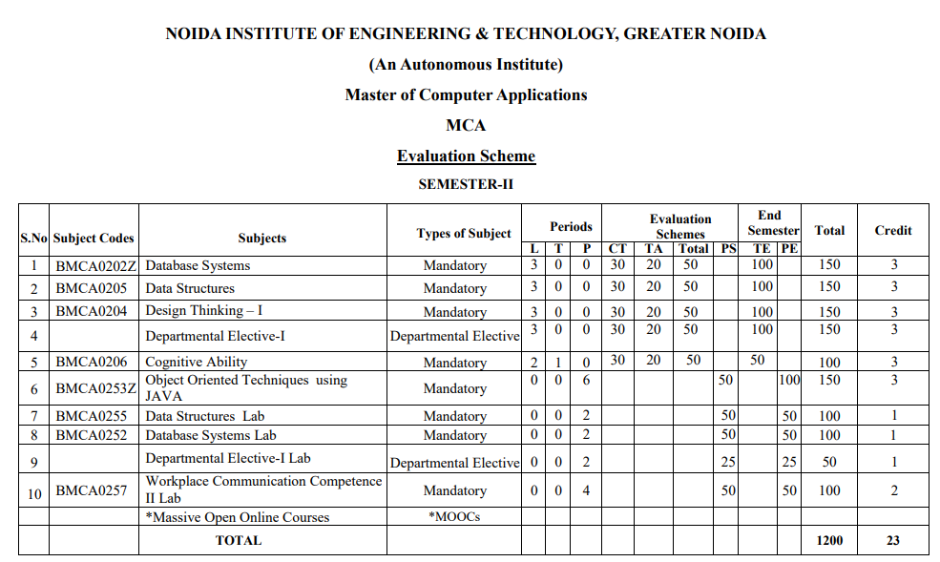
EVALUATION SCHEME

Slide 4
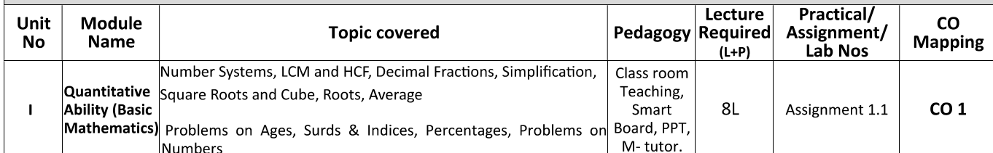
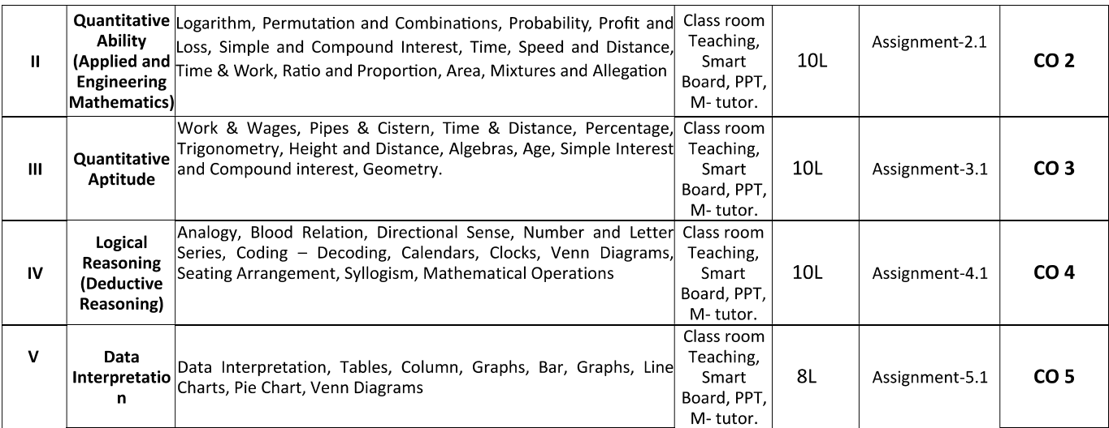
SYLLABUS

Slide 5
COURSE OBJECTIVE
This course is designed to suit the need of the outgoing students.
To acquaint them with frequently asked patterns in quantitative aptitude and logical reasoning during various examinations and campus interviews.

Slide 6
COURSE OUTCOME
CO1- Understand the concept of Number system, LCM, HCF, Square & Cube roots, Average and percentage.
CO2- Remember the concept of Logarithm, Permutation &Combination, Probability, Proft and Loss, Simple and Compound Interest, Time& Work, Ratio & Proportion, Allegation & Mixture.
CO3- Understand the concept of Work Wages, Pipes & Cistern, Time & distance Trigonometry, Height and Distance, Algebras, Geometry.
CO4- Remember the Concept of Analogy, Blood relation, Directional Sense, Number Letter Series, Coding – Decoding, Calendars, Clock, Seating Arrangement, Syllogism.
CO5- Understand the concept of Data Interpretation, Tables, Column, Graphs, Bar, Line Charts, Pie Charts, Venn Diagram.

Slide 7
PROGRAMME OUTCOMES (POS)
 | Programme Outcomes (POs)
Computational Knowledge | To develop/apply knowledge of computing fundamentals, computing specialization, mathematics and domain knowledge for solving real world problems.
Problem Analysis | Identify formulated review research literature and analyze complex problems reaching substantial conclusions using first fundamental principles of mathematics, computing science and relevant domain specific
Design /Development of Solutions | Ability to design and evaluate system, components or processes for complex computing problems that meets specified needs with appropriate consideration for the public health and safety and cultural societal and environmental consideration.

Slide 8
PROGRAMME OUTCOMES (POS)
 | Programme Outcomes (POs)
Conduct investigations of complex Computing problems | Use research-based knowledge and research methods including design of experiments, analysis and interpretation of data, and synthesis of the information to provide valid conclusions.
Modern Tool Usage | Create, select, adapt and apply appropriate techniques, resources, and modern computing tools including prediction and modeling to complex computing activities, with an understanding of the limitations.
Professional Ethics | Understand and commit to professional ethics and cyber regulations, responsibilities, and norms of professional computing practices.

Slide 9
PROGRAMME OUTCOMES (POS)
 | Programme Outcomes (POs)
Societal and Environmental Concern | Understand and assess societal, environmental, health, safety, legal, and cultural issues within local and global contexts, and the consequential responsibilities relevant to professional computing practices.
Individual and Team Work | Function effectively as an individual and as a member or leader in diverse teams and in multidisciplinary environments..
Innovation and Entrepreneurship | Identify a timely opportunity and using innovation to pursue that opportunity to create value and wealth for the betterment of the individual and society at large.

Slide 10
CO-PO MAPPING
Course Name: Master for computer Applications
CO | PO-1 | PO-2 | PO-3 | PO-4 | PO-5 | PO-6 | PO-7 | PO-8 | PO-9 | PO-10 | PO-11 | PO-12
CO1 | L | L | L | - | - | - | - | - | - | - | - | -
CO2 | M | M | L | - | - | - | - | - | - | - | - | -
CO3 | M | M | L | - | - | - | - | - | - | - | - | -
CO4 | M | M | L | - | - | - | - | - | - | - | - | -
CO5 | M | M | L | - | - | - | - | - | - | - | - | -
*L= Low *M= Medium *H= High​
​

Slide 11
PROGRAMME EDUCATIONAL OBJECTIVES(PEOS)
PEO 1: To produce successful graduates for industry, government, academia and research for lifelong learning to fulfill their goals.
PEO 2: To develop ethical leaders with strong communication ability who will excel as an individual and a team in a society.
PEO3: To produce successful innovative professionals with computing and analytical ability to design and develop system with entrepreneurial aptitude.

Slide 12
CO-PEO MAPPING
Course Name: Cognitive Ability
CO | PEO-1 | PEO-2 | PEO-3
CO1 | L | L | M
CO2 | L | L | M
CO3 | M | L | M
CO4 | L | L | M
CO5 | M | L | M

Slide 13
RESULT ANALYSIS

Slide 14
END SEMESTER QUESTION TEMPLATE
50 Marks 50 Marks Question Paper Template.docx
50 Marks Question Paper Template.docxtion Paper Template.docx

Slide 15
Brief Introduction about subject(CO5)
Aptitude and reasoning are crucial skills assessed in various competitive exams and job interviews, evaluating a student’s ability to analyze information, solve problems, and make logical decisions. Aptitude refers to inherent abilities, while reasoning focuses on the process of drawing conclusions based on logic and evidence. We will Enhance the basic aptitude skills.

Slide 16
Unit Contents(CO5)
Data Interpretation: Tables, Columns
Graphs
Charts
Venn Diagrams

Slide 17
Prerequisite
Basic concept of mathematics

Slide 18
Data Interpretation (CO5)
Data Interpretation or DI: refers to the implementation of procedures through which data is reviewed for the purpose of arriving at an inference. Data can be obtained from multiple sources e.g. data from running of industries, census population data etc. Interpreting data requires analyzing data to infer information from it in order to answer questions. Data can be provided in a number of formats via: Bars, tables, line graphs, pie graphs.
Bar Graph: A bar graph or bar chart represents explicit data with rectangular bars. The heights and lengths of these bar graphs are proportional to the values of data they represent. There are two types of bar graph, one is called horizontal bar graph and other is called vertical bar graph. Bar graphs made up of two axis, one is called x- axis and other is called y- axis.

Slide 19
Data Interpretation (CO5)
What is represented in a Data Interpretation Table?
DI Questions based on Tables are very common in competitive exams. Rows and Columns of tables consist of various types of data like income of company, expenditure on various items, and marks of Applicants and so on. First column and row of tables represent the titles. Level of Questions in Tables may be lower or higher in comparison of other graphs form, depending on given data in the table and the way, questions are framed.

Slide 20
Data Interpretation (CO5)
Data Interpretation Forms:-
As every one of you know Data can be composed or spoke to in 4 Forms
1. Numerical: - Data in numerical structure
2. Table Form: - Data in Tabular structure
3. Mixed form: - Data in Mix Form
4. Graphical structure Like Line, Bar chart and so forth.

Slide 21
Data Interpretation (CO5)
Tabular Data Interpretation formulas
1. Average:
Average =total of data/ No.of data
2. Percentage:
If we have to find y% of x, then
y% of x=(x*y)/100
3. Ratio & Proportion:
The ratio of a to b is written as a: b = a / b
The idea of proportions is that two ratio are equal. If a: b = c: d, we write a: b::c: d

Slide 22
Data Interpretation (CO5)
Example-1
Directions (1 -5):

Slide 23
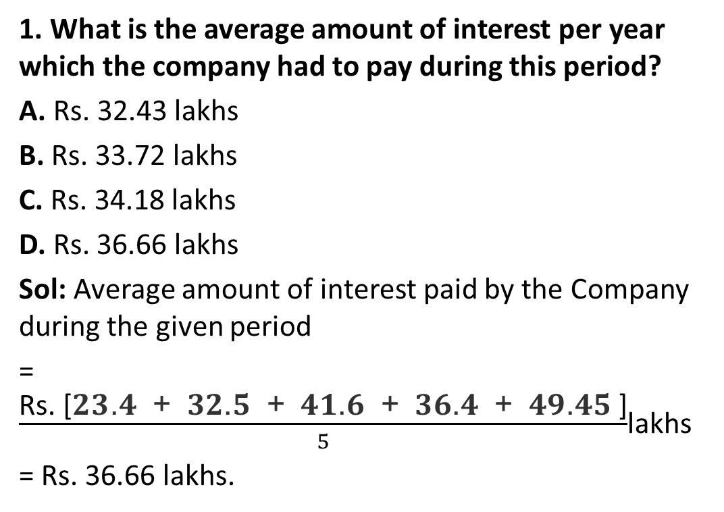
Data Interpretation (CO5)
1. What is the average amount of interest per year which the company had to pay during this period?
A. Rs. 32.43 lakhs
B. Rs. 33.72 lakhs
C. Rs. 34.18 lakhs
D. Rs. 36.66 lakhs
Sol: Average amount of interest paid by the Company during the given period
= $\frac{\text{Rs}\text{. [}\text{23}\text{.}\text{4}\text{ + }\text{32}\text{.}\text{5}\text{ + }\text{41}\text{.}\text{6}\text{ + }\text{36}\text{.}\text{4}\text{ + }\text{49}\text{.}\text{45} \text{]}}{5}$lakhs
= Rs. 36.66 lakhs.

Slide 24
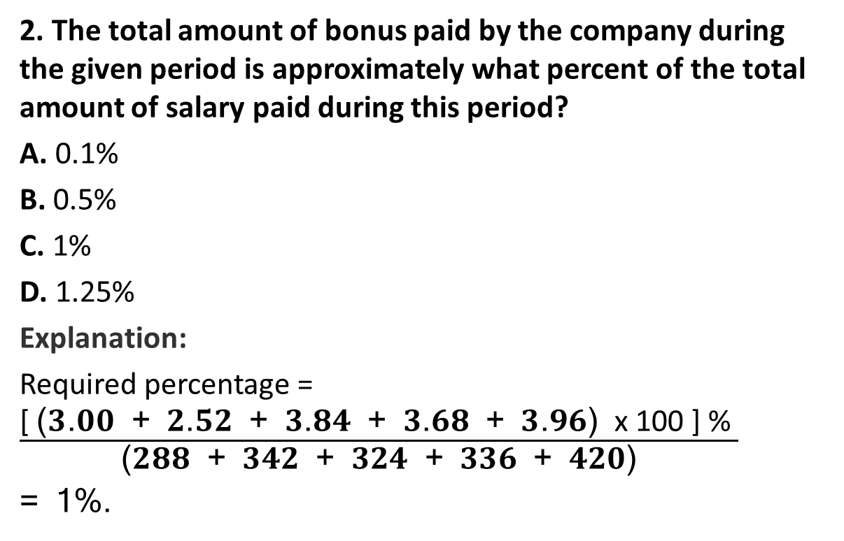
Data Interpretation (CO5)
2. The total amount of bonus paid by the company during the given period is approximately what percent of the total amount of salary paid during this period?
A. 0.1%
B. 0.5%
C. 1%
D. 1.25%
Explanation:
Required percentage = $\frac{\text{[ }\text{(}\text{3}\text{.}\text{00}\text{ + }\text{2}\text{.}\text{52}\text{ + }\text{3}\text{.}\text{84}\text{ + }\text{3}\text{.}\text{68}\text{ + }\text{3}\text{.}\text{96}\text{) }\text{x}\text{ 100 ] \% }}{\text{(}\text{288}\text{ + }\text{342}\text{ + }\text{324}\text{ + }\text{336}\text{ + }\text{420}\text{)}}$
= 1%.

Slide 25
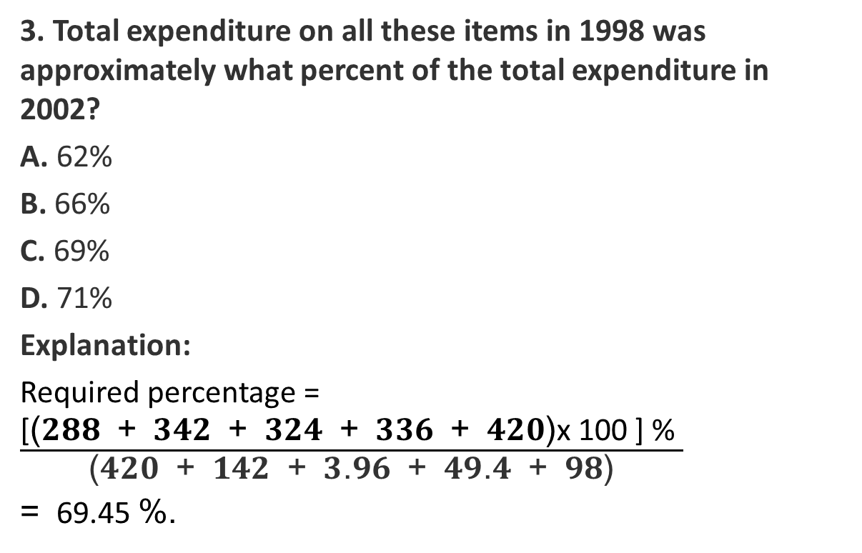
Data Interpretation (CO5)
3. Total expenditure on all these items in 1998 was approximately what percent of the total expenditure in 2002?
A. 62%
B. 66%
C. 69%
D. 71%
Explanation:
Required percentage = $\frac{\text{[}\text{(}\text{288}\text{ + }\text{342}\text{ + }\text{324}\text{ + }\text{336}\text{ + }\text{420}\text{)}\text{x}\text{ 100 ] \% }}{\text{(}\text{420}\text{ + }\text{142}\text{ + }\text{3}\text{.}\text{96}\text{ + }\text{49}\text{.}\text{4}\text{ + }\text{98}\text{)}}$
= 69.45 %.

Slide 26
Data Interpretation (CO5)
4. The total expenditure of the company over these items during the year 2000 is?
A. Rs. 544.44 lakhs
B. Rs. 501.11 lakhs
C. Rs. 446.46 lakhs
D. Rs. 478.87 lakhs
Explanation:
Total expenditure of the Company during 2000
= Rs. (324 + 101 + 3.84 + 41.6 + 74) lakhs
= Rs. 544.44 lakhs.

Slide 27
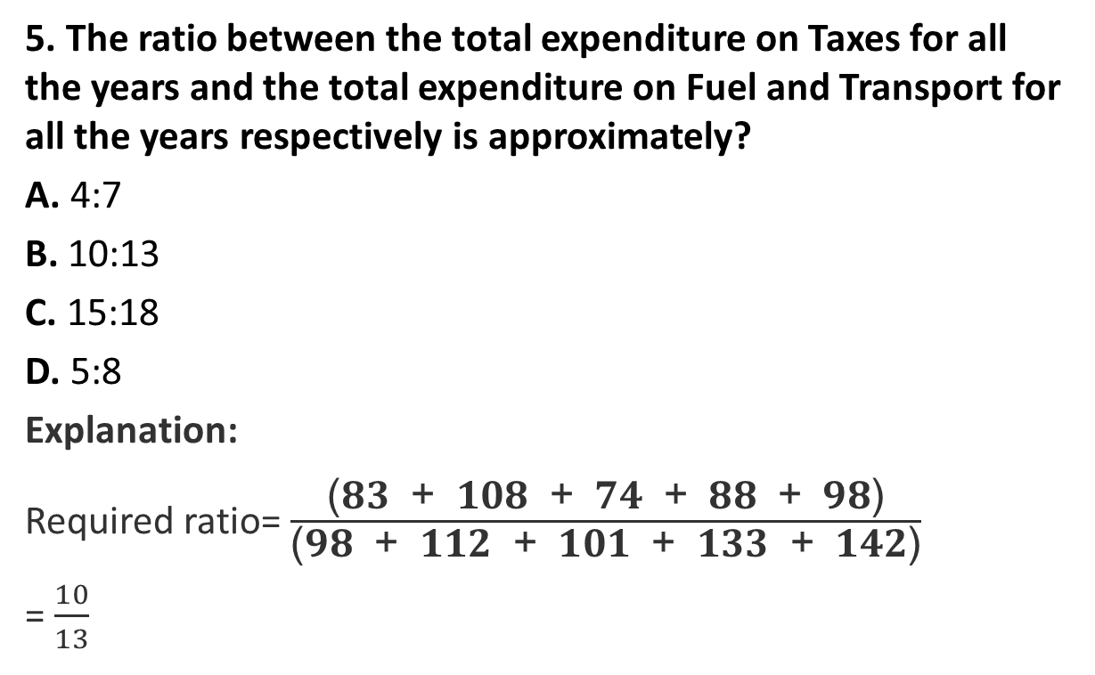
Data Interpretation (CO5)
5. The ratio between the total expenditure on Taxes for all the years and the total expenditure on Fuel and Transport for all the years respectively is approximately?
A. 4:7
B. 10:13
C. 15:18
D. 5:8
Explanation:
Required ratio= $\frac{\text{(}\text{83}\text{ + }\text{108}\text{ + }\text{74}\text{ + }\text{88}\text{ + }\text{98}\text{)}}{\text{(}\text{98}\text{ + }\text{112}\text{ + }\text{101}\text{ + }\text{133}\text{ + }\text{142}\text{)}}$
= $\frac{10}{13}$

Slide 28
Data Interpretation (CO5)
Example:2
Directions (1-5): The following pie-chart shows the number of students who failed in different subjects in an examination, Examine the chart and answer the following questions. The total number of students who have failed in 500.

Slide 29
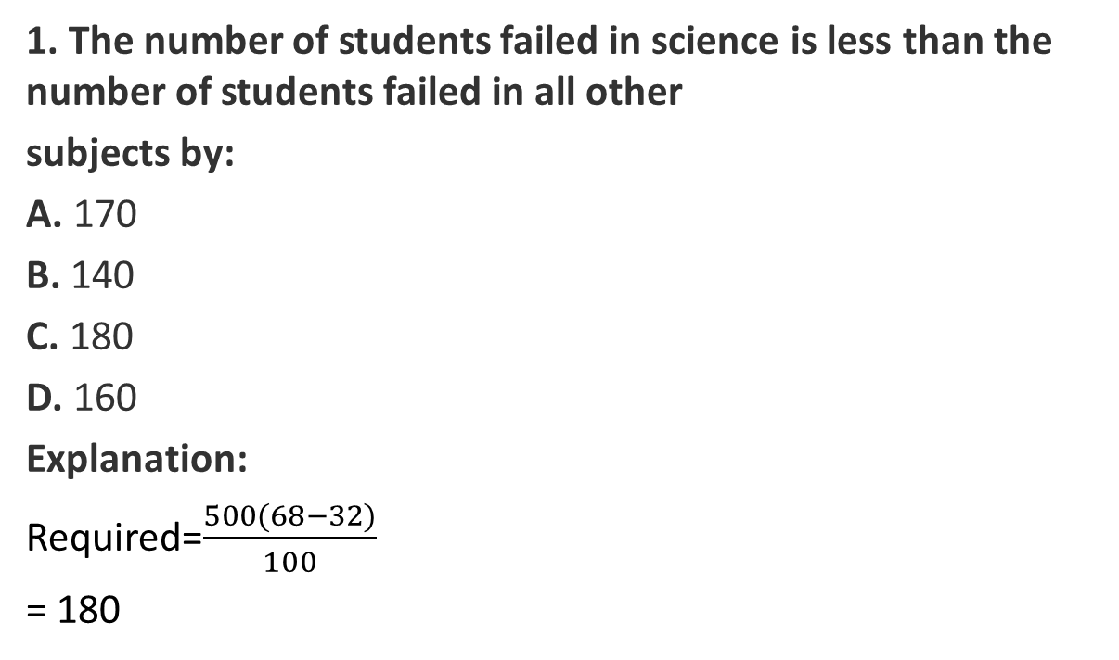
Data Interpretation (CO5)
1. The number of students failed in science is less than the number of students failed in all other
subjects by:
A. 170
B. 140
C. 180
D. 160
Explanation:
Required=$\frac{500(68−32)}{100}$
= 180

Slide 30
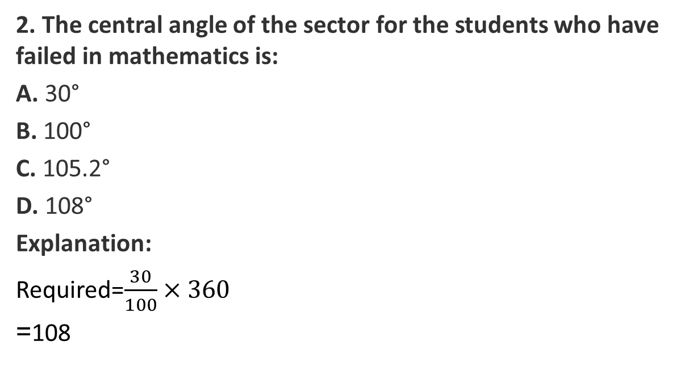
Data Interpretation (CO5)
2. The central angle of the sector for the students who have failed in mathematics is:
A. 30°
B. 100°
C. 105.2°
D. 108°
Explanation:
Required=$\frac{30}{100}×360$
=108

Slide 31
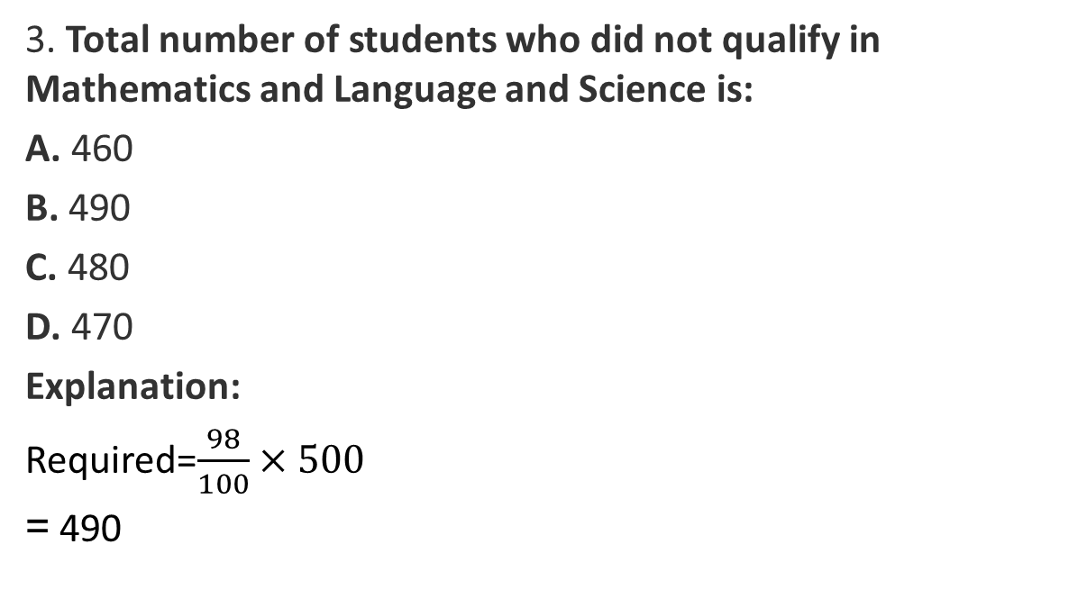
Data Interpretation (CO5)
3. Total number of students who did not qualify in Mathematics and Language and Science is:
A. 460
B. 490
C. 480
D. 470
Explanation:
Required=$\frac{98}{100}×500$
= 490

Slide 32
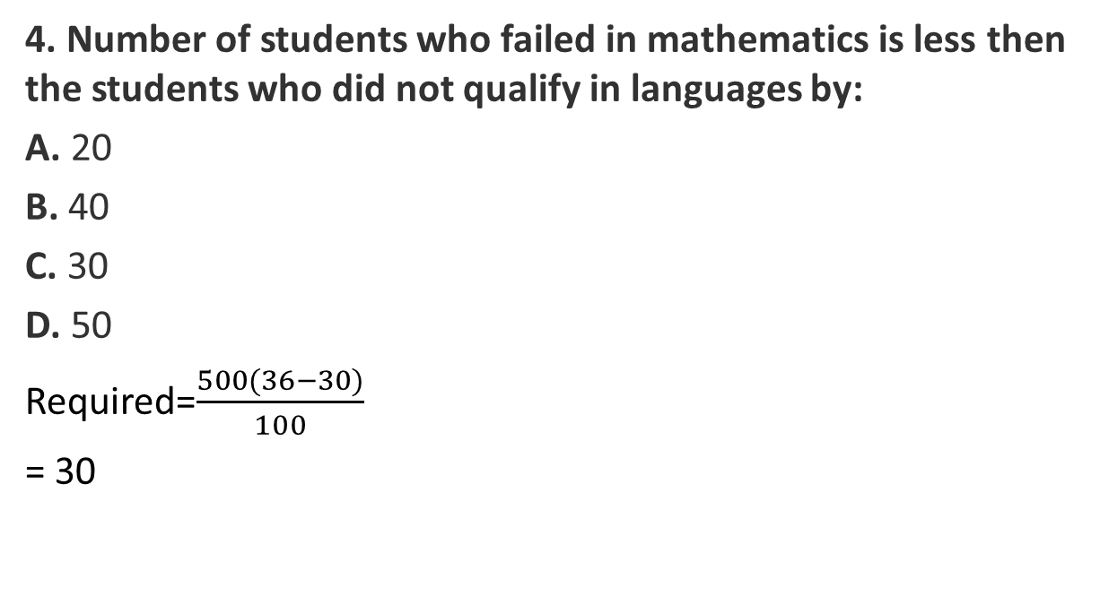
Data Interpretation (CO5)
4. Number of students who failed in mathematics is less then the students who did not qualify in languages by:
A. 20
B. 40
C. 30
D. 50
Required=$\frac{500(36−30)}{100}$
= 30

Slide 33
Data Interpretation (CO5)
5. The percentage of students who have failed in mathematics and language is:
A. 65.5%
B. 60%
C. 66%
D. 62%
Explanation:
Required percentage=(36 + 30) = 66%

Slide 34
Summary
Course Objective
COs and POs of subject
Mapping of COs and Pos
Prerequisite and Recap
Data Interpretation
Graphs
Charts
Venn Diagrams
MCQs

Slide 35
Reference
Website - https://www.GovernmentAdda.com
Books references – R.S. Agarwal
Thank You

