Slide 1






Superwiser
Superwiser
Pour un superviseur plus sage
Pour un superviseur plus sage

Slide 2
Problem
The supervisor-supervisee relationship is a very important relationship that extends over multiple years and has

Slide 3
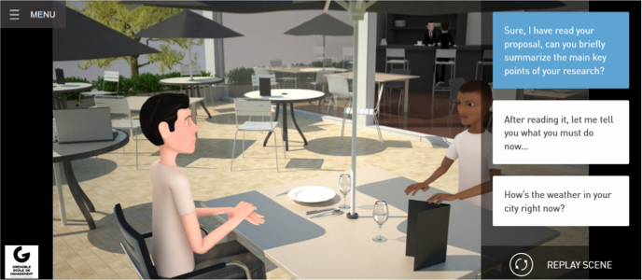
Game

Slide 4
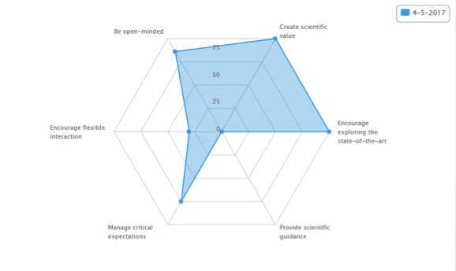
Metrics + Resources

Slide 6



