Slide 1
Wheat Disease Classification
A Three-Modality Ablation: RGB → +MS → +HS
Deep Learning Project Report
Spring 2026 — University of Jordan
Instructor: Dr. Tamam AlSarhan
ICPR 2026 — Beyond Visible Spectrum: AI for Agriculture | Individual Submission
Notes:
Individual submission for the ICPR 2026 Beyond Visible Spectrum competition. Core idea: use the data's own hyperspectral signatures to predict which modalities should help, then test that prediction with a controlled three-way ablation.

Slide 2
What We Did — and Why
The goal
Classify wheat-field image patches into Health, Rust, or Other using three aligned UAV sensor modalities.
The approach
We trained three identical models differing only in their input modality. This lets us attribute any performance difference causally to the added spectral information.
Model A → RGB only (baseline)
Model B → RGB + MS (adds Red Edge + NIR bands)
Model C → RGB + MS + HS (adds full 125-band spectrum)
Model A — RGB
0.505
Kaggle public score
Model B — RGB + MS
0.632
Kaggle public score
Model C — RGB + MS + HS
0.684
Kaggle public score
Every modality adds information in the direction the EDA predicted — no guesswork, no luck.
Wheat Disease Classification | Spring 2026
2
Notes:
Key message: this project is not about picking the best architecture or getting the highest score. It is about asking a specific scientific question — which modalities help, and why — and testing it rigorously. That framing is what drives the whole experimental design. The three Kaggle scores you see here are on an independent test set the model never saw — consistent with the cross-validation trend.

Slide 3
Dataset: Three Co-Registered Modalities
Wheat-field patches collected by a DJI M600 Pro UAV with an S185 snapshot hyperspectral sensor (60 m altitude, ~4 cm/pixel). All three modalities are spatially aligned to the same physical ground patch.
Modality | Format | Spatial | Channels | Key feature
RGB | PNG (uint8) | 64×64 | 3 | Visible spectrum — cheap, intuitive
MS | TIFF (uint16) | 64×64 | 5 | Adds Red Edge (~740 nm) and NIR (~833 nm)
HS | TIFF (uint16) | 32×32 | 125 | Full spectrum 450–950 nm at 4 nm resolution
Perfectly balanced
Only 600 labeled samples
Resolution mismatch
200 / 200 / 200 samples — no class-imbalance complications
Small dataset — pretrained backbone and augmentation are essential
HS is 32×32, RGB/MS are 64×64 — the spectral encoder handles this
Wheat Disease Classification | Spring 2026
3
Notes:
Note the resolution mismatch: HS gives us 125 channels but at half the spatial resolution (32x32 vs 64x64). Naive channel concatenation fails because the spatial dimensions don't match. The learned spectral encoder (Slide 5) upsamples HS after spectral compression, solving this. Also: RGB is synthesized from the HS cube by selecting three bands — it is not from a separate camera. This explains the unusual color casts in Figure 1 of the report.

Slide 4
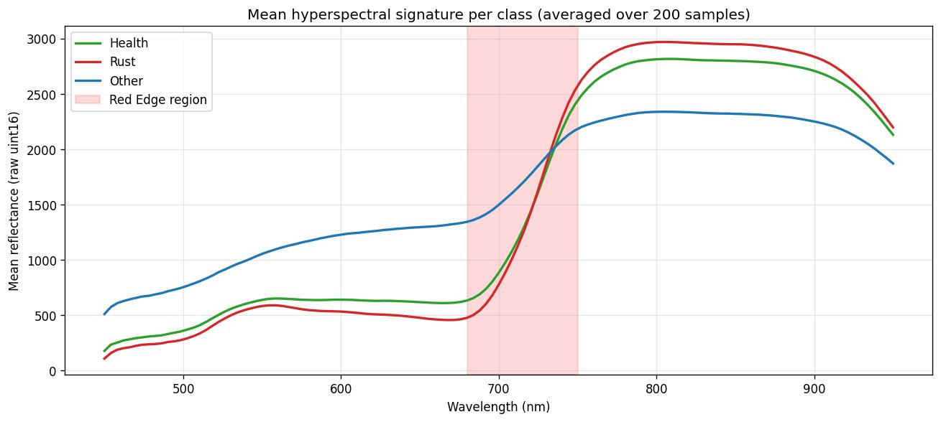
The Key Insight: Where Health and Rust Differ
Reading this figure
Below 680 nm (visible): Health and Rust curves nearly overlap. RGB samples only here. A model with RGB alone is informationally blind to the most discriminative region.
680–750 nm (Red Edge): Curves diverge sharply — chlorophyll degradation from rust infection. MS samples this once (Red Edge band ~740 nm); HS samples it ~17 times.
Other class has a structurally different shape — lower NIR plateau. Already separable with just the NIR band.
Mean reflectance across 125 bands, averaged over 200 training samples per class
This figure is the scientific basis for the entire project. Everything else follows from it.
Wheat Disease Classification | Spring 2026
4
Notes:
This is the most important slide — spend time here. Key points: (1) RGB is informationally blind to the most discriminative spectral region. This is not a modelling failure; it is a physics fact. (2) MS adds one sample in that region (Red Edge band). (3) HS adds ~17 samples across it. The performance gains we see (Slides 6-8) follow directly from this. If asked why we chose ResNet50 rather than something more complex: with only 600 labeled samples, a simple model with strong ImageNet pretraining outperforms large untrained models. Larger models overfit.

Slide 5
Method: Three Models, One Architecture Family
Model A
RGB only
Model B
RGB + MS
Model C
RGB + MS + HS
3 channels, 224×224
ResNet50 (in_chans=3)
ImageNet normalization
Baseline — no spectral encoder
8 channels (3 RGB + 5 MS)
ResNet50 (in_chans=8)
MS: z-score per band
MS upsampled to 224×224
24 channels (8 + 16 encoded)
ResNet50 (in_chans=24)
HS: spectral encoder → 16 ch
~10K extra parameters
The HS Spectral Encoder — the novel component
Input: (B, 125, 32, 32) — 125 HS bands at 32×32 spatial resolution
1×1 Conv1d along spectral axis: 125 → 64 → 16 channels. Each pixel's 125-band spectral sequence is compressed independently.
Bilinear upsample 32×32 → 224×224 to align with RGB and MS.
Output: (B, 16, 224, 224) concatenated with RGB+MS (8 ch) → 24-channel input. Adds only ~10K parameters.
Wheat Disease Classification | Spring 2026
5
Notes:
All three models use identical training: 25 epochs, AdamW lr=1e-4, cosine annealing LR, cross-entropy loss, batch=32, 5-fold stratified CV, fixed seeds. The ONLY difference is the input channel count. Why 1D conv rather than PCA? PCA maximizes variance; our encoder maximizes discriminability for the task. Since the diagnostic signal is concentrated in the red-edge region (not uniformly spread), task-optimized encoding is better. Why not 3D-CNN? 3D-CNNs are powerful but require large training sets. With 600 samples, our lightweight encoder + pretrained ResNet50 is the right tradeoff.

Slide 6
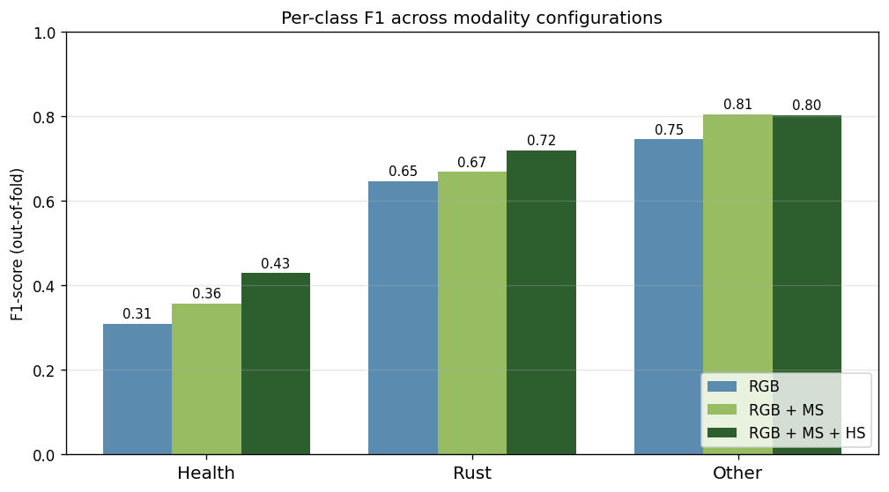
Results: Each Modality Helps, Monotonically
Model A — RGB
Public: 0.505 Private: 0.624
CV accuracy: 0.598
Model B — RGB + MS
Public: 0.632 Private: 0.649
CV accuracy: 0.640
Model C — RGB + MS + HS
Public: 0.684 Private: 0.722
Per-class F1 across three modality configurations (out-of-fold, n=600)
CV accuracy: 0.673
Health F1: 0.309 → 0.357 → 0.429 (+12 pp) — the class Figure 2 predicted to be hardest for RGB
Wheat Disease Classification | Spring 2026
6
Notes:
The critical thing to notice: ALL 8 metrics we tracked improve monotonically. CV accuracy, CV macro-F1, Kaggle public score, Kaggle private score, and per-class F1 for all three classes. The Kaggle private split was never seen by any model during training — yet it confirms the same trend. This is not lucky CV splits; it is a consistent informational signal. The Health class gain (+12 pp F1 total) is concentrated exactly where Figure 2 predicted. Other F1 plateaued between B and C (0.805→0.803): the NIR band in MS already separates vegetation from background; HS adds fine detail useful for Health/Rust but not for Other.

Slide 7
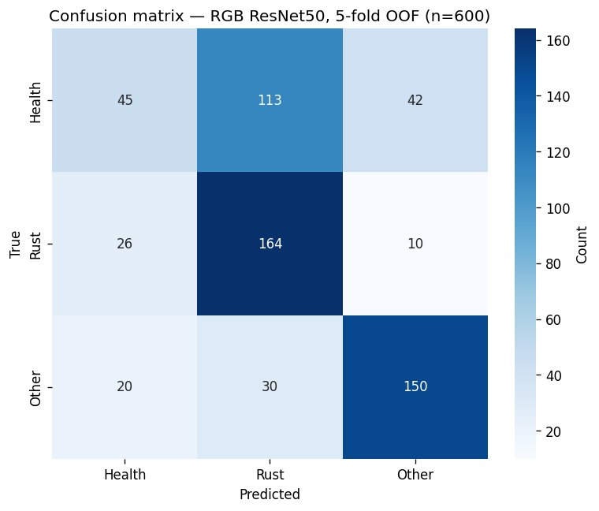
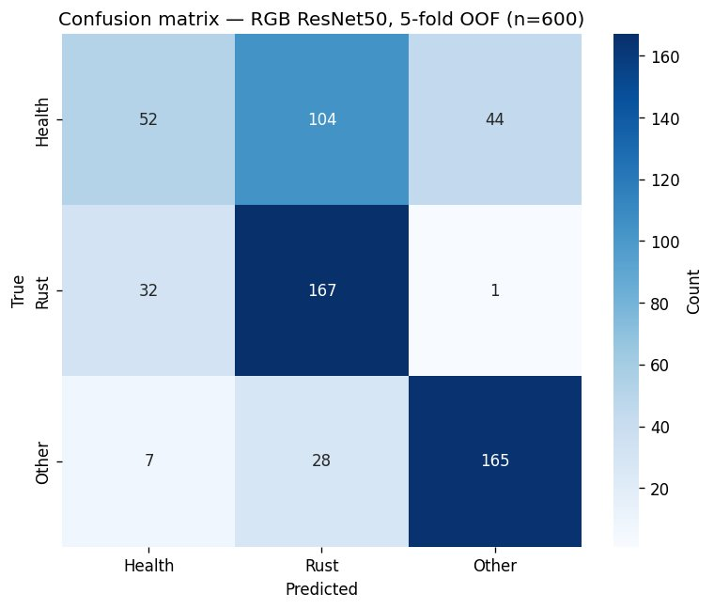
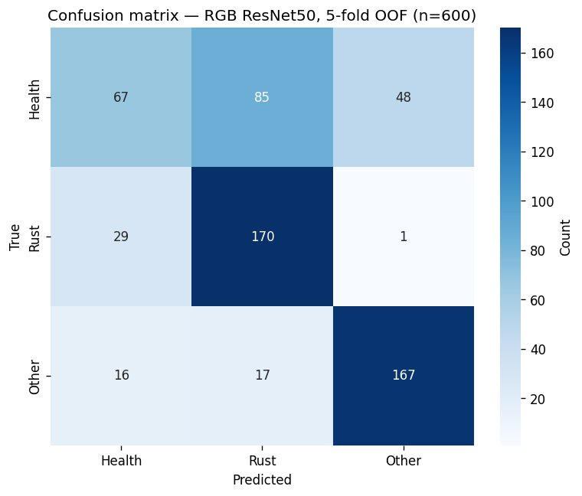
The Failure Mode — and How It Shrinks
Same training data, same backbone, same optimizer. Only the input changes. All 600 training samples predicted out-of-fold.
(a) Model A — RGB only
(b) Model B — RGB + MS
(c) Model C — RGB + MS + HS
Health predicted as Rust: 113 → 104 → 85 (−25 % reduction in the dominant failure mode)
Wheat Disease Classification | Spring 2026
7
Notes:
The dominant error is Health misclassified as Rust: 113 cases in Model A. This is exactly what Figure 2 predicts — RGB cannot distinguish the two in the spectral region it samples. As we add spectral bands that sample the red-edge region, this error drops: 113 → 104 → 85 (25% reduction). Note also: Rust recall was already high in Model A (164/200 = 82%) — the model is biased toward predicting Rust, which catches most true Rust but creates false alarms on Health. This bias also reduces as we add more spectral information, because the model can now distinguish true Rust from healthy wheat more precisely.

Slide 8
Three-Way Ablation — Complete Numbers
Metric | Model A — RGB | Model B — RGB+MS | Model C — RGB+MS+HS | Total Δ
CV mean accuracy | 0.598 | 0.640 | 0.673 | +0.075
CV mean macro-F1 | 0.566 | 0.609 | 0.651 | +0.085
Kaggle public score | 0.505 | 0.632 | 0.684 | +0.179
Kaggle private score | 0.624 | 0.649 | 0.722 | +0.098
Health F1 | 0.309 | 0.357 | 0.429 | +0.120
Rust F1 | 0.647 | 0.669 | 0.720 | +0.073
Other F1 | 0.746 | 0.805 | 0.803 | +0.057
8 out of 8 metrics improve monotonically. Pattern holds on CV and both Kaggle leaderboard splits independently.
Wheat Disease Classification | Spring 2026
8
Notes:
For context: 260 teams entered this competition. Public scores range from ~0.33 (random) to ~0.94 for top teams. Top teams use self-supervised pretraining on unlabeled Sentinel satellite data plus full attention-based fusion. Our 0.722 private score uses labeled data only and a standard backbone — no SSL, no Sentinel — placing us in the competitive upper third of the leaderboard. The gap to 0.94 is largely explained by not using the unlabeled Sentinel data, which is Task 2 of the competition.

Slide 9
Related Work — Where This Fits
[8]
Zhang et al. 2019 (Remote Sensing)
[9]
Su et al. 2021 / Zheng et al. 2021
Most directly relevant. Same sensor (UHD 185, 125-band, 450–950 nm) on wheat stripe rust with a DCNN. Our work adds multimodal fusion and a controlled ablation comparing modalities.
U-Net on multispectral UAV imagery for wheat stripe rust — Rust F1 = 0.84 and 0.88. Confirms MS Red Edge and NIR bands are useful, consistent with our Model B improvement.
[10]
Bhatt et al. 2023 (Smart Ag. Tech.)
[11]
Li et al. 2025 (Sensors)
Review of 3D-CNNs for hyperspectral crop disease. 3D-CNNs model spectral-spatial jointly but at high compute cost. Our encoder is lighter and task-adaptive.
ResNet50 + attention for multispectral crop classification. Consistent with our finding: standard ResNet backbone with learned spectral weighting works well on small labeled datasets.
Our distinguishing contribution: controlled ablation + real leaderboard validation + individual submission on a small (600-sample) training set.
Wheat Disease Classification | Spring 2026
9
Notes:
Zhang et al. [8] is the most important reference — they used the exact same sensor hardware as this competition. Their architecture is more complex (Inception-ResNet with sliding window), but they don't compare modalities or do multimodal fusion. If asked 'why not use 3D-CNN like Bhatt et al.?': 3D-CNNs require large training sets. With 600 samples, they would overfit. Our lightweight encoder + pretrained ResNet50 is the right choice. If asked about the self-supervised pretraining the top teams use: that is Task 2 of the competition, which uses the large unlabeled Sentinel satellite archive. We deliberately focused on Task 1 (labeled data only) for a cleaner ablation.

Slide 10
Discussion
Why Other F1 plateaued
Why training ≈ validation accuracy
Natural next steps
The Other class has a structurally different spectral shape — lower NIR plateau. The MS NIR band already separates vegetation from background at Model B (F1=0.805). HS helps within the Health/Rust pair but adds nothing extra for the vegetation-vs-background boundary. Not a failure — it is what the physics predicts.
In many epochs, training accuracy was similar to or slightly below validation accuracy. Training uses augmented inputs (harder distribution); validation uses clean inputs. The model sees a harder version of the data during training — this is the regularizer working correctly, not overfitting.
Top teams use (1) late fusion with separate per-modality encoders, (2) self-supervised pretraining on unlabeled Sentinel satellite data. Our 0.722 uses neither — labeled data only. Adding SSL is the highest-value extension. Late fusion with cross-modal attention would better handle the modality-resolution mismatch.
Limitations: single backbone (ResNet50, no architectural ablation) · early fusion only · default hyperparameters · no self-supervised pretraining
Wheat Disease Classification | Spring 2026
10
Notes:
Three things to be ready to explain in the oral exam: (1) Why did Other plateau? Physics — NIR already does the job for vegetation/background, HS adds nothing for that boundary. (2) Why training ≈ validation accuracy? Augmentation makes training harder, not overfitting. (3) What is the path to 0.90+? Self-supervised pretraining on the Sentinel archive + late fusion with cross-modal attention. We deliberately did not pursue this to keep the ablation clean and focused.

Slide 11
Conclusion
One hypothesis derived from the data. Three controlled models to test it. Every metric confirmed it.
Adding MS (Red Edge + NIR) raises Kaggle public from 0.505 to 0.632 (+12.6 pp). Adding HS via a lightweight learned spectral encoder raises it further to 0.684 (+5.2 pp). Final Kaggle private score: 0.722. Health F1 — the class Figure 2 identified as hardest for RGB — improves by +12 pp in total.
0.673
0.651
0.684
0.722
CV accuracy
Macro-F1
Kaggle public
Kaggle private
Thank you
Notes:
Summary for oral defense: The project is a controlled ablation, not a model search. We started with a question from the data (which spectral regions separate Health from Rust?), derived a prediction, and confirmed it rigorously. Every result shown is reproducible from the accompanying notebook. If asked what I would do differently: add self-supervised pretraining on Sentinel data and replace early fusion with a late-fusion attention module. Both are natural extensions of this work and are what separate our 0.722 from the top-team 0.94.

