Slide 1

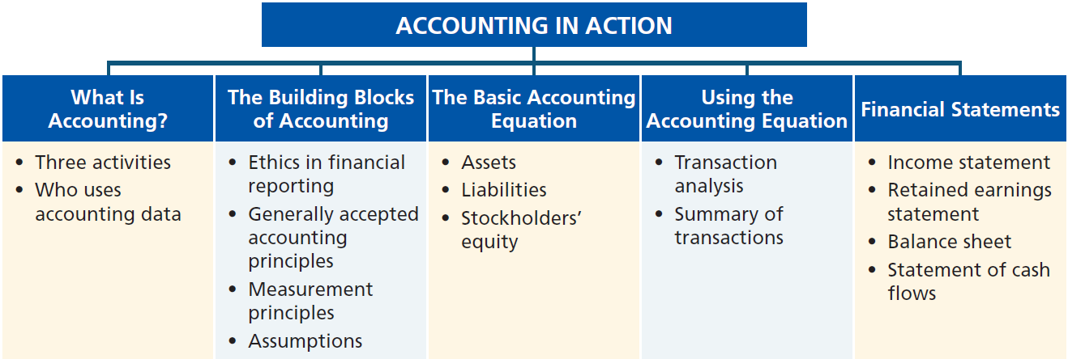
Preview of Chapter 1
Financial Accounting
Ninth Edition
Weygandt Kimmel Kieso

Slide 2
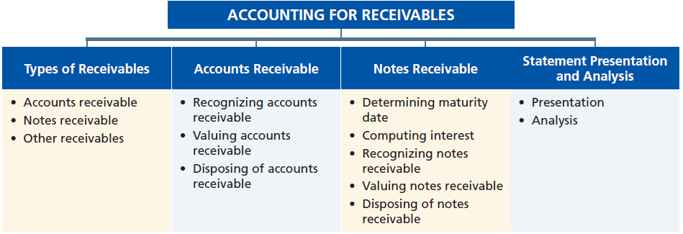
Preview of Chapter 8
Financial Accounting
Ninth Edition
Weygandt Kimmel Kieso

Slide 3

8
Accounting for Receivables
Learning Objectives
After studying this chapter, you should be able to:
[1] Identify the different types of receivables.
[2] Explain how companies recognize accounts receivable.
[3] Distinguish between the methods and bases companies use to value accounts receivable.
[4] Describe the entries to record the disposition of accounts receivable.
[5] Compute the maturity date of and interest on notes receivable.
[6] Explain how companies recognize notes receivable.
[7] Describe how companies value notes receivable.
[8] Describe the entries to record the disposition of notes receivable.
[9] Explain the statement presentation and analysis of receivables.

Slide 4

Types of Receivables
Amounts due from individuals and other companies that are expected to be collected in cash.
Amounts owed by customers on account that result from the sale of goods and services.
Written promise for amounts to be received. Normally requires the collection of interest.
Nontrade receivables such as interest, loans to officers, advances to employees, and income taxes.
Accounts Receivable
Notes Receivable
Other Receivables
LO 1

Slide 5
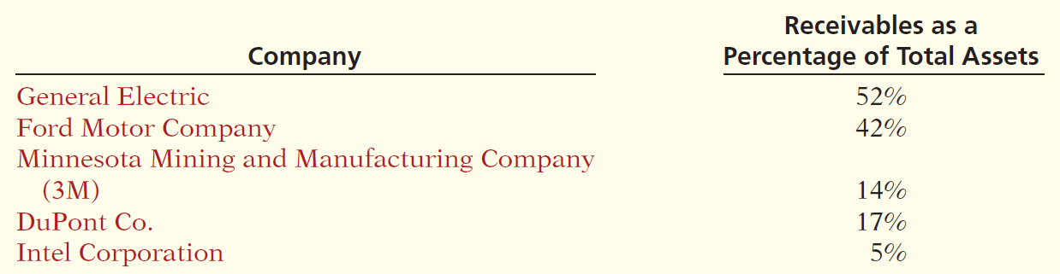
Types of Receivables
Amounts due from individuals and other companies that are expected to be collected in cash.
Illustration 8-1
LO 1

Slide 6
8
Accounting for Receivables
Learning Objectives
After studying this chapter, you should be able to:
[1] Identify the different types of receivables.
[2] Explain how companies recognize accounts receivable.
[3] Distinguish between the methods and bases companies use to value accounts receivable.
[4] Describe the entries to record the disposition of accounts receivable.
[5] Compute the maturity date of and interest on notes receivable.
[6] Explain how companies recognize notes receivable.
[7] Describe how companies value notes receivable.
[8] Describe the entries to record the disposition of notes receivable.
[9] Explain the statement presentation and analysis of receivables.

Slide 7
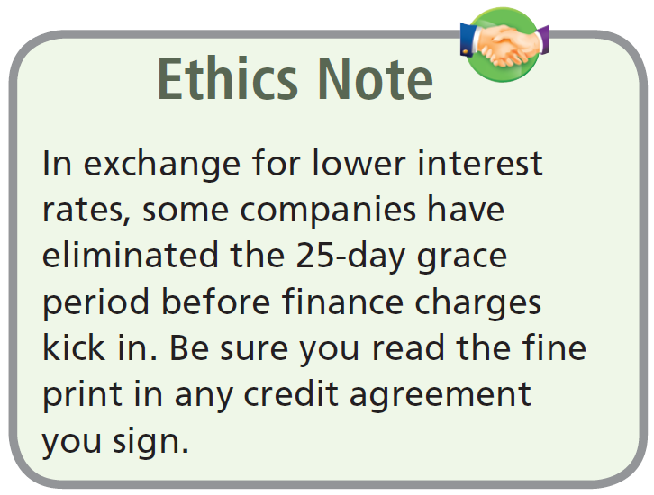
Accounts Receivable
Three accounting issues:
  Recognizing accounts receivable.
  Valuing accounts receivable.
  Disposing of accounts receivable.
Recognizing Accounts Receivable
Service organization records a receivable when it performs service on account.
Merchandiser records accounts receivable at the point of sale of merchandise on account.
LO 2

Slide 8
Accounts Receivable
Illustration: Assume that Jordache Co. on July 1, 2015, sells merchandise on account to Polo Company for $1,000 terms 2/10, n/30. Prepare the journal entry to record this transaction on the books of Jordache Co.
Jul. 1
Accounts Receivable 1,000
Sales Revenue 1,000
LO 2

Slide 9
Accounts Receivable
Illustration: On July 5, Polo returns merchandise worth $100 to Jordache Co.
Jul. 5
Sales Returns and Allowances 100
Accounts Receivable 100
Illustration: On July 11, Jordache receives payment from
Polo Company for the balance due.
Jul. 11
Cash 882
Sales Discounts ($900 x .02) 18
Accounts Receivable 900
LO 2

Slide 10
ANATOMY OF A FRAUD
Tasanee was the accounts receivable clerk for a large non-profit foundation that provided performance and exhibition space for the performing and visual arts. Her responsibilities included activities normally assigned to an accounts receivable clerk, such as recording revenues from various sources that included donations, facility rental fees, ticket revenue, and bar receipts. However, she was also responsible for handling all cash and checks from the time they were received until the time she deposited them, as well as preparing the bank reconciliation. Tasanee took advantage of her situation by falsifying bank deposits and bank reconciliations so that she could steal cash from the bar receipts. Since nobody else logged the donations or matched the donation receipts to pledges prior to Tasanee receiving them, she was able to offset the cash that was stolen against donations that she received but didn’t record. Her crime was made easier by the fact that her boss, the company’s controller, only did a very superficial review of the bank reconciliation and thus didn’t notice that some numbers had been cut out from other documents and taped onto the bank reconciliation.
Total take: $1.5 million
THE MISSING CONTROL
Segregation of duties. The foundation should not have allowed an accounts receivable clerk, whose job was to record receivables, to also handle cash, record cash, make deposits, and especially prepare the bank reconciliation.
Independent internal verification. The controller was supposed to perform a thorough review of the bank reconciliation. Because he did not, he was terminated from his position.
Advance slide in presentation mode to reveal answer.
LO 2

Slide 11
8
Accounting for Receivables
Learning Objectives
After studying this chapter, you should be able to:
[1] Identify the different types of receivables.
[2] Explain how companies recognize accounts receivable.
[3] Distinguish between the methods and bases companies use to value accounts receivable.
[4] Describe the entries to record the disposition of accounts receivable.
[5] Compute the maturity date of and interest on notes receivable.
[6] Explain how companies recognize notes receivable.
[7] Describe how companies value notes receivable.
[8] Describe the entries to record the disposition of notes receivable.
[9] Explain the statement presentation and analysis of receivables.

Slide 12
Accounts Receivable
Valuing Accounts Receivables
Alternative Terminology
You will sometimes see
Bad Debt Expense called
Uncollectible Accounts
Expense.
Current asset.
Valuation (cash realizable value).
Uncollectible Accounts Receivable
Sales on account raise the possibility of accounts not being collected.
Companies record credit losses as debits to Bad Debts Expense.
LO 3

Slide 13
Accounts Receivable
Methods of Accounting for Uncollectible Accounts
Direct Write-Off
Theoretically undesirable:
  No matching.
  Receivable not stated at cash realizable value.
  Not acceptable for financial reporting.
Allowance Method
Losses are estimated:
  Better matching.
  Receivable stated at cash realizable value.
  Required by GAAP.
LO 3

Slide 14
Accounts Receivable
How are these accounts presented on the Balance Sheet?
Allowance for Doubtful Accounts
Accounts Receivable
Beg. 500
25 Beg.
25 End.
End. 500
LO 3

Slide 15
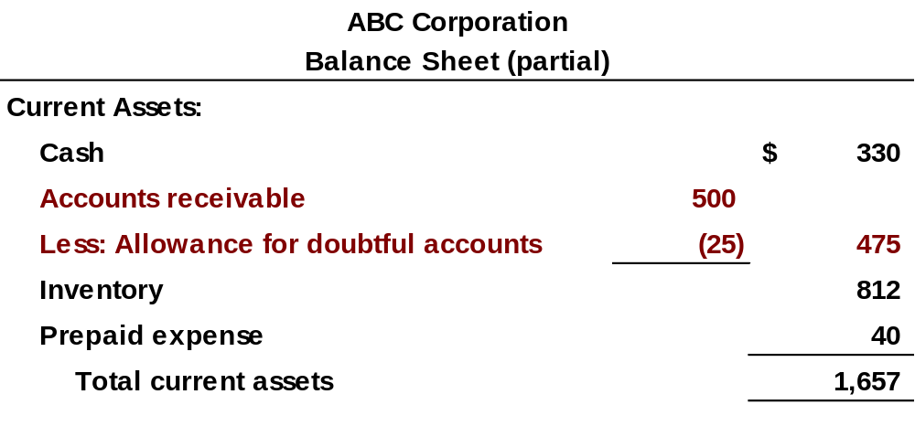
Accounts Receivable
LO 3

Slide 16
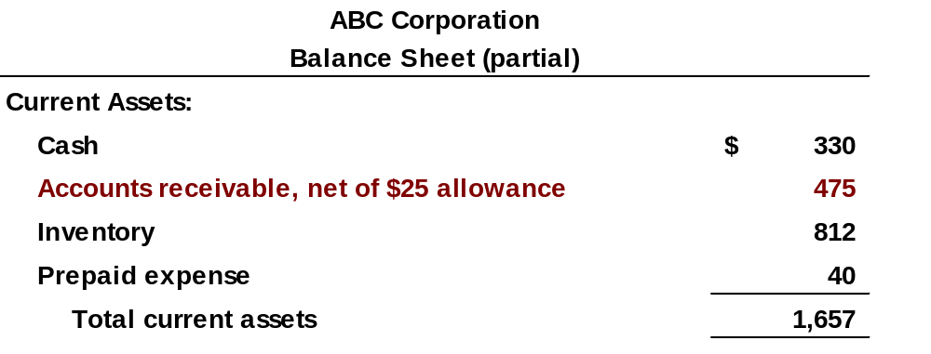
Accounts Receivable
Alternate Presentation
LO 3

Slide 17
Accounts Receivable
Journal entry for credit sale of $100?
Accounts Receivable 100
Sales 100
Allowance for Doubtful Accounts
Accounts Receivable
Beg. 500
25 Beg.
25 End.
End. 500
LO 3

Slide 18
Accounts Receivable
Journal entry for credit sale of $100?
Accounts Receivable 100
Sales 100
Allowance for Doubtful Accounts
Accounts Receivable
Beg. 500
25 Beg.
Sale 100
25 End.
End. 600
LO 3

Slide 19
Accounts Receivable
Collected $333 on account?
Cash 333
Accounts Receivable 333
Allowance for Doubtful Accounts
Accounts Receivable
Beg. 500
25 Beg.
Sale 100
25 End.
End. 600
LO 3

Slide 20
Accounts Receivable
Collected $333 on account?
Cash 333
Accounts Receivable 333
Allowance for Doubtful Accounts
Accounts Receivable
Beg. 500
25 Beg.
Sale 100
333 Coll.
25 End.
End. 267
LO 3

Slide 21
Accounts Receivable
Adjustment of $15 for estimated bad debts?
Bad Debt Expense 15
Allowance for Doubtful Accounts 15
Allowance for Doubtful Accounts
Accounts Receivable
Beg. 500
25 Beg.
Sale 100
333 Coll.
25 End.
End. 267
LO 3

Slide 22
Accounts Receivable
Adjustment of $15 for estimated bad debts?
Bad Debt Expense 15
Allowance for Doubtful Accounts 15
Allowance for Doubtful Accounts
Accounts Receivable
Beg. 500
25 Beg.
Sale 100
333 Coll.
15 Est.
40 End.
End. 267
LO 3

Slide 23
Accounts Receivable
Write-off of uncollectible accounts for $10?
Allowance for Doubtful Accounts 10
Accounts Receivable 10
Allowance for Doubtful Accounts
Accounts Receivable
Beg. 500
25 Beg.
Sale 100
333 Coll.
15 Est.
40 End.
End. 267
LO 3

Slide 24
Accounts Receivable
Write-off of uncollectible accounts for $10?
Allowance for Doubtful Accounts 10
Accounts Receivable 10
Allowance for Doubtful Accounts
Accounts Receivable
Beg. 500
25 Beg.
Sale 100
333 Coll.
15 Est.
10 W/O
W/O 10
30 End.
End. 257
LO 3

Slide 25

Accounts Receivable
LO 3

Slide 26
Accounts Receivable
Direct Write-off Method for Uncollectible Accounts
Illustration: Assume that Warden Co. writes off M. E. Doran’s $200 balance as uncollectible on December 12. Warden’s entry is:
Bad Debts Expense 200
Accounts Receivable 200
Theoretically undesirable:
  No matching.
  Receivable not stated at cash realizable value.
  Not acceptable for financial reporting.
LO 3

Slide 27
Accounts Receivable
Allowance Method for Uncollectible Accounts
Companies estimate uncollectible accounts receivable.
Debit Bad Debts Expense and credit Allowance for Doubtful Accounts (a contra-asset account).
Companies debit Allowance for Doubtful Accounts and credit Accounts Receivable at the time the specific account is written off as uncollectible.
LO 3

Slide 28
Accounts Receivable
Recording Estimated Uncollectibles
Illustration: Hampson Furniture has credit sales of $1,200,000 in 2015, of which $200,000 remains uncollected at December 31. The credit manager estimates that $12,000 of these sales will prove uncollectible.
Dec. 31
Bad Debts Expense 12,000
Allowance for Doubtful Accounts 12,000
LO 3

Slide 29
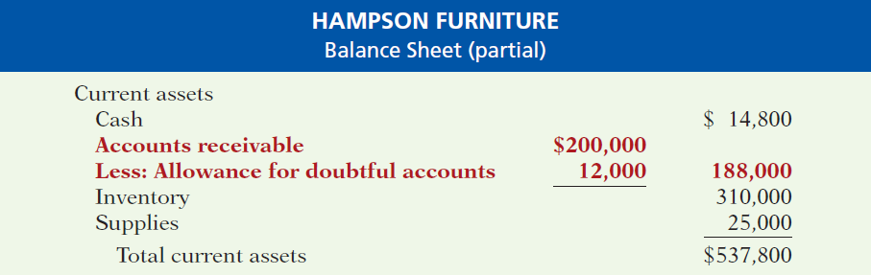
Accounts Receivable
Illustration 8-3
Presentation of allowance
for doubtful accounts
The amount of $188,000 represents the expected cash realizable value of the accounts receivable at the statement date.
LO 3

Slide 30
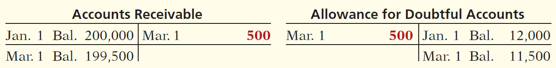
Accounts Receivable
Recording Write-Off of an Uncollectible Account
Illustration: The vice-president of finance of Hampson Furniture on March 1, 2016, authorizes a write-off of the $500 balance owed by R. A. Ware. The entry to record the write-off is:
Mar. 1
Allowance for Doubtful Accounts 500
Accounts Receivable 500
Illustration 8-4 General ledger balances after write-off
LO 3

Slide 31
Accounts Receivable
Recovery of an Uncollectible Account
Illustration: On July 1, R. A. Ware pays the $500 amount that Hampson had written off on March 1. Hampson makes these entries:
July 1
Accounts Receivable 500
Allowance For Doubtful Accounts 500
1
Cash 500
Accounts Receivable 500
LO 3

Slide 32
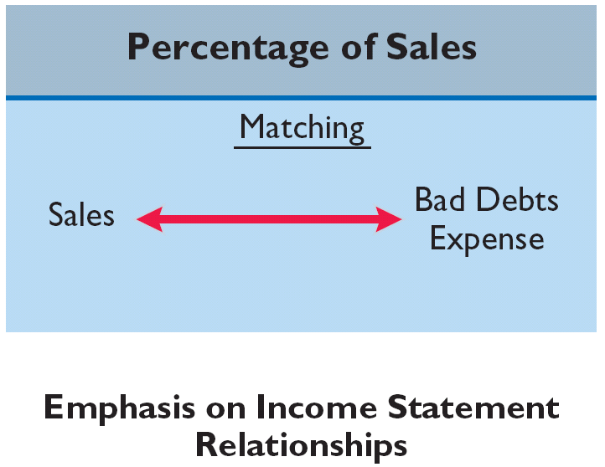
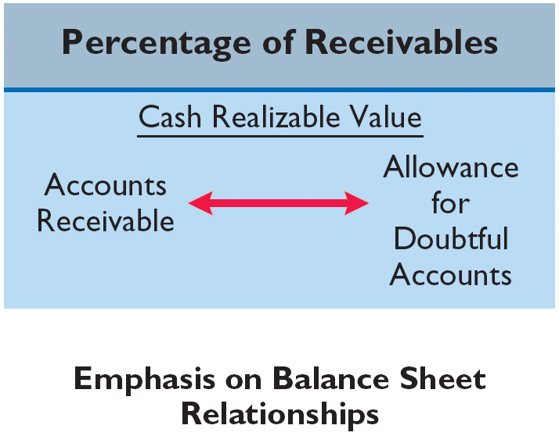
Accounts Receivable
Estimating the Allowance
Illustration 8-6
Comparison of bases for
estimating uncollectibles
LO 3

Slide 33
Accounts Receivable
Estimating the Allowance
Illustration 8-6
Comparison of bases for
estimating uncollectibles
Management estimates what percentage of credit sales will be uncollectible. This percentage is based on past experience and anticipated credit policy.
LO 3

Slide 34
Accounts Receivable
Percentage-of-Sales
Illustration: Assume that Gonzalez Company elects to use
the percentage-of-sales basis. It concludes that 1% of net credit sales will become uncollectible. If net credit sales for 2015 are $800,000, the adjusting entry is:
Dec. 31
Bad Debts Expense 8,000
*
Allowance For Doubtful Accounts 8,000
* $800,000 x 1%
LO 3

Slide 35
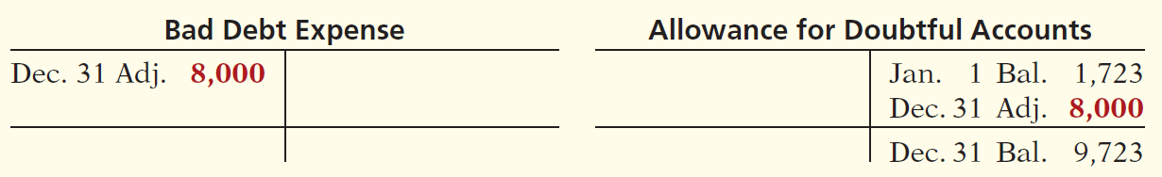
Accounts Receivable
Percentage-of-Sales
  Emphasizes matching of expenses with revenues.
  Adjusting entry to record bad debts disregards the existing balance in Allowance for Doubtful Accounts.
Illustration 8-7 Bad debt accounts after posting
LO 3

Slide 36
Accounts Receivable
Estimating the Allowance
Illustration 8-6
Comparison of bases for
estimating uncollectibles
Management establishes a percentage relationship between the amount of receivables and expected losses from uncollectible accounts.
LO 3

Slide 37
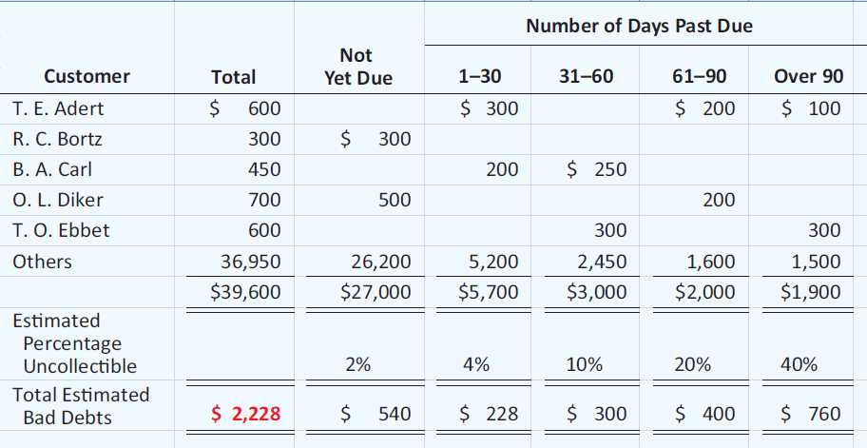
Accounts Receivable
Helpful Hint Where appropriate, companies may use only a single percentage rate.
Aging the accounts receivable - customer balances are classified by the length of time they have been unpaid.
Illustration 8-8
LO 3

Slide 38
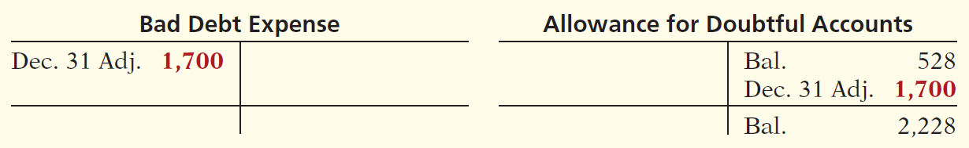
Accounts Receivable
Estimating the Allowance
Illustration: Assume the unadjusted trial balance shows Allowance for Doubtful Accounts with a credit balance of $528. Prepare the adjusting entry assuming $2,228 is the estimate of uncollectible receivables from the aging schedule.
Dec. 31
Bad Debts Expense 1,700
Allowance For Doubtful Accounts 1,700
Illustration 8-9 Bad debts accounts after posting
LO 3

Slide 39
8
Accounting for Receivables
Learning Objectives
After studying this chapter, you should be able to:
[1] Identify the different types of receivables.
[2] Explain how companies recognize accounts receivable.
[3] Distinguish between the methods and bases companies use to value accounts receivable.
[4] Describe the entries to record the disposition of accounts receivable.
[5] Compute the maturity date of and interest on notes receivable.
[6] Explain how companies recognize notes receivable.
[7] Describe how companies value notes receivable.
[8] Describe the entries to record the disposition of notes receivable.
[9] Explain the statement presentation and analysis of receivables.

Slide 40
Accounts Receivable
Disposing of Accounts Receivables
Companies sell receivables for two major reasons.
  Receivables may be the only reasonable source of cash.
  Billing and collection are often time-consuming and costly.
LO 4

Slide 41
Accounts Receivable
Sale of Receivables
Factor
  Finance company or bank.
  Buys receivables from businesses and then collects the payments directly from the customers.
  Typically charges a commission to the company that is selling the receivables.
  Fee ranges from 1-3% of the receivables purchased.
LO 4

Slide 42
Accounts Receivable
Illustration: Assume that Hendredon Furniture factors
$600,000 of receivables to Federal Factors. Federal Factors assesses a service charge of 2% of the amount of receivables sold. The journal entry to record the sale by Hendredon Furniture is as follows.
($600,000 x 2% = $12,000)
Cash 588,000
Service Charge Expense 12,000
Accounts Receivable 600,000
LO 4

Slide 43
Accounts Receivable
Credit Card Sales
  Recorded the same as cash sales.
  Retailer pays card issuer a fee of 2 to 6% for processing the transactions.
LO 4

Slide 44
Accounts Receivable
Illustration: Anita Ferreri purchases $1,000 of compact discs for her restaurant from Karen Kerr Music Co., using her Visa First Bank Card. First Bank charges a service fee of 3%. The entry to record this transaction by Karen Kerr Music is as follows.
Cash 970
Service Charge Expense 30
Sales Revenue 1,000
LO 4

Slide 45
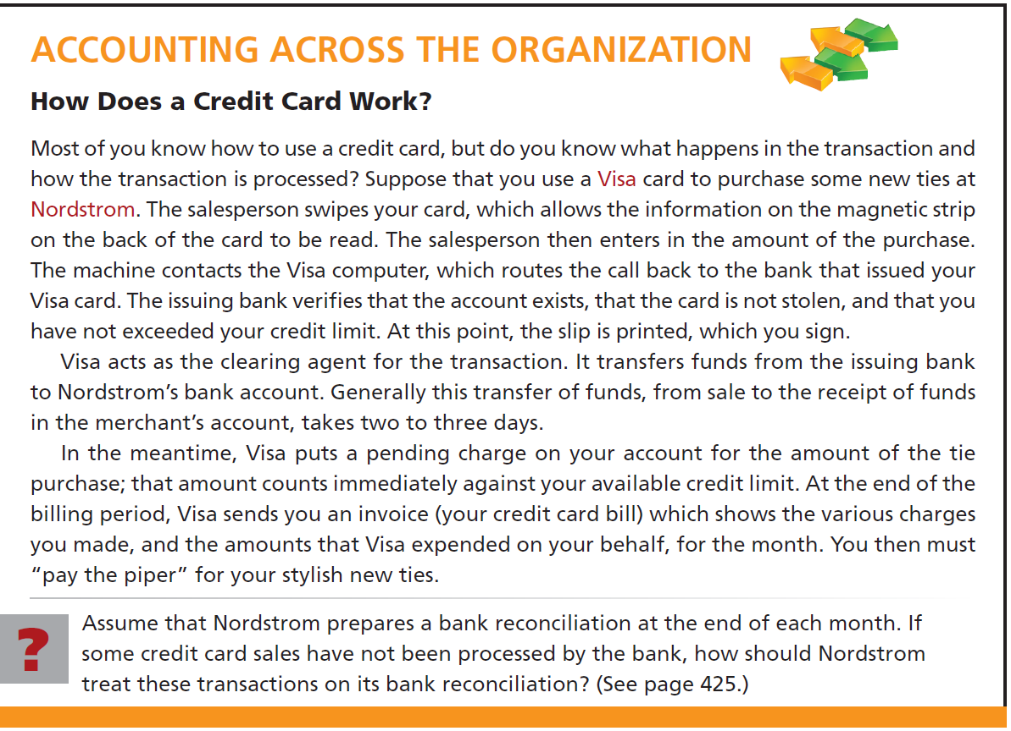
LO 4

Slide 46
8
Accounting for Receivables
Learning Objectives
After studying this chapter, you should be able to:
[1] Identify the different types of receivables.
[2] Explain how companies recognize accounts receivable.
[3] Distinguish between the methods and bases companies use to value accounts receivable.
[4] Describe the entries to record the disposition of accounts receivable.
[5] Compute the maturity date of and interest on notes receivable.
[6] Explain how companies recognize notes receivable.
[7] Describe how companies value notes receivable.
[8] Describe the entries to record the disposition of notes receivable.
[9] Explain the statement presentation and analysis of receivables.

Slide 47
Notes Receivable
Companies may grant credit in exchange for a promissory note. A promissory note is a written promise to pay a specified amount of money on demand or at a definite time.
Promissory notes may be used
  when individuals and companies lend or borrow money,
  when amount of transaction and credit period exceed normal limits, or
  in settlement of accounts receivable.
LO 5

Slide 48
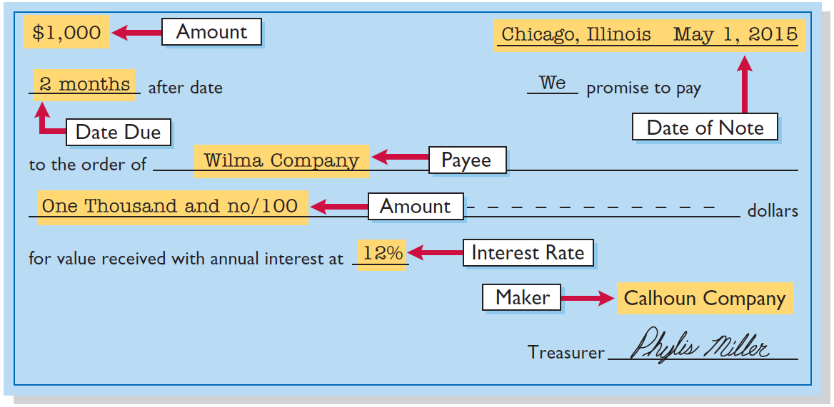
Notes Receivable
To the Payee, the promissory note is a note receivable.
To the Maker, the promissory note is a note payable.
Illustration 8-11
LO 5

Slide 49

Notes Receivable
Determining the Maturity Date
Note expressed in terms of
  Months
  Days
Computing Interest
Illustration 8-14 Formula for computing interest
LO 5

Slide 50
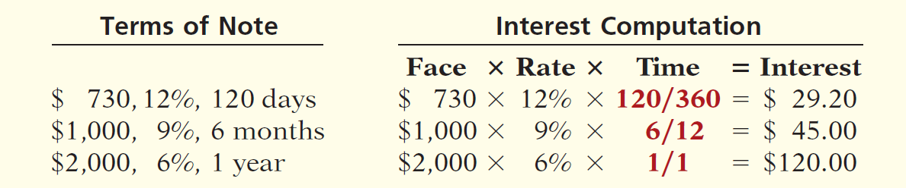
Notes Receivable
Computing Interest
When counting days, omit the date the note is issued, but include the due date.
Illustration 8-15
Helpful Hint
The interest rate specified is the annual rate.
LO 5

Slide 51
8
Accounting for Receivables
Learning Objectives
After studying this chapter, you should be able to:
[1] Identify the different types of receivables.
[2] Explain how companies recognize accounts receivable.
[3] Distinguish between the methods and bases companies use to value accounts receivable.
[4] Describe the entries to record the disposition of accounts receivable.
[5] Compute the maturity date of and interest on notes receivable.
[6] Explain how companies recognize notes receivable.
[7] Describe how companies value notes receivable.
[8] Describe the entries to record the disposition of notes receivable.
[9] Explain the statement presentation and analysis of receivables.

Slide 52
Notes Receivable
Recognizing Notes Receivable
Illustration: Calhoun Company wrote a $1,000, two-month, 12% promissory note dated May 1, to settle an open account. Prepare entry would Wilma Company makes for the receipt of the note.
May 1
Notes Receivable 1,000
Accounts Receivable 1,000
LO 6

Slide 53
8
Accounting for Receivables
Learning Objectives
After studying this chapter, you should be able to:
[1] Identify the different types of receivables.
[2] Explain how companies recognize accounts receivable.
[3] Distinguish between the methods and bases companies use to value accounts receivable.
[4] Describe the entries to record the disposition of accounts receivable.
[5] Compute the maturity date of and interest on notes receivable.
[6] Explain how companies recognize notes receivable.
[7] Describe how companies value notes receivable.
[8] Describe the entries to record the disposition of notes receivable.
[9] Explain the statement presentation and analysis of receivables.

Slide 54
Notes Receivable
Valuing Notes Receivable
Report short-term notes receivable at their cash (net) realizable value.
Estimation of cash realizable value and bad debts expense are done similarly to accounts receivable.
Allowance for Doubtful Accounts is used.
LO 7

Slide 55
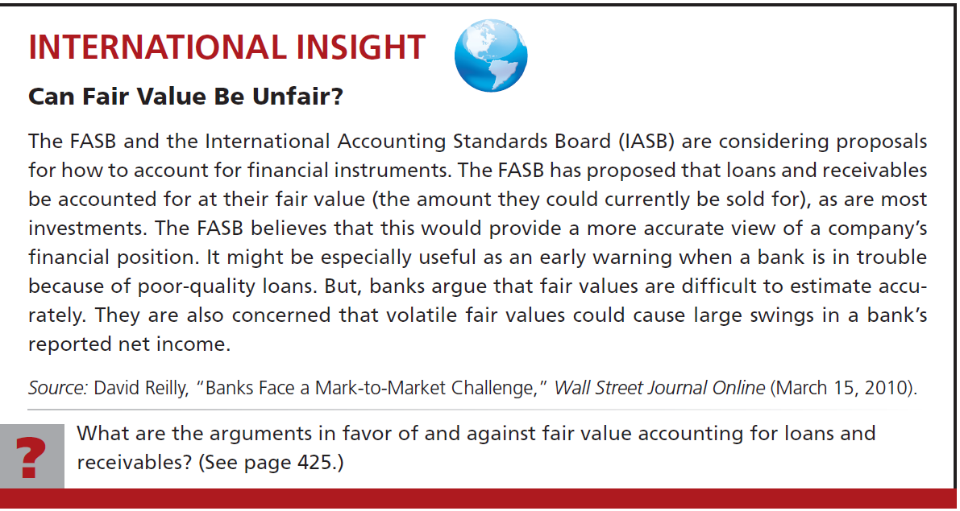
LO 7

Slide 56
8
Accounting for Receivables
Learning Objectives
After studying this chapter, you should be able to:
[1] Identify the different types of receivables.
[2] Explain how companies recognize accounts receivable.
[3] Distinguish between the methods and bases companies use to value accounts receivable.
[4] Describe the entries to record the disposition of accounts receivable.
[5] Compute the maturity date of and interest on notes receivable.
[6] Explain how companies recognize notes receivable.
[7] Describe how companies value notes receivable.
[8] Describe the entries to record the disposition of notes receivable.
[9] Explain the statement presentation and analysis of receivables.

Slide 57
Notes Receivable
Disposing of Notes Receivable
Notes may be held to their maturity date.
Maker may default and payee must make an adjustment to the account.
Holder speeds up conversion to cash by selling the note receivable.
LO 8

Slide 58
Notes Receivable
Disposing of Notes Receivable
Honor of Notes Receivable
Maker pays it in full at its maturity date.
Dishonor of Notes Receivable
Not paid in full at maturity.
No longer negotiable.
LO 8

Slide 59
Notes Receivable
Honor of Notes Receivable
Illustration: Wolder Co. lends Higley Co. $10,000 on June 1, accepting a five-month, 9% interest note. If Wolder presents the note to Higley Co. on November 1, the maturity date, Wolder’s entry to record the collection is:
Nov. 1
Cash 10,375
Notes Receivable 10,000
Interest Revenue 375
($10,000 x 9% x 5/12 = $ 375)
LO 8

Slide 60

Notes Receivable
Accrual of Interest Receivable
Illustration: Suppose instead that Wolder Co. prepares financial statements as of September 30. The adjusting entry by Wolder is for four months ending Sept. 30.
Illustration 8-16
Timeline of interest earned
Sept. 30
Interest Receivable 300
Interest Revenue 300
($10,000 x 9% x 4/12 = $ 300)
LO 8

Slide 61
Notes Receivable
Accrual of Interest Receivable
Illustration: Prepare the entry Wolder’s would make to record the honoring of the Higley note on November 1.
Nov. 1
Cash 10,375
Notes Receivable 10,000
Interest Receivable 300
Interest Revenue 75
LO 8

Slide 62
Notes Receivable
Dishonor of Notes Receivable
Illustration: Assume that Higley Co. on November 1 indicates that it cannot pay at the present time. If Wolder Co. does expect eventual collection, it would make the following entry at the time the note is dishonored (assuming no previous accrual of interest).
Nov. 1
Accounts Receivable 10,375
Notes Receivable 10,000
Interest Revenue 375
LO 8

Slide 63
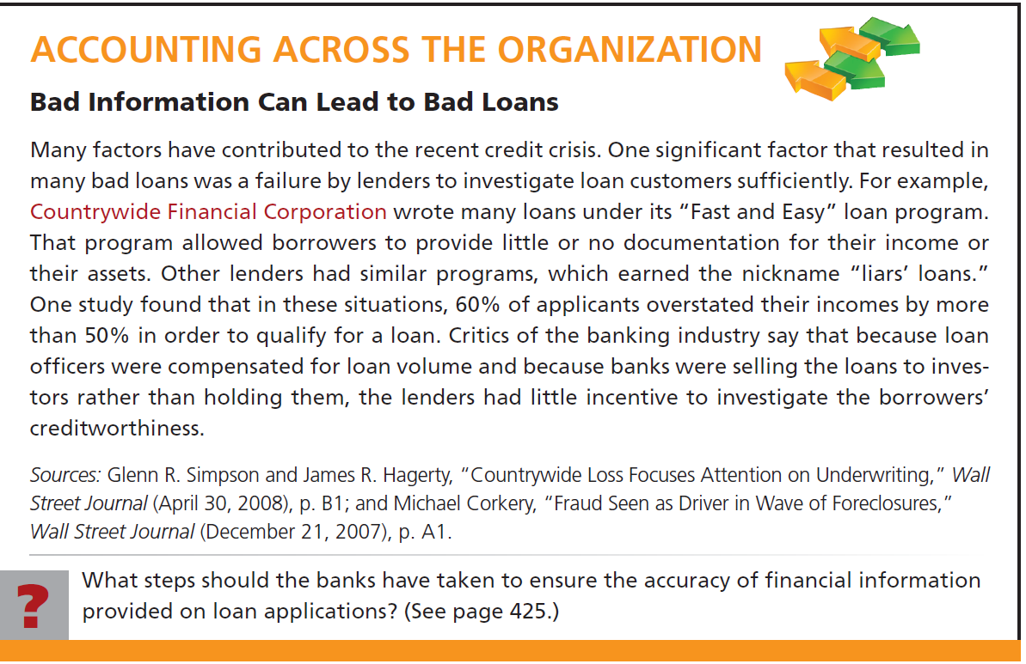
LO 8

Slide 64
8
Accounting for Receivables
Learning Objectives
After studying this chapter, you should be able to:
[1] Identify the different types of receivables.
[2] Explain how companies recognize accounts receivable.
[3] Distinguish between the methods and bases companies use to value accounts receivable.
[4] Describe the entries to record the disposition of accounts receivable.
[5] Compute the maturity date of and interest on notes receivable.
[6] Explain how companies recognize notes receivable.
[7] Describe how companies value notes receivable.
[8] Describe the entries to record the disposition of notes receivable.
[9] Explain the statement presentation and analysis of receivables.

Slide 65
Statement Presentation and Analysis
Presentation
Identify in the balance sheet or in the notes each major type of receivable.
Report short-term receivables as current assets.
Report both gross amount of receivables and allowance for doubtful account.
Report bad debts expense and service charge expense as selling expenses.
Report interest revenue under “Other revenues and gains.”
B/S
I/S
LO 9

Slide 66

Statement Presentation and Analysis
Analysis
Illustration: In 2011 Cisco Systems had net sales of $34,526 million for the year. It had a beginning accounts receivable (net) balance of $4,929 million and an ending accounts receivable (net) balance of $4,698 million. Assuming that Cisco’s sales were all on credit, its accounts receivable turnover is computed as follows.
Illustration 8-17
LO 9

Slide 67

Statement Presentation and Analysis
Analysis
Illustration: Variant of the accounts receivable turnover ratio is average collection period in terms of days.
Illustration 8-17
Illustration 8-18
LO 9

Slide 68

Key Points
  IFRS requires that loans and receivables be accounted for at amortized cost, adjusted for allowances for doubtful accounts. IFRS sometimes refers to these allowances as provisions.
  Although IFRS implies that receivables with different characteristics should be reported separately, there is no standard that mandates this segregation.
  The FASB and IASB have worked to implement fair value measurement for financial instruments. The Boards have adopted a piecemeal approach. The first step is disclosure of fair value information in the notes. The second step is the fair value option, which permits, companies to record some financial instruments at fair values in the financial statements.
LO 10 Compare the accounting procedures for receivables under GAAP and IFRS.

Slide 69
Key Points
  IFRS requires a two-tiered approach to test whether the value of loans and receivables are impaired. First, a company should look at specific loans and receivables to determine whether they are impaired. Then, the loans and receivables as a group should be evaluated for impairment. GAAP does not prescribe a similar two-tiered approach.
  IFRS and GAAP differ in the criteria used to determine how to record a factoring transaction. IFRS uses a combination approach focused on risks and rewards and loss of control. GAAP uses loss of control as the primary criterion. In addition, IFRS permits partial derecognition of receivables; GAAP does not.
LO 10

Slide 70
Looking to the Future
Both the IASB and the FASB have indicated that they believe that financial statements would be more transparent and understandable if companies recorded and reported all financial instruments at fair value. That said, in IFRS 9, which was issued in 2009, the IASB created a split model, where some financial instruments are recorded at fair value, but other financial assets, such as loans and receivables, can be accounted for at amortized cost if certain criteria are met. It has been suggested that IFRS 9 will likely be changed or replaced as the FASB and IASB continue to deliberate the best treatment for financial instruments.
LO 10

Slide 71
IFRS Self-Test Questions
Under IFRS, loans and receivables are to be reported on the balance sheet at:
a. amortized cost.
b. amortized cost adjusted for estimated loss provisions.
c. historical cost.
d. replacement cost.
LO 10

Slide 72
IFRS Self-Test Questions
Which of the following statements is false?
a. Loans and receivables include equity securities purchased by the company.
b. Loans and receivables include credit card receivables.
c. Loans and receivables include amounts owed by employees as a result of company loans to employees
d. Loans and receivables include amounts resulting from transactions with customers
LO 10

Slide 73
IFRS Self-Test Questions
In recording a factoring transaction:
  a. IFRS focuses on loss of control.
b. GAAP focuses on loss of control and risks and rewards.
c. IFRS and GAAP allow partial derecognition.
d. IFRS allows partial derecognition.
LO 10

Slide 74
Copyright
“Copyright © 2014 John Wiley & Sons, Inc. All rights reserved. Reproduction or translation of this work beyond that permitted in Section 117 of the 1976 United States Copyright Act without the express written permission of the copyright owner is unlawful. Request for further information should be addressed to the Permissions Department, John Wiley & Sons, Inc. The purchaser may make back-up copies for his/her own use only and not for distribution or resale. The Publisher assumes no responsibility for errors, omissions, or damages, caused by the use of these programs or from the use of the information contained herein.”

