Slide 1
Pricing Products and Services
Appendix A
Notes:
Appendix A: Pricing Products and Services
This appendix focuses on pricing products and services. It explains the economist’s approach to pricing, the absorption costing approach to cost-plus pricing, and the meaning of target costing.

Slide 2
Learning Objective 1
Compute the profit-maximizing price of a product or service using the price elasticity of demand and variable cost.
Notes:
Learning objective number 1 is to compute the profit-maximizing price of a product or service using the price elasticity of demand and variable cost.

Slide 3
The Economists’ Approach to Pricing
Elasticity of Demand
The price elasticity of demand measures the degree to which the unit sales of a product or service are affected by a change in unit price.
Change
in
Price
Change
in Unit
Sales
versus
Notes:
Economists’ look at pricing by examining the price elasticity of demand for the good or service. The price elasticity of demand measures the degree of change in sales impacted by a change in price.

Slide 4

Price Elasticity of Demand
Demand for a product is inelastic if a change in price has little effect on the number of units sold.
Example
The demand for designer perfumes sold at cosmetic counters in department stores is relatively inelastic.
Notes:
Demand for a product is said to be inelastic if a change in price has little effect on the number of units sold. For example: The demand for designer perfumes sold at cosmetic counters in department stores is relatively inelastic.

Slide 5

Price Elasticity of Demand
Demand for a product is elastic if a change in price has a substantial effect on the number of units sold.
Example
The demand for gasoline is relatively elastic because if a gas station raises its price, unit sales will drop as customers seek lower prices elsewhere.
Notes:
Demand for a product is considered elastic if a change in price has a substantial effect on the number of units sold. We all know that in this period of relatively high gasoline prices, we are more likely to shop for a station that lowers its prices.

Slide 6


Price Elasticity of Demand
As a manager, you should set higher (lower) markups over cost when demand is inelastic (elastic)
Notes:
As a manager, it is important to know that you should set higher markups over cost when demand for your product is inelastic. On the other hand, when demand is elastic, you should set markups over cost at a lower level.

Slide 7

Price Elasticity of Demand
ln(1 + % change in quantity sold)
ln(1 + % change in price)
Є_{d} =
Price elasticity of demand
Natural log function
I can estimate the price elasticity of demand for a product or service using the above formula.
Notes:
This is the equation to calculate the price elasticity of demand.
To determine the price elasticity of demand, we divide the natural log of one plus the percentage change in quantity sold by the natural log of one plus the percentage change in price.

Slide 8


Price Elasticity of Demand
Suppose the managers of Nature’s Garden believe that every 10 percent increase in the selling price of its apple-almond shampoo will result in a 15 percent decrease in the number of bottles of shampoo sold. Let’s calculate the price elasticity of demand.
For its strawberry glycerin soap, managers of Nature’s Garden believe that the company will experience a 20 percent decrease in unit sales if its price is increased by 10 percent.
Apple Almond
Notes:
Here is information provided to us by Nature’s Garden. The first piece of information concerns the company’s apple-almond shampoo, and the second is related to its strawberry glycerin soap. We have been given management’s best estimate of the change in price and resulting change in unit sales.
Managers believe that a 10 percent increase in the selling price of their apple-almond shampoo will result in a 15 percent decrease in the number of bottles sold. For its strawberry glycerin soap, managers believe that the company will experience a 20 percent decrease in unit sales if its price is increased by 10 percent.
Let’s calculate the price elasticity of demand for these two products. We will start with the apple-almond shampoo.

Slide 9
Price Elasticity of Demand
For Nature’s Garden apple-almond shampoo.
ln(1 + % change in quantity sold)
ln(1 + % change in price)
Є_{d} =
ln(1 + (-0.15))
ln(1 + (0.10))
Є_{d} =
Apple Almond
ln(0.85)
ln(1.10)
Є_{d} =
= -1.71
Notes:
We have reproduced the basic equation for calculating the price elasticity of demand.
The numerator of the equation is the natural log of one plus a negative 15 percent, and the denominator is equal to the natural log of one plus a positive 10 percent.
The price elasticity of demand is equal to a negative 1.71. Now, let’s move on to the strawberry glycerin soap.

Slide 10

Price Elasticity of Demand
For Nature’s Garden strawberry glycerin soap.
ln(1 + % change in quantity sold)
ln(1 + % change in price)
Є_{d} =
ln(1 + (-0.20))
ln(1 + (0.10))
Є_{d} =
ln(0.80)
ln(1.10)
Є_{d} =
= -2.34
Notes:
Once again, we have reproduced the basic equation for calculating the price elasticity of demand.
The numerator of the equation is the natural log of one plus a negative 20 percent, and the denominator is equal to the natural log of one plus a positive 10 percent.
The price elasticity of demand is equal to a negative 2.34. Now, we need to see what these two values tell us.

Slide 11

Price Elasticity of Demand
The price elasticity of demand for the strawberry glycerin soap is larger, in absolute value, than the apple-almond shampoo. This indicates that the demand for strawberry glycerin soap is more elastic than the demand for apple-almond shampoo.
Apple Almond
Notes:
The price elasticity of demand for the strawberry glycerin soap is larger, in absolute value, than the apple-almond shampoo. This indicates that the demand for strawberry glycerin soap is more elastic than the demand for apple-almond shampoo.

Slide 12
The Profit-Maximizing Price
Under certain conditions, the profit-maximizing price can be determined using the following formula:
Profit-maximizing
markup on
variable cost
-1
=
1 +
Є_{d}
Using the above markup, the selling price would be set using the formula:
-1
Variable
cost per
unit
Profit-maximizing
price
=
1 +
×
1 +
Є_{d}
Notes:
Profit maximizing markup on variable cost is equal to price elasticity of demand divided by one plus the price elasticity of demand and subtract one from the previous total.
We can determine the profit maximizing price by multiplying the sum of 1 plus the profit maximizing markup on variable cost times the variable cost per unit.

Slide 13
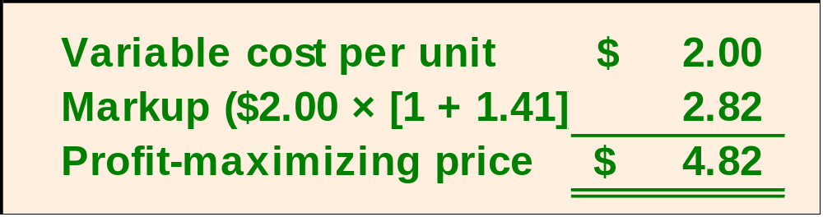
The Profit-Maximizing Price
Let’s determine the profit-maximizing price for the apple-almond shampoo sold by Nature’s Garden. The shampoo has a variable cost per unit of $2.00.
Price elasticity of demand = -1.71
Profit-maximizing
markup
on variable cost
-1.00
=
= 1.41 or 141%
1 + (-1.71)
Apple Almond
Notes:
Let’s return to Nature’s Garden. The variable cost per unit of the apple-almond shampoo is $2. Recall that we calculated the price elasticity of demand at negative 1.71.
Using our equation for profit maximizing on variable cost, we calculate the markup at 141 percent.
The markup on variable cost is $2.82. Our selling price should be $4.82.

Slide 14
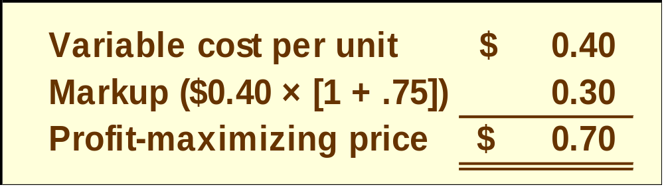
The Profit-Maximizing Price
Now let’s turn to the profit-maximizing price for the strawberry glycerin soap sold by Nature’s Garden. The soap has a variable cost per unit of $0.40.
Price elasticity of demand = -2.34
Profit-maximizing
markup
on variable cost
-1.00
=
= 0.75 or 75%
1 + (-2.34)
Notes:
Now we will look at the profit-maximizing price for the company’s strawberry glycerin soap. The variable cost per unit is $0.40. Recall that we calculated the price elasticity of demand at negative 2.34.
Using our equation for profit-maximizing markup on variable cost, we calculate the markup at 75 percent.
Our selling price should be $0.70. The markup on variable cost is $0.30.

Slide 15
The Profit-Maximizing Price
The 75 percent markup for the strawberry glycerin soap is lower than the 141 percent markup for the apple-almond shampoo. This is because the demand for strawberry glycerin soap is more elastic than the demand for apple-almond shampoo.
Apple Almond
Notes:
Remember, when demand is elastic, we should set markups over cost at a lower level. The elasticity of demand for the soap is lower than that for the shampoo, so we should set a lower markup over cost.

Slide 16
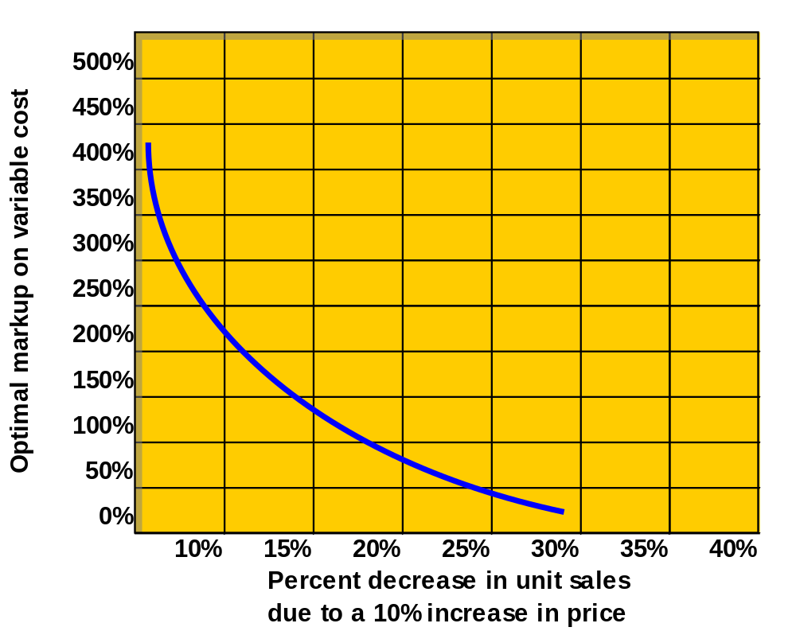
The Profit-Maximizing Price
This graph depicts how the profit-maximizing markup is generally affected by how sensitive unit sales are to price.
Notes:
The graph that is shown depicts how the profit-maximizing markup is generally affected by how sensitive unit sales are to price. For example, if a 10 percent increase in price leads to a 20 percent decrease in unit sales, then the optimal markup on variable cost according to the exhibit is 75 percent – the figure computed for the strawberry glycerin soap. Notice that the optimal selling prices computed using this approach are based on two factors – the variable cost per unit and how sensitive unit sales are to changes in price. While fixed costs are relevant when deciding whether to offer a product, they are not relevant when deciding how much to charge for the product.

Slide 17

The Profit-Maximizing Price
Nature’s Garden is currently selling 200,000 bars of strawberry glycerin soap per year at the price of $0.60 a bar. If the change in price has no effect on the company’s fixed costs or on other products, let’s determine the effect on contribution margin of increasing the price by 10 percent.
Notes:
Currently, Nature’s Garden sells 200,000 bars of strawberry glycerin soap per year. The selling price per bar of soap is $0.60. If a change in price has no effect on the company’s fixed costs or other products, let’s see what will happen if we increase the selling price by 10 percent.

Slide 18
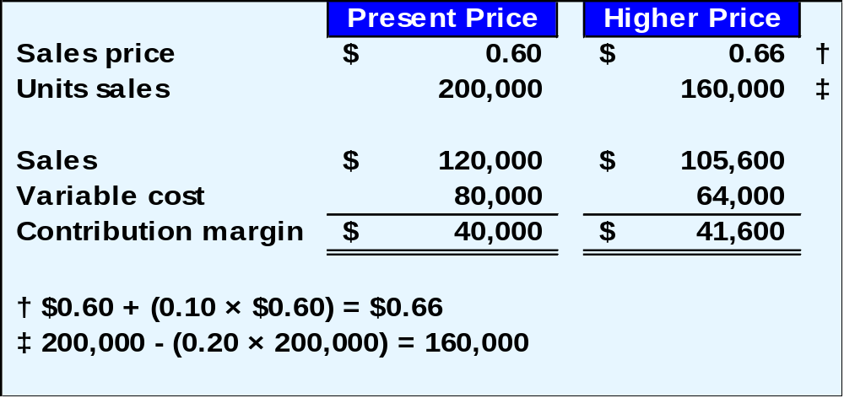
The Profit-Maximizing Price
Contribution margin will increase by $1,600.
Notes:
The contribution margin earned at the current selling price of $0.60 is $40,000. The contribution margin earned at a selling price of $0.66 is $41,600.
Although the number of units sold decreases by 20 percent (from 200,000 to 160,000), the 10 percent increase in selling price (from $0.60 to $0.66) results in a $1,600 increase in contribution margin.

Slide 19
Learning Objective 2
Compute the selling price of a product using the absorption costing approach.
Notes:
Learning objective number 2 is to compute the selling price of a product using the absorption costing approach.

Slide 20

The Cost Base
Under the absorption approach to cost-plus pricing, the cost base is the absorption costing unit product cost rather than the variable cost.
The cost base includes direct materials, direct labor, and variable and fixed manufacturing overhead.
Notes:
The absorption costing approach to product pricing is based on full absorption costing rather than variable costing. The cost base includes direct materials, direct labor, and both variable and fixed manufacturing overhead.

Slide 21
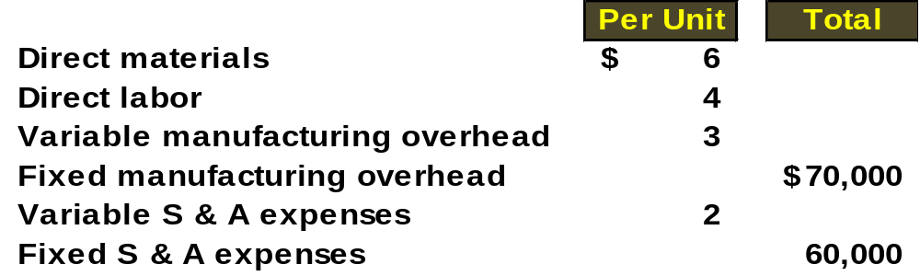
Setting a Target Selling Price
Here is information provided by the management of Ritter Company.
Assuming Ritter will produce and sell 10,000 units of the new product, and that Ritter typically uses a 50% markup percentage, let’s determine the unit product cost.
Notes:
We have gathered information from Ritter Company to help establish the selling price of a new product. Ritter hopes to produce and sell 10,000 units of the new product when it is introduced.
Notice that some of the product costs are expressed per unit and other costs are expressed in total. Ritter wants to produce and sell 10,000 units of a new product and typically uses a 50 percent markup percentage.

Slide 22
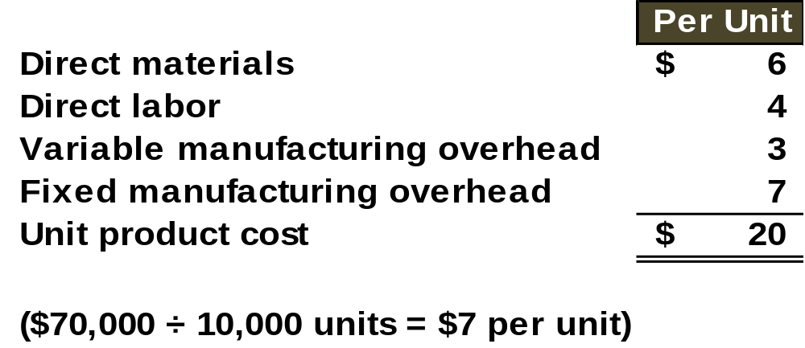
Setting a Target Selling Price
The first step in the absorption costing approach to cost-plus pricing is to compute the unit product cost.
Ritter has a policy of marking up unit product costs by 50%. Let’s calculate the target selling price.
Notes:
The first step in the absorption costing approach to cost-plus pricing is to compute the unit product cost. Under absorption costing, the unit product cost is $20. The fixed manufacturing overhead of $70,000 is to be spread over the 10,000 units to be produced and sold.
Let’s assume that in the past when Ritter introduced a new product, it used a markup of 50 percent of cost.

Slide 23
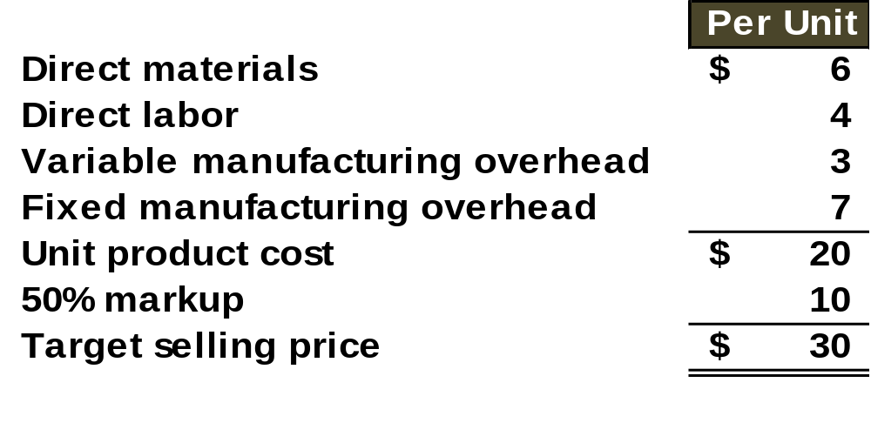
Setting a Target Selling Price
The second step is to calculate the target selling price ($30) by assigning the appropriate markup ($10) to the unit product cost ($20).
Notes:
The second step is to calculate the target selling price ($30) by assigning the appropriate markup ($10) to the unit product cost ($20).

Slide 24
Determining the Markup Percentage
A markup percentage can be based on an industry “rule of thumb,” company tradition, or it can be explicitly calculated.
The equation for calculating the markup percentage on absorption cost is shown below.
Markup %
on absorption
cost
=
(Required ROI × Investment) + S & A expenses
Unit sales × Unit product cost
The markup must be high enough to cover S & A expenses and to provide an adequate return on investment.
Notes:
Now, we will take a closer look at how Ritter may calculate the markup percent on absorption cost. The markup must be high enough to cover its selling and administrative (S & A) expenses and to provide an adequate return on investment.
The numerator of the equation takes the product of the company’s return on investment times the investment funds required and adds to this the S & A expenses. The denominator is the projected unit sales times the unit product cost.

Slide 25

Determining the Markup Percentage
Let’s assume that Ritter must invest $100,000 in the product and market 10,000 units of product each year. The company requires a 20% ROI on all investments. Let’s determine Ritter’s markup percentage on absorption cost.
Notes:
Now, let’s assume Ritter must invest $100,000 in the new product. The company requires an ROI of 20 percent on all investments made.

Slide 26
Determining the Markup Percentage
Markup %
on absorption
cost
=
(20% × $100,000) + ($2 × 10,000 + $60,000)
10,000 × $20
Variable S & A per unit
Total fixed S & A
Markup %
on absorption
cost
=
($20,000 + $80,000)
$200,000
=
50%
Notes:
Here is the basic equation to determine the markup percentage.
The variable selling, general and administrative expenses per unit are $2 and the fixed S & A expenses are $60,000. Recall that Ritter expects to produce and sell 10,000 units.
Under these conditions, the markup percent on absorption cost will be 50 percent. If Ritter actually sells 10,000 units at the price of $30 per unit, the ROI on this product will indeed be 20 percent. However, if more than (less than) 10,000 units are sold, the ROI will be higher than (less than) 20 percent.

Slide 27

Problems with the Absorption Costing Approach
The absorption costing approach essentially assumes that customers need the forecasted unit sales and will pay whatever price the company decides to charge. This is flawed logic simply because customers have a choice.
Notes:
There are several restrictive assumptions underlying the absorption costing approach. The absorption costing approach essentially assumes that customers need the forecasted unit sales and will pay whatever price the company decides to charge. This is flawed logic simply because customers have a choice.

Slide 28
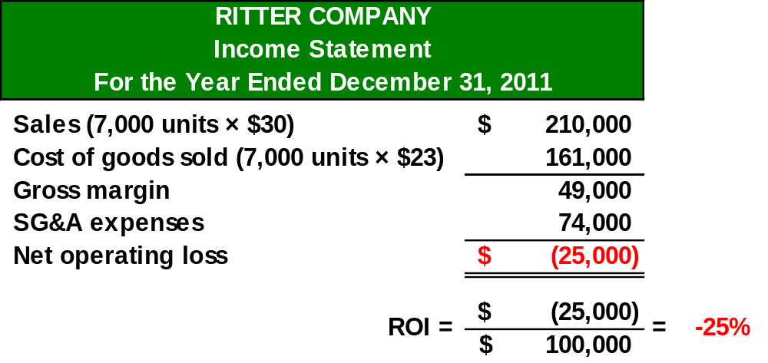
Problems with the Absorption Costing Approach
Let’s assume that Ritter sells only 7,000 units at $30 per unit, instead of the forecasted 10,000 units. Here is the income statement.
Notes:
What would happen if Ritter produced all 10,000 units, but was able to sell only 7,000 at $30 per unit?
The unit cost would now be $23 rather than the $20 originally projected. The reason is that the $70,000 fixed manufacturing overhead would be spread over 7,000 units, thus raising the absorption cost by $3 per unit.
The product line would show a net loss of $25,000 and the project would fail to meet management’s return on investment goal.

Slide 29
Problems with the Absorption Costing Approach
Let’s assume that Ritter sells only 7,000 units at $30 per unit, instead of the forecasted 10,000. units. Here is the income statement.
Absorption costing approach to pricing is a safe
approach only if customers choose to buy at
least as many units as managers forecasted
they would buy.
Notes:
As you can clearly see, the absorption costing approach is only safe when customers purchase at least the number of units forecasted by management.

Slide 30
Learning Objective 3
Compute the target cost for a new product or service.
Notes:
Learning objective number 3 is to compute the target cost for a new product or service.

Slide 31

Target Costing
Target costing is the process of determining the maximum allowable cost for a new product and then developing a prototype that can be made for that maximum target cost figure. The equation for determining a target price is shown below:
Target cost = Anticipated selling price – Desired profit
Once the target cost is determined, the product development team is given the responsibility of designing the product so that it can be made for no more than the target cost.
Notes:
Under the target costing approach, we begin by determining the anticipated selling price of our product in the marketplace. We can look at competitors to help us determine the appropriate selling price for our product.
Once we establish the anticipated selling price, we subtract the desired profit needed to invest in the product. This yields the target cost to the company. Once the target cost is determined, the product development team is given the responsibility of designing the product so that it can be made for no more than the target cost.

Slide 32
Reasons for Using Target Costing
Two characteristics of prices and product costs include:
The market (i.e., supply and demand) determines price.
Most of the cost of a product is determined in the design stage.
Notes:
Target costing grew out of the notion that the marketplace determines price under normal circumstances and that most of the cost of a product is derived as the product is being designed.

Slide 33

Reasons for Using Target Costing
Target costing was developed in recognition of the two characteristics summarized on the previous screen.
Target costing begins the product development process by recognizing and responding to existing market prices. Other approaches allow engineers to design products without considering market prices.
Notes:
Target costing was developed in recognition of the two characteristics summarized on the previous screen.
In target costing, management must begin with product development and design by recognizing and responding to existing market prices. Target costing begins the product development process by recognizing and responding to existing market prices. Other approaches allow engineers to design products without considering market prices.

Slide 34

Reasons for Using Target Costing
Target costing focuses a company’s cost reduction efforts in the product design stage of production.
Other approaches attempt to squeeze costs out of the manufacturing process after they come to the realization that the cost of a manufactured product does not bear a profitable relationship to the existing market price.
Notes:
Target costing focuses a company’s cost reduction efforts in the product design stage of production.
Other approaches attempt to squeeze costs out of the manufacturing process after they come to the realization that the cost of a manufactured product does not bear a profitable relationship to the existing market price.

Slide 35
Target Costing
Handy Appliance feels there is a niche for a hand mixer with special features. The marketing department believes that a price of $30 would be about right and that about 40,000 mixers could be sold. An investment of $2 million is required to gear up for production. The company requires a 15% ROI on invested funds.
Let’s see how we determine the target cost.
Notes:
Let’s look at a specific example of target costing at Handy Appliance. The marketing department believes a new mixer selling for $30 per unit would be able to carve out about 40,000 units from the existing market.
It will cost Handy $2 million to gear up for production. Handy Appliance requires a 15 percent return on its investment.

Slide 36
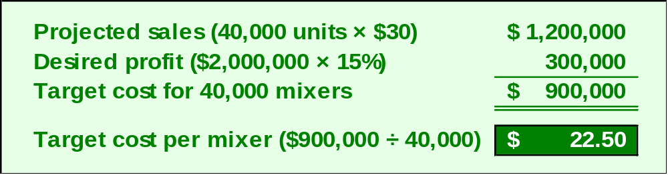
Target Costing
Each functional area within Handy Appliance would be responsible for keeping its actual costs within the target established for that area.
Notes:
The total anticipated sales of the new mixer will be $1.2 million. Handy’s desired profit is 15 percent on its $2 million investment, or $300,000. The target cost of the 40,000 mixers must be $900,000, so each mixer must be produced at a cost no greater than $22.50.
It is now the function of Handy’s development team to see to it that all parties involved understand that the mixer must be manufactured at $22.50 or less with the features specified by the marketing department.

