Slide 1
Managerial Accounting:
An Overview
Chapter 1
Notes:
Chapter 1: Managerial Accounting: An Overview
This chapter explains why managerial accounting is important to the future careers of all business students. It answers three questions: (1) What is managerial accounting? (2) Why does managerial accounting matter to your career? and (3) What skills do managers need to succeed? It also discusses the importance of ethics in business and corporate social responsibility.

Slide 2
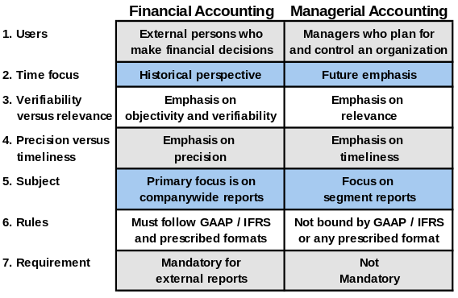
Financial and Managerial Accounting: Seven Key Differences
Notes:
What is Managerial Accounting?
There are seven key differences between financial accounting and managerial accounting:
❶ Users: Financial accounting reports are prepared for external parties, whereas managerial accounting reports are prepared for internal users.
❷ Emphasis on the future: Financial accounting summarizes past transactions. Managerial accounting has a strong future orientation.
❸ Relevance of data: Financial accounting data should be objective and verifiable. Managerial accountants focus on providing relevant data even if these data are not completely objective and verifiable.
❹ Less emphasis on precision: Financial accounting focuses on precision when reporting to external parties. Managerial accounting aids decision makers by providing good estimates as soon as possible rather than waiting for precise data later.
❺ Segments of an organization: Financial accounting is concerned with companywide reports. Managerial accounting focuses on the segment reports. Examples of segments include: product lines, sales territories, divisions, departments, etc..
❻ Managerial accounting–no externally imposed rules: Financial accounting conforms to GAAP and IFRS. Managerial accounting is not bound by GAAP and IFRS.
❼ Managerial accounting–not mandatory: Financial accounting is mandatory because various outside parties require periodic financial statements. Managerial accounting is not mandatory.

Slide 3

Work of Management
Planning
Controlling
Decision
Making
Notes:
Managerial accounting helps managers carry out three main activities – planning, controlling, and decision making.

Slide 4
Planning
Establish Goals.
Specify How Goals
Will Be Achieved.
Develop Budgets.
Notes:
Planning involves establishing goals and specifying how to achieve them. Plans are often accompanied by a budget. A budget is a detailed plan for the future that is usually expressed in formal quantitative terms.

Slide 5

Controlling
The control function gathers feedback to
ensure that plans are being followed.
Feedback in the form of performance reports
that compare actual results with the budget
are an essential part of the control function.
Notes:
Controlling involves gathering feedback to ensure that the plan is being properly executed or modified as circumstances change. Part of the control process includes preparing performance reports. A performance report compares budgeted to actual results to improve future performance.

Slide 6
Decision Making
Decision making involves
making a selection among
competing alternatives.
What should
we be selling?
Who should
we be serving?
How should
we execute?
Notes:
Decision making involves selecting a course of action from competing alternatives.
Many managerial decisions revolve around answering three questions:
a. What should we be selling?
b. Who should we be serving?
c. How should we execute?

Slide 7
Managerial Accounting Activities:
Marketing Majors
Planning
How much should we budget for TV, print, and internet advertising?
How many salespeople should we plan to hire to serve a new territory?
Notes:
Why does managerial accounting matter to your career? Managerial accounting skills are useful in just about any career, organization, and industry. First, let’s consider business majors, specifically marketing majors.
Marketing majors are involved in various planning activities.
How much should we budget for TV, print, and internet advertising?
How many salespeople should we plan to hire to serve a new territory?

Slide 8
Managerial Accounting Activities:
Marketing Majors
Controlling
Is the budgeted price cut increasing unit sales as expected?
Are we accumulating too much inventory during the holiday shopping season?
Notes:
Marketing majors are also involved in controlling activities.
Is the budgeted price cut increasing unit sales as expected?
Are we accumulating too much inventory during the holiday shopping season?

Slide 9
Managerial Accounting Activities:
Marketing Majors
Decision
Making
Should we sell our services as one bundle or sell them separately?
Should we sell directly to customers or use a distributor?
Notes:
Marketing majors are involved in decision making activities.
Should we sell our services as one bundle or sell them separately?
Should we sell directly to customers or use a distributor?

Slide 10
Managerial Accounting Activities:
Operations Management Majors
Planning
How many units should we plan to produce next period?
How much should we budget for next period’s utility expense?
Notes:
Next, let’s consider another business major, specifically operations management majors.
Operations management majors are involved in various planning activities.
How many units should we plan to produce next period?
How much should we budget for next period’s utility expense?

Slide 11
Managerial Accounting Activities:
Operations Management Majors
Controlling
Did we spend more or less than expected for the units we actually produced?
Are we achieving our goal of reducing the number of defective units produced?
Notes:
Operations management majors are also involved in controlling activities.
Did we spend more or less than expected for the units we actually produced?
Are we achieving our goal of reducing the number of defective units produced?

Slide 12
Managerial Accounting Activities:
Operations Management Majors
Decision
Making
Should we buy a new piece of equipment or upgrade our existing machine?
Should we redesign our manufacturing process to lower inventory levels?
Notes:
Operations management majors are involved in decision making activities.
Should we buy a new piece of equipment or upgrade our existing machine?
Should we redesign our manufacturing process to lower inventory levels?

Slide 13
Managerial Accounting Activities:
Human Resource Management Majors
Planning
How much should we plan to spend for occupational safety training?
How much should we plan to spend on employee recruitment advertising?
Notes:
Now let’s consider human resource management majors.
They are involved in various planning activities.
How much should we plan to spend for occupational safety training?
How much should we plan to spend on employee recruitment advertising?

Slide 14
Managerial Accounting Activities:
Human Resource Management Majors
Controlling
Is our employee retention rate exceeding our goals?
Are we meeting our goal of completing timely performance appraisals?
Notes:
Human resource management majors are also involved in controlling activities.
Is our employee retention rate exceeding our goals?
Are we meeting our goal of completing timely performance appraisals?

Slide 15
Managerial Accounting Activities:
Human Resource Management Majors
Decision
Making
Should we hire an on-site medical staff to lower our healthcare costs?
Should we hire temporary workers or full-time employees?
Notes:
Human resource management majors are involved in decision making activities.
Should we hire an on-site medical staff to lower our healthcare costs?
Should we hire temporary workers or full-time employees?

Slide 16

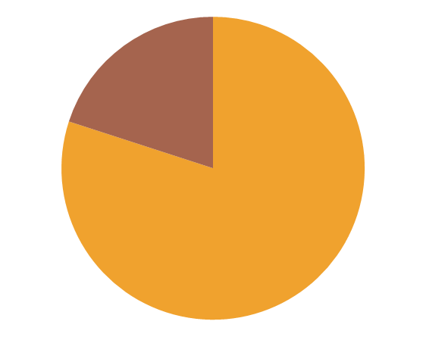
Accounting Majors
Many accounting graduates begin working for public accounting firms. However, most leave at some point to work in other organizations.
80%
The IMA estimates that 80% of professional accountants in the U.S. work in non-public accounting environments.
Notes:
The IMA estimates that more than 80% of professional accountants in the United States work in non-public accounting environments.
If you are an accounting major there is a high likelihood that your future will involve working for a non-public accounting employer.
This employer will expect you to have strong financial accounting skills, but more importantly, it will expect you to help improve organizational performance by applying the planning, controlling, and decision making skills that are the foundation of managerial accounting.

Slide 17

Certified Management Accountant
A management accountant
who has the necessary qualifications
and who passes a rigorous professional
exam earns the right to be known as a
Certified Management Accountant
(CMA).
Notes:
For accounting majors, the Certified Management Accountant (CMA) designation is a globally-respected credential that will increase your credibility, upward mobility, and compensation.

Slide 18
CMA Exam
Part 1 Financial Planning, Performance and Control
Planning, budgeting, and forecasting
Performance management
Cost management
Internal controls
Professional ethics
Part 2 Financial Decision Making
Financial statement analysis
Corporate finance
Decision analysis and risk management
Investment decisions
Professional ethics
Information about becoming a CMA and the CMA program can be accessed
on the IMA’s website at www.imanet.org or by calling 1-800-638-4427.
Notes:
This slide summarizes the topics included in the two-part CMA exam. The CMA focuses on the planning, controlling, and decision making skills that are critically important to non-public accounting employers. It complements the CPA exam, which focuses on rule-based compliance—assurance standards, financial accounting standards, business law, and the tax code.
Information about becoming a CMA and the CMA program can be accessed on the IMA’s website at www.imanet.org or by calling 1-800-638-4427.

Slide 19
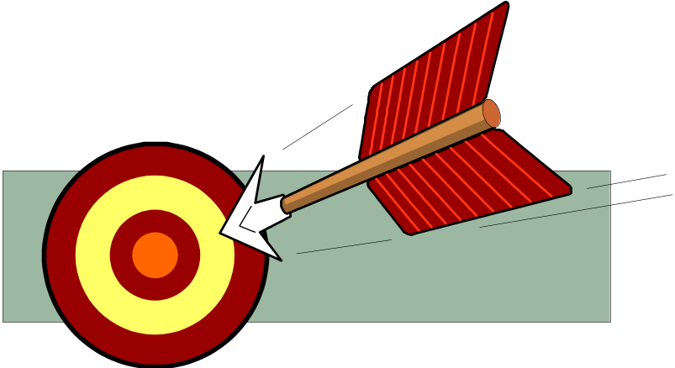
Strategic Management Skills
A strategy
is a “game plan”
that enables a company
to attract customers
by distinguishing itself
from competitors.
The focal point of a
company’s strategy should
be its target customers.
Notes:
A strategy is a “game plan” that enables a company to attract customers by distinguishing itself from competitors.

Slide 20
Customer Value Propositions
Customer
Intimacy
Strategy
Understand and respond to
individual customer needs.
Operational
Excellence
Strategy
Deliver products and services
faster, more conveniently,
and at lower prices.
Product
Leadership
Strategy
Offer higher quality products.
Notes:
Companies that adopt a customer intimacy strategy strive to understand and respond to individual customer needs better than competitors. Examples of companies that pursue this strategy include: Ritz-Carlton, Nordstrom, and Virtuoso.
Companies that adopt an operational excellence strategy strive to deliver products and services faster, more conveniently, and at a lower price than competitors. Examples of companies that pursue this strategy include: Southwest Airlines, Wal-Mart, and The Vanguard Group.
Companies that adopt a product leadership strategy strive to offer higher quality products than competitors. Examples of companies that pursue this strategy include: Apple, BMW, and Cisco Systems.

Slide 21
Process Management
A business
process is a series of
steps that are followed in order to
carry out some task in
a business.
Product Customer
R&D Design Manufacturing Marketing Distribution Service
Business functions making up the value chain
Notes:
A business process is a series of steps that are followed in order to carry out some task in a business.
A value chain consists of the major business functions that add value to a company’s products and services.

Slide 22


Lean Production
Traditional Manufacturing
Produce goods in anticipation of Sales
Store
Inventory
Make Sales from Finished Goods Inventory
Notes:
Traditional manufacturing methods organize work departmentally and encourage those departments to maximize their output even it exceeds customer demand and bloats inventories.

Slide 23
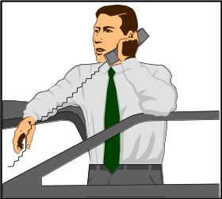


Lean Production
Customer places an order
Create Production Order
Generate component requirements
Goods delivered when needed
Production begins as parts arrive
Components are ordered
Lean Production is often called Just-In-Time (JIT) production.
Notes:
Lean production is a management approach that organizes resources such as people and machines around the flow of business processes and that only produces units in response to customer orders.
Lean production is often called just-in-time (JIT) production because products are only made in response to customer orders and they are completed just-in-time to be shipped to customers.

Slide 24

Lean Production
Because lean thinking only allows production in response to customer orders, the number of units produced tends to equal the number of units sold.
The lean approach also results in fewer defects, less wasted effort, and quicker customer response times than traditional production methods.
Notes:
Because lean thinking only allows production in response to customer orders, the number of units produced tends to equal the number of units sold.
The lean approach also results in fewer defects, less wasted effort, and quicker customer response times than traditional production methods.

Slide 25

Theory of Constraints
A constraint (also called a bottleneck) is anything that prevents you from getting more of what you want.
The Theory of Constraints (TOC) is based on the observation that effectively managing the constraint is the key to success.
The constraint in a system is determined
by the step that has the smallest capacity.
Notes:
A constraint (also called a bottleneck) is anything that prevents you from getting more of what you want. The constraint in a system is determined by the step that has the smallest capacity.
The Theory of Constraints (TOC) is based on the insight that effectively managing the constraint is the key to success. The goal is to manage the constraint with the intent of generating more business rather than cutting the workforce.

Slide 26
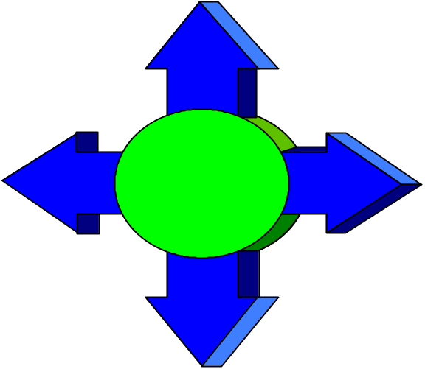
Theory of Constraints
Only actions that strengthen the weakest link in the “chain” improve the process.
2. Allow the weakest link to set the tempo.
3. Focus on improving the weakest link.
1. Identify the weakest link.
4. Recognize that the weakest link
is stronger.
Notes:
The Theory of Constraints offers a four-step approach to process improvement:
❶ Identify the weakest link in the chain, which is the constraint.
❷ Do not place a greater strain on the system than the weakest link can handle – if you do, the chain will break.
❸ Concentrate improvement efforts on strengthening the weakest link.
❹ If the improvement efforts are successful, eventually the weakest link will improve to the point that it is no longer the weakest link. At this point, a new weakest link must be identified and the improvement process starts over again.

Slide 27

Measurement Skills
A good manager complements an understanding of strategy, risks, and business processes with data-driven analysis.
The key to effective analysis is to understand that the question you are addressing defines what you measure and how you analyze the data.
Notes:
The question you are trying to answer defines what you’ll measure and how you analyze it.
Consider the following examples.

Slide 28
Measurement Skills
Planning
The primary purpose of this course is to teach measurement skills that managers use to support planning, controlling, and decision making activities.
Controlling
Decision
Making
Notes:
The primary purpose of this course is to teach you measurement skills that managers use every day to support their planning, controlling, and decision making activities.

Slide 29

Code of Conduct for Management Accountants
The Institute of Management Accountant’s (IMA) Statement of Ethical Professional Practice
consists of two parts that offer guidelines for:
❶ Ethical behavior.
❷ Resolution for an ethical conflict.
Notes:
The IMA’s Statement of Ethical Professional Practice has two main parts – guidelines for ethical behavior and guidelines for resolution of an ethical conflict.

Slide 30
IMA Guidelines for Ethical Behavior
Recognize and communicate professional limitations that preclude responsible judgment.
Maintain professional competence.
Competence
Follow applicable
laws, regulations
and standards.
Provide accurate, clear, concise, and timely decision support information.
Notes:
Management accountants have responsibility for ethical behavior in four broad areas. The first area is professional competence.
Management accountants must:
Maintain professional competence.
Follow applicable laws, regulations, and standards.
Provide accurate, clear, concise, and timely decision support information.
Recognize and communicate professional limitations that preclude responsible judgment.

Slide 31
IMA Guidelines for Ethical Behavior
Do not disclose confidential information unless legally obligated to do so.
Do not use confidential information for unethical or illegal advantage.
Confidentiality
Ensure that subordinates do not disclose confidential information.
Notes:
The second area is confidentiality. The guidelines specify that Management accountants:
Do not disclose confidential information unless legally obligated to do so.
Ensure that subordinates do not disclose confidential information.
Do not use confidential information for unethical or illegal advantage.

Slide 32
IMA Guidelines for Ethical Behavior
Mitigate conflicts of interest and advise others of potential conflicts.
Refrain from conduct that would prejudice carrying out duties ethically.
Integrity
Abstain from activities that might discredit the profession.
Notes:
The third area is integrity. Management accountants must:
Mitigate conflicts of interest and advise others of potential conflicts.
Refrain from conduct that would prejudice carrying out duties ethically.
Abstain from activities that might discredit the profession.

Slide 33
IMA Guidelines for Ethical Behavior
Communicate information fairly and objectively.
Disclose delays or deficiencies in information timeliness, processing, or internal controls.
Credibility
Disclose all relevant information that could influence a user’s understanding of reports
and recommendations.
Notes:
The fourth area is credibility. Management accountants must:
Communicate information fairly and objectively.
Disclose all relevant information that could influence a user’s understanding of reports and recommendations.
Disclose delays or deficiencies in information timeliness, processing, or internal controls.

Slide 34

IMA Guidelines for Resolution of an Ethical Conflict
Follow employer’s established policies.
For an unresolved ethical conflict:
  Discuss the conflict with immediate supervisor or next highest uninvolved managerial level.
  If immediate supervisor is the CEO, consider the board of directors or the audit committee.
  Contact with levels above the immediate supervisor should only be initiated with the supervisor’s knowledge, assuming the supervisor is not involved.
Notes:
When faced with an ethical conflict, a management accountant should follow the organization’s established policies for resolving ethical conflict. If this does not work, consider the following:
Discuss the conflict with immediate superior or next highest uninvolved managerial level.
If immediate supervisor is the CEO, consider discussing the conflict with the board of directors or the audit committee.
Remember that contact with levels above immediate supervisor should only be initiated with the supervisor’s knowledge, assuming the supervisor is not involved.

Slide 35
IMA Guidelines for Resolution of an Ethical Conflict
Follow employer’s established policies.
For an unresolved ethical conflict:
  Except where legally prescribed, maintain confidentiality.
  Clarify issues in a confidential discussion with an objective advisor.
  Consult an attorney as to legal obligations.
Notes:
Additional guidelines for an unresolved ethical conflict are:
Except where legally prescribed, communication with individuals not employed by the organization is not appropriate.
Clarify relevant ethical issues with an objective advisor, such as a member of the IMA’s Ethics Counseling Service.
Consult an attorney regarding your legal obligations.

Slide 36
Why Have Ethical Standards?
Ethical standards in business are essential for a
smooth functioning economy.
Without ethical standards in business, the
economy, and all of us who depend on it for
jobs, goods, and services, would suffer.
Abandoning ethical standards in business would
lead to a lower quality of life with less
desirable goods and services at higher prices.
Notes:
Ethical standards are motivated by a very practical consideration — if the standards are not followed in business, then the economy, and all of us, would suffer.
Abandoning ethical standards would lead to a lower standard of living with lower-quality goods and services, less to choose from, and higher prices.

