Slide 1
Managerial Accounting and Cost Concepts
Notes:
Chapter 2: Managerial Accounting and Cost Concepts. In this chapter we explain how managers need to rely on different cost classifications for different purposes. The four main purposes emphasized in this chapter include preparing external financial reports, predicting cost behavior, assigning costs to cost objects, and decision making.

Slide 2
Learning Objective 1
Identify and give examples of each of the three basic manufacturing cost categories.
Notes:
Learning objective number 1 is to identify and give examples of each of the three basic manufacturing cost categories.

Slide 3
Classifications of Manufacturing Costs
Direct
Materials
Direct
Labor
Manufacturing
Overhead
The Product
Notes:
Manufacturing costs are usually grouped into three main categories: direct materials, direct labor, and manufacturing overhead. These costs are incurred to make a product.

Slide 4
Direct Materials
Raw materials that become an integral part of the product and that can be traced directly to it on a cost effective basis.
Example: A radio installed in an automobile
Notes:
Direct materials are raw materials that become an integral part of the finished product and whose costs can be conveniently traced to it. Examples include the aircraft engines on a Boeing 777, the Intel processing chip in a personal computer, the blank video cassette in a pre-recorded video, and a radio in an automobile.

Slide 5

Direct Labor
Those labor costs that can be easily traced to individual units of product.
Example: Wages paid to automobile assembly workers
Notes:
Direct labor consists of that portion of labor cost that can be easily traced to a product. Direct labor is sometimes referred to as “touch labor,” since it consists of the costs of workers who “touch” the product as it is being made.

Slide 6
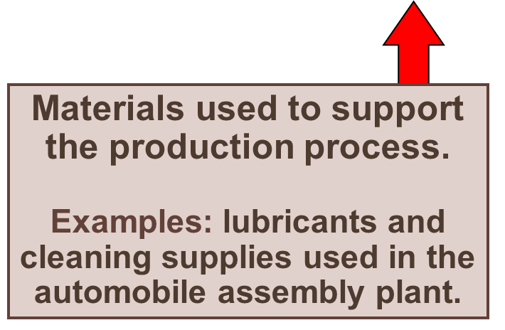
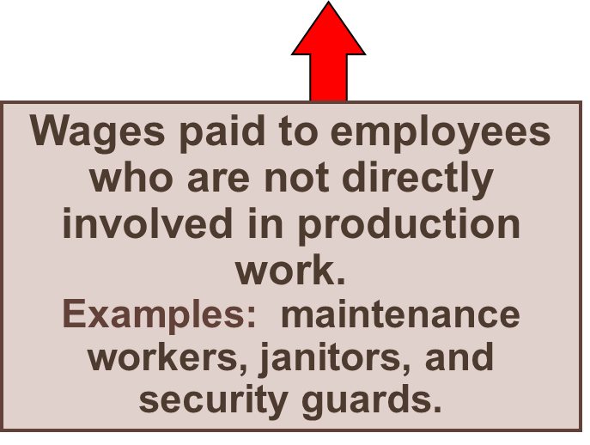
Manufacturing Overhead
Manufacturing costs that cannot be easily traced directly to specific units produced.
Examples: Indirect materials and indirect labor
Notes:
Manufacturing overhead includes all manufacturing costs except direct materials and direct labor. These costs cannot be easily traced to specific units produced (also called indirect manufacturing cost, factory overhead, and factory burden).
Manufacturing overhead includes indirect materials that are part of the finished product, but that cannot be easily traced to it. It includes indirect labor costs that cannot be conveniently traced to the creation of products.
Other examples of manufacturing overhead include: maintenance and repairs on production equipment, heat and light, property taxes, depreciation and insurance on manufacturing facilities, etc.

Slide 7
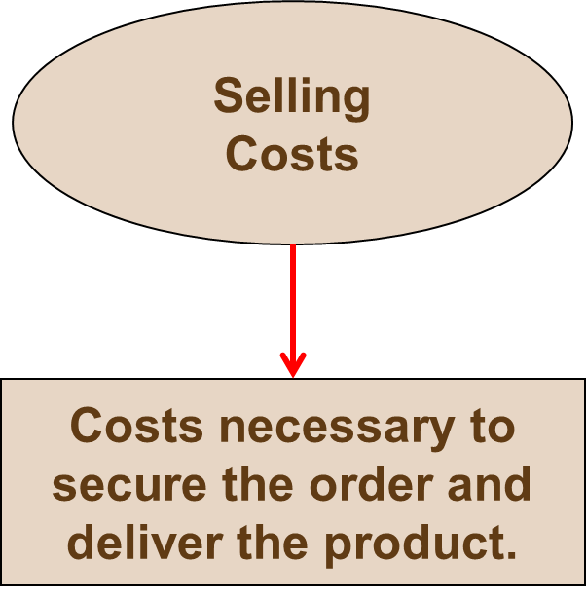


Nonmanufacturing Costs
Administrative Costs
All executive, organizational, and clerical costs.
Notes:
A manufacturing company incurs many other costs in addition to manufacturing costs. For financial reporting purposes, most of these other costs are typically classified as selling costs and administrative costs. These costs are also called selling, general and administrative costs, or SG&A. Selling and administrative costs are incurred in both manufacturing and merchandising firms.
Selling costs include all costs necessary to secure customer orders and get the finished product into the hands of the customer. These costs are also referred to as order-getting and order-filling costs. Examples of selling costs include advertising, shipping, sales travel, sales commissions, sales salaries, and costs of finished goods warehouses.
Administrative costs include all executive, organizational, and clerical costs associated with the general management of an organization. Examples of administrative costs include executive compensation, general accounting, secretarial, public relations, and similar costs involved in the overall general administration of the organization as a whole.

Slide 8
Learning Objective 2
Distinguish between product costs and period costs and give examples of each.
Notes:
Learning objective number 2 is to distinguish between product costs and period costs and give examples of each.

Slide 9
Product Costs Versus Period Costs
Product costs include direct materials, direct labor, and manufacturing overhead.
Period costs include all selling costs and administrative costs.
Inventory
Cost of Good Sold
Expense
Sale
Balance
Sheet
Income
Statement
Income
Statement
Notes:
Costs can also be classified as product or period costs.
Product costs include all the costs that are involved in acquiring or making a product. More specifically, it includes direct materials, direct labor, and manufacturing overhead. Consistent with the matching principle, product costs are recognized as expenses when the products are sold. This can result in a delay of one or more periods between the time in which the cost is incurred and when it appears as an expense on the income statement. Product costs are also known as inventoriable costs. The discussion in the chapter follows the usual interpretation of GAAP in which all manufacturing costs are treated as product costs.
Period costs include all selling costs and administrative costs. These costs are expensed on the income statement in the period incurred. All selling and administrative costs are typically considered to be period costs. The usual rules of accrual accounting apply to period costs. For example, administrative salary costs are “incurred” when they are earned by the employees and not necessarily when they are paid to employees.

Slide 10
Quick Check ✓
Which of the following costs would be considered a period rather than a product cost in a manufacturing company?
  A. Manufacturing equipment depreciation.
  B. Property taxes on corporate headquarters.
  C. Direct materials costs.
  D. Electrical costs to light the production
  facility.
  E. Sales commissions.
Notes:
Which of the following costs would be considered a period rather than a product cost in a manufacturing company?

Slide 11
Learning Objective 3
Understand cost behavior patterns including variable costs, fixed costs, and mixed costs.
Notes:
Learning objective number 3 is to understand cost behavior patterns including variable costs, fixed costs, and mixed costs.

Slide 12
Cost Classifications for Predicting Cost Behavior
Cost behavior refers to how a cost will react to changes in the level of activity. The most common classifications are:
  Variable costs.
  Fixed costs
  Mixed costs.
Notes:
Quite frequently, it is necessary to predict how a certain cost will behave in response to a change in activity. For example, a manager may want to estimate the impact that a 5% increase in sales would have on the company’s total electric bill. Cost behavior refers to how a cost will react to changes in the level of activity within the relevant range. The most commonly used classifications of cost behavior are variable and fixed costs.

Slide 13

Variable Cost
Your total texting bill is based on how many texts you send.
Total Texting Bill
Number of Texts Sent
Notes:
A variable cost varies, in total, in direct proportion to changes in the level of activity. For example, if you don’t have a texting plan on your cell phone, text messaging costs 5 cents per text. Your total texting bill increases with the number of texts you send.

Slide 14
Variable Cost Per Unit
The cost per text sent is constant at
5 cents per text message.
Cost Per Text Sent
Number of Texts Sent
Notes:
Although variable costs change in total as the activity level rises and falls, variable cost per unit is constant. For example, the cost per text message sent is constant at 5 cents per text.

Slide 15

The Activity Base (Cost Driver)
Units
produced
Machine hours
A measure of what causes the incurrence of a variable cost
Miles driven
Labor hours
Notes:
An activity base (also called a cost driver) is a measure of what causes the incurrence of variable costs. As the level of the activity base increases, the total variable cost increases proportionally.
Units produced (or sold) is not the only activity base within companies. A cost can be considered variable if it varies with activity bases such as miles driven, machine hours, or labor hours.

Slide 16
Fixed Cost
Your monthly contract fee for your cell phone is fixed for the number of monthly minutes in your contract. The monthly contract fee does not change based on the number of calls you make.
Monthly Cell Phone Contract Fee
Number of Minutes Used
Within Monthly Plan
Notes:
A fixed cost is constant within the relevant range. In other words, fixed costs do not change for changes in activity that fall within the “relevant range.” For example, your monthly contract fee for your cell phone is a fixed amount for a certain number of minutes. The monthly contract fee does not change based on the number of calls you make.
Of course, if you go over your monthly minutes allotment, you have exceed the relevant range for your monthly contract and will be charged above and beyond your monthly contract fee.

Slide 17
Fixed Cost Per Unit
Within the monthly contract allotment, the average fixed cost per cell phone call made decreases as more calls are made.
Monthly Cell Phone Contract Fee
Number of Minutes Used
Within Monthly Plan
Notes:
However, when expressed on a per unit basis, a fixed cost is inversely related to activity—the per unit cost decreases when activity rises and increases when activity falls. For example, the average fixed cost per cell phone call made decreases as more calls are made in the month.

Slide 18

Types of Fixed Costs
Committed
Long-term, cannot be significantly reduced in the short term.
Discretionary
May be altered in the short-term by current managerial decisions
Examples
Depreciation on Buildings and Equipment and Real Estate Taxes
Examples
Advertising and Research and Development
Notes:
One type of fixed cost is known as committed fixed costs. These are long-term fixed costs that cannot be significantly reduced in the short term. Some examples include depreciation on buildings and equipment and real estate taxes on factory property.
Another type of fixed cost is known as discretionary fixed costs. These fixed costs may be altered in the short-term by current management decisions. Some examples of discretionary fixed costs include advertising and research and development costs.
A cost may be discretionary or committed depending upon management’s strategy. For example, some construction companies may layoff workers during months with minimal customer demand. However, other construction companies may opt to retain their workers all year.

Slide 19
The Linearity Assumption and the Relevant Range
Economist’s
Curvilinear Cost Function
A straight line closely approximates a curvilinear variable cost line within the relevant range.
Relevant
Range
Total Cost
Accountant’s Straight-Line Approximation (constant unit variable cost)
Activity
Notes:
Economists correctly point out that many costs which accountants classify as variable costs actually behave in a curvilinear fashion.
Nonetheless, within a narrow band of activity known as the relevant range, a curvilinear cost can be satisfactorily approximated by a straight line.
The relevant range is that range of activity within which the assumptions made about cost behavior are valid.

Slide 20

Fixed Costs and the Relevant Range
For example, assume office space is available at a rental rate of $30,000 per year in increments of 1,000 square feet.
Fixed costs would increase in a step fashion at a rate of $30,000 for each additional 1,000 square feet.
Notes:
For example, assume office space is available at a rental rate of $30,000 per year in increments of 1,000 square feet.
Fixed costs would increase in a step fashion at a rate of $30,000 for each additional 1,000 square feet.

Slide 21
Fixed Costs and the Relevant Range
90
The relevant range of activity for a fixed cost is the range of activity over which the graph of the cost is flat.
Relevant
Range
60
Rent Cost in Thousands of Dollars
30
0
0 1,000 2,000 3,000
Rented Area (Square Feet)
Notes:
The relevant range of activity for a fixed cost is the range of activity over which the graph of the cost is flat.

Slide 22
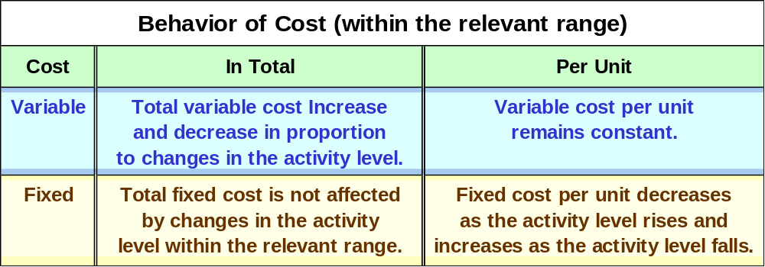
Cost Classifications for Predicting Cost Behavior
Notes:
It is helpful to think about variable and fixed cost behavior in a 2 by 2 matrix, as illustrated here. Take a few minutes and review this summary of cost behavior for variable and fixed costs.

Slide 23
Quick Check ✓
Which of the following costs would be variable with respect to the number of cones sold at a Baskins & Robbins shop? (There may be more than one correct answer.)
  A. The cost of lighting the store.
  B. The wages of the store manager.
  C. The cost of ice cream.
  D. The cost of napkins for customers.
Notes:
Which of the following costs would be variable with respect to the number of cones sold at a Baskins and Robbins shop? (There may be more than one correct answer.)

Slide 24
Mixed Costs
(also called semivariable costs)
A mixed cost contains both variable and fixed elements. Consider the example of utility cost.
Y
Total mixed cost
Total Utility Cost
Variable
Cost per KW
X
Fixed Monthly
Utility Charge
Activity (Kilowatt Hours)
Notes:
Mixed costs (also called semivariable costs) contain both variable and fixed cost elements.
The graph depicts the mixed costs of a normal utility bill. As illustrated in the graph, a utility bill contains a fixed and a variable cost component.
The fixed portion of the utility bill is constant regardless of kilowatt hours consumed. This cost represents the minimum cost that is incurred to have the service ready and available for use.
The variable portion of the utility bill varies in direct proportion to the consumption of kilowatt hours.

Slide 25
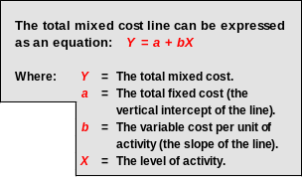
Mixed Costs
Y
Total mixed cost
Total Utility Cost
Variable
Cost per KW
X
Fixed Monthly
Utility Charge
Activity (Kilowatt Hours)
Notes:
The mixed cost line can be expressed with the equation Y = a + bX. This equation should look familiar, from your algebra and statistics classes.
In the equation, Y is the total mixed cost; a is the total fixed cost (or the vertical intercept of the line); b is the variable cost per unit of activity (or the slope of the line), and X is the actual level of activity.
In our utility example, Y is the total mixed cost; a is the total fixed monthly utility charge; b is the cost per kilowatt hour consumed, and X is the number of kilowatt hours consumed.

Slide 26
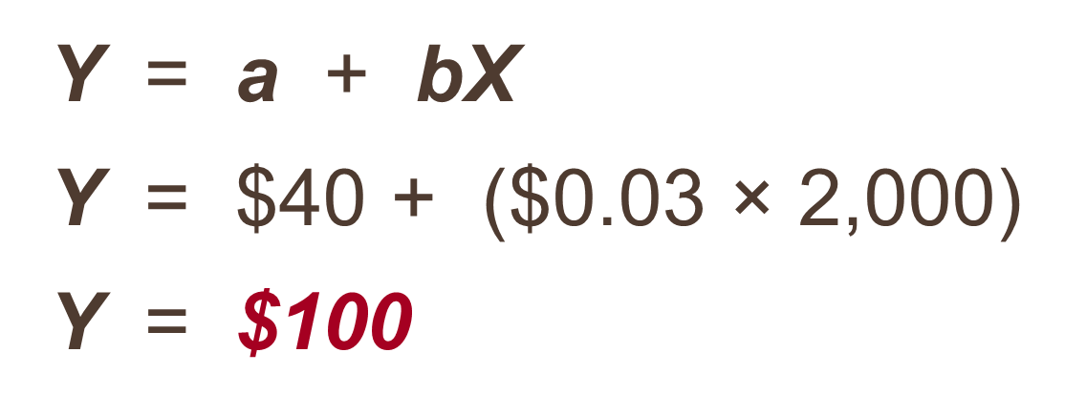
Mixed Costs – An Example
If your fixed monthly utility charge is $40, your variable cost is $0.03 per kilowatt hour, and your monthly activity level is 2,000 kilowatt hours, what is the amount of your utility bill?
Notes:
Read through this short question to see if you can calculate the total utility bill for the month.
The total bill is $100. How did you do?

Slide 27
Learning Objective 5
Prepare income statements for a merchandising company using the traditional and contribution formats.
Notes:
Learning objective number 5 is to prepare income statements for a merchandising company using the traditional and contribution formats.

Slide 28
Contribution Format Income Statements
In financial accounting, you learned to prepare income statements with expenses divided up by source.
  Product cost (i.e. COGS) vs. Period cost (Selling General and Administrative)
  Done because of GAAP.
For managerial accounting, GAAP doesn’t have to be followed, so other formats are possible.
  For decision making, fixed/variable may be a more informative way to divide up costs.

Slide 29
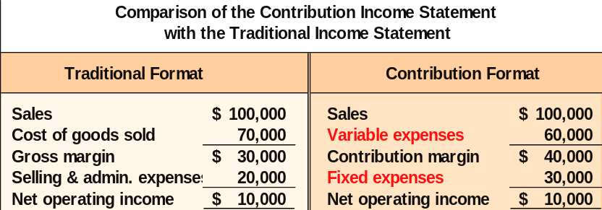
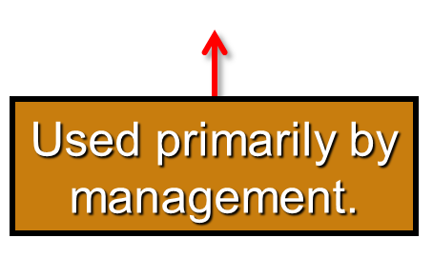
The Traditional and Contribution Formats
Used primarily for
external reporting.
Notes:
The contribution format allocates costs based on cost behavior. The contribution approach differs from the traditional approach illustrated in an earlier chapter.
The traditional approach organizes costs in a functional format. Costs relating to production, administration, and sales are grouped together without regard to their cost behavior.
The traditional approach is used primarily for external reporting purposes.

Slide 30
Uses of the Contribution Format
The contribution income statement format is used as an internal planning and decision-making tool. We will use this approach for:
Cost-volume-profit analysis (Chapter 5).
Budgeting (Chapter 8).
Segmented reporting of profit data (Chapter 6).
Special decisions such as pricing and make-or-buy analysis (Chapter 12).
Notes:
This approach is used as an internal planning and decision-making tool. For example, this approach is useful for and discussed further in Cost-volume-profit analysis (Chapter 5), Budgeting (Chapter 8), Segmented reporting of profit data (Chapter 6), Special decisions such as pricing and make or buy analysis (Chapter 12).

Slide 31
Learning Objective 6
Understand the differences between direct and indirect costs.
Notes:
Learning objective number 6 is to understand the differences between direct and indirect costs.

Slide 32
Assigning Costs to Cost Objects
Direct costs
Costs that can be
easily and conveniently traced to a unit of product or other cost object.
Examples: direct material and direct labor
Indirect costs
Costs that cannot be easily and conveniently traced to a unit of product or other cost object.
Example: manufacturing overhead
Notes:
A cost object is anything for which cost data are desired including products, customers, jobs, organizational subunits, etc. For purposes of assigning costs to cost objects, costs are classified two ways:
Direct costs are costs that can be easily and conveniently traced to a specified cost object. Examples of direct costs are direct material and direct labor.
Indirect costs are costs that cannot be easily and conveniently traced to a specified cost object. An example of an indirect cost is manufacturing overhead. Common costs are indirect costs incurred to support a number of cost objects. These costs cannot be traced to any individual cost object.

Slide 33
Learning Objective 7
Understand cost classifications used in making decisions: differential costs, opportunity costs, and sunk costs.
Notes:
Learning objective number 7 is to understand cost classifications used in making decisions: differential costs, opportunity costs, and sunk costs.

Slide 34
Cost Classifications for Decision Making
Every decision involves a choice between at least two alternatives.
Only those costs and benefits that differ between alternatives are relevant in a decision. All other costs and benefits can and should be ignored as irrelevant.
Notes:
It is important to realize that every decision involves a choice between at least two alternatives. The goal of making decisions is to identify those costs that are either relevant or irrelevant to the decision. Costs and benefits that differ between alternatives are relevant in a decision. All other costs and benefits are irrelevant and can and should be ignored. To make decisions, it is essential to have a grasp on three concepts: differential costs, opportunity costs, and sunk costs.

Slide 35
Differential Cost and Revenue
Costs and revenues that differ among alternatives.
Example: You have a job paying $1,500 per month in your hometown. You have a job offer in a neighboring city that pays $2,000 per month. The commuting cost to the city is $300 per month.
Notes:
Differential costs (or incremental costs) is a difference in cost between any two alternatives. Differential costs can be either fixed or variable. A difference in revenue between two alternatives is called differential revenue.
For example, assume you have a job paying $1,500 per month in your hometown. You have a job offer in a neighboring city that pays $2,000 per month. The commuting cost to the city is $300 per month. In this example, the differential revenue is $500 and the differential cost is $300.

Slide 36

Opportunity Cost
The potential benefit that is given up when one alternative is selected over another.
Example: What would you be doing if you weren’t going to school? What is your total cost to go to school at Pacific?
Notes:
Opportunity cost is the potential benefit that is given up when one alternative is selected over another. These costs are not usually entered into the accounting records of an organization, but must be explicitly considered in all decisions.

Slide 37
Sunk Costs
Sunk costs have already been incurred and cannot be changed now or in the future. These costs should be ignored when making decisions.
Example: Suppose you had purchased gold for $400 an ounce, but now it is selling for $250 an ounce. Should you wait for the gold to reach $400 an ounce before selling it?
Notes:
A sunk cost is a cost that has already been incurred and that cannot be changed by any decision made now or in the future. Since sunk costs cannot be changed and therefore cannot be differential costs, they should be ignored in decision making. While students usually accept the idea that sunk costs should be ignored on an abstract level, like most people, they often have difficulty putting this idea into practice.

Slide 38
Quick Check ✓
Suppose you are trying to decide whether to drive or take the train to Portland to attend a concert. You have ample cash to do either, but you don’t want to waste money needlessly. Is the cost of the train ticket relevant in this decision? In other words, should the cost of the train ticket affect the decision of whether you drive or take the train to Portland?
  A. Yes, the cost of the train ticket is relevant.
  B. No, the cost of the train ticket is not relevant.
Notes:
Take a minute and read the information on this slide. Should the cost of the train ticket affect the decision of whether you drive or take the train to Portland?

Slide 39
Quick Check ✓
Suppose you are trying to decide whether to drive or take the train to Portland to attend a concert. You have ample cash to do either, but you don’t want to waste money needlessly. Is the annual cost of licensing your car relevant in this decision?
  A. Yes, the licensing cost is relevant.
  B. No, the licensing cost is not relevant.
Notes:
Take a minute and read the information on this slide. Is the annual cost of licensing your car relevant in this decision?

Slide 40
Quick Check ✓
Suppose that your car could be sold now for $5,000. Is this a sunk cost?
  A. Yes, it is a sunk cost.
  B. No, it is not a sunk cost.
Notes:
Suppose that your car could be sold now for $5,000. Is this a sunk cost?

