Slide 1
Job-Order Costing
Chapter 3
Notes:
Chapter 3: Job-Order Costing.
Managers need to assign costs to products to facilitate external financial reporting and internal decision making. This chapter illustrates an absorption costing approach to calculating product costs known as job-order costing.

Slide 2
Job Order Costing vs. Process Costing
In order to figure out how much their product costs to produce, firms may use either job order or process costing.
Which method is appropriate depends on the type of product that is being produced.

Slide 3
Similarities Between Job-Order and Process Costing
Both systems assign material, labor, and overhead costs to products and they provide a mechanism for computing unit product costs.
Both systems use the same manufacturing accounts, including Manufacturing Overhead, Raw Materials, Work in Process, and Finished Goods.
The flow of costs through the manufacturing accounts is basically the same in both systems.
Notes:
Job-order and process costing are similar in that they both deal with assigning materials, labor, and overhead to products as a way to calculate the unit product cost.
Both systems use Raw Materials Inventory, Work in Process Inventory, and Finished Goods Inventory.
The flow of costs is similar, but not exactly the same, in the two systems.

Slide 4
Differences Between Job-Order and Process Costing
Process costing:
Is used when a single product is produced on a continuing basis or for a long period of time. Job-order costing is used when many different jobs having different production requirements are worked on each period.
Systems accumulate costs by department. Job-order costing systems accumulated costs by individual jobs.
Systems compute unit costs by department. Job-order costing systems compute unit costs by job on the job cost sheet.
Notes:
Process costing is best suited for the production of a single product that is continuously produced for a long period of time. Recall the mixing and bottling of Coca-Cola from Chapter Three. Job-order costing is best suited when jobs are produced as discrete projects. For example, building a house.
Process costing accumulates costs by department, while job-order costing accumulates costs by individual jobs.
Process costing uses a fundamental document called a department production report, while job-order costing uses the job cost sheet.
In process costing unit cost is computed by department, while in job-order systems unit cost is computed by job.
While there are similarities between the two systems, there are also significant differences.

Slide 5
Job-Order Costing: An Overview
Job-order costing systems are used when:
Many different products are produced each period.
Products are manufactured to order.
The unique nature of each order requires tracing or allocating costs to each job, and maintaining cost records for each job.
Notes:
Job-order costing systems are used when:
Many different products are produced each period.
Products are manufactured to order.
The unique nature of each order requires tracing or allocating costs to each job, and maintaining cost records for each job.

Slide 6

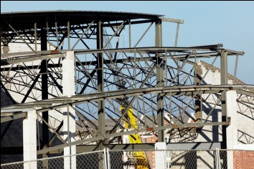

Job-Order Costing: An Overview
Examples of companies that
would use job-order costing include:
Boeing (aircraft manufacturing)
Bechtel International (large scale construction)
Walt Disney Studios (movie production)
Notes:
Companies that may benefit from using job order costing systems include Boeing, Bechtel International, and Walt Disney Studios.
Boeing is an aircraft manufacturer. Bechtel is perhaps the largest international construction company. The company works on huge projects that are unique to customer needs. Walt Disney Studios produces movies and entertainment parks.

Slide 7
Job-Order Costing – An Example
Charge direct material and direct labor costs to each job as work is performed.
Direct Materials
Job No. 1
Direct Labor
Job No. 2
Job No. 3
Notes:
In a job-order costing system, direct materials and direct labor are traced directly to each job as the work is preformed.

Slide 8
Job-Order Costing – An Example
Manufacturing Overhead, including indirect materials and indirect labor, are allocated to all jobs rather than directly traced to each job.
Direct Materials
Job No. 1
Direct Labor
Job No. 2
Manufacturing Overhead
Job No. 3
Notes:
Indirect manufacturing costs are referred to as manufacturing overhead. Manufacturing overhead includes both indirect materials and indirect labor. These costs are allocated to jobs rather than directly traced to each job.

Slide 9
The Job Cost Sheet
PearCo Job Cost Sheet
Job Number A - 143
Date Initiated 3-4-11
Date Completed
Department B3
Units Completed
Item Wooden cargo crate
Direct Materials
Direct Labor
Manufacturing Overhead
Req. No.
Amount
Ticket
Hours
Amount
Hours
Rate
Amount
Cost Summary
Units Shipped
Direct Materials
Date
Number
Balance
Direct Labor
Manufacturing Overhead
Total Cost
Unit Product Cost
Notes:
The job cost sheet is used by the accounting department to track the direct and indirect costs associated with a given job. A job number uniquely identifies each job. Direct material, direct labor, and manufacturing overhead costs are accumulated for each job. The job cost sheet is a subsidiary ledger to the Work in Process account.
We will look at a job cost sheet used by a hypothetical company called PearCo. The company has a job that calls for the construction of wooden cargo crates. You can see the separate sections for direct materials, direct labor, and manufacturing overhead. In addition, we have a section to summarize total costs of the job.

Slide 10
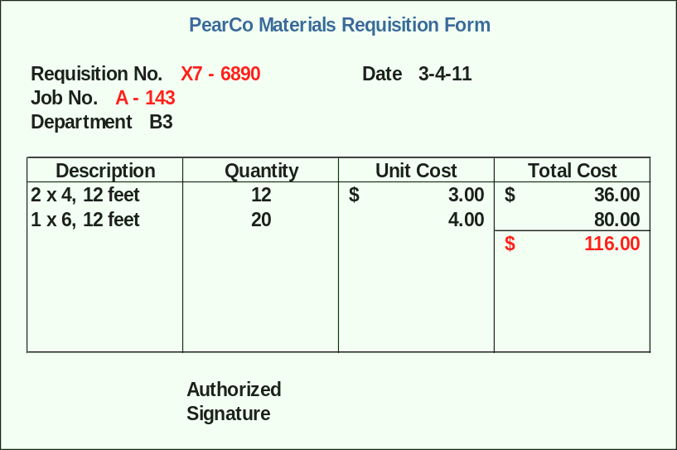
Measuring Direct Materials Cost
Will E. Delite
Notes:
Once a sales order has been received and a production order issued, the Production Department prepares a materials requisition form to specify the type, quantity, and total cost of materials.
Here is the materials requisition form completed for job A - 143. The requisition is number X7 - 6890. The worker has requested twelve 2 by 4s, 12 feet long, and twenty 1 by 6s, 12 feet long. The unit cost of the lumber is shown in the unit cost column. The quantity requested is multiplied by the unit cost to arrive at the total cost for materials. The person in charge of the storeroom will issue the lumber once the materials requisition form has been properly authorized.
For an existing product, the production department can refer to a bill of materials to determine the type and quantity of each item of materials needed to complete a unit of product.

Slide 11
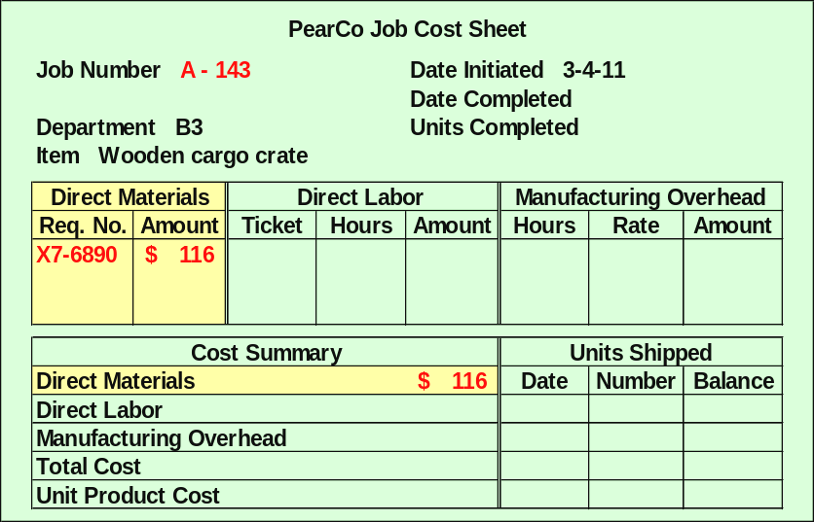
Measuring Direct Materials Cost
Notes:
Once the materials have been issued by the storeroom, they are charged to the job cost sheet for job number A – 143. The Accounting Department records the total direct cost, $116, on the appropriate job cost sheet. Notice, the material requisition number, X7-6869, is included on the job cost sheet to provide easy access to the source document. We have a proper reference for the requisition number and the total amount. If we need to look at the details of the $116 cost, we can ask to see materials requisition form X7-6890.

Slide 12
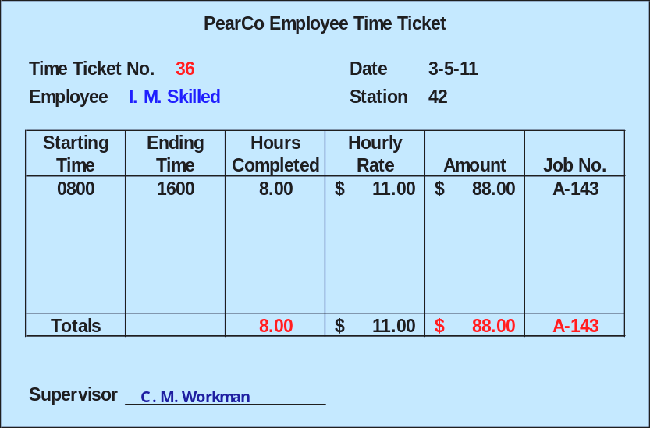
Measuring Direct Labor Costs
Notes:
Workers use time tickets to record the amount of time that they spent on each job. Rather than paper and pencil to maintain employee time tickets. A completed time ticket is an hour-by-hour summary of the employee’s activities throughout the day.
Here is the time ticket for an employee who worked eight hours on job A – 143. The employee’s hourly pay rate is $11, so the total labor cost charged to the job will be $88. The time ticket, number 36, serves as the major source document for labor costs charged to this job.
Let’s look at the labor posting to the job cost sheet.

Slide 13
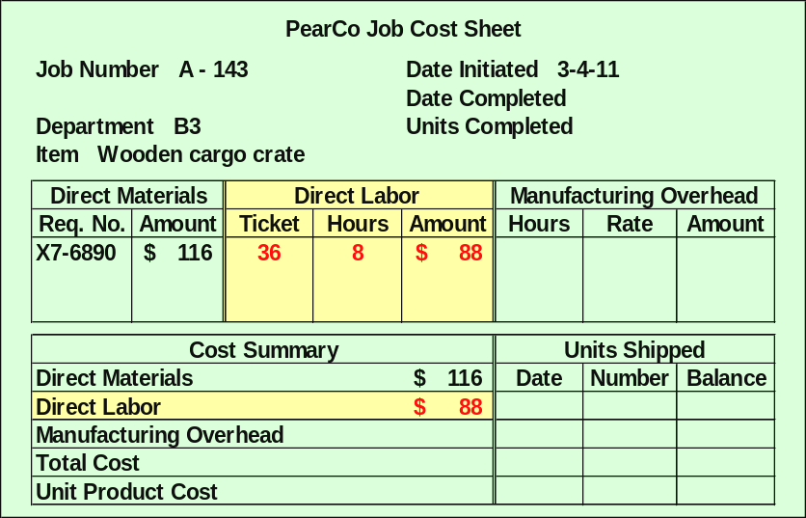
Job-Order Cost Accounting
Notes:
The Accounting Department records the labor costs from each time ticket onto the job cost sheet. On the job cost sheet, we can see that time ticket number 36 posted 8 hours to job A – 143. The total amount of direct labor cost is $88. This amount is also posted to the summary section of the job cost sheet.

Slide 14
Learning Objective 1
Compute a predetermined overhead rate.
Notes:
Learning objective number 1 is to compute a predetermined overhead rate.

Slide 15
Why Use an Allocation Base?
An allocation base, such as direct labor hours, direct labor dollars, or machine hours, is used to assign manufacturing overhead to individual jobs.
We use an allocation base because:
It is impossible or difficult to trace overhead costs to particular jobs.
Manufacturing overhead consists of many different items ranging from the grease used in machines to the production manager’s salary.
Many types of manufacturing overhead costs are fixed even though output fluctuates during the period.
Notes:
An allocation base, such as direct labor hours, direct labor dollars, or machine hours, is used to assign manufacturing overhead to products. Allocation bases are used because:
It is impossible or difficult to trace these costs to particular jobs (i.e., manufacturing overhead is an indirect cost).
Manufacturing overhead consists of many different items ranging from the grease used in machines to the production manager’s salary.
Many types of manufacturing overhead costs are fixed even though output may fluctuate during the year.

Slide 16
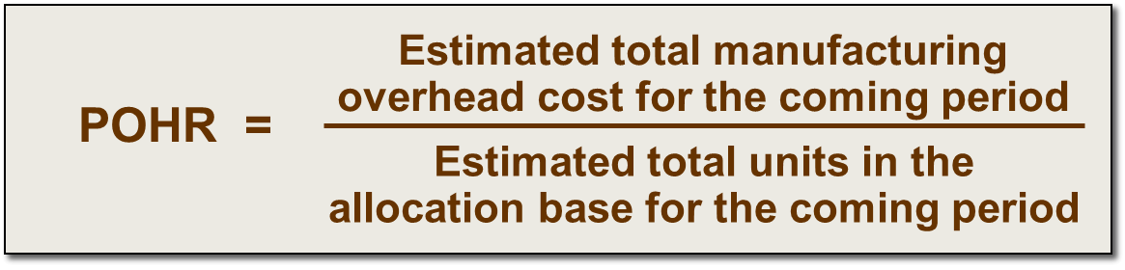
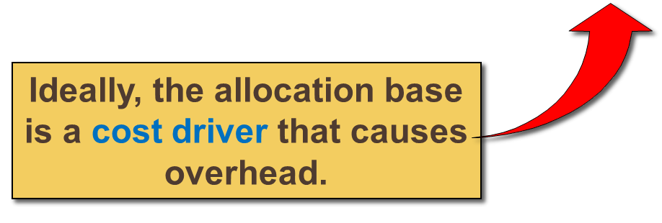
Manufacturing Overhead Application
The predetermined overhead rate (POHR) used to apply overhead to jobs is determined before the period begins.
Notes:
The predetermined overhead rate is calculated by dividing the estimated amount of manufacturing overhead for the coming period by the estimated quantity of the allocation base for the coming period. Ideally, the allocation base chosen should be the cost driver of overhead cost.

Slide 17

The Need for a POHR
Using a predetermined rate makes it
possible to estimate total job costs sooner.
Actual overhead for the period is not
known until the end of the period.
Notes:
Predetermined overhead rates that rely upon estimated data are often used because: (1) actual overhead costs for the period are not known until the end of the period, thus inhibiting the ability to estimate job costs during the period; and (2) actual overhead costs can fluctuate seasonally, thus misleading decision makers.

Slide 18
Computing Predetermined Overhead Rates
The predetermined overhead rate is computed before the period begins using a four-step process.
Estimate the total amount of the allocation base (the denominator) that will be required for next period’s estimated level of production.
Estimate the total fixed manufacturing overhead cost for the coming period and the variable manufacturing overhead cost per unit of the allocation base.
Use the following equation to estimate the total amount of manufacturing overhead:
Compute the predetermined overhead rate.
Y = a + bX
Where,
Y = The estimated total manufacturing overhead cost
a = The estimated total fixed manufacturing overhead cost
b = The estimated variable manufacturing overhead cost
per unit of the allocation base
X = The estimated total amount of the allocation base.
Notes:
The predetermined overhead rate is computed before the period begins using a four-step process.
Estimate the total amount of the allocation base (the denominator) that will be required for next period’s estimated level of production.
Estimate the total fixed manufacturing overhead cost for the coming period and the variable manufacturing overhead cost per unit of the allocation base.
Use the following equation to estimate the total amount of manufacturing overhead:
Y = a + bX
Where,
Y = The estimated total manufacturing overhead cost
a = The estimated total fixed manufacturing overhead cost
b = The estimated variable manufacturing overhead cost
per unit of the allocation base
X = The estimated total amount of the allocation base.
4. Compute the predetermined overhead rate.
Let’s look at a PearCo example.

Slide 19
Learning Objective 2
Apply overhead cost to jobs using a predetermined overhead rate.
Notes:
Learning objective number 2 is to apply overhead cost to jobs using a predetermined overhead rate.

Slide 20
Overhead Application Rate
PearCo estimates that it will require 160,000 direct labor-hours to meet the coming period’s estimated production level. In addition, the company estimates total fixed manufacturing overhead at $200,000, and variable manufacturing overhead costs of $2.75 per direct labor hour.
Y = a + bX
Y = $200,000 + ($2.75 per direct labor-hour × 160,000 direct labor-hours)
Y = $200,000 + $440,000
Y = $640,000
$640,000 estimated total manufacturing overhead
POHR =
160,000 estimated direct labor hours (DLH)
POHR = $4.00 per direct labor-hour
Notes:
PearCo estimates that it will require 160,000 direct labor hours to meet the coming period’s estimated production level. In addition, the company estimates total fixed manufacturing overhead at $200,000, and variable manufacturing overhead costs of $2.75 per direct labor hour.
Using the equation on the previous screen we calculation the estimated total manufacturing overhead as follows:
Y = a + bX
Y = $200,000 + ($2.75 per direct labor-hour × 160,000 direct labor-hours)
Y = $200,000 + $440,000
Y = $640,000
Calculating the predetermined overhead rate we divide the $640,000 estimated total manufacturing overhead by the 160,000 total estimated direct labor-hours to arrive at a rate of $4 per direct labor-hour worked on a specific job.

Slide 21
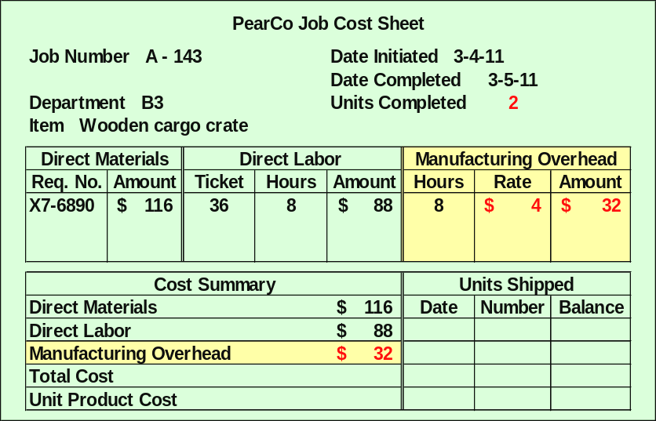
Job-Order Cost Accounting
Notes:
Recall that an employee worked a total of 8 hours on Job A-143. Our predetermined overhead rate is $4 per direct labor-hour, so we will apply $32 (8 hours times $4 per direct labor-hour) of overhead to this job. The computation is shown in the manufacturing overhead section of the job cost sheet and in the summary section.

Slide 22
Learning Objective 3
Compute the total cost and average cost per unit of a job.
Notes:
Learning objective number 3 is to compute the total cost and average cost per unit of a job.

Slide 23
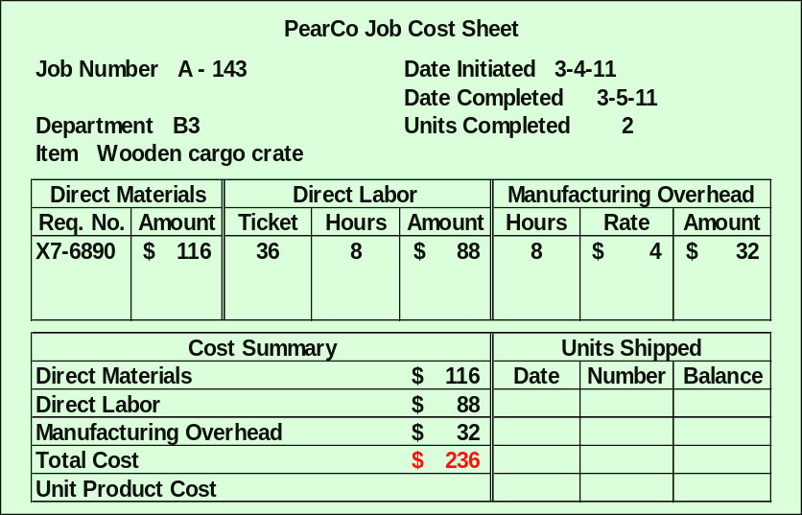
Job-Order Cost Accounting
Notes:
The total direct material, direct labor, and manufacturing overhead costs assigned to Job A-143 is $236.

Slide 24
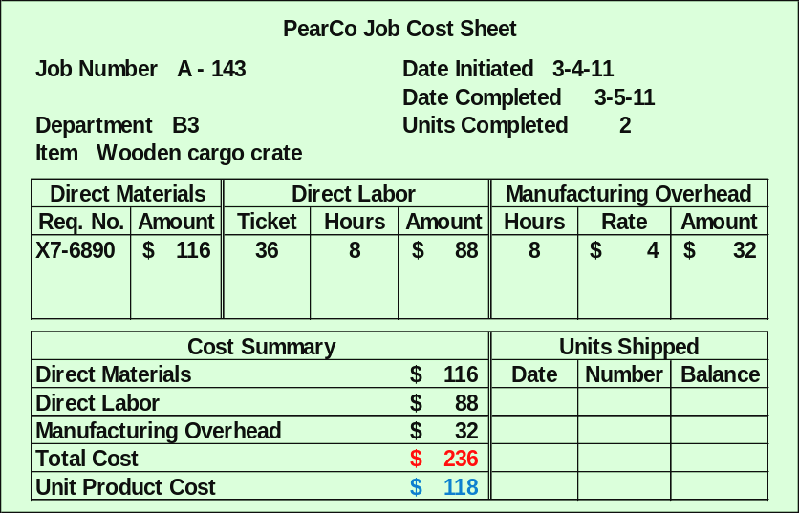
Job-Order Cost Accounting
Notes:
Since this particular job included 2 units of production, the average cost per unit is $118. We calculated the average cost by dividing the total cost of $236 by the 2 crates produced.
The average unit cost should not be interpreted as the costs that would actually be incurred if another unit was produced. The fixed overhead would not change if another unit were produced, so the incremental cost of another unit is something less than $118.

Slide 25

Quick Check ✓
Job WR53 at NW Fab, Inc. required $200 of direct materials and 10 direct labor hours at $15 per hour. Estimated total overhead for the year was $760,000 and estimated direct labor hours were 20,000. What would be recorded as the cost of job WR53?
  a. $200.
  b. $350.
  c. $380.
  d. $730.
Notes:
This problem may take a while to solve, but it will be well worth your time to work it carefully. Remember, we are interested in the total cost of the job. To answer this question, we will need all three elements of product cost at NW Fab, Inc.

Slide 26
Learning Objectives 4 and 5
Learning Objective 4 is to understand the flow of costs in the job-order costing system and prepare appropriate journal entries to record costs.
Learning Objective 5 is to use T-accounts to show the flow of costs in a job-order costing system.
Notes:
Learning objective number 4 is to understand the flow of costs in a job-order costing system and prepare appropriate journal entries to record costs.
Learning objective number 5 is to use T-accounts to show the flow of costs in a job-order costing system.

Slide 27
Key Definitions
Raw materials include any materials that go into the final product.
Work in process consists of units of production that are only partially complete and will require further work before they are ready for sale to customers.
Finished goods consist of completed units of product that have not been sold to customers.
Cost of goods manufactured include the manufacturing costs associated with the goods that were finished during the period,
Notes:
Some key definitions that we must understand before we start on the remainder of the chapter include:
Raw materials include any materials that go into the final product.
Work in process consists of units of production that are only partially complete and will require further work before they are ready for sale to customers.
Finished goods consist of completed units of product that have not been sold to customers.
Cost of goods manufactured include the manufacturing costs associated with the goods that were finished

Slide 28
Flow of Costs: A Conceptual Overview
Balance Sheet
Costs Inventories
Income
Statement
Expenses
Material Purchases
Raw Materials
Direct Labor
Work in
Process
Manufacturing
Overhead
Cost of
Goods
Sold
Finished
Goods
Selling and
Administrative
Period Costs
Selling and
Administrative
Notes:
Raw materials purchases are recorded in the Raw Materials inventory account.
When raw materials are used in production, their costs are transferred to the Work in Process inventory account as direct materials.
Direct labor costs are added directly to Work in Process—they do not flow through Raw Materials inventory.
Manufacturing overhead costs are applied to Work in Process by multiplying the predetermined overhead rate by the actual quantity of the allocation base consumed by each job.
When goods are completed, their costs are transferred from Work in Process to Finished Goods.
The amount transferred from Work in Process to Finished Goods is referred to as the cost of goods manufactured.
As goods are sold, their costs are transferred from Finished Goods to Cost of Goods Sold.
Period costs (or selling and administrative expenses) do not flow through inventories on the balance sheet. They are recorded as expenses on the income statement in the period incurred.

Slide 29

Job-Order Costing: The Flow of Costs
The transactions (in T-account and journal entry form) that capture the flow of costs in a job-order costing system are illustrated on the following slides.
Notes:
The transactions (in T-account and journal entry form) that capture the flow of costs in a job-order costing system are illustrated on the following slides.

Slide 30
The Purchase and Issue of Raw Materials: T-Account Form
Raw Materials
Work in Process
(Job Cost Sheet)
Material
Purchases
Direct
Materials
Direct
Materials
Indirect
Materials
Mfg. Overhead
Actual
Applied
Indirect
Materials
Notes:
When raw materials are purchased they are debited to the raw materials inventory account and credited to accounts payable.
The cost of direct material requisitions is debited to Work in Process and added to the job cost sheet which serve as a subsidiary ledger.
To account for the indirect materials requisition, the manufacturing overhead account is debited and the raw materials inventory account is credited.

Slide 31
Labor Costs
Salaries and Wages Payable
Work in Process
(Job Cost Sheet)
Direct
Labor
Direct
Materials
Indirect
Labor
Direct
Labor
Mfg. Overhead
Actual
Applied
Indirect
Materials
Indirect
Labor
Notes:
Direct labor is debited to Work in Process and added to the job cost sheet which serves as a subsidiary ledger and credited to salaries and wages payable.
Indirect labor is debited to Manufacturing Overhead and credited to salaries and wages payable.

Slide 32
Recording Actual Manufacturing Overhead
Salaries and Wages Payable
Work in Process
(Job Cost Sheet)
Direct
Labor
Direct
Materials
Indirect
Labor
Direct
Labor
Mfg. Overhead
Actual
Applied
Indirect
Materials
Indirect
Labor
Other
Overhead
Notes:
Additional manufacturing overhead amounts are debited to the manufacturing overhead account. The debit side of the manufacturing overhead account represents actual overhead incurred during the period. The credit side of the entry is the various liability accounts, for example, accounts payable and property taxes payable. The credit side will also include prepaid assets (like prepaid insurance) and contra accounts for items like depreciation.

Slide 33
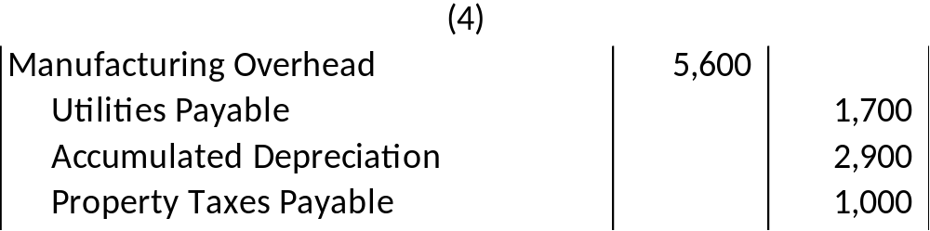
Recording Actual Manufacturing Overhead
During the month the company incurred the following actual overhead costs:
1. Utilities (heat, water, and power) $1,700
2. Depreciation of factory equipment $2,900
3. Property taxes payable on factory $1,000
Notes:
This journal entry represents the accumulation of other actual overhead amounts like property taxes on the manufacturing plant, utilities used in the manufacturing facility, and depreciation of manufacturing assets.

Slide 34
Applying Manufacturing Overhead
Salaries and Wages Payable
Work in Process
(Job Cost Sheet)
Direct
Labor
Direct
Materials
Indirect
Labor
Direct
Labor
Mfg. Overhead
Overhead
Applied
Actual
Applied
Indirect
Materials
If actual and applied manufacturing overhead
are not equal, a year-end adjustment is required.
Overhead
Applied to Work in
Process
Indirect
Labor
Other
Overhead
Notes:
The manufacturing overhead account is a clearing account. The actual amount of overhead incurred during the period on the debit side of the account will almost certainly not equal the amount applied to work in process on the credit side of the account. This requires a year-end adjustment.
When we apply overhead to a particular job, we debit work in process inventory (and the job cost sheet) and credit the manufacturing overhead account. Amounts on the credit side of the manufacturing overhead account represent overhead applied.
The Manufacturing Overhead account is a clearing account. The actual amount of overhead incurred during the period on the debit side of the account will almost certainly not equal the amount applied to Work in Process as shown on the credit side of the account. This requires a year-end adjusting entry that will be discussed shortly.

Slide 35
Accounting for Nonmanufacturing Cost
Nonmanufacturing costs are not assigned to individual jobs, rather they are expensed in the period incurred.
Examples:
1. Salary expense of employees
who work in a marketing, selling,
or administrative capacity.
2. Advertising expenses are expensed
in the period incurred.
Notes:
Period costs are not directly related to the actual manufacture of the products, they are expensed as incurred. We previously discussed the treatment of selling, general, and administrative salaries expense during the period. Nonmanufacturing costs are charged to the respective expense accounts (marketing, selling, administrative) in the period the expenses were incurred.
Nonmanufacturing costs should not go into the Manufacturing Overhead account. Nonmanufacturing costs are not assigned to individual jobs, rather they are expensed in the period incurred. Examples include salary expense of employees who work in marketing, selling or administrative capacity and advertising expenses. Let’s look at an example of the journal entry for nonmanufacturing costs.

Slide 36

Transferring Completed Units
Work in Process
(Job Cost Sheet )
Finished Goods
Direct
Materials
Cost of
Goods
Mfd.
Cost of
Goods
Mfd.
Direct
Labor
Overhead
Applied
Notes:
The sum of all amounts transferred from work in process to finished goods represents the cost of goods manufactured for the period. As a job is completed, its costs are transferred from the work in process inventory to finished goods inventory.

Slide 37
Transferring Units Sold
Work in Process
(Job Cost Sheet)
Finished Goods
Direct
Materials
Cost of
Goods
Mfd.
Cost of
Goods
Sold
Cost of
Goods
Mfd.
Direct
Labor
Overhead
Applied
Cost of Goods Sold
Cost of
Goods
Sold
Notes:
When a finished job is sold to the customer, the cost of that job is transferred from finished goods inventory to cost of goods sold. Recall that cost of goods sold is an income statement account. If only a portion of the units associated with a particular job are shipped, then the unit cost figure from the job cost sheet is used to determine the amount of the journal entry.

Slide 38
Learning Objective 6
Prepare schedules of cost of goods manufactured and cost of goods sold and an income statement.
Notes:
Learning objective number 6 is to prepare schedules of cost of goods manufactured and cost of goods sold and an income statement.

Slide 39
Schedule of Cost of Goods Manufactured: Key Concepts
    This schedule contains three types of costs, namely direct materials, direct labor, and manufacturing overhead.
    It calculates the manufacturing costs associated with goods that were finished during the period.
    It calculates the cost of raw material and direct labor used in production and the amount of manufacturing overhead applied to production.
Notes:
The schedule of cost of goods manufactured contains the three elements of costs mentioned previously, namely direct materials, direct labor, and manufacturing overhead. It calculates the cost of raw material, direct labor, and manufacturing overhead applied to production. It also calculates the manufacturing costs associated with goods that were finished during the period.

Slide 40
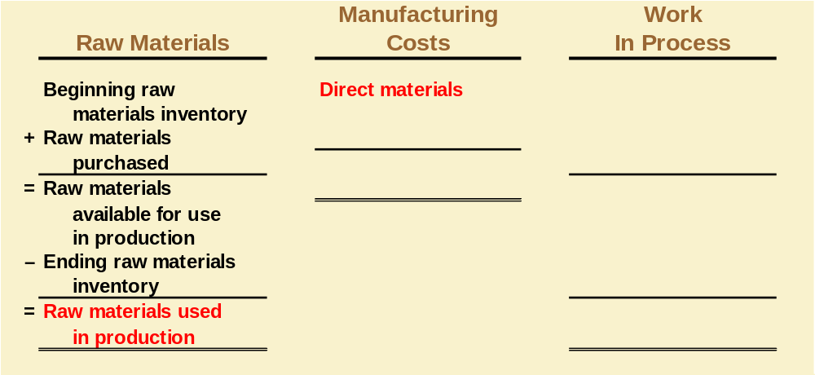
Product Cost Flows
As items are removed from raw materials inventory and placed into the production process, they are
called direct materials.
Notes:
To create a schedule of cost of goods manufactured, as well as a balance sheet and income statement, it is important to understand the flow of product costs.
Raw material purchases made during the period are added to beginning raw materials inventory. The ending raw materials inventory is deducted to arrive at the raw materials used in production.
As items are removed from the raw materials inventory and placed into the production process, they are called direct materials.

Slide 41
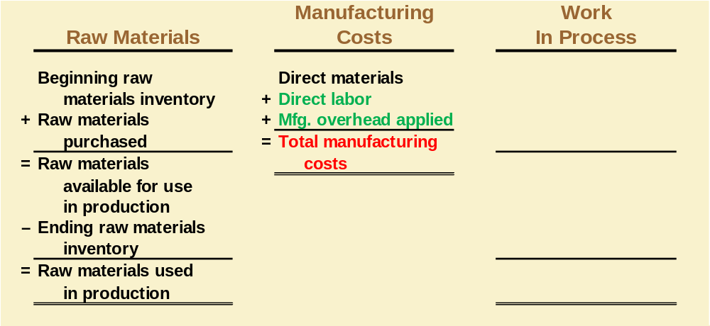
Product Cost Flows
Conversion costs are costs incurred to convert the direct material into a finished product.
Notes:
Direct labor used in production and manufacturing overhead applied to production (also called conversion costs) are added to direct materials to arrive at total manufacturing costs.

Slide 42
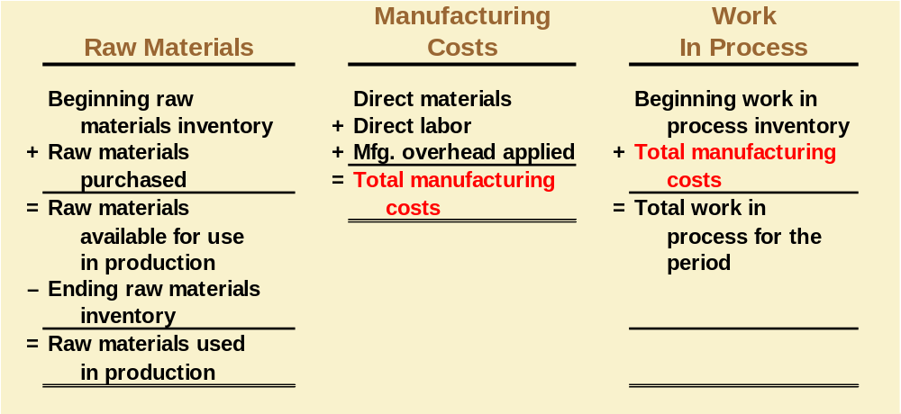
Product Cost Flows
All manufacturing costs added to production during the period are added to the beginning balance of work in process.
Notes:
Total manufacturing costs are added to the beginning work in process to arrive at total work in process.

Slide 43
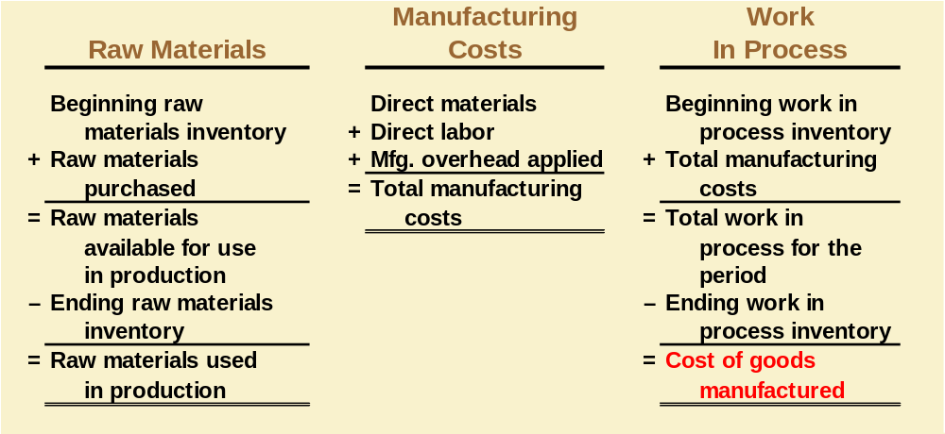
Product Cost Flows
Costs associated with the goods that are completed during the period are transferred to finished goods inventory.
Notes:
The ending work in process inventory is deducted from the total work in process for the period to arrive at the cost of goods manufactured.

Slide 44
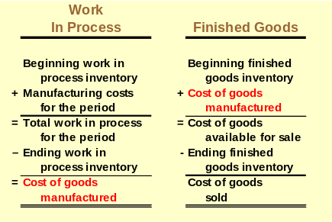
Product Cost Flows
Notes:
The cost of goods manufactured is added to the beginning finished goods inventory to arrive at cost of goods available for sale. The ending finished goods inventory is deducted from this figure to arrive at cost of goods sold.

Slide 45
Quick Check ✓
Beginning raw materials inventory was $32,000. During the month, $276,000 of raw material was purchased. A count at the end of the month revealed that $28,000 of raw material was still present. What is the cost of direct material used?
    $276,000
    $272,000
    $280,000
    $ 2,000
Notes:
Beginning raw materials inventory was $32,000. During the month, $276,000 of raw material was purchased. A count at the end of the month revealed that $28,000 of raw material was still present. What is the cost of direct material used?

Slide 46
Quick Check ✓
Direct materials used in production totaled $280,000. Direct labor was $375,000, and $180,000 of manufacturing overhead was added to production for the month. What were total manufacturing costs incurred for the month?
    $555,000
    $835,000
    $655,000
    Cannot be determined.
Notes:
Direct materials used in production totaled $280,000. Direct labor was $375,000, and $180,000 of manufacturing overhead was added to production for the month. What were total manufacturing costs incurred for the month?

Slide 47
Quick Check ✓
Beginning work in process was $125,000. Manufacturing costs added to production for the month were $835,000. There were $200,000 of partially finished goods remaining in work in process inventory at the end of the month. What was the cost of goods manufactured during the month?
    $1,160,000
    $ 910,000
    $ 760,000
    Cannot be determined.
Notes:
Beginning work in process was $125,000. Manufacturing costs incurred for the month were $835,000. There were $200,000 of partially finished goods remaining in work in process inventory at the end of the month. What was the cost of goods manufactured during the month?

Slide 48
Quick Check ✓
Beginning finished goods inventory was $130,000. The cost of goods manufactured for the month was $760,000. And the ending finished goods inventory was $150,000. What was the cost of goods sold for the month?
  $ 20,000
  $740,000
  $780,000
  $760,000
Notes:
Beginning finished goods inventory was $130,000. The cost of goods manufactured for the month was $760,000. And the ending finished goods inventory was $150,000. What was the cost of goods sold for the month?

Slide 49
Learning Objective 7
Compute underapplied or overapplied overhead cost and prepare the journal entry to close the balance in Manufacturing Overhead to the appropriate accounts.
Notes:
Learning objective number 7 is to compute underapplied or overapplied overhead cost and prepare the journal entry to close the balance in Manufacturing Overhead to the appropriate accounts.

Slide 50
Underapplied and Overapplied Overhead―A Closer Look
The difference between the overhead cost applied to Work in Process and the actual overhead costs of a period is referred to as either underapplied or overapplied overhead.
Underapplied overhead exists when the amount of overhead applied to jobs during the period using the predetermined overhead rate is less than the total amount of overhead actually incurred during the period.
Overapplied overhead exists when the amount of overhead applied to jobs during the period using the predetermined overhead rate is greater than the total amount of overhead actually incurred during the period.
Notes:
When we apply overhead on the basis of a predetermined overhead rate, it’s likely that the amount of overhead applied will be different from the amount of overhead actually incurred during the period. When there is a difference, we refer to the amount as either underapplied overhead or overapplied overhead.
Underapplied overhead exists when the amount of overhead applied to jobs during the period using the predetermined overhead rate is less than the total amount of overhead actually incurred during the period.
Overapplied overhead exists when the amount of overhead applied to jobs during the period using the predetermined overhead rate is greater than the total amount of overhead actually incurred during the period.

Slide 51
Overhead Application Example
PearCo’s actual overhead for the year was $650,000 with a total of 170,000 direct labor hours worked on jobs.
How much total overhead was applied to PearCo’s jobs during the year? Use PearCo’s predetermined overhead rate of $4.00 per direct labor hour.
Overhead Applied During the Period
Applied Overhead = POHR × Actual Direct Labor Hours
Applied Overhead = $4.00 per DLH × 170,000 DLH = $680,000
Notes:
Let’s assume that PearCo incurred actual overhead of $650,000 during the period and worked a total of 170,000 direct labor hours. PearCo applies overhead at the rate of $4 per direct labor hour worked. How much overhead did PearCo apply to jobs during the period?
PearCo would have applied $680,000 of overhead during the period. That is $4 per direct labor hour times the 170,000 direct labor hours actually worked. Can you see our problem?

Slide 52
Quick Check ✓
Tiger, Inc. had actual manufacturing overhead costs of $1,210,000 and a predetermined overhead rate of $4.00 per machine hour. Tiger, Inc. worked 290,000 machine hours during the period. Tiger’s manufacturing overhead is:
a. $50,000 overapplied.
b. $50,000 underapplied.
c. $60,000 overapplied.
d. $60,000 underapplied.
Notes:
In this question, you are asked to calculate the overapplied or underapplied overhead. Be careful with your intermediate computations.

Slide 53
Disposition of Under- or Overapplied Overhead
PearCo’s Method
$30,000
may be allocated
to these accounts.
$30,000 may be
closed directly to
cost of goods sold.
OR
Work in
Process
Finished
Goods
Cost of
Goods Sold
Cost of
Goods Sold
Notes:
There are two ways to dispose of over- or underapplied overhead. The more complex approach is to allocate a portion of the over- or underapplied overhead to work in process inventory, finished goods inventory, and cost of goods sold. The allocation would be based on the relative dollar value in each of the three accounts involved.
An easier way to deal with the problem, and the method PearCo uses, is to adjust cost of goods sold for the entire amount of the over- or underapplied overhead.

Slide 54
Disposition of Under- or Overapplied Overhead
PearCo’s Cost
of Goods Sold
PearCo’s
Mfg. Overhead
Unadjusted Balance
Actual
overhead costs
$650,000
Overhead applied
to jobs
$680,000
$30,000
Adjusted
Balance
$30,000
$30,000
overapplied
Notes:
We know that PearCo applied $680,000 of overhead but incurred only $650,000 of actual overhead. The manufacturing overhead account has a $30,000 credit balance, representing the overapplied overhead during the year.
PearCo chooses to adjust cost of goods sold for the entire amount. The adjustment necessary at the end of the year is to debit the manufacturing overhead account for $30,000, and credit, or reduce, cost of goods sold by the same amount.

Slide 55
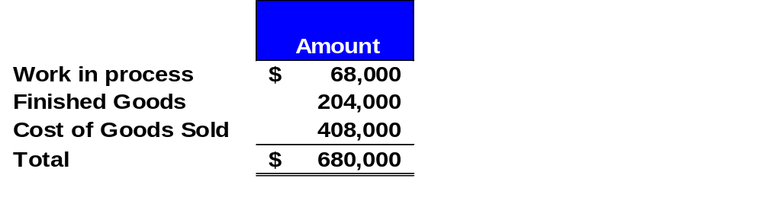

Allocating Under- or Overapplied
Overhead Between Accounts
Assume the overhead applied in ending Work in Process Inventory, ending Finished Goods Inventory, and Cost of Goods Sold is shown below:
Notes:
Let’s assume that at the end of the period PearCo had the following overhead costs in each of the accounts shown. We may elect to allocate the over- or underapplied overhead to ending Work in Process Inventory, ending Finished Goods Inventory, and Cost of Goods Sold.

Slide 56
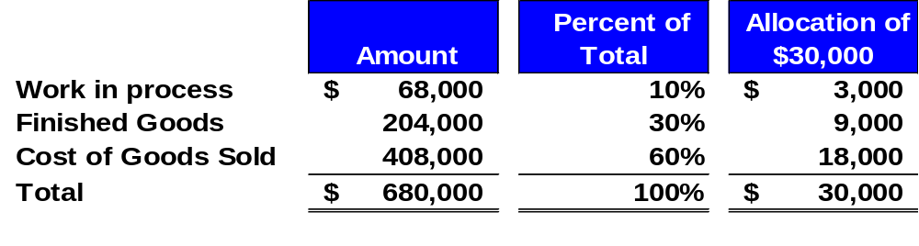
Allocating Under- or Overapplied
Overhead Between Accounts
We would complete the following allocation of $30,000 overapplied overhead:
$68,000 ÷ $680,000
10% × $30,000
Notes:
We will complete the following allocation of the $30,000 of overapplied overhead. We will reduce ending Work in Process Inventory by $3,000, Finished Goods Inventory by $9,000, and Cost of Goods Sold for the period by $18,000.

Slide 57
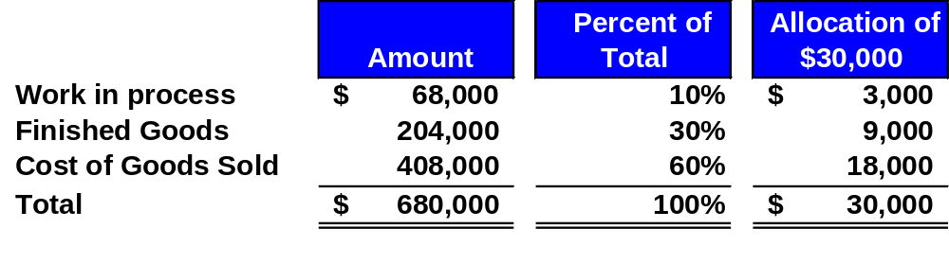
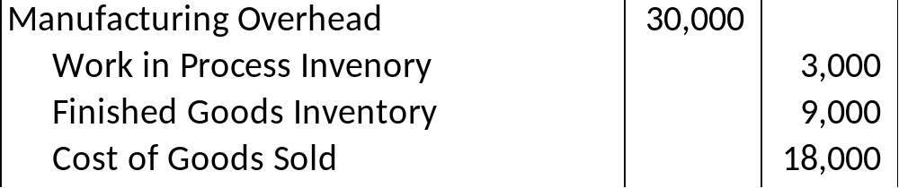
Allocating Under- or Overapplied
Overhead Between Accounts
Notes:
The journal entry to record the allocation is to debit Manufacturing Overhead for $30,000, credit Work in Process Inventory for $3,000, credit Finished Goods Inventory for $9,000, and credit Cost of Goods Sold for $18,000.

Slide 58
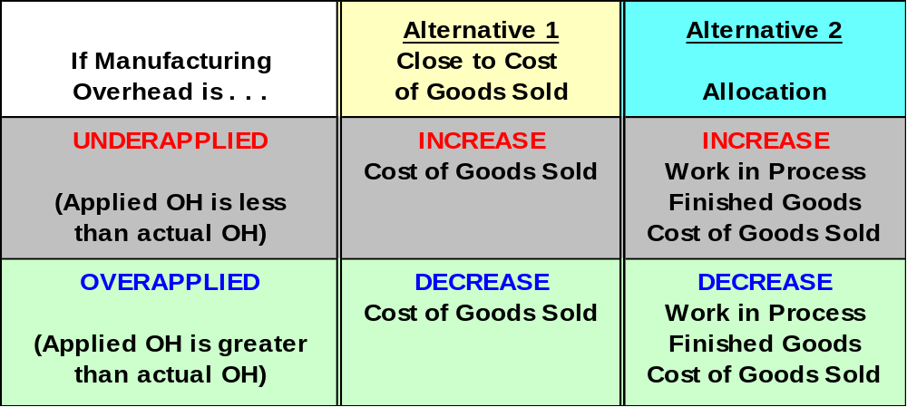
Overapplied and Underapplied Manufacturing Overhead - Summary
PearCo’s Method
More accurate but more complex to compute.
Notes:
We have provided a good study aid for dealing with overapplied or underapplied overhead. We have shown the impact of both the allocation approach to the solution to the problem and the direct adjustment to cost of goods sold approach. Alternative 2 is considered more accurate, but it is more complex to apply. It is a good idea to review this chart before your next exam.

Slide 59
Quick Check ✓
What effect will the overapplied overhead have on PearCo’s net operating income?
  a. Net operating income will increase.
  b. Net operating income will be unaffected.
  c. Net operating income will decrease.
Notes:
Give this question some thought before deciding on your answer.

Slide 60
Multiple Predetermined Overhead Rates
To this point, we have assumed that there is a single predetermined overhead rate called a plantwide overhead rate.
Large companies often use multiple predetermined overhead rates.
May be more complex but . . .
May be more accurate because it reflects differences across departments.
Notes:
We have assumed that the company has used one single predetermined overhead rate for the entire factory.
Many large companies use multiple predetermined overhead rates.
Using multiple overhead rates can create more complexity. However, the use of multiple rates promotes greater accuracy in the allocation process because it reflects the differences across departments in how overhead costs are incurred.

Slide 61



Job-Order Costing in Service Companies
Job-order costing is used in many different types of service companies.
Notes:
Although our attention has focused upon manufacturing applications, it bears re-emphasizing that job-order costing is also used in services industries. In a law firm, each client represents a job. Legal forms and similar inputs represent direct materials. The time expended by attorneys represents direct labor. The costs of secretaries, clerks, rent, depreciation, and so forth, represent the overhead.

