Slide 1
Profit Planning
Chapter 8
Notes:
Chapter 8: Profit Planning
This chapter focuses on the steps taken by businesses to achieve their planned levels of profits - a process called profit planning. Profit planning is accomplished by preparing numerous budgets, which, when brought together, form an integrated business plan known as a master budget.

Slide 2
Learning Objective 1
Understand why organizations budget and the processes they use to create budgets.
Notes:
Learning objective number 1 is to understand why organizations budget and the processes they use to create budgets.

Slide 3
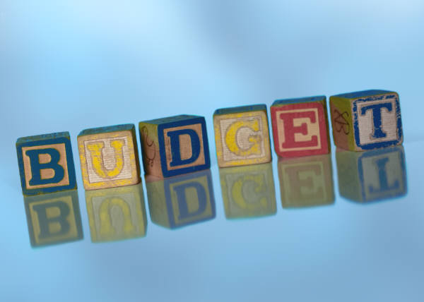
The Basic Framework of Budgeting
A budget is a detailed quantitative plan for acquiring and using financial and other resources over a specified forthcoming time period.
The act of preparing a budget is called budgeting.
The use of budgets to control an organization’s activities is known as budgetary control.
Notes:
A budget is a detailed quantitative plan for acquiring and using financial and other resources over a specified forthcoming time period. The act of preparing a budget is called budgeting. The use of budgets to control an organization’s activities is known as budgetary control.

Slide 4


Planning and Control
Planning –
involves developing objectives and preparing various budgets to achieve those objectives.
Control –
involves the steps taken by management to increase the likelihood that the objectives set down while planning are attained and that all parts of the organization are working together toward that goal.
Notes:
Planning involves developing objectives and preparing various budgets to achieve those objectives.
Control involves the steps taken by management to increase the likelihood that the objectives set down at the planning stage are attained and that all parts of the organization are working together toward that goal.
To be effective, a good budgeting system must provide for both planning and control. Good planning without effective control is time wasted.

Slide 5
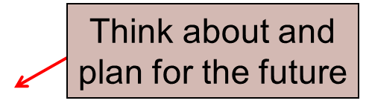
Advantages of Budgeting
Define goals
and objectives
Communicate
plans
Advantages
Coordinate
activities
Means of allocating
resources
Uncover potential
bottlenecks
Notes:
Budgets communicate management’s plans throughout the organization. Budgets force managers to think about and plan for the future. The budgeting process provides a means of allocating resources to those parts of the organization where they can be used most effectively. The budget process can uncover potential bottlenecks before they occur. Budgets coordinate the activities of the entire organization by integrating the plans of its various parts. Budgets define goals and objectives that can serve as benchmarks for evaluating subsequent performance.
While our focus in this chapter is on preparing operating budgets for a one-year time frame, longer term budgets also can be very helpful to organizations from a planning standpoint.

Slide 6

Responsibility Accounting
Managers should be held responsible for those items - and only those items - that they can actually control
to a significant extent.
Notes:
The premise of responsibility accounting is that managers should be held responsible only for those items that they can control to a significant extent. Responsibility accounting systems enable organizations to react quickly to deviations from their plans and to learn from feedback obtained by comparing budgeted goals to actual results. The point is not to penalize individuals for missing targets.

Slide 7

Choosing the Budget Period
Operating Budget
2011
2012
2013
2014
Operating budgets ordinarily
cover a one-year period
corresponding to a company’s fiscal year. Many companies divide their annual budget
into four quarters.
A continuous budget is a
12-month budget that rolls
forward one month (or quarter)
as the current month (or quarter)
is completed.
Notes:
Operating budgets ordinarily cover a one-year period corresponding to a company’s fiscal year. Many companies divide their annual budget into four quarters. In this chapter, we focus on one-year operating budgets.
A continuous or perpetual budget is a 12-month budget that rolls forward one month (or quarter) as the current month (or quarter) is completed. This approach keeps managers focused on the future at least one year ahead.

Slide 8
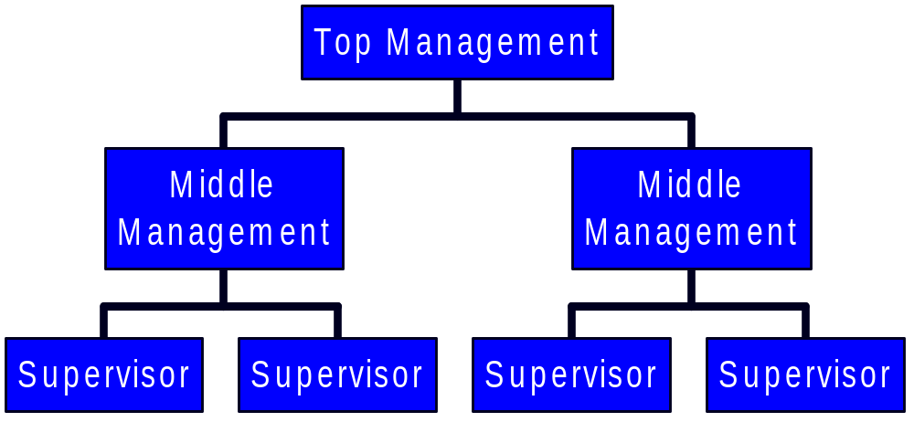
Self-Imposed Budget
A self-imposed budget or participative budget is a budget that is prepared with the full cooperation and participation of managers at all levels.
Notes:
A self-imposed budget or participative budget is a budget that is prepared with the full cooperation and participation of managers at all levels. It is a particularly useful approach if the budget will be used to evaluate managerial performance.

Slide 9
Advantages of Self-Imposed Budgets
Individuals at all levels of the organization are viewed as members of the team whose judgments are valued by top management.
Budget estimates prepared by front-line managers are often more accurate than estimates prepared by top managers.
Motivation is generally higher when individuals participate in setting their own goals than when the goals are imposed from above.
A manager who is not able to meet a budget imposed from above can claim that it was unrealistic. Self-imposed budgets eliminate this excuse.
Notes:
The key to self-imposed budgets is to get operational managers involved in the budgeting process and to clearly state their goals and expectations. Here is a list of four major advantages of self-imposed budgets.
First, individuals at all levels of the organization are viewed as members of the team whose judgments are valued by top management.
Second, budget estimates prepared by front-line managers (who have intimate knowledge of day-to-day operations) are often more accurate than estimates prepared by top managers.
Third, motivation is generally higher when individuals participate in setting their own goals than when the goals are imposed from above.
Fourth, a manager who is not able to meet a budget imposed from above can claim that it was unrealistic. Self-imposed budgets eliminate this excuse.

Slide 10

Self-Imposed Budgets
Self-imposed budgets should be reviewed by higher levels of management to prevent “budgetary slack.”
Most companies issue broad guidelines in terms of overall profits or sales. Lower level managers are directed to prepare budgets that meet those targets.
Notes:
Self-imposed budgets should be reviewed by higher levels of management. Without such a review, self-imposed budgets may have too much “budgetary slack,” or may not be aligned with overall strategic objectives. Most companies do not rely exclusively upon self-imposed budgets in the sense that top managers usually initiate the budget process by issuing broad guidelines in terms of overall target profits or sales. Lower level managers are directed to prepare budgets that meet those targets.

Slide 11

Human Factors in Budgeting
The success of a budget program depends on three important factors:
Top management must be enthusiastic and
committed to the budget process.
Top management must not use the budget to
pressure employees or blame them when
something goes wrong.
Highly achievable budget targets are usually
preferred when managers are rewarded based on
meeting budget targets.
Notes:
The success of a budget program depends upon three important factors:
Top management must be enthusiastic and committed to the budget process, otherwise nobody will take it seriously.
Top management must not use the budget to pressure employees or blame them when something goes wrong. This breeds hostility and mistrust rather than cooperative and coordinated efforts.
Highly achievable budget targets are usually preferred (rather than “stretch budget” targets) when managers are rewarded based on meeting budget targets.

Slide 12
The Master Budget: An Overview
Sales budget
Selling and
administrative
budget
Ending inventory
budget
Production budget
Direct materials
budget
Direct labor
budget
Manufacturing
overhead budget
Cash Budget
Budgeted
income
statement
Budgeted
balance sheet
Notes:
The master budget consists of a number of separate but interdependent budgets. We have developed this schematic of the budgeting process to illustrate the interdependency of the various individual budgets. The sales budget shows the expected sales for the budget period expressed in dollars and units. It is usually based on a company’s sales forecast. All other parts of the master budget are dependent on the sales budget.
The production budget is prepared after the sales budget. It lists the number of units that must be produced during each budget period to meet sales needs and to provide for the desired ending inventory. The production budget in turn directly influences the direct materials, direct labor, and manufacturing overhead budgets, which in turn enable the preparation of the ending finished goods inventory budget. These budgets are then combined with data from the sales budget and the selling and administrative expense budget to determine the cash budget. The cash budget is a detailed plan showing how cash resources will be acquired and used over a specified time period. All of the operating budgets have an impact on the cash budget.
The last step of the process is to prepare a budgeted income statement and a budgeted balance sheet.

Slide 13
Learning Objective 2
Prepare a sales budget, including a schedule of expected cash collections.
Notes:
Learning objective number 2 is to prepare a sales budget, including a schedule of expected cash collections.

Slide 14
Budgeting Example
Royal Company is preparing budgets for the
quarter ending June 30th.
Budgeted sales for the next five months are:
  April 20,000 units
  May 50,000 units
  June 30,000 units
  July 25,000 units
  August 15,000 units
The selling price is $10 per unit.
Notes:
The marketing department of Royal Company prepares the following information that will be used to prepare a budget for the quarter ending June 30th.

Slide 15
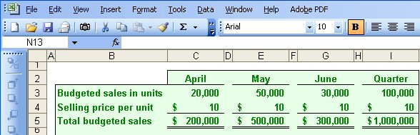
The Sales Budget
The individual months of April, May, and June are summed to obtain the total budgeted sales in units and dollars for the quarter ended June 30th
Notes:
Royal sells only one product and that product has a selling price of $10 per unit. To calculate the total sales in dollars for any period, we multiply the budgeted sales in units times the unit selling price. As you can see, Royal forecasts unit sales of 100,000 and total sales revenue of $1,000,000 for the quarter ended June 30th.
Once we complete the sales budget, we can move on to the expected cash collections from sales.

Slide 16
Expected Cash Collections
All sales are on account.
Royal’s collection pattern is:
  70% collected in the month of sale,
  25% collected in the month following sale,
  5% uncollectible.
In April, the March 31st accounts receivable balance of $30,000 will be collected in full.
Notes:
All sales at Royal are made on account. The company collects 70 percent of the sales revenue in the month of sale, 25 percent in the following month, and estimates that 5 percent of all credit sales will prove uncollectible.
At the start of the quarter, Royal had $30,000 in accounts receivable that were deemed to be fully collectible.
Let’s prepare the budget of expected cash collections on sales.

Slide 17
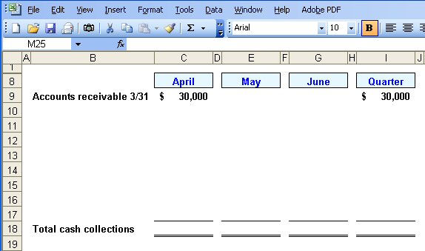
Expected Cash Collections
Notes:
The first step in calculating Royal’s cash collections is to insert the March 31st beginning accounts receivable, $30,000, into the April column of the cash collections schedule. This balance will be collected in full in April.

Slide 18
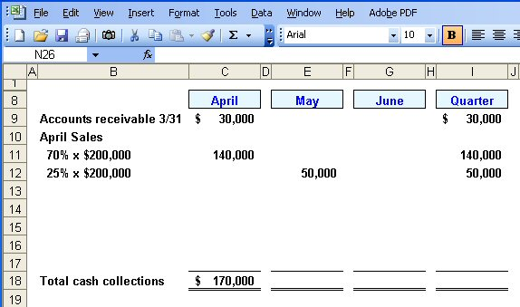
Expected Cash Collections
From the Sales Budget for April.
Notes:
The second step is to calculate the April credit sales that will be collected during each month of the quarter. We will collect another $140,000 ($200,000 times 70 percent) in April. In addition, 25% of April projected sales will be collected in May, so $50,000 of April sales will be collected in May. Finally, 5 percent of April’s sales will prove to be uncollectible. This amounts to $10,000 ($200,000 times 5 percent).

Slide 19
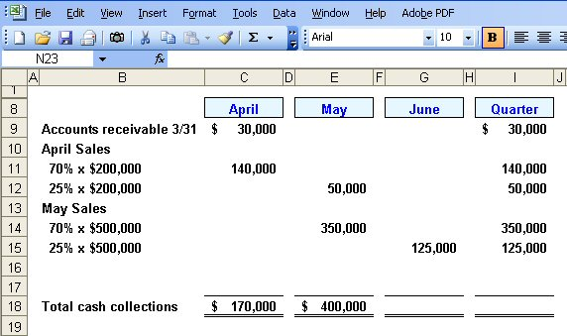
Expected Cash Collections
From the Sales Budget for May.
Notes:
The third step is to calculate the May credit sales that will be collected during each month of the quarter. We will collect $350,000 ($500,000 times 70 percent) in the month of May and an additional 25 percent of the $500,000 will be collected in June. Finally, 5 percent of May’s sales will prove to be uncollectible. The uncollectible amount will be $25,000 ($500,000 times 5 percent).
Can you complete the final month of June to get the total expected cash collections for the quarter?

Slide 20

Quick Check ✓
What will be the total cash collections for the quarter?
  a. $700,000
  b. $220,000
  c. $190,000
  d. $905,000
Notes:
Take your time and remember that we are asking for the total cash collections for the quarter ended June 30th.

Slide 21
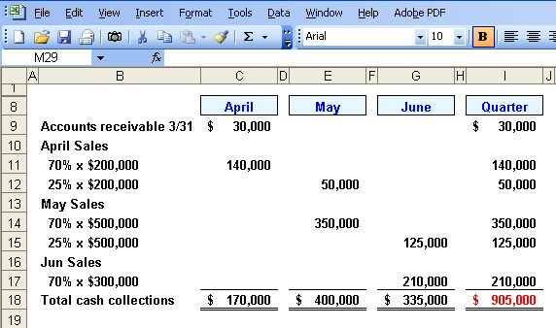
Expected Cash Collections
Notes:
The fourth step is to calculate the June credit sales that will be collected during the month of June. We expect to collect $210,000 ($300,000 times 70 percent) from June sales in the month of June.
The fifth step is to calculate the total for each column in the schedule and the total for the quarter ($905,000).
Now let’s turn our attention to the production budget.

Slide 22
Learning Objective 3
Prepare a production budget.
Notes:
Learning objective number 3 is to prepare a production budget.

Slide 23

The Production Budget
Sales
Budget
and
Expected
Cash
Collections
Production
Budget
Completed
The production budget must be adequate to
meet budgeted sales and to provide for
the desired ending inventory.
Notes:
After we have budgeted our sales and expected cash collection, we must make sure the production budget is adequate to meet the forecasted sales and to provide for the desired ending inventory. We need inventory on hand at the end of the period to minimize the likelihood of an inventory stock-out.

Slide 24
The Production Budget
The management at Royal Company wants ending inventory to be equal to 20% of the following month’s budgeted sales in units.
On March 31st, 4,000 units were on hand.
Let’s prepare the production budget.
Notes:
The management at Royal wants to minimize the probability of a stock out of inventory items. A policy has been implemented that requires the company to maintain ending inventory of 20 percent of the following month’s budgeted sales. At the beginning of the quarter, Royal had 4,000 units in inventory. If Royal was a merchandising company it would prepare a merchandise purchases budget instead of a production budget.
Let’s get started on the production budget.

Slide 25
Quick Check ✓
What is the required production for May?
  a. 56,000 units
  b. 46,000 units
  c. 62,000 units
  d. 52,000 units
Notes:
What did you calculate as the required production for May?

Slide 26
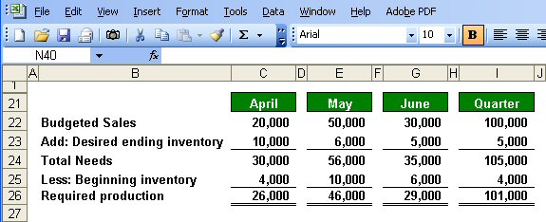

The Production Budget
Assumed ending inventory.
Notes:
The fourth step is to calculate the required production for June (29,000 units). Notice, we are assuming a desired ending inventory of 5,000 units. This implies that projected sales in July are 25,000 units because 20 percent of 25,000 units is 5,000 units.
The fifth step is to complete the Quarter columns. Notice, April’s beginning inventory and June’s ending inventory are carried over to the column. For the quarter, we will need to produce 101,000 units to meet our sales and inventory goals. Now that we know our required production, let’s look at the direct materials budget.

Slide 27
Learning Objective 4
Prepare a direct materials budget, including a schedule of expected cash disbursements for purchases of materials.
Notes:
Learning objective number 4 is to prepare a direct materials budget, including a schedule of expected cash disbursements for purchases of materials.

Slide 28
The Direct Materials Budget
At Royal Company, five pounds of material are required per unit of product.
Management wants materials on hand at the end of each month equal to 10% of the following month’s production.
On March 31, 13,000 pounds of material are on hand. Material cost is $0.40 per pound.
Let’s prepare the direct materials budget.
Notes:
Each good unit of output requires 5 pounds of direct material. Management does not want to run out of direct materials, so a policy has been established that materials on hand at the end of each month must be equal to 10% of the following month’s production. At the beginning of the month, Royal has 13,000 pounds of direct material on hand. Each pound of direct material costs $0.40.
Let’s complete the direct materials budget.

Slide 29
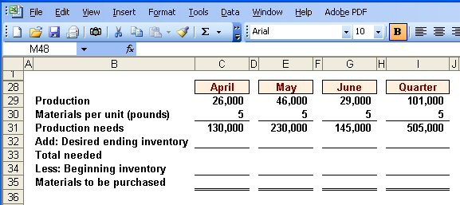
The Direct Materials Budget
From production budget.
Notes:
The first step in preparing the direct materials budget is to insert the required production in units from the production budget.

Slide 30
The Direct Materials Budget
Notes:
The second step is to calculate the monthly and quarterly production needs, which in this case are stated in terms of pounds of direct material.

Slide 31
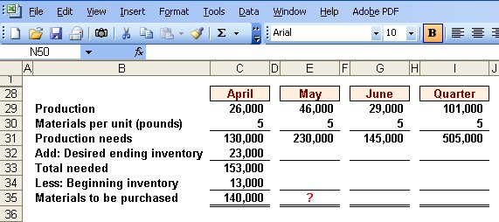
The Direct Materials Budget
March 31 inventory.
10% of following month’s production needs.
Calculate the materials to
be purchased in May.
Notes:
The third step is to calculate the materials to be purchased for April (140,000 pounds).
April’s desired ending inventory is equal to 10% of May’s production needs, or 23,000 pounds. The total number of pounds needed in April is 153,000 pounds.
Finally, we subtract our materials on hand to determine the number of pounds of material that must be purchased. During April, Royal must purchase 140,000 pounds of direct materials.

Slide 32
Quick Check ✓
How much materials should be purchased in May?
  a. 221,500 pounds
  b. 240,000 pounds
  c. 230,000 pounds
  d. 211,500 pounds
Notes:
Refer back to the previous slide and determine how much materials should be purchased in May.

Slide 33
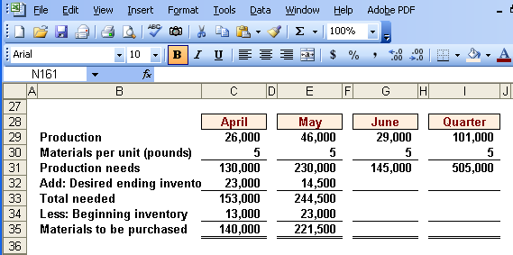
The Direct Materials Budget
Notes:
The fourth step is to calculate the materials to be purchased for May (221,500 pounds). Notice that April’s desired ending inventory becomes May’s beginning inventory. May’s desired ending inventory is 10% of June’s production needs of 145,000 pounds.

Slide 34
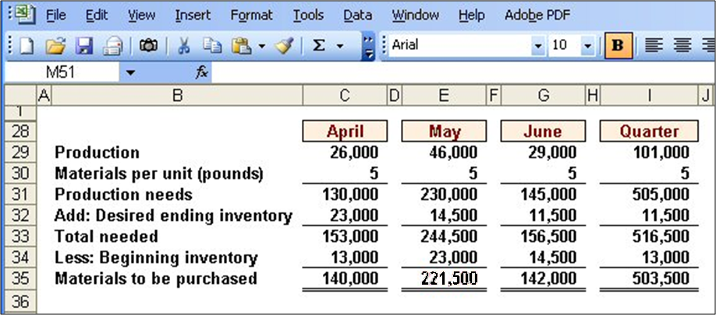
The Direct Materials Budget
Assumed ending inventory.
Notes:
The fifth step is to calculate the materials to be purchased for June (142,000 pounds). The desired ending inventory for May becomes the beginning inventory for June. We are assuming a desired ending inventory for June of 11,500 pounds. April’s beginning inventory and June’s ending inventory carry over to the quarter columns.

Slide 35
Expected Cash Disbursement for Materials
Royal pays $0.40 per pound for its materials.
One-half of a month’s purchases is paid for in the month of purchase; the other half is paid in the following month.
The March 31 accounts payable balance is $12,000.
Let’s calculate expected cash disbursements.
Notes:
Recall that Royal pays $0.40 per pound of direct materials. The company pays for one-half of its purchases in the month of the purchase and one-half in the following month. At the beginning of the quarter, Royal owed creditors $12,000 for purchases of direct materials.
Let’s begin the expected cash disbursement for direct materials schedule.

Slide 36
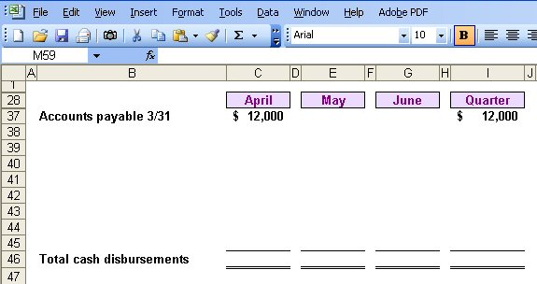
Expected Cash Disbursement for Materials
Notes:
The first step in calculating Royal’s cash disbursements is to insert the beginning accounts payable balance ($12,000) into the April column of the cash disbursements schedule. This balance will be paid in full in April.

Slide 37
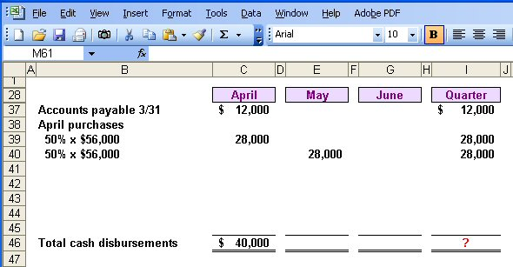
Expected Cash Disbursement for Materials
Compute the expected cash
disbursements for materials
for the quarter.
140,000 lbs. × $0.40/lb. = $56,000
Notes:
The second step is to calculate the April credit purchases that will be paid during each month of the quarter. In April $28,000 ($56,000 x 50%) will be paid in April and $28,000 will be paid in May. The $56,000 is derived by multiplying 140,000 pounds by the $0.40 per pound purchase price. Now it is time for you to go to work. See if you can complete the expected cash disbursements for materials for the quarter.
Please complete the schedule for the quarter and see how your work is progressing.

Slide 38
Quick Check ✓
What are the total cash disbursements for the quarter?
  a. $185,000
  b. $ 68,000
  c. $ 56,000
  d. $201,400
Notes:
Which answer did you get for total cash disbursements for the quarter?

Slide 39
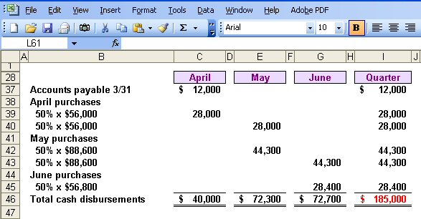
Expected Cash Disbursement for Materials
Notes:
The remaining steps include calculating the May and June credit purchases that are paid during each month of the quarter. We also calculate the totals for all columns in the schedule and the total for the quarter ($185,000).
Now let’s move to the direct labor budget.

Slide 40
Learning Objective 5
Prepare a direct labor budget.
Notes:
Learning objective number 5 is to prepare a direct labor budget.

Slide 41
The Direct Labor Budget
At Royal, each unit of product requires 0.05 hours (3 minutes) of direct labor.
The Company has a “no layoff” policy so all employees will be paid for 40 hours of work each week.
For purposes of our illustration assume that Royal has a “no layoff” policy, workers are paid at the rate of $10 per hour regardless of the hours worked.
For the next three months, the direct labor workforce will be paid for a minimum of 1,500 hours per month.
Let’s prepare the direct labor budget.
Notes:
Carefully review the information on the screen. A unique aspect of direct labor at Royal is the no overtime policy. The company agrees to no layoffs of employees if work is slow, but in return, pays its employees straight time at $10 per hour for all hours worked. With the current work force, Royal will have to pay for a minimum of 1,500 hours of direct labor regardless of the work available.
Let’s prepare this budget.

Slide 42
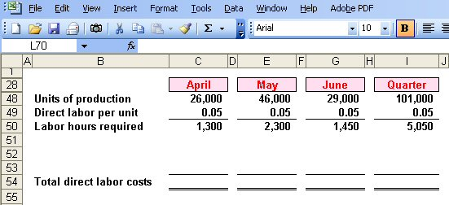
The Direct Labor Budget
From production budget.
Notes:
The first step in preparing the direct labor budget is to insert the production in units from the production budget.

Slide 43
The Direct Labor Budget
Notes:
The second step is to compute the direct labor hours required to meet the production needs. Remember each unit of output requires 0.05 direct labor hour. We will require 1,300 direct labor hours in April, 2,300 direct labor hours in May, and 1,450 direct labor hours in June.

Slide 44
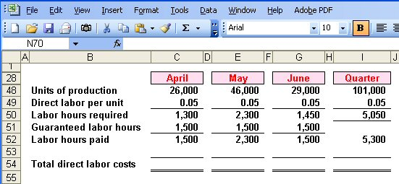
The Direct Labor Budget
Greater of labor hours required
or labor hours guaranteed.
Notes:
Because of the no layoff policy, Royal is committed to paying for a minimum of 1,500 hours per month. The third step, in this example, is to compute the direct labor hours paid each month and for the quarter. The number of hours paid will be the greater of the direct labor hours required, or 1,500 hours.
In April, Royal will pay for 1,500 direct labor hours when there is only work for 1,300 hours. In May, Royal will pay for 2,300 direct labor hours, and the company will pay for 1,500 hours in June. For the quarter, the company will pay for 5,300 direct labor hours.

Slide 45
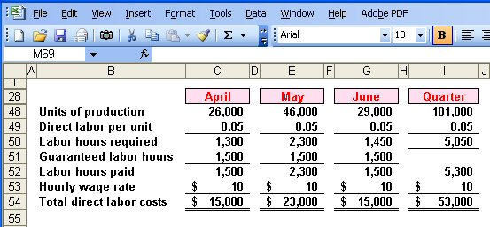
The Direct Labor Budget
Notes:
The fourth step is to compute the total direct labor cost. Based on the $10 per hour rate, Royal will pay $15,000 for direct labor in April, $23,000 in May, and $15,000 in June, for a total of $53,000 for the quarter.

Slide 46
Quick Check ✓
What would be the total direct labor cost for the quarter if the company follows its no lay-off policy, but pays $15 (time-and-a-half) for every hour worked in excess of 1,500 hours in a month?
  a. $79,500
  b. $64,500
  c. $61,000
  d. $57,000
Notes:
Determine the total direct labor costs if Royal were to pay time-and-one-half for all hours in excess of 1,500 hours per month.

Slide 47
Learning Objective 6
Prepare a manufacturing overhead budget.
Notes:
Learning objective number 6 is to prepare a manufacturing overhead budget.

Slide 48
Manufacturing Overhead Budget
At Royal, manufacturing overhead is applied to units of product on the basis of direct labor hours.
The variable manufacturing overhead rate is $20 per direct labor hour.
Fixed manufacturing overhead is $50,000 per month, which includes $20,000 of noncash costs (primarily depreciation of plant assets).
Let’s prepare the manufacturing overhead budget.
Notes:
Royal applies overhead on the basis of direct labor hours. The variable manufacturing overhead rate is $20 per direct labor hour. The fixed manufacturing overhead is $50,000 per month, of which $25,000 is noncash costs, primarily depreciation on the factory assets. This budget will provide a schedule of all costs of production other than direct materials and direct labor.

Slide 49
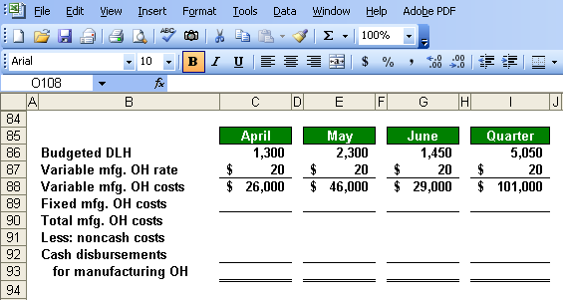
Manufacturing Overhead Budget
Direct Labor Budget.
Notes:
The first step in preparing the manufacturing overhead budget is to calculate the variable manufacturing overhead costs for each month and in total. We begin by multiplying our variable manufacturing overhead rate of $20 times the number of direct labor hours used in the month. For April, we expect to apply $26,000 of variable overhead.

Slide 50
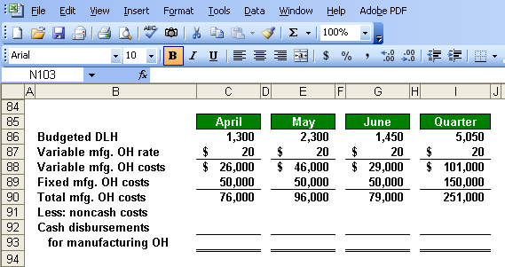
Manufacturing Overhead Budget
Total mfg. OH for quarter $251,000
Total labor hours required 5,050
= $49.70 per hour *
* rounded
Notes:
The second step is to add the fixed manufacturing overhead costs ($50,000 per month) to the variable overhead costs to arrive at total manufacturing overhead costs for each month and in total. We estimate total overhead of $76,000 in April and for the quarter, we expect a total of $251,000.
If we divide the manufacturing overhead of $251,000 by the total labor hours required during the quarter, we get a predetermined overhead rate of $49.70 (rounded). Once the level of fixed costs has been determined in the budget, the costs really are fixed; hence, the time to adjust fixed costs is during the budgeting process.

Slide 51
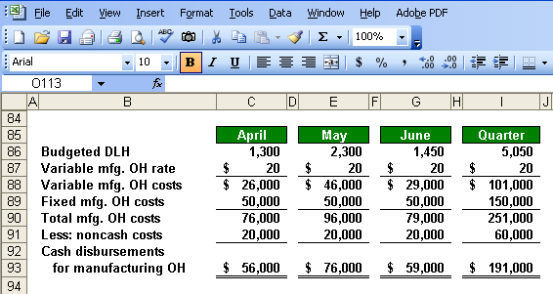
Manufacturing Overhead Budget
Depreciation is a noncash charge.
Notes:
The third step is to calculate the cash disbursements for manufacturing overhead by subtracting noncash expenses from the total manufacturing overhead costs. When we subtract the noncash overhead costs from the total manufacturing overhead costs, we get the cash paid for overhead costs. We will use this cash overhead amount in our cash budget. In our example, $20,000 of depreciation is deducted from each month’s total overhead costs to arrive at the cash disbursements for manufacturing overhead.

Slide 52
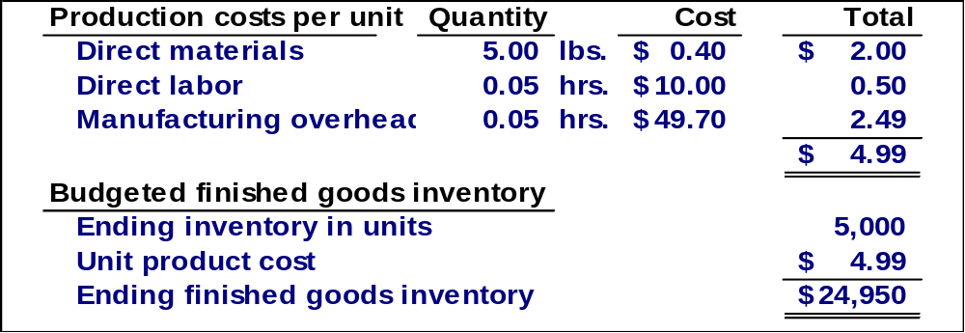
Ending Finished Goods Inventory Budget
Production Budget.
Notes:
The fourth step is to calculate the value of the ending finished goods inventory. We estimate there will be 5,000 units in ending inventory and at a per unit cost of $4.99, we have a total cost of $24,950. The finished goods inventory will appear on our budgeted balance sheet. The ending inventory in units is derived from the production budget.

Slide 53
Learning Objective 7
Prepare a selling and administrative expense budget.
Notes:
Learning objective number 7 is to prepare a selling and administrative expense budget.

Slide 54
Selling and Administrative Expense Budget
At Royal, the selling and administrative expense budget is divided into variable and fixed components.
The variable selling and administrative expenses are $0.50 per unit sold.
Fixed selling and administrative expenses are $70,000 per month.
The fixed selling and administrative expenses include $10,000 in costs – primarily depreciation – that are not cash outflows of the current month.
Let’s prepare the company’s selling and administrative expense budget.
Notes:
Royal has a variable and fixed component to its selling and administrative (S & A) expenses. The company estimates variable selling and administrative expenses at $0.50 per unit sold. Fixed selling and administrative expenses are estimated at $70,000 per month. Of this amount, $10,000 are noncash expenses, primarily depreciation.
The selling and administrative expense budget will be prepared in a manner similar to our overhead budget. This budget lists the budgeted expenses for areas other than manufacturing and it is typically a compilation of many smaller individual budgets.

Slide 55
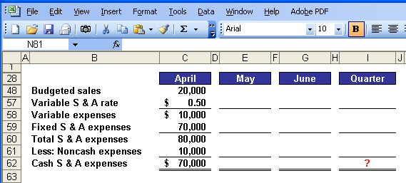
Selling and Administrative Expense Budget
Calculate the selling and administrative
cash expenses for the quarter.
Notes:
The first step in preparing this budget is to multiply the variable selling and administrative (S & A) rate by the number of units sold. In April, we expect to sell 20,000 units and apply the variable rate of $0.50 per unit.
The second step is to add in the fixed S & A expenses to arrive at total S & A expenses. To our variable expenses, we add our estimated $70,000 fixed selling and administrative expenses to get total selling and administrative expenses of $80,000.
The third step is to deduct noncash S & A expenses to arrive at cash disbursements for S & A expenses. Cash selling and administrative expenses for April of $70,000.
Take a few minutes to complete the schedule and see what kind of progress you are making.

Slide 56
Quick Check ✓
What are the total cash disbursements for selling and administrative expenses for the quarter?
  a. $180,000
  b. $230,000
  c. $110,000
  d. $ 70,000
Notes:
What are the total cash selling and administrative expenses for the quarter?

Slide 57
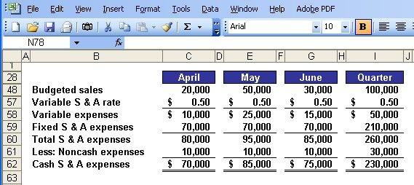
Selling Administrative Expense Budget
Notes:
The same steps are followed for the months of May and June to arrive at total cash disbursements for S & A expenses for the quarter of $230,000.

Slide 58
Learning Objective 8
Prepare a cash budget.
Notes:
Learning objective number 8 is to prepare a cash budget.

Slide 59
Format of the Cash Budget
The cash budget is divided into four sections:
Cash receipts section lists all cash inflows excluding cash received from financing;
Cash disbursements section consists of all cash payments excluding repayments of principal and interest;
Cash excess or deficiency section determines if the company will need to borrow money or if it will be able to repay funds previously borrowed; and
Financing section details the borrowings and repayments projected to take place during the budget period.
Notes:
The preparation of the cash budget can be quite complex. This budget should be broken down into time periods that are as short as feasible. It consists of four major sections:
Cash receipts section lists all cash inflows excluding cash received from financing;
Cash disbursements section consists of all cash payments excluding repayments of principal and interest;
Cash excess or deficiency section determines if the company will need to borrow money or if it will be able to repay funds previously borrowed; and
Financing section details the borrowings and repayments projected to take place during the budget period.

Slide 60
The Cash Budget
Assume the following information for Royal:
  Maintains a 16% open line of credit for $75,000
  Maintains a minimum cash balance of $30,000
  Borrows on the first day of the month and repays loans on the last day of the month
  Pays a cash dividend of $49,000 in April
  Purchases $143,700 of equipment in May and $48,300 in June (both purchases paid in cash)
  Has an April 1 cash balance of $40,000
Notes:
It would be a good idea to jot down this additional information or merely print the screen. We will need all of this information to prepare the cash budget.

Slide 61
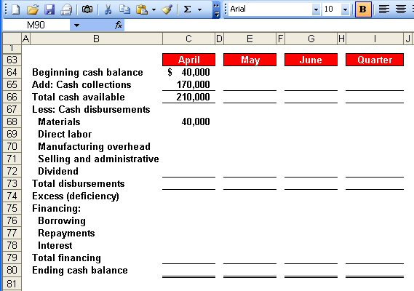
The Cash Budget
Schedule of Expected
Cash Collections.
Notes:
The first step in preparing this budget is to calculate the total cash available. We began April with $40,000 in cash. To this amount, we add our expected cash collections from sales of $170,000 for the month of April. We complete the first section by calculating the total cash available of $210,000.
Now, let’s continue with the budget preparation.

Slide 62
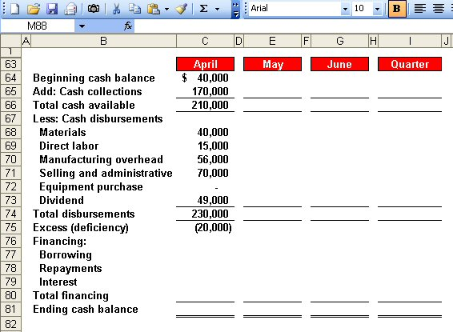
The Cash Budget
Schedule of Expected
Cash Disbursements.
Direct Labor
Budget.
Manufacturing
Overhead Budget.
Selling and Administrative
Expense Budget.
Notes:
The second step is to calculate the total cash disbursements. During April, we expect to pay $40,000 for raw materials, $15,000 for direct labor, $56,000 for cash manufacturing overhead, and $70,000 for selling and administrative expense. This is not the total manufacturing overhead because we have excluded noncash depreciation costs.
During April, the Board of Directors paid a cash dividend of $49,000.
We have now completed the second major section of the cash budget, the cash disbursements.

Slide 63
The Cash Budget
Because Royal maintains
a cash balance of $30,000,
the company must borrow $50,000 on its line-of-credit.
Notes:
The third step is to calculate the excess (deficiency) of cash available over disbursements. In the month of April, we expect to have a cash deficiency of $20,000, given that Royal has a policy that the company will always maintain an ending cash balance of $30,000.

Slide 64
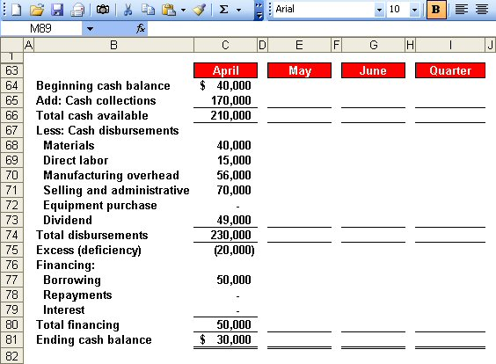
The Cash Budget
Because Royal maintains
a cash balance of $30,000,
the company must borrow $50,000 on its line-of-credit.
Ending cash balance for April
is the beginning May balance.
Notes:
The fourth step is to determine the financing requirements and the ending cash balance. After Royal borrows $50,000 on its line-of-credit, it will have an ending cash balance of $30,000. The ending cash balance for April becomes the beginning cash balance for May.
Let’s complete the cash budget for the month of May.

Slide 65
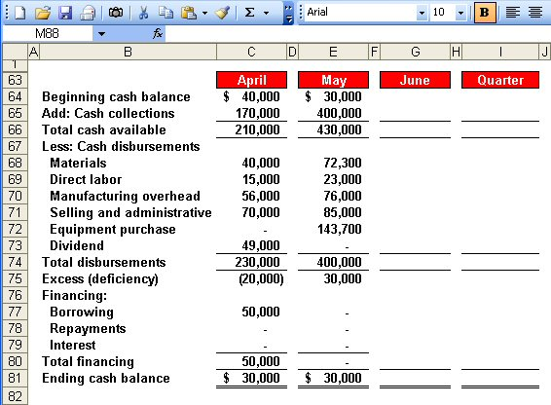
The Cash Budget
Notes:
These four steps are repeated for the month of May. The result is a $30,000 excess of cash available over disbursements. Since Royal must maintain a minimum cash balance of $30,000 it will not repay any of its loan in May.

Slide 66
Quick Check ✓
What is the excess (deficiency) of cash available over disbursements for June?
  a. $ 85,000
  b. $(10,000)
  c. $ 75,000
  d. $ 95,000
Notes:
Now, it’s your turn to calculate the cash excess or deficiency for the month of June. Which amount did you determine to be correct?

Slide 67
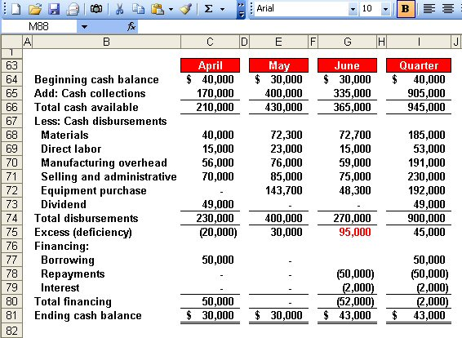
The Cash Budget
$50,000 × 16% × 3/12 = $2,000
Borrowings on April 1 and
repayment on June 30.
Notes:
The same four steps are repeated for June. The result is an excess of cash available of $95,000.
At the end of June, Royal will have sufficient cash to repay the $50,000 borrowed in April plus the interest on the loan. The total interest is $2,000 as demonstrated in the computation of interest box on the left side of your screen.
Royal will end the quarter with $43,000 cash on hand. This cash balance will appear on our budgeted balance sheet.

Slide 68
The Budgeted Income Statement
Cash
Budget
Budgeted
Income
Statement
Completed
With interest expense from the cash budget, Royal can prepare the budgeted income statement.
Notes:
We are now ready to move from the preparation of individual budgets to preparing our budgeted financial statements. The cash budget must be prepared first so that the interest expense can be determined for the budgeted income statement. Let’s begin with the budgeted income statement.

Slide 69
Learning Objective 9
Prepare a budgeted income statement.
Notes:
Learning objective number 9 is to prepare a budgeted income statement.

Slide 70
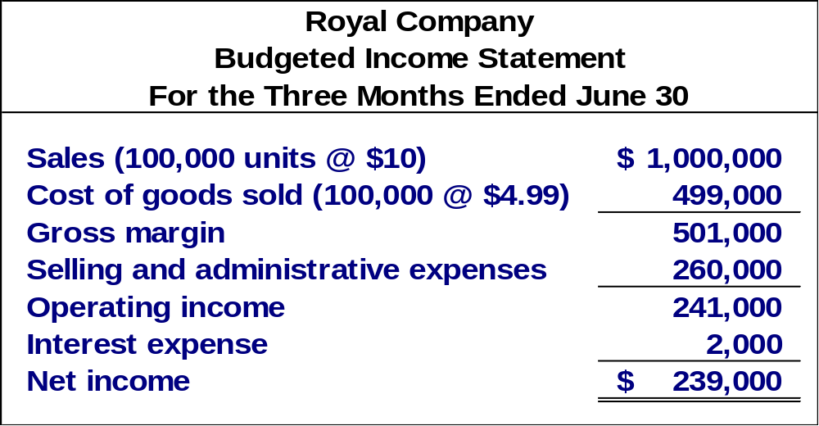
The Budgeted Income Statement
Sales Budget.
Ending Finished
Goods Inventory.
Selling and
Administrative
Expense Budget.
Cash Budget.
Notes:
The numbers for the budgeted income statement come from other budgets that have already been prepared. More specifically, the sales revenue comes from the sales budget. The cost of goods sold, on a per unit basis comes from the ending finished goods inventory budget. The selling and administrative expenses come from the S & A budget. The interest expense comes from the cash budget. Royal calculates budgeted net income for the quarter is $239,000.
With the income statement complete, we can move on to the budgeted balance sheet.

Slide 71
Learning Objective 10
Prepare a budgeted balance sheet.
Notes:
Learning objective number 10 is to prepare a budgeted balance sheet.

Slide 72
The Budgeted Balance Sheet
Royal reported the following account balances prior to preparing its budgeted financial statements:
  Land - $50,000
  Common stock - $200,000
  Retained earnings - $146,150 (April 1)
  Equipment - $175,000
Notes:
Please make note of this supplemental information as we will need it to complete the budgeted balance sheet.

Slide 73
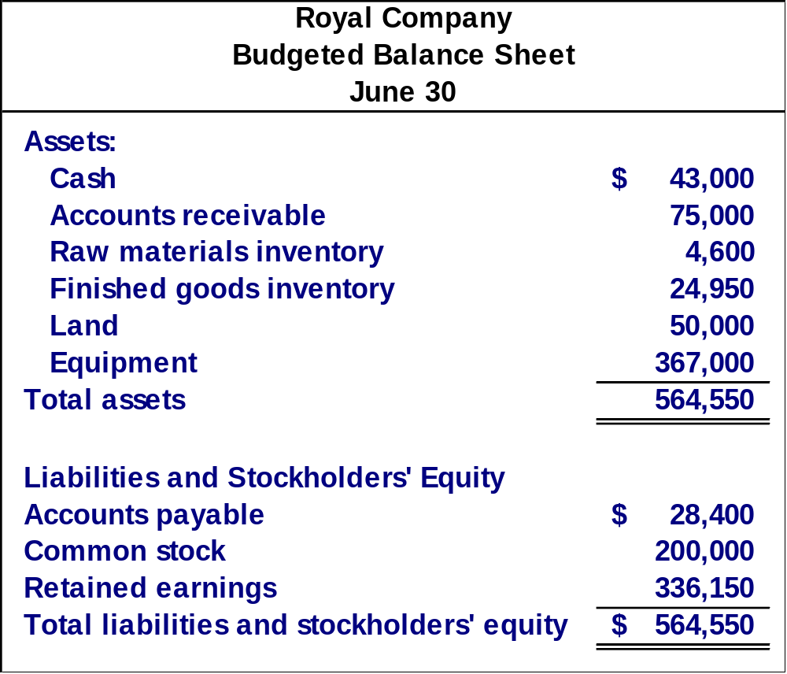
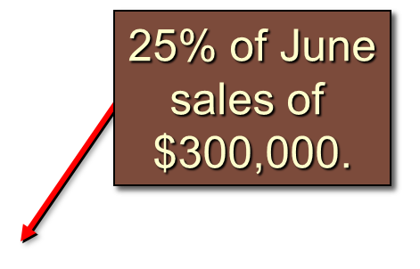
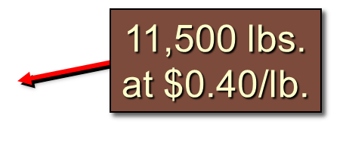
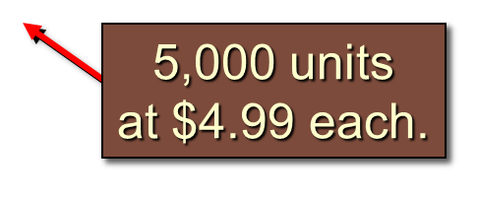
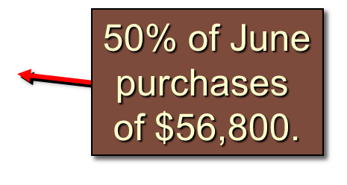
Notes:
You can see our cash balance of $43,000 comes directly from the cash budget. Accounts receivable ($75,000) is 25% of June’s sales ($300,000). Raw materials inventory ($4,600) is calculated by multiplying the ending inventory of raw material in pounds (11,500) by the cost per pound. The finished goods inventory ($24,950) is taken from the ending finished goods inventory budget. The land and equipment amounts are given. Accounts payable ($28,400) is 50% of June’s purchases ($56,800). The balance in the common stock account is given.

Slide 74
Notes:
The balance of retained earnings at June 30 is $336,150, which is based on: beginning balance + net income - dividends paid ($146,150 + $239,000 - $49,000).

