Slide 1
Capital Budgeting Decisions
Chapter 13
Notes:
Chapter 13: Capital Budgeting Decisions
The term capital budgeting is used to describe how managers plan significant cash outlays on projects that have long-term implications, such as the purchase of new equipment and the introduction of new products. This chapter describes several tools that can be used by managers to help make these types of investment decisions.

Slide 2
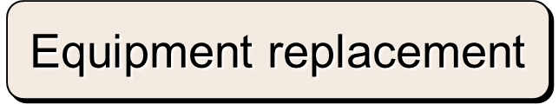
Typical Capital Budgeting Decisions
Plant expansion
Equipment selection
Lease or buy
Cost reduction
Notes:
Capital budgeting analysis can be used for any decision that involves an outlay now in order to obtain some future return. Typical capital budgeting decisions include:
Cost reduction decisions. Should new equipment be purchased to reduce costs?
Expansion decisions. Should a new plant or warehouse be purchased to increase capacity and sales?
Equipment selection decisions. Which of several available machines should be purchased?
Lease or buy decisions. Should new equipment be leased or purchased?
Equipment replacement decisions. Should old equipment be replaced now or later?

Slide 3
Typical Capital Budgeting Decisions
Capital budgeting tends to fall into two broad categories.
  Screening decisions. Does a proposed project meet some preset standard of acceptance?
  Preference decisions. Selecting from among several competing courses of action.
Notes:
There are two main types of capital budgeting decisions:
Screening decisions relate to whether a proposed project passes a preset hurdle. For example, a company may have a policy of accepting projects only if they promise a return of 20% on the investment.
Preference decisions relate to selecting among several competing courses of action. For example, a company may be considering several different machines to replace an existing machine on the assembly line.
In this chapter, we initially discuss ways of making screening decisions. Preference decisions are discussed toward the end of the chapter.

Slide 4

Time Value of Money
A dollar today is worth more than a dollar a year from now.
Therefore, projects that promise earlier returns are preferable to those that promise later returns.
Notes:
The time value of money concept recognizes that a dollar today is worth more than a dollar a year from now. Therefore, projects that promise earlier returns are preferable to those that promise later returns.

Slide 5

Time Value of Money
The capital budgeting techniques that best recognize the time value of money are those that involve discounted cash flows.
Notes:
The capital budgeting techniques that best recognize the time value of money are those that involve discounted cash flows (the concepts of discounting cash flows and using present value tables are explained in greater detail in Appendix 14A).

Slide 6
Present Value
Are future cash flows worth the same amount as cash flows today?
To compare cash flows that occur at different points in time, we need to calculate an equivalent amount in today’s $ (the present value)
Present value = future cash flow * present value factor from the appropriate table.

Slide 7
Learning Objective 1
Evaluate the acceptability of an investment project using the net present value method.
Notes:
Learning objective number 1 is to evaluate the acceptability of an investment project using the net present value method.

Slide 8
The Net Present Value Method
To determine net present value we . . .
  Calculate the present value of cash inflows,
  Calculate the present value of cash outflows,
  Subtract the present value of the outflows from the present value of the inflows.
Notes:
The net present value method compares the present value of a project’s cash inflows with the present value of its cash outflows. The difference between these two streams of cash flows is called the net present value.

Slide 9
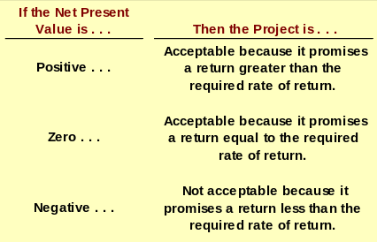
The Net Present Value Method
Notes:
The net present value is interpreted as follows:
If the net present value is positive, then the project is acceptable.
If the net present value is zero, then the project is acceptable.
If the net present value is negative, then the project is not acceptable.

Slide 10

The Net Present Value Method
Net present value analysis emphasizes cash flows and not accounting net income.
The reason is that accounting net income is based on accruals that ignore the timing of cash flows into and out of an organization.
Notes:
Net present value analysis (as well as the internal rate of return, which will be discussed shortly) emphasizes cash flows and not accounting net income. The reason is that accounting net income is based on accruals that ignore the timing of cash flows into and out of an organization.

Slide 11
Typical Cash Outflows
Repairs and
maintenance
Working
capital
Initial
investment
Incremental
operating
costs
Notes:
Examples of typical cash outflows that are included in net present value calculations are as shown. Notice the term working capital which is defined as current assets less current liabilities.
The initial investment in working capital is a cash outflow at the beginning of the project for items such as inventories. It is recaptured at the end of the project when working capital is no longer required. Thus, working capital is recognized as a cash outflow at the beginning of the project and a cash inflow at the end of the project.

Slide 12
Typical Cash Inflows
Salvage
value
Release of
working
capital
Reduction
of costs
Incremental
revenues
Notes:
Examples of typical cash inflows that are included in net present value calculations are as shown.

Slide 13
Recovery of the Original Investment
Depreciation is not deducted in computing the present value of a project because . . .
  It is not a current cash outflow.
  Discounted cash flow methods automatically provide for a return of the original investment.
Notes:
The net present value method excludes depreciation for two reasons:
First, depreciation is not a current cash outflow.
Second, discounted cash flow methods automatically provide for a return of the original investment, thereby making a deduction for depreciation unnecessary.

Slide 14

Recovery of the Original Investment
Carver Hospital is considering the purchase of an attachment for its X-ray machine.
No investments are to be made unless they have an annual return of at least 10%.
Will we be allowed to invest in the attachment?
Notes:
Assume the facts as shown with respect to Carver Hospital. Will we be allowed to invest in the attachment?

Slide 15
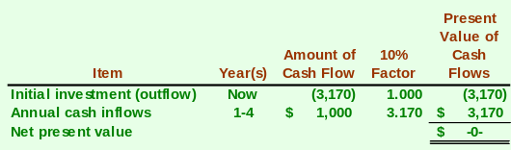
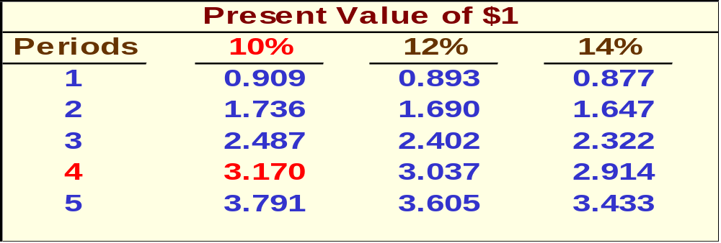
Recovery of the Original Investment
Present value
of an annuity
of $1 table
Notes:
The net present value of the investment is zero.

Slide 16
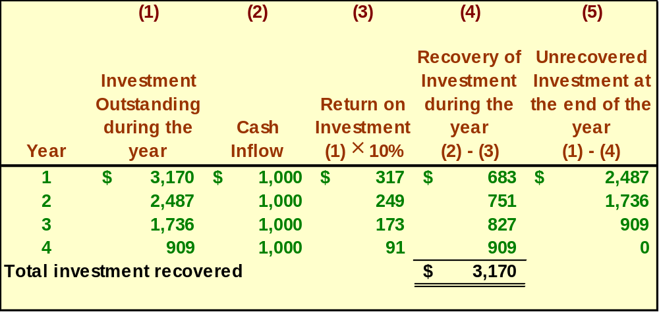
Recovery of the Original Investment
This implies that the cash inflows are sufficient to recover the $3,170 initial investment (therefore depreciation is unnecessary) and to provide exactly a 10% return on the investment.
Notes:
This implies that the cash inflows are sufficient to recover the $3,170 initial investment (therefore depreciation is unnecessary) and to provide exactly a 10 percent return on the investment.

Slide 17

Two Simplifying Assumptions
Two simplifying assumptions are usually made in net present value analysis:
All cash flows other than the initial investment occur at the end of periods.
All cash flows generated by an investment project are immediately reinvested at a rate of return equal to the discount rate.
Notes:
Two simplifying assumptions are usually made in net present value analysis:
The first assumption is that all cash flows other than the initial investment occur at the end of periods.
The second assumption is that all cash flows generated by an investment project are immediately reinvested at a rate of return equal to the discount rate.

Slide 18
Choosing a Discount Rate
The firm’s cost of capital is usually regarded as the minimum required rate of return.
The cost of capital is the average rate of return the company must pay to its long-term creditors and stockholders for the use of their funds.
Notes:
A company’s cost of capital, which is defined as the average rate of return a company must pay to its long-term creditors and shareholders for the use of their funds, is usually regarded as the minimum required rate of return. When the cost of capital is used as the discount rate, it serves as a screening device in net present value analysis.

Slide 19
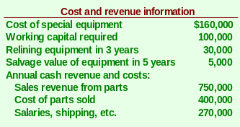
The Net Present Value Method
Lester Company has been offered a five year contract to provide component parts for a large manufacturer.
Notes:
Assume the information as shown with respect to Lester Company.

Slide 20

The Net Present Value Method
At the end of five years the working capital will be released and may be used elsewhere by Lester.
Lester Company uses a discount rate of 10%.
Should the contract be accepted?
Notes:
Also assume that at the end of five years the working capital will be released and may be used elsewhere.
Lester Company’s discount rate is 10 percent.
Should the contract be accepted?

Slide 21

The Net Present Value Method
Annual net cash inflow from operations
Notes:
The annual net cash inflow from operations of $80,000 is computed as shown.

Slide 22
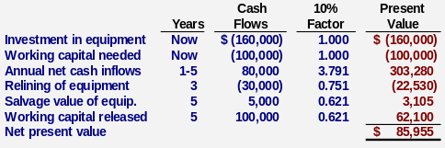
The Net Present Value Method
Accept the contract because the project has a positive net present value.
Notes:
The net present value of the investment opportunity is $85,955. Since the net present value is positive, it suggests making the investment.

Slide 23
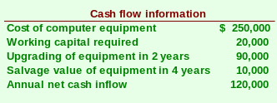

Quick Check ✓
Denny Associates has been offered a four-year contract to supply the computing requirements for a local bank.
The working capital would be released at the end of the contract.
Denny Associates requires a 14% return.
Notes:
Assume the information provided for Denny Associates.

Slide 24
Quick Check ✓
What is the net present value of the contract with the local bank?
  a. $150,000
  b. $ 28,230
  c. $ 92,340
  d. $132,916
Notes:
What is the net present value of the contract with the local bank?

Slide 25
Learning Objective 2
Evaluate the acceptability of an investment project using the internal rate of return method.
Notes:
Learning objective number 2 is to evaluate the acceptability of an investment project using the internal rate of return method.

Slide 26
Learning Objective 3
Evaluate an investment project that has uncertain cash flows.
Notes:
Learning objective number 3 is to evaluate an investment project that has uncertain cash flows.

Slide 27
Uncertain Cash Flows – An Example
Assume that all of the cash flows related to an investment in a supertanker have been estimated, except for its salvage value in 20 years.
Using a discount rate of 12%, management has determined that the net present value of all the cash flows, except the salvage value is a negative $1.04 million.
How large would the salvage value need to be to make this investment attractive?
Notes:
Assume that all of the cash flows related to an investment in a supertanker have been estimated, except for its salvage value in 20 years.
Using a discount rate of 12 percent, management has determined that the net present value of all the cash flows, except the salvage value is a negative $1.04 million.
This negative net present value will be offset by the salvage value of the supertanker.
How large would the salvage value need to be to make this investment attractive?

Slide 28
Uncertain Cash Flows – An Example
This equation can be used to determine that if the salvage value of the supertanker is at least $10,000,000, the net present value of the investment would be positive and therefore acceptable.
Notes:
The equation shown can be used to determine that if the salvage value of the supertanker is at least $10 million, the net present value of the investment would be positive and therefore acceptable.
While the salvage value is not known with certainty, the $10 million figure offers a useful reference point for making the decision.

Slide 29
Real Options
Delay the start of a project.
Expand a project if conditions are favorable.
Cut losses if conditions are unfavorable.
The ability to consider these real options adds value to many investments. The value of these options can be quantified using what is called real options analysis, which is beyond the scope of the book.
Notes:
The analysis in this chapter has assumed that an investment cannot be postponed and that, once started, nothing can be done to alter the course of the project.
The ability to delay the start of a project, to expand it if conditions are favorable, and to cut losses if they are unfavorable adds value to many investments.
The value of these real options can be quantified using what is called real options analysis, which is beyond the scope of the book.

Slide 30
Learning Objective 4
Rank investment projects in order of preference.
Notes:
Learning objective number 4 is to rank investment projects in order of preference.

Slide 31

Preference Decision – The Ranking of Investment Projects
Screening Decisions
Preference Decisions
Pertain to whether or not some proposed investment is acceptable; these decisions come first.
Attempt to rank acceptable alternatives from the most to least appealing.
Notes:
Recall that when considering investment opportunities, managers must make two types of decisions – screening decisions and preference decisions.
Screening decisions, which come first, pertain to whether or not some proposed investment is acceptable.
Preference decisions, which come after screening decisions, attempt to rank acceptable alternatives from the most to least appealing.
Preference decisions need to be made because the number of acceptable investment alternatives usually exceeds the amount of available funds.

Slide 32
Internal Rate of Return Method
When using the internal rate of return method to rank competing investment projects, the preference rule is:
The higher the internal rate of return, the more desirable the project.
Notes:
When using the internal rate of return method to rank competing investment projects, the preference rule is: the higher the internal rate of return, the more desirable the project.

Slide 33

Net Present Value Method
The net present value of one project cannot be directly compared to the net present value of another project unless the investments are equal.
Notes:
The net present value of one project cannot be directly compared to the net present value of another project, unless the investments are equal.

Slide 34
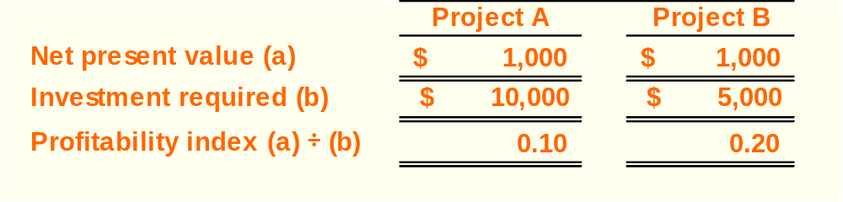
Ranking Investment Projects
Project Net present value of the project
profitability Investment required
index
=
The higher the profitability index, the
more desirable the project.
Notes:
In the case of unequal investments, a profitability index can be computed as the net present value of the project divided by the investment required. Notice three things:
The profitability indexes for investments A and B are 0.10 and 0.20, respectively.
The higher the profitability index, the more desirable the project. Therefore, investment B is more desirable than investment A.
As in this type of situation, the constrained resource is the limited funds available for investment, the profitability index is similar to the contribution margin per unit of the constrained resource as discussed an earlier chapter.

Slide 35

Other Approaches to
Capital Budgeting Decisions
Other methods of making capital budgeting decisions include:
  The Payback Method.
  Simple Rate of Return.
Notes:
This section focuses on two other methods of making capital budgeting decisions – the payback method and the simple rate of return. The payback method will be discussed first followed by the simple rate of return method.

Slide 36
Learning Objective 5
Determine the payback period for an investment.
Notes:
Learning objective number 5 is to determine the payback period for an investment.

Slide 37
The Payback Method
The payback period is the length of time that it takes for a project to recover its initial cost out of the cash receipts that it generates.
When the annual net cash inflow is the same each year, this formula can be used to compute the payback period:
Investment required
Annual net cash inflow
Payback period =
Notes:
The payback method focuses on the payback period, which is the length of time that it takes for a project to recoup its initial cost out of the cash receipts that it generates.
When the annual net cash inflow is the same every year, the formula for computing the payback period is the investment required divided by the annual net cash inflow.

Slide 38
The Payback Method
Management at The Daily Grind wants to install an espresso bar in its restaurant that
  Costs $140,000 and has a 10-year life.
  Will generate annual net cash inflows of $35,000.
Management requires a payback period of 5 years or less on all investments.
What is the payback period for the espresso bar?
Notes:
Assume the management of the Daily Grind wants to install an espresso bar in its restaurant.
The cost of the espresso bar is $140,000 at it has a ten-year life.
The bar will generate annual net cash inflows of $35,000.
Management requires a payback period of five years or less.
What is the payback period on the espresso bar?

Slide 39
The Payback Method
Investment required
Annual net cash inflow
Payback period =
$140,000
$35,000
Payback period =
Payback period =
4.0 years
According to the company’s criterion, management would invest in the espresso bar because its payback period is less than 5 years.
Notes:
The payback period is 4 years. Therefore, management would choose to invest in the bar.

Slide 40
Quick Check ✓
Consider the following two investments:
Project X Project Y
Initial investment $100,000 $100,000
Year 1 cash inflow $60,000 $60,000
Year 2 cash inflow $40,000 $35,000
Year 14-10 cash inflows $0 $25,000
Which project has the shortest payback period?
  a. Project X
  b. Project Y
  c. Cannot be determined
Notes:
Consider the information provided for two investments. Which project has the shortest payback period?

Slide 41


Evaluation of the Payback Method
Ignores the
time value
of money.
Short-comings
of the payback
period.
Ignores cash
flows after
the payback
period.
Notes:
Criticisms of the payback method include the following.
First, a shorter payback period does not always mean that one investment is more desirable than another. This is because the payback method ignores cash flows after the payback period, thus it has no inherent mechanism for highlighting differences in useful life between investments.
Second, the payback method does not consider the time value of money.

Slide 42
Evaluation of the Payback Method
Serves as screening tool.
Identifies investments that recoup cash investments quickly.
Strengths
of the payback
period.
Identifies products that recoup initial investment quickly.
Notes:
Strengths of the payback method include the following.
It can serve as a screening tool to help identify which investment proposals are in the “ballpark.”
It can aid companies that are “cash poor” in identifying investments that will recoup cash investments quickly.
It can help companies that compete in industries where products become obsolete rapidly to identify products that will recoup their initial investment quickly.

Slide 43

Payback and Uneven Cash Flows
When the cash flows associated with an investment project change from year to year, the payback formula introduced earlier cannot be used.
Instead, the un-recovered investment must be tracked year by year.
$1,000
$0
$2,000
$1,000
$500
1
2
3
4
5
Notes:
When the cash flows associated with an investment project change from year to year, the payback formula introduced earlier cannot be used. Instead, the un-recovered investment must be tracked year by year.

Slide 44
Payback and Uneven Cash Flows
For example, if a project requires an initial investment of $4,000 and provides uneven net cash inflows in years 1-5 as shown, the investment would be fully recovered in year 4.
$1,000
$0
$2,000
$1,000
$500
1
2
3
4
5
Notes:
For example, if a project requires an initial investment of $4,000 and provides uneven net cash inflows in years one to five as shown, the investment would be fully recovered in year four.

Slide 45
Learning Objective 6
Compute the simple rate of return for an investment.
Notes:
Learning objective number 6 is to compute the simple rate of return for an investment.

Slide 46
Simple Rate of Return Method
Does not focus on cash flows -- rather it focuses on accounting net operating income.
The following formula is used to calculate the simple rate of return:
-
Annual incremental net operating income
Simple rate
of return
=
Initial investment*
*Should be reduced by any salvage from the sale of the old equipment
Notes:
The simple rate of return method (also known as the accounting rate of return or the unadjusted rate of return) does not focus on cash flows, rather it focuses on accounting net operating income.
The equation for computing the simple rate of return is as shown.

Slide 47

Simple Rate of Return Method
Management of The Daily Grind wants to install an espresso bar in its restaurant that:
  Cost $140,000 and has a 10-year life.
  Will generate incremental revenues of $100,000 and incremental expenses of $65,000 including depreciation.
What is the simple rate of return on the investment project?
Notes:
Assume the management of the Daily Grind wants to install an espresso bar in its restaurant.
The cost of the espresso bar is $140,000 and it has a ten-year life.
The espresso bar will generate incremental revenues of $100,000 and incremental expenses of $65,000 including depreciation.
What is the simple rate of return on this project?

Slide 48
Simple Rate of Return Method
Simple rate
of return
$35,000
$140,000
=
= 25%
Notes:
The simple rate of return is 25 percent.

Slide 49
Criticism of the Simple Rate of Return
Ignores the
time value
of money.
Short-comings
of the simple
rate of return.
The same project
may appear
desirable in some
years and
undesirable
in other years.
Notes:
Criticisms of the simple rate of return include the following:
First, it does not consider the time value of money.
Second, the simple rate of return fluctuates from year to year when used to evaluate projects that do not have constant annual incremental revenues and expenses. The same project may appear desirable in some years and undesirable in others.

Slide 50

Postaudit of Investment Projects
A postaudit is a follow-up after the project has been completed to see whether or not expected results were actually realized.
Notes:
A postaudit is a follow-up after the project has been completed to see whether or not expected results were actually realized.
The data used in a postaudit analysis should be actual observed data rather than estimated data.

Slide 51
Income Taxes in Capital Budgeting Decisions
Appendix 13C
Notes:
Appendix 13C: Income Taxes in Capital Budgeting Decisions

Slide 52
Learning Objective 8
(Appendix 13C)
Include income taxes in a capital budgeting analysis.
Notes:
Learning objective number 8 is to include income taxes in a capital budgeting analysis.

Slide 53
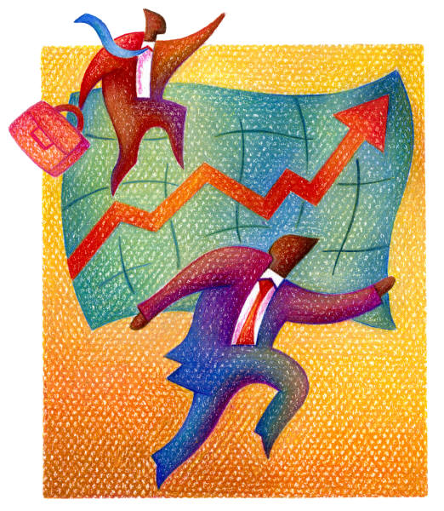
Simplifying Assumptions
Taxable income equals net income as computed for financial reports.
The tax rate is a flat percentage of taxable income.
Notes:
First, let’s identify some simplifying assumptions.
Taxable income equals net income as computed for financial reports.
The tax rate is a flat percentage of taxable income.

Slide 54
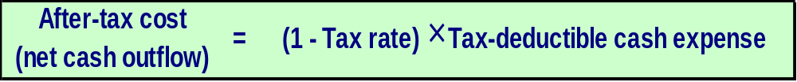
Concept of After-tax Cost
An expenditure net of its tax effect is known as after-tax cost.
Here is the equation for determining the after-tax cost of any tax-deductible cash expense:
Notes:
An expenditure net of its tax effect is known as after-tax cost.
The equation for determining the after-tax cost of any tax-deductible cash expense is as shown.

Slide 55
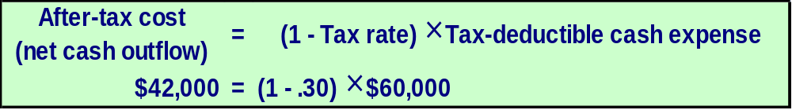
After-tax Cost – An Example
Assume a company with a 30% tax rate is contemplating investing in a training program that will cost $60,000 per year.
We can use this equation to determine that the after-tax cost of the training program is $42,000.
Notes:
Assume a company with a 30 percent tax rate is contemplating investing in a training program that will cost $60,000 per year.
The aforementioned equation can be used to determine that the after-tax cost of the training program is $42,000.

Slide 56
After-tax Cost – An Example
The answer can also be determined by calculating the taxable income and income tax for two alternatives—without the training program and with the training program.
The after-tax cost of the training program is the same—$42,000.
Notes:
The answer can also be determined by calculating the taxable income and income tax for two alternatives – without the training program and with the training program.
Notice that the after-tax cost of the training program would be the same – $42,000.

Slide 57
After-tax Cost – An Example
The amount of net cash inflow realized from a taxable cash receipt after income tax effects have been considered is known as the after-tax benefit.
Notes:
The amount of net cash inflow realized from a taxable cash receipt after income tax effects have been considered is known as the after-tax benefit.
The equation for determining the after-tax benefit of any taxable cash receipt is as shown.

Slide 58
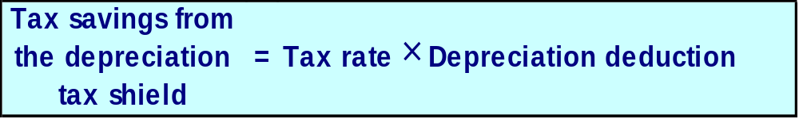
Depreciation Tax Shield
While depreciation is not a cash flow, it does affect the taxes that must be paid and therefore has an indirect effect on a company’s cash flows.
Notes:
While depreciation is not a cash flow, it does affect the taxes that must be paid and therefore has an indirect effect on a company’s cash flows.
When depreciation deductions shield revenues from taxation, they are generally referred to as a depreciation tax shield. The equation for calculating the tax savings from a depreciation tax shield is as shown.
Remember that when as asset is purchased, a cash outflow occurs. Depreciation is just the allocation of that purchase price over some estimated life.

Slide 59
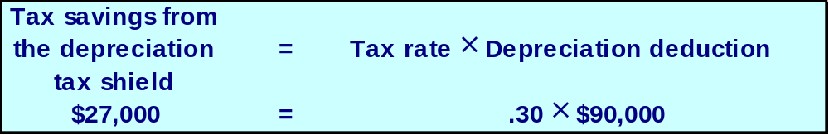
Depreciation Tax Shield – An Example
Assume a company has annual cash sales and cash operating expenses of $500,000 and $310,000, respectively; a depreciable asset, with no salvage value, on which the annual straight-line depreciation expense is $90,000; and a 30% tax rate.
Notes:
Assume that a company has: annual cash sales and cash operating expenses of $500,000 and $310,000, respectively; a depreciable asset, with no salvage value, on which the annual straight-line depreciation expense is $90,000; and a 30 percent tax rate.

Slide 60
Depreciation Tax Shield – An Example
Assume a company has annual cash sales and cash operating expenses of $500,000 and $310,000, respectively; a depreciable asset, with no salvage value, on which the annual straight-line depreciation expense is $90,000; and a 30% tax rate.
The depreciation tax shield is $27,000.
Notes:
The aforementioned equation can be used to calculate the depreciation tax shield of $27,000.

Slide 61
Depreciation Tax Shield – An Example
The answer can also be determined by calculating the taxable income and income tax for two alternatives—without the depreciation deduction and with the depreciation deduction.
The depreciation tax shield is the same—$27,000.
Notes:
The answer can also be determined by calculating the taxable income and income tax for two alternatives – without the depreciation deduction and with the depreciation deduction.
Notice that the depreciation tax shield would be the same – $27,000.

Slide 62

Holland Company – An Example
Holland Company owns the mineral rights to land that has a deposit of ore. The company is deciding whether to purchase equipment and open a mine on the property. The mine would be depleted and closed in 10 years and the equipment would be sold for its salvage value.
More information is provided on the next slide.
Notes:
Holland Company owns the mineral rights to land that has a deposit of ore. The company is deciding whether to purchase equipment and open a mine on the property. The mine would be depleted and closed in ten years and the equipment would be sold for its salvage value.

Slide 63
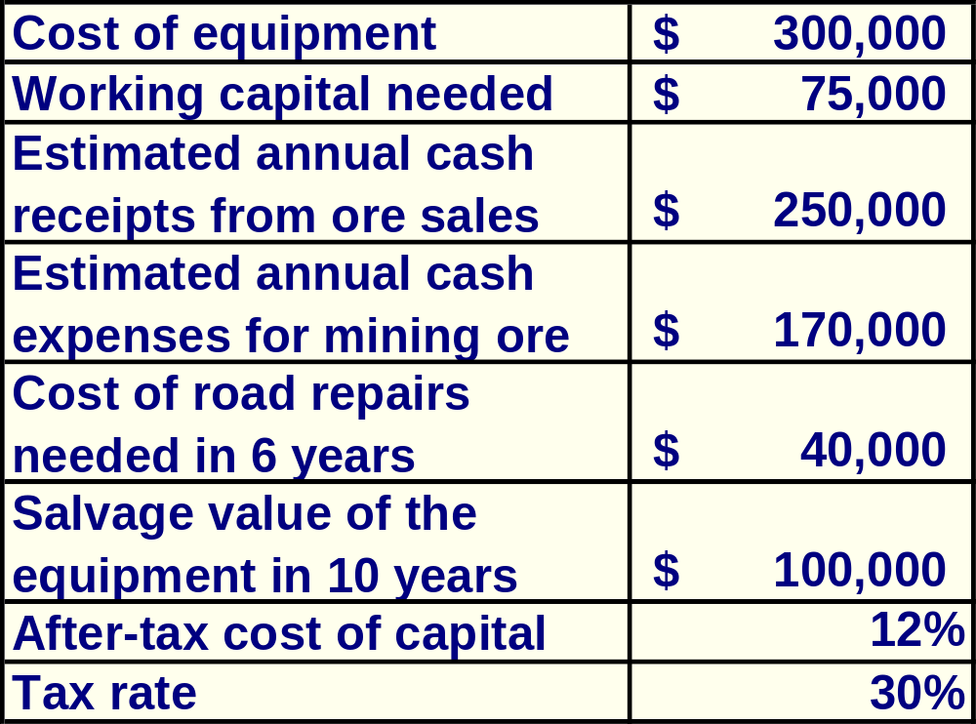
Holland Company – An Example
Should Holland open a mine on the property?
Notes:
Pertinent financial information is as shown.
Holland’s after-tax cost of capital is 12 percent and its tax rate is 30 percent.
Should Holland open a mine on the property?

Slide 64
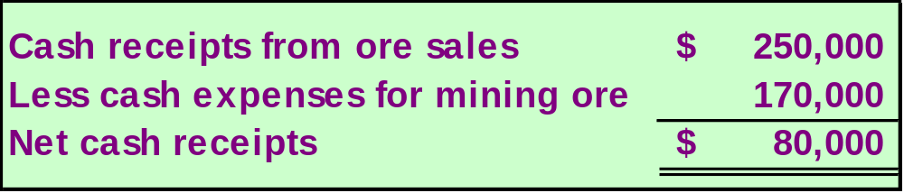
Holland Company – An Example
Step One: Compute the annual net cash receipts from operating the mine.
Notes:
The first step is to compute the annual net cash receipts of $80,000 from operating the mine.

Slide 65
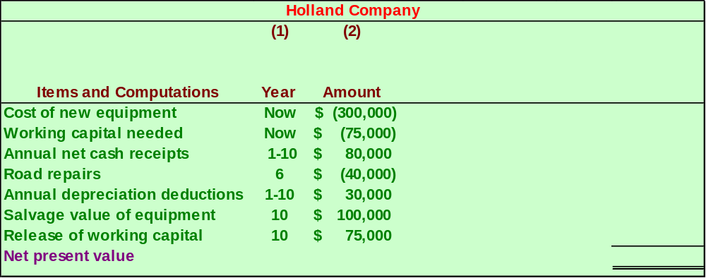
Holland Company – An Example
Step Two: Identify all relevant cash flows as shown.
Notes:
The second step is to identify all relevant cash flows as shown.
Notice, that Holland uses straight-line depreciation, assuming no salvage value, to compute depreciation deductions for tax purposes.

Slide 66
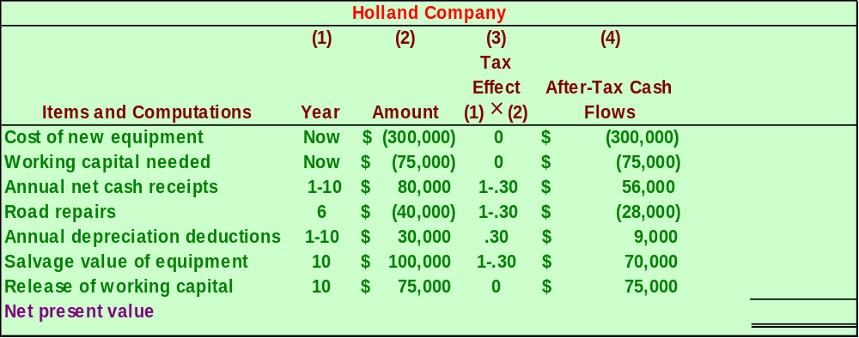
Holland Company – An Example
Step Three: Translate the relevant cash flows to after-tax cash flows as shown.
Notes:
The third step is to translate the relevant cash flows to after-tax cash flows as shown.

Slide 67
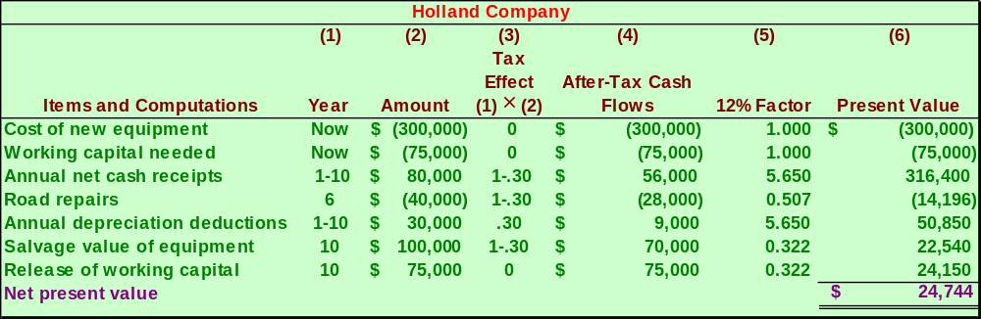
Holland Company – An Example
Step Four: Discount all cash flows to their present value as shown.
Notes:
The fourth step is to discount all cash flows to their present value as shown.
Notice that the net present value of the project is $24,744.

