Slide 1


Slide 2
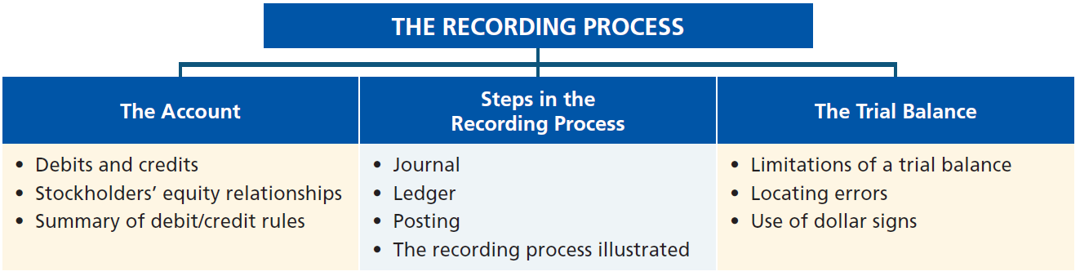
Preview of Chapter 2
Financial Accounting
Ninth Edition
Weygandt Kimmel Kieso

Slide 3

2
The Recording Process
Learning Objectives
After studying this chapter, you should be able to:
[1] Explain what an account is and how it helps in the recording process.
[2] Define debits and credits and explain their use in recording business transactions.
[3] Identify the basic steps in the recording process.
[4] Explain what a journal is and how it helps in the recording process.
[5] Explain what a ledger is and how it helps in the recording process.
[6] Explain what posting is and how it helps in the recording process.
[7] Prepare a trial balance and explain its purposes.

Slide 4
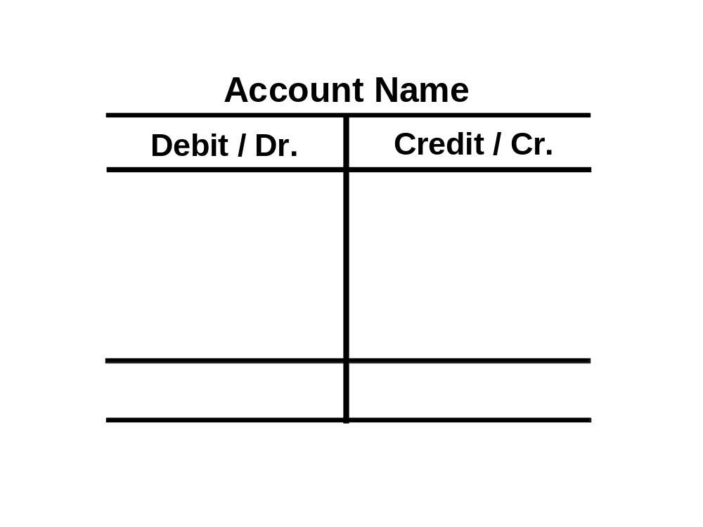
The Account
A record of increases and decreases in a specific asset, liability, equity, revenue, or expense item.
Debit = “Left”
Credit = “Right”
Account
An account can be illustrated in a
T-account form.
LO 1

Slide 5
2
The Recording Process
Learning Objectives
After studying this chapter, you should be able to:
[1] Explain what an account is and how it helps in the recording process.
[2] Define debits and credits and explain their use in recording business transactions.
[3] Identify the basic steps in the recording process.
[4] Explain what a journal is and how it helps in the recording process.
[5] Explain what a ledger is and how it helps in the recording process.
[6] Explain what posting is and how it helps in the recording process.
[7] Prepare a trial balance and explain its purposes.

Slide 6

The Account
Debit and Credit Procedure
Double-entry system
  Each transaction must affect two or more accounts to keep the basic accounting equation in balance.
  Recording done by debiting at least one account and crediting another.
  DEBITS must equal CREDITS.
LO 2

Slide 7

Debits and Credits
If Debit amounts are greater than Credit amounts, the account will have a debit balance.
Transaction #1
$10,000
$3,000
Transaction #2
Transaction #3
8,000
Balance
$15,000
LO 2

Slide 8
Debits and Credits
If Debit amounts are less than Credit amounts, the account will have a credit balance.
Transaction #1
$10,000
$3,000
Transaction #2
8,000
Transaction #3
Balance
$1,000
LO 2

Slide 9
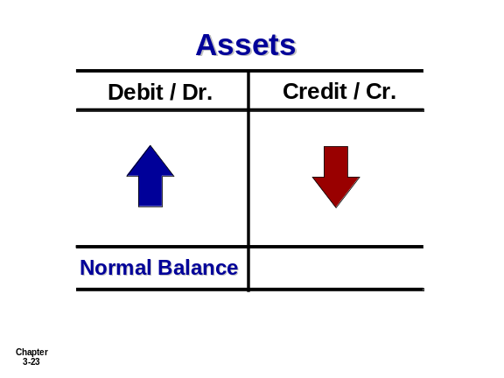
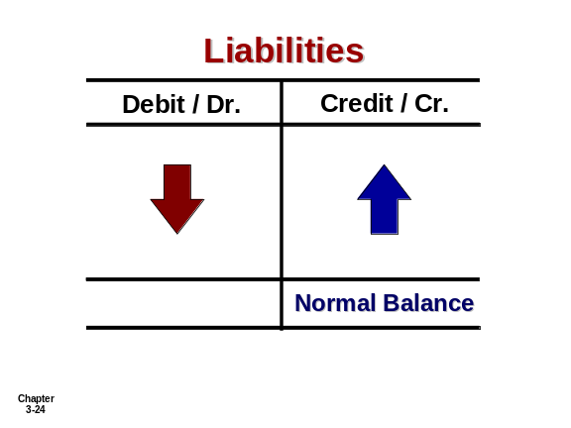
Debits and Credits
Assets - Debits should exceed credits.
Liabilities – Credits should exceed debits.
Normal balance is on the increase side.
LO 2

Slide 10
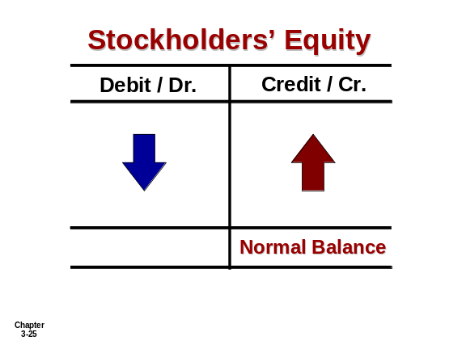
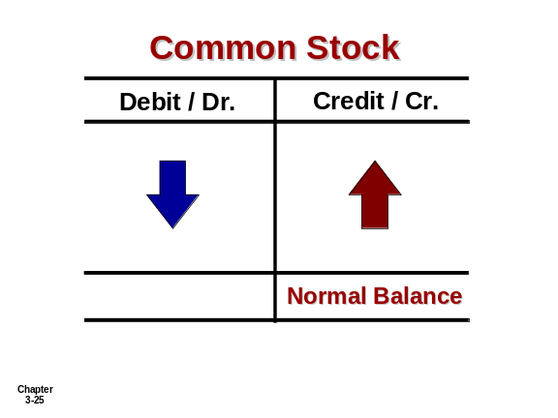
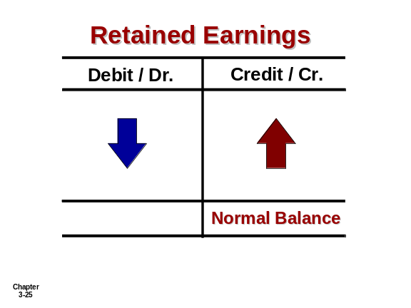
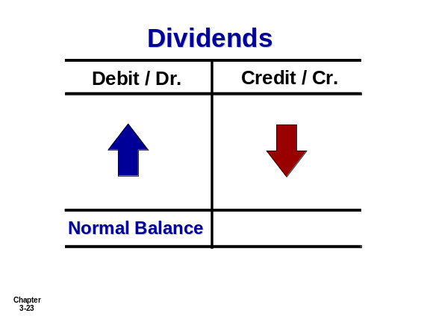
Debits and Credits
Owner’s investments and revenues increase stockholders’ equity (credit).
Dividends and expenses decrease stockholders’ equity (debit).
LO 2

Slide 11
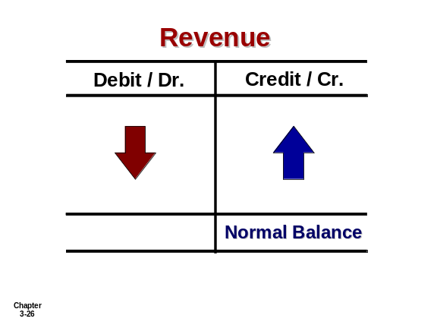

Debits and Credits
The purpose of earning revenues is to benefit the stockholders.
The effect of debits and credits on revenue accounts is the same as their effect on stockholders’ equity.
Expenses have the opposite effect: expenses decrease stockholders’ equity.
LO 2

Slide 12
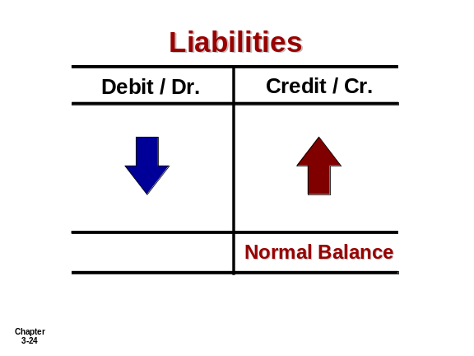
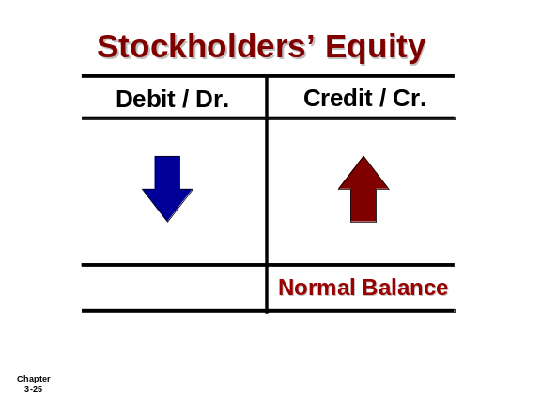
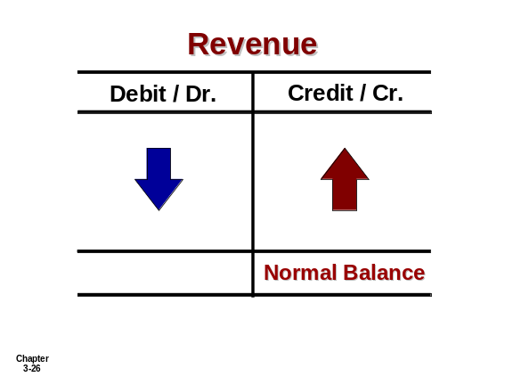
Debits/Credits Rules
Normal Balance Debit
Normal Balance Credit
LO 2

Slide 13


Debits/Credits Rules
Balance Sheet Income Statement
Asset
Liability
+
-
=
Equity
Revenue
Expense
Debit
Credit
LO 2

Slide 14
Debits/Credits Rules
Question
Debits:
  increase both assets and liabilities.
  decrease both assets and liabilities.
  increase assets and decrease liabilities.
  decrease assets and increase liabilities.
LO 2

Slide 15
Debits/Credits Rules
Question
Accounts that normally have debit balances are:
  assets, expenses, and revenues.
  assets, expenses, and equity.
  assets, liabilities, and dividends.
  assets, dividends, and expenses.
LO 2

Slide 16
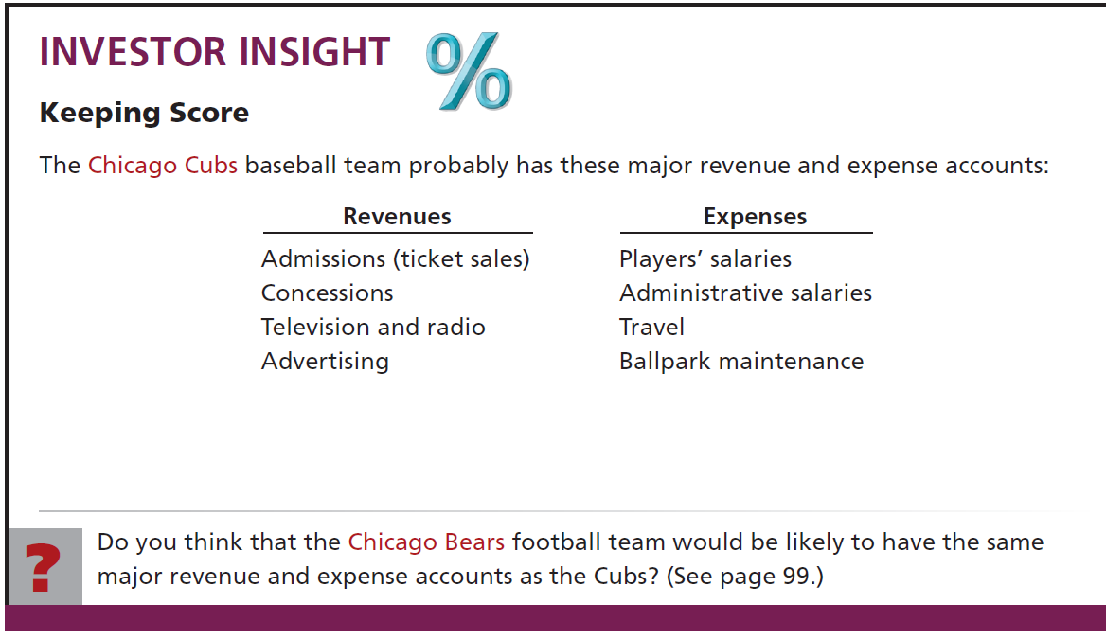
LO 2

Slide 17
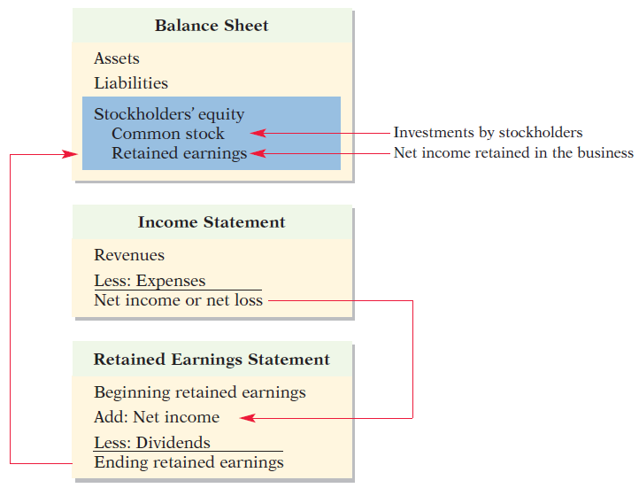
Stockholders’ Equity Relationships
Illustration 2-11
LO 2

Slide 18
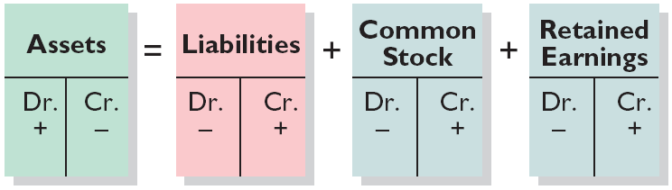
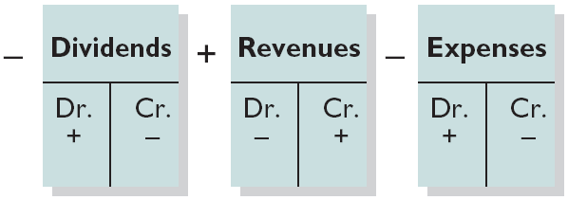
Summary of Debit/Credit Rules
Relationship among the assets, liabilities and stockholders’ equity of a business:
Illustration 2-12
Basic Equation
Assets
=
Liabilities
+
Stockholders’ Equity
Expanded Equation
Debit/Credit Effects
The equation must be in balance after every transaction. For every Debit there must be a Credit.
LO 2

Slide 19
Kate Browne, president of Hair It Is, Inc., has just rented space in a shopping mall in which she will open and operate a beauty salon. A friend has advised Kate to set up a double-entry set of accounting records in which to record all of her business transactions. Identify the balance sheet accounts that Hair It Is, Inc., will likely need to record the transactions needed to establish and open the business. Also, indicate whether the normal balance of each account is a debit or a credit.
Assets
Liabilities
Equity
Cash (debit)
Supplies (debit)
Equipment (debit)
Notes payable (credit) if the business borrows money
Accounts payable (credit)
Common stock (credit)
LO 2

Slide 20
2
The Recording Process
Learning Objectives
After studying this chapter, you should be able to:
[1] Explain what an account is and how it helps in the recording process.
[2] Define debits and credits and explain their use in recording business transactions.
[3] Identify the basic steps in the recording process.
[4] Explain what a journal is and how it helps in the recording process.
[5] Explain what a ledger is and how it helps in the recording process.
[6] Explain what posting is and how it helps in the recording process.
[7] Prepare a trial balance and explain its purposes.

Slide 21
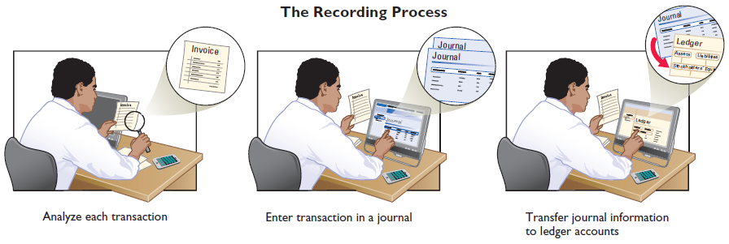
Steps in the Recording Process
Illustration 2-13
Analyze each transaction
Enter transaction in a journal
Transfer journal information to ledger accounts
Business documents, such as a sales slip, a check, a bill, or a cash register tape, provide evidence of the transaction.
LO 3

Slide 22
2
The Recording Process
Learning Objectives
After studying this chapter, you should be able to:
[1] Explain what an account is and how it helps in the recording process.
[2] Define debits and credits and explain their use in recording business transactions.
[3] Identify the basic steps in the recording process.
[4] Explain what a journal is and how it helps in the recording process.
[5] Explain what a ledger is and how it helps in the recording process.
[6] Explain what posting is and how it helps in the recording process.
[7] Prepare a trial balance and explain its purposes.

Slide 23
Steps in the Recording Process
The Journal
Book of original entry.
Transactions recorded in chronological order.
Contributions to the recording process:
  Discloses the complete effects of a transaction.
  Provides a chronological record of transactions.
  Helps to prevent or locate errors because the debit and credit amounts can be easily compared.
LO 4

Slide 24
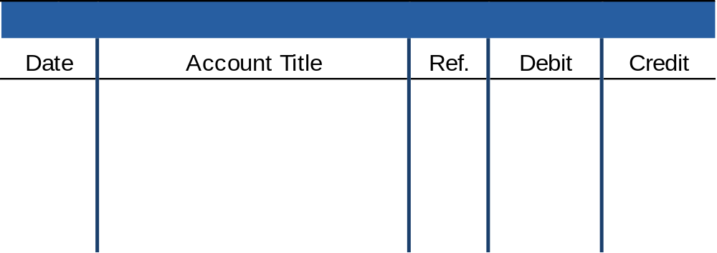
Steps in the Recording Process
Journalizing - Entering transaction data in the journal.
Illustration: On September 1, stockholders’ invested $15,000 cash in the corporation in exchange for shares of stock, and Softbyte purchased computer equipment for $7,000 cash.
Illustration 2-14
General Journal
Sept. 1
Cash
15,000
  Common stock
15,000
Equipment
7,000
  Cash
7,000
LO 4

Slide 25
Steps in the Recording Process
Simple and Compound Entries
Illustration: On July 1, Butler Company purchases a delivery truck costing $14,000. It pays $8,000 cash now and agrees to pay the remaining $6,000 on account.
Illustration 2-15
General Journal
July 1
Equipment
14,000
  Cash
8,000
  Accounts Payable
6,000
LO 4

Slide 26
2
The Recording Process
Learning Objectives
After studying this chapter, you should be able to:
[1] Explain what an account is and how it helps in the recording process.
[2] Define debits and credits and explain their use in recording business transactions.
[3] Identify the basic steps in the recording process.
[4] Explain what a journal is and how it helps in the recording process.
[5] Explain what a ledger is and how it helps in the recording process.
[6] Explain what posting is and how it helps in the recording process.
[7] Prepare a trial balance and explain its purposes.

Slide 27
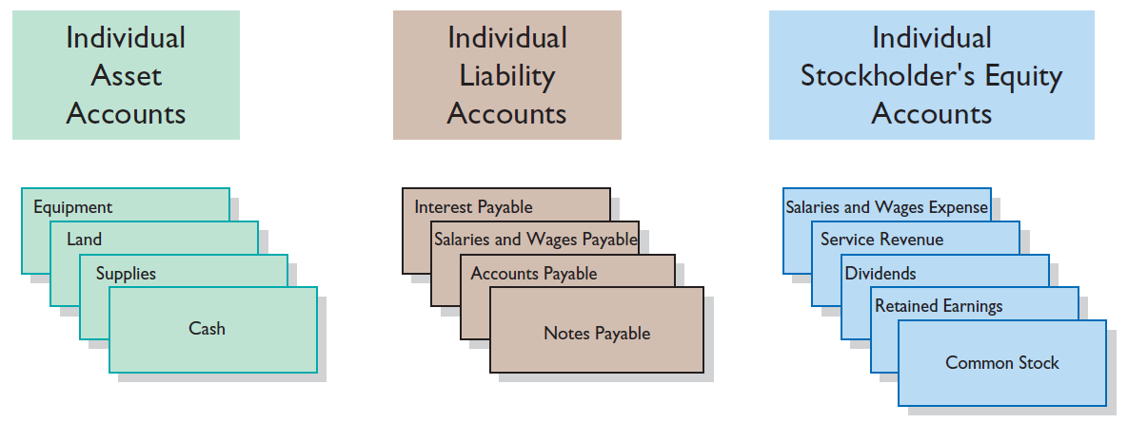
Steps in the Recording Process
The Ledger
General Ledger contains the entire group of accounts maintained by a company.
Illustration 2-16
LO 5

Slide 28

LO 5

Slide 29
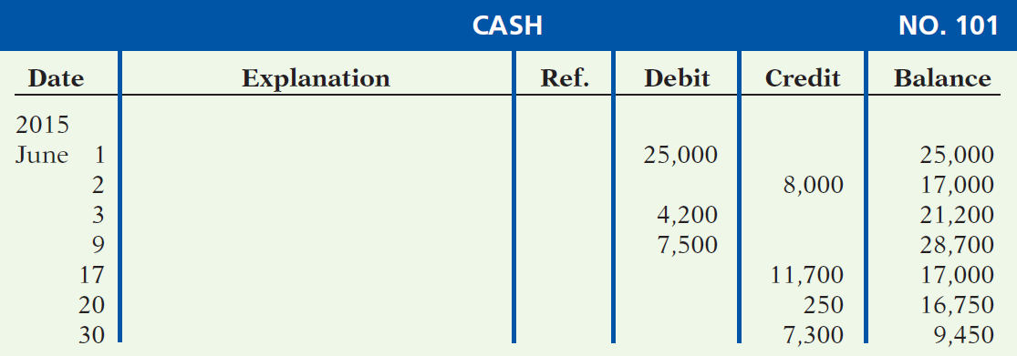
Steps in the Recording Process
Standard Form of Account
Illustration 2-17
LO 5

Slide 30
2
The Recording Process
Learning Objectives
After studying this chapter, you should be able to:
[1] Explain what an account is and how it helps in the recording process.
[2] Define debits and credits and explain their use in recording business transactions.
[3] Identify the basic steps in the recording process.
[4] Explain what a journal is and how it helps in the recording process.
[5] Explain what a ledger is and how it helps in the recording process.
[6] Explain what posting is and how it helps in the recording process.
[7] Prepare a trial balance and explain its purposes.

Slide 31
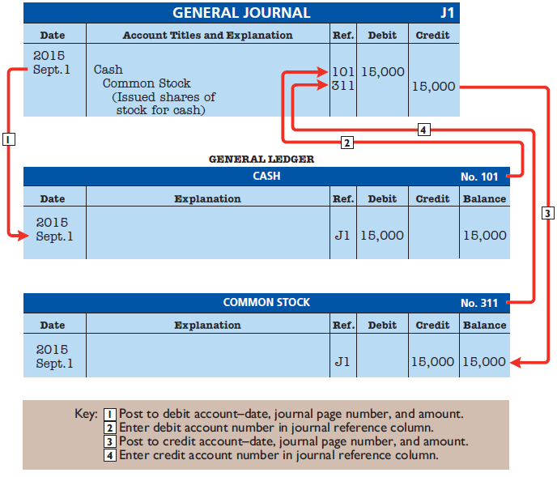
Steps
Posting – process of transferring amounts from the journal to the ledger accounts.
Illustration 2-18
LO 6

Slide 32
Posting
Question
Posting:
  normally occurs before journalizing.
  transfers ledger transaction data to the journal.
  is an optional step in the recording process.
  transfers journal entries to ledger accounts.
LO 6

Slide 33
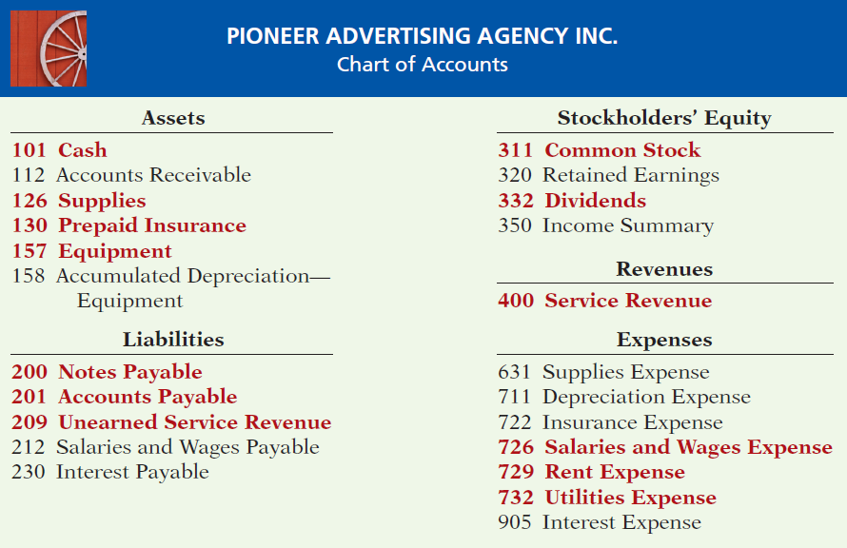

Chart of Accounts
Accounts and account numbers arranged in sequence in which they are presented in the financial statements.
Illustration 2-19
LO 6

Slide 34
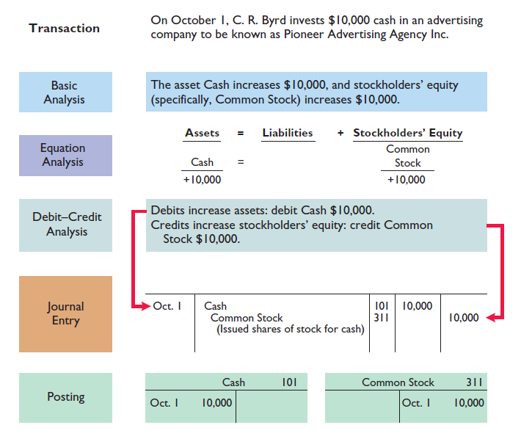
The Recording Process Illustrated
Follow these steps:
1. Determine what type of account is involved.
2. Determine what items increased or decreased and by how much.
3. Translate the increases and decreases into debits and credits.
Illustration 2-20
LO 6

Slide 35
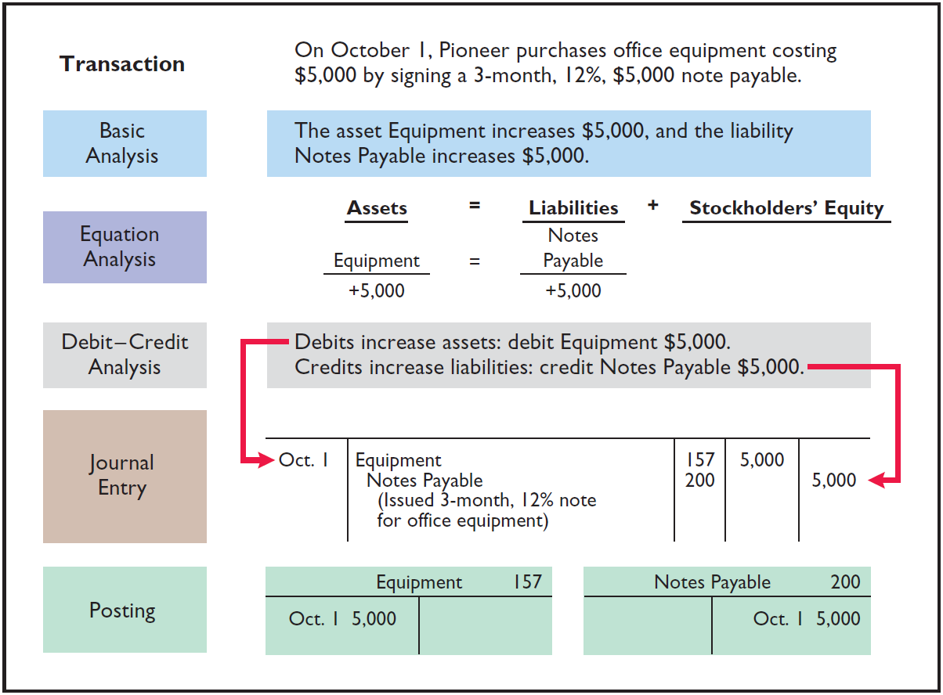
The Recording Process Illustrated
Illustration 2-21
LO 6

Slide 36
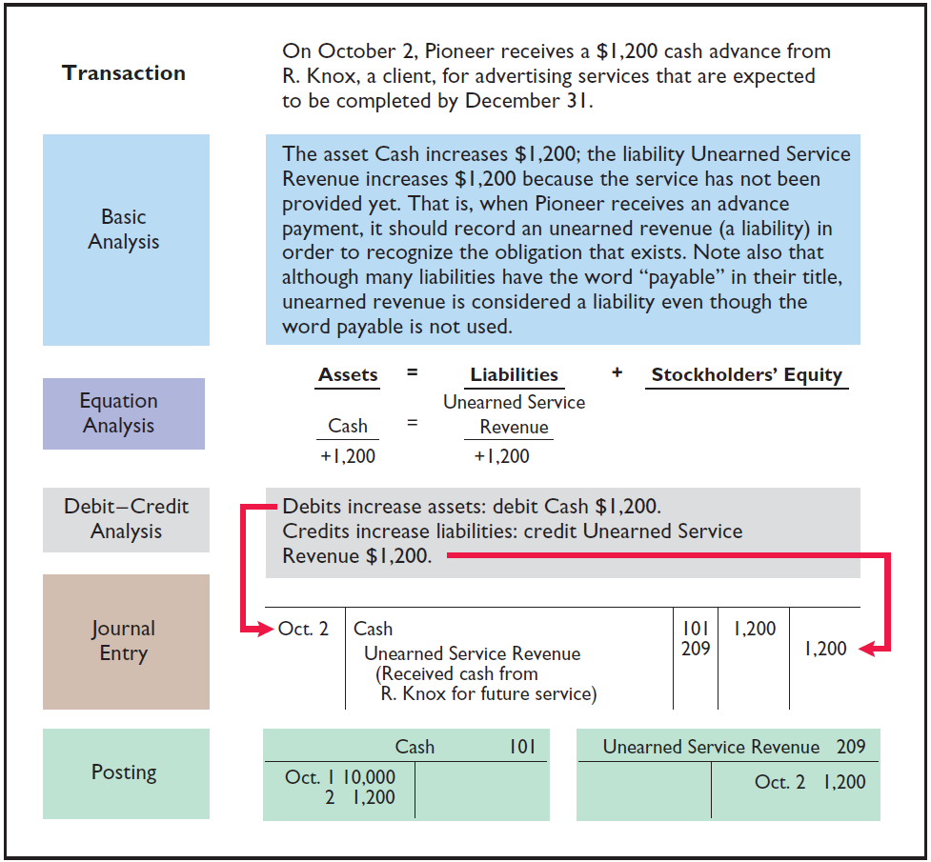
The Recording Process Illustrated
Illustration 2-22
LO 6

Slide 37
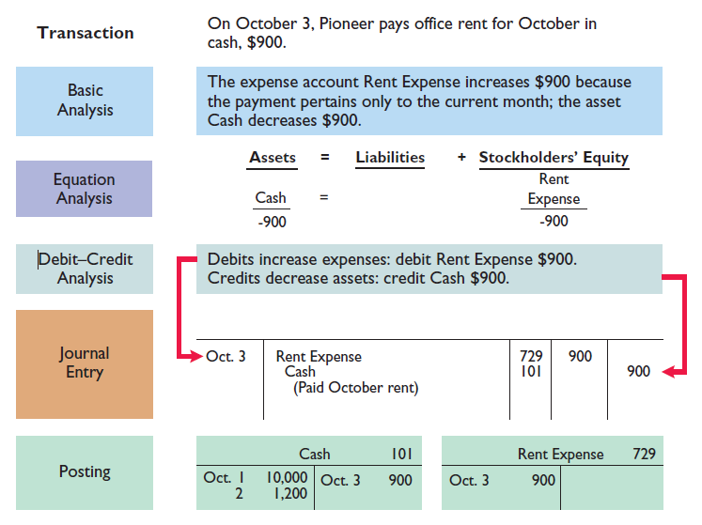
The Recording Process Illustrated
Illustration 2-23
LO 6

Slide 38
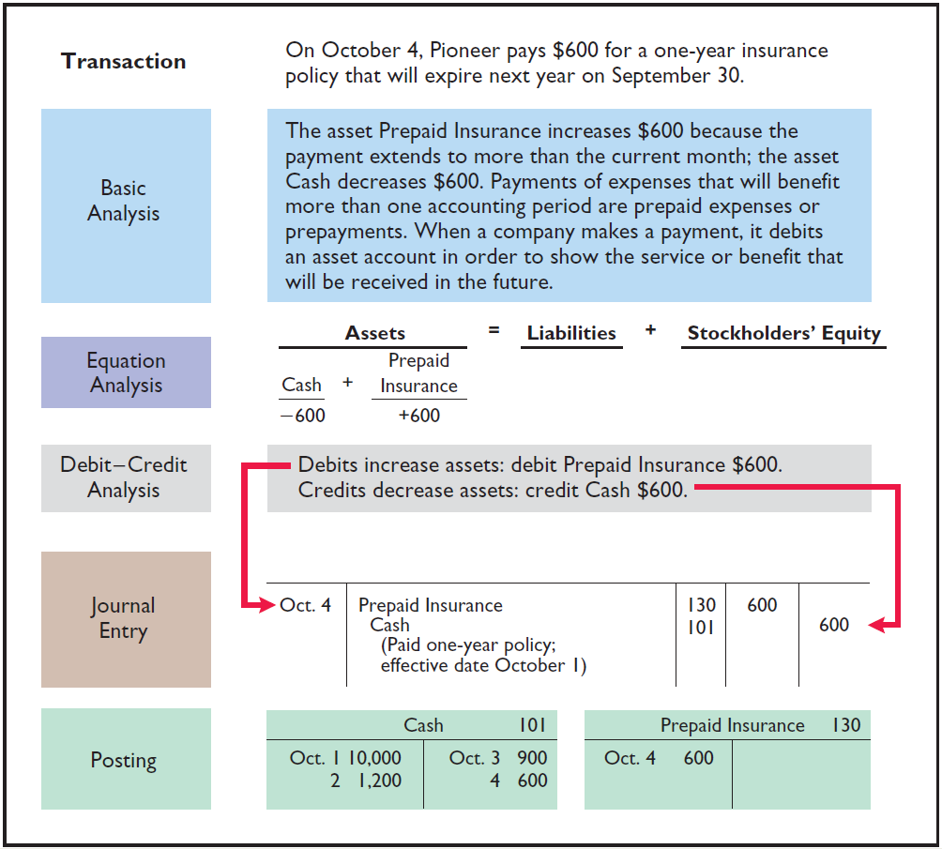
The Recording Process Illustrated
Illustration 2-24
LO 6

Slide 39
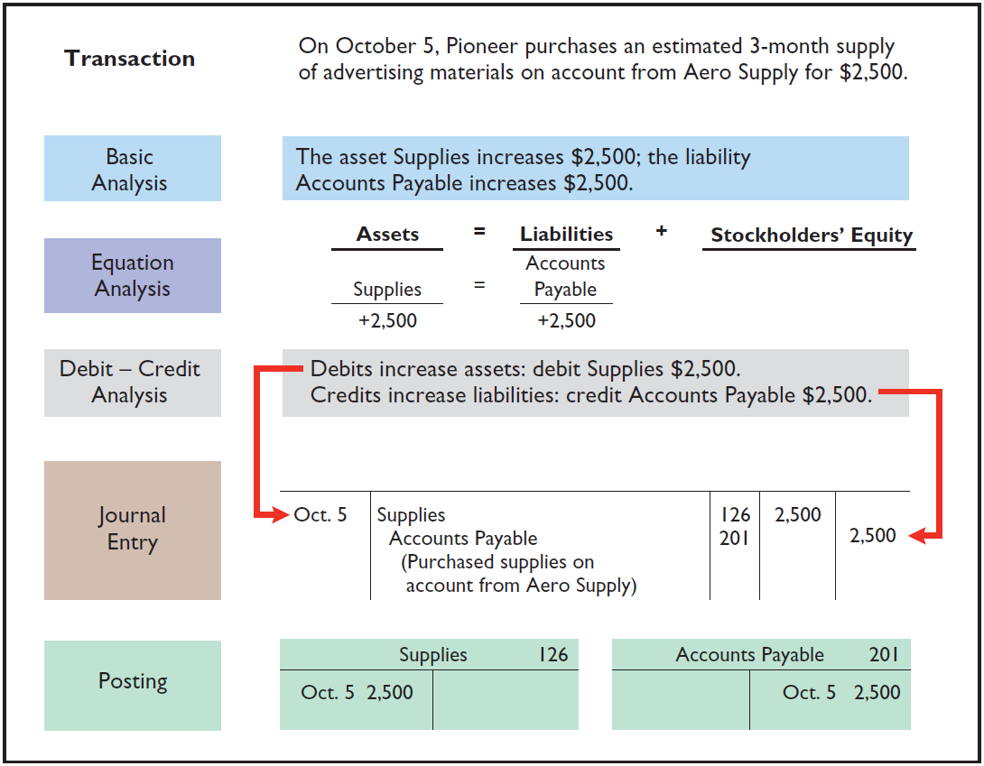
The Recording Process Illustrated
Illustration 2-25
LO 6

Slide 40
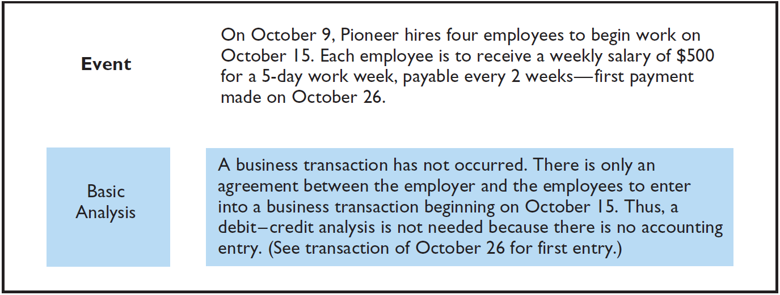
The Recording Process Illustrated
Illustration 2-26
LO 6

Slide 41
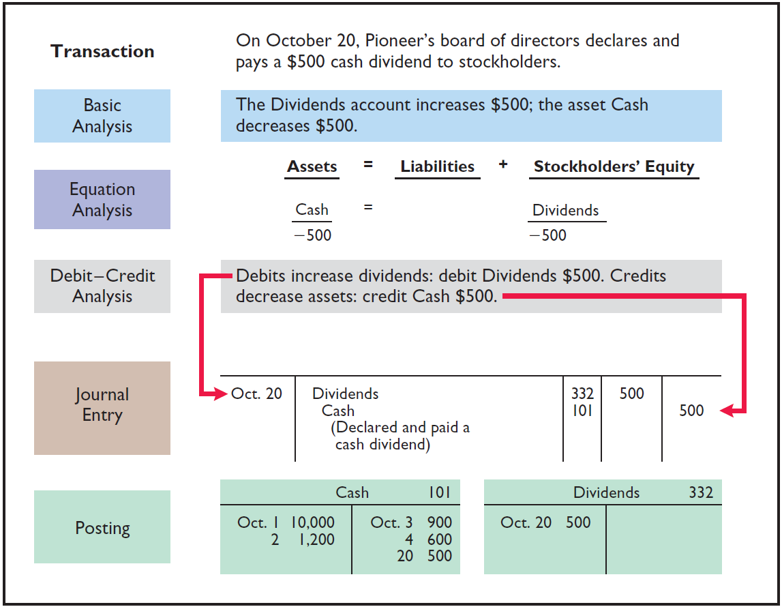
The Recording Process Illustrated
Illustration 2-27
LO 6

Slide 42
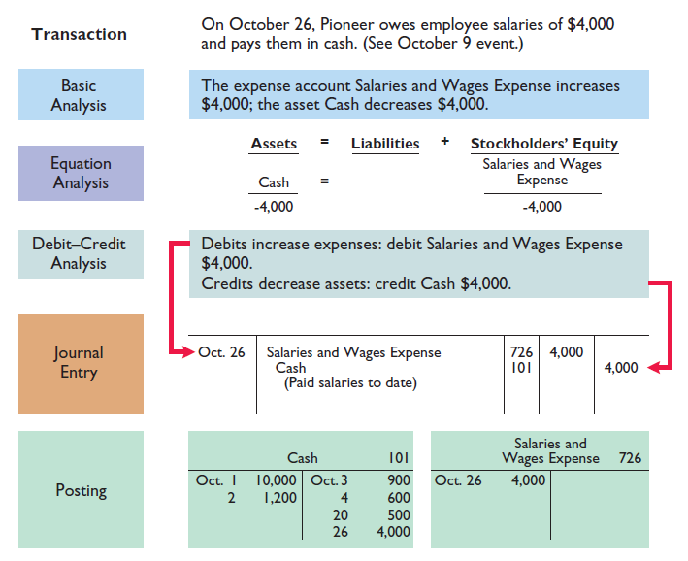
The Recording Process Illustrated
Illustration 2-28
LO 6

Slide 43
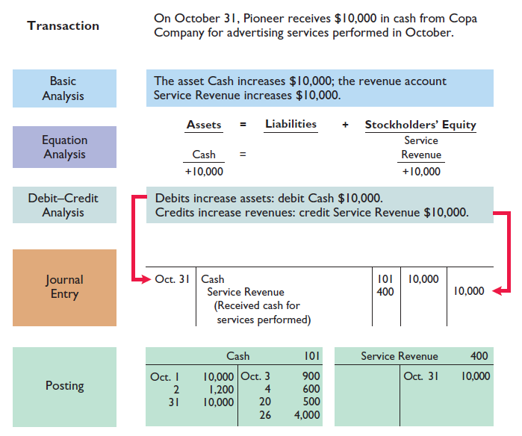
The Recording Process Illustrated
Illustration 2-29
LO 6

Slide 44
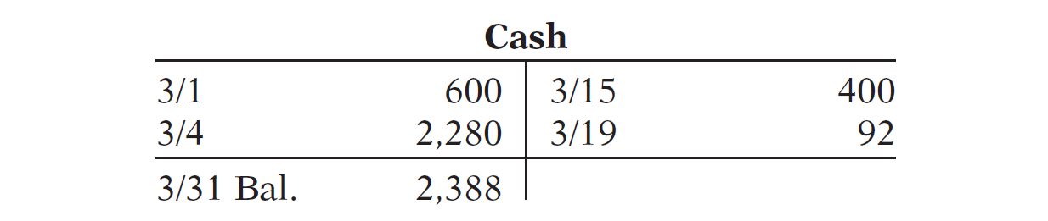
Kate Brown recorded the following transactions in a general journal during the month of March. Post these entries to the Cash account.
Mar. 4 Cash 2,280
Service Revenue 2,280
Mar. 15 Salaries and Wages Expense 400
Cash 400
Mar. 19 Utilities Expense 92
Cash 92
LO 6

Slide 45
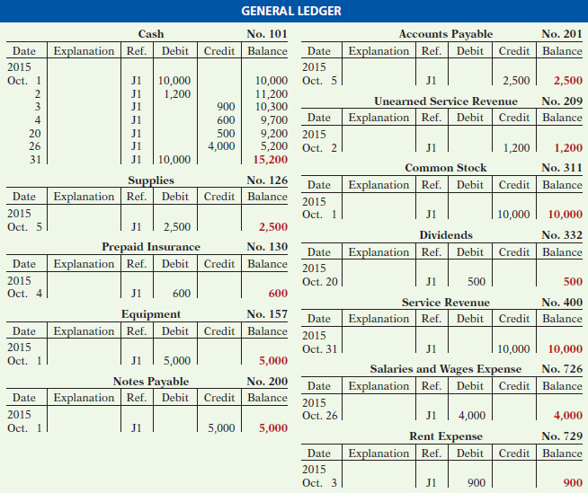
Illustration 2-31
LO 6

Slide 46
2
The Recording Process
Learning Objectives
After studying this chapter, you should be able to:
[1] Explain what an account is and how it helps in the recording process.
[2] Define debits and credits and explain their use in recording business transactions.
[3] Identify the basic steps in the recording process.
[4] Explain what a journal is and how it helps in the recording process.
[5] Explain what a ledger is and how it helps in the recording process.
[6] Explain what posting is and how it helps in the recording process.
[7] Prepare a trial balance and explain its purposes.

Slide 47
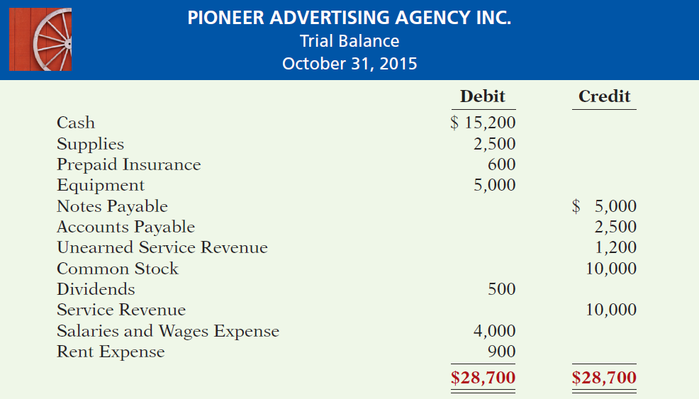
Trial Balance
Illustration 2-32
LO 7

Slide 48
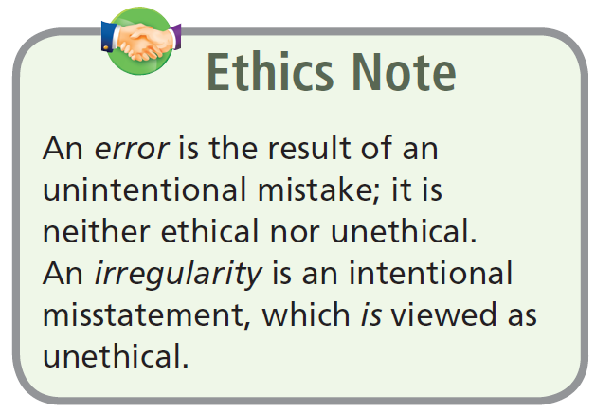
Trial Balance
Limitations of a Trial Balance
The trial balance may balance even when:
  A transaction is not journalized.
  A correct journal entry is not posted.
  A journal entry is posted twice.
  Incorrect accounts are used in journalizing or posting.
  Offsetting errors are made in recording the amount of a transaction.
LO 7

Slide 49
Trial Balance
Question
A trial balance will not balance if:
  a correct journal entry is posted twice.
  the purchase of supplies on account is debited to Supplies and credited to Cash.
  a $100 cash drawing by the owner is debited to Owner’s Drawing for $1,000 and credited to Cash for $100.
  a $450 payment on account is debited to Accounts Payable for $45 and credited to Cash for $45.
LO 7

Slide 50
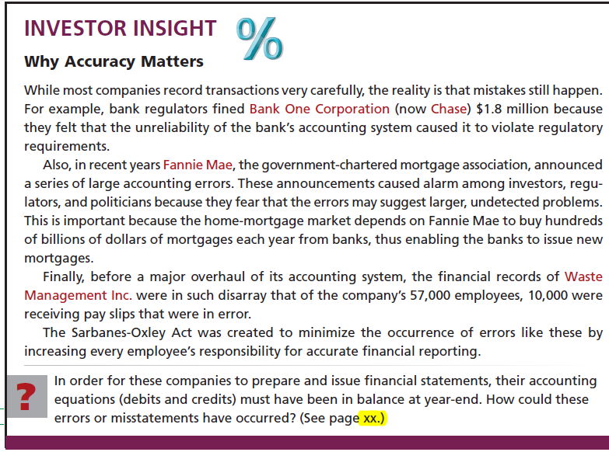
LO 7

Slide 51

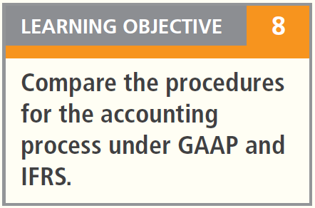
Key Points
  Transaction analysis is the same under IFRS and GAAP but, as you will see in later chapters, different standards sometimes impact how transactions are recorded.
  Rules for accounting for specific events sometimes differ across countries. Despite the differences, the double-entry accounting system is the basis of accounting systems worldwide.
  Both the IASB and FASB go beyond the basic definitions provided in this textbook for the key elements of financial statements, that is, assets, liabilities, equity, revenues, and expenses.
LO 8

Slide 52
Key Points
  A trial balance under IFRS follows the same format as shown in the textbook.
  As shown in the textbook, dollars signs are typically used only in the trial balance and the financial statements. The same practice is followed under IFRS, using the currency of the country that the reporting company is headquartered.
  In February 2010, the SEC expressed a desire to continue working toward a single set of high-quality standards.
LO 8

Slide 53
Looking to the Future
The basic recording process shown in this textbook is followed by companies across the globe. It is unlikely to change in the future. The definitional structure of assets, liabilities, equity, revenues, and expenses may change over time as the IASB and FASB evaluate their overall conceptual framework for establishing accounting standards.
LO 8

Slide 54
IFRS Self-Test Questions
Which statement is correct regarding IFRS?
  IFRS reverses the rules of debits and credits, that is, debits are on the right and credits are on the left.
  IFRS uses the same process for recording transactions as GAAP.
  The chart of accounts under IFRS is different because revenues follow assets.
  None of the above statements are correct.
LO 8

Slide 55
IFRS Self-Test Questions
A trial balance:
  is the same under IFRS and GAAP.
  proves that transactions are recorded correctly.
  proves that all transactions have been recorded.
  will not balance if a correct journal entry is posted twice.
LO 8

Slide 56
IFRS Self-Test Questions
One difference between IFRS and GAAP is that:
  GAAP uses accrual-accounting concepts and IFRS uses primarily the cash basis of accounting.
  IFRS uses a different posting process than GAAP.
  IFRS uses more fair value measurements than GAAP.
  the limitations of a trial balance are different between IFRS and GAAP.
LO 8

Slide 57
Copyright
“Copyright © 2013 John Wiley & Sons, Inc. All rights reserved. Reproduction or translation of this work beyond that permitted in Section 117 of the 1976 United States Copyright Act without the express written permission of the copyright owner is unlawful. Request for further information should be addressed to the Permissions Department, John Wiley & Sons, Inc. The purchaser may make back-up copies for his/her own use only and not for distribution or resale. The Publisher assumes no responsibility for errors, omissions, or damages, caused by the use of these programs or from the use of the information contained herein.”

