Slide 1

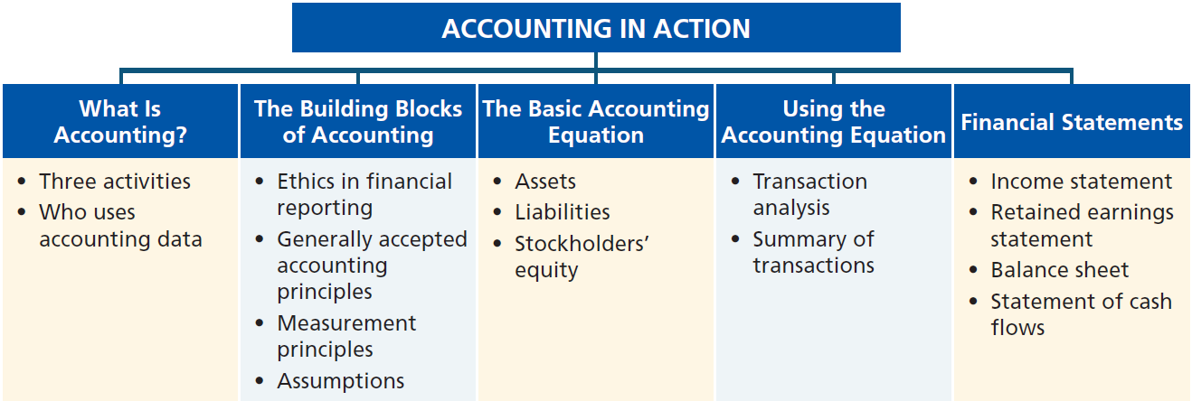
Preview of Chapter 1
Financial Accounting
Ninth Edition
Weygandt Kimmel Kieso

Slide 2
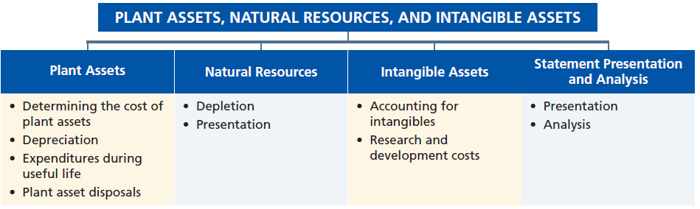
Preview of Chapter 9
Financial Accounting
Ninth Edition
Weygandt Kimmel Kieso

Slide 3

9
Plant Assets, Natural Resources, and Intangible Assets
Learning Objectives
After studying this chapter, you should be able to:
[1] Describe how the historical cost principle applies to plant assets.
[2] Explain the concept of depreciation and how to compute it.
[3] Distinguish between revenue and capital expenditures, and explain the entries for each.
[4] Explain how to account for the disposal of a plant asset.
[5] Compute periodic depletion of natural resources.
[6] Explain the basic issues related to accounting for intangible assets.
[7] Indicate how plant assets, natural resources, and intangible assets are reported.

Slide 4
Plant Assets
Plant assets are resources that have
  physical substance (a definite size and shape),
  are used in the operations of a business,
  are not intended for sale to customers,
  are expected to be of use to the company for a number of years.
Referred to as property, plant, and equipment; plant and equipment; and fixed assets.
LO 1

Slide 5
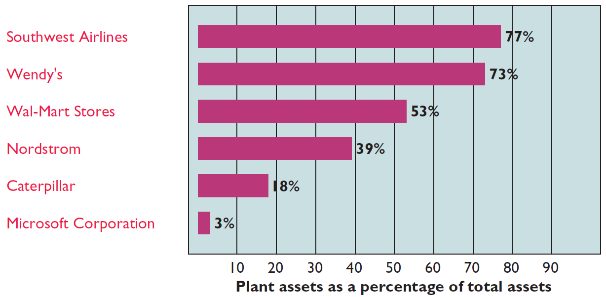
Plant Assets
Plant assets are critical to a company’s success
Illustration 9-1
LO 1

Slide 6
Plant Assets
Determining the Cost of Plant Assets
Historical Cost Principle requires that companies record plant assets at cost.
Cost consists of all expenditures necessary to acquire an asset and make it ready for its intended use.
LO 1

Slide 7
Determining the Cost of Plant Assets
Land
All necessary costs incurred in making the land ready for its intended use increase (debit) the Land account.
  Costs typically include:
    cash purchase price,
    closing costs such as title and attorney’s fees,
    real estate brokers’ commissions, and
    accrued property taxes and other liens on the land assumed by the purchaser.
LO 1

Slide 8
Determining the Cost of Plant Assets
Illustration: Hayes Company acquires real estate at a cash cost of $100,000. The property contains an old warehouse that is razed at a net cost of $6,000 ($7,500 in costs less $1,500 proceeds from salvaged materials). Additional expenditures are the attorney’s fee, $1,000, and the real estate broker’s commission, $8,000.
Required: Determine the amount to be reported as the cost of the land.
LO 1

Slide 9
Determining the Cost of Plant Assets
Required: Determine amount to be reported as the cost of the land.
Land
Cash price of property ($100,000)
$100,000
Net removal cost of warehouse ($7,500-$1,500)
6,000
Attorney's fees ($1,000)
1,000
Real estate broker’s commission ($8,000)
8,000
Cost of Land
$115,000
Illustration 9-2
Computation of cost of land
LO 1

Slide 10
Determining the Cost of Plant Assets
Land Improvements
Structural additions made to land. Cost includes all expenditures necessary to make the improvements ready for their intended use.
Examples: driveways, parking lots, fences, landscaping, and underground sprinklers.
Limited useful lives.
Expense (depreciate) the cost of land improvements over their useful lives.
LO 1

Slide 11
Determining the Cost of Plant Assets
Buildings
Includes all costs related directly to purchase or construction.
Purchase costs:
  Purchase price, closing costs (attorney’s fees, title insurance, etc.) and real estate broker’s commission.
  Remodeling and replacing or repairing the roof, floors, electrical wiring, and plumbing.
Construction costs:
  Contract price plus payments for architects’ fees, building permits, and excavation costs.
LO 1

Slide 12
Determining the Cost of Plant Assets
Equipment
Include all costs incurred in acquiring the equipment and preparing it for use.
Costs typically include:
  Cash purchase price.
  Sales taxes.
  Freight charges.
  Insurance during transit paid by the purchaser.
  Expenditures required in assembling, installing, and testing the unit.
LO 1

Slide 13
Determining the Cost of Plant Assets
Illustration: Lenard Company purchases a delivery truck at a cash price of $22,000. Related expenditures are sales taxes $1,320, painting and lettering $500, motor vehicle license $80, and a three-year accident insurance policy $1,600. Compute the cost of the delivery truck.
Truck
Cash price
$22,000
Sales taxes
1,320
Painting and lettering
500
Illustration 9-4
Cost of Delivery Truck
$23,820
LO 1

Slide 14
Determining the Cost of Plant Assets
Illustration: Lenard Company purchases a delivery truck at a cash price of $22,000. Related expenditures are sales taxes $1,320, painting and lettering $500, motor vehicle license $80, and a three-year accident insurance policy $1,600. Prepare the journal entry to record these costs.
Equipment 23,820
License Expense 80
Prepaid Insurance 1,600
Cash 25,500
LO 1

Slide 15
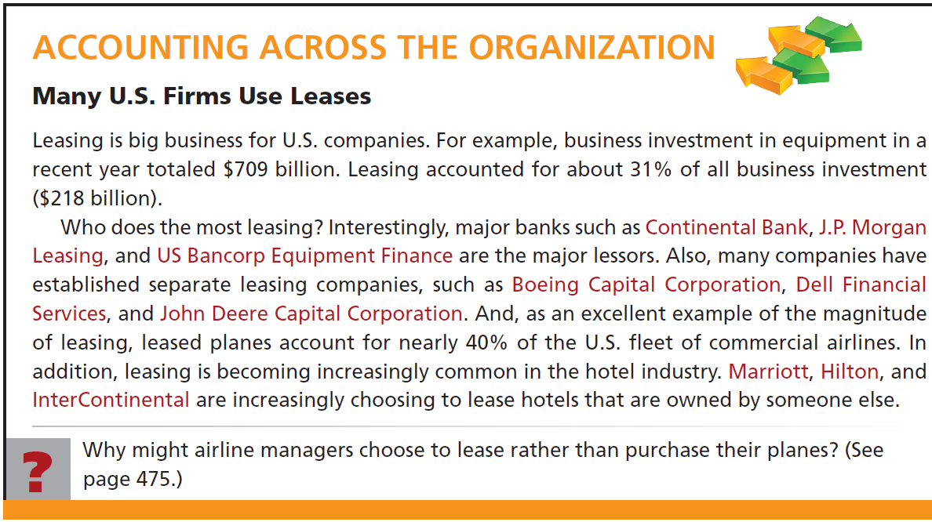
LO 1

Slide 16
9
Plant Assets, Natural Resources, and Intangible Assets
Learning Objectives
After studying this chapter, you should be able to:
[1] Describe how the historical cost principle applies to plant assets.
[2] Explain the concept of depreciation and how to compute it.
[3] Distinguish between revenue and capital expenditures, and explain the entries for each.
[4] Explain how to account for the disposal of a plant asset.
[5] Compute periodic depletion of natural resources.
[6] Explain the basic issues related to accounting for intangible assets.
[7] Indicate how plant assets, natural resources, and intangible assets are reported.

Slide 17
Plant Assets
Depreciation
Process of allocating to expense the cost of a plant asset over its useful (service) life in a rational and systematic manner.
  Process of cost allocation, not asset valuation.
  Applies to land improvements, buildings, and equipment, not land.
  Depreciable because the revenue-producing ability of asset will decline over the asset’s useful life.
LO 2

Slide 18
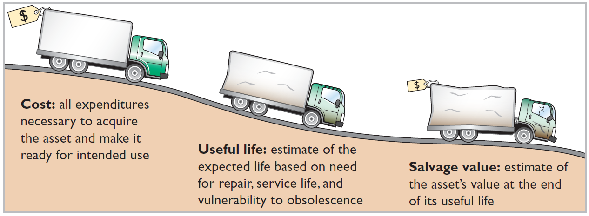
Depreciation
Factors in Computing Depreciation
Illustration 9-6
Helpful Hint Depreciation expense is reported on the income statement. Accumulated depreciation
is reported on the balance sheet as a deduction from plant assets.
Alternative Terminology
Another term sometimes used for salvage value is residual value.
LO 2

Slide 19
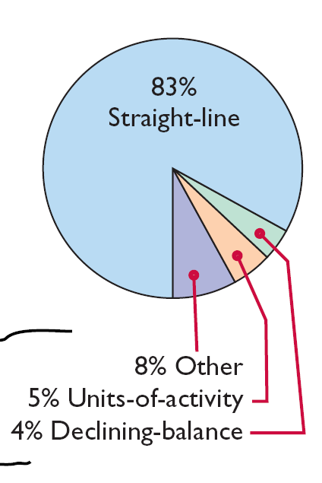
Depreciation
Depreciation Methods
Management selects the method it believes best measures an asset’s contribution to revenue over its useful life.
Examples include:
  Straight-line method.
  Units-of-activity method.
  Declining-balance method.
Illustration 9-8
Use of depreciation methods in major U.S. companies
LO 2

Slide 20
Depreciation
Illustration: Barb’s Florists purchased a small delivery truck on January 1, 2015.
Cost $13,000
Expected salvage value $1,000
Estimated useful life in years 5
Estimated useful life in miles 100,000
Illustration 9-7
Delivery truck data
Required: Compute depreciation using the following.
(a) Straight-Line. (b) Units-of-Activity. (c) Declining Balance.
LO 2

Slide 21
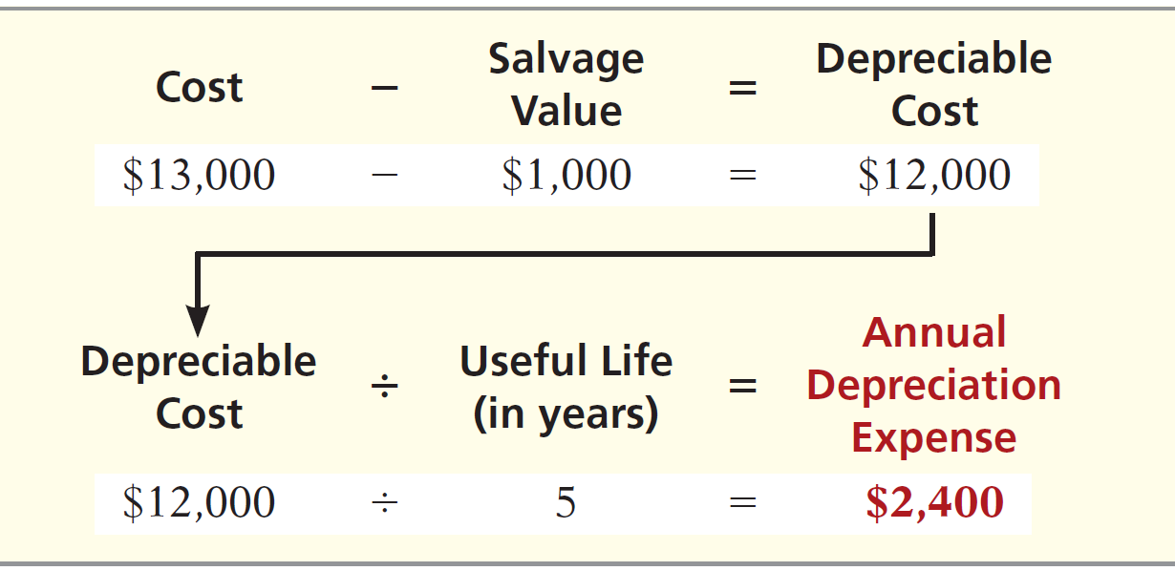
Depreciation
Straight-Line
Expense is same amount for each year.
Depreciable cost = Cost less salvage value.
Illustration 9-9
Formula for straight-line method
LO 2

Slide 22
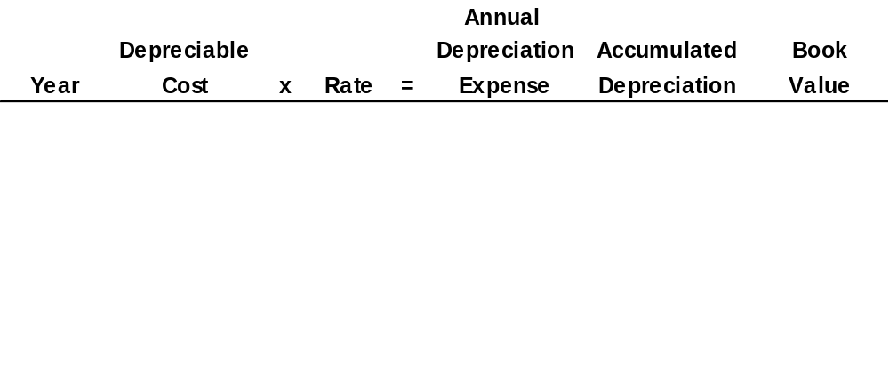
Depreciation
Illustration: (Straight-Line)
Illustration 9-10
2015
$ 12,000
20%
$ 2,400
$ 2,400
$ 10,600
*
2016
12,000
20
2,400
4,800
8,200
2017
12,000
20
2,400
7,200
5,800
2018
12,000
20
2,400
9,600
3,400
2019
12,000
20
2,400
12,000
1,000
2015 Journal Entry
Depreciation expense 2,400
Accumulated depreciation 2,400
* Book value = Cost - Accumulated depreciation = ($13,000 - $2,400).
LO 2

Slide 23
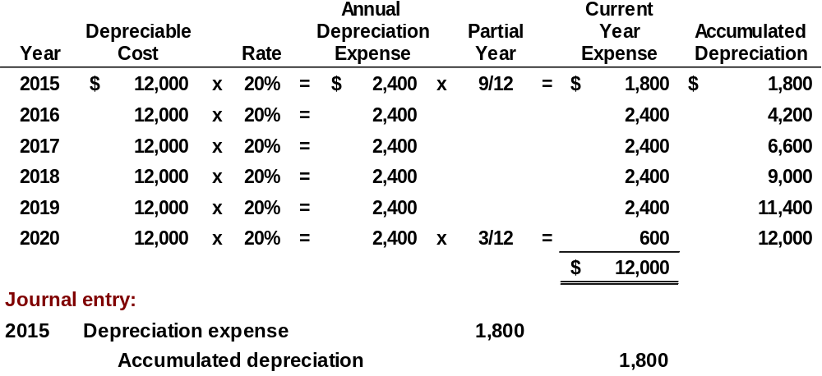
Depreciation
Partial Year
Illustration: (Straight-Line)
Assume the delivery truck was purchased on April 1, 2015.
LO 2

Slide 24
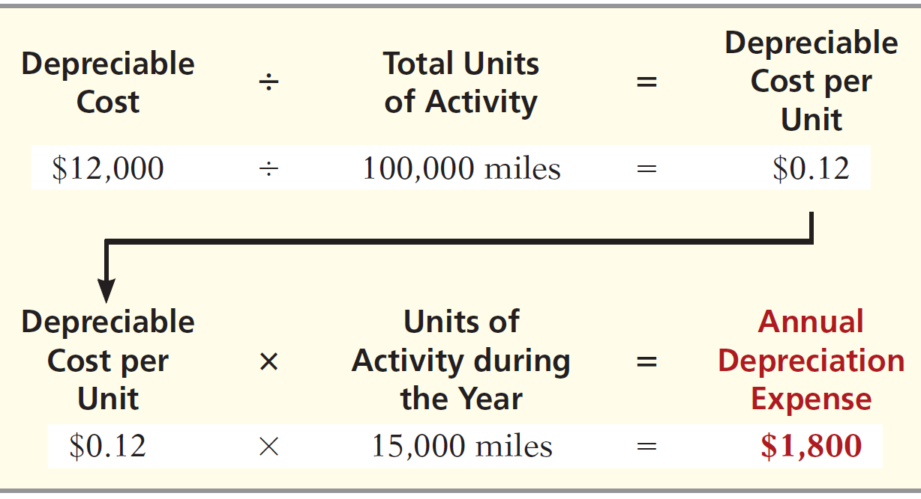
Depreciation
Units-of-Activity
Companies estimate total units of activity to calculate depreciation cost per unit.
Expense varies based on units of activity.
Depreciable cost is cost less salvage value.
Illustration 9-11
Alternative Terminology
Another term often used
is the units-of-production
method.
LO 2

Slide 25
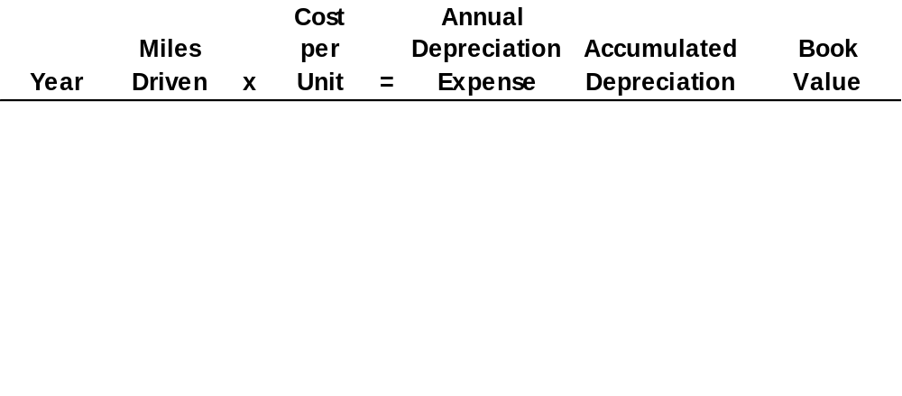
Depreciation
Illustration: (Units-of-Activity)
Illustration 9-12
2015
15,000
$ 0.12
$ 1,800
$ 1,800
$ 11,200
2016
30,000
0.12
3,600
5,400
7,600
2017
20,000
0.12
2,400
7,800
5,200
2018
25,000
0.12
3,000
10,800
2,200
2019
10,000
0.12
1,200
12,000
1,000
2015 Journal Entry
Depreciation expense 1,800
Accumulated depreciation 1,800
LO 2

Slide 26
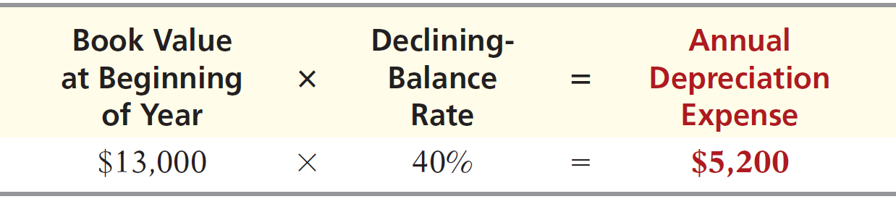
Depreciation
Declining-Balance
Accelerated method.
Decreasing annual depreciation expense over the asset’s useful life.
Twice the straight-line rate with Double-Declining-Balance.
Rate applied to book value.
Illustration 9-13
LO 2

Slide 27
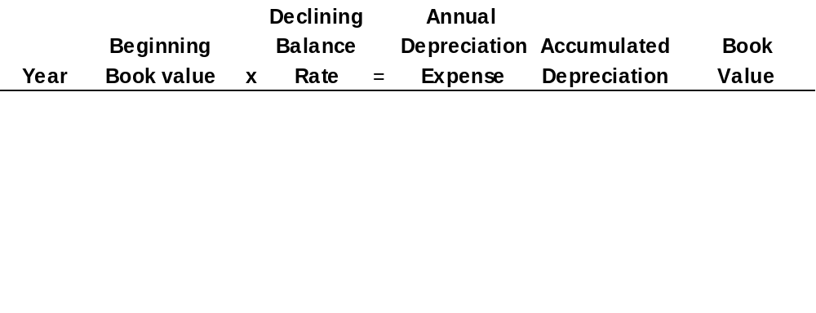
Depreciation
Illustration: (Declining-Balance)
Illustration 9-14
2015
$13,000
40%
$ 5,200
$ 5,200
$ 7,800
2016
7,800
40
3,120
8,320
4,680
2017
4,680
40
1,872
10,192
2,808
2018
2,808
40
1,123
11,315
1,685
2019
1,685
40
685*
12,000
1,000
2015 Journal Entry
Depreciation expense 5,200
Accumulated depreciation 5,200
* Computation of $674 ($1,685 x 40%) is adjusted to $685.
LO 2

Slide 28
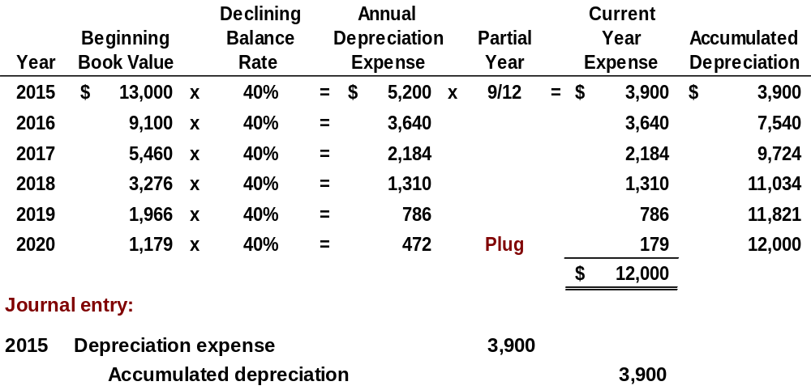
Depreciation
Partial Year
Illustration: (Declining-Balance)
LO 2

Slide 29
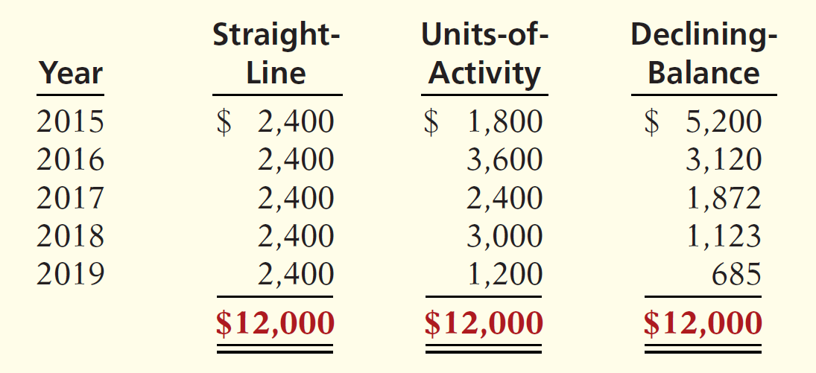
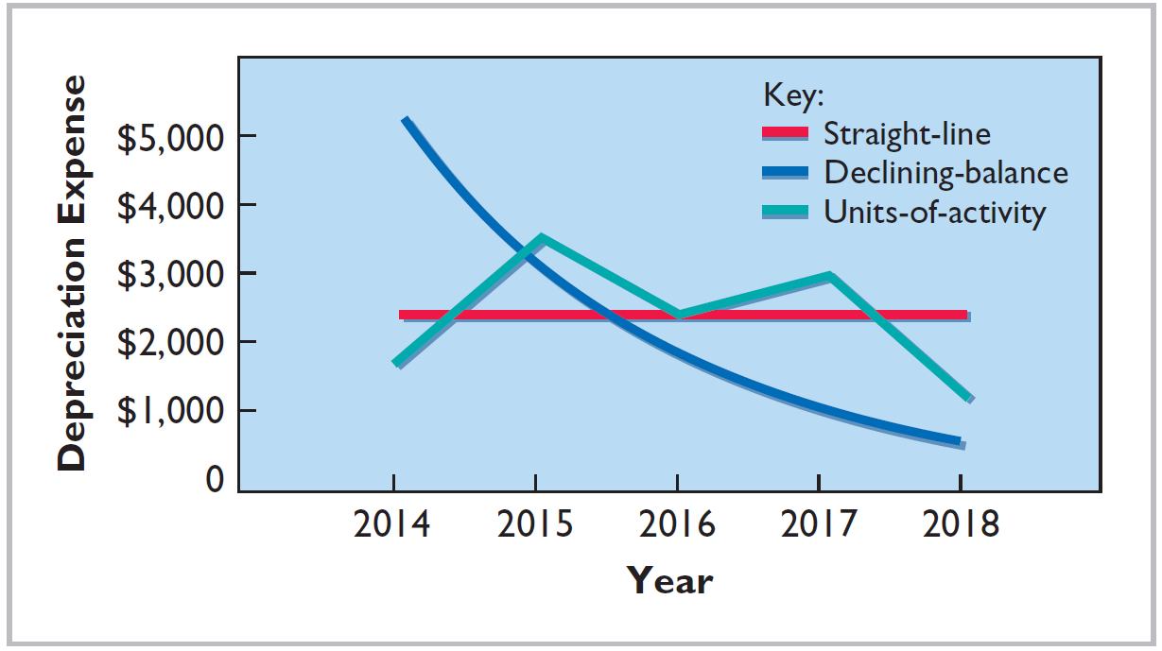
Depreciation
Illustration 9-15
Comparison of Methods
Illustration 9-16
Helpful Hint
Under any method,
depreciation stops when
the asset’s book value
equals expected salvage
value.
LO 2

Slide 30
Depreciation
Depreciation and Income Taxes
IRS does not require taxpayer to use the same depreciation method on the tax return that is used in preparing financial statements.
Taxpayers must use the straight-line method or a special accelerated-depreciation method called the Modified Accelerated Cost Recovery System (MACRS).
MACRS is NOT acceptable under GAAP.
LO 2

Slide 31
Depreciation
Revising Periodic Depreciation
Accounted for in the period of change and future periods (Change in Estimate).
No change in depreciation reported for prior years.
Not considered an error.
LO 2

Slide 32
Depreciation
Illustration: Arcadia HS, purchased equipment for $510,000 which was estimated to have a useful life of 10 years with a salvage value of $10,000 at the end of that time. Depreciation has been recorded for 7 years on a straight-line basis. In 2015 (year 8), it is determined that the total estimated life should be 15 years with a salvage value of $5,000 at the end of that time.
Questions:
  What is the journal entry to correct the prior years’ depreciation?
  Calculate the depreciation expense for 2015.
No Entry
Required
LO 2

Slide 33
Depreciation
After 7 years
Equipment cost $510,000
Salvage value - 10,000
Depreciable base 500,000
Useful life (original) ÷ 10 years
Annual depreciation $ 50,000
First, establish NBV at date of change in estimate.
x 7 years = $350,000
Balance Sheet (Dec. 31, 2015)
Plant Assets:
Equipment
$510,000
Accumulated depreciation
350,000
Net book value (NBV)
$160,000
LO 2

Slide 34
Depreciation
After 7 years
Net book value $160,000
Salvage value (new) - 5,000
Depreciable base 155,000
Useful life remaining 8 years
Annual depreciation $ 19,375
Depreciation Expense calculation for 2015.
Journal entry for 2015 and future years.
Depreciation Expense 19,375
Accumulated Depreciation 19,375
LO 2

Slide 35
9
Plant Assets, Natural Resources, and Intangible Assets
Learning Objectives
After studying this chapter, you should be able to:
[1] Describe how the historical cost principle applies to plant assets.
[2] Explain the concept of depreciation and how to compute it.
[3] Distinguish between revenue and capital expenditures, and explain the entries for each.
[4] Explain how to account for the disposal of a plant asset.
[5] Compute periodic depletion of natural resources.
[6] Explain the basic issues related to accounting for intangible assets.
[7] Indicate how plant assets, natural resources, and intangible assets are reported.

Slide 36
Plant Assets
Expenditures During Useful Life
Ordinary Repairs are expenditures to maintain the operating efficiency and productive life of the unit.
  Debit to Maintenance and Repair Expense.
  Referred to as revenue expenditures.
Additions and Improvements are costs incurred to increase the operating efficiency, productive capacity, or useful life of a plant asset.
  Debit the plant asset affected.
  Referred to as capital expenditures.
LO 3

Slide 37
ANATOMY OF A FRAUD
Bernie Ebers was the founder and CEO of the phone company WorldCom. The
company engaged in a series of increasingly large, debt-financed acquisitions of other companies. These acquisitions made the company grow quickly, which made the stock price increase dramatically. However, because the acquired companies all had different accounting systems, WorldCom’s financial records were a mess. When WorldCom’s performance started to flatten out, Bernie coerced WorldCom’s accountants to engage in a number of fraudulent activities to make net income look better than it really was and thus prop up the stock price. One of these frauds involved treating $7 billion of line costs as capital expenditures. The line costs, which were rental fees paid to other phone companies to use their phone lines, had always been properly expensed in previous years. Capitalization delayed expense recognition to future periods and thus boosted current-period profits.
Total take: $7 billion
THE MISSING CONTROLS
Documentation procedures. The company’s accounting system was a disorganized collection of non-integrated systems, which resulted from a series of corporate acquisitions. Top management took advantage of this disorganization to conceal its fraudulent activities.
Independent internal verification. A fraud of this size should have been detected by a routine comparison of the actual physical assets with the list of physical assets shown in the accounting records.
Advance slide in presentation mode to reveal answer.
LO 3

Slide 38
9
Plant Assets, Natural Resources, and Intangible Assets
Learning Objectives
After studying this chapter, you should be able to:
[1] Describe how the historical cost principle applies to plant assets.
[2] Explain the concept of depreciation and how to compute it.
[3] Distinguish between revenue and capital expenditures, and explain the entries for each.
[4] Explain how to account for the disposal of a plant asset.
[5] Compute periodic depletion of natural resources.
[6] Explain the basic issues related to accounting for intangible assets.
[7] Indicate how plant assets, natural resources, and intangible assets are reported.

Slide 39
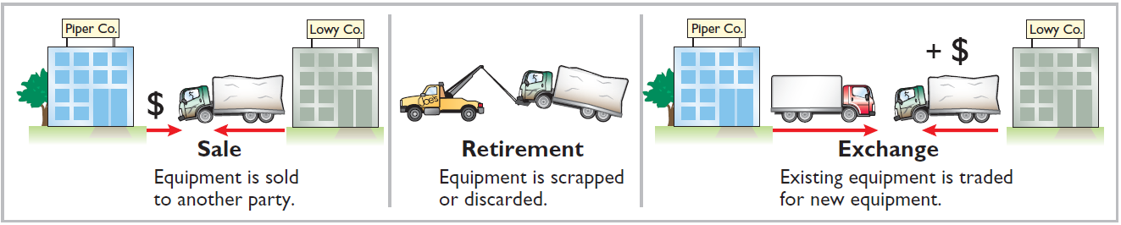
Plant Asset Disposals
Plant Asset Disposals
Companies dispose of plant assets in three ways —Retirement, Sale, or Exchange (appendix).
Illustration 9-18
Record depreciation up to the date of disposal.
Eliminate asset by (1) debiting Accumulated Depreciation, and (2) crediting the asset account.
LO 4

Slide 40
Plant Asset Disposals
Retirement of Plant Assets
No cash is received.
Decrease (credit) the asset account for the original cost in the asset.
Decrease (debit) Accumulated Depreciation for the full amount of depreciation taken over the life of the asset.
LO 4

Slide 41
Plant Asset Disposals
Illustration: Hobart Enterprises retires its computer printers, which cost $32,000. The accumulated depreciation on these printers is $32,000. Prepare the entry to record this retirement.
Accumulated Depreciation 32,000
Equipment 32,000
Question: What happens if a fully depreciated plant asset is still useful to the company?
LO 4

Slide 42
Plant Asset Disposals
Illustration: Sunset Company discards delivery equipment that cost $18,000 and has accumulated depreciation of $14,000. The journal entry is?
Accumulated Depreciation 14,000
Loss on Disposal of Plant Assets 4,000
Equipment 18,000
Companies report a loss on disposal in the “Other expenses and losses” section of the income statement.
LO 4

Slide 43
Plant Asset Disposals
Sale of Plant Assets
Compare the book value of the asset with the proceeds received from the sale.
    If proceeds exceed the book value, a gain on disposal occurs.
    If proceeds are less than the book value, a loss on disposal occurs.
LO 4

Slide 44
Plant Asset Disposals
Gain or Loss on Sale
Illustration: On July 1, 2015, Wright Company sells office furniture for $16,000 cash. The office furniture originally cost $60,000. As of January 1, 2015, it had accumulated depreciation of $41,000. Depreciation for the first six months of 2015 is $8,000. Prepare the journal entry to record depreciation expense up to the date of sale.
July 1
Depreciation Expense 8,000
Accumulated Depreciation 8,000
LO 4

Slide 45
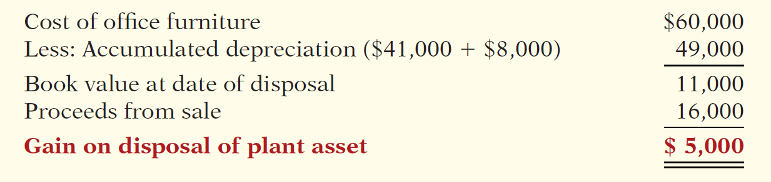
Plant Asset Disposals
Illustration 9-19
Computation of gain on disposal
Illustration: Wright records the sale as follows.
July 1
Cash 16,000
Accumulated Depreciation 49,000
Equipment 60,000
Gain on Disposal of Plant Assets 5,000
LO 4

Slide 46
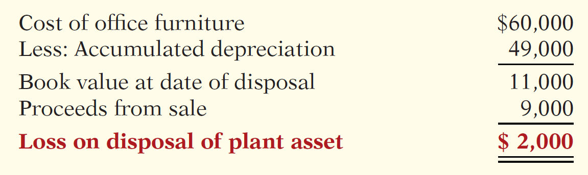
Plant Asset Disposals
Illustration: Assume that instead of selling the office furniture for $16,000, Wright sells it for $9,000.
Illustration 9-20
Computation of loss on disposal
July 1
Cash 9,000
Accumulated Depreciation 49,000
Loss on Disposal of Plant Assets 2,000
Equipment 60,000
LO 4

Slide 47
9
Plant Assets, Natural Resources, and Intangible Assets
Learning Objectives
After studying this chapter, you should be able to:
[1] Describe how the historical cost principle applies to plant assets.
[2] Explain the concept of depreciation and how to compute it.
[3] Distinguish between revenue and capital expenditures, and explain the entries for each.
[4] Explain how to account for the disposal of a plant asset.
[5] Compute periodic depletion of natural resources.
[6] Explain the basic issues related to accounting for intangible assets.
[7] Indicate how plant assets, natural resources, and intangible assets are reported.

Slide 48
Natural Resources
Natural resources consist of standing timber and underground deposits of oil, gas, and minerals.
Distinguishing characteristics:
Physically extracted in operations.
Replaceable only by an act of nature.
Cost is he price needed to acquire the resource and prepare it for its intended use.
LO 5

Slide 49
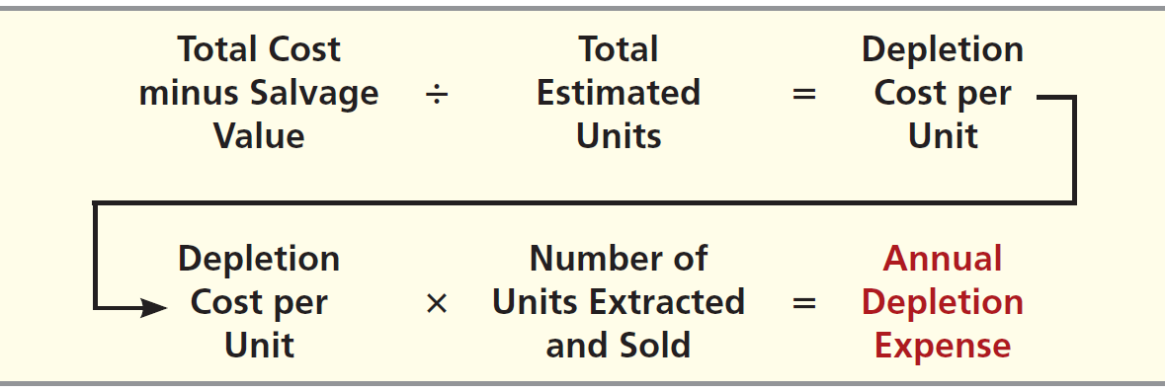
Natural Resources
Depletion
The allocation of the cost to expense in a rational and systematic manner over the resource’s useful life.
Companies generally use units-of-activity method.
Depletion generally is a function of the units extracted.
Illustration 9-21
Formula to compute depletion expense
LO 5

Slide 50
Natural Resources
Illustration: Lane Coal Company invests $5 million in a mine estimated to have 10 million tons of coal and no salvage value. In the first year, Lane extracts and sells 800,000 tons of coal. Lane computes the depletion expense as follows:
$5,000,000 ÷ 10,000,000 = $0.50 depletion cost per ton
$0.50 x 800,000 = $400,000 annual depletion expense
Journal entry:
Depletion Expense 400,000
Accumulated Depletion 400,000
LO 5

Slide 51
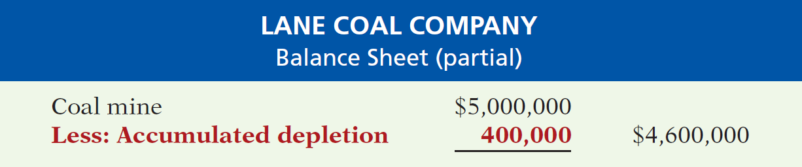
Natural Resources
Presentation
Illustration 9-22
Statement presentation of accumulated depletion
Extracted resources that have not been sold are reported as inventory in the current assets section.
Many companies do not use an accumulated depletion account.
LO 5

Slide 52
9
Plant Assets, Natural Resources, and Intangible Assets
Learning Objectives
After studying this chapter, you should be able to:
[1] Describe how the historical cost principle applies to plant assets.
[2] Explain the concept of depreciation and how to compute it.
[3] Distinguish between revenue and capital expenditures, and explain the entries for each.
[4] Explain how to account for the disposal of a plant asset.
[5] Compute periodic depletion of natural resources.
[6] Explain the basic issues related to accounting for intangible assets.
[7] Indicate how plant assets, natural resources, and intangible assets are reported.

Slide 53
Intangible Assets
Intangible assets are rights, privileges, and competitive advantages that result from ownership of long-lived assets that do not possess physical substance.
Limited life or indefinite life.
Common types of intangibles:
Patents
Copyrights
Goodwill
Trademarks and Trade Names
Franchises
LO 6

Slide 54
Accounting for Intangible Assets
Limited-Life Intangibles:
  Amortize to expense.
  Credit asset account.
Helpful Hint Amortization
is to intangibles what
depreciation is to plant
assets and depletion is to
natural resources.
Indefinite-Life Intangibles:
  No foreseeable limit on time the asset is expected to provide cash flows.
  No amortization.
LO 6

Slide 55
Accounting for Intangible Assets
Patents
Exclusive right to manufacture, sell, or otherwise control an invention for a period of 20 years from the date of the grant.
Capitalize costs of purchasing a patent and amortize over its 20-year life or its useful life, whichever is shorter.
Expense any R&D costs in developing a patent.
Legal fees incurred successfully defending a patent are capitalized to the Patent account.
LO 6

Slide 56
Accounting for Intangible Assets
Illustration: National Labs purchases a patent at a cost of $60,000 on June 30. National estimates the useful life of the patent to be eight years. Prepare the journal entry to record the amortization for the six-month period ended December 31.
Cost $60,000
Useful life ÷ 8
Annual expense $ 7,500
6 months x 6/12
Amortization $ 3,750
Dec. 31
Amortization Expense 3,750
Patent 3,750
LO 6

Slide 57
Accounting for Intangible Assets
Copyrights
Give the owner the exclusive right to reproduce and sell an artistic or published work.
Extend for the life of the creator plus 70 years.
Cost of the copyright is the cost of acquiring and defending it.
Amortized to expense over useful life.
LO 6

Slide 58
Accounting for Intangible Assets
Trademarks and Trade Names
  Word, phrase, jingle, or symbol that identifies a particular enterprise or product.
    Wheaties, Monopoly, Kleenex, Coca-Cola, Big Mac, and Jeep.
  Legal protection for indefinite number of 20 year renewal periods.
  Capitalize acquisition costs.
  No amortization.
LO 6

Slide 59
Accounting for Intangible Assets
Franchises
  Contractual arrangement between a franchisor and a franchisee.
    Shell, Subway, and Rent-A-Wreck are franchises.
  Franchise (or license) with a limited life should be amortized to expense over its useful life.
  If the life is indefinite, the cost is not amortized.
LO 6

Slide 60
Accounting for Intangible Assets
Goodwill
Includes exceptional management, desirable location, good customer relations, skilled employees, high-quality products, etc.
Only recorded when an entire business is purchased.
Goodwill is recorded as the excess of purchase price over the fair value of the net assets acquired.
Not amortized.
LO 6

Slide 61
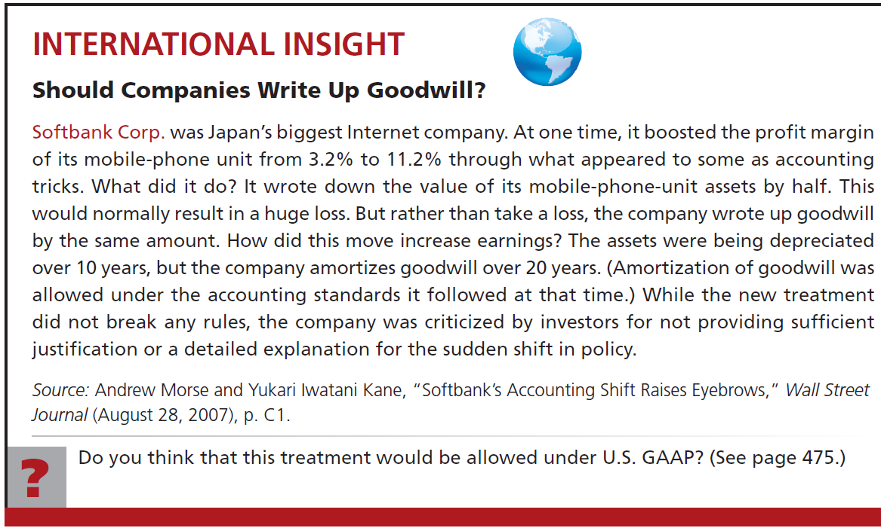
LO 6

Slide 62
Accounting for Intangible Assets
Research and Development Costs
Expenditures that may lead to
  patents,
  copyrights,
  new processes, and
  new products.
All R & D costs are expensed when incurred.
Helpful Hint
Research and development (R&D) costs are not intangible assets. But because they may lead to patents and copyrights, we discuss them in this section.
LO 6

Slide 63
Illustration: Identify the term most directly associated with each statement.
1. The allocation of the cost of a natural resource to expense in a rational and systematic manner.
2. Rights, privileges, and competitive advantages that result from the ownership of long-lived assets that do not possess physical substance.
3. An exclusive right granted by the federal government to reproduce and sell an artistic or published work.
Depletion
Intangible Assets
Copyrights
LO 6

Slide 64
Illustration: Identify the term most directly associated with each statement.
4. A right to sell certain products or services or to use certain trademarks or trade names within a designated geographic area.
5. Costs incurred by a company that often lead to patents or new products. These costs must be expensed as incurred.
Franchise
Research and Development Costs
LO 6

Slide 65
9
Plant Assets, Natural Resources, and Intangible Assets
Learning Objectives
After studying this chapter, you should be able to:
[1] Describe how the historical cost principle applies to plant assets.
[2] Explain the concept of depreciation and how to compute it.
[3] Distinguish between revenue and capital expenditures, and explain the entries for each.
[4] Explain how to account for the disposal of a plant asset.
[5] Compute periodic depletion of natural resources.
[6] Explain the basic issues related to accounting for intangible assets.
[7] Indicate how plant assets, natural resources, and intangible assets are reported.

Slide 66
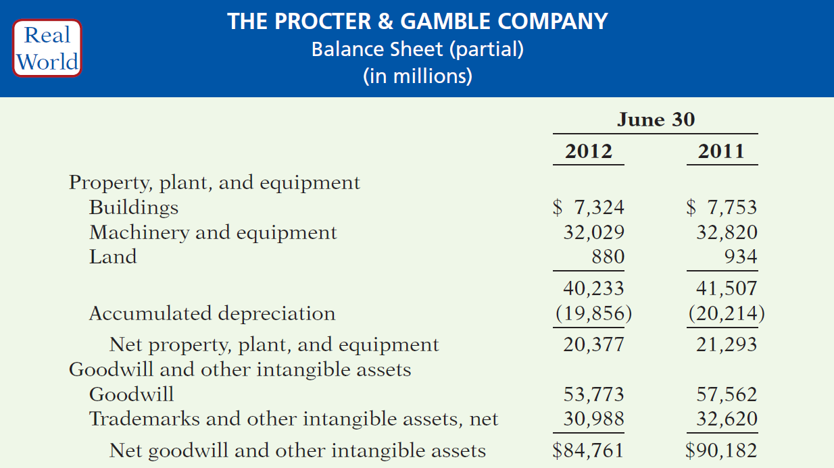
Statement Presentation and Analysis
Presentation
Illustration 9-23
LO 7

Slide 67
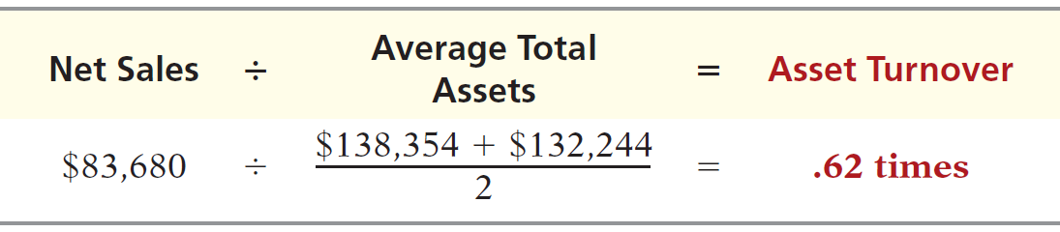
Statement Presentation and Analysis
Analysis
Illustration 9-25
Asset turnover formula and computation
Each dollar invested in assets produced $0.62 in sales. If a company is using its assets efficiently, each dollar of assets will create a high amount of sales.
LO 7

Slide 68
APPENDIX 9A Exchange of Plant Assets
Ordinarily, companies record a gain or loss on the exchange of plant assets.
Most exchanges have commercial substance.
Commercial substance if the future cash flows change as a result of the exchange.
LO 8 Explain how to account for the exchange of plant assets.

Slide 69
APPENDIX 9A Exchange of Plant Assets
Illustration: Roland Co. exchanged used trucks (cost $64,000 less $22,000 accumulated depreciation) plus cash of $17,000 for a new semi-truck. The used trucks had a fair market value of $26,000.
Illustration 9A-1 & 9A-2
Cost of used trucks $64,000
Less: Accumulated depreciation 22,000
Book value 42,000
Fair market value of used trucks 26,000
Loss on disposal of plant assets $16,000
Fair market value of used trucks $26,000
Cash paid 17,000
Cost of new truck $43,000
LO 8

Slide 70
APPENDIX 9A Exchange of Plant Assets
Illustration: Roland Co. exchanged old trucks (cost $64,000 less $22,000 accumulated depreciation) plus cash of $17,000 for a new semi-truck. The old trucks had a fair market value of $26,000.
Prepare the entry to record the exchange of assets by Roland Co.
Equipment (new) 43,000
Accumulated Depreciation 22,000
Loss on Disposal of Plant Assets 16,000
Equipment (used) 64,000
Cash 17,000
LO 8

Slide 71
APPENDIX 9A Exchange of Plant Assets
Illustration: Mark Express Delivery trades its old delivery equipment (cost $40,000 less $28,000 accumulated depreciation) for new delivery equipment. The old equipment had a fair market value of $19,000. Mark also paid $3,000.
Cost of old equipment $40,000
Less: Accumulated depreciation 28,000
Book value 12,000
Fair market value of old equipment 19,000
Gain on disposal of plant assets $ 7,000
Fair market value of old equipment $19,000
Cash paid 3,000
Cost of new equipment $22,000
Illustration 9A-3 & 9A-4
LO 8

Slide 72
APPENDIX 9A Exchange of Plant Assets
Illustration: Mark Express Delivery trades its old delivery equipment (cost $40,000 less $28,000 accumulated depreciation) for new delivery equipment. The old equipment had a fair market value of $19,000. Mark also paid $3,000.
Prepare the entry to record the exchange of assets by Mark Express.
Equipment (new) 22,000
Accumulated Depreciation 28,000
Equipment (old) 40,000
Gain on Disposal of Plant Assets 7,000
Cash 3,000
LO 8

Slide 73

Key Points
  The definition for plant assets for both IFRS and GAAP is essentially the same.
  Both IFRS and GAAP follow the historical cost principle when accounting for property, plant, and equipment at date of acquisition. Cost consists of all expenditures necessary to acquire the asset and make it ready for its intended use.
  Under both IFRS and GAAP, interest costs incurred during construction are capitalized. Recently, IFRS converged to GAAP requirements in this area.
LO 9 Compare the accounting procedures for long-lived assets under GAAP and IFRS.

Slide 74
Key Points
  IFRS, like GAAP, capitalizes all direct costs in self-constructed assets such as raw materials and labor. IFRS does not address the capitalization of fixed overhead although in practice these costs are generally capitalized.
  IFRS also views depreciation as an allocation of cost over an asset’s useful life. IFRS permits the same depreciation methods (e.g., straight-line, accelerated, and units-of-activity) as GAAP. However, a major difference is that IFRS requires component depreciation. Component depreciation specifies that any significant parts of a depreciable asset that have different estimated useful lives should be separately depreciated. Component depreciation is allowed under GAAP but is seldom used.
LO 9

Slide 75
Key Points
  IFRS uses the term residual value rather than salvage value to refer to an owner’s estimate of an asset’s value at the end of its useful life for that owner.
  IFRS allows companies to revalue plant assets to fair value at the reporting date. Companies that choose to use the revaluation framework must follow revaluation procedures. If revaluation is used, it must be applied to all assets in a class of assets. Assets that are experiencing rapid price changes must be revalued on an annual basis, otherwise less frequent revaluation is acceptable.
LO 9

Slide 76
Key Points
  Under both GAAP and IFRS, changes in the depreciation method used and changes in useful life are handled in current and future periods. Prior periods are not affected. GAAP recently conformed to international standards in the accounting for changes in depreciation methods.
  The accounting for subsequent expenditures, such as ordinary repairs and additions, are essentially the same under IFRS and GAAP.
  The accounting for plant asset disposals is essentially the same under IFRS and GAAP.
  Initial costs to acquire natural resources are essentially the same under IFRS and GAAP.
  The definition of intangible assets is essentially the same under IFRS and GAAP.
LO 9

Slide 77
Key Points
  As in GAAP, under IFRS the costs associated with research and development are segregated into the two components. Costs in the research phase are always expensed under both IFRS and GAAP. Under IFRS, however, costs in the development phase are capitalized as Development Costs once technological feasibility is achieved.
  IFRS permits revaluation of intangible assets (except for goodwill). GAAP prohibits revaluation of intangible assets.
LO 9

Slide 78
Key Points
  IFRS requires an impairment test at each reporting date for plant assets and intangibles, and records an impairment if the asset’s carrying amount exceeds its recoverable amount. The recoverable amount is the higher of the asset’s fair value less costs to sell or its value-in-use. Value-in use is the future cash flows to be derived from the particular asset, discounted to present value. Under GAAP, impairment loss is measured as the excess of the carrying amount over the asset’s fair value.
LO 9

Slide 79
Key Points
  IFRS allows reversal of impairment losses when there has been a change in economic conditions or in the expected use of the asset. Under GAAP, impairment losses cannot be reversed for assets to be held and used; the impairment loss results in a new cost basis for the asset. IFRS and GAAP are similar in the accounting for impairments of assets held for disposal.
  The accounting for exchanges of nonmonetary assets has recently converged between IFRS and GAAP. GAAP now requires that gains on exchanges of nonmonetary assets be recognized if the exchange has commercial substance. This is the same framework used in IFRS.
LO 9

Slide 80
Looking to the Future
With respect to revaluations, as part of the conceptual framework project, the Boards will examine the measurement bases used in accounting. It is too early to say whether a converged conceptual framework will recommend fair value measurement (and revaluation accounting) for plant assets and intangibles. However, this is likely to be one of the more contentious issues, given the longstanding use of historical cost as a measurement basis in GAAP. The IASB and FASB have identified a project that would consider expanded recognition of internally generated intangible assets. IFRS permits more recognition of intangibles compared to GAAP. Thus, it will be challenging to develop converged standards for intangible assets, given the long-standing prohibition on capitalizing internally generated intangible assets and research and development costs in GAAP.
LO 9

Slide 81
IFRS Self-Test Questions
Which of the following statements is correct?
  Both IFRS and GAAP permit revaluation of property, plant, and equipment and intangible assets (except for goodwill).
  IFRS permits revaluation of property, plant, and equipment and intangible assets (except for goodwill).
  Both IFRS and GAAP permit revaluation of property, plant, and equipment but not intangible assets.
  GAAP permits revaluation of property, plant, and equipment but not intangible assets.
LO 9

Slide 82
IFRS Self-Test Questions
Research and development costs are:
  expensed under GAAP.
  expensed under IFRS.
  expensed under both GAAP and IFRS.
  None of the above.
LO 9

Slide 83
IFRS Self-Test Questions
Under IFRS, value-in-use is defined as:
  net realizable value.
  fair value.
  future cash flows discounted to present value.
  total future undiscounted cash flows.
LO 9

Slide 84
Copyright
“Copyright © 2014 John Wiley & Sons, Inc. All rights reserved. Reproduction or translation of this work beyond that permitted in Section 117 of the 1976 United States Copyright Act without the express written permission of the copyright owner is unlawful. Request for further information should be addressed to the Permissions Department, John Wiley & Sons, Inc. The purchaser may make back-up copies for his/her own use only and not for distribution or resale. The Publisher assumes no responsibility for errors, omissions, or damages, caused by the use of these programs or from the use of the information contained herein.”

