Slide 1
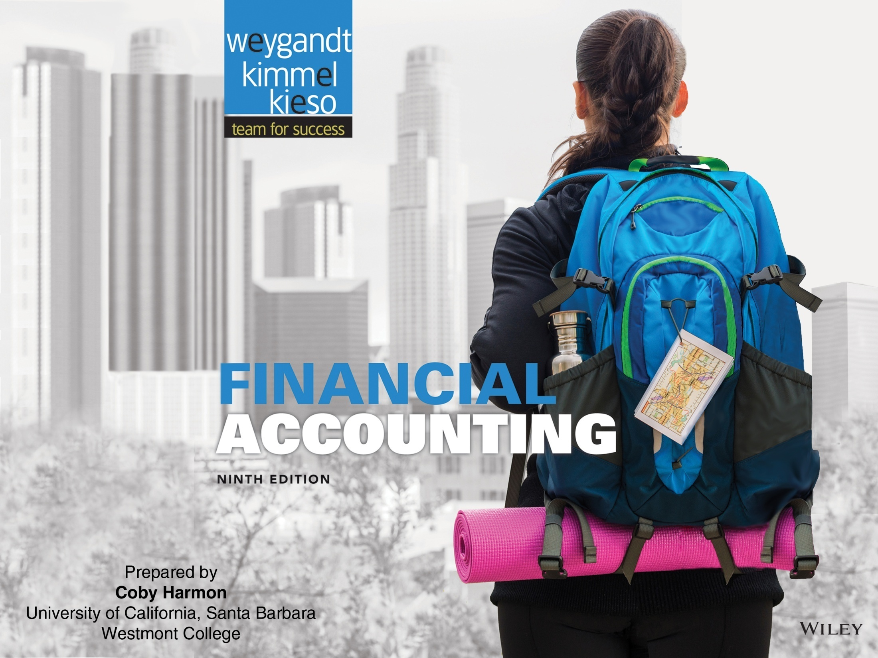
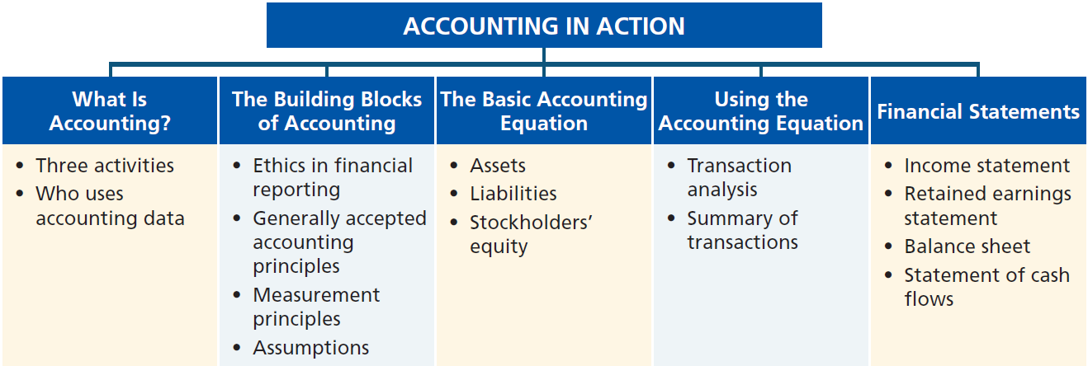
Preview of Chapter 1
Financial Accounting
Ninth Edition
Weygandt Kimmel Kieso

Slide 2
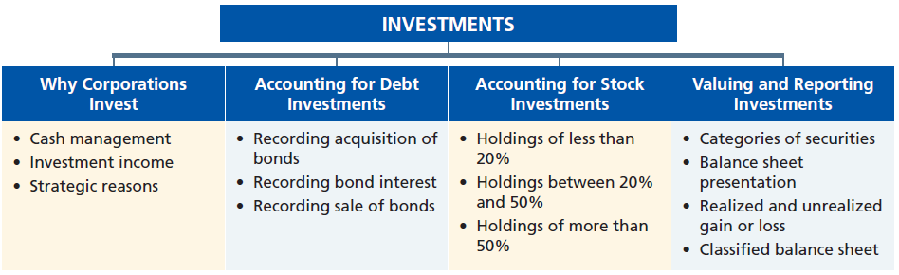
Preview of Chapter 12
Financial Accounting
Ninth Edition
Weygandt Kimmel Kieso

Slide 3

12
Investments
Learning Objectives
After studying this chapter, you should be able to:
[1] Discuss why corporations invest in debt and stock securities.
[2] Explain the accounting for debt investments.
[3] Explain the accounting for stock investments.
[4] Describe the use of consolidated financial statements.
[5] Indicate how debt and stock investments are reported in financial statements.
[6] Distinguish between short-term and long-term investments.

Slide 4
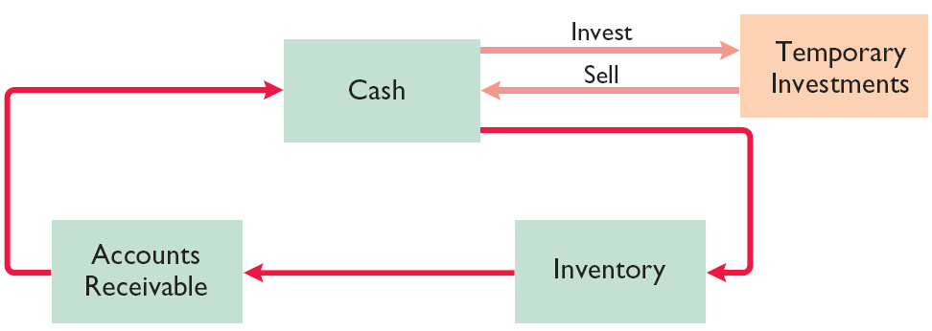
Why Corporations Invest
Corporations purchase investments in debt or stock securities generally for one of three reasons.
  Corporation may have excess cash.
  Generate earnings from investment income.
  For strategic reasons.
Illustration 12-1
Temporary investments and the operating cycle
LO 1

Slide 5
Why Corporations Invest
Question
Pension funds and banks regularly invest in debt and stock securities to:
  house excess cash until needed.
  generate earnings.
  meet strategic goals.
  avoid a takeover by disgruntled investors.
LO 1

Slide 6
12
Investments
Learning Objectives
After studying this chapter, you should be able to:
[1] Discuss why corporations invest in debt and stock securities.
[2] Explain the accounting for debt investments.
[3] Explain the accounting for stock investments.
[4] Describe the use of consolidated financial statements.
[5] Indicate how debt and stock investments are reported in financial statements.
[6] Distinguish between short-term and long-term investments.

Slide 7
Accounting for Debt Investments
Investments in government and corporation bonds.
Entries are made to record
  the acquisition,
  the interest revenue, and
  the sale.
Recording Acquisition of Bonds
Cost includes all expenditures necessary to acquire these investments, such as the price paid plus brokerage fees (commissions), if any.
LO 2

Slide 8
Accounting for Debt Investments
Recording Bond Interest
Calculate and record interest revenue based upon the
carrying value of the bond
times the interest rate
times the portion of the year the bond is outstanding.
LO 2

Slide 9
Accounting for Debt Investments
Recording Sale of Bonds
Credit the investment account for the cost of the bonds.
Record as a gain or loss
  any difference between the net proceeds from the sale (sales price less brokerage fees) and
  the cost of the bonds.
LO 2

Slide 10
Accounting for Debt Investments
Illustration: Kuhl Corporation acquires 50 Doan Inc. 8%, 10-year, $1,000 bonds on January 1, 2015, for $50,000. The entry to record the investment is:
Jan. 1
Debt Investments 50,000
Cash 50,000
LO 2

Slide 11
Accounting for Debt Investments
Illustration: Kuhl Corporation acquires 50 Doan Inc. 8%, 10-year, $1,000 bonds on January 1, 2015, for $50,000. The bonds pay interest semiannually on July 1 and January 1. The entry for the receipt of interest on July 1 is:
July 1
Cash 2,000
Interest Revenue 2,000
*
* ($50,000 x 8% x ½ = $2,000)
LO 2

Slide 12
Accounting for Debt Investments
Illustration: If Kuhl Corporation’s fiscal year ends on December 31, prepare the entry to accrue interest since July 1.
Dec. 31
Interest Receivable 2,000
Interest Revenue 2,000
Kuhl reports receipt of the interest on January 1 as follows.
Jan. 1
Cash 2,000
Interest Receivable 2,000
LO 2

Slide 13
Accounting for Debt Investments
Illustration: Assume that Kuhl corporation receives net proceeds of $54,000 on the sale of the Doan Inc. bonds on January 1, 2016, after receiving the interest due. Prepare the entry to record the sale of the bonds.
Jan. 1
Cash 54,000
Debt Investments 50,000
Gain on Sale of Debt Investments 4,000
LO 2

Slide 14
Accounting for Debt Investments
Question
An event related to an investment in debt securities that does not require a journal entry is:
  acquisition of the debt investment.
  receipt of interest revenue from the debt investment.
  a change in the name of the firm issuing the debt securities.
  sale of the debt investment.
LO 2

Slide 15
Accounting for Debt Investments
Question
When bonds are sold, the gain or loss on sale is the difference between the:
  sales price and the cost of the bonds.
  net proceeds and the cost of the bonds.
  sales price and the market value of the bonds.
  net proceeds and the market value of the bonds.
LO 2

Slide 16
12
Investments
Learning Objectives
After studying this chapter, you should be able to:
[1] Discuss why corporations invest in debt and stock securities.
[2] Explain the accounting for debt investments.
[3] Explain the accounting for stock investments.
[4] Describe the use of consolidated financial statements.
[5] Indicate how debt and stock investments are reported in financial statements.
[6] Distinguish between short-term and long-term investments.

Slide 17
Accounting for Stock Investments
Ownership Percentages
0 ------------------20% -------------- 50% -------------------- 100%
No significant influence usually exists
Significant influence usually exists
Control usually exists
Investment valued on parent’s books using Cost Method or Equity Method (investment eliminated in Consolidation)
Investment valued using Cost Method
Investment valued using Equity Method
The accounting depends on the extent of the investor’s influence over the operating and financial affairs of the issuing corporation (investee).
LO 3
Notes:
Fair Value – next slide
Equity Method -

Slide 18
Accounting for Stock Investments
Holding of Less than 20%
  Companies use the cost method.
  Investment is recorded at cost and revenue recognized only when cash dividends are received.
  Cost includes all expenditures necessary to acquire these investments, such as the price paid plus any brokerage fees (commissions), if any.
Helpful Hint
The entries for investments in common stock also apply to investments in preferred stock.
LO 3

Slide 19
Holding of Less than 20%
Recording Acquisition of Stock Investments
Illustration: On July 1, 2015, Sanchez Corporation acquires 1,000 shares (10% ownership) of Beal Corporation common stock. Sanchez pays $40 per share. The entry for the purchase is:
July 1
Stock Investments 40,000
Cash 40,000
LO 3

Slide 20
Holding of Less than 20%
Recording Dividends
Illustration: During the time Sanchez owns the stock it makes entries for any cash dividends received. If Sanchez receives a $2 per share dividend on December 31, the entry is:
Dec. 31
Cash 2,000
Dividend Revenue 2,000
LO 3

Slide 21
Holding of Less than 20%
Recording Sale of Stock
Illustration: Assume that Sanchez Corporation receives net proceeds of $39,000 on the sale of its Beal stock on February 10, 2016. Because the stock cost $40,000, Sanchez incurred a loss of $1,000. The entry to record the sale is:
Feb. 10
Cash 39,000
Loss on Sale of Stock Investments 1,000
Stock Investments 40,000
LO 3

Slide 22
Accounting for Stock Investments
Holding Between 20% and 50%
Equity Method: Investor records the investment at cost and subsequently adjust the amount each period for the
  their proportionate share of the earnings (losses) and
  dividends received.
If investor’s share of investee’s losses exceeds the carrying amount of the investment, the investor ordinarily should discontinue applying the equity method.
LO 3

Slide 23
Holdings Between 20% and 50%
Illustration: Milar Corporation acquires 30% of the common shares of Beck Company for $120,000 on January 1, 2015. For 2015, Beck reports net income of $100,000 and paid dividends of $40,000. Prepare the entries for these transactions.
Jan. 1
Stock Investments 120,000
Cash 120,000
Dec. 31
Stock Investments ($100,000 x 30%) 30,000
Revenue from Stock Investments 30,000
Cash ($40,000 x 30%) 12,000
Dec. 31
Stock Investments 12,000
LO 3

Slide 24
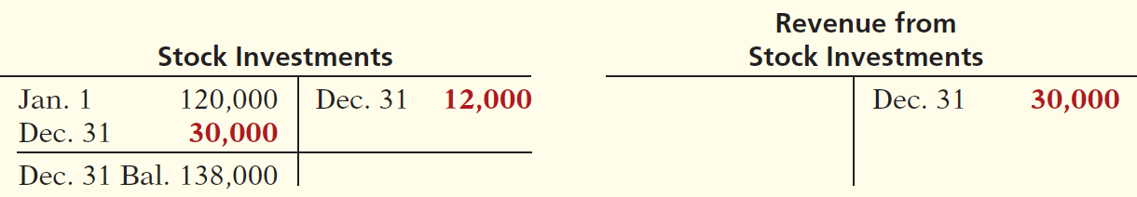
Holdings Between 20% and 50%
Illustration: Milar Corporation acquires 30% of the common shares of Beck Company for $120,000 on January 1, 2015. For 2015, Beck reports net income of $100,000 and paid dividends of $40,000. Prepare the entries for these transactions.
After Milar posts the transactions for the year, its investment and revenue accounts will show the following.
Illustration 12-4
LO 3

Slide 25
Holdings Between 20% and 50%
Question
Under the equity method, the investor records dividends received by crediting:
  Dividend Revenue.
  Investment Income.
  Revenue from Investment.
  Stock Investments.
LO 3

Slide 26
12
Investments
Learning Objectives
After studying this chapter, you should be able to:
[1] Discuss why corporations invest in debt and stock securities.
[2] Explain the accounting for debt investments.
[3] Explain the accounting for stock investments.
[4] Describe the use of consolidated financial statements.
[5] Indicate how debt and stock investments are reported in financial statements.
[6] Distinguish between short-term and long-term investments.

Slide 27
Accounting for Stock Investments
Holdings of More than 50%
Controlling Interest - When one corporation acquires a voting interest of more than 50 percent in another corporation
  Investor is referred to as the parent.
  Investee is referred to as the subsidiary.
  Investment in the subsidiary is reported on the parent’s books as a long-term investment.
  Parent generally prepares consolidated financial statements.
LO 4

Slide 28
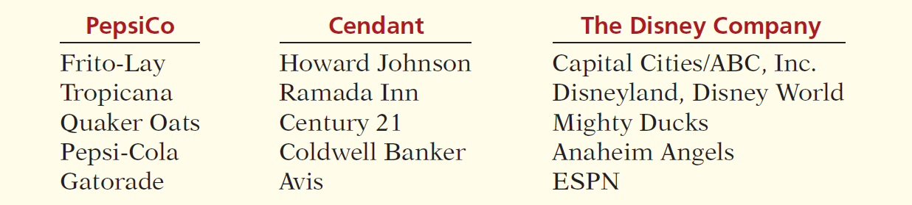
Accounting for Stock Investments
Holdings of More than 50%
Consolidated statements indicate the magnitude and scope of operations of the companies under common control.
Illustration 12-5
Examples of consolidated companies and their subsidiaries
LO 4

Slide 29
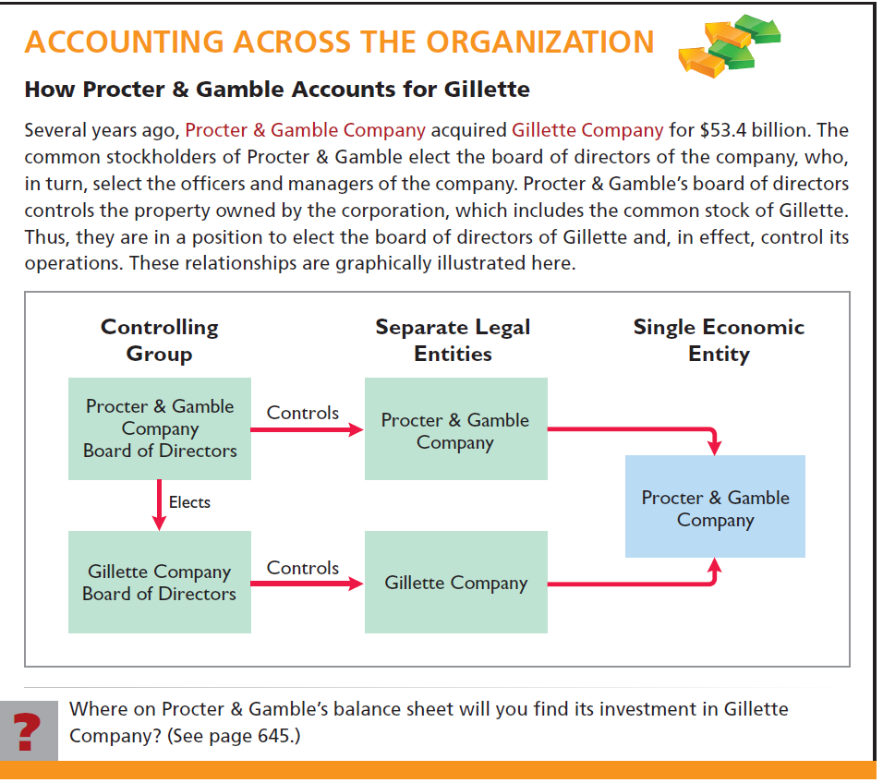
LO 4

Slide 30
12
Investments
Learning Objectives
After studying this chapter, you should be able to:
[1] Discuss why corporations invest in debt and stock securities.
[2] Explain the accounting for debt investments.
[3] Explain the accounting for stock investments.
[4] Describe the use of consolidated financial statements.
[5] Indicate how debt and stock investments are reported in financial statements.
[6] Distinguish between short-term and long-term investments.

Slide 31
Valuing and Reporting Investments
Categories of Securities
Classifications of debt and stock investments:
Debt Investments
  Trading
  Available-for-sale
  Held-to-maturity
Equity Investments
  Trading
  Available-for-sale
These guidelines apply to all debt securities and all stock investments in which the holdings are less than 20%.
LO 5

Slide 32
Categories of Securities
Trading Securities
  Companies hold with intention of selling in a short period.
  Trading means frequent buying and selling.
  Reported at fair value.
  Changes from cost are reported in the income statement as unrealized gains or losses.
LO 5

Slide 33
Categories of Securities
Question
Marketable securities bought and held primarily for sale in the near term are classified as:
  available-for-sale securities.
  held-to-maturity securities.
  stock securities.
  trading securities
LO 5

Slide 34
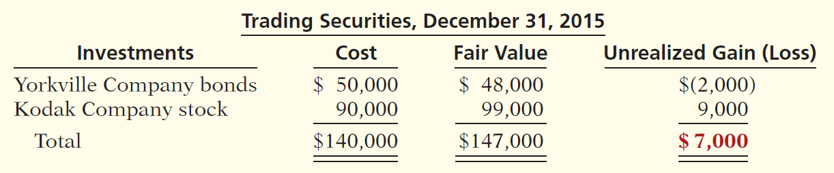
Trading Securities
Illustration: Cost and fair values for investments of Pace Corporation classified as trading securities on December 31, 2015.
Illustration 12-7
The adjusting entry for Pace Corporation is:
Dec. 31
Fair Value Adjustment—Trading 7,000
Unrealized Gain—Income 7,000
LO 5

Slide 35
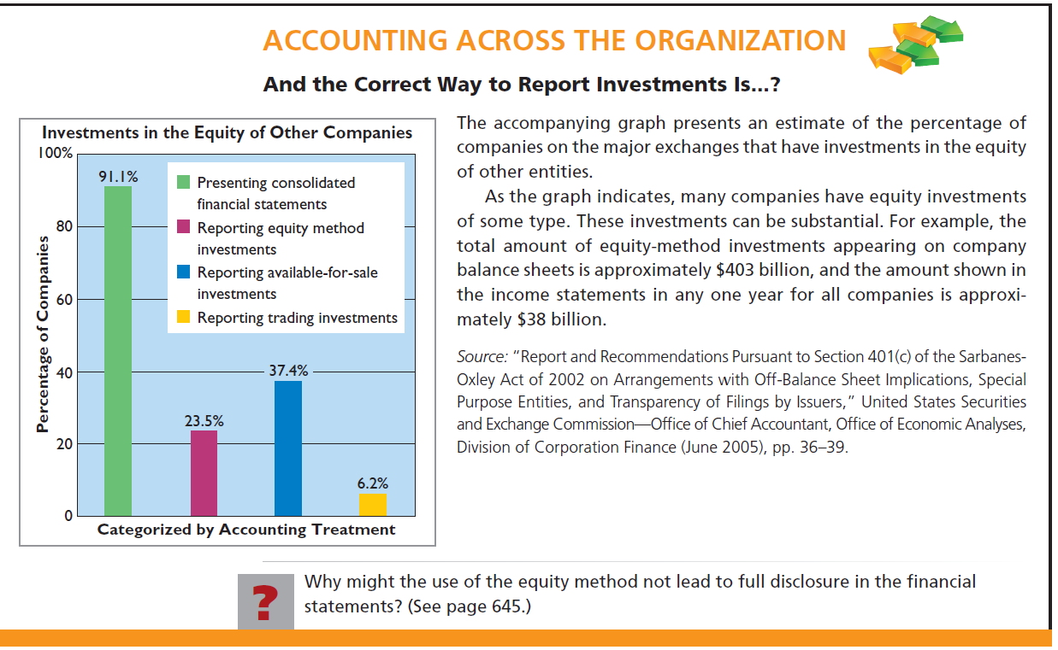
LO 5

Slide 36
Categories of Securities
Available-for-Sale Securities
  Held with the intent of selling sometime in the future.
  Classified as current assets or as long-term assets, depending on the intent of management.
  Reported at fair value.
  Changes from cost are reported in stockholders’ equity as unrealized gains or losses.
LO 5

Slide 37
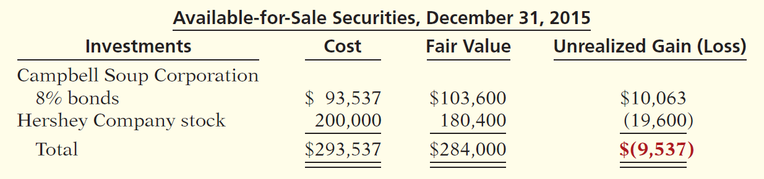
Available-For-Sale Securities
Illustration: Assume that Ingrao Corporation has two securities that it classifies as available-for-sale.
Illustration 12-8
The adjusting entry is:
Dec. 31
Unrealized Gain or Loss—Equity 9,537
Fair Value Adjustment—AFS 9,537
LO 5

Slide 38
Available-For-Sale Securities
Question
An unrealized loss on available-for-sale securities is:
  reported under Other Expenses and Losses in the income statement.
  closed-out at the end of the accounting period.
  reported as a separate component of stockholders' equity.
  deducted from the cost of the investment.
LO 5

Slide 39
12
Investments
Learning Objectives
After studying this chapter, you should be able to:
[1] Discuss why corporations invest in debt and stock securities.
[2] Explain the accounting for debt investments.
[3] Explain the accounting for stock investments.
[4] Describe the use of consolidated financial statements.
[5] Indicate how debt and stock investments are reported in financial statements.
[6] Distinguish between short-term and long-term investments.

Slide 40
Balance Sheet Presentation
Short-Term Investments
Also called marketable securities, are securities held by a company that are
  readily marketable and
  intended to be converted into cash within the next year or operating cycle, whichever is longer.
Investments that do not meet both criteria are classified as long-term investments.
Helpful Hint
Trading securities are always
classified as short-term.
Available-for-sale securities
can be either short-term or
long-term.
LO 6

Slide 41
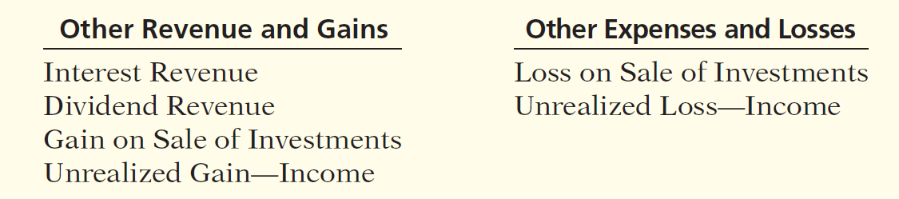
Valuing and Reporting Investments
Presentation of Realized and Unrealized Gain or Loss
Illustration 12-10
Nonoperating items related to investments
LO 6

Slide 42
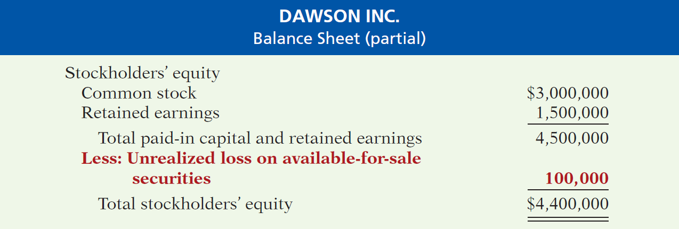
Valuing and Reporting Investments
Realized and Unrealized Gain or Loss
Unrealized gains or losses on available-for-sale securities are reported as a separate component of stockholders’ equity.
Illustration 12-11
LO 6

Slide 43
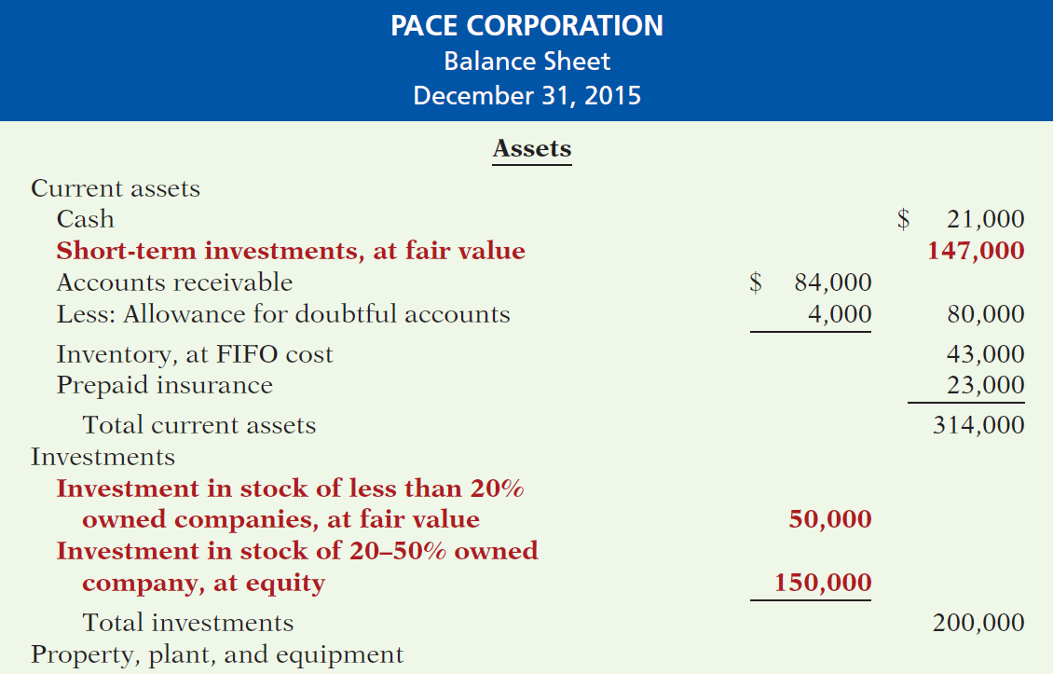
Balance Sheet Presentation
Illustration 12-12
Classified balance sheet
(Partial Statement)
LO 6

Slide 44
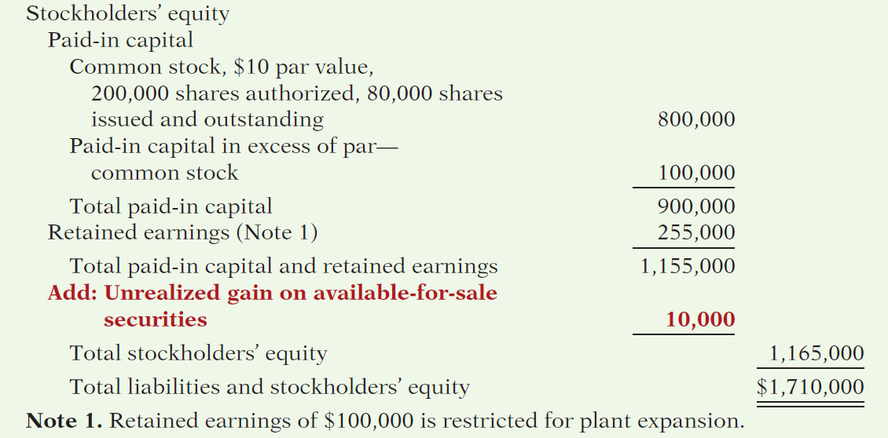
Balance Sheet Presentation
Illustration 12-12
Classified balance sheet
(Partial Statement)
LO 6

Slide 45
APPENDIX 12A Preparing Consolidated Statements
Consolidated Balance Sheet
  Prepared from the individual balance sheets of their affiliated companies.
  Transactions between the affiliated companies are eliminated.
LO 7 Describe the form and content of consolidated financial statements as well as how to prepare them.

Slide 46
APPENDIX 12A Preparing Consolidated Statements
Consolidated Balance Sheet
  Illustration: Assume that on January 1, 2015, Powers Construction Company pays $150,000 in cash for 100% of Serto Brick Company’s common stock. Powers Company records the investment at cost, as required by the cost principle.
  The combined totals do not represent a consolidated balance sheet, because there has been a double counting of assets and stockholders’ equity in the amount of $150,000.
LO 7

Slide 47
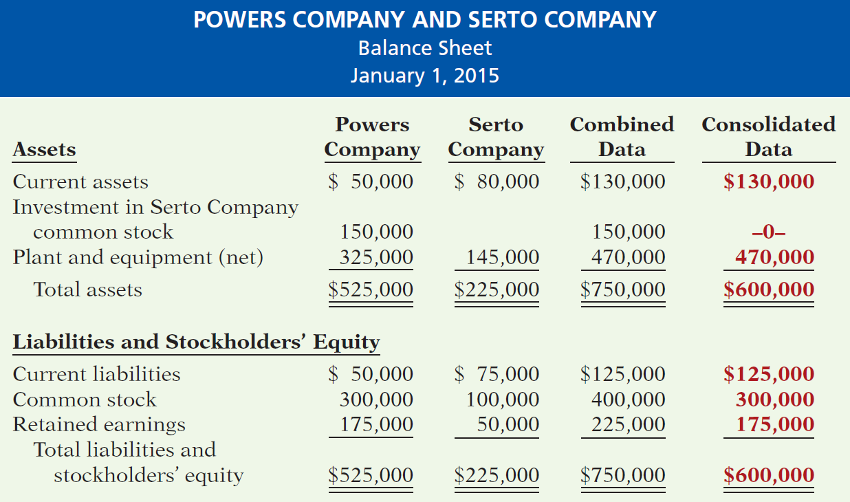
APPENDIX 12A Preparing Consolidated Statements
Illustration 12A-1
LO 7

Slide 48
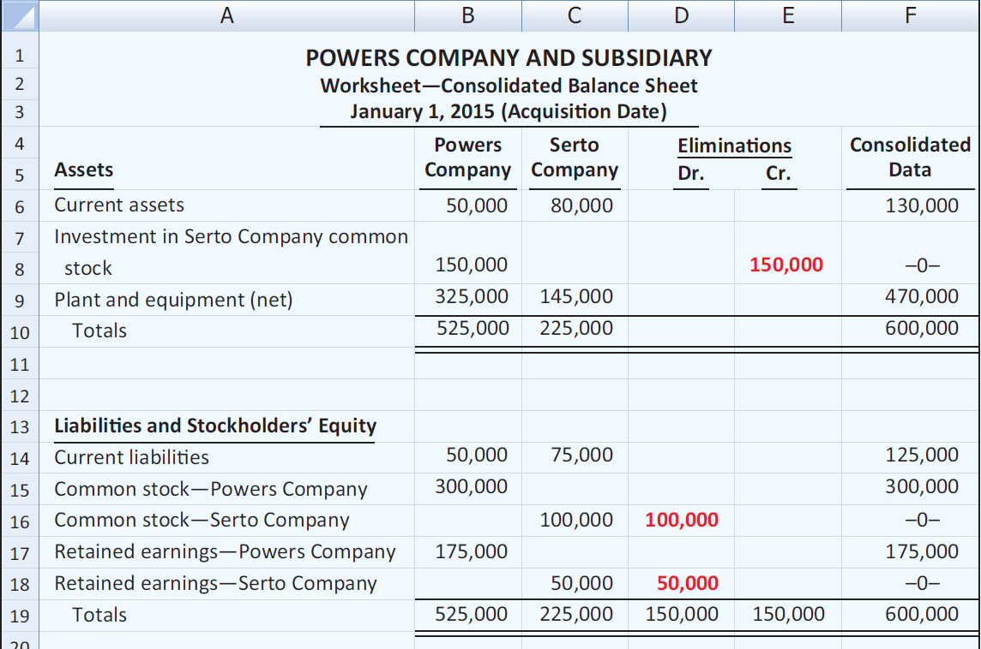
APPENDIX 12A Preparing Consolidated Statements
Use of a Worksheet—Cost Equal to Book Value
Illustration 12A-2
LO 7

Slide 49
APPENDIX 12A Preparing Consolidated Statements
Use of a Worksheet—Cost Above Book Value
  Illustration: Assume that on January 1, 2015, Powers Construction Company pays $165,000 in cash for 100% of Serto’s common stock. The excess of cost over book value is $15,000 ($165,000 - $150,000).
LO 7

Slide 50
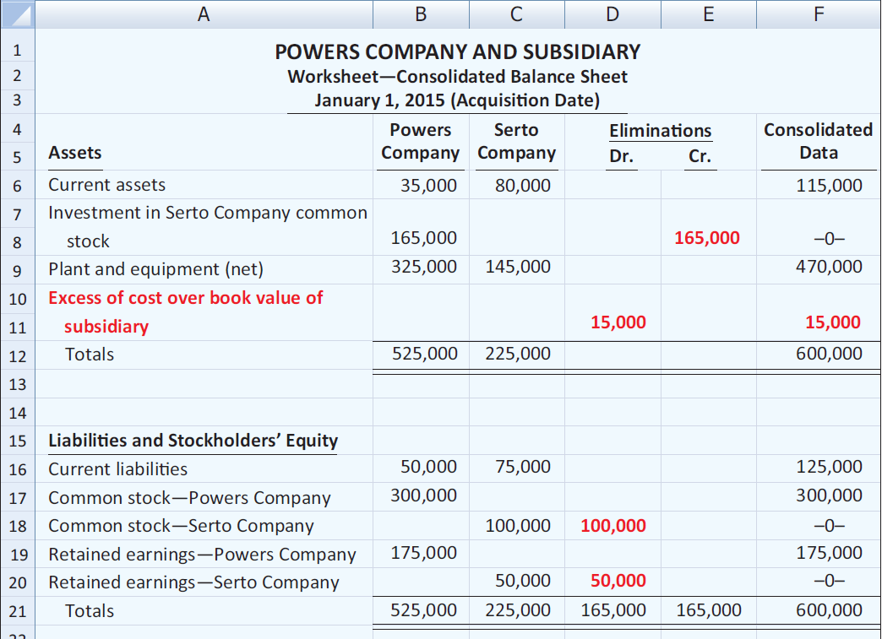
APPENDIX 12A Preparing Consolidated Statements
Use of a Worksheet—Cost Above Book Value
Illustration 12A-3
LO 7

Slide 51
APPENDIX 12A Preparing Consolidated Statements
Content of a Consolidated Balance Sheet
  Illustration: The prior worksheet shows an excess of cost over book value of $15,000. In the consolidated balance sheet, Powers first allocates this amount to specific assets, such as inventory and plant equipment, if their fair market values on the acquisition date exceed their book values. Any remainder is considered to be goodwill. For Serto Company, assume that the fair market value of property and equipment is $155,000.Thus, Powers allocates $10,000 of the excess of cost over book value to property and equipment, and the remainder, $5,000, to goodwill.
LO 7

Slide 52
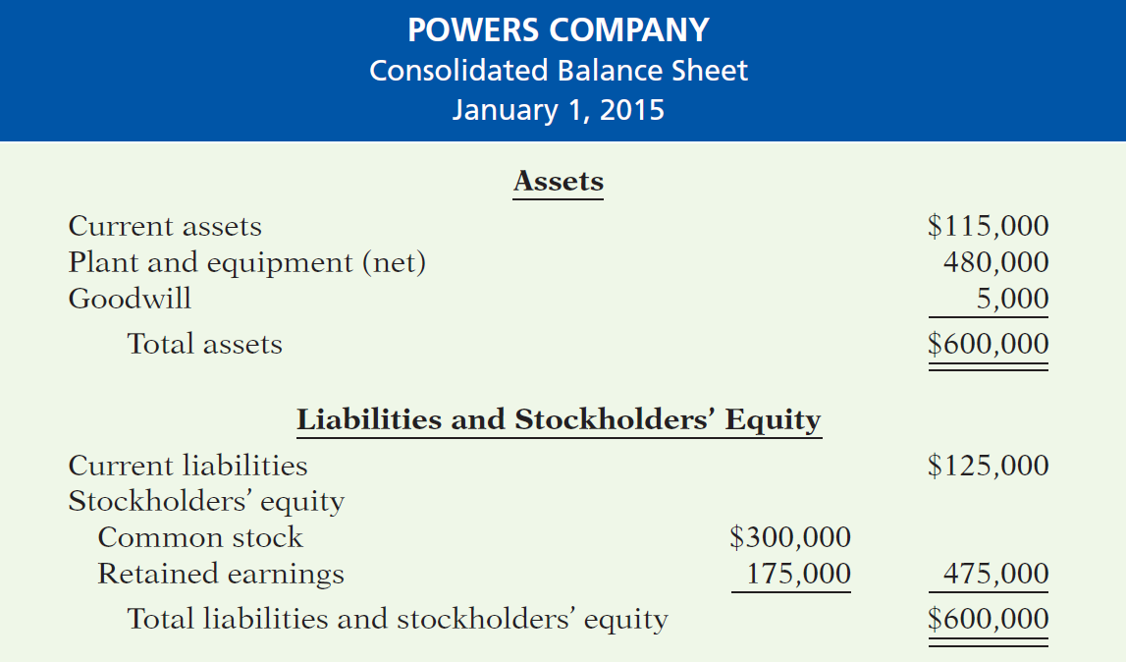
APPENDIX 12A Preparing Consolidated Statements
Content of a Consolidated Balance Sheet
Illustration 12A-4
LO 7

Slide 53
APPENDIX 12A Preparing Consolidated Statements
Consolidated Income Statement
  Statement shows the results of operations of affiliated companies as though they are one economic unit.
  All intercompany revenue and expense transactions must be eliminated.
  A worksheet facilitates the preparation of consolidated income statements in the same manner as it does for the balance sheet.
LO 7

Slide 54

Key Points
  The basic accounting entries to record the acquisition of debt securities, the receipt of interest, and the sale of debt securities are the same under IFRS and GAAP.
  The basic accounting entries to record the acquisition of stock investments, the receipt of dividends, and the sale of stock securities are the same under IFRS and GAAP.
  Both IFRS and GAAP use the same criteria to determine whether the equity method of accounting should be used—that is, significant influence with a general guide of over 20% ownership, IFRS uses the term associate investment rather than equity investment to describe its investment under the equity method.
LO 8 Compare the accounting for investments under GAAP and IFRS.

Slide 55
Key Points
  Under IFRS, both the investor and an associate company should follow the same accounting policies. As a result, in order to prepare financial information, adjustments are made to the associate’s policies to conform to the investor’s books. GAAP does not have that requirement.
  The basis for consolidation under IFRS is control. Under GAAP, a bipolar approach is used, which is a risk-and-reward model (often referred to as a variable-entity approach) and a voting-interest approach. However, under both systems, for consolidation to occur, the investor company must generally own 50% of another company.
LO 8

Slide 56
Key Points
  In general, IFRS requires that companies determine how to measure their financial assets based on two criteria:
    The company’s business model for managing their financial assets; and
    The contractual cash flow characteristics of the financial asset.
  If a company has (1) a business model whose objective is to hold assets in order to collect contractual cash flows and (2) the contractual terms of the financial asset gives specified dates to cash flows that are solely payments of principal and interest on the principal amount outstanding, then the company should use cost (often referred to as amortized cost).
LO 8

Slide 57
Key Points
  Equity investments are generally recorded and reported at fair value under IFRS. In general, equity investments are valued at fair value, with all gains and losses reported in income.
  GAAP classifies investments as trading, available-for-sale (both debt and equity investments), and held-to-maturity (only for debt investments). IFRS uses held-for-collection (debt investments), trading (both debt and equity investments), and non-trading equity investment classifications. GAAP classifications are based on management’s intent with respect to the investment. IFRS classifications are based on the business model used to manage the investments and the type of security.
LO 8

Slide 58
Key Points
  The accounting for trading investments is the same between GAAP and IFRS. Held-to-maturity (GAAP) and held-for-collection (IFRS) investments are accounted for at amortized cost. Gains and losses related to available-for-sale securities (GAAP) and non-trading equity investments (IFRS) are reported in other comprehensive income.
  Unrealized gains and losses related to available-for-sale securities are reported in other comprehensive income under GAAP and IFRS. These gains and losses that accumulate are then reported in the balance sheet.
  IFRS does not use “Other revenues and gains” or “Other expenses and losses” in its income statement presentation. It will generally classify these items as unusual items or financial items.
LO 8

Slide 59
Looking to the Future
The FASB and IASB are close to developing a converged standard on the classification and measurement of financial instruments. It appears that companies will continue to classify financial instruments into three categories: trading, available-for-sale, and held-to-maturity (held-for-collection). In general, all equity investments will be reported at fair value and changes reported in net income. Debt investments will be reported at fair value unless held for collection. In that case, any gains or losses are reported in other comprehensive income.
LO 8

Slide 60
IFRS Self-Test Questions
The following asset is not considered a financial asset under IFRS:
  trading securities.
  held-for-collection securities.
  equity securities.
  inventories.
LO 8

Slide 61
IFRS Self-Test Questions
Under IFRS, the equity method of accounting for long-term investments in common stock should be used when the investor has significant influence over an investee and owns:
  between 20% and 50% of the investee’s common stock.
  30% or more of the investee’s common stock.
  more than 50% of the investee’s common stock.
  less than 20% of the investee’s common stock.
LO 8

Slide 62
IFRS Self-Test Questions
Under IFRS, unrealized gains on non-trading stock investments should:
  be reported as other revenues and gains in the income statement as part of net income.
  be reported as other gains on the income statement as part of net income.
  not be reported on the income statement or balance sheet.
  be reported as other comprehensive income.
LO 8

Slide 63
Copyright
“Copyright © 2014 John Wiley & Sons, Inc. All rights reserved. Reproduction or translation of this work beyond that permitted in Section 117 of the 1976 United States Copyright Act without the express written permission of the copyright owner is unlawful. Request for further information should be addressed to the Permissions Department, John Wiley & Sons, Inc. The purchaser may make back-up copies for his/her own use only and not for distribution or resale. The Publisher assumes no responsibility for errors, omissions, or damages, caused by the use of these programs or from the use of the information contained herein.”

