Slide 1
Cost-Volume-Profit Relationships
Chapter 5
Notes:
Chapter 5: Cost-volume-profit relationships
Cost-volume-profit (CVP) analysis helps managers understand the interrelationships among cost, volume, and profit by focusing their attention on the interactions among the prices of products, volume of activity, per unit variable costs, total fixed costs, and mix of products sold. It is a vital tool used in many business decisions such as deciding what products to manufacture or sell, what pricing policy to follow, what marketing strategy to employ, and what type of productive facilities to acquire.

Slide 2
Learning Objective 1
Explain how changes in activity affect contribution margin and net operating income.
Notes:
Learning objective number 1 is to explain how changes in activity affect contribution margin and net operating income.

Slide 3

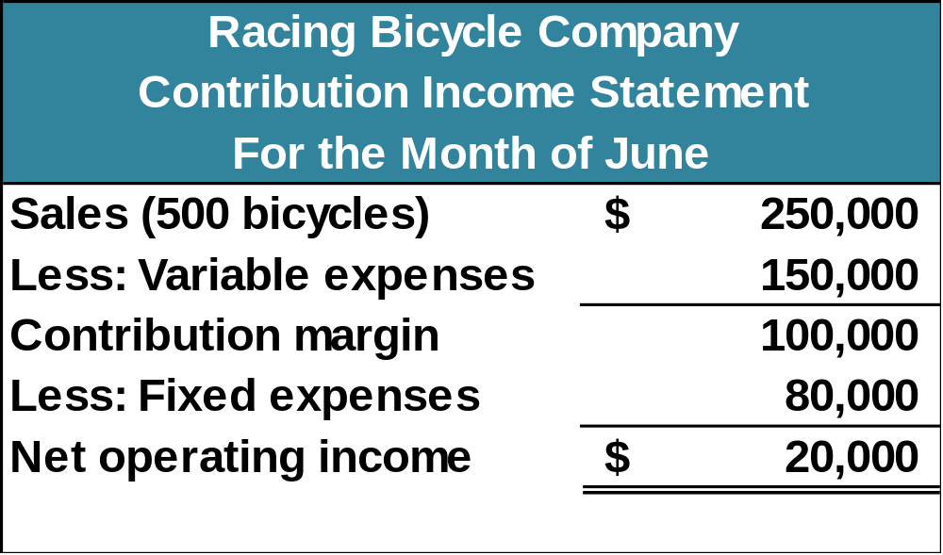
Basics of Cost-Volume-Profit Analysis
The contribution income statement is helpful to managers in judging the impact on profits of changes in selling price, cost, or volume. The emphasis is on cost behavior.
Contribution Margin (CM) is the amount remaining from sales revenue after variable expenses have been deducted.
Notes:
The contribution income statement is helpful to managers in judging the impact on profits of changes in selling price, cost, or volume. For example, let's look at a hypothetical contribution income statement for Racing Bicycle Company (RBC). Notice the emphasis on cost behavior. Variable costs are separate from fixed costs. The contribution margin is defined as the amount remaining from sales revenue after variable expenses have been deducted.

Slide 4
Basics of Cost-Volume-Profit Analysis
CM is used first to cover fixed expenses. Any remaining CM contributes to net operating income.
Notes:
Contribution margin is used first to cover fixed expenses. Any remaining contribution margin contributes to net operating income.

Slide 5
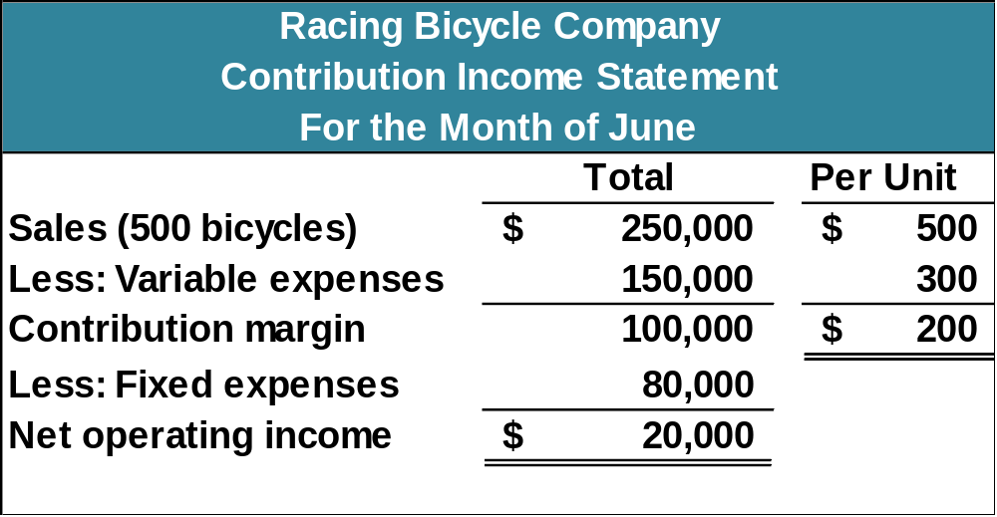
The Contribution Approach
Sales, variable expenses, and contribution margin can also be expressed on a per unit basis. If Racing sells an additional bicycle, $200 additional CM will be generated to cover fixed expenses and profit.
Notes:
Sales, variable expenses, and contribution margin can also be expressed on a per unit basis. For each additional unit Racing Bicycle Company sells, $200 more in contribution margin will help to cover fixed expenses and provide a profit.

Slide 6
The Contribution Approach
Each month, RBC must generate at least $80,000 in total contribution margin to break-even (which is the level of sales at which profit is zero).
Notes:
Each month Racing Bicycle must generate at least $80,000 in total contribution margin to break-even (which is the level of sales at which profit is zero).

Slide 7
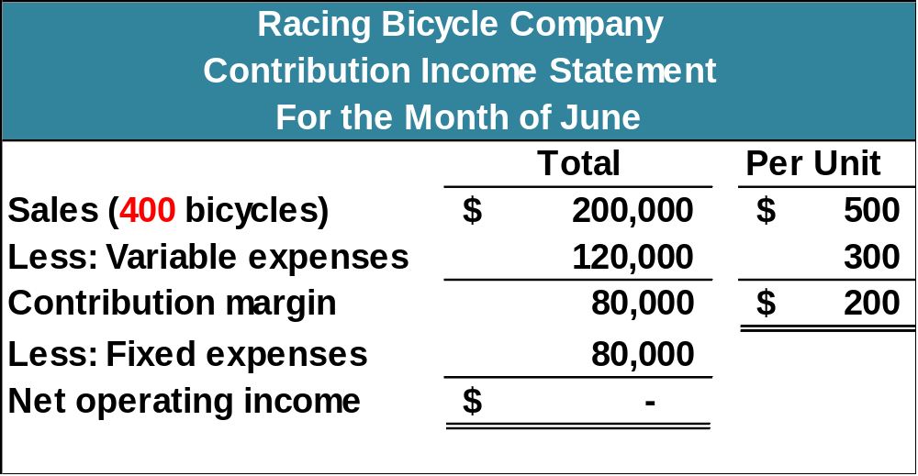
The Contribution Approach
If RBC sells 400 units in a month, it will be operating at the break-even point.
Notes:
If Racing sells 400 units a month, it will be operating at the break-even point. Total sales will be 400 units times $500 each or $200,000, and total variable expenses will be 400 units times $300 each for $120,000. Contribution margin is exactly equal to total fixed expenses. Let’s see what happens if Racing sells one more bike or a total of 401 bikes.

Slide 8
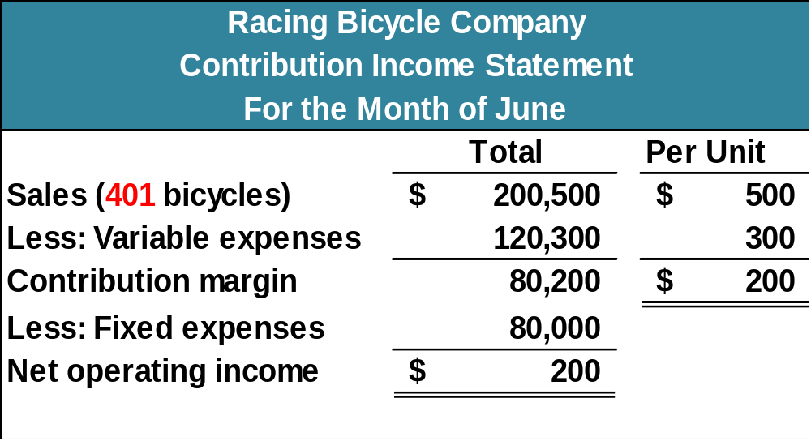
The Contribution Approach
If RBC sells one more bike (401 bikes), net
operating income will increase by $200.
Notes:
You can see that the sale of one unit above the break-even point yields net operating income of $200, which is the contribution margin per unit sold.

Slide 9

The Contribution Approach
We do not need to prepare an income statement to estimate profits at a particular sales volume. Simply multiply the number of units sold above break-even by the contribution margin per unit.
If Racing sells 430 bikes, its net operating income will be $6,000.
Notes:
If we develop equations to calculate break-even and net income, we will not have to prepare an income statement to determine what net income will be at any level of sales. For example, we know that if Racing Bicycle sells 430 units, net operating income will be $6,000. The company will sell 30 units above the break-even unit sales and the contribution margin is $200 per unit, or $6,000.

Slide 10
CVP Relationships in Equation Form
The contribution format income statement can be expressed in the following equation:
Profit = (Sales – Variable expenses) – Fixed expenses
Notes:
The contribution format income statement can be expressed as profit is equal to sales less variable expenses (contribution margin) less fixed costs. Let’s use the equation to calculate profit assuming Racing Bicycle sells 401 units at $500 each. The company has variable expenses of $300 per unit sold, and total fixed expenses of $80,000.
Sales is equal to $200,500, that is, 401 units sold at $500 per unit.
Variable expenses is $120,300, 401 units sold at $300 per unit.
With fixed expenses of $80,000, we can see that profit or net operating income is equal to $200. Exactly the same answer we got using the contribution income statement approach.

Slide 11
CVP Relationships in Equation Form
This equation can be used to show the profit RBC earns if it sells 401. Notice, the answer of $200 mirrors our earlier solution.
Profit = (Sales – Variable expenses) – Fixed expenses
401 units × $500
$80,000
401 units × $300
Profit = ($200,500 – Variable expenses) – Fixed
Profit = ($200,500 – $120,300) – Fixed expenses
Profit = ($200,500 – $120,300) – $80,000
$200 = ($200,500 – $120,300) – $80,000
Notes:
We begin by calculating sales.
Sales are equal to $200,500, that is, 401 units sold at $500 per unit.
Variable expenses are $120,300, 401 units sold at $300 per unit.
With fixed expenses of $80,000, we can see that profit or net operating income is equal to $200. Exactly the same answer we got using the contribution income statement approach.

Slide 12
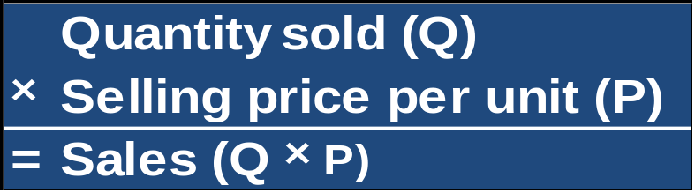
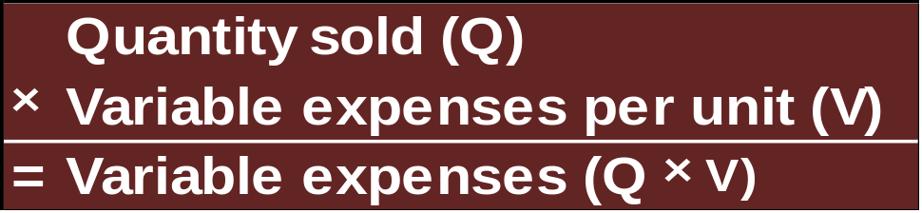
CVP Relationships in Equation Form
When a company has only one product we can further refine this equation as shown on this slide.
Profit = (Sales – Variable expenses) – Fixed expenses
Profit = (P × Q – V × Q) – Fixed expenses
Notes:
If the company sells a single product, like Racing Bicycle Company, we can express the sales and variable expenses as shown in the blue and brown boxes. Sales are equal to the quantity sold (Q) times the selling price per unit sold (P), and variable expenses are equal to the quantity sold (Q) times the variable expenses per unit (V).
For the single product company we can refine the equation as shown on the screen. We can complete the calculations shown in the previous slides using the contribution income statement approach using this equation. Let’s see how we do this.

Slide 13

CVP Relationships in Equation Form
This equation can also be used to show the $200 profit RBC earns if it sells 401 bikes.
Profit = (Sales – Variable expenses) – Fixed expenses
Profit = (P × Q – V × Q) – Fixed expenses
$200 = ($500 × 401 – $300 × 401) – $80,000
Profit = ($500 × 401 – $300 × 401) – $80,000
Notes:
We begin by gathering the information for the variables in the equation.
We have now entered all the known amounts into the equation and solve for the unknown, profit.
As you can see, our net operating income or profit is once again determined to be $200.

Slide 14
CVP Relationships in Equation Form
It is often useful to express the simple profit equation in terms of the unit contribution margin (Unit CM) as follows:
Unit CM = Selling price per unit – Variable expenses per unit
Unit CM = P – V
Profit = (P × Q – V × Q) – Fixed expenses
Profit = (P – V) × Q – Fixed expenses
Profit = Unit CM × Q – Fixed expenses
Notes:
Unit contribution margin is equal to the unit selling price less the unit variable expenses. Using the equations we have developed, we can express the Unit CM as P less V.
Now, let’s rearrange the basic profit equation for a single product company and we can see that profit is equal to the unit CM times the quantity sold less the fixed expenses. Let’s use this new profit equation to calculate net operating income when Racing Bicycle sells 401 units.

Slide 15
CVP Relationships in Equation Form
Profit = (P × Q – V × Q) – Fixed expenses
Profit = (P – V) × Q – Fixed expenses
Profit = Unit CM × Q – Fixed expenses
Profit = ($500 – $300) × 401 – $80,000
Profit = $200 × 401 – $80,000
Profit = $80,200 – $80,000
Profit = $200
This equation can also be used to compute RBC’s $200 profit if it sells 401 bikes.
Notes:
Unit contribution margin is equal to the unit selling price less the unit variable expenses. Using the equations we have developed, we can express the Unit CM as P less V.
Now, let’s rearrange the basic profit equation for a single product company and we can see that profit is equal to the unit CM times the quantity sold less the fixed expenses. Let’s use this new profit equation to calculate net operating income when Racing Bicycle sells 401 units.

Slide 16
Learning Objective 2
Prepare and interpret a cost-volume-profit (CVP) graph and a profit graph.
Notes:
Learning objective number 2 is to prepare and interpret a cost-volume-profit (CVP) graph and a profit graph.

Slide 17
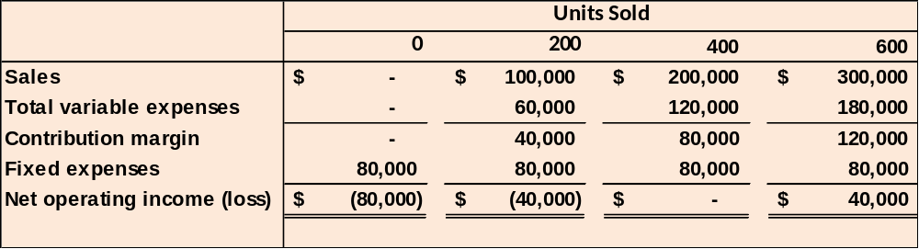
CVP Relationships in Graphic Form
The relationships among revenue, cost, profit, and volume can be expressed graphically by preparing a CVP graph. Racing Bicycle developed contribution margin income statements at 0, 200, 400, and 600 units sold. We will use this information to prepare the CVP graph.
Notes:
The relationships among revenue, cost, profit, and volume can be expressed graphically by preparing a cost-volume-profit (CVP) graph. To illustrate, we will use contribution income statements for Racing Bicycle Company at 0, 200, 400, and 600 units sold.

Slide 18
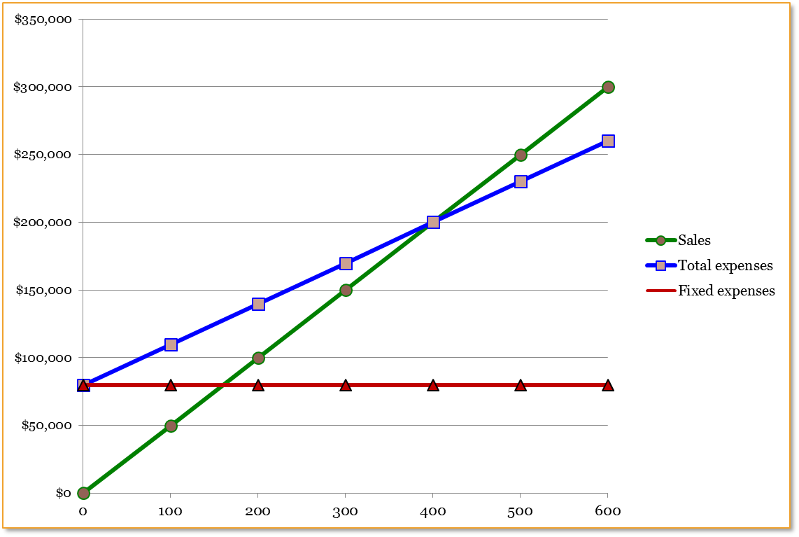
Preparing the CVP Graph
Profit Area
Dollars
Loss Area
Units
Notes:
The break-even point is where the total revenue and total expenses lines intersect. In the case of Racing Bicycle, break-even is 400 bikes sold, or sales revenue of $200,000.
The profit or loss at any given sales level is measured by the vertical distance between the total revenue and the total expenses lines.

Slide 19
Learning Objective 3
Use the contribution margin ratio (CM ratio) to compute changes in contribution margin and net operating income resulting from changes in sales volume.
Notes:
Learning objective number 3 is to use the contribution margin ratio (CM ratio) to compute changes in contribution margin and net operating income resulting from changes in sales volume.

Slide 20
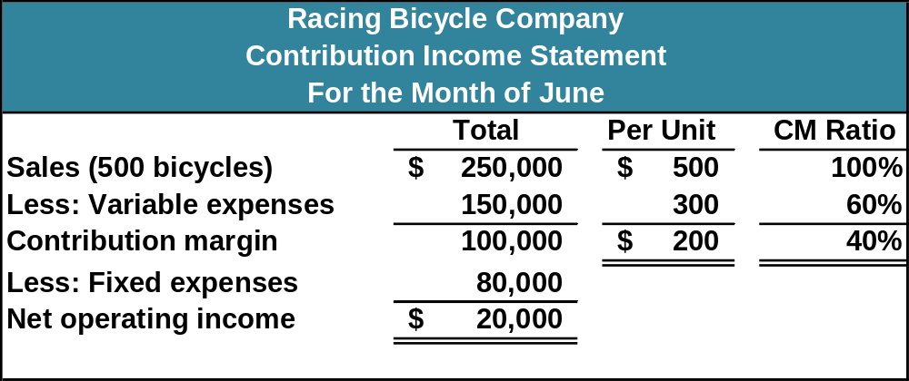
Contribution Margin Ratio (CM Ratio)
The CM ratio is calculated by dividing the total contribution margin by total sales.
$100,000 ÷ $250,000 = 40%
Notes:
The contribution margin ratio is calculated by dividing the total contribution margin by total sales. In the case of Racing Bicycle, the ratio is 40%. Thus, each $1.00 increase in sales results in a total contribution margin increase of 40¢.

Slide 21
Contribution Margin Ratio (CM Ratio)
The contribution margin ratio at Racing Bicycle is:
CM per unit
SP per unit
$200
$500
CM Ratio =
=
= 40%
The CM ratio can also be calculated by dividing the contribution margin per unit by the selling price per unit.
Notes:
The CM ratio can also be calculated by dividing the contribution margin per unit by the selling price per unit. Racing Bicycle has a CM ratio of 40%. This means that for each dollar increase in sales the company will produce 40¢ in contribution margin.

Slide 22
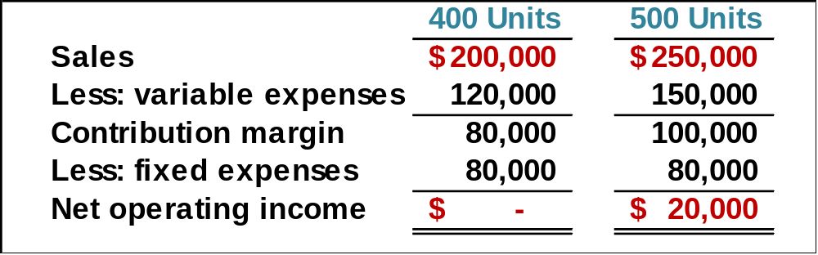
Contribution Margin Ratio (CM Ratio)
If Racing Bicycle increases sales from 400 to 500 bikes ($50,000),
contribution margin will increase by $20,000 ($50,000 × 40%).
Here is the proof:
A $50,000 increase in sales revenue results in a $20,000 increase in CM ($50,000 × 40% = $20,000).
Notes:
Let’s see how we can use the contribution margin ratio to look at the contribution margin income statement of Racing Bicycle in a little different way. If RBC is able to increase its sales from 400 to 500 bikes, the increase in contribution margin by $20,000, that is, $50,000 (100 bikes times $500 per bike) times 40%.

Slide 23

Quick Check ✓
Coffee Klatch is an espresso stand in a downtown office building. The average selling price of a cup of coffee is $1.49 and the average variable expense per cup is $0.36. The average fixed expense per month is $1,300. An average of 2,100 cups are sold each month. What is the CM Ratio for Coffee Klatch?
  a. 1.319
  b. 0.758
  c. 0.242
  d. 4.139
Notes:
Can you calculate the contribution margin ratio for Coffee Klatch? The calculation may take a minute or so to complete.

Slide 24

Contribution Margin Ratio (CM Ratio)
The relationship between profit and the CM ratio can be expressed using the following equation:
Profit = (CM ratio × Sales) – Fixed expenses
If Racing Bicycle increased its sales volume to 500 bikes, what would management expect profit or net operating income to be?
Profit = (40% × $250,000) – $80,000
Profit = $100,000 – $80,000
Profit = $20,000
Notes:
The relationship between profit and the CM ratio can be expressed using the following equation: Profit equals CM ratio times Sales less Fixed expenses.
If Racing Bicycle reported sales of $250,000, what would management expect net operating profits to be?
As you can see, the expected net operating profit is $20,000.

Slide 25
Learning Objective 4
Show the effect on net operating income of changes in variable costs, fixed costs, selling price, and volume.
Notes:
Learning objective number 4 is to show the effects on net operating income of changes in variable costs, fixed costs, selling price, and volume.

Slide 26
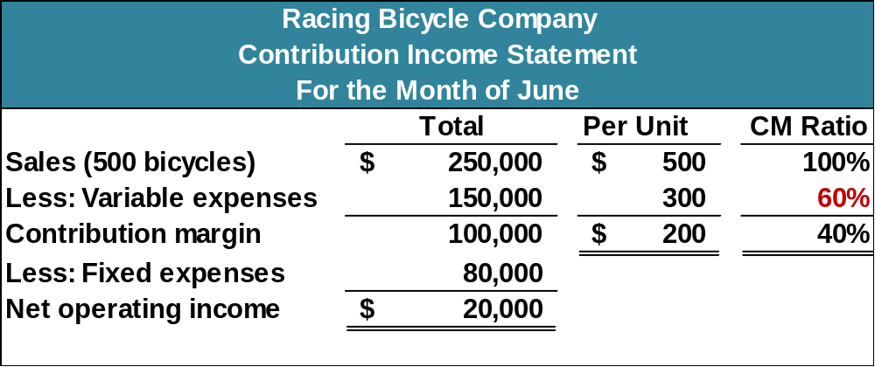
The Variable Expense Ratio
The variable expense ratio is the ratio of variable expenses to sales. It can be computed by dividing the total variable expenses by the total sales, or in a single product analysis, it can be computed by dividing the variable expenses per unit by the unit selling price.
Notes:
Before proceeding with five examples that demonstrate various applications of CVP concepts, we need to define the variable expense ratio as the ratio of variable expenses to sales.

Slide 27

Changes in Fixed Costs and Sales Volume
What is the profit impact if Racing Bicycle can increase unit sales from 500 to 540 by increasing the monthly advertising budget by $10,000?
Notes:
Let’s assume that the management of RBC believes it can increase unit sales from 500 to 540 if it spends $10,000 on advertising. Would you recommend that the advertising campaign be undertaken? See if you can solve this problem before going to the next screen.

Slide 28
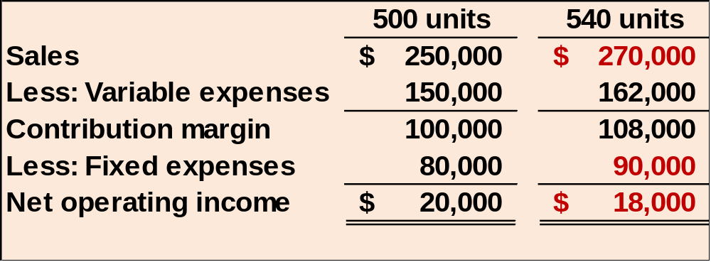
Changes in Fixed Costs and Sales Volume
$80,000 + $10,000 advertising = $90,000
Sales increased by $20,000, but net operating income decreased by $2,000.
Notes:
As you can see, even if sales revenue increases to $270,000, RBC will experience a $12,000 increase in variable costs and a $10,000 increase in fixed costs (the new advertising campaign). As a result, net operating income will actually drop by $2,000. The advertising campaign certainly would not be a good idea. We can help management see the problem before any additional monies are spent.

Slide 29
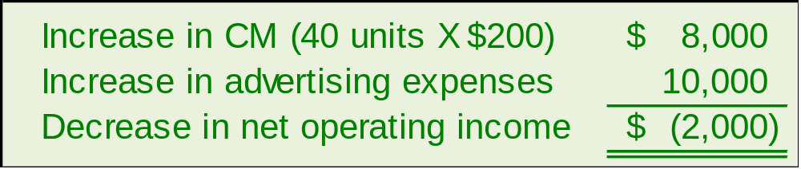

Changes in Fixed Costs and Sales Volume
A shortcut solution using incremental analysis
Notes:
Here is a shortcut approach to looking at the problem. You can see that an increase in contribution margin is more than offset by the increased advertising costs.

Slide 30
Change in Variable Costs and Sales Volume
What is the profit impact if Racing Bicycle can use higher quality raw materials, thus increasing variable costs per unit by $10, to generate an increase in unit sales from 500 to 580?
Notes:
Management at RBC believes that using higher quality raw materials will result in an increase in sales from 500 to 580. The higher quality raw materials will lead to a $10 increase in variable costs per unit. Would you recommend the use of the higher quality raw materials?
Take a couple of minutes help management solve this problem before moving to the next slide.

Slide 31
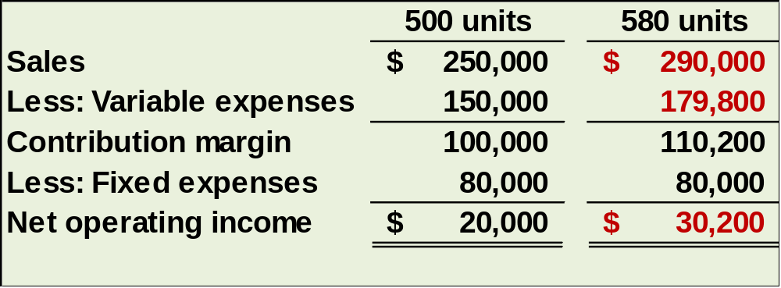
Change in Variable Costs and Sales Volume
580 units × $310 variable cost/unit = $179,800
Sales increase by $40,000 and net operating income increases by $10,200.
Notes:
As you can see, revenues will increase by $40,000 (80 bikes times $500 per bike), and variable costs will increase by $29,800. Contribution margin will increase by $10,200. With no change in fixed costs, net operating income will also increase by $10,200.
The use of higher quality raw materials appears to be a profitable idea.

Slide 32
Change in Fixed Cost, Sales Price, and Volume
What is the profit impact if RBC: (1) cuts its selling price $20 per unit, (2) increases its advertising budget by $15,000 per month, and (3) increases sales from 500 to 650 units per month?
Notes:
Here is a more complex situation. What is the profit impact if RBC: (1) cuts its selling price $20 per unit, (2) increases its advertising budget by $15,000 per month, and (3) increases sales from 500 to 650 units per month?

Slide 33
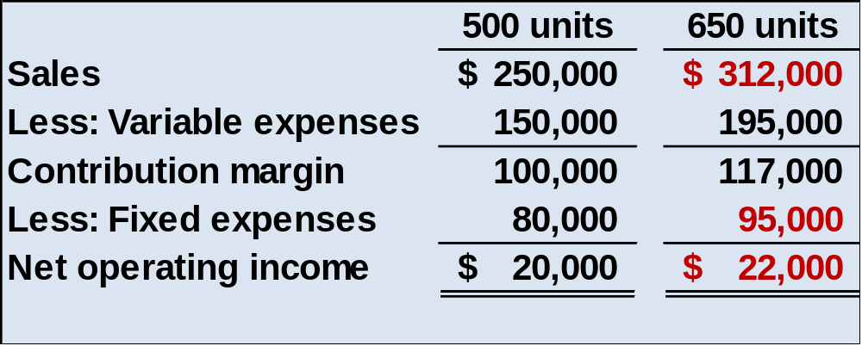
Change in Fixed Cost, Sales Price, and Volume
650 units × $480 = $312,000
Sales increase by $62,000, fixed costs increase by $15,000, and net operating income increases by $2,000.
Notes:
This appears to be a good plan because net operating income will increase by $2,000. Take a few minutes and analyze the change in sales revenue, variable expenses and fixed expenses.

Slide 34
Change in Variable Cost, Fixed Cost, and Sales Volume
What is the profit impact if RBC: (1) pays a $15 sales commission per bike sold instead of paying salespersons flat salaries that currently total $6,000 per month, and (2) increases unit sales from 500 to 575 bikes?
Notes:
Here is another complex question involving cost-volume-profit relationships. What is the profit impact if RBC: (1) pays a $15 sales commission per bike sold instead of paying salespersons flat salaries that currently total $6,000 per month, and (2) increases unit sales from 500 to 575 bikes?

Slide 35
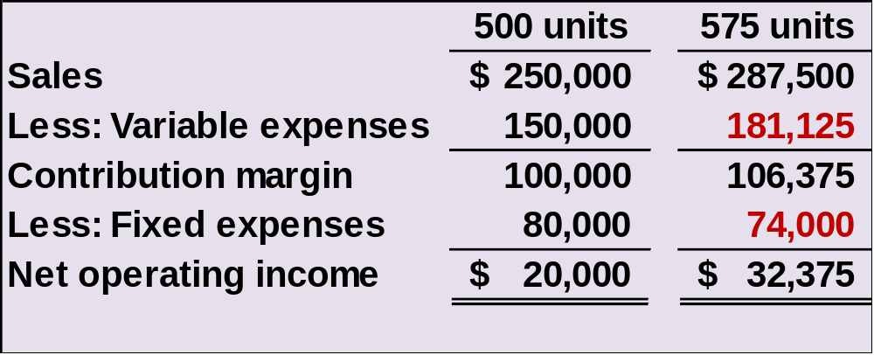
Change in Variable Cost, Fixed Cost, and Sales Volume
575 units × $315 = $181,125
Sales increase by $37,500, fixed expenses decrease by $6,000, and net operating income increases by $12,375.
Notes:
Net operating income increased by $12,375. Notice that sales revenue and variable expenses increased as well. Fixed expenses were decreased as a result of making sales commissions variable in nature.
How did you do? We hope you are beginning to see the potential power of CVP analysis.

Slide 36
Change in Regular Sales Price
If RBC has an opportunity to sell 150 bikes to a wholesaler without disturbing sales to other customers or fixed expenses, what price would it quote to the wholesaler if it wants to increase monthly profits by $3,000?
Notes:
Suppose RBC has a one-time opportunity to sell 150 bikes to a wholesaler. There would be no change in the cost structure as a result of this sale. Racing wants the one-time sale to produce a profit of $3,000. What selling price should RBC quote to the wholesaler?

Slide 37
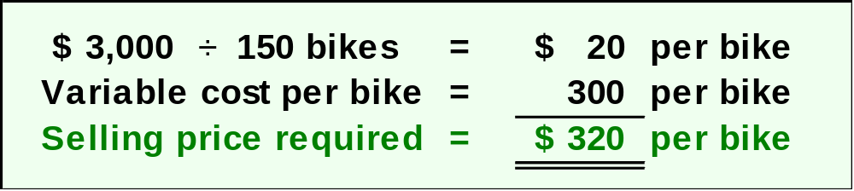
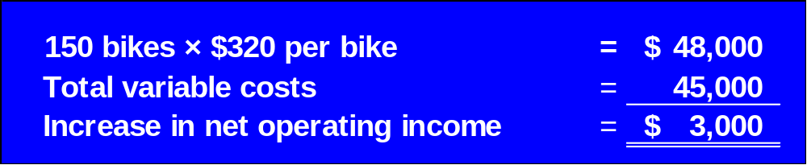
Change in Regular Sales Price
Notes:
If we desire a profit of $3,000 on the sale of 150 bikes, we must have a profit of $20 per bike. The variable expenses associated with each bike are $300, so we would quote a selling price of $320.
You can see the proof of the quote. If we quote a price of $320 per unit and sell an additional 150 units, sales will go up by $48,000. Variable costs for the 150 units is $45,000, so net operating income increases by the difference, $3,000.

Slide 38
Learning Objective 6
Determine the break-even point.
Notes:
Learning objective number 6 is to determine the break-even point.

Slide 39
Break-even Analysis
The equation and formula methods can be used to determine the unit sales and dollar sales needed to achieve a target profit of zero. Let’s use the RBC information to complete the break-even analysis.
Notes:
The equation and formula methods can be used to determine the unit sales and sales dollars needed to achieve a target profit of zero. Let’s use the Racing Bicycle information to complete the break-even analysis.

Slide 40
Break-even in Unit Sales:
Equation Method
Profits = Unit CM × Q – Fixed expenses
Suppose RBC wants to know how many bikes must be sold to break-even (earn a target profit of $0).
$0 = $200 × Q - $80,000
Profits are zero at the break-even point.
Notes:
To find the break-even point, we set profits equal to zero, and solve for the unknown quantity, Q. Suppose RBC wants to know how many bikes must be sold to break-even (earn a target profit of $0).
Racing Bicycle has a unit contribution margin of $200, and total fixed expenses of $80,000. Take a second and solve this equation.

Slide 41
Break-even in Unit Sales:
Equation Method
Profits = Unit CM × Q – Fixed expenses
$0 = $200 × Q + $80,000
$200 × Q = $80,000
Q = 400 bikes
Notes:
How did you do? In the case of Racing Bicycle, 400 bikes must be sold for the company to break-even. If the company sells less than 400 units, it will incur a net operating loss and if it sells more than 400 units, it will report net operating income.

Slide 42
Break-even in Unit Sales:
Formula Method
Let’s apply the formula method to solve for the break-even point.
Unit sales to
break even
Fixed expenses
CM per unit
=
$80,000
$200
Unit sales =
Unit sales = 400
Notes:
A quicker way to solve this problem is to add the desired profits to the fixed cost and divide the total by the contribution margin per unit.
Notice we get the same result of 400 bikes.

Slide 43
Break-even in Dollar Sales:
Equation Method
Suppose Racing Bicycle wants to compute the sales dollars required to break-even (earn a target profit of $0). Let’s use the equation method to solve this problem.
Profit = CM ratio × Sales – Fixed expenses
Solve for the unknown “Sales.”
Notes:
Suppose Racing Bicycle wants to compute the sales dollars required to break-even, earn a target profit of $0. Let’s use the equation method to solve this problem. We must setup the equation and solve for the unknown value of sales.

Slide 44
Break-even in Dollar Sales:
Equation Method
Profit = CM ratio × Sales – Fixed expenses
$ 0 = 40% × Sales – $80,000
40% × Sales = $80,000
Sales = $80,000 ÷ 40%
Sales = $200,000
Notes:
Here is the equation that will always be used to calculate the break-even point in a single product company. Remember, we solve for the unknown “Sales.”
In the case of Racing Bicycle dollar sales must be $200,000 for the company to break-even.

Slide 45
Break-even in Dollar Sales:
Formula Method
Now, let’s use the formula method to calculate the dollar sales at the break-even point.
Dollar sales to
break even
Fixed expenses
CM ratio
=
$80,000
40%
Dollar sales =
Dollar sales = $200,000
Notes:
You can see that if we elect to use the formula method, we calculate the same sales of $200,000 at the break-even point.

Slide 46
Quick Check ✓
Coffee Klatch is an espresso stand in a downtown office building. The average selling price of a cup of coffee is $1.49 and the average variable expense per cup is $0.36. The average fixed expense per month is $1,300. An average of 2,100 cups are sold each month. What is the break-even sales dollars?
  a. $1,300
  b. $1,715
  c. $1,788
  d. $3,129
Notes:
Let’s calculate the break-even in sales dollars for Coffee Klatch.

Slide 47
Quick Check ✓
Coffee Klatch is an espresso stand in a downtown office building. The average selling price of a cup of coffee is $1.49 and the average variable expense per cup is $0.36. The average fixed expense per month is $1,300. An average of 2,100 cups are sold each month. What is the break-even sales in units?
a. 872 cups
b. 3,611 cups
c. 1,200 cups
d. 1,150 cups
Notes:
Now use the contribution margin approach to calculate the break-even point in cups of coffee sold.

Slide 48
Learning Objective 5
Determine the level of sales needed to achieve a desired target profit.
Notes:
Learning objective number 5 is to determine the level of sales needed to achieve a desired target profit.

Slide 49

Target Profit Analysis
We can compute the number of units that must be sold to attain a target profit using either:
  (1) Equation method, or
  (2) Formula method.
Notes:
We can compute the number of units that must be sold to attain a target profit using either the equation method or the formula method.

Slide 50

Equation Method
Profit = Unit CM × Q – Fixed expenses
Our goal is to solve for the unknown “Q” which represents the quantity of units that must be sold to attain the target profit.
Notes:
The equation method is based on the contribution approach income statement. The equation we have used is that profit equals unit CM times units sold, Q, less fixed expenses. Our goal is to solve for the unknown “Q” which represents the quantity of units that must be sold to attain the target profit.

Slide 51
Target Profit Analysis
Suppose RBC’s management wants to know how many bikes must be sold to earn a target profit of $100,000.
Profit = Unit CM × Q – Fixed expenses
$100,000 = $200 × Q – $80,000
$200 × Q = $100,000 – $80,000
Q = ($100,000 + $80,000) ÷ $200
Q = 900
Notes:
Suppose Racing Bicycle management wants to know how many bikes must be sold to earn a target profit of $100,000. Let’s use the Equation Method to help management.
Our equation should read $100,000 (the target profit) equals $200 (the Unit CM) times Q, (the unknown units to sell) less $80,000 (total fixed expenses). Now we solve this equation.
As you can see, the target unit sales to produce net operating income of $100,000 is 900 bikes. Why not take a few minutes and verify this answer.

Slide 52

The Formula Method
The formula uses the following equation.
Unit sales to attain
the target profit
Target profit + Fixed expenses
CM per unit
=
Notes:
Target profit is expressed in units sold. For this equation we divide the sum of the desired target profit plus total fixed expenses by the contribution margin per unit.

Slide 53
Target Profit Analysis in Terms of
Unit Sales
Suppose Racing Bicycle Company wants to know how many bikes must be sold to earn a profit of $100,000.
Unit sales to attain
the target profit
Target profit + Fixed expenses
CM per unit
=
$100,000 + $80,000
$200
Unit sales =
Unit sales = 900
Notes:
Suppose Racing Bicycle Company wants to earn net operating income of $100,000. How many bikes must the company sell to achieve this profit level? Let’s use the formula method.
Unit sales to attain the target profit level is equal to the sum of $100,000 (the target profit) plus $80,000 (total fixed expenses) divided by the unit contribution margin of $200. We arrive at 900 units sold to earn net operating income of $100,000.

Slide 54
Target Profit Analysis
We can also compute the target profit in terms of sales dollars using either the equation method or the formula method.
Equation
Method
Formula
Method
OR
Notes:
We can also compute the target profit in terms of sales dollars using either the equation method or the formula method.

Slide 55
Equation Method
Profit = CM ratio × Sales – Fixed expenses
Our goal is to solve for the unknown “Sales,” which represents the dollar amount of sales that must be sold to attain the target profit.
Suppose RBC management wants to know the sales volume that must be generated to earn a target profit of $100,000.
$100,000 = 40% × Sales – $80,000
40% × Sales = $100,000 + $80,000
Sales = ($100,000 + $80,000) ÷ 40%
Sales = $450,000
Notes:
The equation method is based on the contribution approach income statement. The equation we have used is that profit equals CM ratio times units sold, Sales, less fixed expenses. Our goal is to solve for the unknown “Sales,” which represents the dollar amount of sales that must be generated to attain the target profit. Suppose RBC management wants to know the sales volume that must be generated to earn a target profit of $100,000.
The company must generate sales of $450,000 if it wants to earn net operating income of $100,000.

Slide 56
Formula Method
We can calculate the dollar sales needed to attain a target profit (net operating profit) of $100,000 at Racing Bicycle.
Dollar sales to attain
the target profit
Target profit + Fixed expenses
CM ratio
=
$100,000 + $80,000
40%
Dollar sales =
Dollar sales = $450,000
Notes:
The formula method is summarized on this slide. It can also be used to compute the dollar sales needed to attain a target profit. Study the equation in the box on your screen.
Suppose RBC wants to compute the dollar sales required to earn a target profit of $100,000. The formula method can be used to determine that sales must be $450,000 to earn the desired target profit.

Slide 57
Quick Check ✓
Coffee Klatch is an espresso stand in a downtown office building. The average selling price of a cup of coffee is $1.49 and the average variable expense per cup is $0.36. The average fixed expense per month is $1,300. Use the formula method to determine how many cups of coffee would have to be sold to attain target profits of $2,500 per month.
  a. 3,363 cups
  b. 2,212 cups
  c. 1,150 cups
  d. 4,200 cups
Notes:
The Coffee Klatch wants to earn a monthly profit of $2,500. How many cups of coffee must the company sell to reach this profit goal?

Slide 58
Quick Check ✓
Coffee Klatch is an espresso stand in a downtown office building. The average selling price of a cup of coffee is $1.49 and the average variable expense per cup is $0.36. The average fixed expense per month is $1,300. Use the formula method to determine the sales dollars that must be generated to attain target profits of $2,500 per month.
  a. $2,550
  b. $5,013
  c. $8,458
  d. $10,555
Notes:
The Coffee Klatch wants to earn a monthly profit of $2,500. How many sales dollars must be generated to attain the target profit level?

Slide 59
Learning Objective 7
Compute the margin of safety and explain its significance.
Notes:
Learning objective number 7 is to compute the margin of safety and explain its significance.

Slide 60
The Margin of Safety in Dollars
The margin of safety in dollars is the excess of budgeted (or actual) sales over the break-even volume of sales.
Margin of safety in dollars = Total sales - Break-even sales
Let’s look at Racing Bicycle Company and determine the margin of safety.
Notes:
The margin of safety helps management assess how far above or below the break-even point the company is currently operating. To calculate the margin of safety in dollars, we take total current sales and subtract break-even sales.
Let’s calculate the margin of safety for RBC.

Slide 61
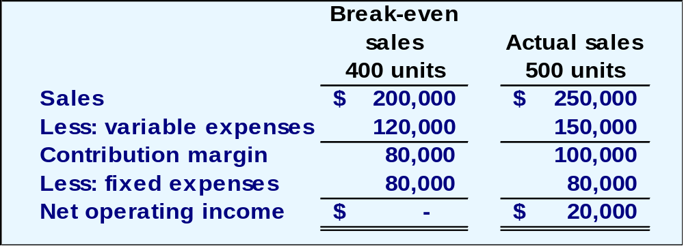
The Margin of Safety in Dollars
If we assume that RBC has actual sales of $250,000, given that we have already determined the break-even sales to be $200,000, the margin of safety is $50,000 as shown.
Notes:
RBC is currently selling 500 bikes and producing total sales revenue of $250,000. Sales at the break-even point are $200,000, so the company’s margin of safety is $50,000.

Slide 62
The Margin of Safety
The margin of safety can be expressed in terms of the number of units sold. The margin of safety at RBC is $50,000, and each bike sells for $500; hence, RBC’s margin of safety is 100 bikes.
Margin of
Safety in units
$50,000
$500
=
= 100 bikes
Notes:
The margin of safety can be expressed in terms of the number of units sold. The margin of safety at Racing is $50,000, and each bike sells for $500, so the margin of safety in units is 100 bikes. Racing Bicycle is selling 100 more bikes than are needed to break-even.

Slide 63
Quick Check ✓
Coffee Klatch is an espresso stand in a downtown office building. The average selling price of a cup of coffee is $1.49 and the average variable expense per cup is $0.36. The average fixed expense per month is $1,300. An average of 2,100 cups are sold each month. What is the margin of safety expressed in cups?
  a. 3,250 cups
  b. 950 cups
  c. 1,150 cups
  d. 2,100 cups
Notes:
Let’s see if you can calculate the margin of safety in cups of coffee for the Coffee Klatch.

Slide 64

Cost Structure and Profit Stability
Cost structure refers to the relative proportion of fixed and variable costs in an organization. Managers often have some latitude in determining their organization’s cost structure.
Notes:
A company’s cost structure refers to the relative proportion of fixed and variable expenses. Some companies have high fixed expenses relative to variable expenses. Do you remember our discussion of utility companies? Because of the heavy investment in property, plant, and equipment, many utility companies have a high proportion of fixed costs.

Slide 65
Cost Structure and Profit Stability
There are advantages and disadvantages to high fixed cost (or low variable cost) and low fixed cost (or high variable cost) structures.
An advantage of a high fixed
cost structure is that income
will be higher in good years
compared to companies
with lower proportion of
fixed costs.
A disadvantage of a high fixed
cost structure is that income
will be lower in bad years
compared to companies
with lower proportion of
fixed costs.
Companies with low fixed cost structures enjoy greater stability in income across good and bad years.
Notes:
Generally, companies with a high fixed cost structure will show higher net income in good years than companies with lower fixed cost structures. Just the opposite is true in bad years. Companies with low fixed cost structures enjoy greater stability in income across good and bad years.

Slide 66
Learning Objective 8
Compute the degree of operating leverage at a particular level of sales and explain how it can be used to predict changes in net operating income.
Notes:
Learning objective number 8 is to compute the degree of operating leverage at a particular level of sales and explain how it can be used to predict changes in net operating income.

Slide 67

Operating Leverage
Operating leverage is a measure of how sensitive net operating income is to percentage changes in sales. It is a measure, at any given level of sales, of how a percentage change in sales volume will affect profits.
Degree of
operating leverage
Contribution margin
Net operating income
=
Notes:
Operating leverage is a measure of how sensitive net operating income is to percentage changes in sales. The degree of operating leverage is a measure, at any given level of sales, of how a percentage change in sales volume will affect profits. It is computed by dividing contribution margin by net operating income.
Let’s look at Racing Bicycle.

Slide 68
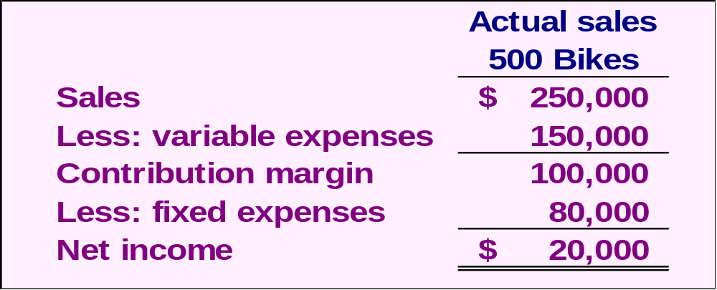
Operating Leverage
To illustrate, let’s revisit the contribution income statement for RBC.
Degree of
Operating
Leverage
$100,000
$20,000
=
= 5
Notes:
Recall that Racing is currently selling 500 bikes and producing net income of $20,000. Contribution margin is $100,000. Operating leverage is 5, which is determined by dividing the $100,000 contribution margin by the net income of $20,000.
Now that we have calculated the degree of operating leverage for RBC, let’s see exactly what this means to management.

Slide 69
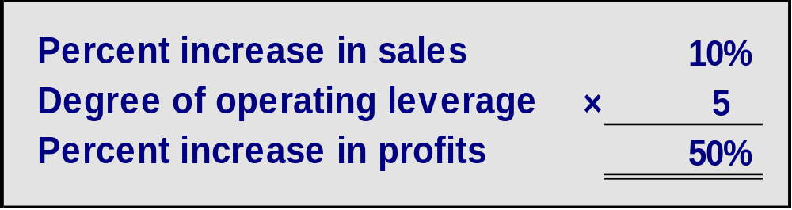
Operating Leverage
With an operating leverage of 5, if RBC increases its sales by 10%, net operating income would increase by 50%.
Here’s the verification!
Notes:
If Racing is able to increase sales by 10%, net income will increase by 50%. We multiply the percentage increase in sales by the degree of operating leverage. Let’s verify the 50% increase in profit.

Slide 70
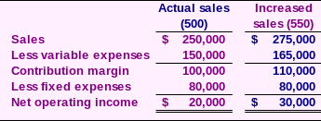
Operating Leverage
10% increase in sales from
$250,000 to $275,000 . . .
. . . results in a 50% increase in
income from $20,000 to $30,000.
Notes:
A 10% increase in sales would increase bike sales from the current level of 500 to 550. Look at the contribution margin income statement and notice that income increased from $20,000 to $30,000. That $10,000 increase in net income is a 50% increase.
So it is true that a 10% increase in sales results in a 50% in net income. This is powerful information for a manager to have.

Slide 71
Quick Check ✓
Coffee Klatch is an espresso stand in a downtown office building. The average selling price of a cup of coffee is $1.49 and the average variable expense per cup is $0.36. The average fixed expense per month is $1,300. An average of 2,100 cups are sold each month. What is the operating leverage?
  a. 2.21
  b. 0.45
  c. 0.34
  d. 2.92
Notes:
See if you can calculate the degree of operating leverage for the Coffee Klatch.

Slide 72
Quick Check ✓
At Coffee Klatch the average selling price of a cup of coffee is $1.49, the average variable expense per cup is $0.36, the average fixed expense per month is $1,300, and an average of 2,100 cups are sold each month.
If sales increase by 20%, by how much should net operating income increase?
  a. 30.0%
  b. 20.0%
  c. 22.1%
  d. 44.2%
Notes:
If the Coffee Klatch is able to increase sales by 20%, what will be the increase in net income?

Slide 73
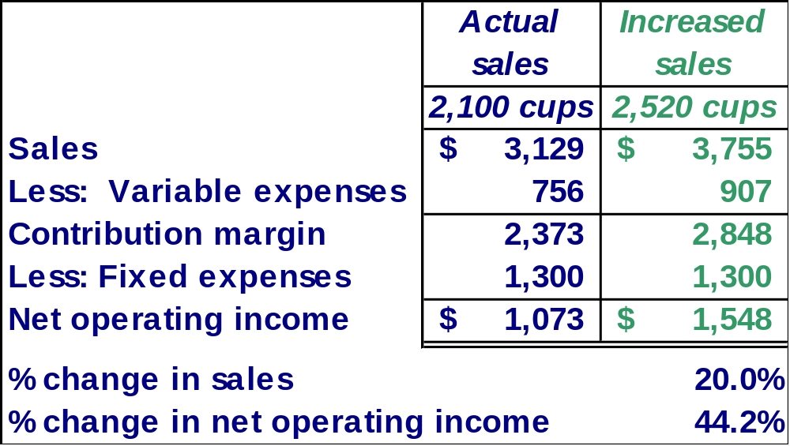
Verify Increase in Profit
Notes:
Here is our verification of the increase in net operating income. Take a few minutes and make sure you understand how we calculated all the numbers.

Slide 74

Structuring Sales Commissions
Companies generally compensate salespeople by paying them either a commission based on sales or a salary plus a sales commission. Commissions based on sales dollars can lead to lower profits in a company.
Let’s look at an example.
Notes:
You have probably heard that salespersons can be compensated on a commission basis. The commission is usually based on sales revenue generated. Some salespersons work on a salary plus commission.
When salespersons are paid a commission based on sales dollars generated, the income statement impact may not be fully understood.
Let’s look at an example.

Slide 75

Structuring Sales Commissions
Pipeline Unlimited produces two types of surfboards, the XR7 and the Turbo. The XR7 sells for $100 and generates a contribution margin per unit of $25. The Turbo sells for $150 and earns a contribution margin per unit of $18.
The sales force at Pipeline Unlimited is compensated based on sales commissions.
Notes:
Pipeline Unlimited produces two surfboards. The XR7 model sells for $100 dollars and has a contribution margin per unit of $25. The second surfboard, the Turbo model, sells for $150 and has a contribution margin of $18 per unit sold. The sales force at Pipeline is paid on sales commissions.

Slide 76
Learning Objective 9
Compute the break—even point for a multiproduct company and explain the effects of shifts in the sales mix on contribution margin and the break-even point.
Notes:
Learning objective number 9 is to compute the break-even point for a multiproduct company and explain the effects of shifts in the sales mix on contribution margin and the break-even point.

Slide 77
The Concept of Sales Mix
Sales mix is the relative proportion in which a company’s products are sold.
Different products have different selling prices, cost structures, and contribution margins.
When a company sells more than one product, break-even analysis becomes more complex as the following example illustrates.
Let’s assume Racing Bicycle Company sells bikes and carts and that the sales mix between the two products remains the same.
Notes:
When a company sells more than one product, break-even analyses become more complex because of the relative mix of the products sold. Different products will have different selling prices, cost structures, and contribution margins.
Let’s expand the product line at Racing Bicycle Company and see what impact this has on break-even. We are going to assume that the sales mix between the products remains the same in our example.

Slide 78
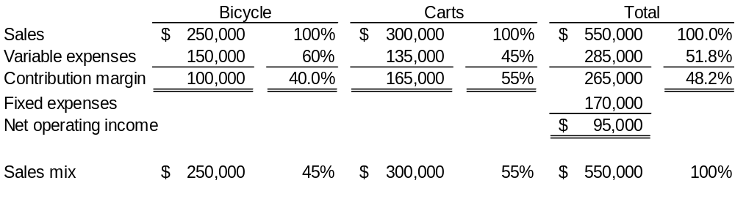
Multi-Product Break-Even Analysis
Bikes comprise 45% of RBC’s total sales revenue and the carts comprise the remaining 55%. RBC provides the following information:
$265,000
$550,000
= 48.2% (rounded)
Notes:
Racing Bicycle sells both bikes and carts. Look at the contribution margin for each product. Notice that we subtract fixed expenses from the total contribution margin. We do not allocate the fixed costs to each product.
The sales mix shows that 45% of the company’s sales revenue comes from the sale of bikes and 55% comes from the sale of carts.
The combined contribution margin ratio is 48.2% (rounded). Let’s look at break-even.

Slide 79
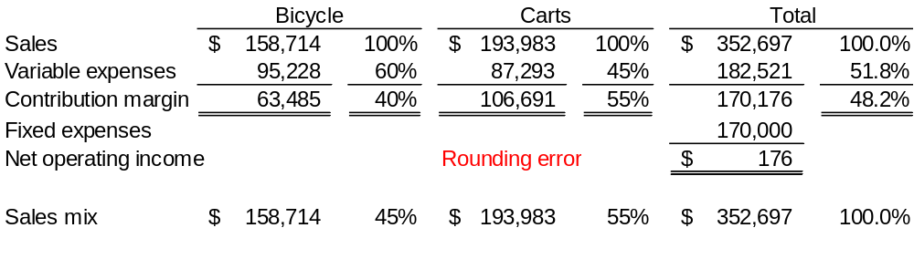
Multi-Product Break-Even Analysis
Dollar sales to
break even
Fixed expenses
CM ratio
=
Dollar sales to
break even
$170,000
48.2%
=
= $352,697
Notes:
Break-even in sales dollars is $352,697. We calculate this amount in the normal way. We divide total fixed expenses of $170,000 by the combined contribution margin ratio.
We begin by allocating total break-even sales revenue to the two products. Note that 45% of the total is assigned to the bikes and 55% to the carts.
The variable costs-by-product are determined by multiplying the variable expense percent times the assigned revenue. The contribution margin is the difference between the assigned revenue and the variable expenses. Once again, we subtract fixed expenses from the combined total contribution margin for the two products. Because we used a rounded contribution margin percent, we have a rounding error of $176.
Obviously, the more products a company has, the more complex the break-even analysis becomes.

Slide 80
Key Assumptions of CVP Analysis
Selling price is constant.
Costs are linear and can be accurately divided into variable (constant per unit) and fixed (constant in total) elements.
In multiproduct companies, the sales mix is constant.
In manufacturing companies, inventories do not change (units produced = units sold).
Notes:
Here are the four key assumptions of cost-volume-profit analysis. You are probably familiar with the first three by now. The forth assumption tells us that there can be no change in inventory levels. That is, all units produced are sold in the current period.

